Slide 1
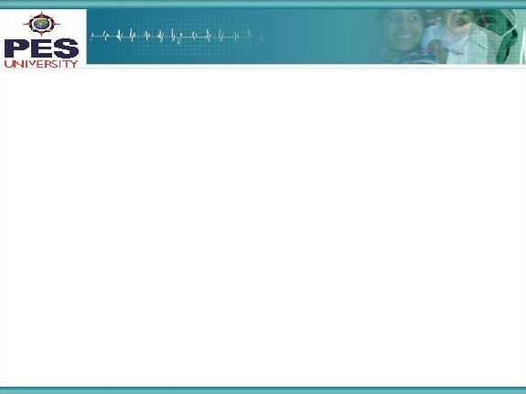

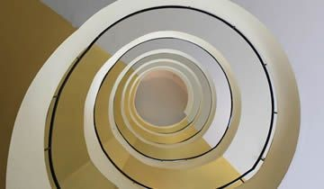

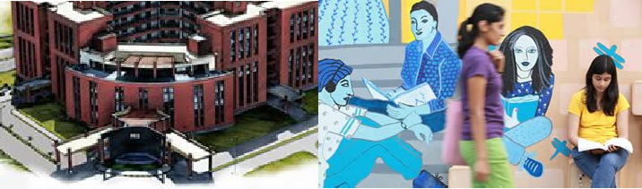

Project Presentation
(Final - ESA)
Project Title
: Multiple cops catching a criminal using Multi Agent Reinforcement Learning
Project Team : Saahil B Jain PES1201700241
Jeevana R Hegde PES1201700633
Rishabh Jain PES1201700099

Slide 2
Project Abstract and Scope
Project description:
A group of cops are trained to chase and catch a criminal by reinforcement learning.
The criminal is programmed to dodge the cops.
Four test cases have been taken. Two for 2 cops and two for 3 cops. Out of the two, in one case the Q table is shared amongst the cops and in the other, they have their independent Q tables.
The episode ends either when the criminal is caught or once 200 steps are have been taken.
Reason behind choosing this problem statement:
Broadly, reinforcement learning is an active area of research hence the project opted was in this domain.
To learn and gain more insight about the cooperativeness of multi-agent reinforcement learning, this topic was chosen.
The applications are also wide-ranged.

Slide 3
Project Scope -2
Uniqueness and comparison of our solution:
In generic cases of reinforcement learning, a common Q table is shared amongst the various agents and complete visibility is provided in a small environment like the one used in our project.
However, to reduce the size of the Q table, partial visibility has been provided to the agents.
Scope of our project:
As and when technology and AI play a bigger role in real life, this could be a possible application for robo-cops.
Autonomous drone clusters in army.
Additional information:
The reason for choosing shared Q tables is for quicker learning and smaller model size.
The reason for choosing independent Q tables was assuming that different agents would opt for different roles.
3

Slide 4
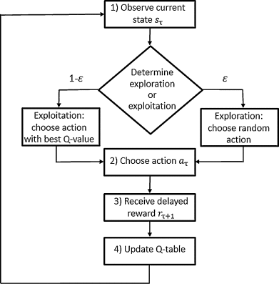
Solution Architecture
PICTORIAL REPRESENTATION

Slide 5
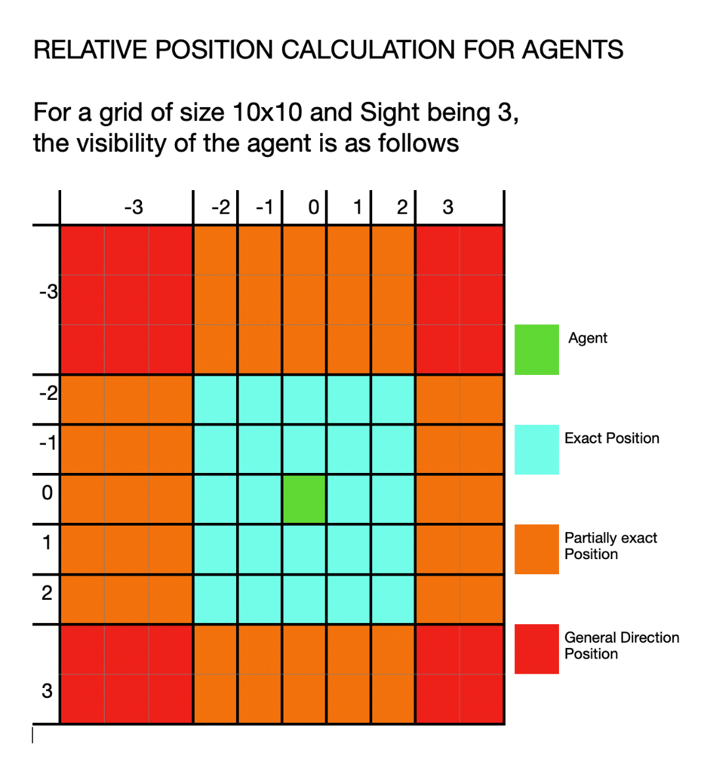
Solution Architecture
A Q table is used to make the predictions.
The discrete states/observations that the agent see are represented as rows of the Q table.
The various actions it can perform which are UP, DOWN, LEFT or RIGHT are represented as columns.
To reduce the grid space, relative positions of the other agents and criminal are provided to each agent.
This is further reduced by limiting the sight of the agent as shown in the diagram.

Slide 6
Solution
Shared Q tables, Independent Q tables for 2 agents and three agents:
1. Algorithm:
The new reward for the current action in a particular state is the sum of a fraction (1-learning rate) of its current value and a fraction(learning rate) times sum of current reward and maximum future reward.

Slide 7
Solution-2
2. Math:
Given a Q-table Q with the possible discrete states as rows and possible actions as columns, Updating Q table is given as follows:
given state S
and action performed as A
Q[S][A] = ((1- LEARNING_RATE) * Q[S][A]) + (LEARNING_RATE * (Current_Reward + (DISCOUNT * max(Q[Perform_Action(A)]))))
Here, Perform_Action(A) returns the new state when the agent performs the action.

Slide 8
Solution
3. Testing carried out:
Each of the four solutions were tested for 100000 iterations.
The number of times the cops succeeded in catching the criminal is taken in percentage.
4. Results:
 | 2 - shared | 2 - Independent | 3 - shared | 3 - independent
Catching Percentage
Average Steps to Catch
74.727
75.054
78.601
81.494
106.81956
105.29157
101.90124
93.26331

Slide 9
Constraints, Assumptions & Dependencies
Constraints:
The constraint is for the cops to catch the criminal within 200 steps. If the cops were unable to catch, the criminal wins.
Assumptions:
At each step, the cops and criminal have the same speed.
The grid is assumed to be wrap around. (Ex: -1 is n-1 if the cells are assumed to be numbered from 0 to n-1. This case is true for both x and y directions.)
The grid is assumed to be free of obstacles.
The agent is unaware of the whole picture of the environment. They are rather known to have the relative positions of the criminal as well as the other agents at all times.
Dependencies:
There are no dependencies as such.

Slide 10
Future work plan
Future work plans:
We have catered to all the essential requirements.
However additional features can be taken care of such as providing a more visual feed rather than relative positions. This would enable the same model to be applicable for any number of agents.
The environment can be made more realistic by taking into consideration some obstacles.

Slide 11
References
References:
Lecture notes
[1] Srinivas K.S
https://drive.google.com/open?id=1x2w5T-zNNcBlKhuwpDJbt3xEiITtnucwL
Internet tutorial
[2] Sendex, Q-Learning introduction and Q Table - Reinforcement Learning
https://pythonprogramming.net/q-learning-reinforcement-learning-python-tutorial/

Slide 12
Thank You

