Slide 1
Image Segmentation on Brain MRI Images Using U-Net
Mukka himaneesh, Do quan & Saahil Anande

Slide 2
Introduction & motivation
Brain image segmentation is one of the most time-consuming and challenging procedures in a clinical environment
Nearly 1 in 6 of world’s population suffer from neurological disorders
We are attempting use U-Net on Brain MRI images to apply image segmentation to isolate LGG tumor cells in the brain.
This method will aid in Brain Cancer diagnosis and treatment planning.

Slide 3
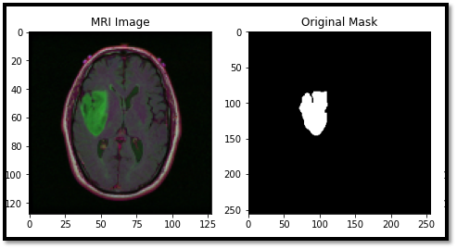
Dataset Used
Used LGG segmentation dataset from Kaggle
The dataset consists of Brain MR images together with manual FLAIR abnormality segmentations masks
They correspond to 110 patients included in the cancer genome atlas (TCGA) - Lower Grade Glioma collection with Fluid-Attenuated Inversion Recovery (FLAIR) sequence
The tumor clusters and patient data is provided in a CSV file

Slide 4
Approach (Pipeline):
Loading dataset from Kaggle
Splitting the images into Train, Test, & Validation
Preprocessing the Images
Defining the U-Net Model
Training the model
Evaluating the model based on multiple coefficients
Testing the model on Test images

Slide 5
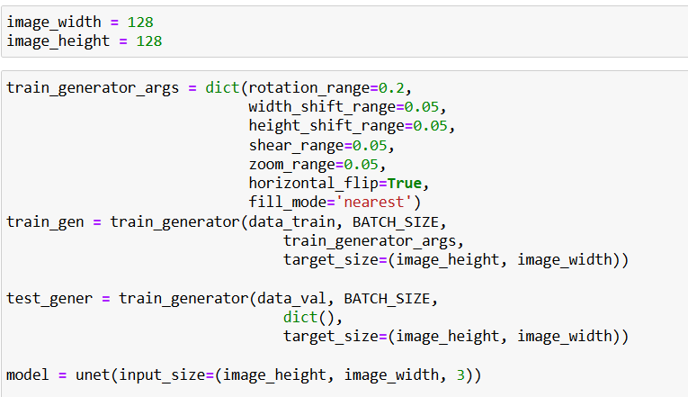
Preprocessing:
Resizing the image to 128X128
Augmenting the images
rotation_range=0.2,
width_shift_range=0.05,
height_shift_range=0.05,
shear_range=0.05,
zoom_range=0.05,
horizontal_flip
Thresholding the images

Slide 6
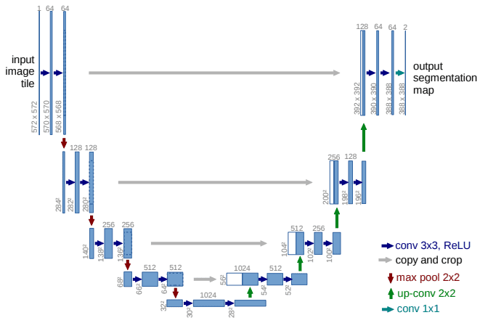
U-Net

Slide 7

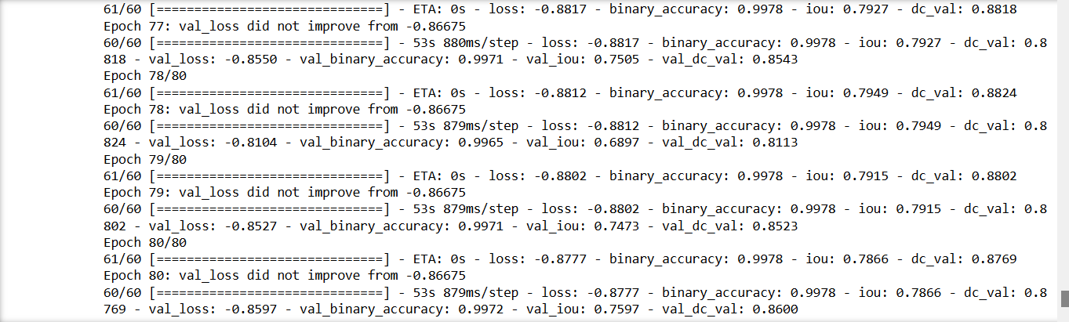
Training:
Optimizer used: Adam
Learning Rate: 0.0001
Epochs: 80
Batch size: 32
Decay rate: 0.0001/80

Slide 8
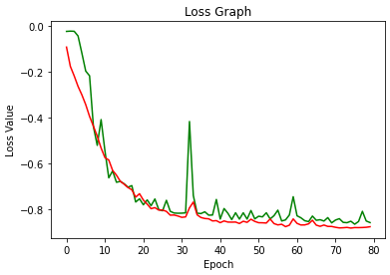
Evaluation Parameters
IOU value : 0.7866
Dice Coefficient Value: 0.8769
Loss Value : -0.8777
Jaccard Accuracy : 0.9987

Slide 9
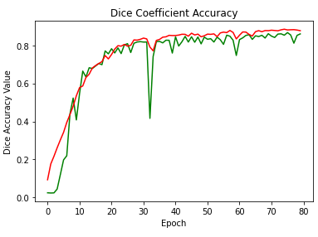
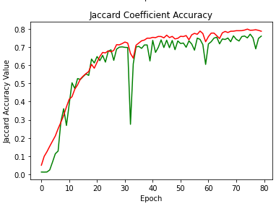
Accuracy Graph

Slide 10
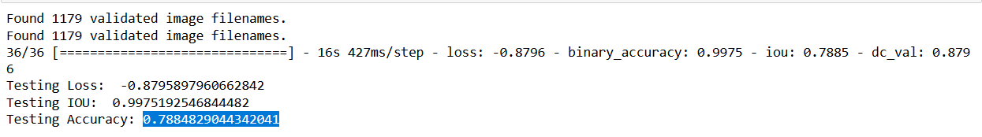
Testing Results

Slide 11
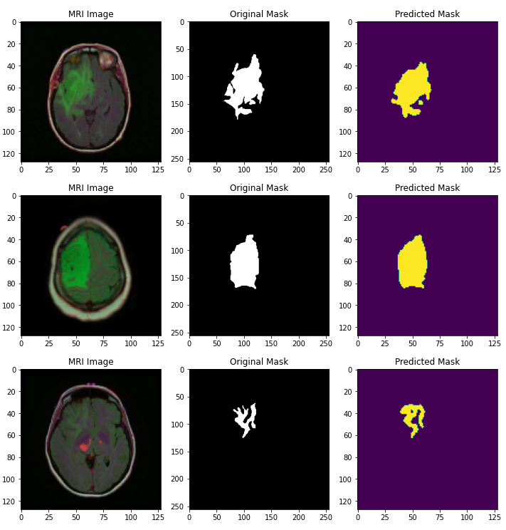
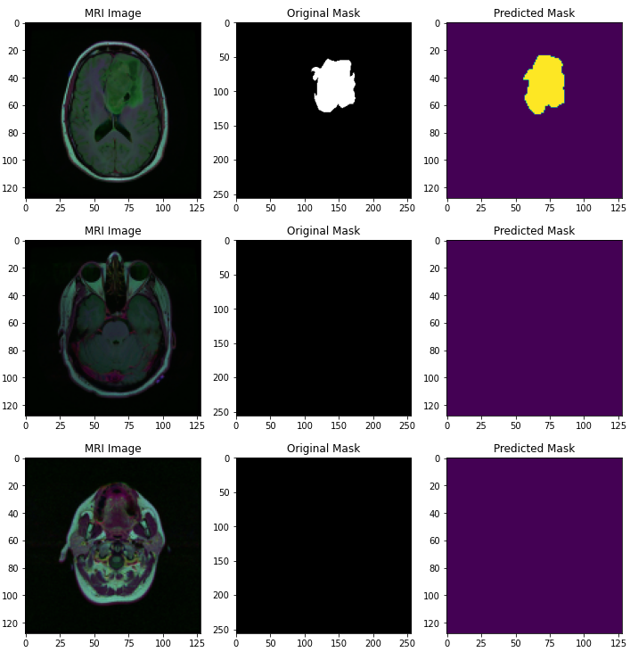
Resultant Images

Slide 12
Challenges Faced
Since we did not have access to high powered GPU, training time was very high which prevented us from experimenting with various model parameters.
We were unable to run the model for longer iterations due to the processing issue.

Slide 13
THANK YOU

