Slide 1
: Conditional and Looping Statement

Slide 2
if,
else if,
switch •
for loop •
while loop •
do while loop
Jump statement (break, continue& return keyword)
Arrays Declaration and initialization of an array 1-D and 2-D arrays

Slide 3
The conditional statements (also known as decision control structures) such as if, if else, switch, etc. are used for decision-making purposes in C/C++ programs.
They are also known as Decision-Making Statements and are used to evaluate one or more conditions and make the decision whether to execute a set of statements or not. These decision-making statements in programming languages decide the direction of the flow of program execution.

Slide 4
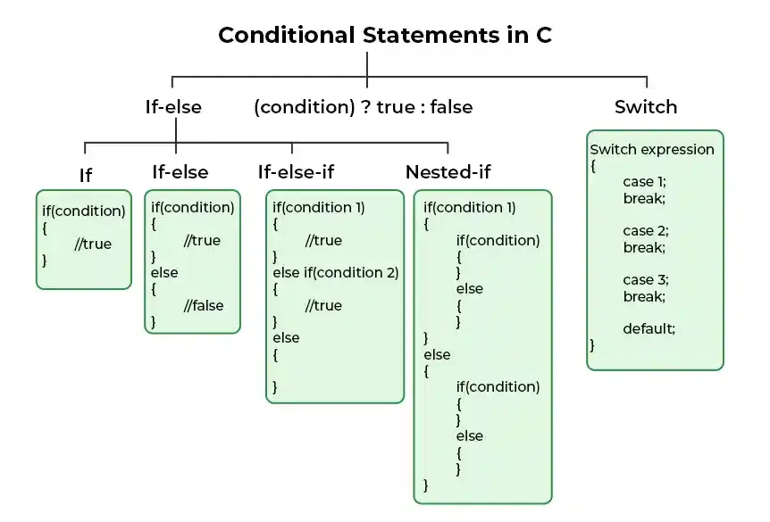

Slide 5
C++ Loops
In Programming, sometimes there is a need to perform some operation more than once or (say) n number of times. Loops come into use when we need to repeatedly execute a block of statements.
For example: Suppose we want to print “Hello World” 10 times. This can be done in two ways as shown below:
Manual Method (Iterative Method)
Manually we have to write cout for the C++ statement 10 times. Let’s say you have to write it 20 times (it would surely take more time to write 20 statements) now imagine you have to write it 100 times, it would be really hectic to re-write the same statement again and again. So, here loops have their role.
Using Loops
In Loop, the statement needs to be written only once and the loop will be executed 10 times as shown below. In computer programming, a loop is a sequence of instructions that is repeated until a certain condition is reached.

Slide 6
There are mainly two types of loops:
Entry Controlled loops: In this type of loop, the test condition is tested before entering the loop body. For Loop and While Loop is entry-controlled loops.
Exit Controlled Loops: In this type of loop the test condition is tested or evaluated at the end of the loop body. Therefore, the loop body will execute at least once, irrespective of whether the test condition is true or false. the do-while loop is exit controlled loop.

Slide 7
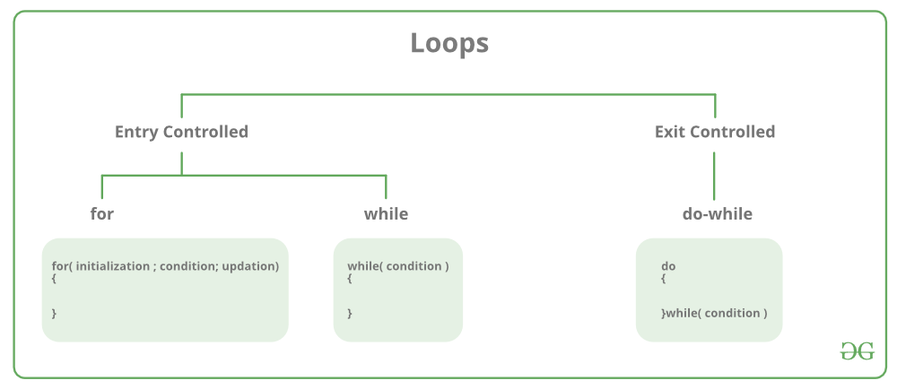

Slide 8
For Loop-
A For loop is a repetition control structure that allows us to write a loop that is executed a specific number of times. The loop enables us to perform n number of steps together in one line.
Syntax:
for (initialization expr; test expr; update expr)
{
// body of the loop
// statements we want to execute
}

Slide 9
Explanation of the Syntax:
Initialization statement: This statement gets executed only once, at the beginning of the for loop. You can enter a declaration of multiple variables of one type, such as int x=0, a=1, b=2. These variables are only valid in the scope of the loop. Variable defined before the loop with the same name are hidden during execution of the loop.
Condition: This statement gets evaluated ahead of each execution of the loop body, and abort the execution if the given condition get false.
Iteration execution: This statement gets executed after the loop body, ahead of the next condition evaluated, unless the for loop is aborted in the body (by break, goto, return or an exception being thrown.)

Slide 10
While Loop-
While studying for loop we have seen that the number of iterations is known beforehand, i.e. the number of times the loop body is needed to be executed is known to us. while loops are used in situations where we do not know the exact number of iterations of the loop beforehand. The loop execution is terminated on the basis of the test conditions. We have already stated that a loop mainly consists of three statements – initialization expression, test expression, and update expression. The syntax of the three loops – For, while, and do while mainly differs in the placement of these three statements.
Syntax:
initialization expression;
while (test_expression)
{ // statements
update_expression;
}

Slide 11
Do-while loop
In Do-while loops also the loop execution is terminated on the basis of test conditions. The main difference between a do-while loop and the while loop is in the do-while loop the condition is tested at the end of the loop body, i.e do-while loop is exit controlled whereas the other two loops are entry-controlled loops. Note: In a do-while loop, the loop body will execute at least once irrespective of the test condition. Syntax:
initialization expression;
do{ // statements
update_expression;
} while (test_expression);

Slide 12
Important Points
Use for a loop when a number of iterations are known beforehand, i.e. the number of times the loop body is needed to be executed is known.
Use while loops, where an exact number of iterations is not known but the loop termination condition, is known.
Use do while loop if the code needs to be executed at least once like in Menu-driven programs

Slide 13
Jump statements in C++
Jump statements are used to manipulate the flow of the program if some conditions are met. It is used to terminate or continue the loop inside a program or to stop the execution of a function.
Types of Jump Statements in C++
In C++, there is four jump statement
break
continue
return

Slide 14
continue in C++
The C++ continue statement is used to execute other parts of the loop while skipping some parts declared inside the condition, rather than terminating the loop, it continues to execute the next iteration of the same loop. It is used with a decision-making statement which must be present inside the loop.
This statement can be used inside for loop or while or do-while loop.

Slide 15
break in C++
The C++ break statement is used to terminate the whole loop if the condition is met. Unlike the continue statement after the condition is met, it breaks the loop and the remaining part of the loop is not executed.
The break statement is used with decision-making statements such as if, if-else, or switch statement which is inside the for loop which can be for loop, while loop, or do-while loop. It forces the loop to stop the execution of the further iteration.
return in C++
The return statement takes control out of the function itself. It is stronger than a break. It is used to terminate the entire function after the execution of the function or after some condition.
Every function has a return statement with some returning value except the void() function. Although void() function can also have the return statement to end the execution of the function

Slide 16
C++ Arrays
C++ provides a data structure, the array, which stores a fixed-size sequential collection of elements of the same type. An array is used to store a collection of data, but it is often more useful to think of an array as a collection of variables of the same type.
Instead of declaring individual variables, such as number0, number1, ..., and number99, you declare one array variable such as numbers and use numbers[0], numbers[1], and ..., numbers[99] to represent individual variables. A specific element in an array is accessed by an index.
All arrays consist of contiguous memory locations. The lowest address corresponds to the first element and the highest address to the last element.

Slide 17
To declare an array in C++, the programmer specifies the type of the elements and the number of elements required by an array as follows −
type arrayName [ arraySize ];
This is called a single-dimension array. The arraySize must be an integer constant greater than zero and type can be any valid C++ data type. For example, to declare a 10-element array called balance of type double, use this statement −
double balance[10];

Slide 18
Initializing Arrays
You can initialize C++ array elements either one by one or using a single statement as follows −
double balance[5] = {1000.0, 2.0, 3.4, 17.0, 50.0};
The number of values between braces { } can not be larger than the number of elements that we declare for the array between square brackets [ ]. Following is an example to assign a single element of the array −
Accessing Array Elements
An element is accessed by indexing the array name. This is done by placing the index of the element within square brackets after the name of the array. For example −
double salary = balance[9];

Slide 19
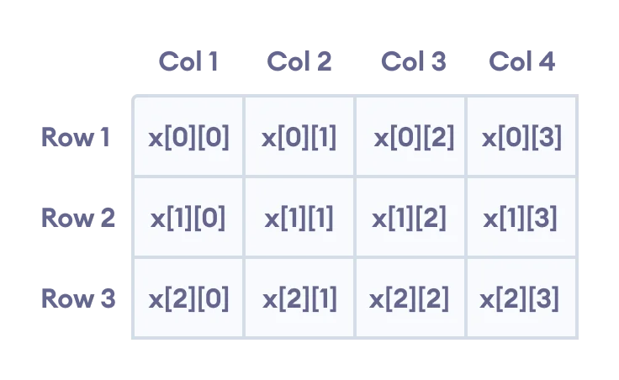
C++ Multidimensional Arrays
In C++, we can create an array of an array, known as a multidimensional array. For example:
int x[3][4];

