Slide 1
FALL 2021 | CS 767 PROJECT REPORT
malaria parasite detection (D-detectron)
Sahil Khanna

Slide 2
01
Introduction
02
Preprocessing & EDA
Table of contents
03
Model Architecture
04
Model Assessment
05
Summary
Dataset description
Tools & Objective
Data Pre-processing
Exploratory Data Analysis
D-detectron (CNN)
Evaluation metrics
Prediction on new image
Conclusion
Future Scope

Slide 3
Dataset description dataset source: NLM
Objective
Introduction
The dataset is from National Library of Medicine (NLM) hosts a repository of segmented cells from the thin blood smear slide images from the Malaria Screener research activity
The dataset contains a total of 27,558 cell images with equal instances of parasitized and uninfected cells.
NN Architecture
CNN with 3 convolution layer(filters 32, 64, 64). Each layer has a MaxPool layer of (2,2), Kernel_size of 3x3 and Activation function ‘relu’
One FC with 128 neurons and ‘relu’ as the activation function, Dropout layer (0.5) and Adam optimizer
Output layer with 1 neuron and sigmoid activation function
Using deep neural network build a model to detect malaria parasite in thin-blood smear images

Slide 4
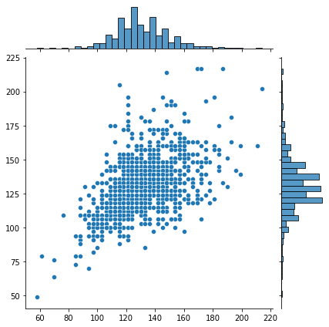
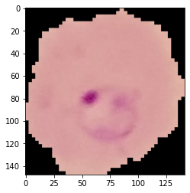
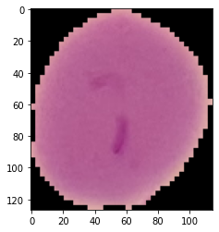
Preprocessing & EDA
Preprocessing & EDA
Since, images were acquired using smartphone’s built-in camera these images are of different size. I reshaped all the image with the average size of 130.
Visualization to capture average size
Infected cell
Uninfected cell

Slide 5
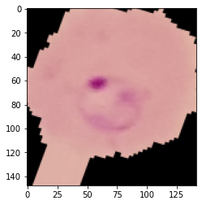
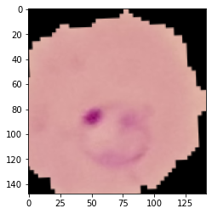
Image Data Generator
Preprocessing & EDA
Original Image
Random shift
Random rotation
Notes:
# rotate the image 20 degrees # Shift the pic width by a max of 5% # Shift the pic height by a max of 5% # Rescale the image by normalzing it. # Shear means cutting away part of the image (max 10%) # Zoom in by 10% max # Horizontal flipping # Fill in missing pixels with the nearest filled value

Slide 6
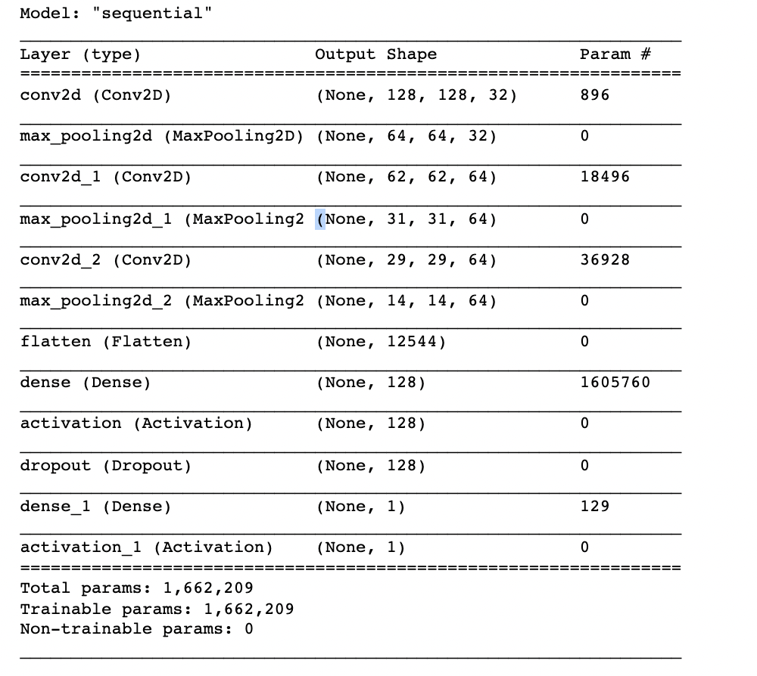
Model Architecture
3 CNN layers (filters 32, 64, 64)
Kernel (3x3)
Activation ‘relu’
MaxPool2d (2,2)
FC layer
# neurons 128
Activation ‘relu’
Dropout 0.5
Output layer
# neurons 1
Activation ‘sigmoid’
Optimizer ‘Adam’

Slide 7
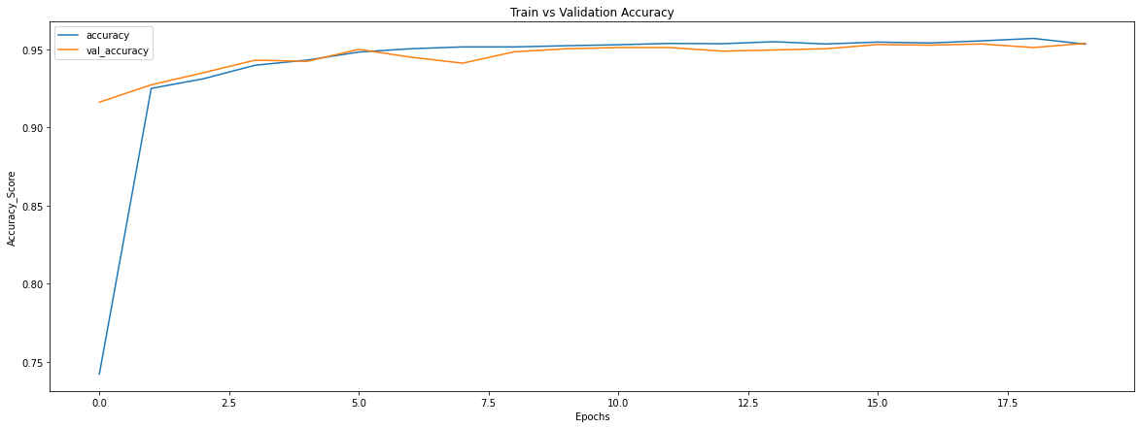
Model Assessment
95%
loss
TnR
0.13
0.94
TPR
0.96

Slide 8
Model Assessment
classification report
Confusion matrix
 | Precision | Recall | F-Measure | class
 | 0.96 | 0.94 | 0.95 | 0
 | 0.94 | 0.97 | 0.95 | 1
Weighted Avg | 0.95 | 0.95 | 0.95
0 | 1 | class
1223 | 77 | 0
45 | 1255 | 1

Slide 9
Model Assessment
Models | Precision | Recall | F-Measure | Accuracy
AlexNet | 0.941 | 0.947 | 0.944 | 0.944
VGG-16 | 0.969 | 0.949 | 0.959 | 0.959
ResNet-50 | 0.972 | 0.947 | 0.959 | 0.959
D-detectron | 0.952 | 0.955 | 0.954 | 0.954
D-detectron vs Pre-trained

Slide 10
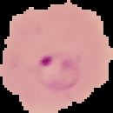
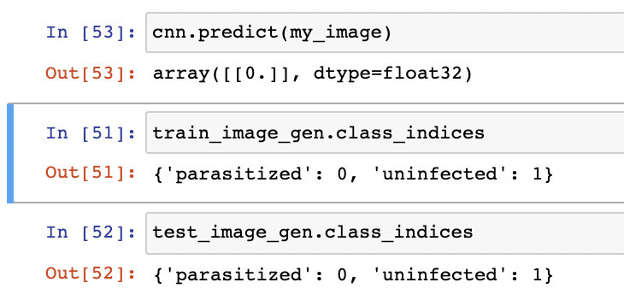
Model Assessment
Prediction on new image
Test image
Model Prediction vs actual

Slide 11
Summary

Slide 12
conclusion
Future scope
Summary
The customized model converged to an optimal solution due to hyper-parameter optimization, implicit regularization and data augmentation method imposed by smaller convolutional filter sizes and aggressive dropouts in the fully connected layers.
Pre-trained convolutional neural networks as feature extractors toward improved Malaria parasite detection in thin blood smear images.
Ensemble learning reduces the model variance by optimally combining the predictions of multiple models
Detection of other parasitic cell diseases like cancer

Slide 13
Thank you
Questions?

