Slide 1

ENPM808A – Data driven Motion Planning
By-
Sahruday Patti - 118218366

Slide 2
Need for a Data Driven Motion Planner
Robot navigation means the robot's ability to determine its own position in its frame of reference and then to plan a path towards some goal location.
Path planning involves the creation of a map of the environment by analyzing various types of sensor data, which involves a lot of computation processing.
To reduce these computations, this project presents a data-driven motion planner.

Slide 3
Problem Statement
The goal is to develop a model, which provides action commands in the form of a translational velocity command (v) and a rotational velocity command (w)
The data given consists of a certain laser data having moving obstacles given the model is trained on two environments (A corridor scenario with moving obstacles & an open box/hall environment with moving obstacles).
The data is generated from a Motion Planning Algorithm called A*
The data-Driven approach does not require a global map to navigate. Given the sensor data and the relative final and local goal positions, the robot will be able to navigate to the local goal keeping in mind the final goal while also avoiding obstacles.
.

Slide 4
The Steps Involved in Solving the Problem
Download and preprocess the data
Development of a loss function to optimize i.e., the error measure
Model Selection by use of Cross-Validation which optimizes the loss function
Testing the model on test data and get an estimate of out of sample error

Slide 5
Data Preprocessing
Reduced the number of dimensions to 26 by taking relative distances and orientations
Normalizing vs Standardizing.
The data is already Preprocessed
Data separation for Training and Validation
Only a fraction of the given data has been used due to memory constraints

Slide 6
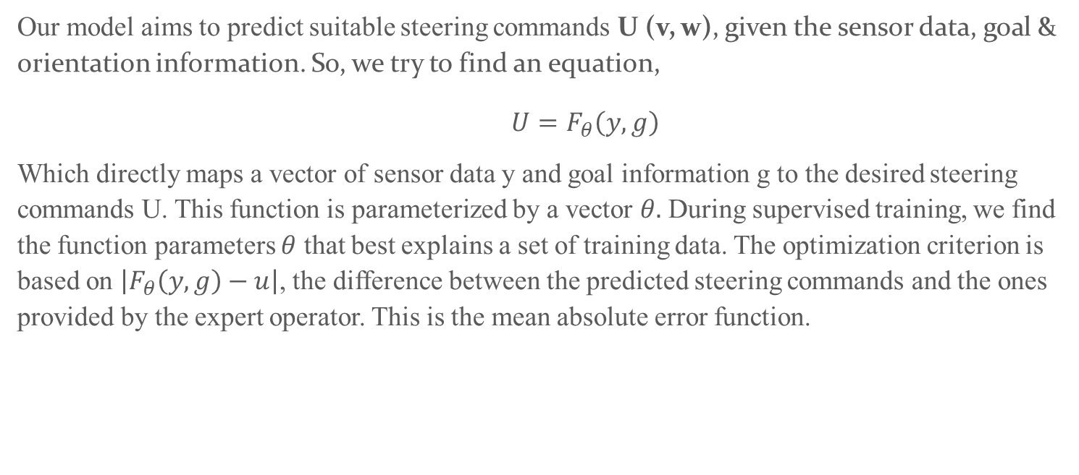
Loss function
Our model aims to predict suitable steering commands U (v, w), given the sensor data, goal & orientation information. So, we try to find an equation,
$U=F_{θ}\left(y,g\right)$
Which directly maps a vector of sensor data y and goal information g to the desired steering commands U. This function is parameterized by a vector $θ.$ During supervised training, we find the function parameters $θ$ that best explains a set of training data. The optimization criterion is based on $\left|F_{θ}\left(y,g\right)−u\right|$, the difference between the predicted steering commands and the ones provided by the expert operator. This is the mean absolute error function.

Slide 7
Model Selection
The given problem statement is of regression data type.
Hyperparameter Tuning is done by looking at the validation curve.
Neural Network has following Hyperparameters & have been tuned to optimize the classifier:
Training Length (number of epochs)
Batch size
Number of Layers
Learning rate
Regularization
Activation Layer Types
Optimizer
Weights Initialization

Slide 8
Hyperparameter Tuning
The apt Hyperparameters can be tuned by looking at the learning and validation curve.
Validation Curve: The validation curve was used to tune the Hyperparameters of the model. After each change in the hyperparameter, the validation curve & the learning curve was plotted and see how the model is fitting. The curve helped in understanding how the model is fitting the data and what effect the change in the hyperparameter had on the model which helped in making decisions to improve the model.
Regularization:
We are using a mean absolute error loss function to optimize so constraint on the weights based on the ‘absolute value of magnitude seemed more logical. But the data doesn’t have any inherent noise as seen in the model selection process. Hence, decided not to put any constraint on the weights.
But to be sure, tried l2 regularization too and saw the validation curve which showed similar results. Hence, did not use any regularization on the final model.

Slide 9
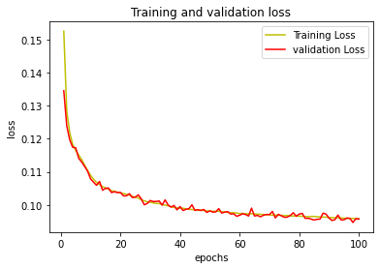
Final Model Evaluation
The final model is chosen from all the above models which had the least validation error that is a neural network with 5 layers. Below is the Training loss plotted against the validation error of the model.
With this model, the in-sample decreases along with the validation loss
Starts to diverge at iterations 250, which is where we need to stop training.

Slide 10
Metrics of Test Data
The In-sample Error of the above model is: 0.0957
The mean absolute error of the model on test data was: 0.0995
The test error is used to give a bound on the out-of-sample estimate.
R2 Score: R-squared (R2) is a statistical measure that represents the proportion of the variance for a dependent variable that's explained by an independent variable or variables in a regression model.

Slide 11
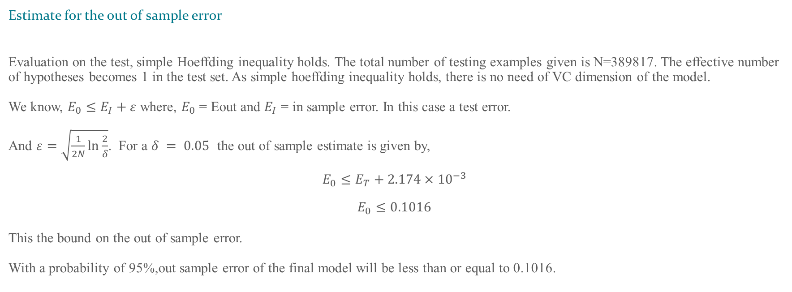
Evaluation
Estimate for the out of sample error
Evaluation on the test, simple Hoeffding inequality holds. The total number of testing examples given is N=389817. The effective number of hypotheses becomes 1 in the test set. As simple hoeffding inequality holds, there is no need of VC dimension of the model.
We know, $E_{0}≤E_{I}+ε$ where, $E_{0}$ = Eout and $E_{I}$ = in sample error. In this case a test error.
And $ε=\sqrt{\frac{1}{2N}\ln{\frac{2}{δ}}}$. For a $δ = 0.05$ the out of sample estimate is given by,
$$E_{0}≤E_{T}+2.174×{10}^{−3}$$
$$E_{0}≤0.1016$$
This the bound on the out of sample error.
With a probability of 95%,out sample error of the final model will be less than or equal to 0.1016.

Slide 12
Improvements
The Hypothesis set considered was very limited. Needs to be expanded to more complex models to fit the model better.
Development of the architecture of the CNN model can be approached as a classification problem first, and then as a regression problem.

