Slide 1
Reinforcement Learning for an Autonomous Vehicle for obstacle avoidance
using LiDAR data
By:
Sahruday Patti(118218366)
Denesh Nallur Narasimman (117514339)

Slide 2
Markov Property
“The future is independent of the past given the present”
•A state S_{t} is Markov if and only if
P [S_{t+1} | S_{t} ] = P [S_{t+1} | S₁, ..., S_{t} ].
•The state captures all relevant information from the history.

Slide 3
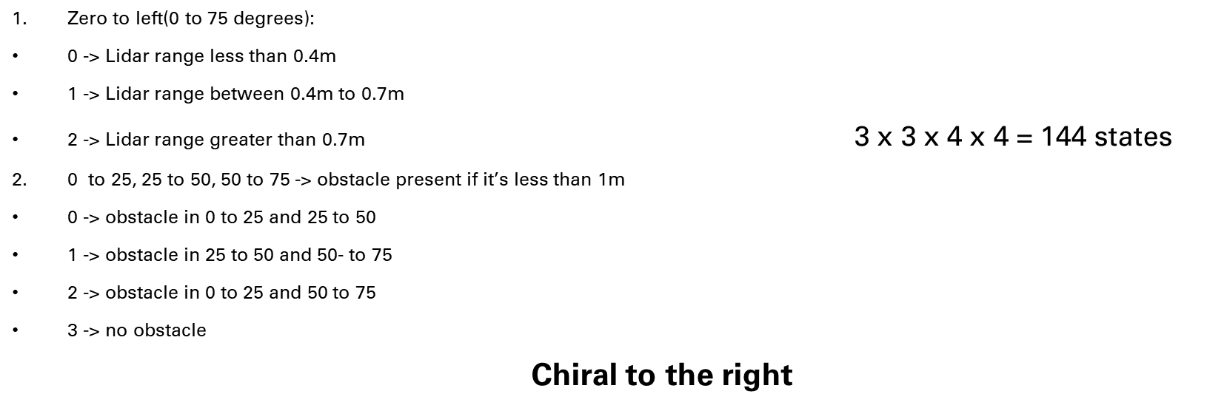
State representation for the car

Slide 4
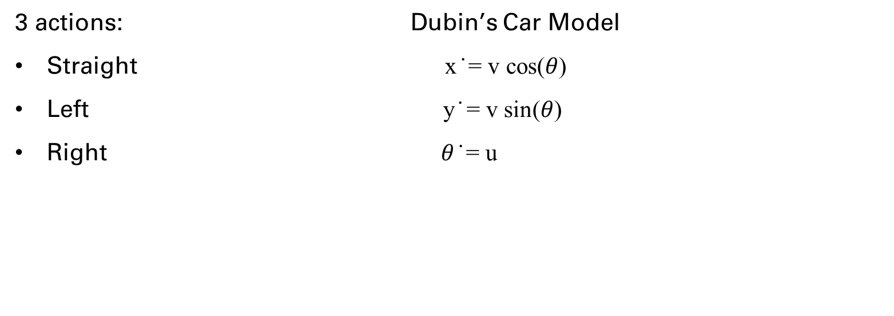
Control

Slide 5
Rewards
For every crash the reward is -100
For choosing an action to go straight the reward will be +0.2
The reward to take a turn will be -0.1
The reward for avoiding Obstacle +0.2
A reward of -0.8 will be awarded if the decision to change the direction is changed twice i.e when it takes left and then decides to take a right.

Slide 6
MARKOV DECISION PROCESS (MDP)
​ It is an environment in which all the states are Markov.
A Markov Decision Process is a tuple ⟨S,A,P,R,𝜸⟩
S is a finite set of states.
A is a finite set of actions.
P is a state transition probability matrix.
Pª_{ss’} = ℙ [S_{t+1} = S’ | S_{t} = s, A_{t} = a]
R is a reward function, Rª_{s} = E [R_{t+1} | S_{t} = s, A_{t} = a ]
𝜸 is a discount factor 𝜸 ϵ [0,1].

Slide 7
Bellman’s Optimality Equation for Q*
q*(s, a) ← s, a
r
s’
q* (s, a) ← a’
q*(s, a) = Rª_{s} + 𝜸 ∑ _{s’ϵs} Pª_{ss’} max _{a’} q* (s’, a’)
One of the interactive solutions to solving the Bellman's Optimality Equation is:
Q - Learning.

Slide 8
Epsilon Greedy Exploration
Greedy policy improvement over Q(s, a) is model-free
π’ (s) = argmax a∈A Q(s, a)
Simplest idea for ensuring continual exploration
All m actions are tried with non-zero probability
With probability 1 − epsilon choose the greedy action
With probability epsilon choose an action at random
epsilon/m + 1 − epsilon if a∗ = argmax a∈A Q(s, a)
π(a|s) =
epsilon/m otherwise

Slide 9
Updating Action-Value Functions SARSA MAX (Qlearning)
S,A
R
S’
A’
Q(S, A) ← Q(S, A) + α (R + γ max Q(S’ , a’ ) − Q(S, A))

Slide 10
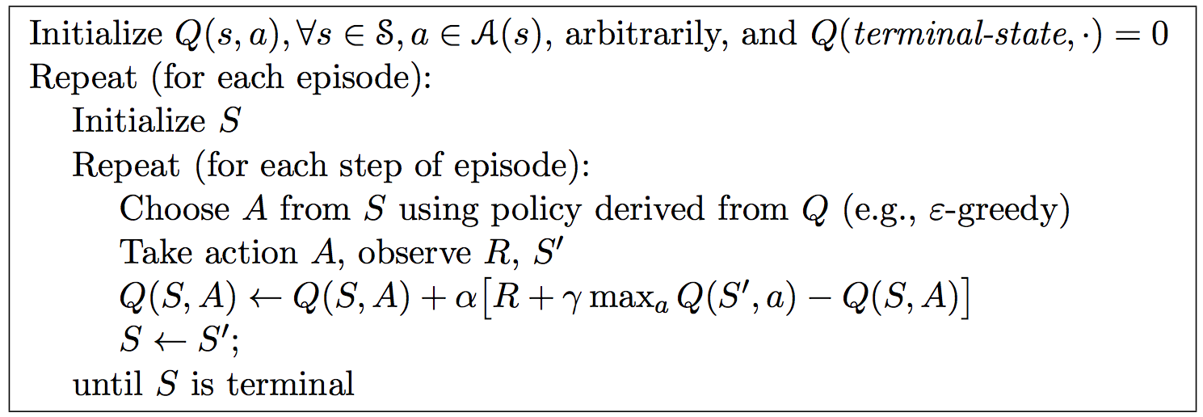
Q-Learning Algorithm for Off Policy Control

Slide 11
START
Initialize
S, A, Q - table
Initialize
𝛼, 𝛾, 𝜖
Epochs := 1
Set agent in initial position
Steps := 1
s := ScanDiscretization
a := 𝜀 - GreedyExploration
epochs := epochs + 1
𝜖 := 𝛿𝜀
steps := steps + 1
a_{prev} := a
s := s’
s’ := ScanDiscretization
r := RewardFunction
Q(s,a) := [1 - 𝛼]Q(s,a) + 𝛼[r + 𝛾max_{𝛼’}Q(s’, a’)]
Terminal State?
Final epoch?
End

Slide 12
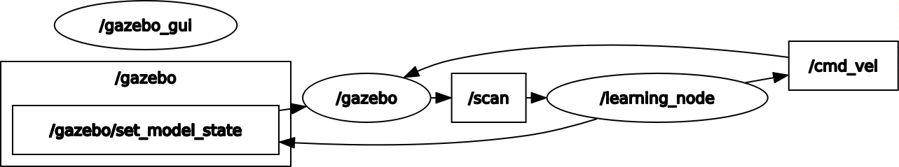
Link to Simulation:
https://drive.google.com/file/d/1Uv3KiijD9ZArwYggWG9ZadWC_HBhB8q5/view?usp=sharing

Slide 13
Thank You
Questions?
The only stupid question is the one you were afraid to ask but never did.

