Slide 1

Chapter 9
Using Telephone
and Cable Networks
for Data Transmission
9.<number>
Copyright © The McGraw-Hill Companies, Inc. Permission required for reproduction or display.

Slide 2
9-1 TELEPHONE NETWORK
Telephone networks use circuit switching. The telephone network had its beginnings in the late 1800s. The entire network, which is referred to as the plain old telephone system (POTS), was originally an analog system using analog signals to transmit voice.
Topics discussed in this section:
Major Components
LATAs
Signaling
Services Provided by Telephone Networks
9.<number>

Slide 3
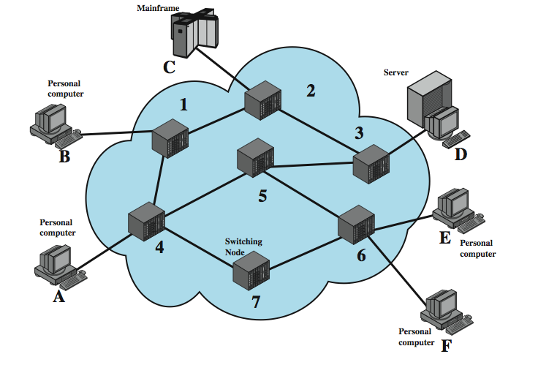
Switched Network
9.<number>
Notes:
For transmission of data beyond a local area, communication is typically achieved by transmitting data from source to destination through a network of intermediate switching nodes; this switched network design is typically used to implement LANs as well. The switching nodes are not concerned with the content of the data; rather, their purpose is to provide a switching facility that will move the data from node to node until they reach their destination. Stallings DCC8e Figure 10.1 illustrates a simple network. The devices attached to the network may be referred to as stations. The stations may be computers, terminals, telephones, or other communicating devices. We refer to the switching devices whose purpose is to provide communication as nodes. Nodes are connected to one another in some topology by transmission links. Node-station links are generally dedicated point-to-point links. Node-node links are usually multiplexed, using either frequency division multiplexing (FDM) or time division multiplexing (TDM). In a switched communication network, data entering the network from a station are routed to the destination by being switched from node to node. For example, in Figure 10.1, data from station A intended for station F are sent to node 4. They may then be routed via nodes 5 and 6 or nodes 7 and 6 to the destination.

Slide 4
Circuit Switching
uses a dedicated path between two stations
has three phases
  establish
  transfer
  disconnect
inefficient
  channel capacity dedicated for duration of connection
  if no data, capacity wasted
set up (connection) takes time
once connected, transfer is transparent
9.<number>
Notes:
Communication via circuit switching implies that there is a dedicated communication path between two stations. That path is a connected sequence of links between network nodes. On each physical link, a logical channel is dedicated to the connection. Communication via circuit switching involves three phases:
Circuit establishment - Before any signals can be transmitted, an end-to-end (station-to-station) circuit must be established.
Data transfer - Data can now be transmitted through the network between these two stations. The transmission may be analog or digital, depending on the nature of the network. As the carriers evolve to fully integrated digital networks, the use of digital (binary) transmission for both voice and data is becoming the dominant method. Generally, the connection is full duplex.
Circuit disconnect - After some period of data transfer, the connection is terminated, usually by the action of one of the two stations. Signals must be propagated to the intermediate nodes to deallocate the dedicated resources.
Circuit switching can be rather inefficient. Channel capacity is dedicated for the duration of a connection, even if no data are being transferred. For a voice connection, utilization may be rather high, but it still does not approach 100%. For a client/server or terminal-to-computer connection, the capacity may be idle during most of the time of the connection. In terms of performance, there is a delay prior to signal transfer for call establishment. However, once the circuit is established, the network is effectively transparent to the users.

Slide 5
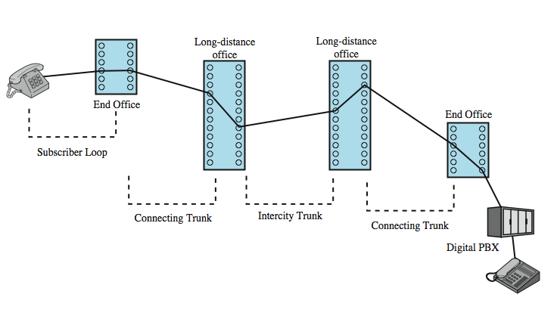
Public Circuit Switched Network
private branch exchange (PBX)
9.<number>
Notes:
Circuit switching was developed to handle voice traffic but is now also used for data traffic. The best-known example of a circuit-switching network is the public telephone network (see Stallings DCC8e Figure 10.2 above). This is actually a collection of national networks interconnected to form the international service. A public telecommunications network can be described using four generic architectural components:
• Subscribers: The devices that attach to the network, typically telephones, but the percentage of data traffic increases year by year.
• Subscriber line: The link between the subscriber and the network, also referred to as the subscriber loop or local loop, mostly using twisted-pair wire.
• Exchanges: The switching centers in the network. A switching center that directly supports subscribers is known as an end office.
Trunks: The branches between exchanges. Trunks carry multiple voice-frequency circuits using either FDM or synchronous TDM

Slide 6
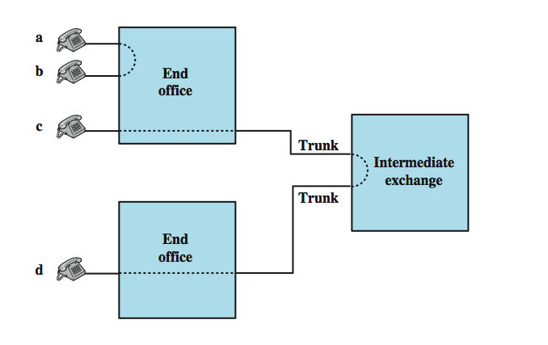
Circuit Establishment
9.<number>
Notes:
Subscribers connect directly to an end office, which switches traffic between subscribers and between a subscriber and other exchanges. The other exchanges are responsible for routing and switching traffic between end offices. This distinction is shown here in Stallings DCC8e Figure 10.3. To connect two subscribers attached to the same end office, a circuit is set up between them. If two subscribers connect to different end offices, a circuit between them consists of a chain of circuits through one or more intermediate offices. In the figure, a connection is established between lines a and b by simply setting up the connection through the end office. The connection between c and d is more complex. In c's end office, a connection is established between line c and one channel on a TDM trunk to the intermediate switch. In the intermediate switch, that channel is connected to a channel on a TDM trunk to d's end office. In that end office, the channel is connected to line d.
Circuit-switching technology has been driven by those applications that handle voice traffic. One of the key requirements for voice traffic is that there must be virtually no transmission delay and certainly no variation in delay. A constant signal transmission rate must be maintained, because transmission and reception occur at the same signal rate. These requirements are necessary to allow normal human conversation. Further, the quality of the received signal must be sufficiently high to provide, at a minimum, intelligibility. Circuit switching achieved its widespread, dominant position because it is well suited to the analog transmission of voice signals. In today's digital world, its inefficiencies are more apparent. However, despite the inefficiency, circuit switching will remain an attractive choice for both local area and wide area networking.

Slide 7
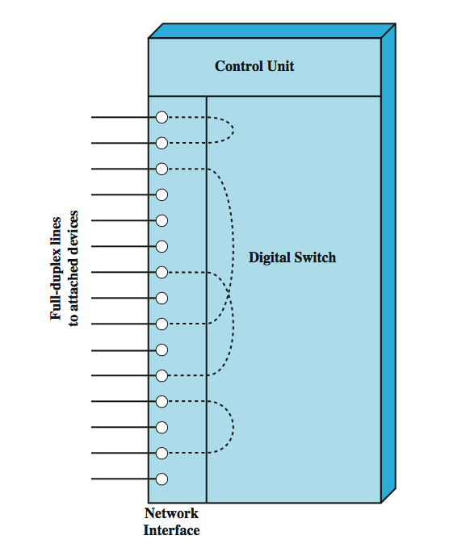
Circuit Switch Elements
9.<number>
Notes:
The technology of circuit switching is best approached by examining the operation of a single circuit-switching node. A network built around a single circuit-switching node consists of a collection of stations attached to a central switching unit. The central switch establishes a dedicated path between any two devices that wish to communicate. Stallings DCC8e Figure 10.4 depicts the major elements of such a one-node network. The dotted lines inside the switch symbolize the connections that are currently active.
The heart of a modern system is a digital switch. The function of the digital switch is to provide a transparent signal path between any pair of attached devices. The path is transparent in that it appears to the attached pair of devices that there is a direct connection between them. Typically, the connection must allow full-duplex transmission.
The network interface element represents the functions and hardware needed to connect digital devices, such as data processing devices and digital telephones, to the network. Analog telephones can also be attached if the network interface contains the logic for converting to digital signals. Trunks to other digital switches carry TDM signals and provide the links for constructing multiple-node networks.
The control unit performs three general tasks. First, it establishes connections. This is generally done on demand, that is, at the request of an attached device. Second, the control unit must maintain the connection. Because the digital switch uses time division principles, this may require ongoing manipulation of the switching elements. Third, the control unit must tear down the connection, either in response to a request from one of the parties or for its own reasons.

Slide 8
Blocking or Non-blocking
blocking network
  may be unable to connect stations because all paths are in use
  used on voice systems
non-blocking network
  permits all stations to connect at once
  used for some data connections
9.<number>
Notes:
An important characteristic of a circuit-switching device is whether it is blocking or nonblocking. Blocking occurs when the network is unable to connect two stations because all possible paths between them are already in use. A blocking network is one in which such blocking is possible. Hence a nonblocking network permits all stations to be connected (in pairs) at once and grants all possible connection requests as long as the called party is free. When a network is supporting only voice traffic, a blocking configuration is generally acceptable, because it is expected that most phone calls are of short duration and that therefore only a fraction of the telephones will be engaged at any time. However, when data processing devices are involved, these assumptions may be invalid. For example, for a data entry application, a terminal may be continuously connected to a computer for hours at a time. Hence, for data applications, there is a requirement for a nonblocking or "nearly nonblocking" (very low probability of blocking) configuration.

Slide 9
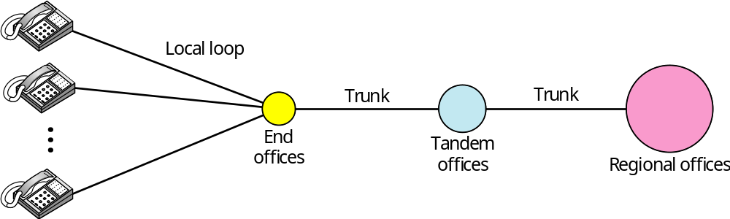
Figure 9.1 A telephone system
9.<number>

Slide 10
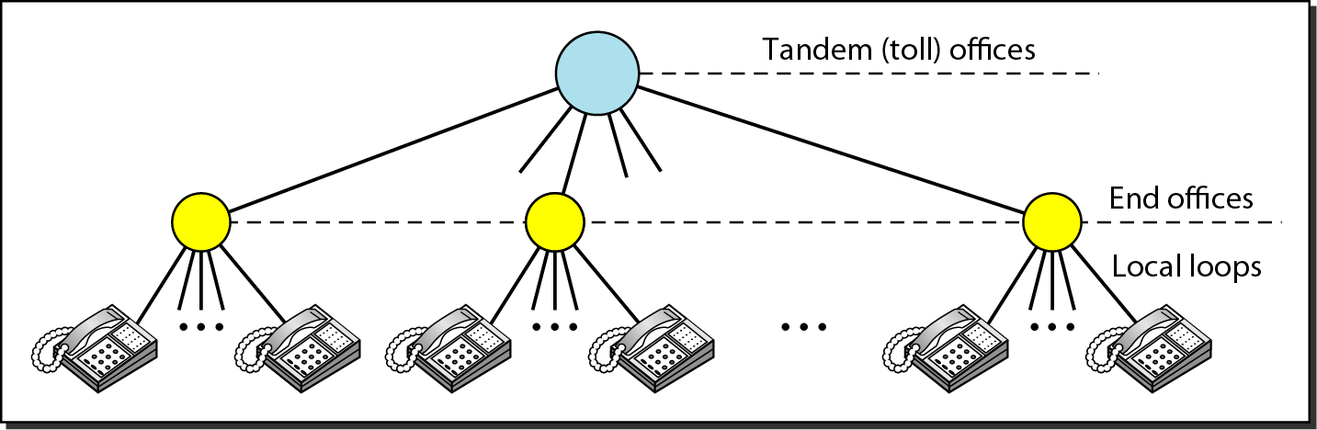
Figure 9.2 Switching offices in a LATA (local-access transport area)
9.<number>

Slide 11

Note
Intra-LATA (local access transport area) services are provided by local exchange carriers (LECs).
Since 1996, there are two
types of LECs: incumbent local exchange carriers and competitive
local exchange carriers.
IXC (Interexchange carrier, long distance company)
9.<number>

Slide 12
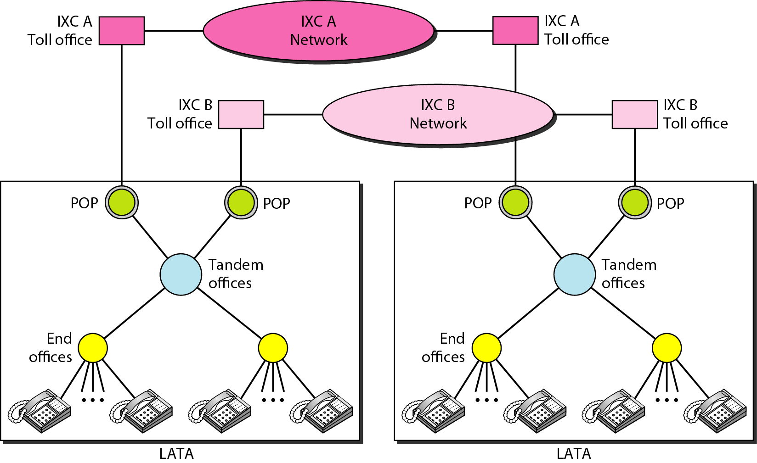
Figure 9.3 Point of presences (POPs)
Normally digitized data
Pop: point of presence
9.<number>

Slide 13
Note
The tasks of data transfer and signaling are separated in modern telephone networks: data transfer is done by one network, signaling by another.
9.<number>

Slide 14
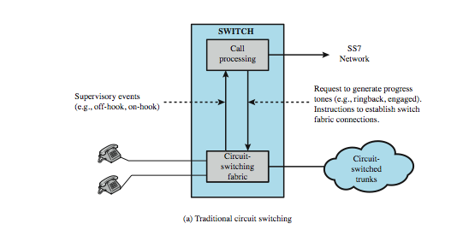
Traditional Circuit Switching
9.<number>
Notes:
Stallings DCC8e Figure 10.7a contrasts the the softswitch architecture with that of a traditional telephone network circuit switch.

Slide 15
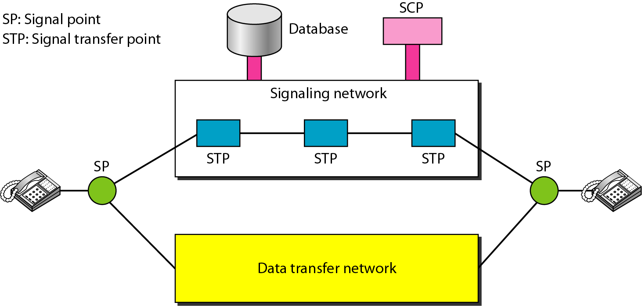
Figure 9.4 Data transfer and signaling networks
Packet-switch
Packet-switch or circuit-switch
9.<number>

Slide 16
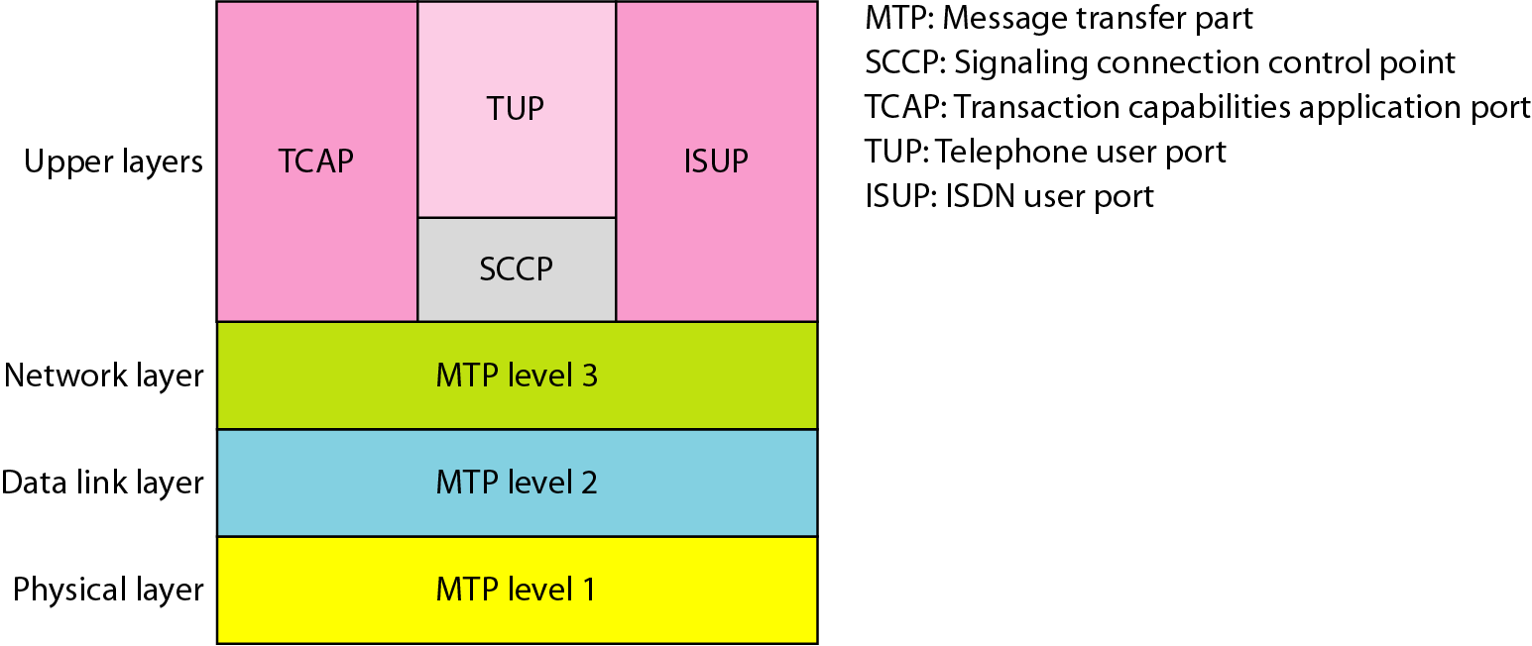
Figure 9.5 Layers in SS7 (signaling system seven)
Very similar to OSI Internet
7 layer model
9.<number>

Slide 17
9-2 DIAL-UP MODEMS
Traditional telephone lines can carry frequencies between 300 and 3300 Hz, giving them a bandwidth of 3000 Hz. All this range is used for transmitting voice, where a great deal of interference and distortion can be accepted without loss of intelligibility.
Topics discussed in this section:
Modem Standards
9.<number>

Slide 18
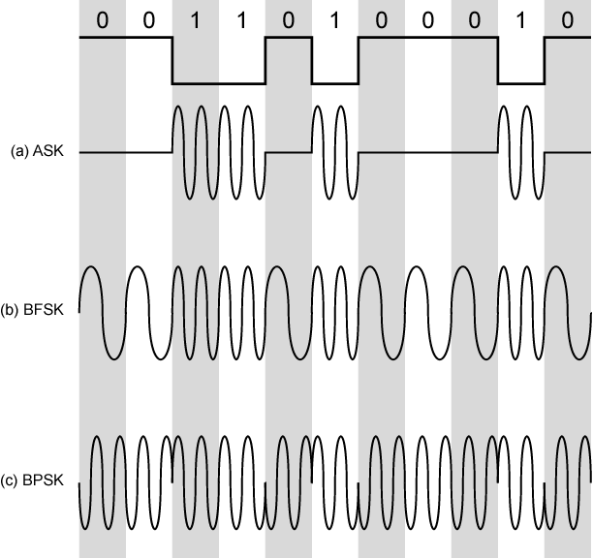
Digital Data, Analog Signal: Modulation Techniques
9.<number>
Notes:
Have stated that modulation involves operation on one or more of the three characteristics of a carrier signal: amplitude, frequency, and phase. Accordingly, there are three basic encoding or modulation techniques for transforming digital data into analog signals, as illustrated in Stallings DCC8e Figure 5.7 (above): amplitude shift keying (ASK), frequency shift keying (FSK), and phase shift keying (PSK). In all these cases, the resulting signal occupies a bandwidth centered on the carrier frequency.

Slide 19
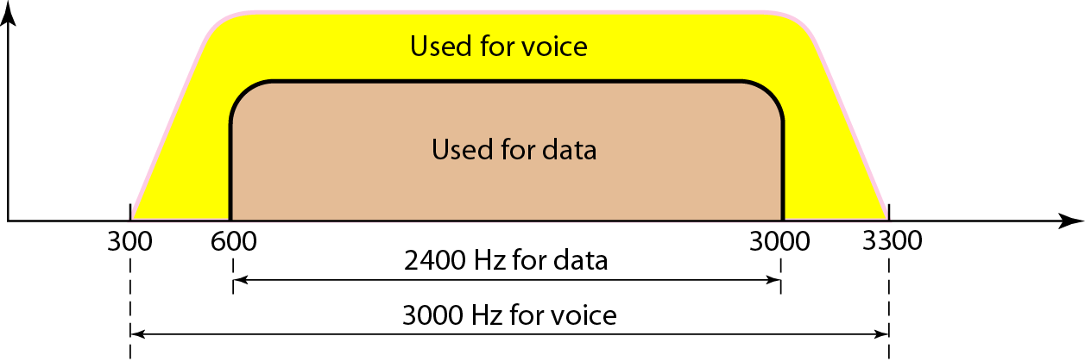
Figure 9.6 Traditional Telephone line bandwidth
Modern phone line has higher bandwidth
9.<number>

Slide 20
Note
Modem
stands for modulator/demodulator.
9.<number>

Slide 21
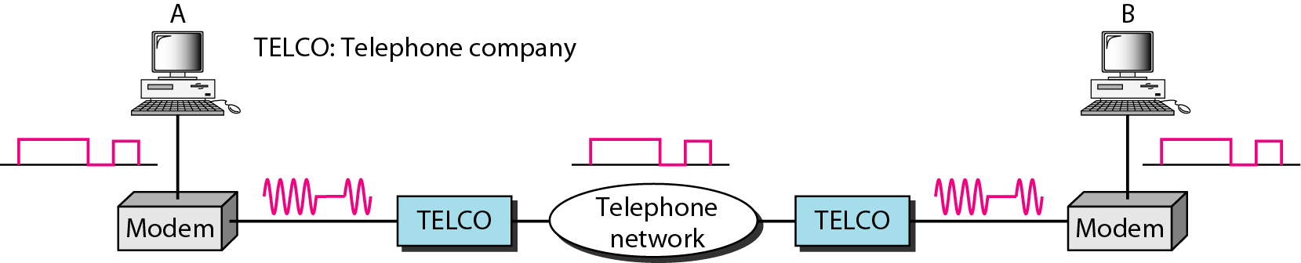
Figure 9.7 Modulation/demodulation
TELCO: telephone company
(unnecessary acronyms! I think)
9.<number>

Slide 22
Quadrature Amplitude Modulation (QAM)
QAM used on asymmetric digital subscriber line (ADSL) and some wireless
combination of ASK and PSK
logical extension of QPSK
send two different signals simultaneously on same carrier frequency
  use two copies of carrier, one shifted 90°
  each carrier is PSK modulated
  two independent signals over same medium
  demodulate and combine for original binary output
9.<number>
Notes:
Quadrature amplitude modulation (QAM) is a popular analog signaling technique that is used in the asymmetric digital subscriber line (ADSL), described in Chapter 8, and in some wireless standards. This modulation technique is a combination of ASK and PSK. QAM can also be considered a logical extension of QPSK. QAM takes advantage of the fact that it is possible to send two different signals simultaneously on the same carrier frequency, by using two copies of the carrier frequency, one shifted by 90˚ with respect to the other. For QAM, each carrier is ASK modulated. The two independent signals are simultaneously transmitted over the same medium. At the receiver, the two signals are demodulated and the results combined to produce the original binary input.

Slide 23
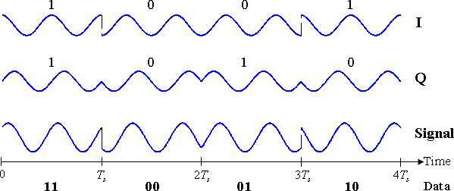
QPSK Illustration
This figure copied from wikipedia
9.<number>

Slide 24
Modem Standards
V-series standard | Modulation | Data Rate | Baud Rate
V.32 | 32-QAM | 9600 bps | 2400 baud | Only 4 bits represent data
V.32 bis | 128-QAM | 14,400 bps | 2400 baud | Only 6 bits represent data
V.34 bis | M-QAM | 28,800-33,600 bps
V.90 | M-QAM | 56 Kbps (downstream) 33.6 Kbps (upstream)
V.92 | M-QAM | 56 Kbps (downstream) 48 Kbps (upstream) |  | A modem adjusts its speed
9.<number>

Slide 25
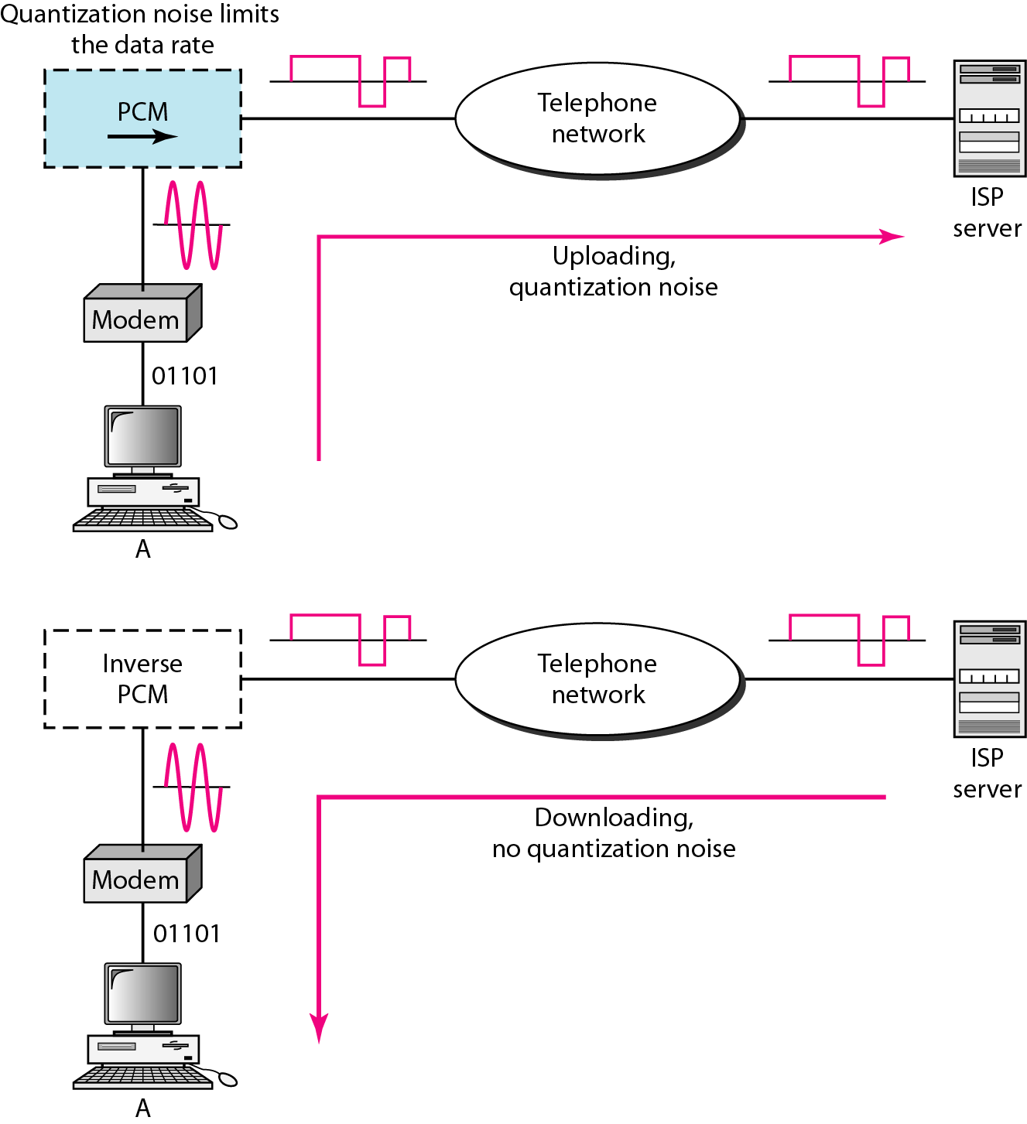
Figure 9.9 Uploading and downloading in 56K modems
SNR explains why download speed is higher
9.<number>

Slide 26
9-3 DIGITAL SUBSCRIBER LINE
After traditional modems reached their peak data rate, telephone companies developed another technology, DSL, to provide higher-speed access to the Internet. Digital subscriber line (DSL) technology is one of the most promising for supporting high-speed digital communication over the existing local loops.
Topics discussed in this section:
ADSL
ADSL Lite
HDSL
SDSL
VDSL
9.<number>

Slide 27
Note
ADSL is an asymmetric communication technology designed for residential users; it is not suitable for businesses.
Because business needs larger upload bandwidth
9.<number>

Slide 28
Note
The existing local loops (twisted-pair lines) can handle bandwidths up to
1.1 MHz.
Traditional phone has a low-pass filter in front of it,
Which limits its bandwidth to 4KHz.
9.<number>

Slide 29
Note
ADSL is an adaptive technology.
The system uses a data rate
based on the condition of
the local loop line.
Distance between residence to switching office
Size of the cable
Signaling used
9.<number>

Slide 30
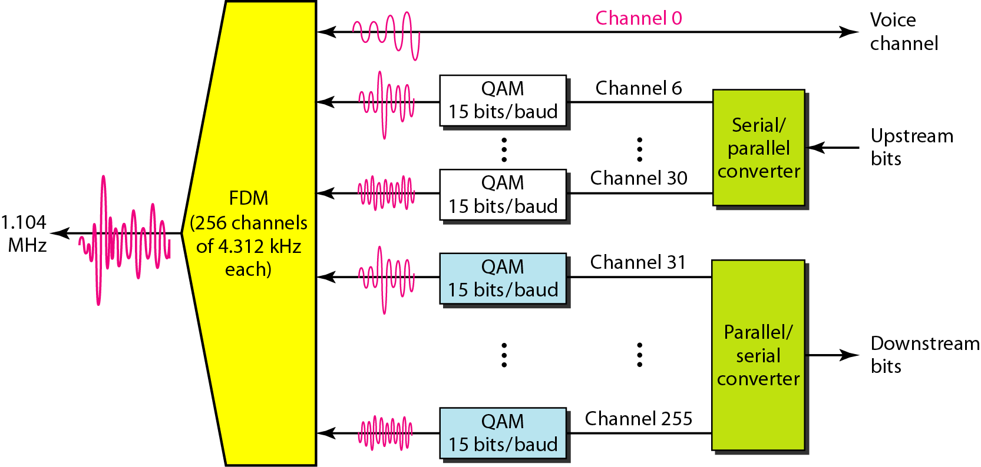
Figure 9.10 Discrete multitone technique (QAM + FDM)
9.<number>

Slide 31
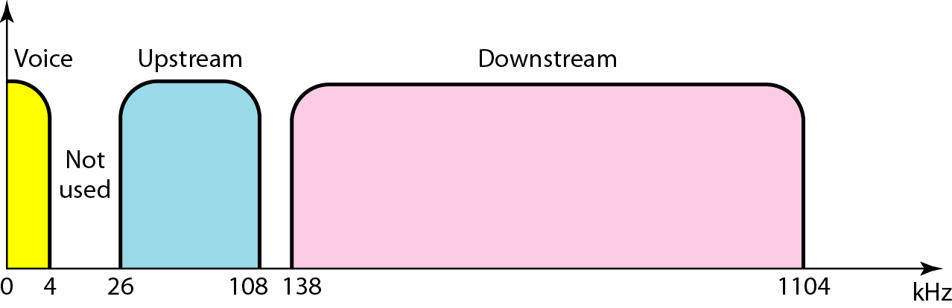
Figure 9.11 Bandwidth division in ADSL
9.<number>

Slide 32
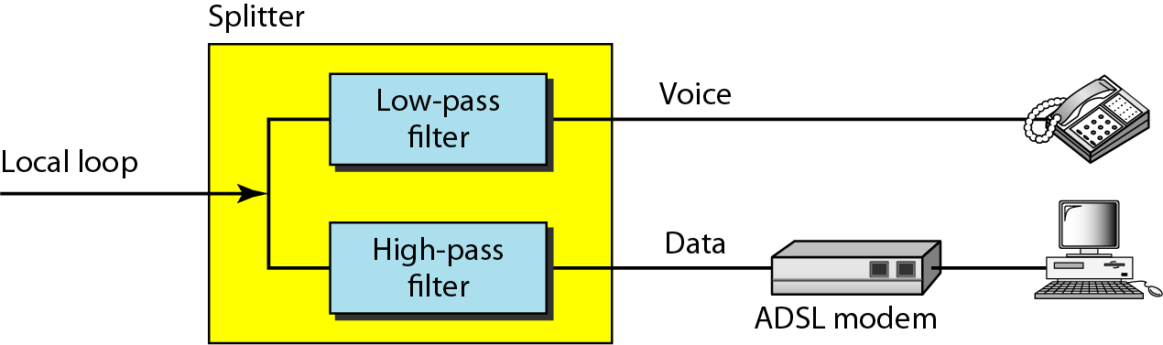
Figure 9.12 Customer site: ADSL modem
Splitter and data line need installation
(maybe expensive)
ADSL Lite (universal ADSL or spliterless ADSL:
does not need additional installation from telephone company
9.<number>

Slide 33
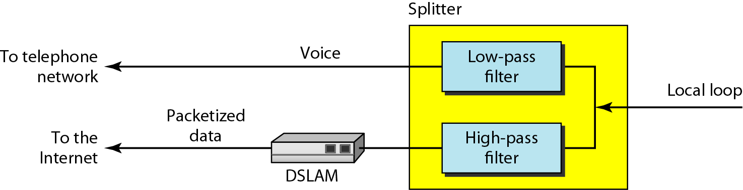
Figure 9.13 telephone company site
9.<number>

Slide 34
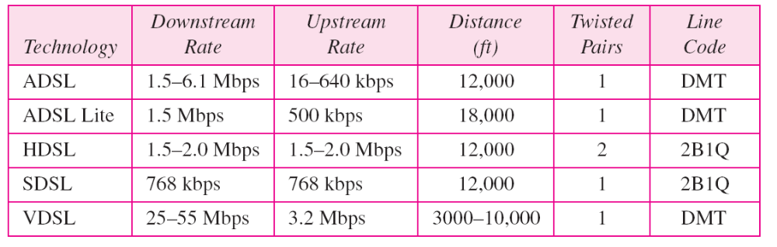
Table 9.2 Summary of DSL technologies
ADSL Lite: does not need additional installation
from telephone company
9.<number>

Slide 35
9-4 CABLE TV NETWORKS
The cable TV network started as a video service provider, but it has moved to the business of Internet access. In this section, we discuss cable TV networks per se; in Section 9.5 we discuss how this network can be used to provide high-speed access to the Internet.
Topics discussed in this section:
Traditional Cable Networks
Hybrid Fiber-Coaxial (HFC) Network
9.<number>

Slide 36
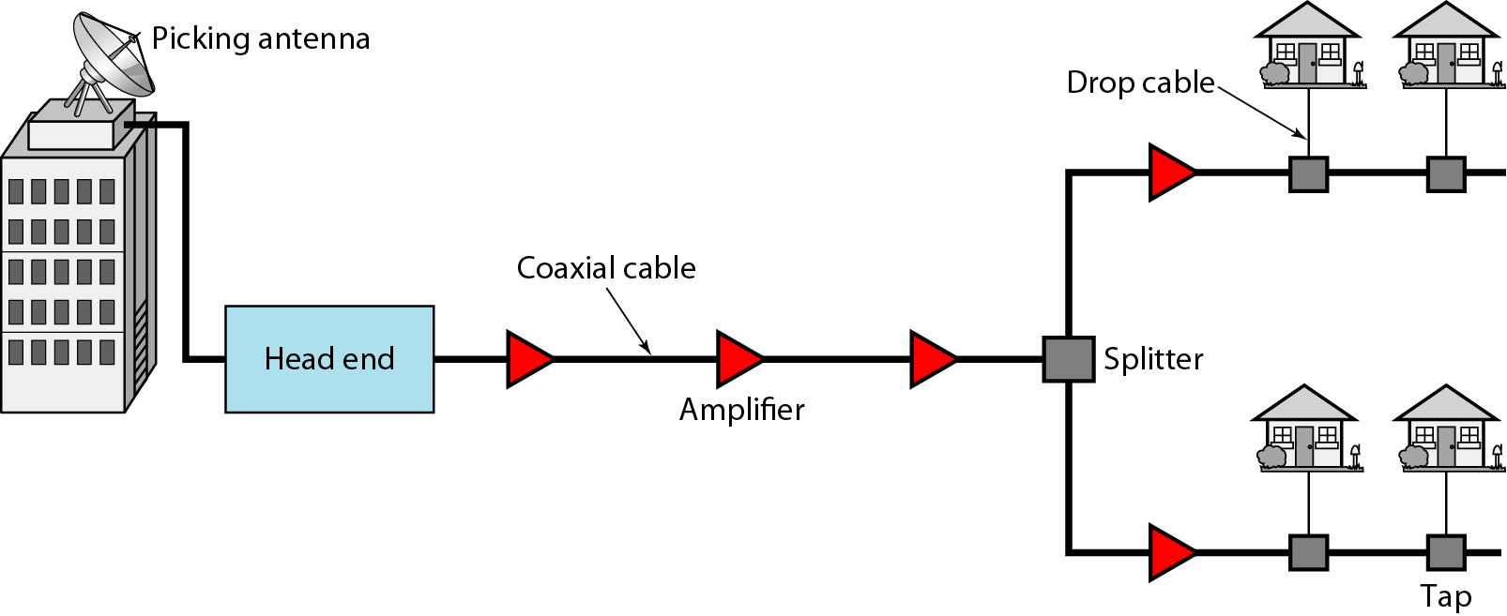
Figure 9.14 Traditional cable TV network
9.<number>

Slide 37
Note
Communication in the traditional cable TV network is unidirectional.
9.<number>

Slide 38
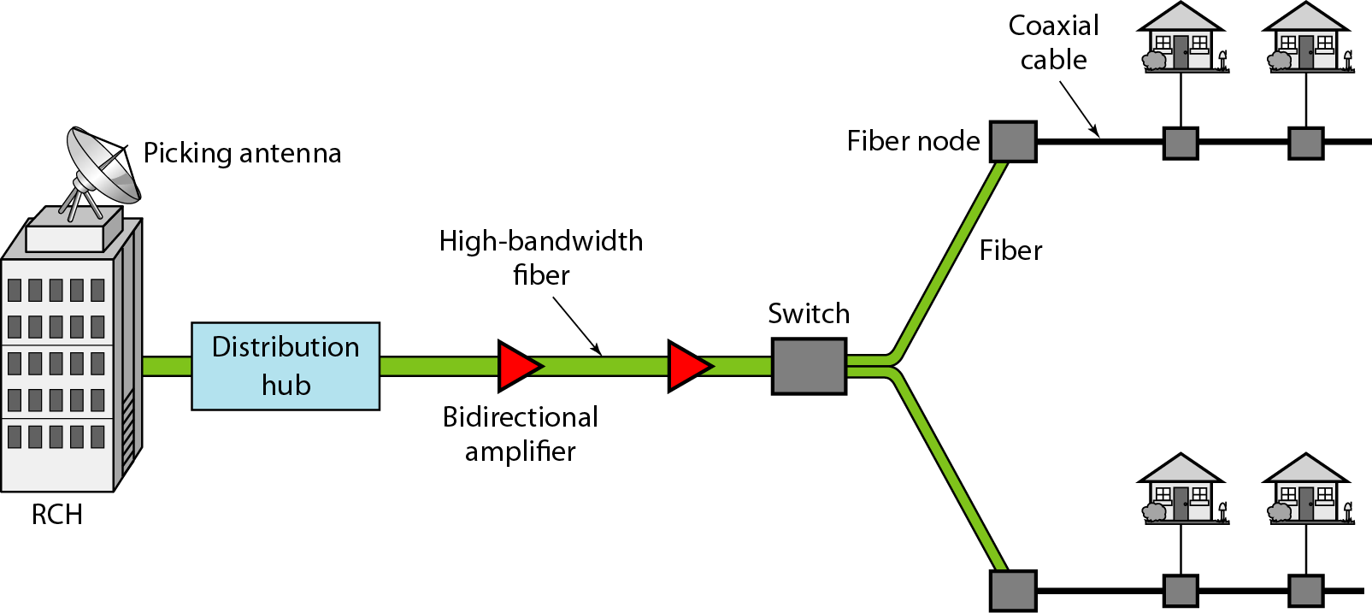
Figure 9.15 Hybrid fiber-coaxial (HFC) network
9.<number>

Slide 39
Note
Communication in an HFC cable TV network can be bidirectional.
9.<number>

Slide 40
9-5 CABLE TV FOR DATA TRANSFER
Cable companies are now competing with telephone companies for the residential customer who wants high-speed data transfer. In this section, we briefly discuss this technology.
Topics discussed in this section:
Bandwidth
Sharing
CM and CMTS
Data Transmission Schemes: DOCSIS
9.<number>

Slide 41
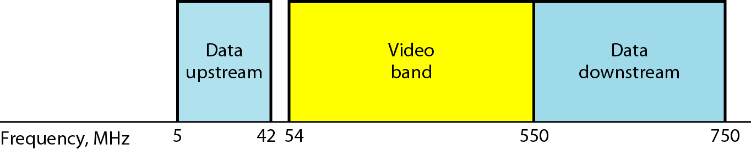
Figure 9.16 Division of coaxial cable band by CATV
Each video TV channel uses 6MHz
9.<number>

Slide 42
Note
Downstream data are modulated using the 64-QAM modulation technique.
9.<number>

Slide 43
Note
The theoretical downstream data rate
is 30 Mbps.
9.<number>

Slide 44
Note
Upstream data are modulated using the QPSK modulation technique.
This figure copied from wikipedia
9.<number>

Slide 45
Note
The theoretical upstream data rate
is 12 Mbps.
9.<number>

Slide 46
Sharing: Upstream sharing
The upstream bandwidth is 37 MHz.
There are six 6-MHz channels available.
How can the channels be shared in an area with 1000,2000 or even 200,000 subscribers?
Using FDM/timesharing.
Subscribers have to contend for the channels with others.
9.<number>

Slide 47
Sharing: Downstream sharing
The downstream band has 33 channels of 6 MHz.
We have a multicast situation.
If there is data for any of subscribers in the group, the data are sent to that channel.
9.<number>

Slide 48
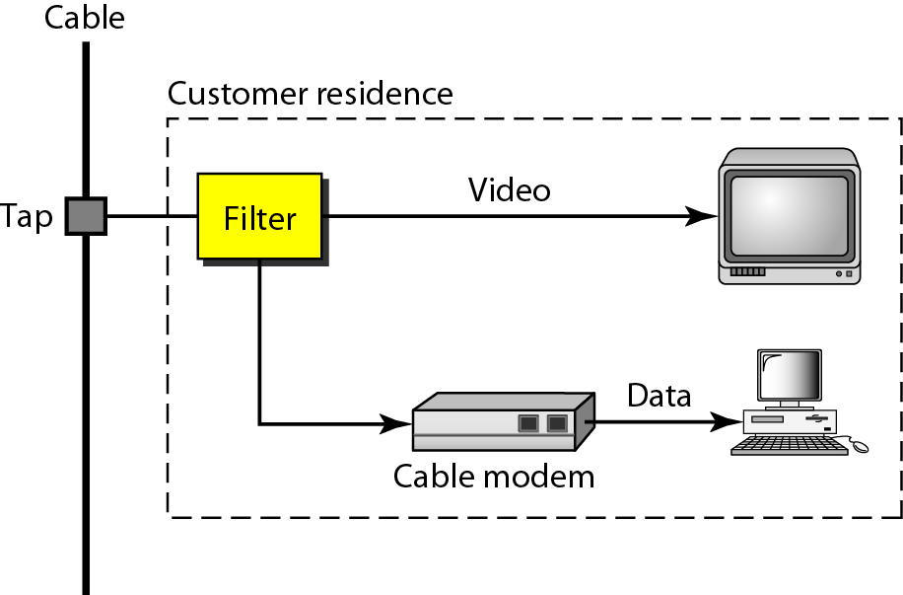
Figure 9.17 Cable modem (CM)
9.<number>

Slide 49
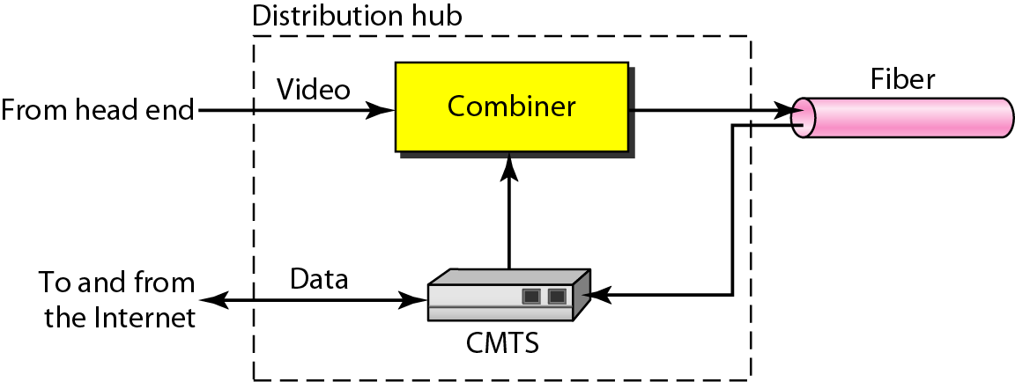
Figure 9.18 In cable company: Cable modem transmission system (CMTS)
9.<number>

Slide 50
Data Transmission Schemes: Data Over Cable System Interface Specification
Defines all the protocols necessary to transport data from a CMTS to a Cable Modem.
Upstream Communication
  CM checks for specific packets sent by CMTS.
  The CMTS sends a packet to CM, defining its allocated downstream and upstream channels.
  The CM starts ranging process (to determine the distance for synchronization).
9.<number>

Slide 51
Data Transmission Schemes: Data Over Cable System Interface Specification
  The CM sends a packet to the ISP, asking for the IP address.
  The CM and CMTS exchange some packets to establish security parameters.
  The CM sends its unique identifier to the CMTS.
  Upstream communication can start in the allocated upstream channel.
9.<number>

Slide 52
Data Transmission Schemes: Data Over Cable System Interface Specification (DOCSIS)
Downstream Communication
  No contention because only one sender.
  The CMTS sends the packet with the address of the receiving CM, using the allocated downstream channel.
9.<number>

