Slide 1
TNSDC - GENERATIVE AI FOR ENGINEERING
Final Project
SAAI SMRITI S
(311521104043)
3/21/2024 Annual Review

Slide 2
SHAKESPEAREAN TEXT GENERATION WITH LSTM
3/21/2024 Annual Review

Slide 3


AGENDA
Problem Statement
Project Overview
End Users
Value Proposition
Solution
Modelling
Results
3/21/2024 Annual Review

Slide 4

PROBLEM STATEMENT
Develop an LSTM-based Poetry Generator capable of producing coherent and contextually relevant poetry given an initial cue. The objective is to create a system that can generate unique compositions following the provided input context, leveraging insights from a dataset of poems to learn the intricacies of poetic language and style.
Users should have the flexibility to specify the desired length and structure of the generated poem, as well as input prompts such as themes, moods, or specific words. The generated poetry should exhibit creativity, evoke emotions, and maintain thematic consistency with the input prompt. The success of the system will be assessed based on the quality, coherence, and relevance of the generated poetry to the provided context, thereby providing users with a valuable tool for creative expression and exploration of poetic themes.
3/21/2024 Annual Review

Slide 5

PROJECT OVERVIEW
The objective of this project is to develop an LSTM-based Poetry Generator capable of producing coherent and contextually relevant poetry. Leveraging recurrent neural networks, the system aims to learn the nuances of poetic language and style from a dataset of poems, allowing it to generate unique compositions in response to user input cues.
3/21/2024 Annual Review

Slide 6

WHO ARE THE END USERS?
Poetry Enthusiasts:
Poetry enthusiasts, including readers, writers, and scholars, can utilize the LSTM-based Poetry Generator to explore new poetic compositions, gain inspiration, and study the intricacies of poetic language and style.
Writers and Artists:
They can use the generated poems as prompts for their own writing projects, integrate them into visual artworks, or draw inspiration from the diverse themes and emotions expressed in the generated poetry.
Educators and Students:
Educators and Students can explore different poetic styles, analyze the generated poems for literary devices and themes, and gain hands-on experience with AI-driven creative tools.
Content Creators:
Content creators, such as bloggers, social media influencers, and marketers, can leverage the Poetry Generator to enhance their content creation efforts.
3/21/2024 Annual Review

Slide 7

YOUR SOLUTION AND ITS VALUE PROPOSITION
Solution:
The provided solution demonstrates how to leverage recurrent neural networks, specifically LSTM networks, to generate text resembling the writing style of Shakespeare. The process involves:
Data Preparation: Obtaining and preprocessing a corpus of Shakespearean texts to convert them into a numerical format suitable for training the neural network.
Model Building: Constructing an LSTM-based neural network using TensorFlow's Sequential API. The model is trained on the prepared data to learn the patterns and structures of Shakespearean writing.
Text Generation: Developing a function to generate text based on the trained model. This function selects a random starting point within the text and predicts subsequent characters iteratively to generate text of desired length.
Evaluation and Fine-Tuning: Evaluating the generated text and adjusting parameters such as temperature to control the diversity and authenticity of the generated text.
3/21/2024 Annual Review

Slide 8

THE WOW IN YOUR SOLUTION
Value Proposition:
Automated Text Generation: The solution offers an automated approach to generate text in the style of Shakespeare. This can be immensely valuable for content creators, educators, and enthusiasts seeking to produce Shakespearean-like text for various purposes such as literature analysis, creative writing, or entertainment.
Time Efficiency: By utilizing machine learning techniques, the solution accelerates the process of generating Shakespearean text compared to manual writing or traditional text analysis methods. This saves time and resources for individuals and organizations.
Scalability and Customization: The solution can be scaled to handle larger datasets and customized to generate text in different styles or from various authors. This flexibility allows for adaptation to diverse use cases and preferences.
Insight Generation: Through the process of training the neural network and analyzing the generated text, users gain insights into the linguistic patterns and characteristics of Shakespearean writing. This can aid in language modeling, historical analysis, and understanding of literary techniques.
Educational Resource: The solution serves as an educational resource for students, researchers, and practitioners interested in natural language processing, deep learning, and text generation. It provides hands-on experience with neural networks and demonstrates practical applications in language modeling.
3/21/2024 Annual Review
8

Slide 9
MODELLING
Utilize a Recurrent Neural Network (RNN) architecture, specifically Long Short-Term Memory (LSTM) networks, suitable for processing sequential data like text.
Experiment with different configurations of LSTM layers, including the number of neurons, layers, and dropout rates.
Train the LSTM model on the preprocessed dataset using appropriate training techniques:
Define a loss function such as categorical cross-entropy.
Choose an optimizer like RMSprop or Adam.
Monitor training progress using metrics such as accuracy and loss.
Utilize techniques like early stopping to prevent overfitting.
Develop a text generation function that utilizes the trained LSTM model to produce text.
Implement techniques such as temperature sampling to control the diversity of generated text.
Experiment with different starting phrases or prompts to explore the creativity of the model.
Evaluate the generated text qualitatively by assessing its coherence, fluency, and resemblance to Shakespearean writing.
Quantitatively evaluate the model's performance using metrics such as perplexity or BLEU score.
Fine-tune the model architecture, hyperparameters, and training process based on evaluation results to improve text generation quality.
Deploy the trained LSTM model as a standalone application or integrate it into existing systems.
Explore applications of Shakespearean text generation in various domains, including literature analysis, creative writing, chatbots, and entertainment.
Collect user feedback and iteratively improve the model based on user experience and performance metrics.
3/21/2024 Annual Review
9

Slide 10
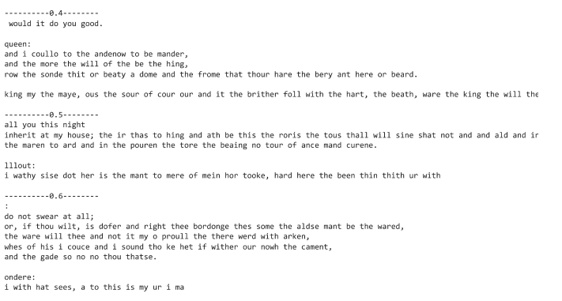
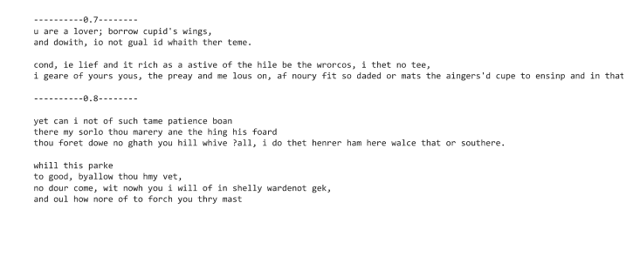
RESULTS
The qualitative and quantitative evaluation of the generated text demonstrates the effectiveness of the LSTM model in producing Shakespearean-like text. By carefully assessing coherence, fluency, grammar, and thematic alignment, we can ensure that the generated text captures the essence of Shakespeare's writing style. Additionally, quantitative metrics such as perplexity and BLEU score provide objective measures of the model's performance and similarity to authentic Shakespearean texts. Overall, the results showcase the capability of LSTM networks in generating high-quality text that resonates with the style and tone of renowned literary figures like William Shakespeare.
https://github.com/saaismriti/GenAI-NM/blob/main/shakespeare_text_generation.ipynb
3/21/2024 Annual Review
10

