Slide 1
Team Name: The Outliers
State: Jammu And Kashmir
College: Model Institute Of Engineering And Technology (M.I.E.T)

Slide 2
Team Members:
Saajan Shridhar
Mithleshwar Lakhanpuria
Abhishek Charak
Faculty Mentor:
Mrs. Ankita Bansal

Slide 3
Project Scenario:
Social Networking Website
for Social Responsibility

Slide 4
CONTENTS
Functional Requirements.
Non-functional Requirements.
Use case Diagrams
Architecture Design
Features
Future Scope
Roles
References

Slide 5
FUNCTIONAL REQUIREMENTS
Warning : This site requires a latest HTML 5 browser or it won't work properly.
This website is a common platform for all the users i.e. all the users have their own profile through which they can raise their voice and involve more crowd with them. The views of different users can be shared through the features like status, scraps, chat and private messages.
NGOs can also promote their perspective events on our site. The Govt. Officials can also pay heed towards the problem being faced by general public through complaint boxes.
One can start debates and discussions on current affairs through forums. The latest discussions and related topics of the forums being joined by different users are prompted in the inbox of the corresponding user.
All the users will be able to customize their profile as per their choice with the help of change account settings option.

Slide 6
Each user is able to score positive or negative you find your classmate did a good job at the college function arrangements, you can increase his responsibility score by +1. If you find your neighbor smoking in public in front of children, you can decrement his responsibility score by 1 through our score feature
The authentication process done by the admin is using valid documents, thumb impression so that no user can have more than one account in our website.
Once the discussion about dispute between some individuals comes to conclusion, the people in friend list of the person that comes out to be culprit can decrement his/her responsibility score.

Slide 7
Non-Functional Requirements
Secure access of confidential data (user’s details). SSL can be used.
24 X 7 availability
Better component design to get better performance at peak time
Flexible service based architecture will be highly desirable for future extension

Slide 8
Features

Slide 9
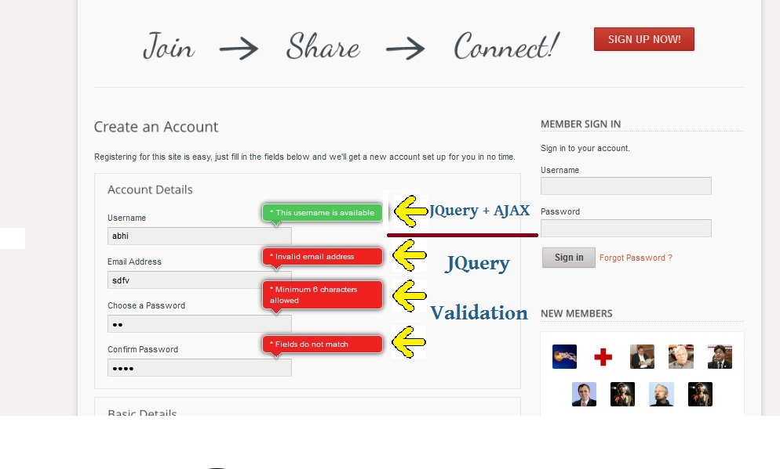
HTML 5, AJAX, JavaScript

Slide 10
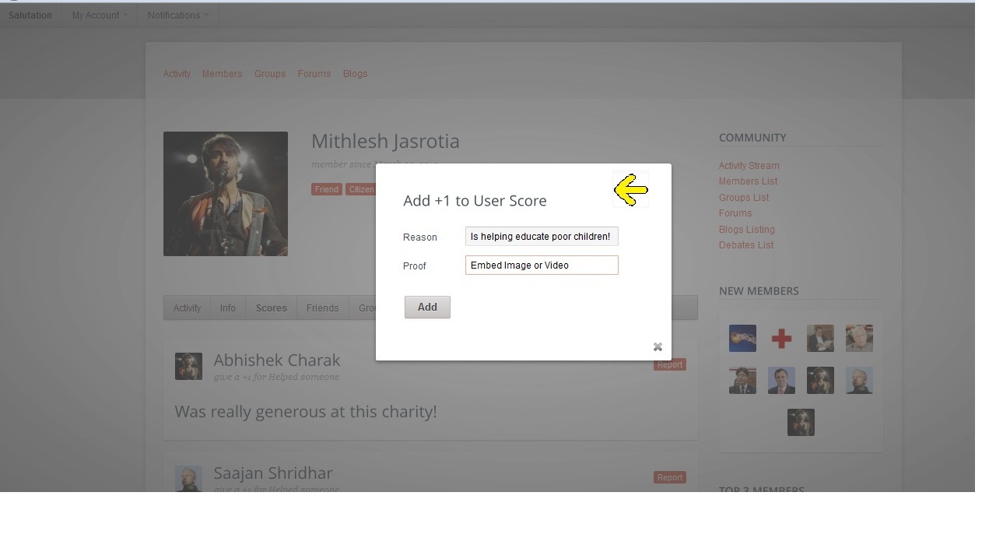
Increase someone's score ( +1)

Slide 11
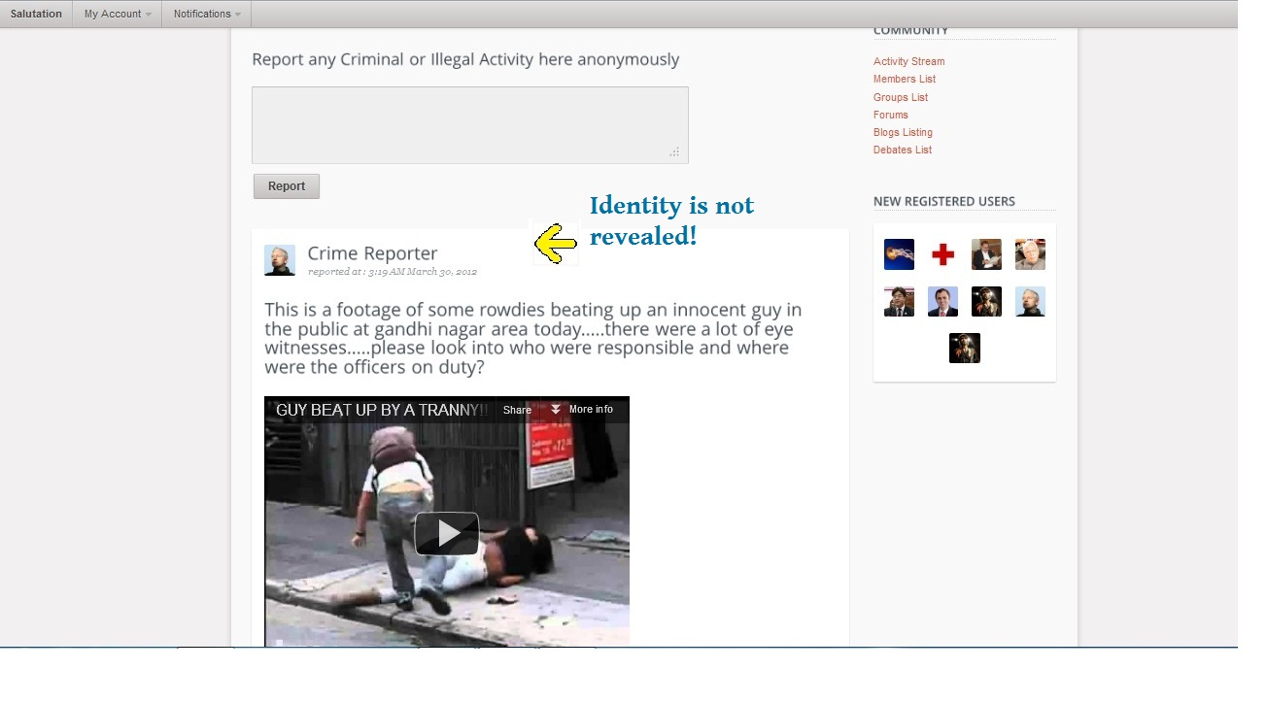
Reasons List

Slide 12
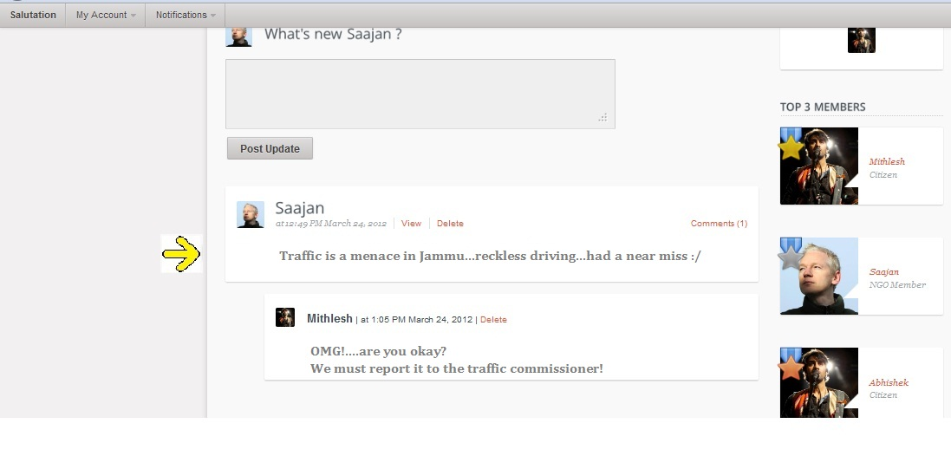
Status Update

Slide 13
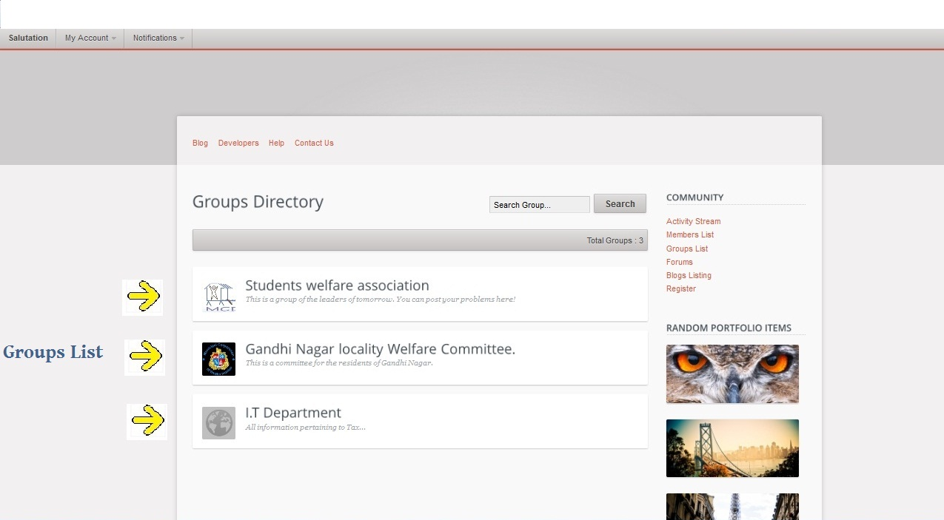
Groups

Slide 14
Crime Reporter (anonymous)

Slide 15
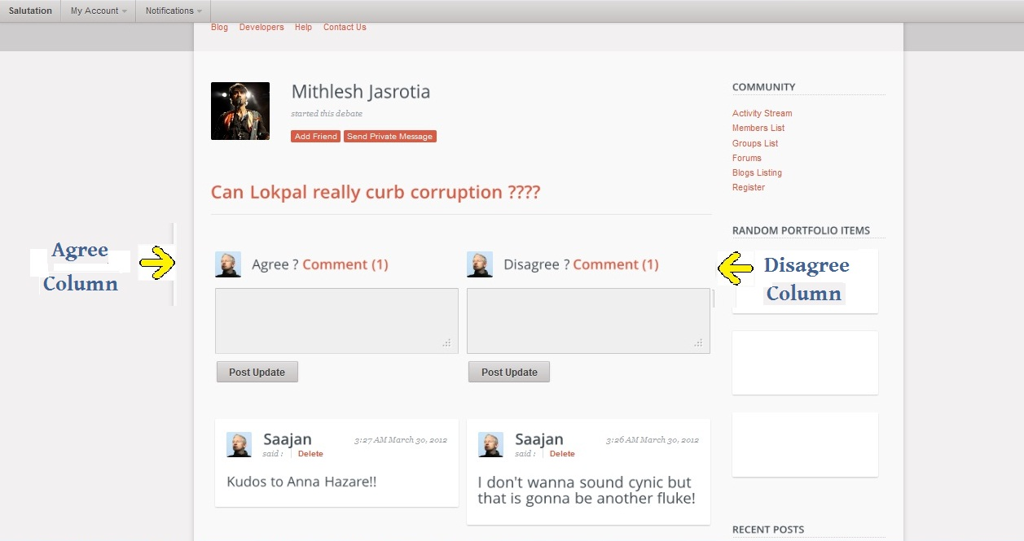
Debates

Slide 16
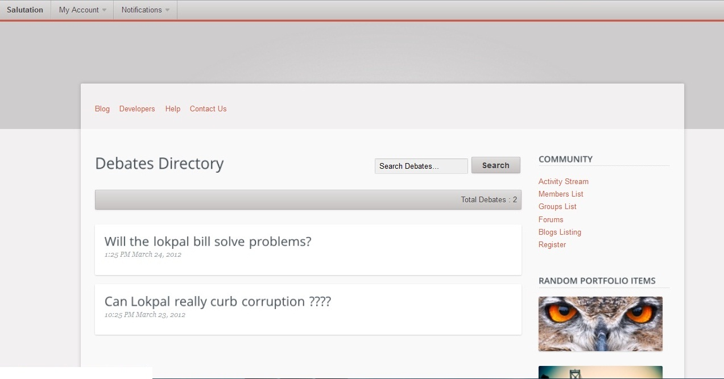

Slide 17
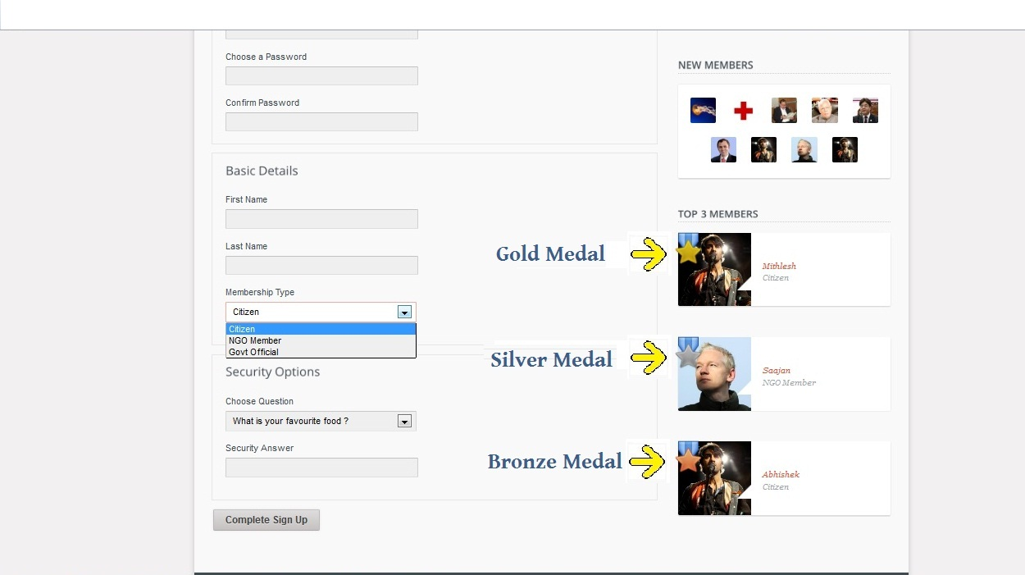
User Ranking

Slide 18
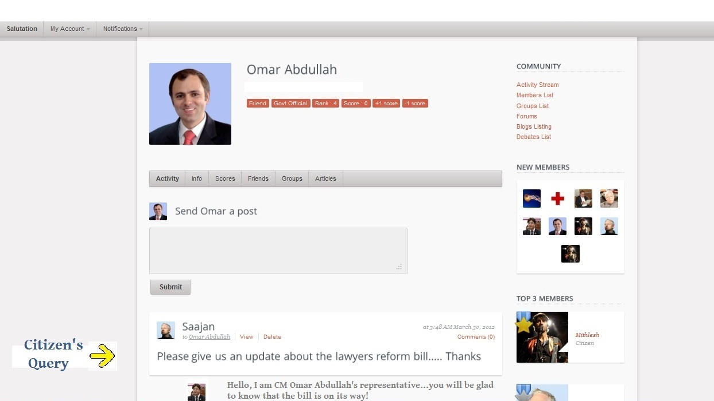
Govt Official Profile

Slide 19
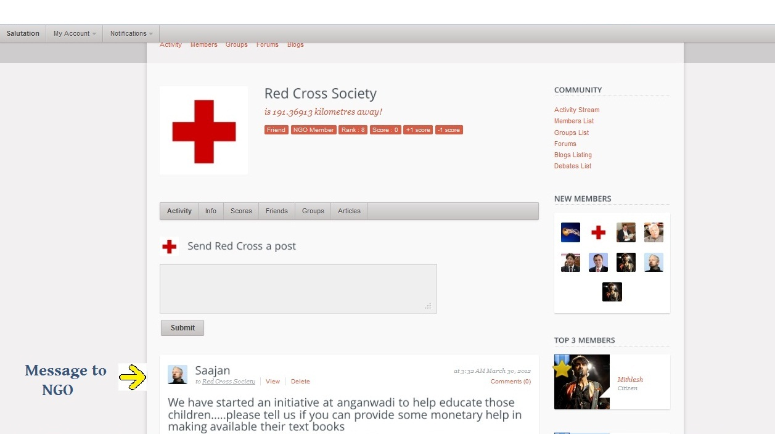
NGO Page

Slide 20
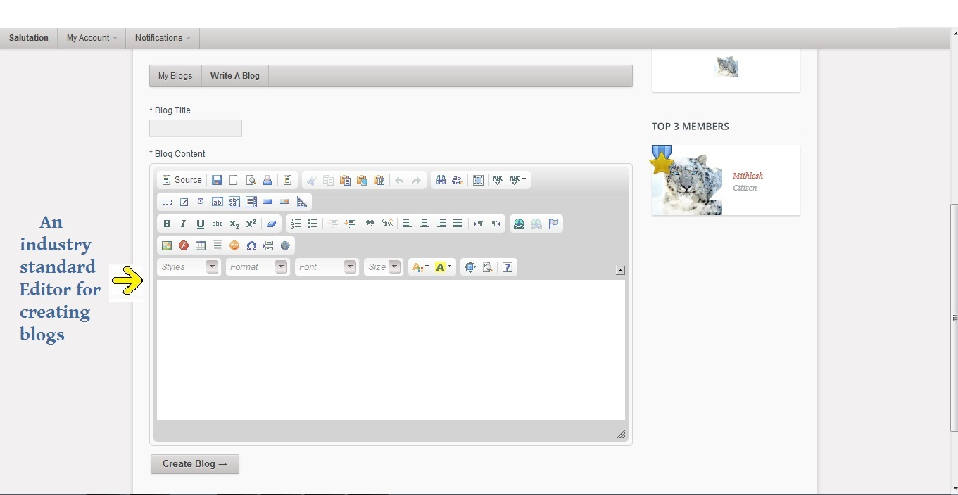
Blogs

Slide 21
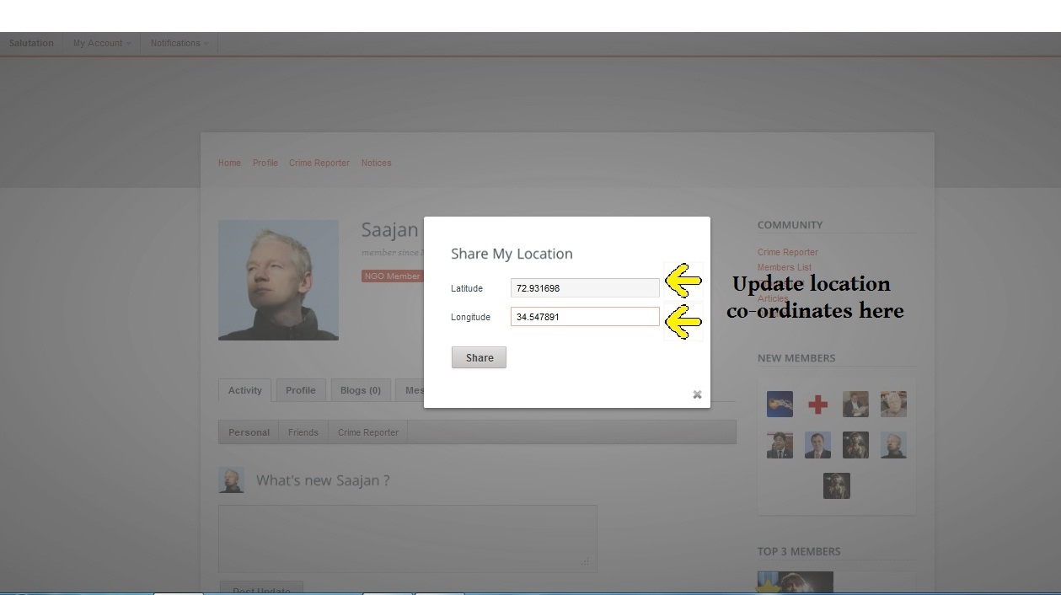
Update current location

Slide 22
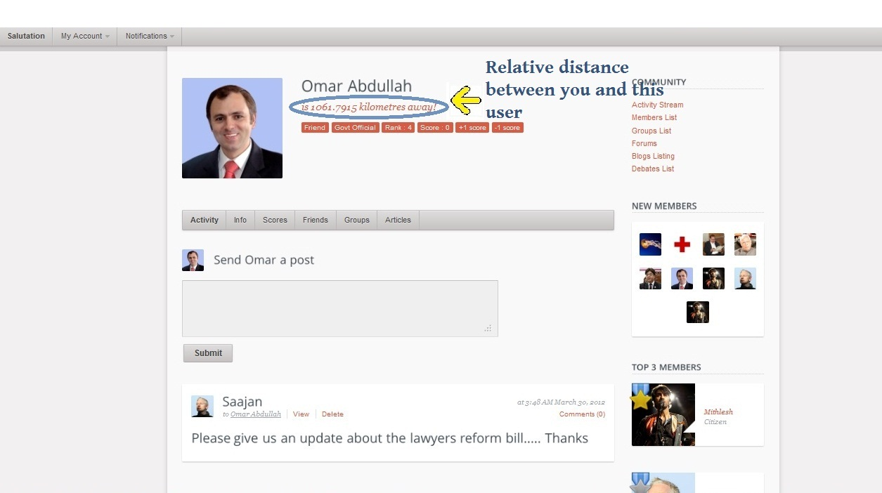
Updated relative distance

Slide 23
Features
1. Reward good social work by giving +1 to other user to improve their overall rank.
2. Likewise, ability to -1 someone for being bad socially.
3. Gold, silver and bronze medal to top three citizens on each page.
4. Debate function to be able to create a debate or join someone else's debate. Fluidic interface with comment columns neatly divided into agree or disagree.

Slide 24
5. Crime reporter page, to be able to report some crime without letting out your name. At no place in the site, the name of the reporter is shown and once reported, there is no way to delete the post.
6. Ability to form social groups based on interests in a particular social cause and add more people to it.
7. Ability to retrieve all the social work (good or bad), associated to a person simply by clicking on his current rank button.
8. Option for bulk registration for NGOs and Govt. organizations simply by uploading a .CSV file to the site.
9. Option to generate user statistics reports and to export them in either .PDF or .DOC format.

Slide 25
10. To be able to update status along with ability to comment.
11. To be able to post on someone else's wall, NGO , CITIZEN or GOVT. OFFICIAL.
12. Ability to embed media content from other sites such as photo or video.
13. Whole application is completely based on the modern HTML 5 technology.

Slide 26
INNOVATIVE FEATURE
Through this site, we are trying to leverage the capability of the user to
share his location to make our site more intelligent.
The user can share his location by manually entering his location
co-ordinates in the 'Share Location' button. (Though this process is
supposed to be automated in the future by fetching location data through
GPS or the IP address.)
When you click on someone's profile, the site tells you how far away the
other person is in Kms.
We are trying to introduce something called a 'Location Based Status
Update'. So if you post a status and mark it as location based and
relevant only to people around you right now, let's say in a 2KM radius,
it ill be visible to only the friends you are around you right now.

Slide 27
Use case may include a hypothetical situation where in case of a social
emergency, you need your friends' help. You can post out an SOS and
mark it location based. This SOS should only be relevant to people around
you right then because there is no way someone who is too far away can
come to your rescue. And because you have already shared your location,
they already know where you are and can join you to stop the misdeed.

Slide 28
FUTURE SCOPE
Owing to limited time frame, we were not able to include some of the relatively less important functions in the current scenario requirement. We are likely to further add these following options :
Online chatting
Photo and video tagging

Slide 29
ROLES
BUSINESS LOGIC:-
SAAJAN SHRIDHAR
MITHLESHWAR LAKHANPURIA
ABHISHEK CHARAK
PRESENTATION LAYER AND DATABASE:-
SAAJAN SHRIDHAR
MITHLESHWAR LAKHANPURIA
TESTING AND VALIDATION:-
ABHISHEK CHARAK

Slide 30
REFERENCES
www.google.com
www.bing.com.
http://en.wikipedia.org/wiki
http://javadocs.org/
http://www.java2s.com/
www.ibm.com/software/data/db2/
www.w3schools.com
www.themeforest.net

