Slide 1


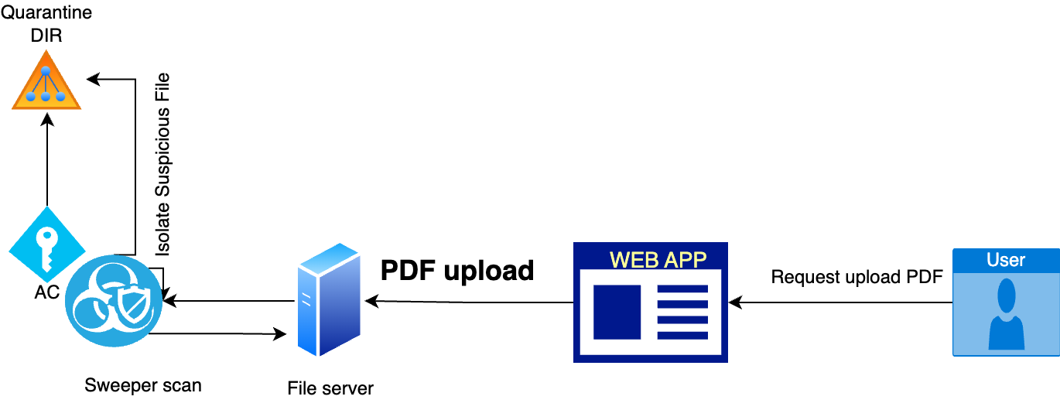
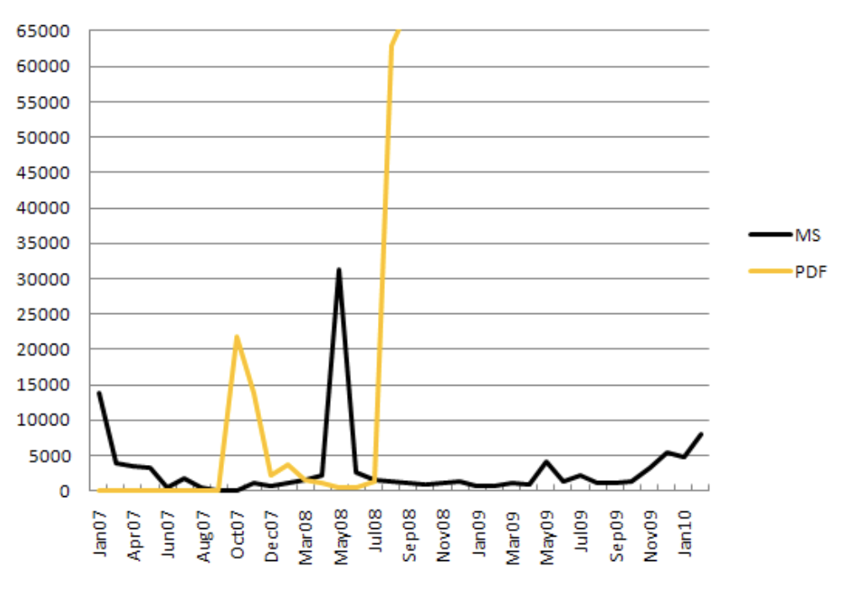
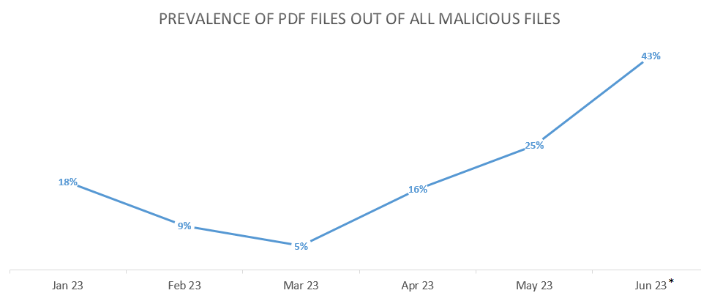
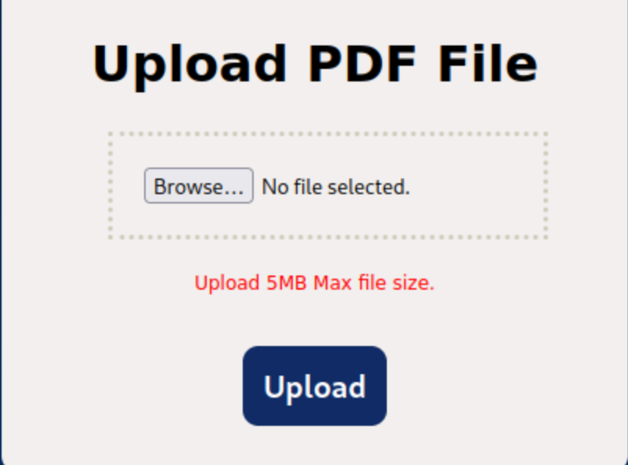
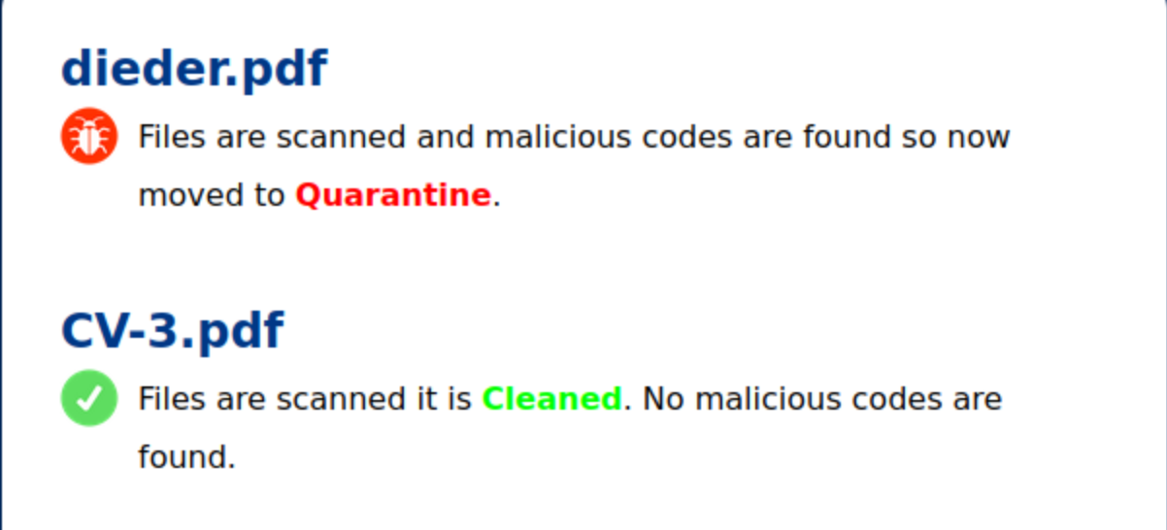
SWEEPER – PDF SCANNER
Oluwatosin FASANMI, Saajan Maharjan, Shiron dev Newton, Abdallah Hamdan
Cyber security - 2022
PROJECT DESCRIPTION
Due to the significant challenges faced to mitigate the malware infections through uploading PDF files via email attachments on the file servers, mainly for targeted companies our tool Sweeper is built in order to detect any suspicious malware on pdf files uploaded.
The platform site is developed specifically to protect the user’s workflow to be done easily by avoiding these risk to the organizations.
The Goal is to completely eradicate the effects faced by such threats to our clients.
DESIGN
METHODOLOGY AND
TOOLS
Number of attacks : MS office vs PDF
> Clamav - Sweeper utilizes the ClamD because it improves resource management by retaining the ClamAV engine loaded in memory and removing the requirement to load the engine for each request
>YARA Rule set - YARA rules match string patterns to detect suspicious activity in files or data. They include the rule name, strings with malware patterns, and conditions for detection, making YARA a powerful tool for threat hunting and malware detection.
>YARA Elements and strings – the rule contain the name , Strings and the conditions : the strings define the rule with the rule name and condition specify the function of the strings written
RESEARCH CONCLUSIONS
SUMMARY / COMMENTS
>Sweeper is project based on increasing the user efficiency for mitigating the risk of uploading malware pdf files
> Project target is to increase the success rate of Malware threats to organization
>Project is in built with clam av signature based detection for malicious patterns
> Heart of the project is combining the layer of security with Yara rules for signature based detection to avoid malicious intent
> The project aims to address challenges faced by companies in detecting and neutralizing malware in PDF files received via email attachments or uploaded to front-facing file servers.
> To reduce the possibility of cyber-attacks, the project proposes improved approaches for detecting and mitigating malware in PDF files.
> A robust scanning system implemented using clamav and Yara rule set will be established to track incoming PDF files and handle malware suspicious indication effectively.
>
Continuous improvement will be emphasized, with regular updates to the malware detection tool based on emerging threats and new malware patterns.
Source: Checkpoint
DEVELOPMENT
QUICK FACTS
> In March 2023 Barracuda reported that 45.7% of all HTML attachments scanned were malicious
> 66% of malware is delivered through PDFs (Palo Alto)
> Attack attempts increased by 228% in 2022 compared to 2021
> In 2018, there were at least 47k attacks involving PDF, this number rose to 143k in 2019.
> Research and analysis – conducted current research on malware pdf attacks and how embedded file works by reviewing the existing security measure to access the problem
>Define objective and requirements – isolating the specific objects , analyzing the pdf structures and studied the possible malware detection mostly targets this format of file
>Tool development – Introduced Sweeper scanner to detect the malicious intent by adding the layers of signature-based scans with clamav and Yara rule
> Testing and validation – conducted the research using sweeper with different types of malware file ( js script , embedded malware within pdfs etc.
> Documentation - Record every step of the development process, such as design choices, testing procedures, and implementation specifics.
IMAGE HERE
IMAGE HERE
Upload function
Scanning Result
CS S3,29 July 2023
Notes:
Contents
This template must be used for your Action Learning project poster to ensure the same look and feel for all posters.
The best posters will be printed and mounted; displayed in our classrooms.
The category titles for the sections of text are fixed. The amount of text for each section could vary based on your project.
Do not change the fonts, sizes or the colors - pay attention to the title banner at the top.
Methodology and Tools would include your project management method and applicable programming languages that were used.
The “Box Header” title can be changed. The facts should be taken from your research, not about your project
The charts and image boxes are provided only as placeholders. You do not have to use the sample charts provided and likely prefer others.
Three charts and two images are not required, but you should use graphics to illustrate key points and to make your poster attractive.
Ensuring quality printed posters
We will print the final version at A1 size, so you must use high quality images as they will be enlarged.
Zoom the poster by 500% or more, to see any quality issues on your screen.
Print a A3 or A4 version to see the placement of all elements
For trimming, the border around the edges must stay exactly as it is - do not put any information closer to the border
Submit PDF and PPT versions and not any printed copies - when creating the PDF, make it high resolution.

