Slide 1
Final Project
Saaki V

Slide 2
Assaulted LMPD Officers
Louisville Metro Open Data
Private Member
Louisville/Jefferson County Information Consortium
Incidents of Officers assaulted by individuals since 2010.

Slide 3
Variables
INCIDENT_NUMBER
CRIME_TYPE
LEOKA_APPLIES
OFFICER_KILLED
TYPE_OF_ASSIGNMENT
TYPE_OF_ACTIVITY
LMPD_DIVISION
PREMISE_TYPE
OFFENSE_CITY
Excluded dates, ID, special codes or classifications when filing a report

Slide 4
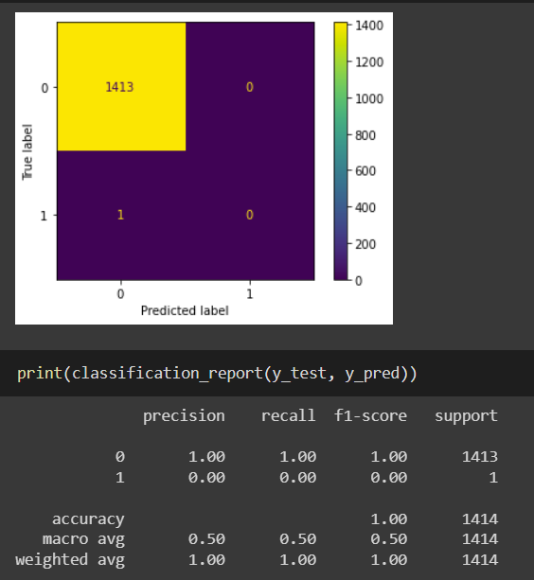
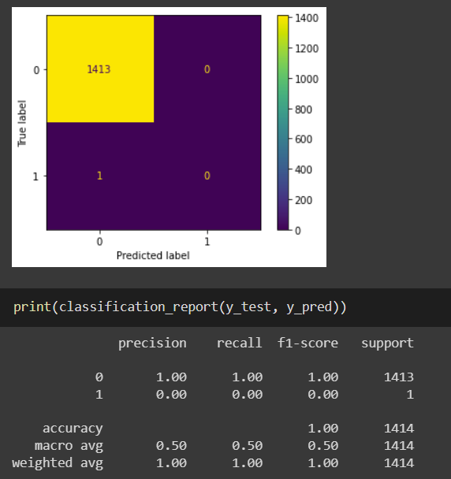
Logistic Regression
Random Forest

Slide 5
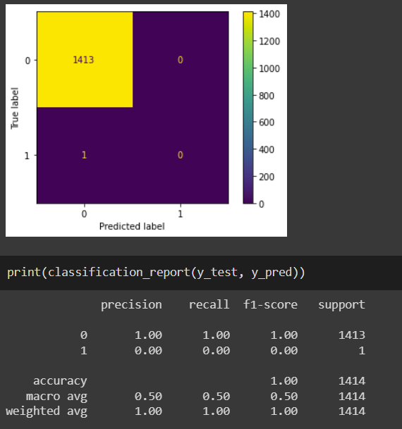
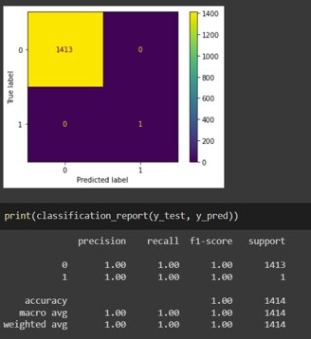
SVC
DT w/ Gini

Slide 6
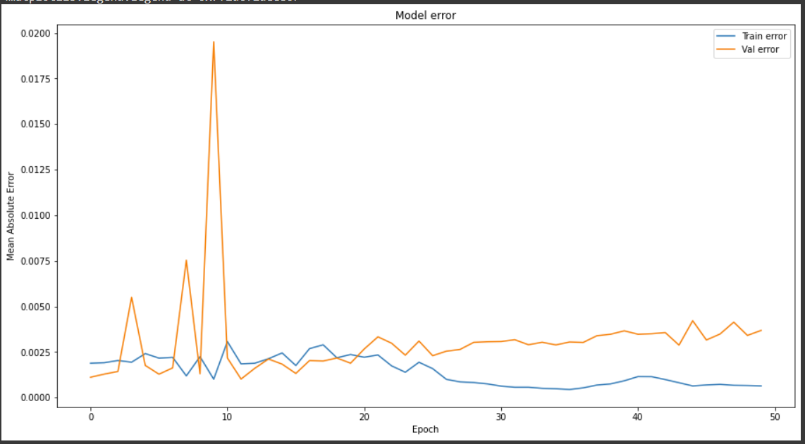
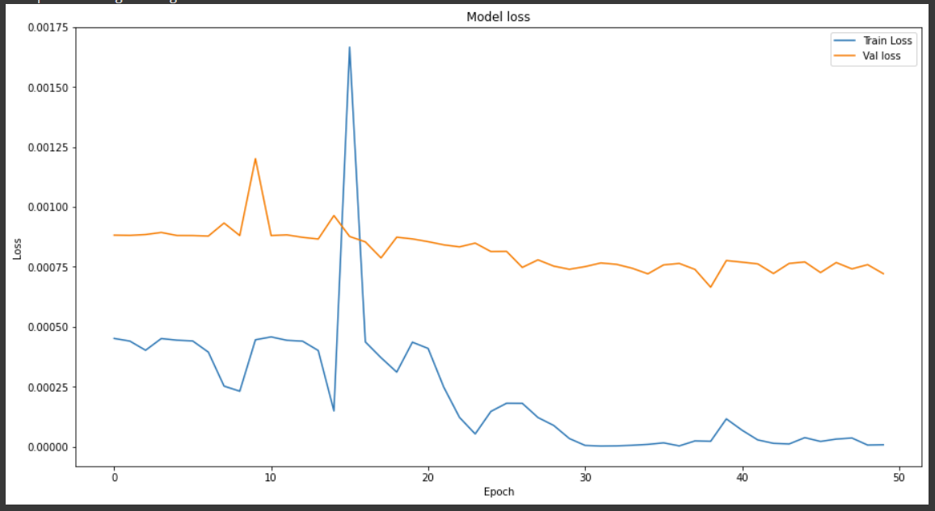
ANN w/ 50 epochs

Slide 7
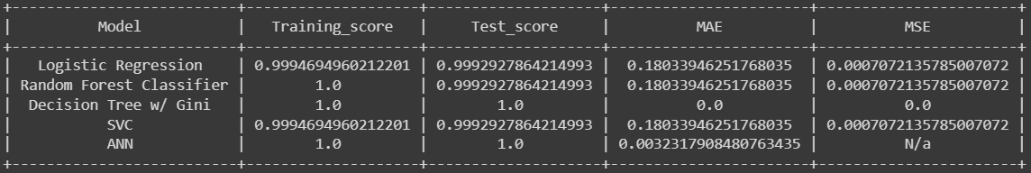

Slide 8
Final Thoughts

