Slide 1
Gradient Boosting Classifier
Saaki V

Slide 2
What is it?
Gradient boosting is a technique used for its prediction speed and accuracy, especially with large and complex data.
Machine learning models can be fitted to data individually or combined in an ensemble.
Gradient boosting starts by fitting initial model. Second model is built on where the first model performed poorly. Repeated over and over to obtain best combined model.
Each new model takes a step in the direction that minimizes prediction error

Slide 3
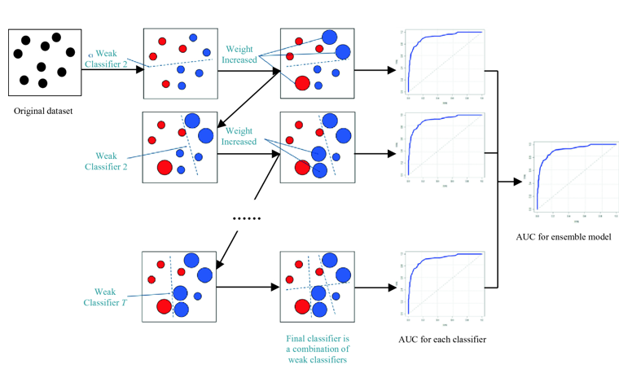
It relies on the intuition that the best possible next model, when combined with previous models, minimizes the overall prediction error.
The name gradient boosting arises because target outcomes for each case are set based on the gradient of the error with respect to the prediction.
small change causes a large drop in error, then next target outcome is a high value
Small change causes no change, then next target outcome is zero

Slide 4
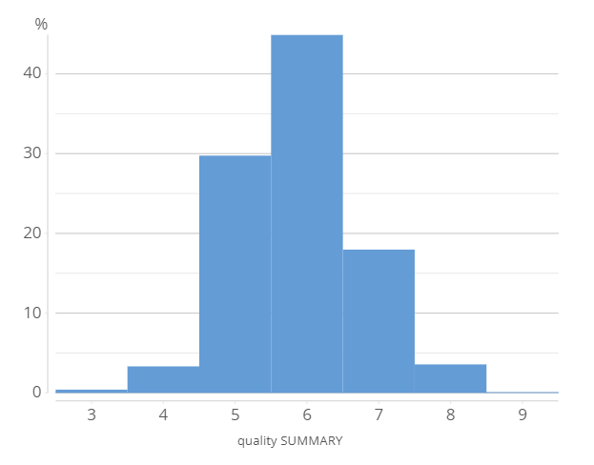
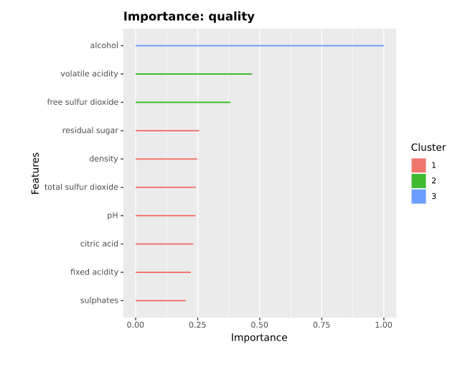
Example
The data set used describes nearly 5000 Portuguese white wine
Quality is the median of at least 3 evaluations made by wine experts, on a scale from 1 to 10.

Slide 5
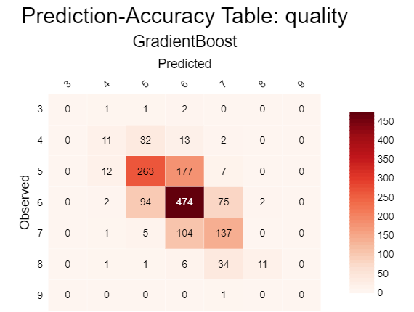
Due to possibility of overfitting, the prediction accuracy on the training data is of little use.
The table to the right illustrates the overlap between the categories predicted by the model and the original category of each case within the testing sample.

Slide 6
Important parameters
n_estimators
learning_rate
max_depth

Slide 7
Pros vs Cons
PROS
It is a generalized algorithm which works for any differentiable loss function
It often provides predictive scores that are far better than other algorithms
It can handle missing data
CONS
This method is sensitive to outliers.
It is prone to overfit if number of trees is too large.
Computation can take a long time.

