Slide 1
Car Purchase Design
By: Saaki V

Slide 2
Dataset
This dataset contains details of 1000 customers who intend to buy a car, considering their annual salaries.
Columns:
User ID
Gender
Age
Annual Salary
Purchase Decision (No = 0; Yes = 1)

Slide 3

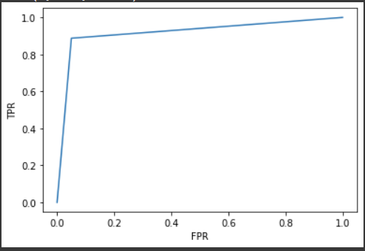
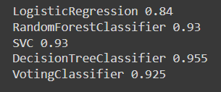
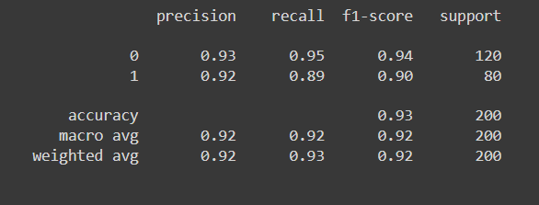
Experiment 1 (80/20 split)

Slide 4
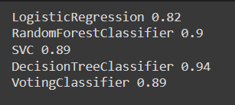
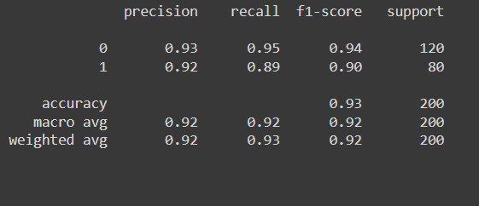
Experiment 2 (90/10 split)

Slide 5
Conclusion

