Slide 1
CODEBASICS RESUME CHALLENGE – SEPTEMBER, 2022
Designed and Presented By
Saakshi dikshit

Slide 2
INTRODUCTION
Domain - Hospitality
Function - Revenue

Slide 3
BACKGROUND
AtliQ Grands owns multiple five-star hotels across India. They have been in the hospitality industry for the past 20 years. Due to strategic moves from other competitors & ineffective decision-making in management, AtliQ Grands are losing its market share and revenue in the luxury/business hotels category. As a strategic move, the authorities at AtliQ Grands wanted to incorporate “Business and Data Intelligence” to regain their market share and revenue. However, they do not have an in-house data analytics team to provide them with these insights. Their revenue management team had decided to hire a 3rd party service provider to provide them with insights from their historical data.

Slide 4
PROBLEM STATEMENT
You are a data analyst who has been provided with sample data and a mock-up dashboard to work on the following task. You can download all relevant documents from the download section.
Create the metrics according to the metric list.
Create a dashboard according to the mock-up provided by stakeholders.
Create relevant insights that are not provided in the metric list/mock-up dashboard.

Slide 5
DATASET DETAILS
We are provided 3 moths booking details data of all the atliq hotels.
Dataset contains 5 excel files.
Dim_date
Dim_hotels
Dim_rooms
Fact_aggregated_bookings
Fact_bookings
Metric list excel file
Mock-up Dashboard

Slide 6
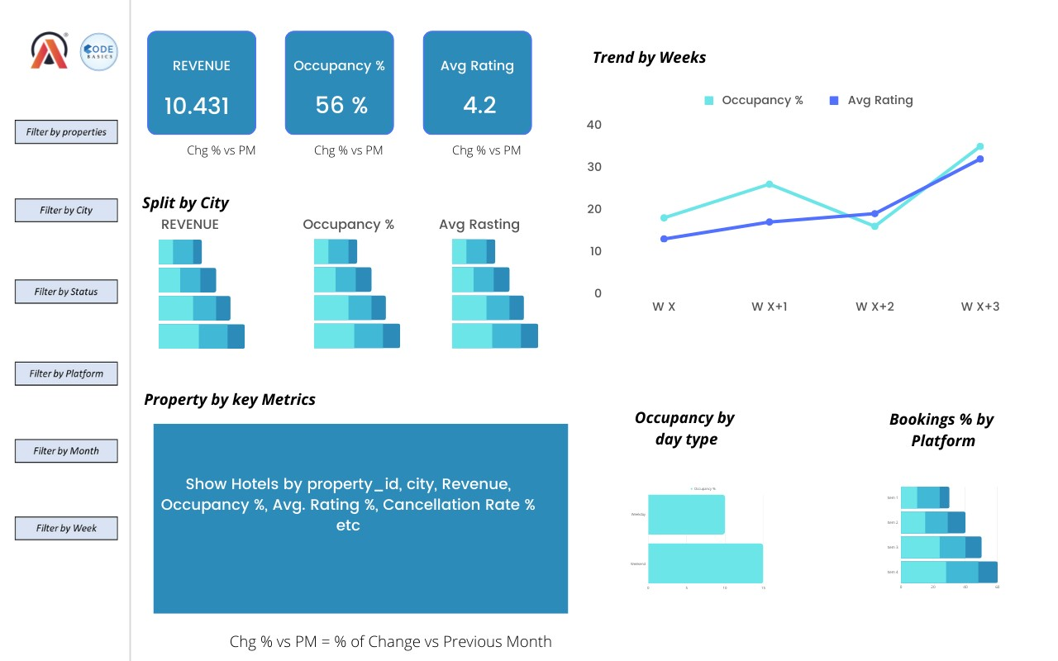
MOCKUP DASHBOARD

Slide 7
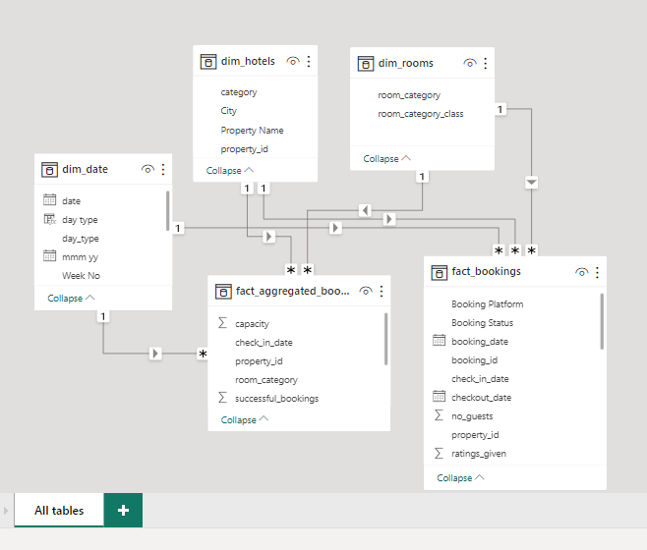
DATA MODEL

Slide 8
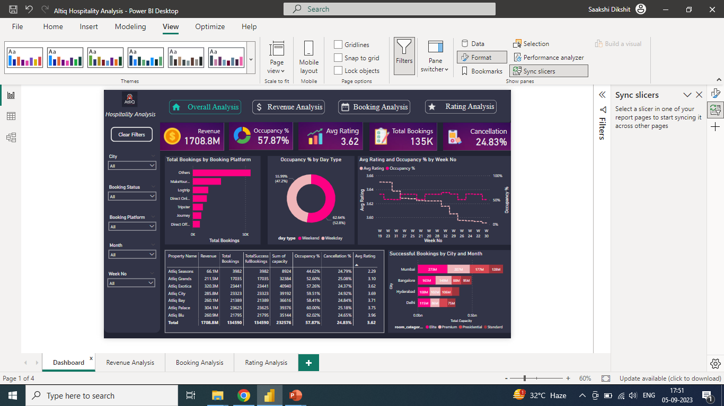

Slide 9
OBSERVATIONS
We need to make good connections with MakeYourTrip and Logtrip as these are the ones directing maximum bookings (after others).
Atliq Palace are the best properties that we hold as they have the maximum no. of bookings and second highest rating. They need to be maintained.
We need to focus more on Elite customers as they drive the revenue.

Slide 10
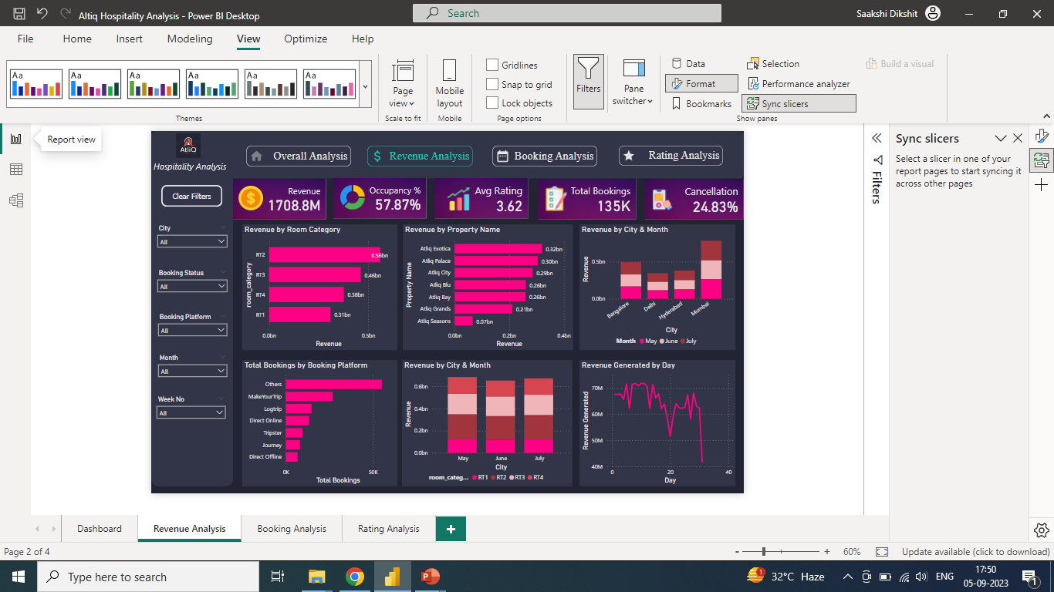

Slide 11
OBSERVATIONS
We need to focus on RT2 rooms as they drive the maximum revenue.
Atliq Exotica, Palace and City are the top 3 properties that we hold. They need to be maintained.
Mumbai has been the best performing city across all the months.
There is a sharp downfall in the revenue in the last two weeks.

Slide 12
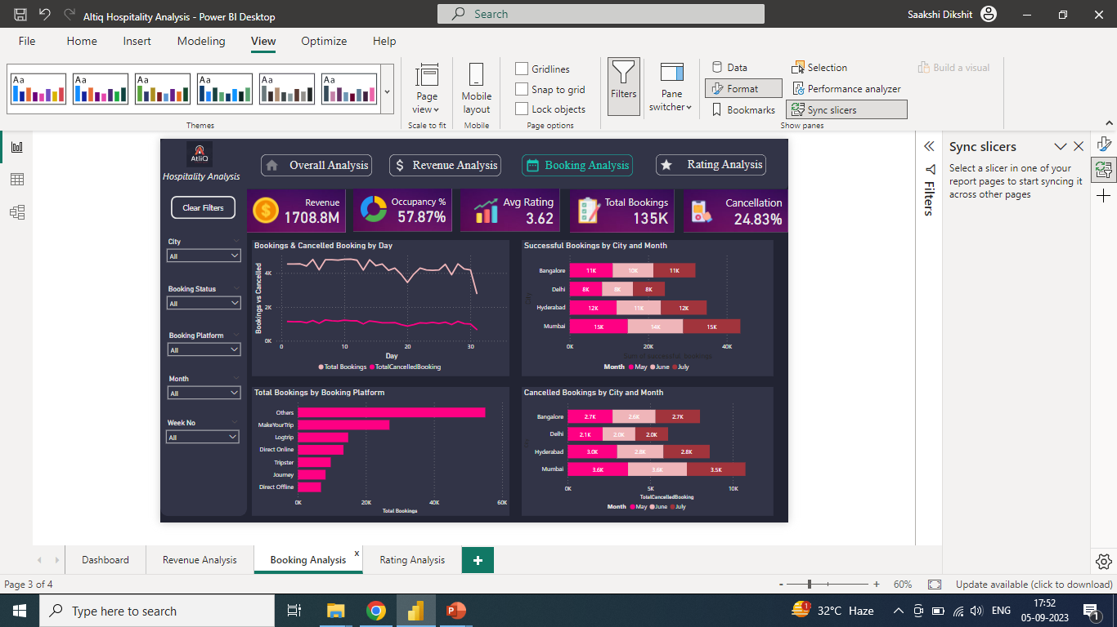

Slide 13
OBSERVATIONS
MakeYourTrip had the highest total bookings of 26898 which is 398.19% higher than direct offline which is 6755.
Total Bookings started dropping towards the end of the month for all the months.
Successful bookings were nearly equal for the months of May and July.
Mumbai had the maximum number of bookings (successful as well as cancelled).

Slide 14
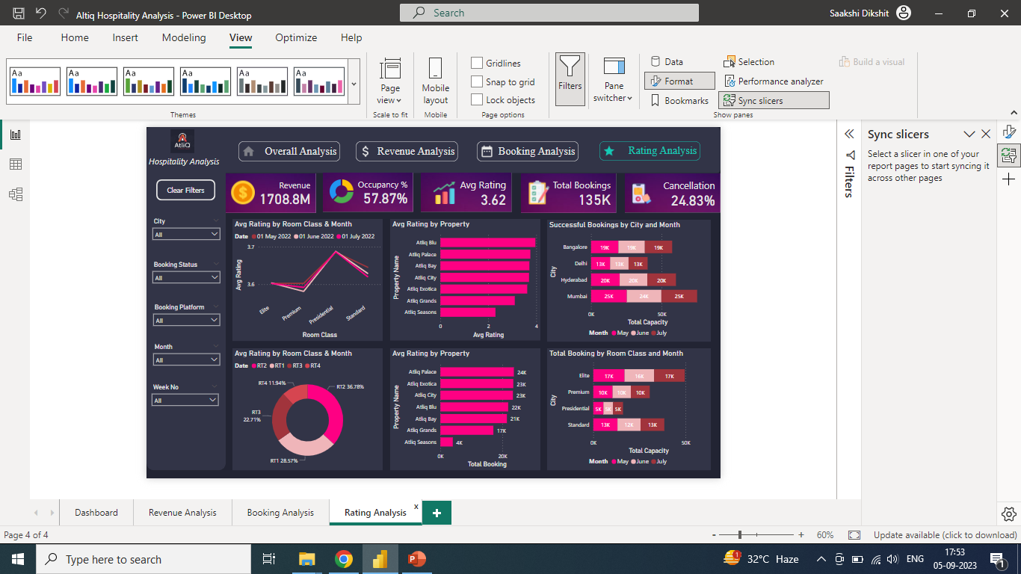

Slide 15
OBSERVATIONS
May had the highest avg. rating of 3.69 for Presidential class.
Altiq Blu had the highest avg. rating of 3.96.
RT2 rooms have the highest number of booking of 49505.
Elite class had the maximum number of bookings for all the 3 months.
Mumbai had the maximum number of successful bookings.
May had the highest No of bookings 45882 and highest no of cancelled bookings 11447.

Slide 16
Thank You

