Slide 1
Discovery of sleep composition types using expectation-maximization
Sergio A. Alvarez (Boston College, USA)
Joint work with Amro Khasawneh, Carolina Ruiz, Shivin Misra (Worcester Polytechnic Institute) and Majaz Moonis (U. of Massachusetts Medical School)
CBMS 2010, Perth, Australia, Oct. 2010

Slide 2
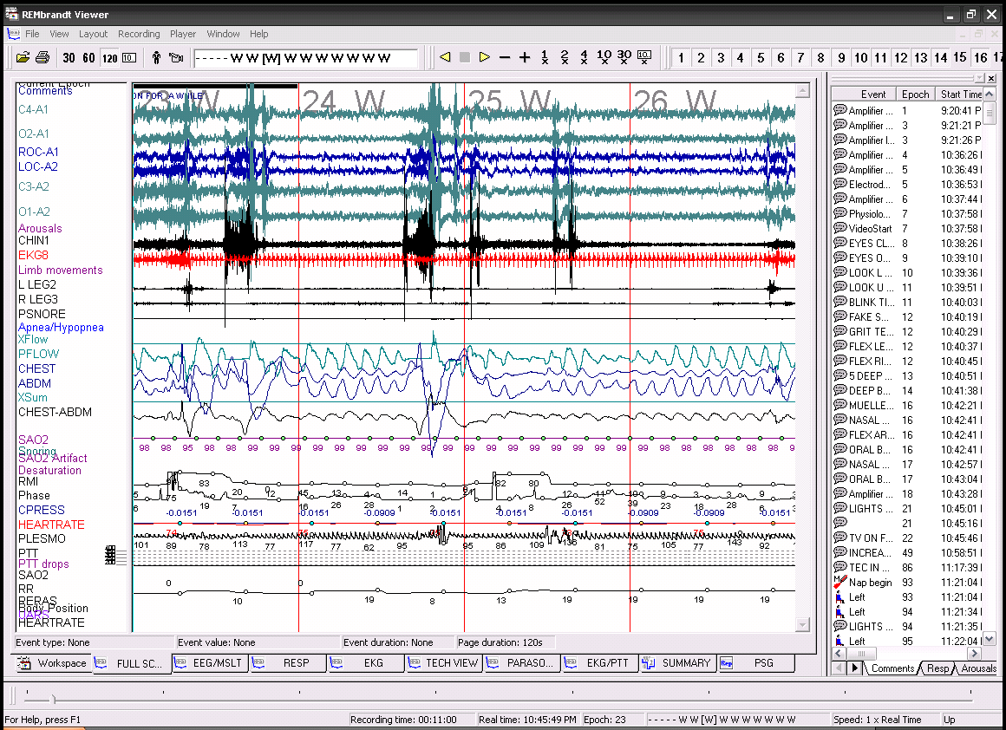
Polysomnographic time series data

Slide 3
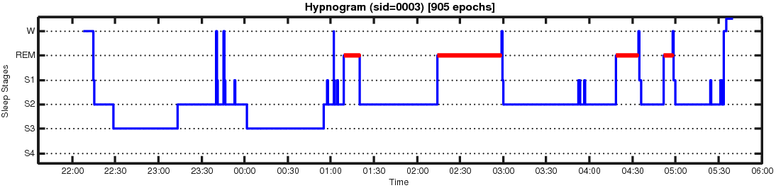
Sleep staging
(RECHTSCHAFFEN AND KALES (R&K) SYSTEM)
Six stages assigned, based on PSG signals
Stage | Description
Wake | Pre-sleep
Stage 1 | Light sleep, easily awakened
Stage 2 | Slower EEG waves with some bursts (sleep spindles)
Stages 3,4 (SWS) | Very slow EEG waves (delta waves) mixed with faster ones
REM | Rapid eye movement, breathing, heart rate

Slide 4
Summary descriptors of sleep stage composition
Variable |  |  | Range of values
Total Sleep Time (TST) |  | 0 – 500 min
Sleep Efficiency |  | 0 – 1
Percentage of sleep period time (SPT) in stages: | NREM1 | 0 – 100%
 | NREM2 | 0 – 100%
 | SWS (NREM3+NREM4) | 0 – 100%
 | REM | 0 – 100%
 | Wake | 0 – 100%

Slide 5
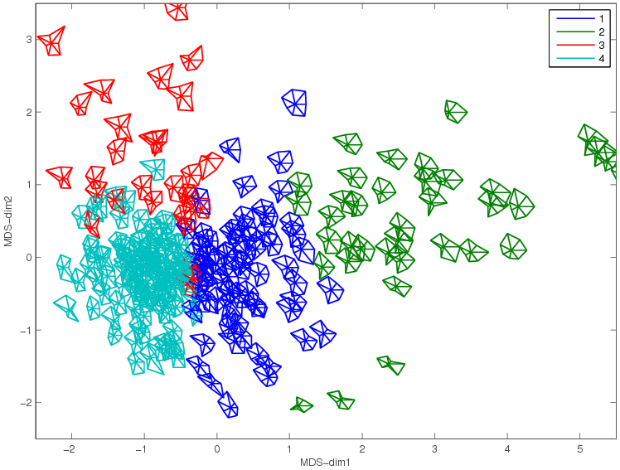
Multidimensional scaling of E-M output
(in terms of a combination of all eight sleep composition variables)

Slide 6
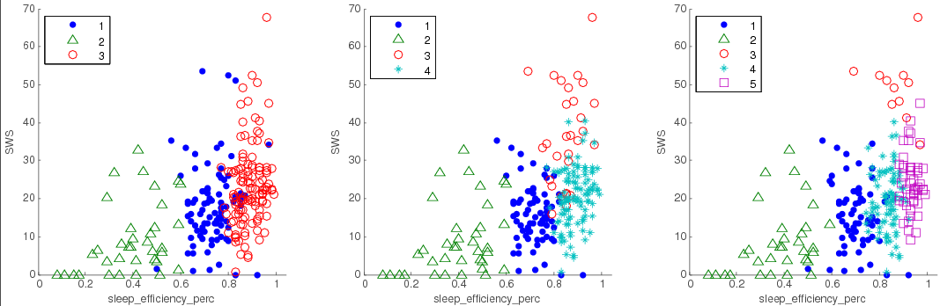
E-M clusters
(in terms of sleep efficiency and SWS)

Slide 7
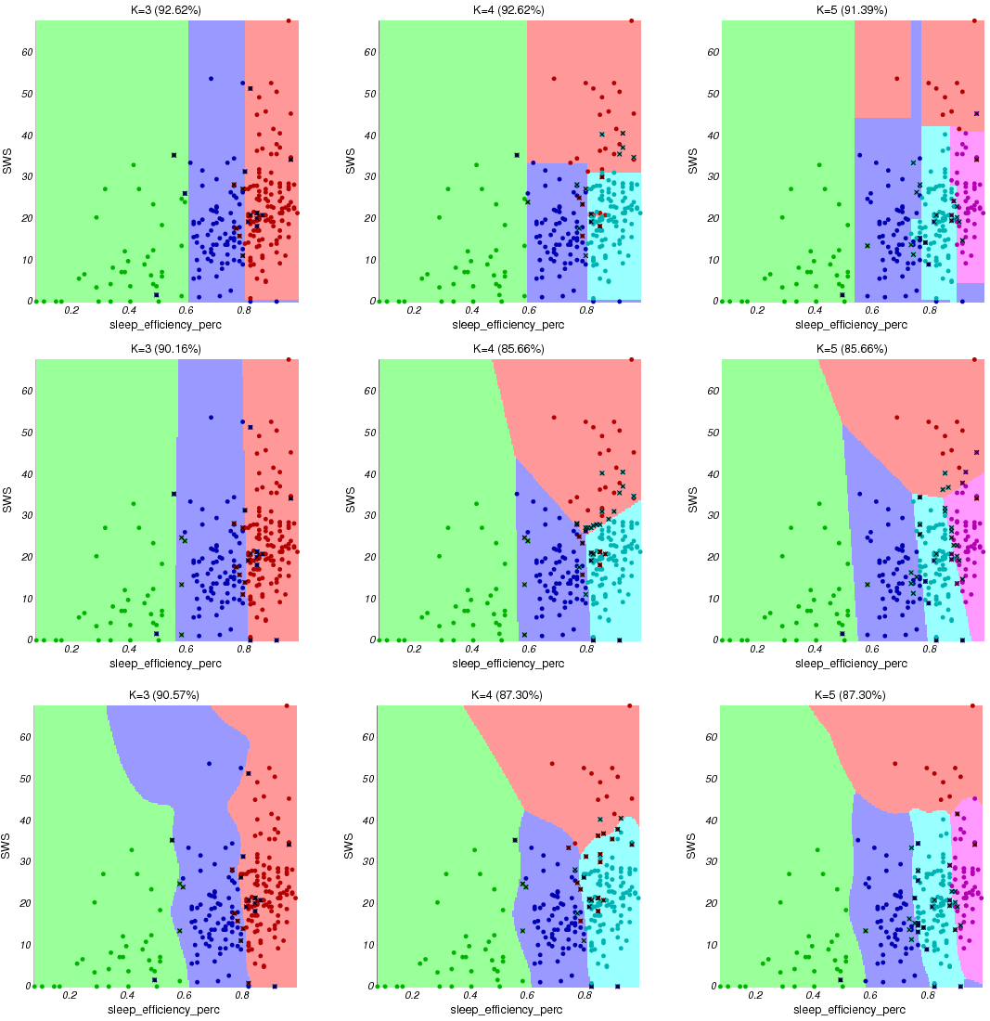
C4.5 Decision Trees
LDA
Cluster decision boundaries
(in space spanned by sleep efficiency vs SWS)
Naïve
Bayes

Slide 8
STATISTICAL SIGNIFICANCE
Discrete attributes:
  χ² test of independence
Continuous attributes:
  Pairwise tests
    Paired t-test or Wilcoxon rank sum test, depending on normality
  Multiple comparison tests
    ANOVA or Kruskal-Wallis, depending on normality

Slide 9
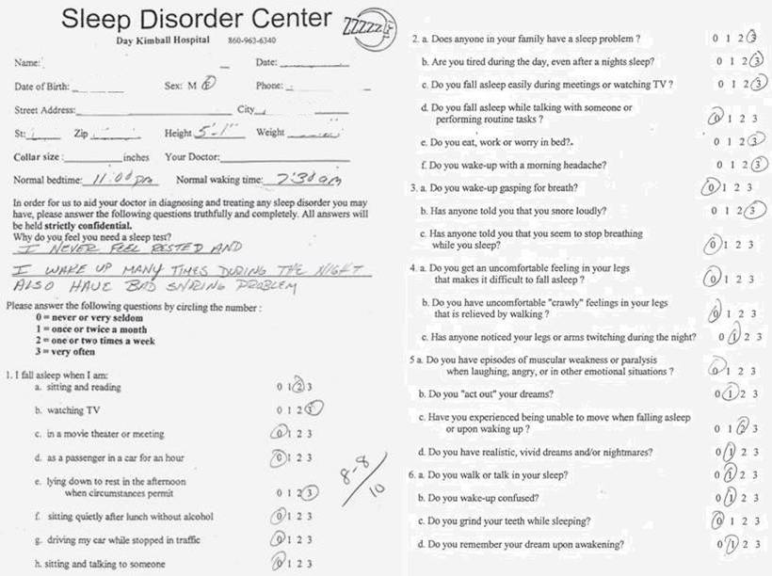
Sleep Questionnaire

Slide 10
Questionnaire attributes
age | gender | height | weight | bmi | feel_sad | epworth | ess1 | ess2
24 | m | 71 | 158 | 22 | 2 | 29 | 4 | 4
38 | m | 73 | 320 | 42.2 | 1 | 25 | 4 | 5
25 | m | 70 | 180 | 25.8 | 3 | 21 | 8 | 7
26 | f | 62 | 215 | 39.3 | 0 | 42 | 15 | 12
67 | m | 72 | 260 | 35.3 | 0 | 8 | 6 | 1

Slide 11
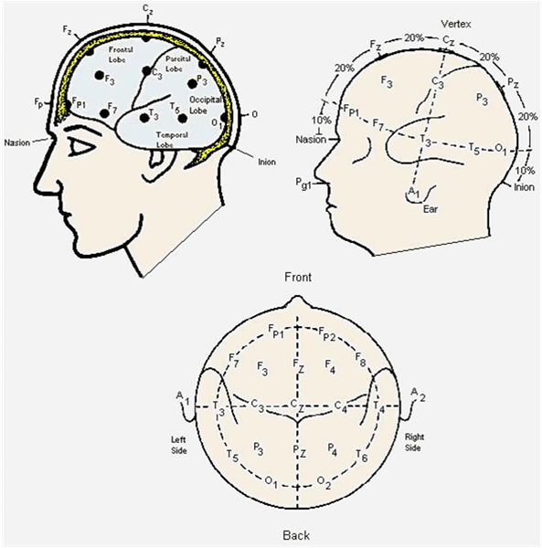
EEG electrode placement

