Slide 1
Lottie Animations
Greg Fein
Saamer Monsoor

Slide 2
What is Lottie?
Lottie is a light weight iOS, Android, and React Native library that makes it easy to add high quality animation to any app.
The library renders After Effects animations in real time, allowing apps to use animations as easily as they use static images.
Lottie provides a flexible animation format that is playable on multiple platforms - Web, iOS and Android, thus enabling companies to provide a uniform UX and UI.

Slide 3
How Lottie Works
Like SVGs, Lottie is a vector-based JSON format.
This means that the file is very small compared to traditional imagery and frame data.
Since this is vector-based…
It means that there is no dependent resolution and that scaling will be clean and aliased, no matter the device.
It means that there is no platform dependencies or interaction model to be accounted for in the design process.
There are some caveats though:
Certain types of After Effects features are not supported (merge shapes, alpha inverted masks, 3d, etc.)
Certain types of vector elements are not supported (like mask gradients, layer blend modes, etc.)

Slide 4
Demo time!
You can load a Lottie animation from a packaged anim in the bundle
You can also load the animation from a URL!
(show off the simulator here)

Slide 5
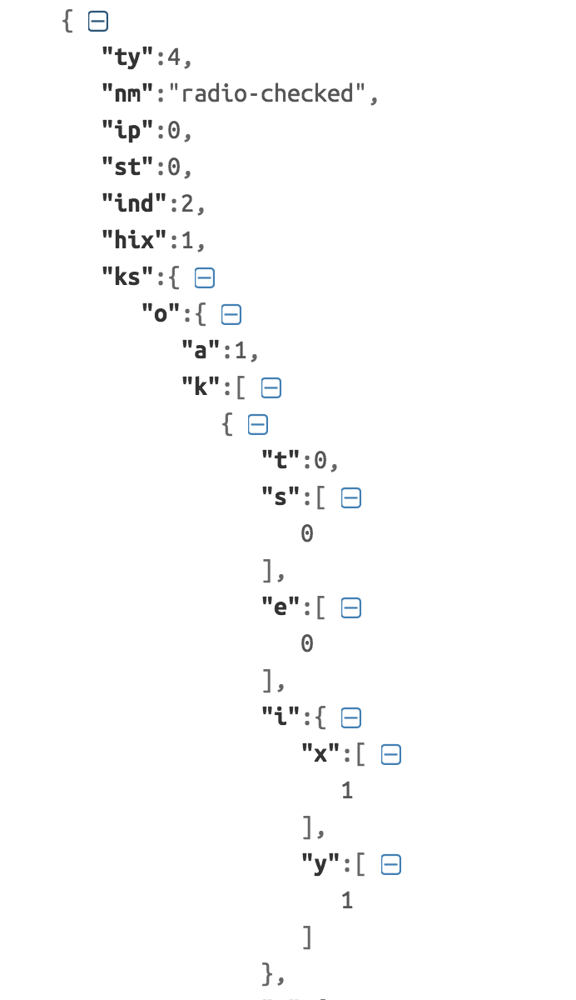
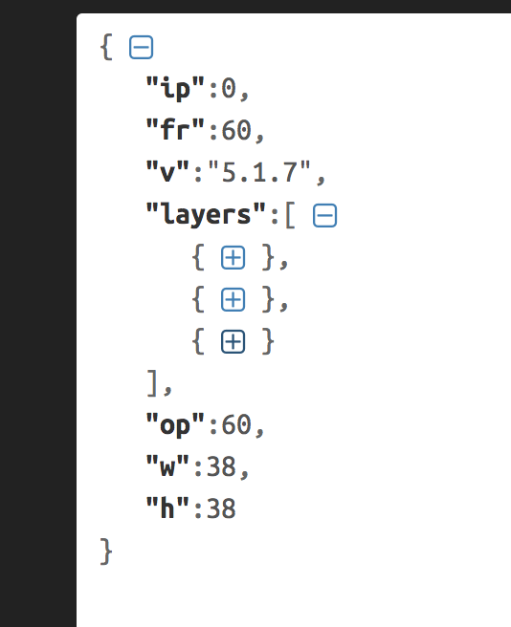
JSON Peek-a-boo
Frame Rate, Version, Width, Height, Layers, etc.
Otherwise, minify’d unreadable values to be used dynamically by executing code

Slide 6
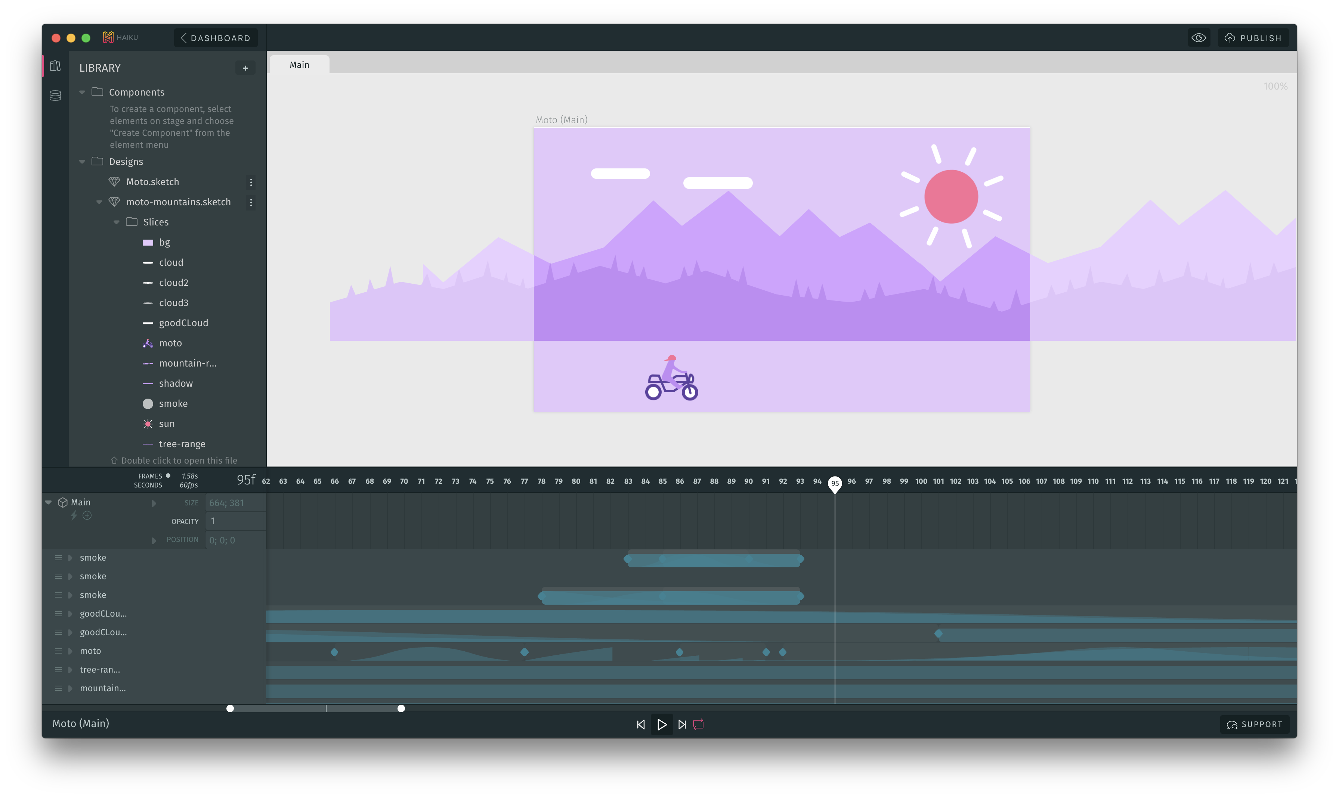
JSON Rundown
The JSON for a Lottie animation can be exported directly from After Effects
It can also be made by creating assets in Sketch, importing to Haiku, then exporting to the Lottie JSON with a plugin.
www.haiku.ai

Slide 7
From the Designer’s Desk…
A 6 minute presentation by MyStrength’s Creative Director, Derek Balmer, about how he made a checkmark anim for our app using Sketch -> Haiku -> Lottie
(play video!)

Slide 8
Implementation Description
Talk about high-level SDK and the classes you can use.
Show some code.

Slide 9
View Hierarchy
Show how LottieAnimationView needs to be used programmatically and is usually layered under another control
Show LOTCheckBox on iOS

Slide 10
LottieFiles.com
Show all the cool anims you can use for free, lead into demo

Slide 11
Demo
Show web anim
Then show same anim loading in a simulator
Show loading from URL and from Bundle (code next to simulator open)

Slide 12
SDK Advanced
Easing, transitions, forward/backward stuff

Slide 13
After Effects demonstration
Show how the designer workflow is and how to export (I’ll provide like a 5m video narrated by my designer)

Slide 14
MultiPlat
Show the Xamarin.iOS and Xamarin.Android stuff

Slide 15
Pros/Cons
Talk about how lottie is awesome, but it is basically a unique frame that you have to manually control. Have to layer in UIViewController.View hierarchy.

Slide 16
QA
Open the floor

