Slide 1
Lottie Animations
Greg Fein
Saamer Monsoor

Slide 2
What is Lottie?
Lottie is an open-source framework provided by AirBnB.
It is a light weight iOS, Android, and React Native library that makes it easy to add high quality animation to any app.
The library renders After Effects animations in real time, allowing apps to use animations as easily as they use static images.
Lottie provides a flexible animation format that is playable on multiple platforms - Web, iOS and Android, thus enabling companies to provide a uniform UX and UI.

Slide 3
From AirBnB
Animations can be played, resized, looped, sped up, slowed down, reversed, and even interactively scrubbed. Lottie can play or loop just a portion of the animation as well, the possibilities are endless! Animations can even be changed at runtime in various ways! Change the color, position or any keyframable value! Lottie also supports native UIViewController Transitions out of the box!
ottie is named after a German film director and the foremost pioneer of silhouette animation. Her best known films are The Adventures of Prince Achmed (1926) – the oldest surviving feature-length animated film, preceding Walt Disney's feature-length Snow White and the Seven Dwarfs (1937) by over ten years The art of Lotte Reineger

Slide 4
How Lottie Works
Like SVGs, Lottie is a vector-based JSON format.
This means that the file is very small compared to traditional imagery and frame data.
Since this is vector-based…
It means that there is no dependent resolution and that scaling will be clean and aliased, no matter the device.
It means that there is no platform dependencies or interaction model to be accounted for in the design process.
There are some caveats though:
Certain types of After Effects features are not supported (merge shapes, alpha inverted masks, 3d, etc.)
Certain types of vector elements are not supported (like mask gradients, layer blend modes, etc.)

Slide 5
Demo time!
You can load a Lottie animation from a packaged anim in the bundle
You can also load the animation from a URL!
(show off the simulator here)

Slide 6
Not Just Swift!
Lottie has a Xamarin NuGet package for Xamarin.Native applications (iOS and Android)
Demo the Xam and show the C#

Slide 7
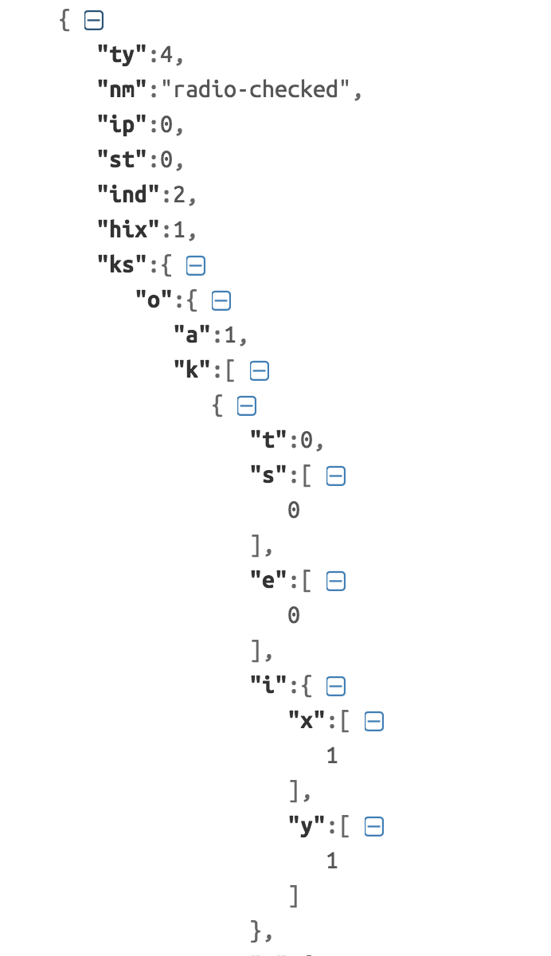
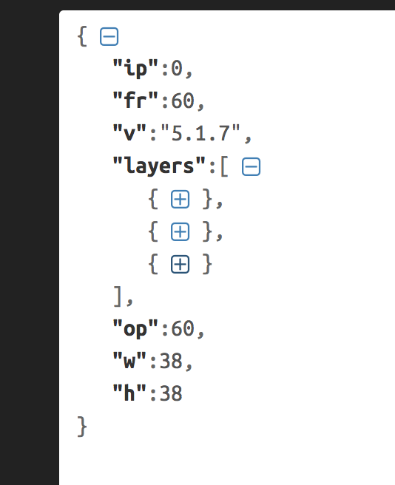
JSON Peek-a-boo
Frame Rate, Version, Width, Height, Layers, etc.
Otherwise, minify’d unreadable values to be used dynamically by executing code

Slide 8
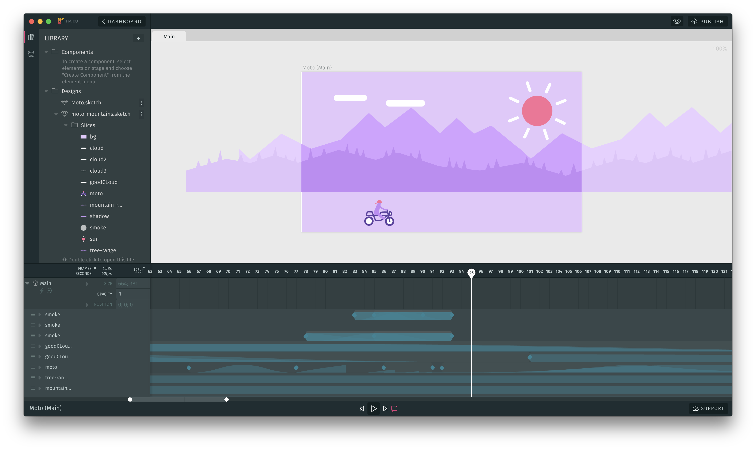
JSON Rundown
The JSON for a Lottie animation can be exported directly from After Effects
It can also be made by creating assets in Sketch, importing to Haiku, then exporting to the Lottie JSON with a plugin.
www.haiku.ai

Slide 9
From the Designer’s Desk…
A 6 minute presentation by MyStrength’s Creative Director, Derek Balmer, about how he made a checkmark anim for our app using Sketch -> Haiku -> Lottie
(play video!)

Slide 10
Implementation Description
Show some code.
LOTAnimationView
programmatically instantiated
give a frame and an animation (URL, local file, etc.)
Control play with touch events of an overlaid UIButton
LOTAnimatedSwitch
Similar to LOTAnimationView but has touch events attached
Has “Enabled” flag for Boolean state

Slide 11
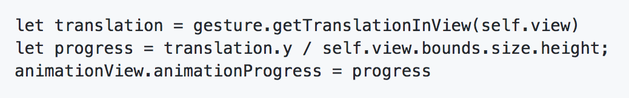
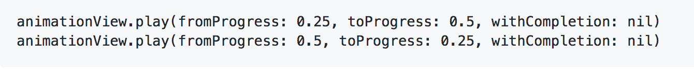
Going Fancy
Using progress (0.0f – 1.0f) to set position of animation or use as pseudo keyframes
Cordon sections of an animation to repeat or act as states

Slide 12
LottieFiles.com
Huge free repo of Lottie animations you can download in JSON form or directly link to via URL web-loading
Co-Founder is a Forbes 30 Under 30.

Slide 13
Pros/Cons
Pros
Allows A/B testing by supporting loading JSON files over the network
Optional caching mechanism
Can change animation speed in app
Animations can be driven by gestures
Easy to create with AfterEffects
Cons
Design work can take a while to get right
Keyframing is very difficult to do properly and using PlayProgress() is a lot easier (but a whole lot more prone to bugs)
Alternatives-
Marcus Eckert’s Squall- Only supports iOS, but popular because of the After Effects preview app.
Facebook’s Keyframes- Only supports a small set of After Effects features to support, since they were focusing mainly on reactions

Slide 14
QA
Open the floor

