Slide 1
SAMBA
SAAMIR
MANI
ABOLAJI
AARUSH
BURAQ
Virtual Chemical Pilot Plant
GNG1103

Slide 2
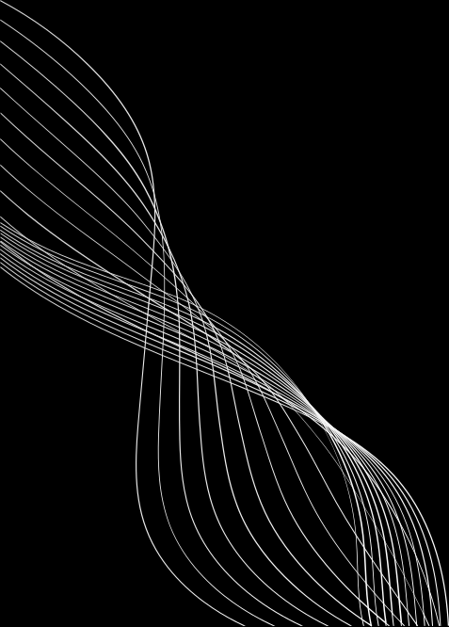

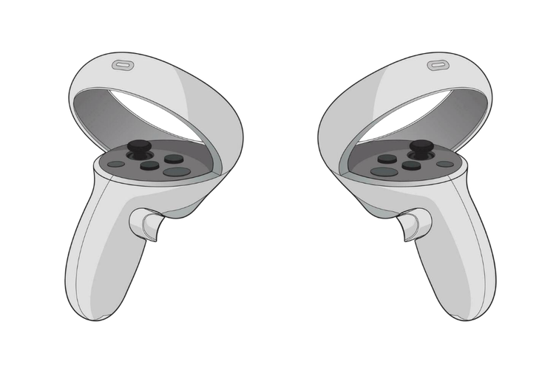
WHAT IS THE PROBLEM?
  Chemical engineering pilot plant is essential to learning and growth
  Pilot plant access is limited to a small group of upper-year student
  Students often miss out on exploring this unique environment

Slide 3
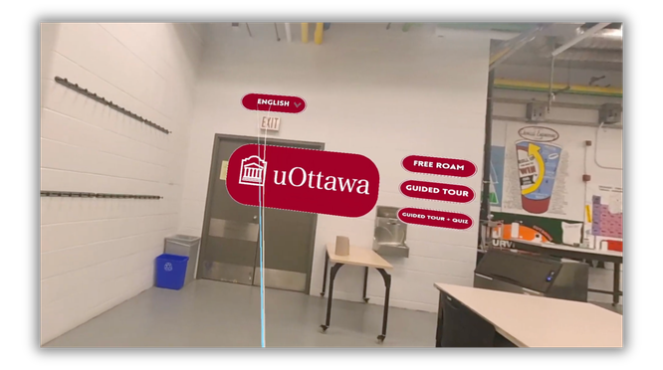
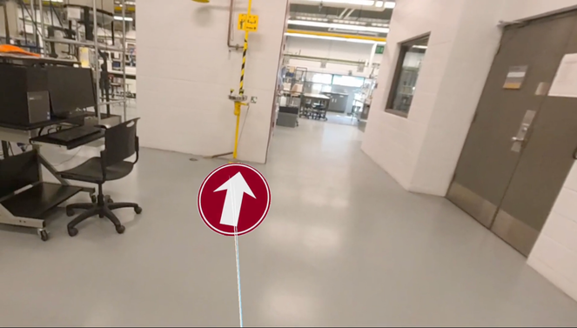
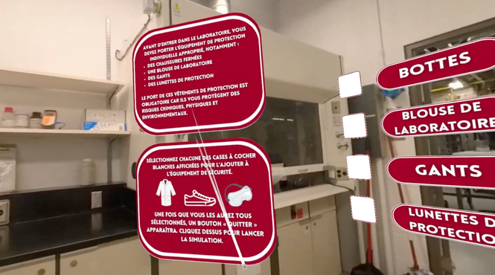
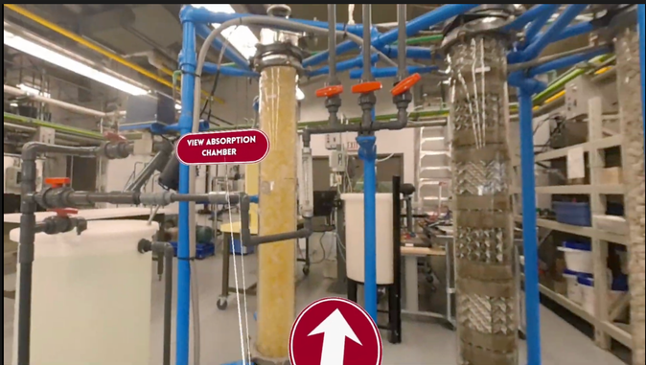
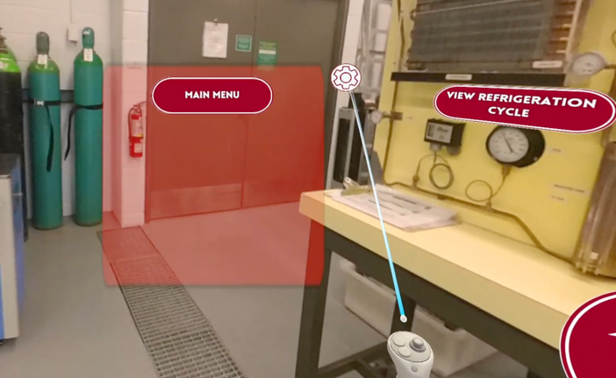
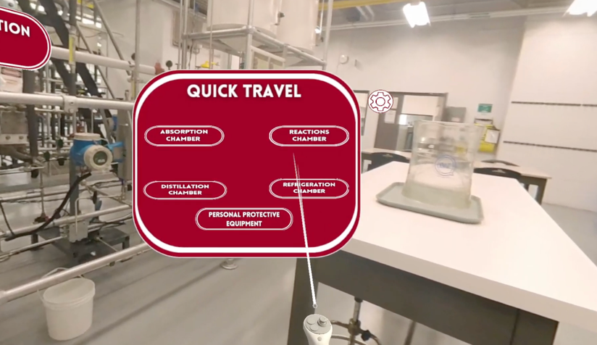
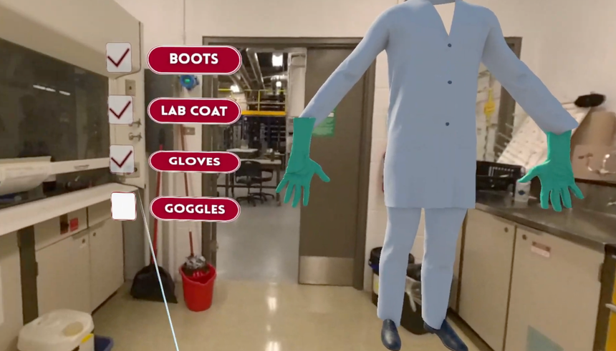
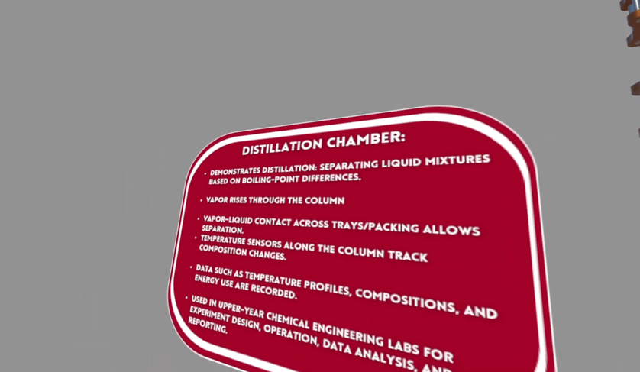
UOTTAWA RXN, A VIRTUAL EXPERIENCE
Core Scenes
Two Forms of Navigation
PPE Interface
Main Menu
Interactivity
Avatar
Information Panel
Panels

Slide 4
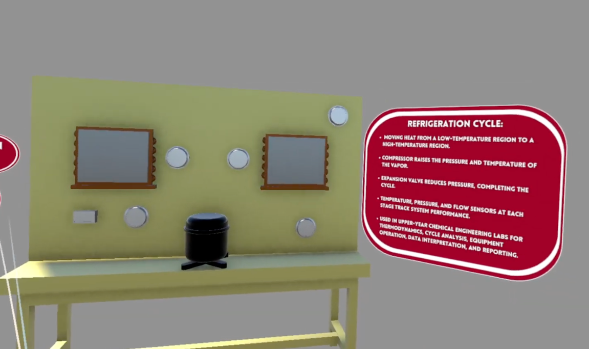
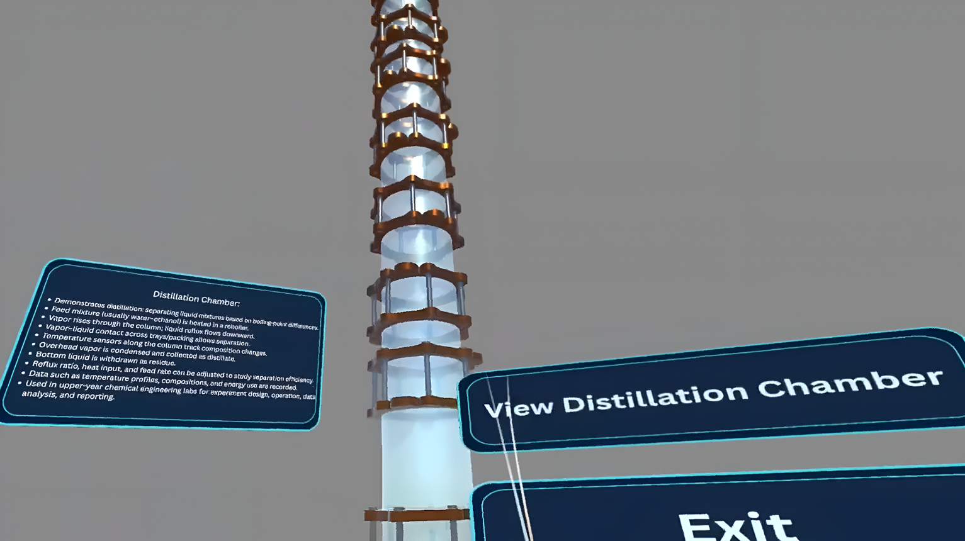
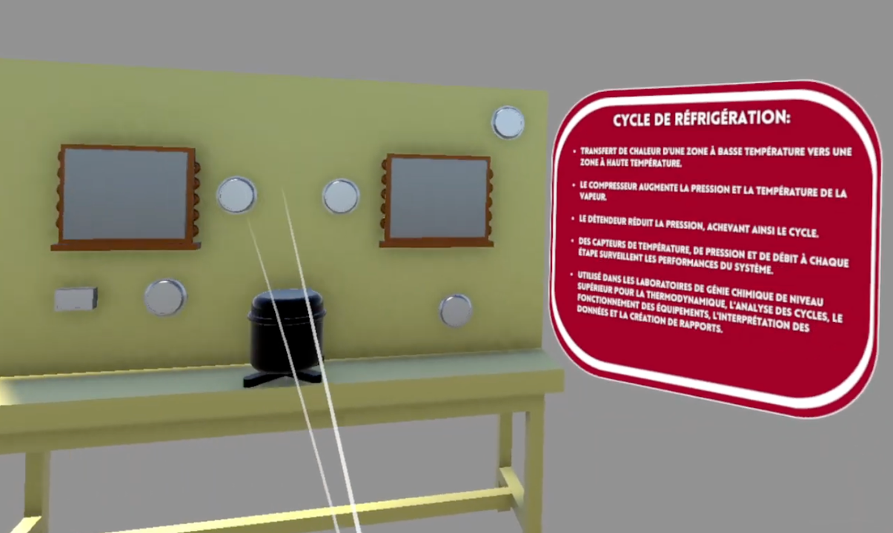
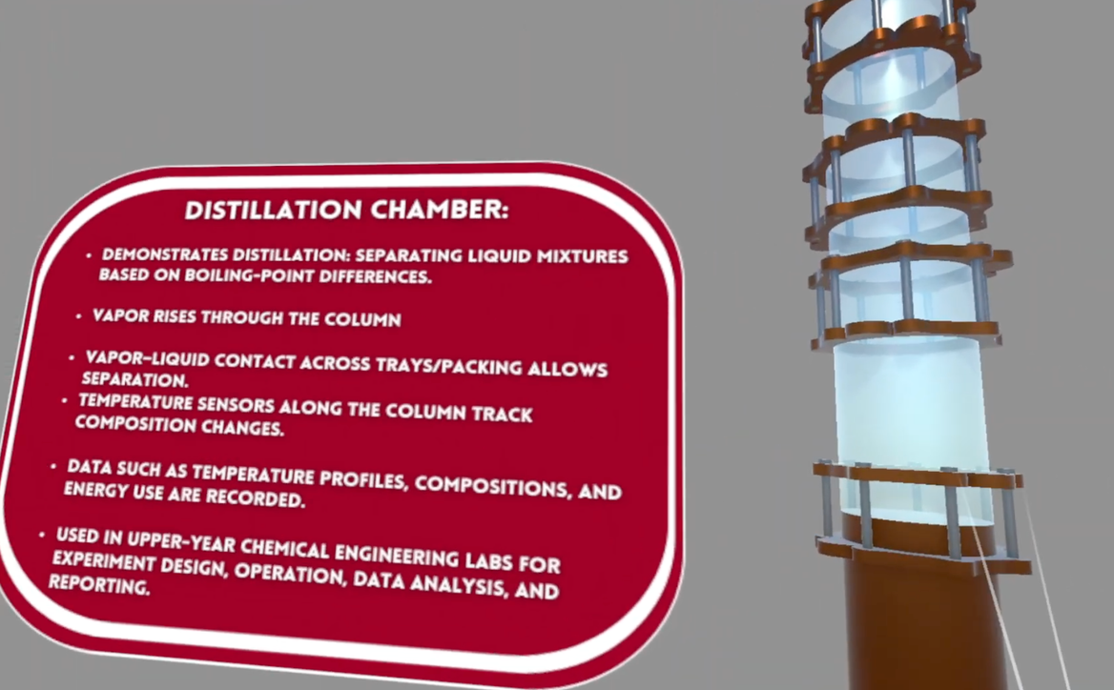
Test Results
accessible
Improvements
Before
After

Slide 5
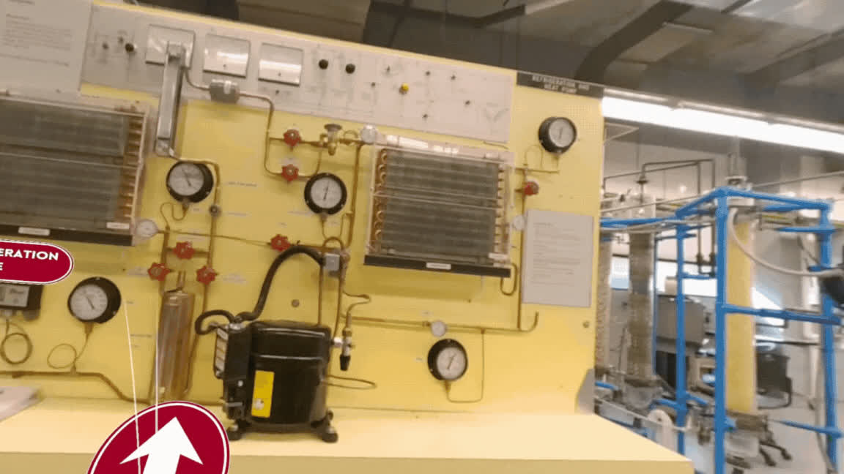
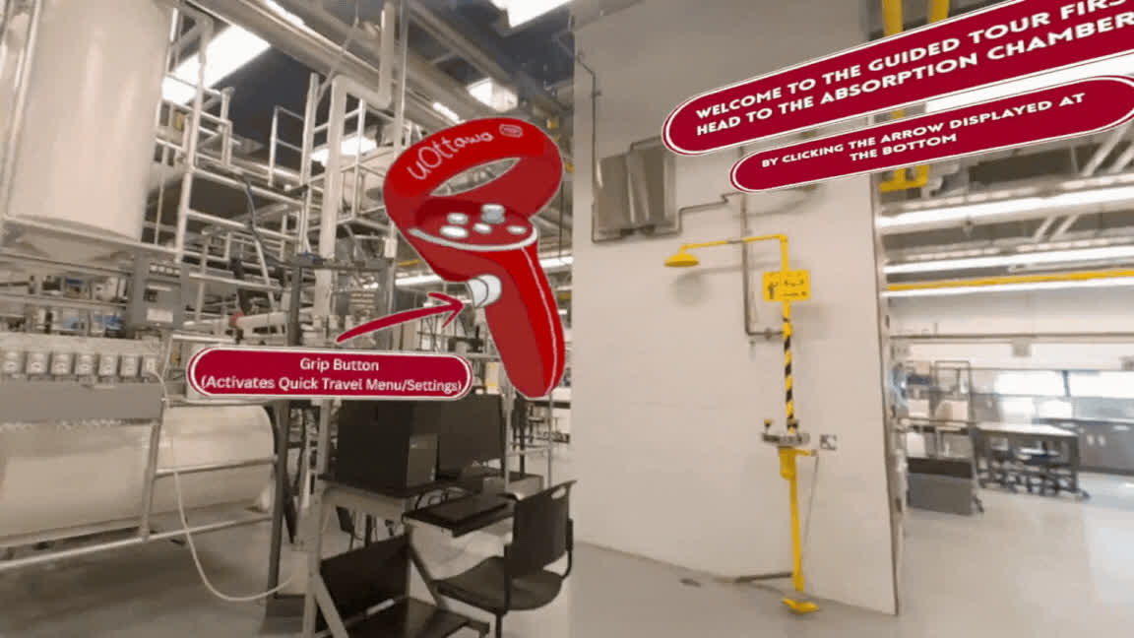
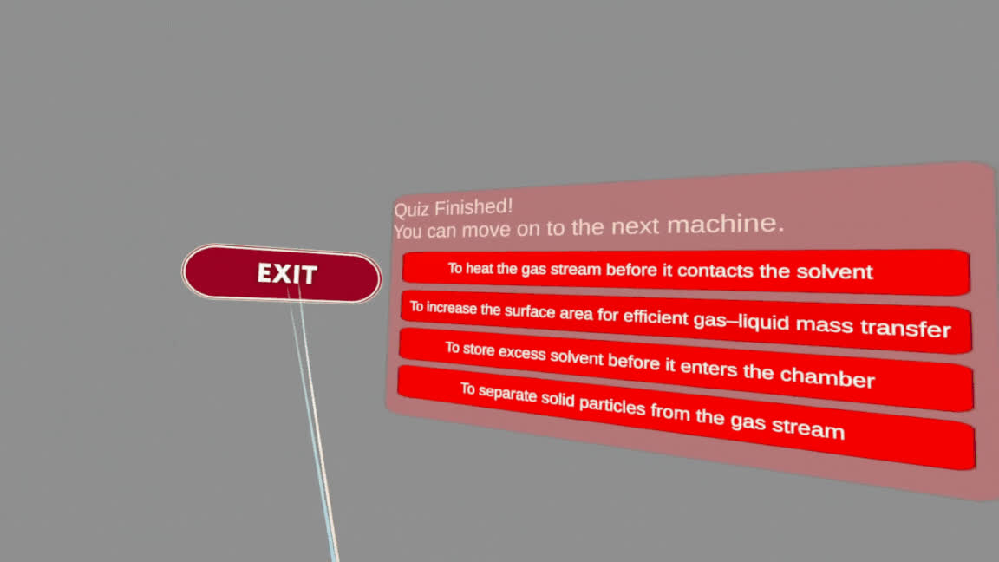
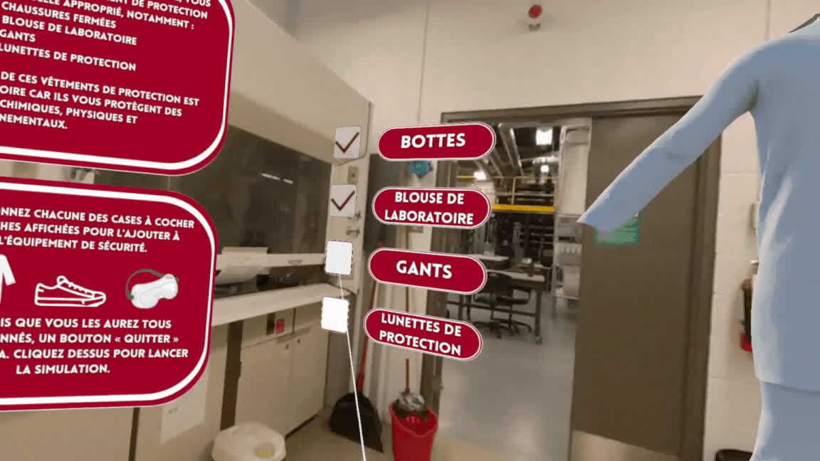
DEMO
Free Roam
Guided
Quizzes
PPE

Slide 6
SAMBA
SAAMIR
MANI
ABOLAJI
AARUSH
BURAQ
Thank You For Listening
The End

Slide 7
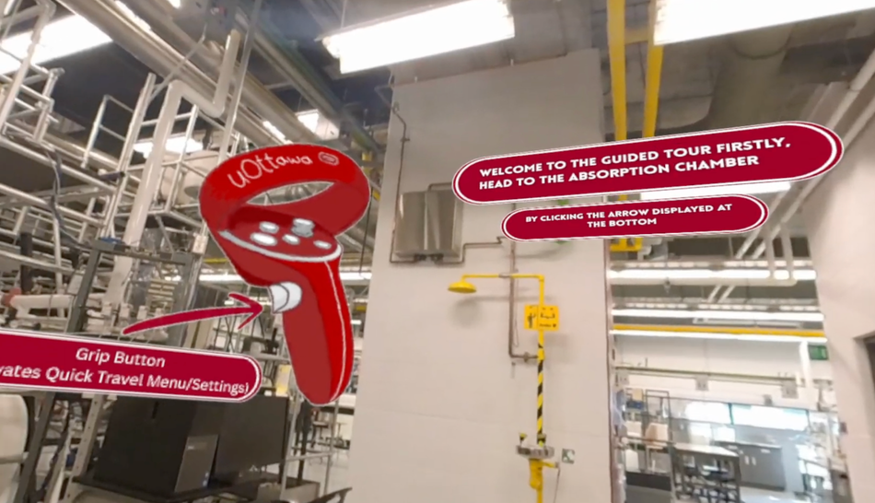
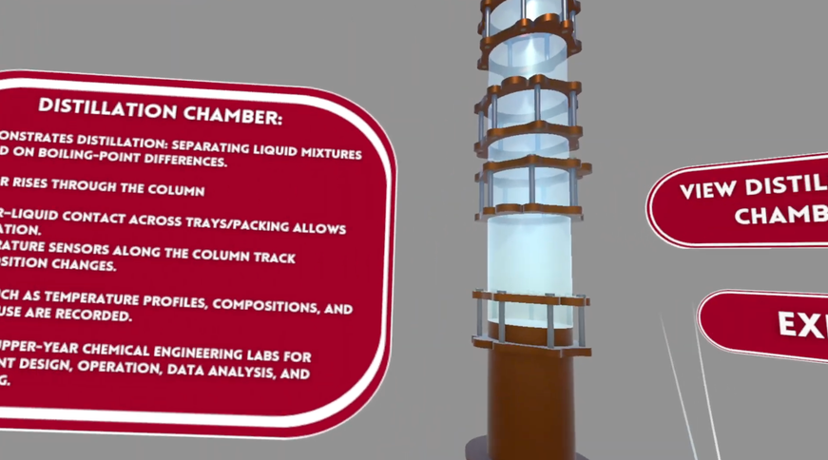
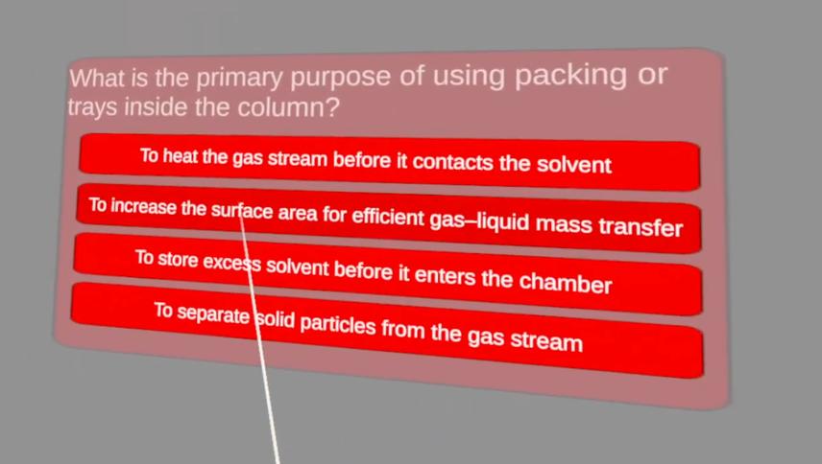
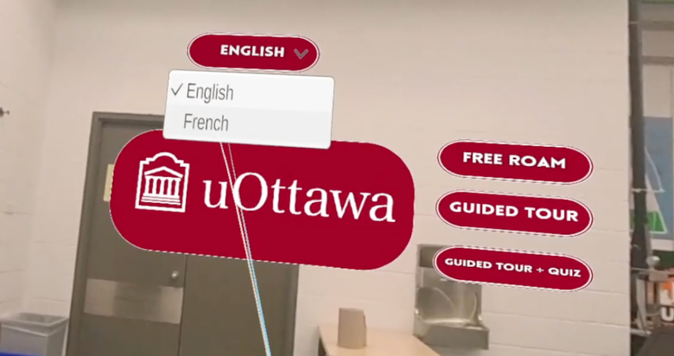
Take Aways
  3 quiz modes (Free roam, Guided & Guided + Quizzes).
  Virtual environment (360° images + 3D models) for better conceptual understanding.
  Conceptual and intuitive User Interface.
  Easily expandable to include more equipment.

