Slide 1
Project Presentation of CO-OP Project at Industry (Module-2) (22CS421)
On
Effect of Screen Time on Productivity and Mental Health Among University Students: A Data-Driven and Machine Learning Approach
Saanchi Madaan
2210992199
Supervised By
Dr. Simarjit Kaur
Associate Professor, Department of Computer Science and Engineering
Department of Computer Science and Engineering,
Chitkara University, Punjab

Slide 2
Introduction
Technology has become an essential part of students’ academic and personal lives
Significant increase in daily screen usage among university students
Devices like smartphones, laptops, and tablets are widely used for:
Learning
Communication
Entertainment
While technology offers many benefits, excessive screen time is a growing concern
Negative effects of prolonged screen usage:
Reduced concentration
Increased stress levels
Poor sleep quality
Need for a data-driven and machine learning approach to analyze its impact
‹#›

Slide 3
Problem Statement
With the increasing use of digital devices, university students are spending more time on screens for both academic and personal activities. While technology is beneficial, excessive screen time has raised concerns regarding its impact on productivity and mental well-being. However, there is limited data-driven analysis to clearly understand these effects.
Key Issues:
Increased screen time
Reduced productivity and focus
Higher stress levels
Poor sleep quality
Core Problem: To analyze the impact of screen time on productivity, stress, and sleep quality using a data-driven approach.

Slide 4
Objectives
The main objectives of this study are:
To analyze the relationship between screen time and productivity
To examine the impact of screen time on stress levels
To study the effect of screen time on sleep quality
To apply machine learning techniques for prediction and analysis

Slide 5
Literature Review
Several studies highlight the significant impact of screen time on students’ mental health and academic performance
Increased screen usage is consistently associated with higher stress levels, reduced concentration, and decreased academic efficiency
Excessive screen exposure, especially for non-academic purposes, leads to:
Poor sleep quality
Increased mental fatigue
Lower productivity levels
Many studies also indicate that media multitasking and prolonged device usage negatively affect attention span and cognitive control
While moderate screen usage can support learning and communication, excessive use results in adverse psychological and behavioral effects
However, most existing research relies on traditional statistical methods, with limited use of machine learning techniques for predictive and data-driven analysis

Slide 6
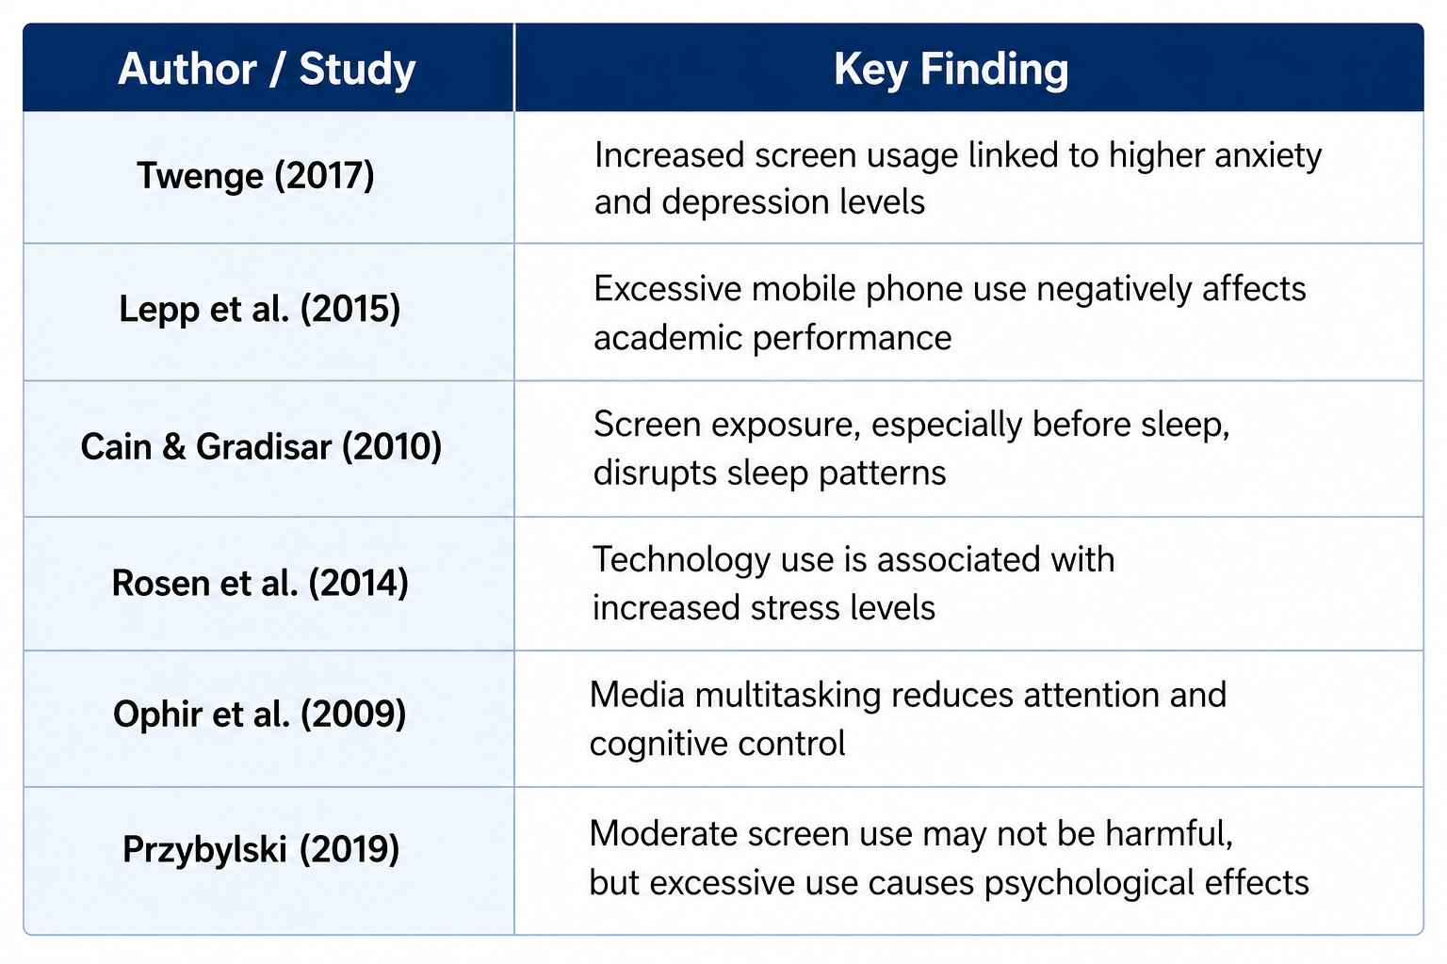
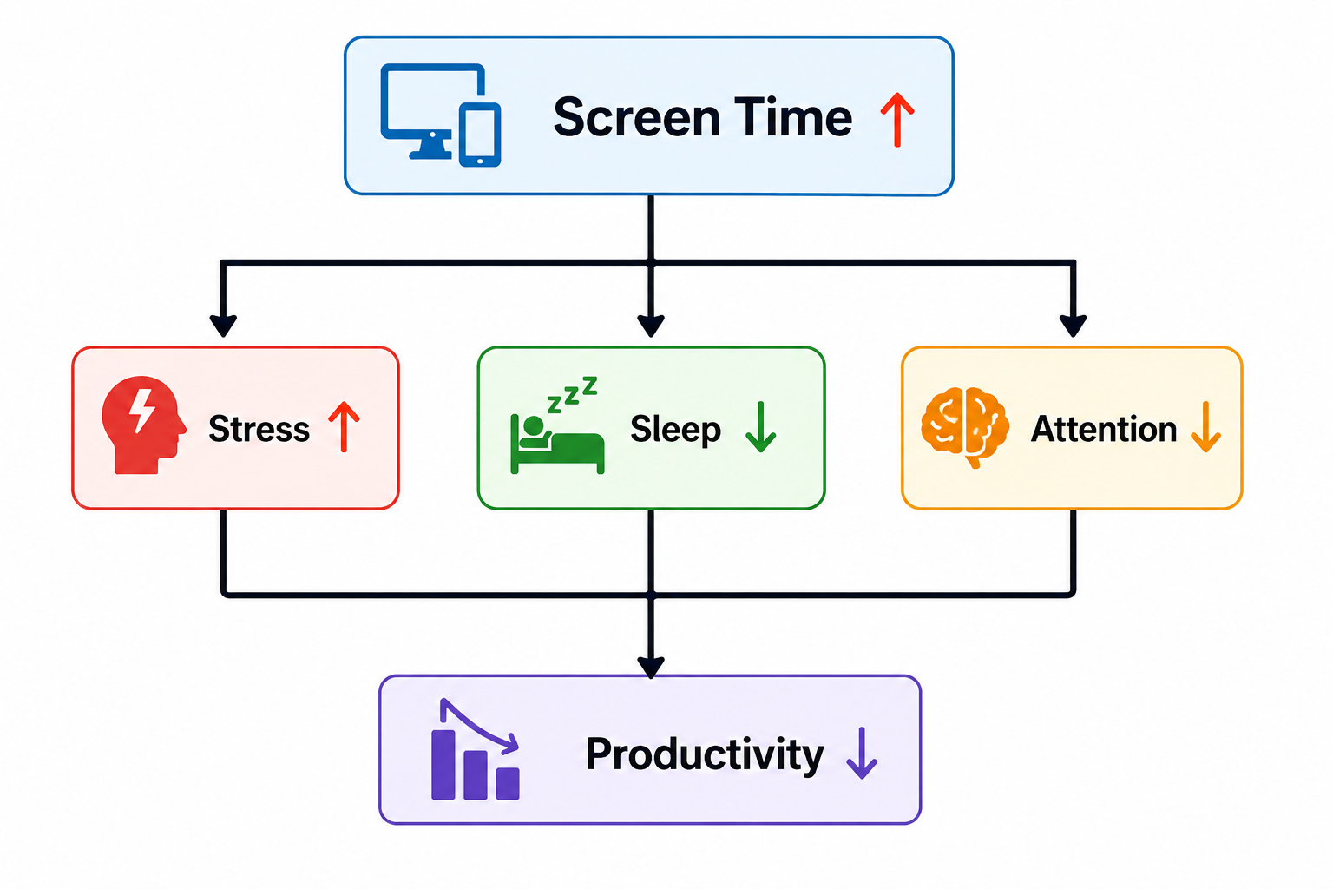

Slide 7
Methodology
This study follows a data-driven approach to analyze the impact of screen time on students’ productivity and mental health.
Dataset of 150 students collected with key variables:
Screen Time
Productivity
Stress Levels
Sleep Quality
Data preprocessing and analysis performed using:
Python (Pandas, Matplotlib, Seaborn)
Exploratory Data Analysis (EDA) used to identify patterns and relationships
Machine Learning model applied:
Linear Regression to predict productivity based on screen time

Slide 8
Machine Learning Model
A Linear Regression model was used to analyze the relationship between screen time and productivity.
Model Used: Linear Regression
Objective: Predict productivity based on screen time
Dataset Split:
80% Training Data
20% Testing Data
Model Evaluation Metrics:
Mean Squared Error (MSE)
R² Score
The model shows a negative relationship, indicating that increased screen time leads to lower productivity.

Slide 9
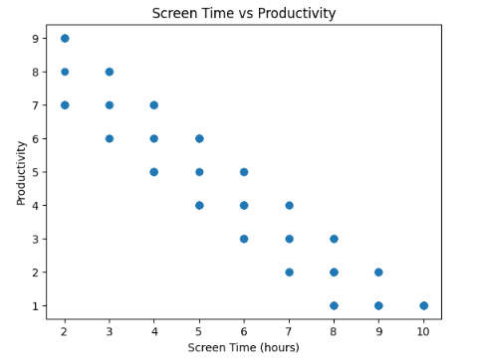
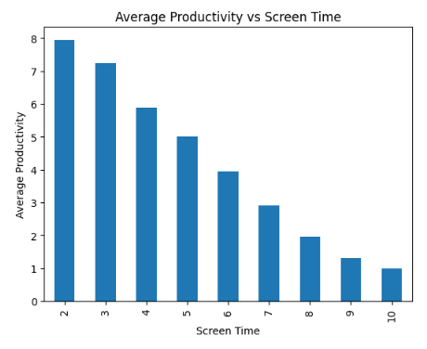
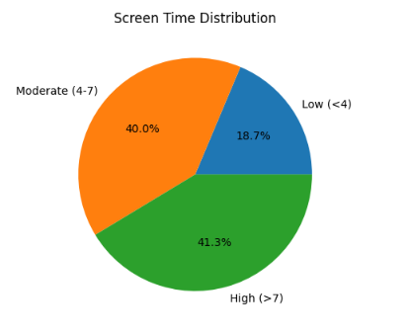
Exploratory Data Analysis (EDA)
Exploratory Data Analysis was performed to identify patterns and relationships between variables.
Scatter Plot: Shows relationship between screen time and productivity
Bar Chart: Displays average productivity across different screen time groups
Pie Chart: Represents distribution of students based on screen usage
Key Insight: Productivity decreases as screen time increases, showing a clear negative trend.

Slide 10
Correlation Analysis
Correlation analysis was performed to understand the relationship between screen time and other variables such as productivity, stress levels, and sleep quality. It helps in identifying how strongly these variables are connected and whether the relationship is positive or negative.
Negative correlation between:
Screen Time and Productivity
Screen Time and Sleep Quality
Positive correlation between:
Screen Time and Stress Levels
Key Insight: Higher screen time leads to lower productivity and reduced sleep quality, while increasing stress levels. This indicates that excessive screen usage has a negative impact on both academic performance and mental well-being.

Slide 11
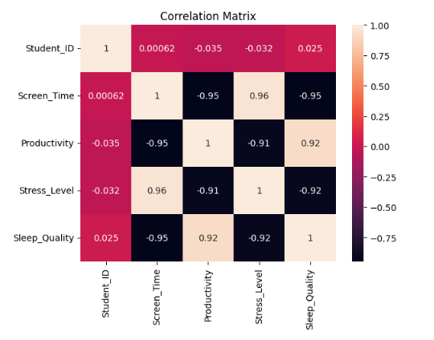

Slide 12
Results & Discussion
The analysis highlights the significant impact of screen time on students’ productivity and mental health.
Moderate screen usage can support learning and productivity
Excessive screen time leads to:
Decreased productivity
Increased stress levels
Poor sleep quality
Key factors affecting performance:
Distraction
Cognitive fatigue
Reduced concentration
The machine learning model confirms a negative relationship between screen time and productivity.

Slide 13
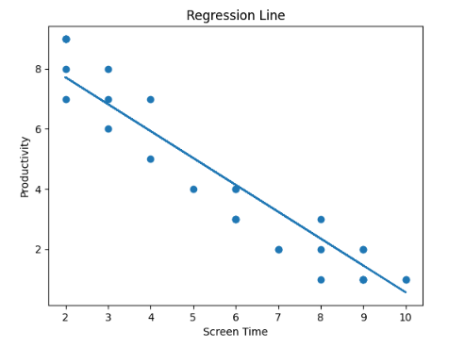

Slide 14
Conclusion
This study highlights that screen time plays a significant role in influencing students’ productivity and mental well-being.
Excessive screen usage leads to:
Reduced productivity
Increased stress levels
Poor sleep quality
Controlled and mindful usage of digital devices can improve overall performance and well-being
A data-driven and machine learning approach helps in better understanding and predicting these effects.

Slide 15
Recommendations
To improve productivity and mental well-being, the following measures are suggested:
Limit non-academic screen time
Take regular breaks during screen usage
Avoid screen exposure before sleep
Maintain a balanced daily routine
Practice digital detox to reduce dependency
Adopting these habits can help students achieve better focus, reduced stress, and improved sleep quality.

Slide 16
Future Work
The study can be extended in the following ways:
Use advanced machine learning models for better prediction
Increase dataset size for more accurate results
Collect real-time data using apps or tracking tools
Analyze additional factors such as physical activity and lifestyle
These improvements can provide deeper insights into the impact of screen time on students’ behavior and performance.

Slide 17
Thank You
‹#›

