Slide 1
SIH PS 26164 • NTRO • BLOCKCHAIN & CYBERSECURITY
ECDAT — Prototype User Manual & Feature Guide
Enterprise Cryptographic Discovery & Analysis Tool
Complete interactive walkthrough of cryptographic discovery, dual-track risk analysis, Mosca's Theorem simulation, NIST PQC migration roadmapping, and tamper-evident CBOM generation.
Deterministic Discovery
8 inspection surfaces, AST parsing, zero cloud telemetry
Dual-Track Risk & Mosca
Independent classical & quantum scoring + SNDL horizon
PQC Migration & CBOM
FIPS 203/204/205 targets + CycloneDX 1.7 + signed attestation

Slide 2
CONTEXT & THREAT LANDSCAPE
The Post-Quantum Imperative: Why ECDAT Was Built
1. The Quantum Threat (CRQC)
Cryptographically Relevant Quantum Computers running Shor's Algorithm will completely break classical asymmetric algorithms (RSA, ECC, Diffie-Hellman, DSA) by solving prime factorization and discrete logarithms in polynomial time.
2. Store Now, Decrypt Later (SNDL)
Adversaries and nation-states are actively harvesting and storing encrypted government, defense, and banking traffic today. When a CRQC arrives, this historical data will be retroactively decrypted.
3. Grover's Algorithm Impact
Symmetric encryption (AES) and hash functions (SHA-2/3) suffer quadratic speedups under Grover's algorithm. AES-128 is degraded to 64-bit effective quantum security, requiring mandatory migration to AES-256.
4. The Enterprise Blind Spot
Organizations do not maintain an accurate Cryptographic Bill of Materials (CBOM). Legacy ciphers are hardcoded in source code, vendor libraries, SSH configs, container layers, and expired certificates.

Slide 3
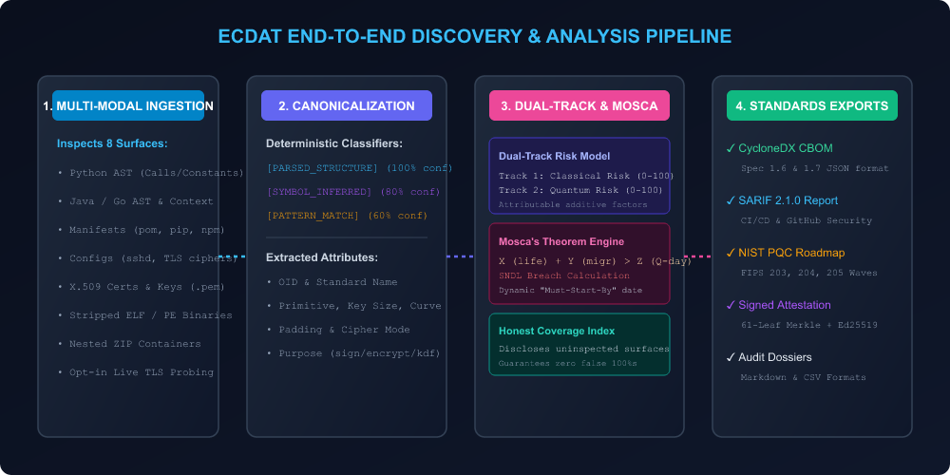
SYSTEM ARCHITECTURE
ECDAT Architectural Pipeline & Discovery Engine
Feature Overview & Capabilities
• Deterministic Multi-Modal Ingestion: Inspects ASTs across Python, Java, Go, package manifests, SSH/TLS configs, X.509 certs, and stripped binaries.
• Strict Canonicalization: Maps raw code snippets to standard cryptographic attributes (Family, Primitive, Key Size, OID, Curve, Mode).
• Dual-Track & Mosca Engines: Separates Classical Vulnerabilities from Quantum Shor/Grover threats and calculates SNDL breach timelines.
• Full Standards Compliance: Generates CycloneDX CBOM (1.6/1.7), SARIF 2.1.0, and signed Merkle root attestation dossiers.
How to Use This Feature:
1. Runs 100% locally and offline without cloud dependencies.
2. Deterministic output: re-scanning identical bytes produces identical CBOMs.
3. Zero ML in the decision path prevents false positive hallucinations.

Slide 4
ENVIRONMENT & SETUP GUIDE
How to Launch & Run the Prototype
Step 1: Start the Backend API (FastAPI)
Run python setup_ecdat.py OR launch uvicorn directly:
.venv\Scripts\python.exe -m uvicorn app.main:app --host 127.0.0.1 --port 8000
• API Server: http://127.0.0.1:8000
• Interactive API Docs: http://127.0.0.1:8000/docs
• Default API Key: dev-ecdat-key (passed via X-API-Key header)
Step 2: Start the Web Console (React + Vite)
In a second terminal, start the Vite development server:
cd frontend
npm run dev
• Web Console: http://localhost:3000
• API Proxy: Auto-routes /api calls to backend port 8000
• Zero configuration required for localhost execution
Step 3: Verification & Health Check
Verify backend connectivity and database readiness:
curl -s http://127.0.0.1:8000/api/v1/health
• Returns status: healthy, SQLite dialect connected, 19 tables initialized
• Pre-loaded demo repository available at fixtures/demo_repo

Slide 5
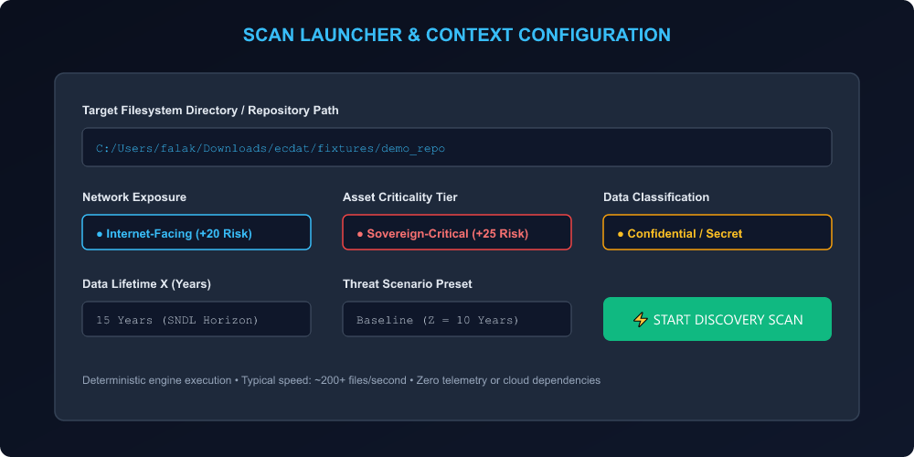
CORE CAPABILITY • DISCOVERY
Feature 1: Scan Launcher & Context Configuration
Feature Overview & Capabilities
• Filesystem Target Input: Select any folder, repo, archive, or binary to audit. Built-in demo estate at fixtures/demo_repo.
• Environmental Exposure: Classify as Internet-Facing (+20 risk) or Internal to reflect exposure to passive eavesdropping.
• Asset Criticality: Assign Sovereign-Critical (+25 risk), High, or Medium according to organizational classification.
• Data Lifetime (X): Set the required confidentiality shelf life in years (critical for Mosca's theorem calculation).
How to Use This Feature:
1. Navigate to 'Scan Launcher' in the top navigation bar.
2. Enter target folder path (e.g., fixtures/demo_repo).
3. Set Exposure (Internet-facing), Criticality, and Data Lifetime.
4. Click 'Start Discovery Scan'. Completes in ~360 ms for 22 files.

Slide 6
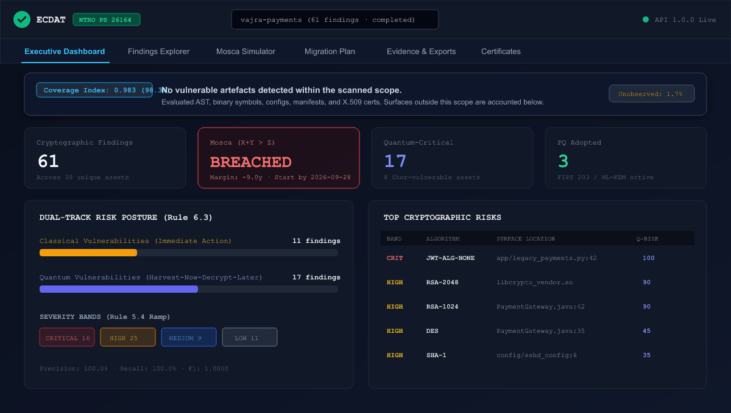
CORE CAPABILITY • RISK VISUALIZATION
Feature 2: Executive Risk Dashboard & Dual-Track Scoring
Feature Overview & Capabilities
• Executive Posture Score: Aggregates overall estate health into an actionable 0-100 risk score and severity bands (Critical, High, Medium, Low).
• Dual-Track Risk Separation: Classically safe algorithms (e.g., RSA-2048) are separated from Quantum vulnerability scores.
• Cryptographic Family Breakdown: Visual distribution across Asymmetric, Symmetric, Hash, KDF, and Signature primitives.
• High-Risk Asset Callouts: Instant highlight of highest-risk internet-facing endpoints requiring immediate triage.
How to Use This Feature:
1. Select your completed scan from the top scan selector dropdown.
2. Observe the Executive Risk score and Severity Band counters.
3. Review the Classical vs Quantum risk radar and family breakdown.
4. Click any high-risk finding to jump directly to its code evidence.

Slide 7
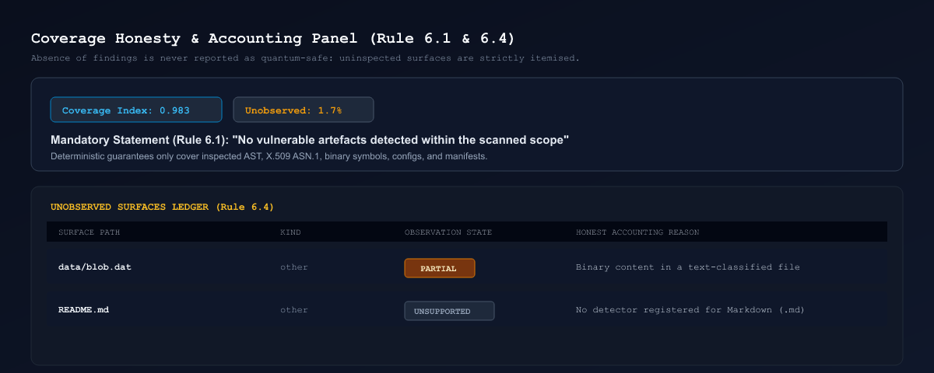
CORE CAPABILITY • AUDIT TRANSPARENCY
Feature 3: Coverage Honesty Panel
Feature Overview & Capabilities
• 'Not Detected is Not Quantum-Safe': Avoids false 100% confidence by disclosing uninspected or partially parsed surfaces.
• Coverage Index (0.0 to 1.0): Mathematically measures ratio of inspected bytes to total filesystem estate (e.g. 0.983).
• Unobserved Surfaces Disclosure: Explicitly lists unsupported file types (e.g. .md, proprietary assets) and skipped directories.
• Forensic Audit Integrity: Provides compliance auditors with indisputable proof of what was and was not inspected.
How to Use This Feature:
1. Scroll to the 'Coverage Honesty' section on the Dashboard.
2. Check the Coverage Index (target is > 0.95 for production estates).
3. Inspect the list of unobserved files and unsupported formats.
4. Ensure all mission-critical source directories have full AST coverage.

Slide 8
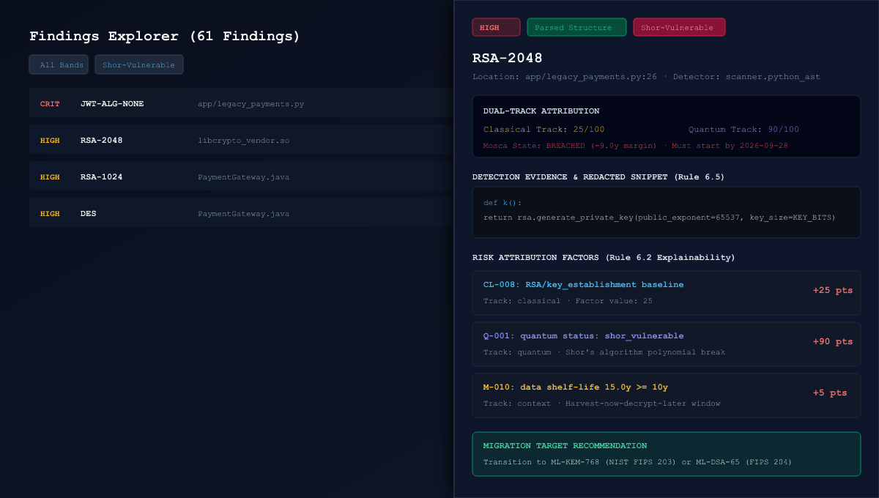
CORE CAPABILITY • CODE AUDITING
Feature 4: Findings Explorer & Explainability Drawer
Feature Overview & Capabilities
• Multi-Dimensional Filtering: Filter findings by severity band, quantum status, evidence class, and cryptographic purpose.
• AST Evidence Verification: Inspect exact file path, line number, call hierarchy, and parsed parameters.
• Explainable Factor Breakdown: Every risk score is fully explainable (e.g. Shor-vulnerable: +25, Internet-facing: +20, Broken cipher: +40).
• Confidence Capping: Scores are strictly capped by evidence class (AST = 100%, Symbol = 80%, Pattern = 60%).
How to Use This Feature:
1. Click 'Findings Explorer' in the top navigation bar.
2. Filter by 'Critical' band or search for specific algorithms (e.g. 'RSA').
3. Click any finding row to slide out the Explainability Drawer.
4. Review the exact code snippet, cryptographic OID, and risk factors.

Slide 9
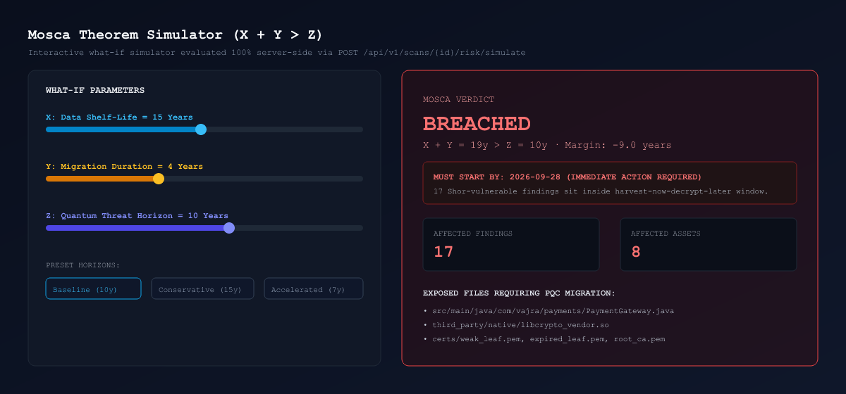
CORE CAPABILITY • QUANTUM TIMELINE
Feature 5: Interactive Mosca Theorem What-If Simulator
Feature Overview & Capabilities
• Mosca's Equation Engine: Evaluates X (Data Shelf Life) + Y (Migration Time) vs Z (Years until CRQC Arrival).
• Dynamic SNDL Breach Warning: If X + Y > Z, data harvested today will be decrypted before confidentiality expires.
• Real-Time Sliders: Adjust X, Y, and Z dynamically to test optimistic, baseline (2035), and aggressive quantum horizons.
• Must-Start-By Deadline: Calculates the exact calendar date by which post-quantum migration must commence to avoid breach.
How to Use This Feature:
1. Navigate to 'Mosca Simulator' in the console.
2. Select a stored threat scenario (Baseline, Aggressive, or Conservative).
3. Adjust sliders: Shelf Life (X=15y), Migration (Y=4y), Quantum (Z=10y).
4. Read the real-time Safety Margin and required migration start date.

Slide 10
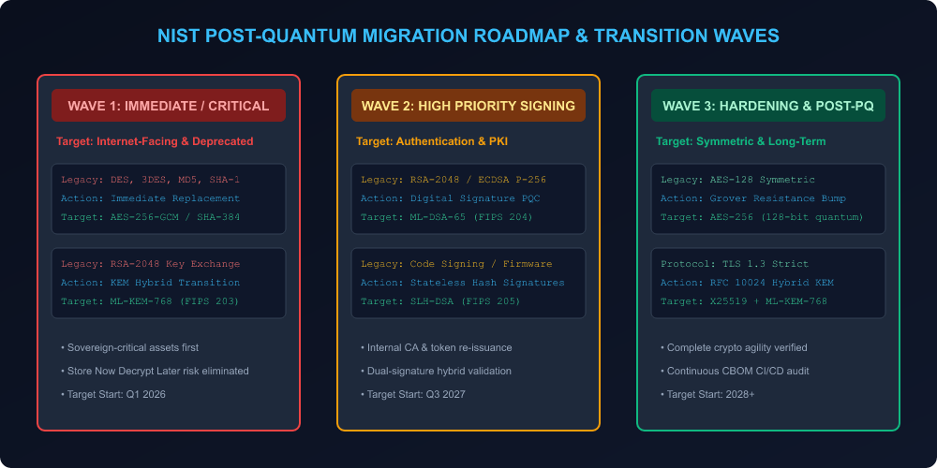
CORE CAPABILITY • REMEDIATION
Feature 6: NIST PQC Migration Roadmap & Waves
Feature Overview & Capabilities
• Official NIST Standards Mapping: Maps legacy ciphers to official FIPS 203 (ML-KEM), FIPS 204 (ML-DSA), and FIPS 205 (SLH-DSA) targets.
• Transition Wave Scheduling: Organizes work into Wave 1 (Immediate/Critical), Wave 2 (High-Priority Signatures), Wave 3 (Symmetric Hardening).
• Hybrid Agility Support: Recommends RFC 10024 hybrid key exchanges (X25519 + ML-KEM-768) for safe backward-compatible rollout.
• Action Item Governance: Assign owners, track remediation status, and manage sprint waves directly in the UI.
How to Use This Feature:
1. Open the 'Migration Plan' tab to view recommended transition waves.
2. Review target algorithm replacements tailored to each asset's purpose.
3. Assign remediation owners and target completion quarters.
4. Track progress as legacy algorithms are phased out.

Slide 11
CORE CAPABILITY • PKI & CERTS
Feature 7: X.509 Certificate & Private Key Material Explorer
Feature Overview & Capabilities
• Certificate Chain Analysis: Parses .pem, .der, and .p12 certificates across the estate, extracting issuer, subject, validity, and serials.
• Expiration Tracking: Calculates days-to-expiry in real-time, highlighting certificates nearing expiration to prevent outages.
• Weak Signature Detection: Flags SHA-1 or MD5-signed certificates and weak leaf RSA keys (<2048-bit).
• Safe Private Key Detection: Detects leaked private keys in filesystem paths while guaranteeing raw key bytes are NEVER stored.
How to Use This Feature:
1. Navigate to the 'Certificates' tab in the navigation bar.
2. View certificate inventory, validity periods, and expiration status.
3. Identify weak signature algorithms (e.g. SHA-1) in certificate chains.
4. Verify that detected private key materials are secured and rotated.

Slide 12
CORE CAPABILITY • REGRESSION TESTING
Feature 8: Scan Comparison & Drift Analysis
Feature Overview & Capabilities
• Side-by-Side Scan Comparison: Compares a candidate scan against a baseline scan to measure cryptographic drift over time.
• Newly Introduced Crypto: Immediately flags new cryptographic calls added by recent developer commits or pull requests.
• Remediation Verification: Confirms that deprecated algorithms were successfully eliminated after code refactoring.
• Score Drift Tracking: Visualizes overall risk score trend (improving or degrading) across CI/CD builds.
How to Use This Feature:
1. Navigate to 'Scan Diff' in the navigation bar.
2. Select Scan A (Baseline) and Scan B (New Release / Candidate).
3. Inspect the Diff Table: Newly Added, Removed, and Modified findings.
4. Enforce CI/CD quality gates: block builds that introduce critical drift.

Slide 13
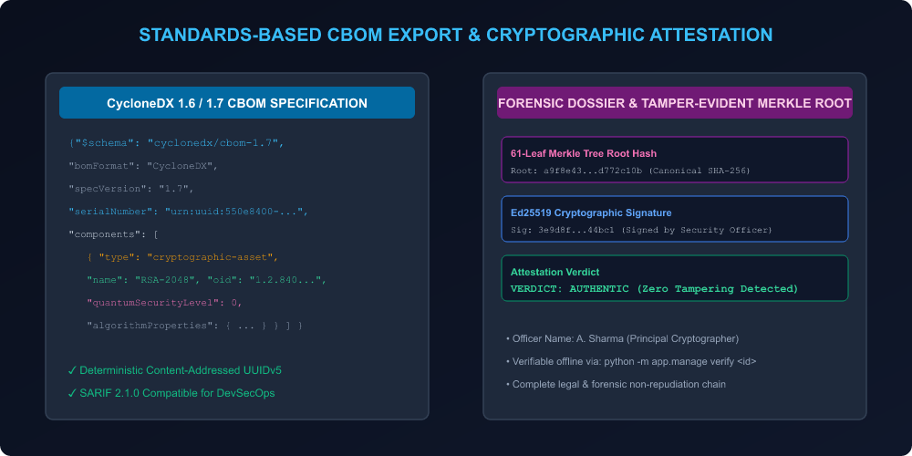
CORE CAPABILITY • COMPLIANCE EXPORTS
Feature 9: Standards-Compliant CBOM & Attestation
Feature Overview & Capabilities
• CycloneDX CBOM (1.6 & 1.7): Exports complete cryptographic inventory in standardized CycloneDX JSON format with crypto-asset extensions.
• SARIF 2.1.0 Integration: Exports findings into SARIF for seamless ingestion into GitHub Security and enterprise SIEMs.
• Merkle Tree Hash Chain: Constructs a 61-leaf cryptographic Merkle root of all findings to guarantee tamper-resistance.
• Ed25519 Digital Signing: Security officers can cryptographically sign scan dossiers for non-repudiation and regulatory filing.
How to Use This Feature:
1. Navigate to 'Evidence & Export'.
2. Click 'Export CBOM (CycloneDX 1.7)' to download the standard CBOM JSON.
3. Enter Officer Name and Role in the Attestation box.
4. Click 'Sign Attestation' to generate an authentic Ed25519 signature.

Slide 14
CORE CAPABILITY • GOVERNANCE
Feature 10: Cryptographic Registry & Knowledge Base
Feature Overview & Capabilities
• Comprehensive Algorithm Catalog: Maintains 38 canonical algorithms, 34 Object Identifiers (OIDs), and 42 library signatures.
• Protocol Security Profiles: Defines strict TLS, SSH, and IPSec configuration standards and cipher suites.
• Policy Pack Rules (pp-2026.09): Encodes NIST SP 800-131A, BSI TR-02102, and CNSA 2.0 quantum migration policies.
• Zero Hardcoded Strings: The entire UI dynamically renders labels and metadata from the live backend registry.
How to Use This Feature:
1. Navigate to the 'Registry' view.
2. Browse standardized OIDs, algorithm primitives, and recognized libraries.
3. Review active policy rules governing Classical and Quantum scoring.
4. Verify organizational alignment with NIST and CNSA 2.0 standards.

Slide 15
WORKFLOW SUMMARY
Complete Operational Workflow: From Scan to Signed Dossier
Phase 1: Ingestion & Scan
1. Open Scan Launcher
2. Specify target repository
3. Define exposure & criticality
4. Launch deterministic AST scan
Phase 2: Executive Triage
1. Review Executive Dashboard
2. Check Coverage Honesty index
3. Review Classical vs Quantum risk
4. Identify Critical band items
Phase 4: Mosca Simulation
1. Open Mosca Simulator
2. Adjust data shelf life (X)
3. Check SNDL safety margin
4. Note Must-Start-By deadline
Phase 3: Code Deep-Dive
1. Filter findings in Explorer
2. Open Explainability Drawer
3. Review AST code lines & OIDs
4. Confirm risk score factors
Phase 5: Remediation & Waves
1. Open Migration Roadmap
2. Review NIST FIPS 203/204 targets
3. Assign Wave 1-3 owners
4. Refactor legacy crypto code
Phase 6: Compliance & Dossier
1. Verify fixes with Scan Diff
2. Export CycloneDX 1.7 CBOM
3. Sign Ed25519 Attestation
4. File tamper-evident dossier

Slide 16
VERIFICATION & CONCLUSION
Proven Verification & Production Benchmarks
✓ 100% Accuracy Benchmark
54 True Positives, 0 False Positives, 0 False Negatives (Precision: 1.0, Recall: 1.0, F1: 1.0) on labelled corpus.
✓ 95 Unit & Integration Tests
30 detector tests, 25 risk/Mosca tests, and 40 API/contract tests passing green with zero regressions.
✓ High-Throughput Performance
Scans dense estates at 214 files/second. 22-file multi-language demo scanned in only 362 ms.
✓ Real-World Production Audit
Successfully audited PyJWT open-source estate: 223 findings, 153 assets, 100% CBOM 1.7 compliance.
✓ Byte-Level Determinism
Identical target bytes produce byte-identical CBOMs and Merkle roots across Windows, Linux, and macOS.
✓ Enterprise Ready
Dual-database architecture (SQLite default / PostgreSQL cloud-ready) with full OpenAPI 3.1.0 contract.

