Slide 1
Prior Authorization &
Insurance Appeals Advocate
An evidence-grounded agentic AI system for safer prior authorization review and appeal drafting
RAG
Tree of Thoughts
Multi-Agent
Guardrails
Human Review
Saanjaana Rahman | Agentic AI Capstone | Carnegie Mellon University
Notes:
Open with the real-world problem: prior authorization appeals require staff to connect denial rationale, payer policy, and patient documentation.,My capstone turns that process into a bounded agentic workflow that can retrieve evidence, reason across alternatives, decide whether an appeal is supported, and draft only when appropriate.

Slide 2
Why this problem matters: high-friction review under evidence constraints
Intended users: clinic administrators, medical billers, utilization-management staff, and physicians
1 Fragmented evidence
2 High cognitive burden
3 Consequential output
Denial rationale, payer criteria, clinical documentation, treatment history, and supporting records live in different places. Staff must reconcile them manually.
The reviewer must determine what the policy actually requires, whether the record satisfies it, and what is missing, without introducing unsupported claims.
A persuasive letter is not enough. The system must know when NOT to appeal, when evidence is incomplete, and when a human must intervene.
Why agentic AI?
The task requires retrieval + multi-step reasoning + tool use + conditional routing + verification—not just one prompt.
Notes:
The core problem is not simply writing an appeal letter. It is deciding whether the appeal is supported in the first place.,That makes this a good agentic use case because the system needs to retrieve evidence, reason across it, enforce constraints, route cases differently, and verify its own output.

Slide 3
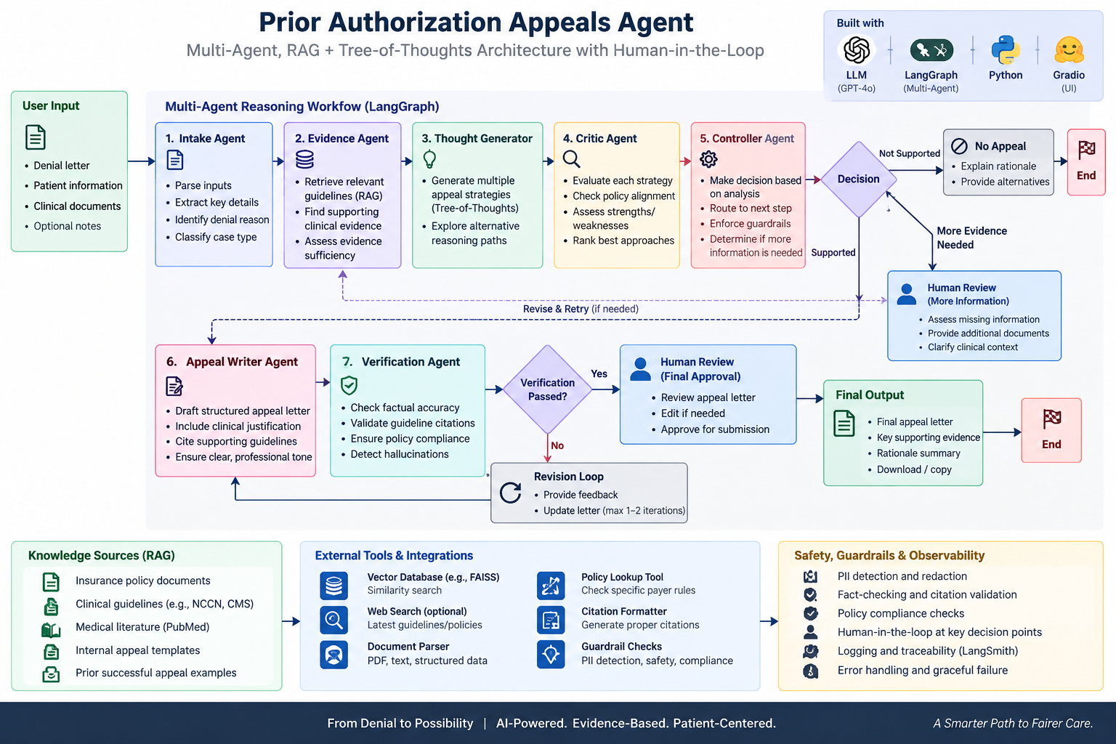
System architecture
A stateful LangGraph workflow coordinates evidence retrieval, reasoning, decision control, verification, and human oversight
Notes:
Walk left to right through the architecture.,The evidence agent retrieves case-specific policy and patient evidence. The thought generator creates alternative reasoning paths. The critic evaluates them, and the controller decides the next state.,Supported cases can reach the writer and verifier. Unsupported cases terminate without drafting. Uncertain or unresolved cases can escalate to human review.

Slide 4
What makes the system agentic?
The LLM is one component inside a controlled reasoning and orchestration harness
1
2
3
4
5
Retrieve
Branch
Critique
Control
Act / Abstain
RAG retrieves policy and patient evidence using case-aware metadata.
Tree of Thoughts generates multiple candidate appeal pathways.
A critic scores clinical, policy, and logical validity.
LangGraph state + deterministic rules select the next route.
Draft only if supported; otherwise stop or escalate.
Design principle: use LLMs for synthesis and judgment; use deterministic code for rules, routing, and hard safety gates.
Notes:
The key design choice was not to let one model do everything.,RAG answers what evidence the system should reason from. Tree of Thoughts answers how to explore competing reasoning paths. The critic evaluates them, and LangGraph controls what happens next.,Deterministic code handles rules that should not depend on probabilistic generation.

Slide 5
Safety, reliability, and human oversight
Layered controls prevent unsupported appeals and route uncertainty to people
Pre-generation
During reasoning
Post-generation
Case validation • source/case metadata • evidence-only instructions • input guardrails
Deterministic policy checks • risk guardrail • critic review • structured decision parsing
Hard writer gate • grounding verification • one bounded revision • trajectory logging
Human-in-the-Loop
Hard stop
Escalate when evidence is missing/conflicting, risk is high, policy application is uncertain, or verification remains unresolved.
If the structured decision is APPEAL_NOT_SUPPORTED, the writer cannot draft an appeal. The workflow ends with a rationale.
Notes:
Safety is layered rather than relying on a single instruction to the model.,The most important safeguard is the writer gate: an unsupported decision cannot enter appeal drafting.,Human review is targeted to uncertainty and unresolved failures rather than being required at every internal step. External submission remains a human responsibility.

Slide 6
Evaluation and results: can the workflow take the right action?
Synthetic end-to-end scenarios tested evidence grounding, routing, decision controls, and drafting behavior
SUPPORTED PATH
UNSUPPORTED PATH
APPEAL_SUPPORTED
APPEAL_NOT_SUPPORTED
Policy criterion satisfied by retrieved patient evidence
Controller routes to Appeal Writer
Draft is grounded and verified
Human review remains before external action
Retrieved evidence does not meet policy requirement
Deterministic check reinforces the decision
Writer gate prevents appeal generation
Workflow returns rationale instead of fabricating support
Result: the prototype demonstrated functional differentiation between “draft” and “do not draft” outcomes while remaining evidence-grounded.
Notes:
I evaluated the system with synthetic end-to-end scenarios that included both supported and unsupported policy situations.,The important result is behavioral: the system does not simply generate a letter every time. It can distinguish when evidence supports an appeal and when the safe action is to stop.,This is functional proof-of-concept evaluation, not clinical or production validation.

Slide 7
Implementation & public repository
The prototype is executable in Colab and documented for technical review
Python
LangGraph
Core implementation
Stateful orchestration
GitHub
OpenAI API
Sentence Transformers
README
Architecture diagram
Executable notebook
Demo screenshots
Safety & limitations
Reasoning, critique, drafting
Embeddings
scikit-learn
Gradio
Cosine similarity retrieval
Interactive demo UI
https://github.com/saanjaanarahman/prior-authorization-appeals-agent
MCP
Minimal standardized tool interface
Credentials are stored through Colab Secrets rather than hard-coded in the notebook.
Notes:
The entire implementation is available in the public GitHub repository.,The notebook contains the RAG pipeline, LangGraph state machine, Tree-of-Thought generation and critique, deterministic checks, verification, human-review routing, MCP wrapper, and Gradio interface.,The repository also includes the architecture diagram and demonstration outputs so the system can be reviewed without first reading every code cell.

Slide 8
Closing reflection
What worked, what I learned, and where I would take the system next
What worked
What I learned
What I would improve
Combining RAG, multi-path reasoning, critic evaluation, deterministic controls, and verification created a system that could both act and abstain.
Agentic AI is less about adding more agents and more about designing state, routing, tools, termination conditions, and boundaries around probabilistic reasoning.
Richer conditional outcomes between nodes, broader policy/version validation, stronger observability and calibration, and larger-scale evaluation before real-world use.
The goal is not autonomous appeal generation-it is safer, evidence-grounded decision support with human accountability.
Notes:
My main takeaway is that autonomy should be bounded by evidence, deterministic controls, and explicit escalation.,The prototype works as a coherent proof of concept, but real-world deployment would require broader evaluation, live policy versioning, privacy and security controls, and deeper integration with healthcare workflows.,A future architectural improvement would be richer conditional outcomes and feedback paths between nodes, making the graph less pipeline-like while preserving bounded autonomy.

