Slide 1
MINI PROJECT
Name | Sakshi Mayya Bhoomika G Hegde Sourabh Hegde
Registration Numbers | 241058001 | 241058002 | 241058025
Branch | M.E Big Data Analytics
Project Title | Development of a Supervised Model for the Detection of Toxicophore Using Significant Feature Prediction
Guide | Mr. Balaji B

Slide 2
CONTENTS
Introduction
Literature Review
Objective
Operational Flow
Functional Requirements
Work Done
References

Slide 3
INTRODUCTION
The development of new drugs involves identifying lead compounds and extensive safety testing, often using animals like mice. This process is time-consuming, costly, and raises ethical concerns.
This project aims to reduce animal testing and cut drug development costs by using a machine learning model to screen for toxicophores—features that may indicate toxicity. The model will identify and flag compounds for further investigation.
This approach enables early toxicity screening, reducing animal use and addressing ethical concerns while lowering time and costs in drug development. It supports the demand for more humane and efficient practices.

Slide 4
LITERATURE REVIEW
Author and Title | Purpose of Study | Key findings
1.Raj Kumar,Pankaj Kumar Singh,Arvind Negi,Pawan Gupta.Toxicophore exploration as a screening technology for drug design and discovery: techniques, scope and limitations | The study aims to explore toxicophores, which are structural features in drugs responsible for toxicity. It reviews various techniques, including biological and computational methods, for identifying and predicting these toxicophores. This information helps in designing safer drugs with fewer toxic side effects | Toxicophores, which are harmful parts of drug structures, play a key role in causing drug toxicity. Identifying them is important for safer drug design. Advanced tools like QSAR models, toxicophore mapping, and software like DEREK and TOPKAT help predict and prevent toxic drug reactions
2.Leander Schietgat,[a,b] Bertrand Cuissart,[c] Kurt De Grave,[d] Kyriakos Efthymiadis. Automated detection of toxicophores and prediction of mutagenicity using PMCSFG algorithm | The study aims to use the PMCSFG algorithm to automatically detect toxicophores and predict mutagenicity in chemical compounds. This helps improve the identification of toxic features, aiding safer drug and chemical design | The PMCSFG algorithm efficiently detects toxicophores, matching or exceeding the performance of traditional chemical fingerprints while being more interpretable. It also successfully identified over 40 known toxicophores and proposed a new structural alert for mutagenicity
3.Claudio N. Cavasotto and Valeria Scardino.MachineLearningToxicityPrediction:LatestAdvancesbyToxicity EndPoint | The study reviews recent advancements in machine learning methods for predicting the toxicity of small molecules in drug discovery. It highlights various toxic endpoints and the challenges associated with developing reliable predictive models | Machine learning models, such as DeepTox and GGL-Tox, show promise in predicting various toxicity endpoints, including cardiotoxicity and hepatotoxicity. The study emphasizes the importance of high-quality data and the need for model evaluation based on specific toxicity endpoints for reliable predictions

Slide 5
OBJECTIVE
Data Pre-processing:
Pre-process a dataset comprising approximately 20,000 natural compounds, integrating data on around 6 different toxicophores.
Extract relevant features using tools such as T.E.S.T to prepare the data for model training.
Ensure the dataset is well-organized and suitable for accurate and effective screening of potential toxicity.
Model Training and Toxicophore Screening:
Train the machine learning model using the pre-processed dataset, developing a comprehensive pipeline for both training and testing to ensure its accuracy.
The model will be designed to screen and classify compounds based on the likelihood of containing toxicophores. This will help predict potential toxicity and support safer drug development processes.

Slide 6
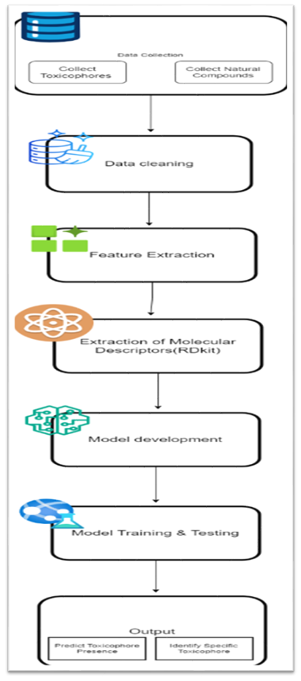
OPERATIONAL FLOW
Fig 1: FlowChart

Slide 7
Data Collection and Toxicophore Screening
Data Sources: Collected toxicophore data from databases like PubChem and Lotus, and gathered diverse natural compounds for analysis.
Data Cleaning: Removed duplicates, handled missing values, normalized features, and corrected errors to ensure data quality.
Feature Extraction: Utilized PCA and PLS for molecular descriptors and fingerprints, focusing on key features predictive of toxicity.

Slide 8
Data Collection and Toxicophore Screening
Model Development: Selected algorithms implemented in Python; trained, tested and validated using a 70:20:10 split for robust evaluation.
Validation: Employed k-fold cross-validation and external validation to confirm model reliability.
Outcome: The final model predicts toxicophore presence in new compounds, aiding in safety assessments in drug development.

Slide 9
FUNCTIONAL REQUIREMENTS
Python
Python is popular for building supervised machine learning models because it offers extensive libraries like scikit-learn and TensorFlow, making it easy to implement complex models.
Scikit-learn
(often referred to as sklearn)is one of the most widely used libraries for machine learning in Python. It provides simple and efficient tools for data mining and data analysis, built on top of other scientific libraries such as NumPy, SciPy, and matplotlib

Slide 10
1.LASSO with Cross-Validation (LASSO CV):
LASSO (Least Absolute Shrinkage and Selection Operator) regression helps with feature selection by penalizing coefficients and determining the best regularization strength through cross-validation.
2.Principal Component Analysis (PCA):
It reduces dimensionality by capturing the most variance, making it easier to analyze or
visualize complex data.
3.Partial Least Squares (PLS):
PLS establishes a regression model between predictors and responses by projecting them onto a new space, useful for high-dimensional datasets.

Slide 11
Toxicity Estimation Software Tool (T.E.S.T.)
A program to estimate toxicity from molecular structure.
It has been developed to allow users to easily estimate toxicity using a variety of QSAR methodologies, without requiring any external programs.
Users can input a chemical to be evaluated by drawing it in an included chemical sketcher window, entering a CAS, SMILES, or name, entering a structure text file, or importing it from an included database of structures.

Slide 12
WORK DONE
STEP1:
We have collected 20000 compounds belonging to 6 type of toxicophores.
STEP2:

Slide 13
REFERENCES

Slide 14
THANK YOU

