Slide 1
MINI PROJECT
Name | Samarth Prathap M Sanjana Y Alva
Registration Numbers | 241057022 | 241057015
Branch | AIML
Project Title | Anomaly Detection In Multivariate Time Series Data Using Transformers
Guide | Mr. Sudarshan N S Acharya

Slide 2
CONTENTS
Introduction
Objective
Operational Flow
Implementation
Results

Slide 3
INTRODUCTION
Anomaly Detection in Time Series:
Identifies unexpected patterns in sequential data, essential for monitoring and predictive maintenance.
Multivariate Data Significance:
Captures multiple variables simultaneously, allowing for more accurate and comprehensive anomaly detection.
Leveraging Transformers:
Transformers excel in handling complex dependencies in time series data, enhancing the detection of subtle anomalies.

Slide 4
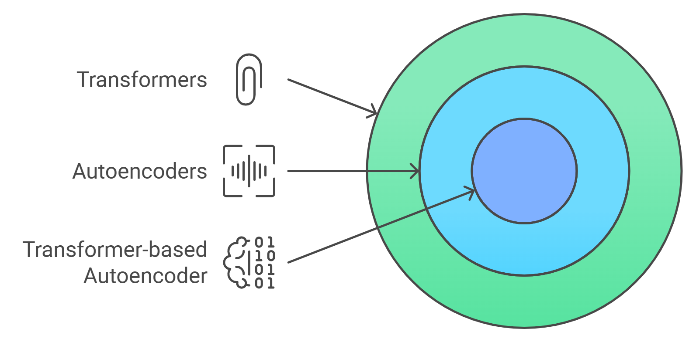
KEY TECHNOLOGIES USED
Transformer Models:
Self-attention to capture long-range dependencies.
Autoencoders:
A neural network that learns to compress and reconstruct data, used for tasks like anomaly detection.
Transformer-based Autoencoder:
Merges strengths of Transformers with Autoencoders for anomaly detection through reconstruction.

Slide 5
OBJECTIVE
Develop an Advanced Anomaly Detection System:
Leverage transformers to accurately detect anomalies in multivariate time series data from hydraulic systems.
Capture Complex Dependencies:
Use transformer models to effectively learn temporal and feature dependencies, providing a robust approach to anomaly detection in industrial settings.
Enhance Predictive Maintenance:
Identify early signs of equipment failure to minimize downtime and maintenance costs.

Slide 6
HYDRAULIC SYSTEM CONDITION MONITORING DATASET
Attribute Information:
The dataset contains raw process sensor data, structured as tab-delimited matrices with rows representing cycles and columns representing data points within each cycle.
Data Characteristics:
Instances: 2205
Attributes: 43,680 (8x60 (1 Hz) + 2x600 (10 Hz) + 7x6000 (100 Hz))
Type: Multivariate time-series (Classification & Regression)
Data Collection:
Collected from a hydraulic test rig with cyclical load cycles (60 seconds).

Slide 7
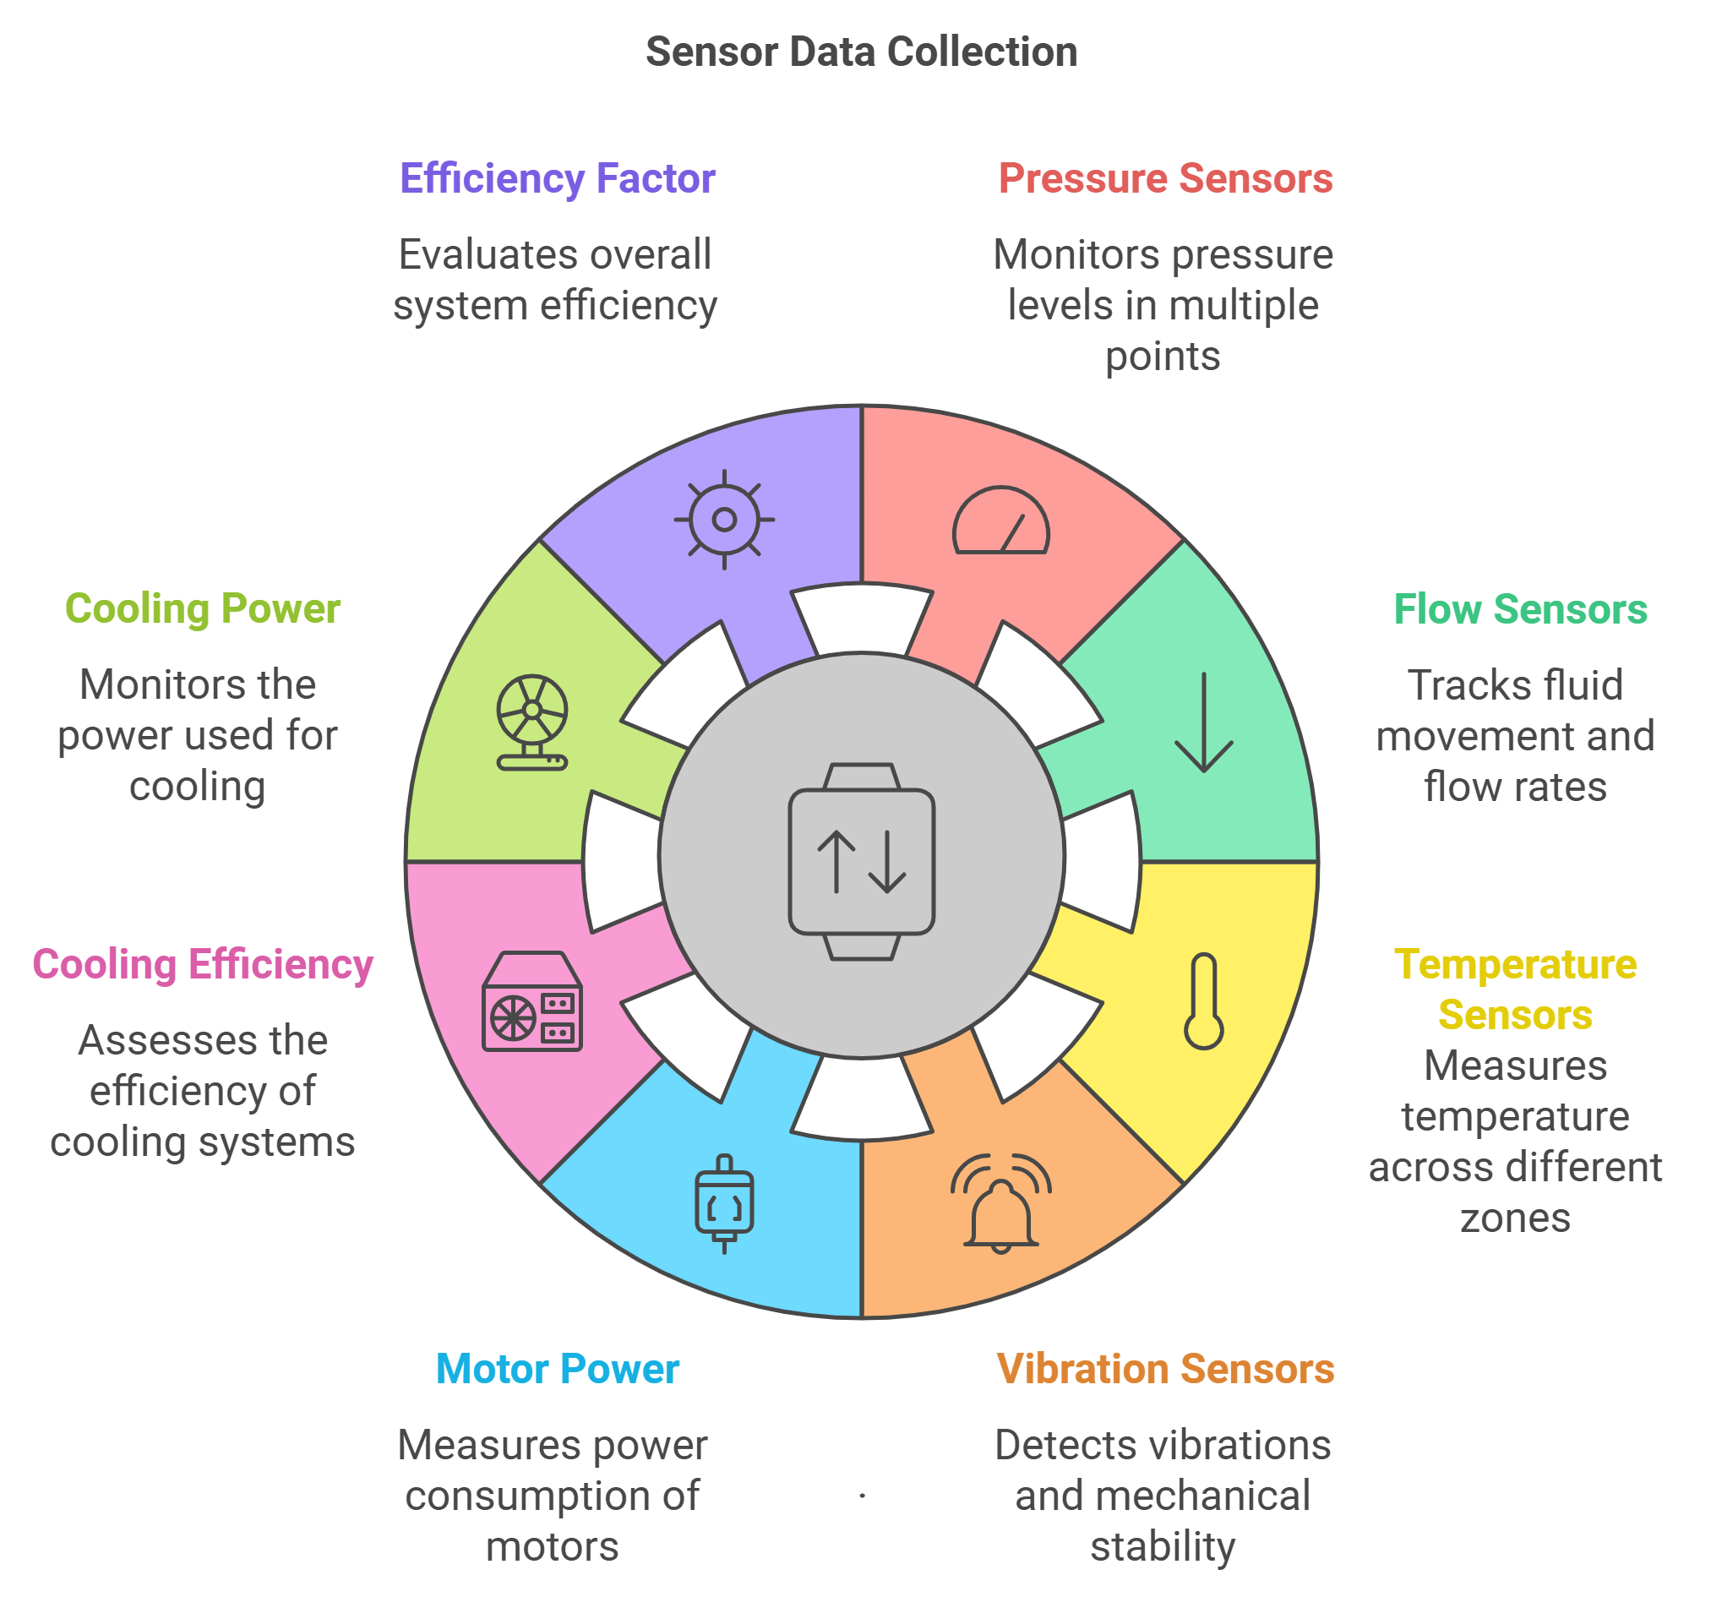
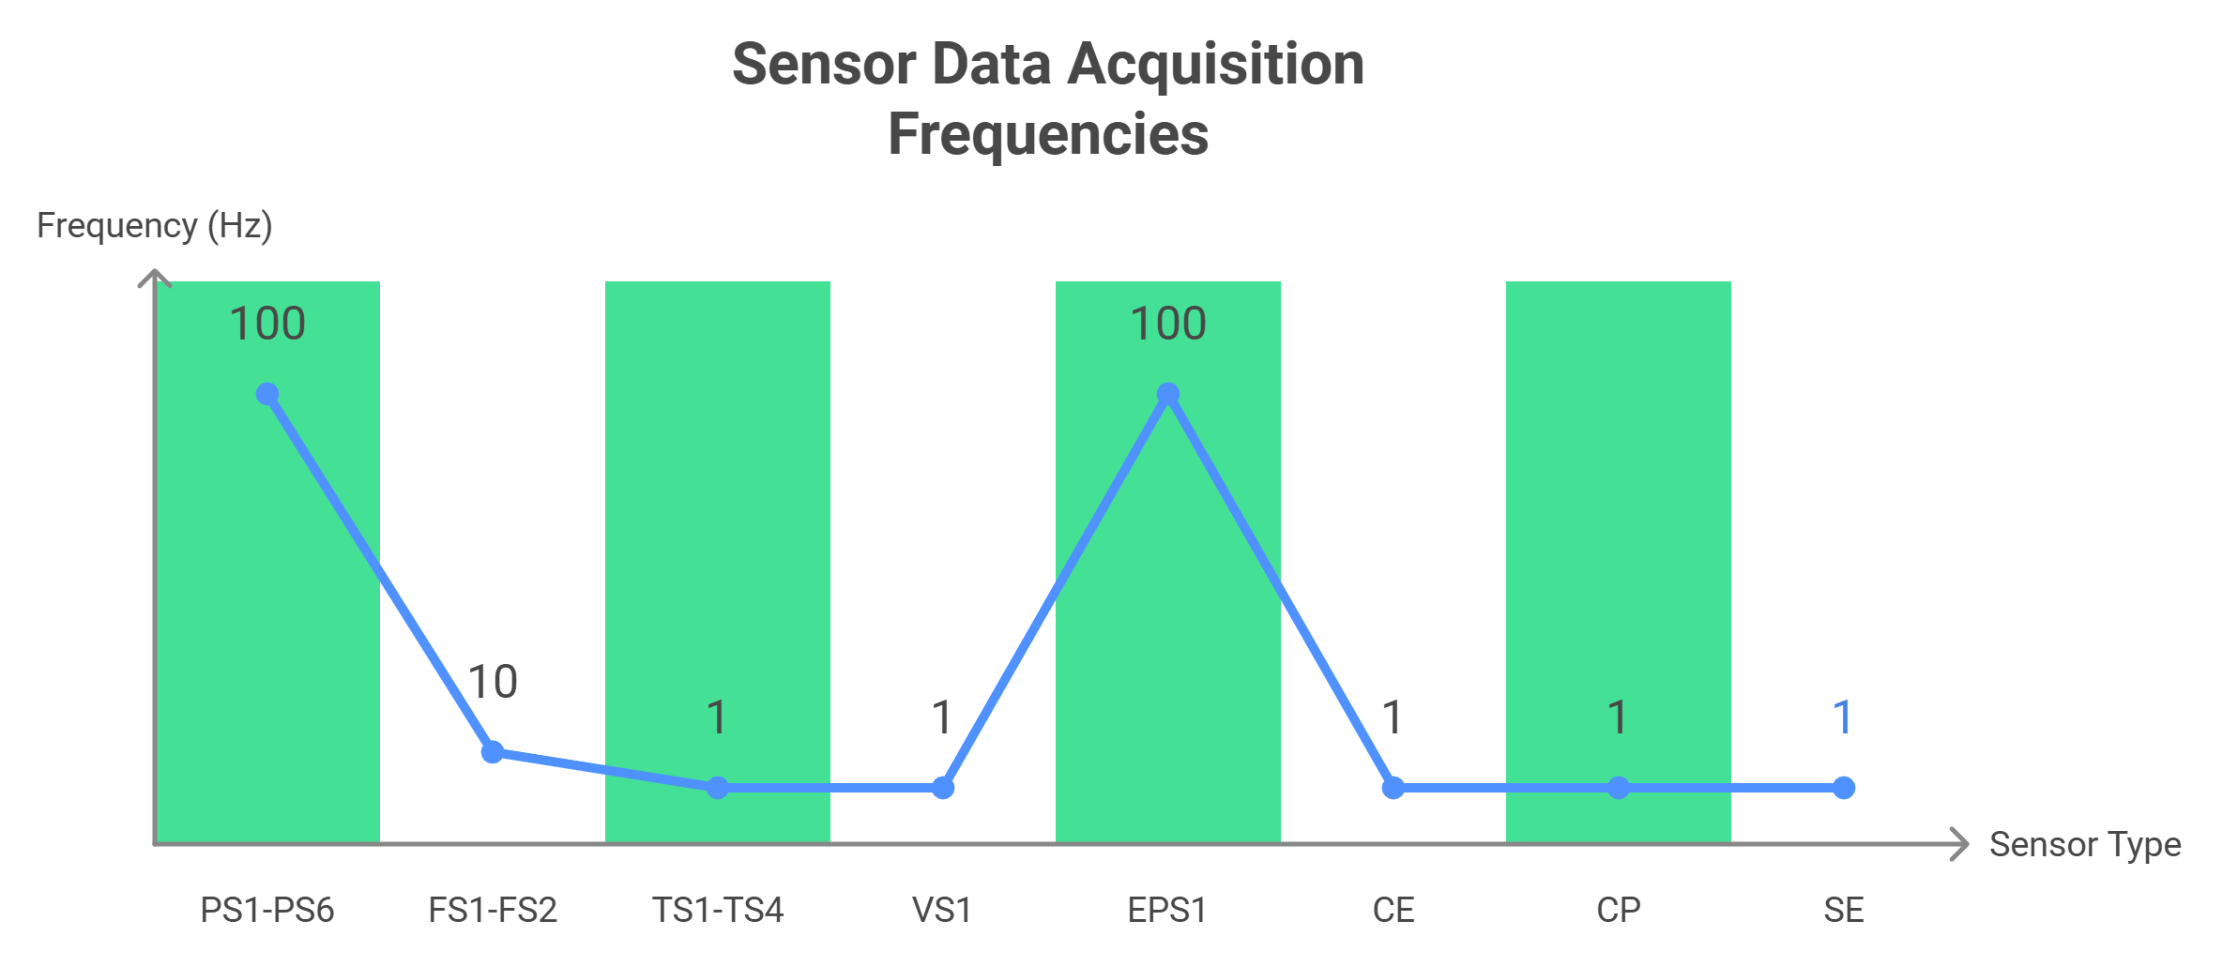
SENSOR DATA

Slide 8
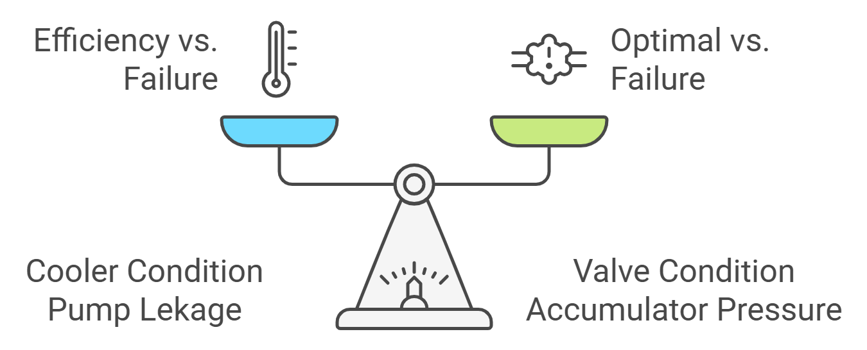
OPTIMAL CONDITIONS

Slide 9
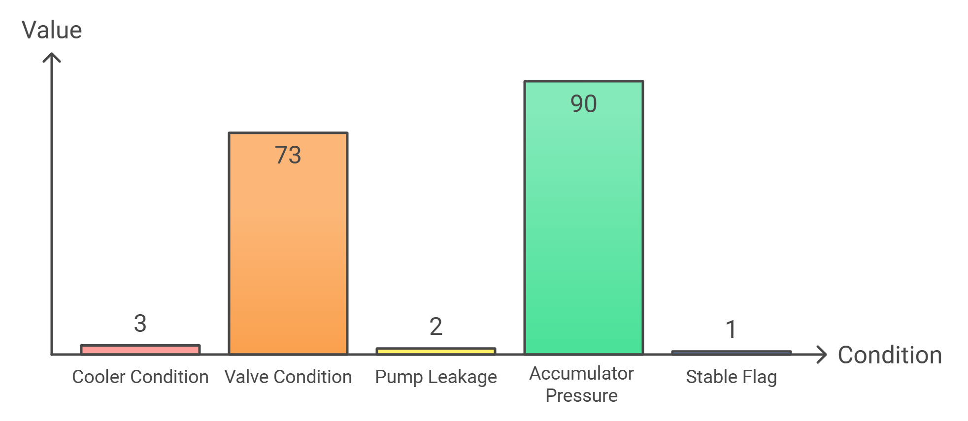
CLASS DISTRIBUTION
Cooler condition: 3% (close to total failure) to 100% (full efficiency)
Valve condition: 100% (optimal) to 73% (close to total failure)
Pump leakage: 0 (no leakage) to 2 (severe leakage)
Accumulator pressure: 90 bar (close to total failure) to 130 bar (optimal pressure)
Stable flag: 0 (stable) to 1 (static conditions not reached)

Slide 10
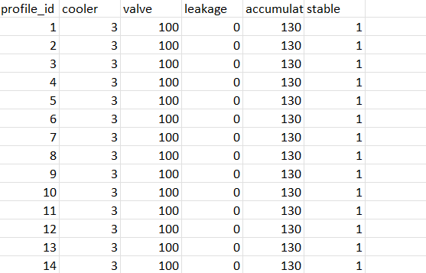

Slide 11
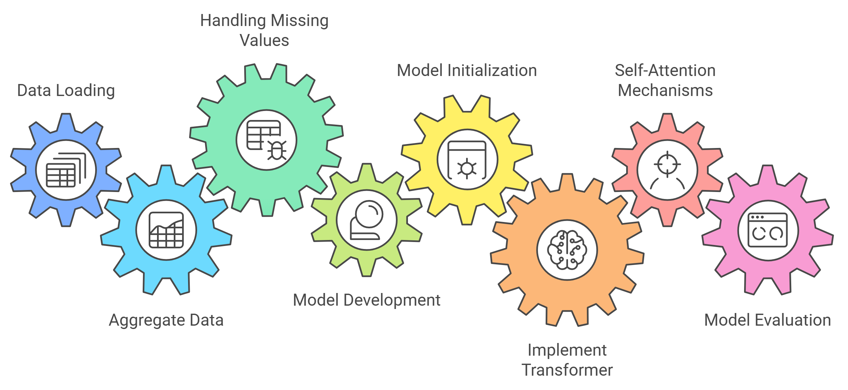
OPERATIONAL FLOW

Slide 12
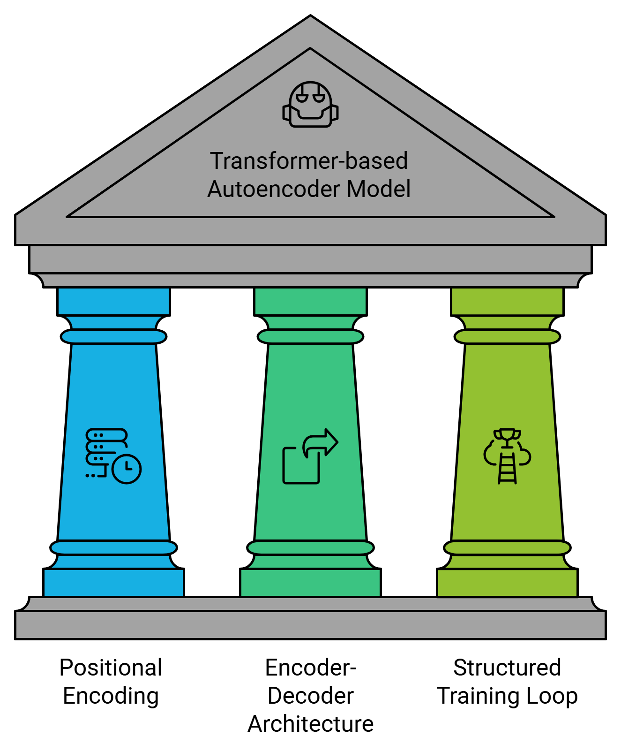
TRANSFORMER AUTO-ENCODER

Slide 13
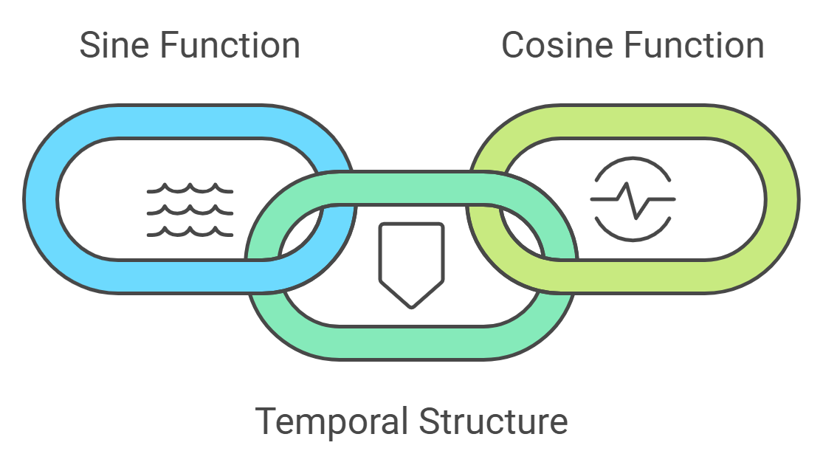
POSITIONAL ENCODING
Positional encoding adds temporal or sequential information to the input data, allowing the model to differentiate between time steps and capture the order of events.

Slide 14
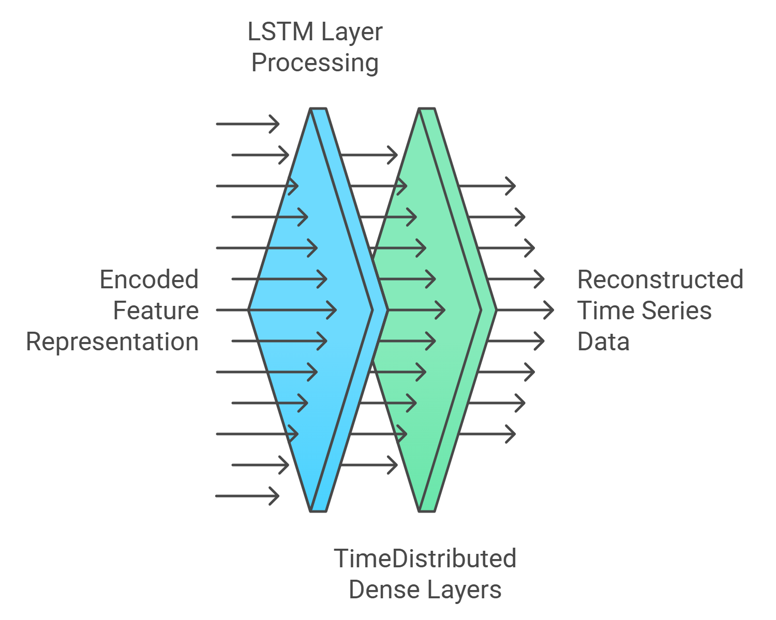
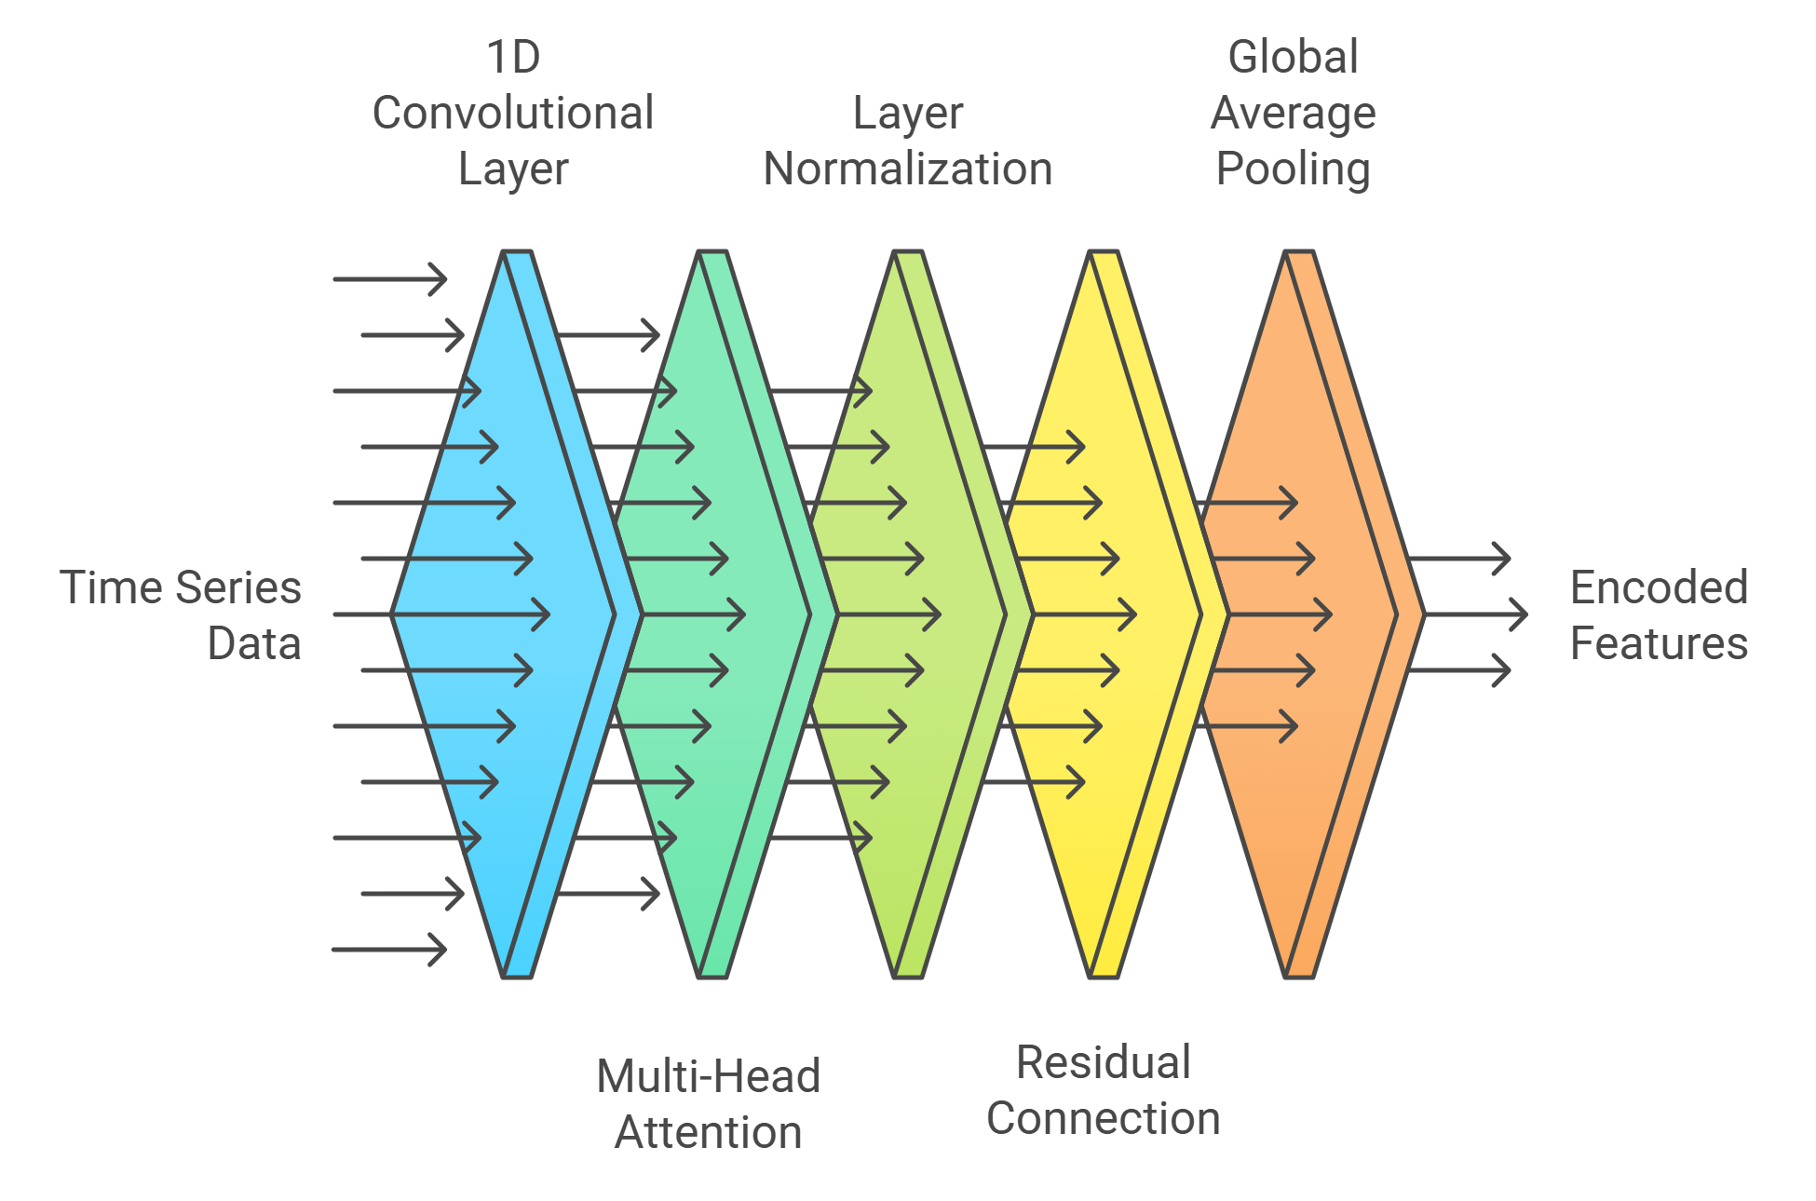
TRANSFORMER AUTO-ENCODER
ENCODER
DECODER

Slide 15
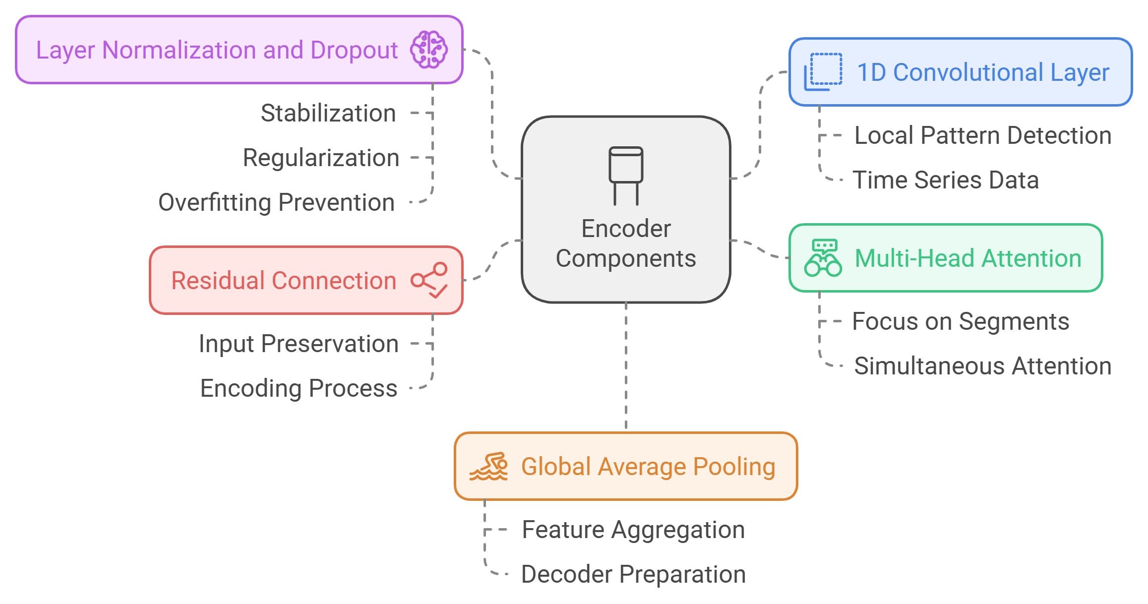
ENCODER
The Encoder processes the input time series data to extract useful features for reconstruction.

Slide 16
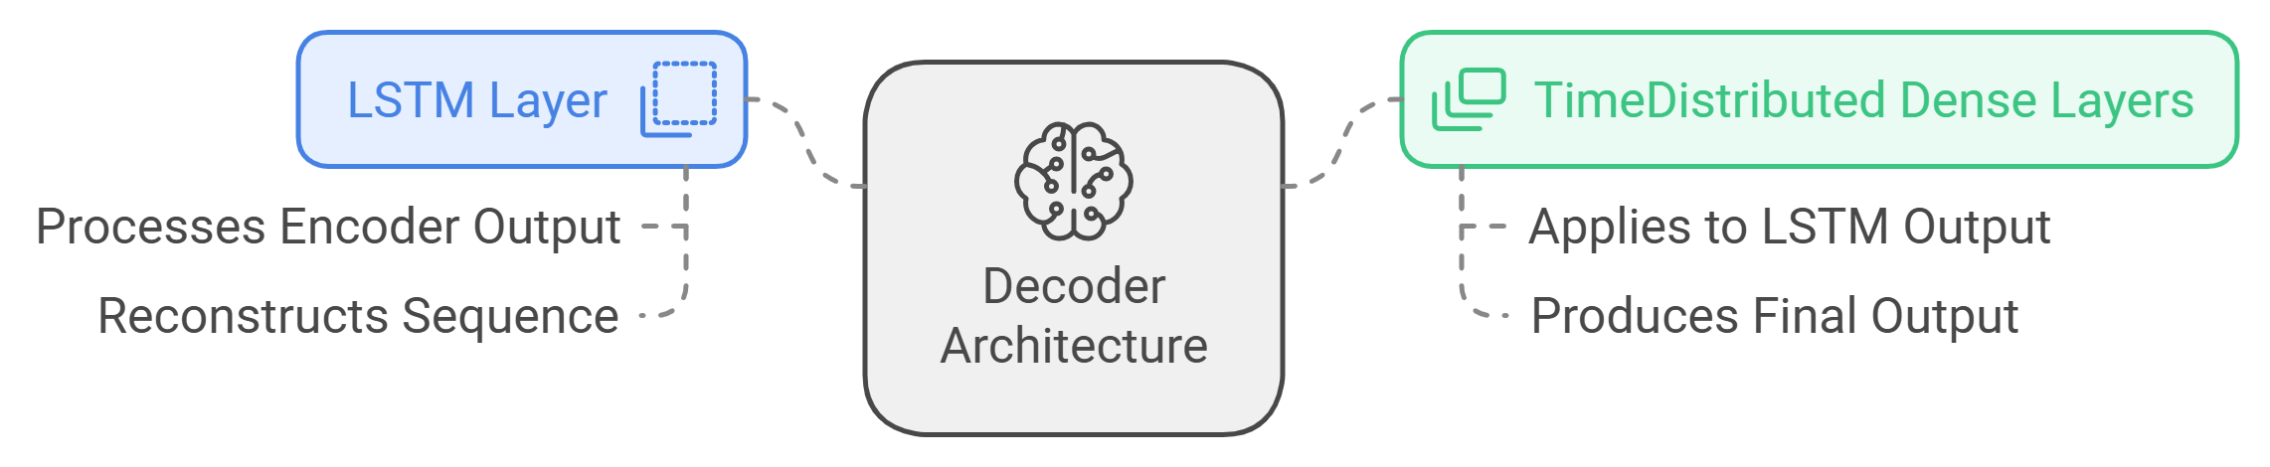
DECODER
The Decoder reconstructs the original time series data from the encoded feature representation provided by the Encoder

Slide 17
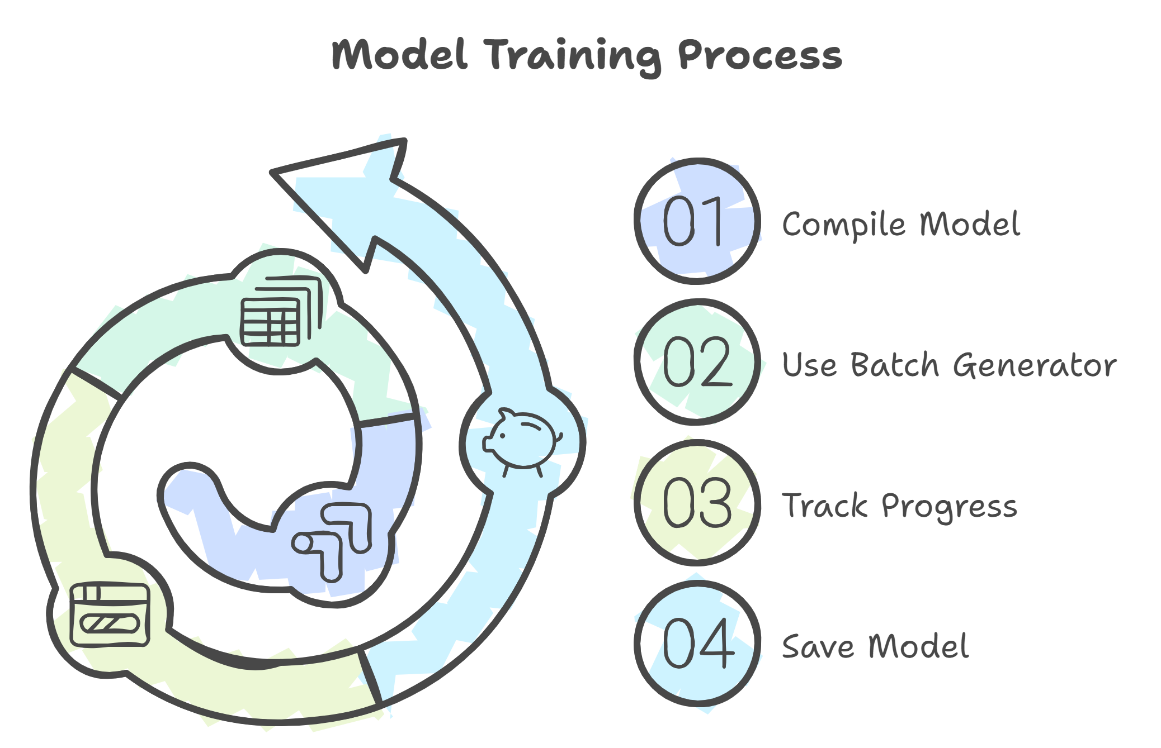
MODEL TRAINING

Slide 18
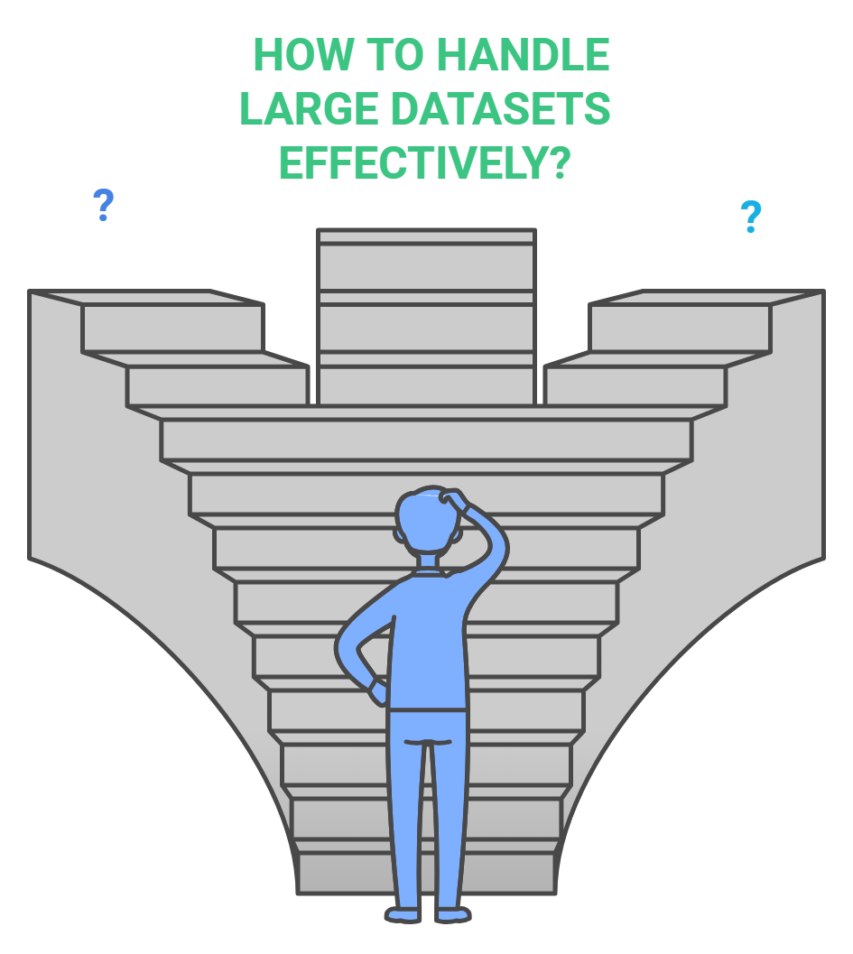

Slide 19
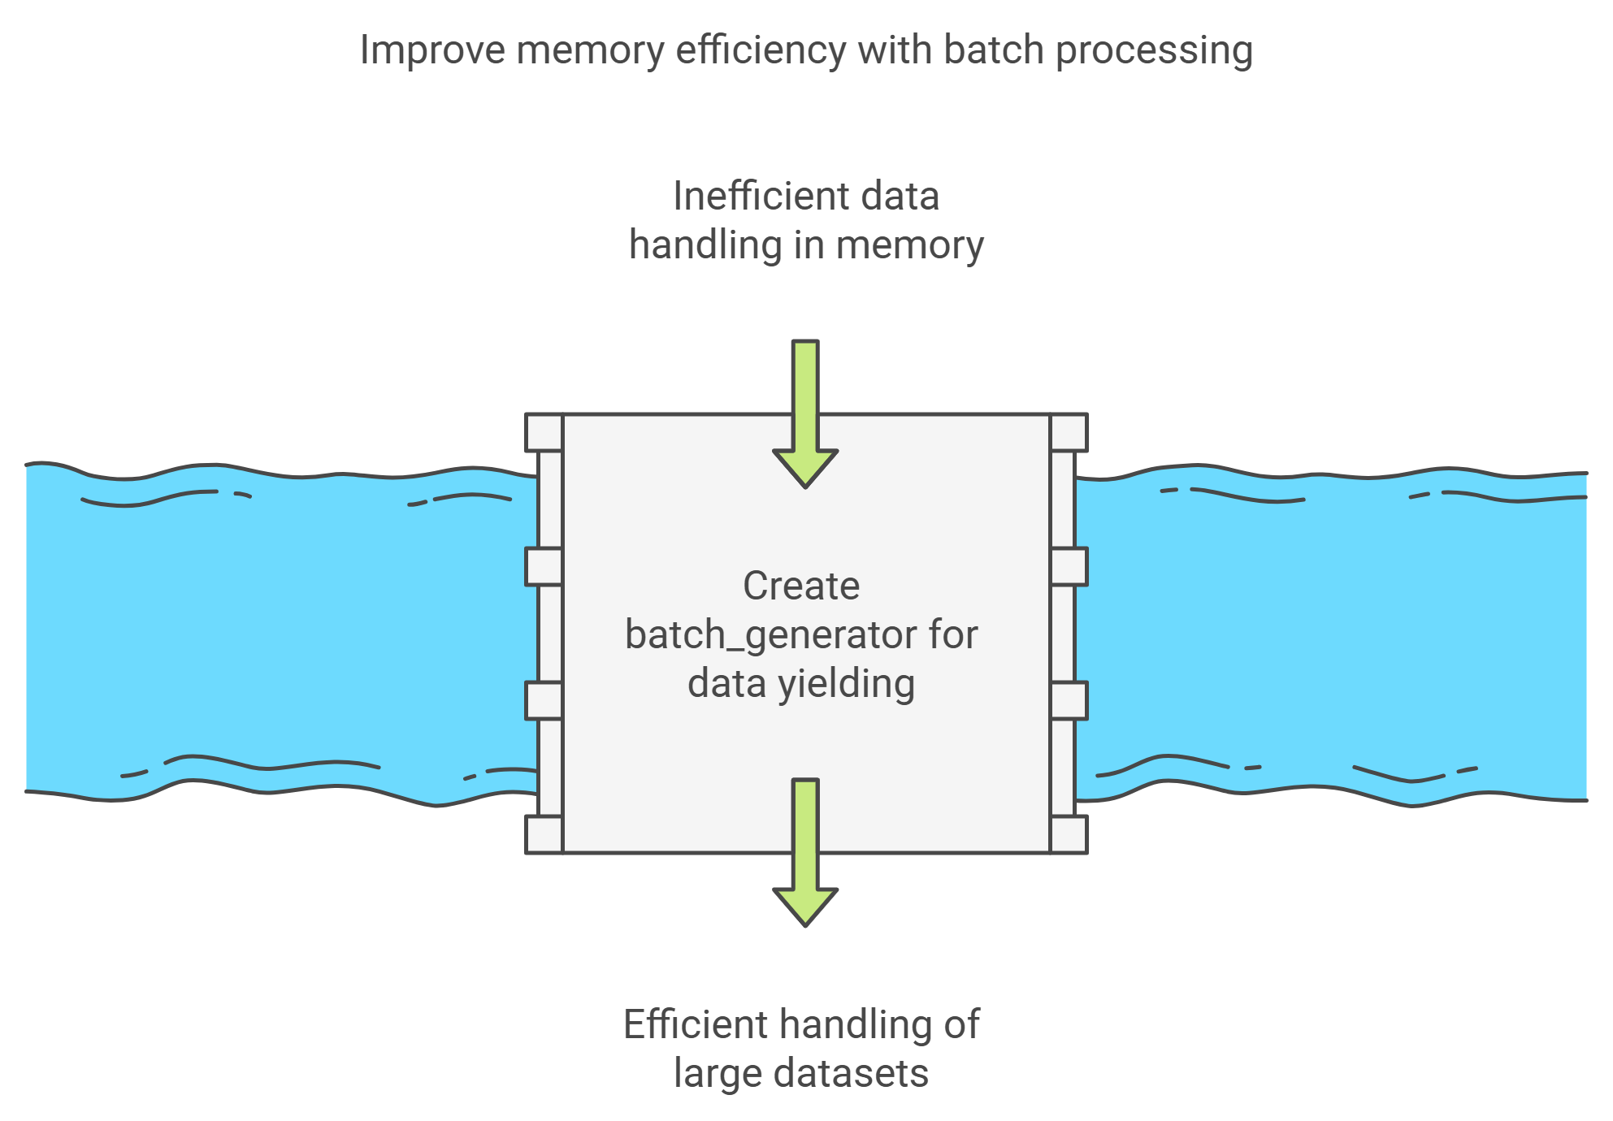
BATCH GENERATOR

Slide 20
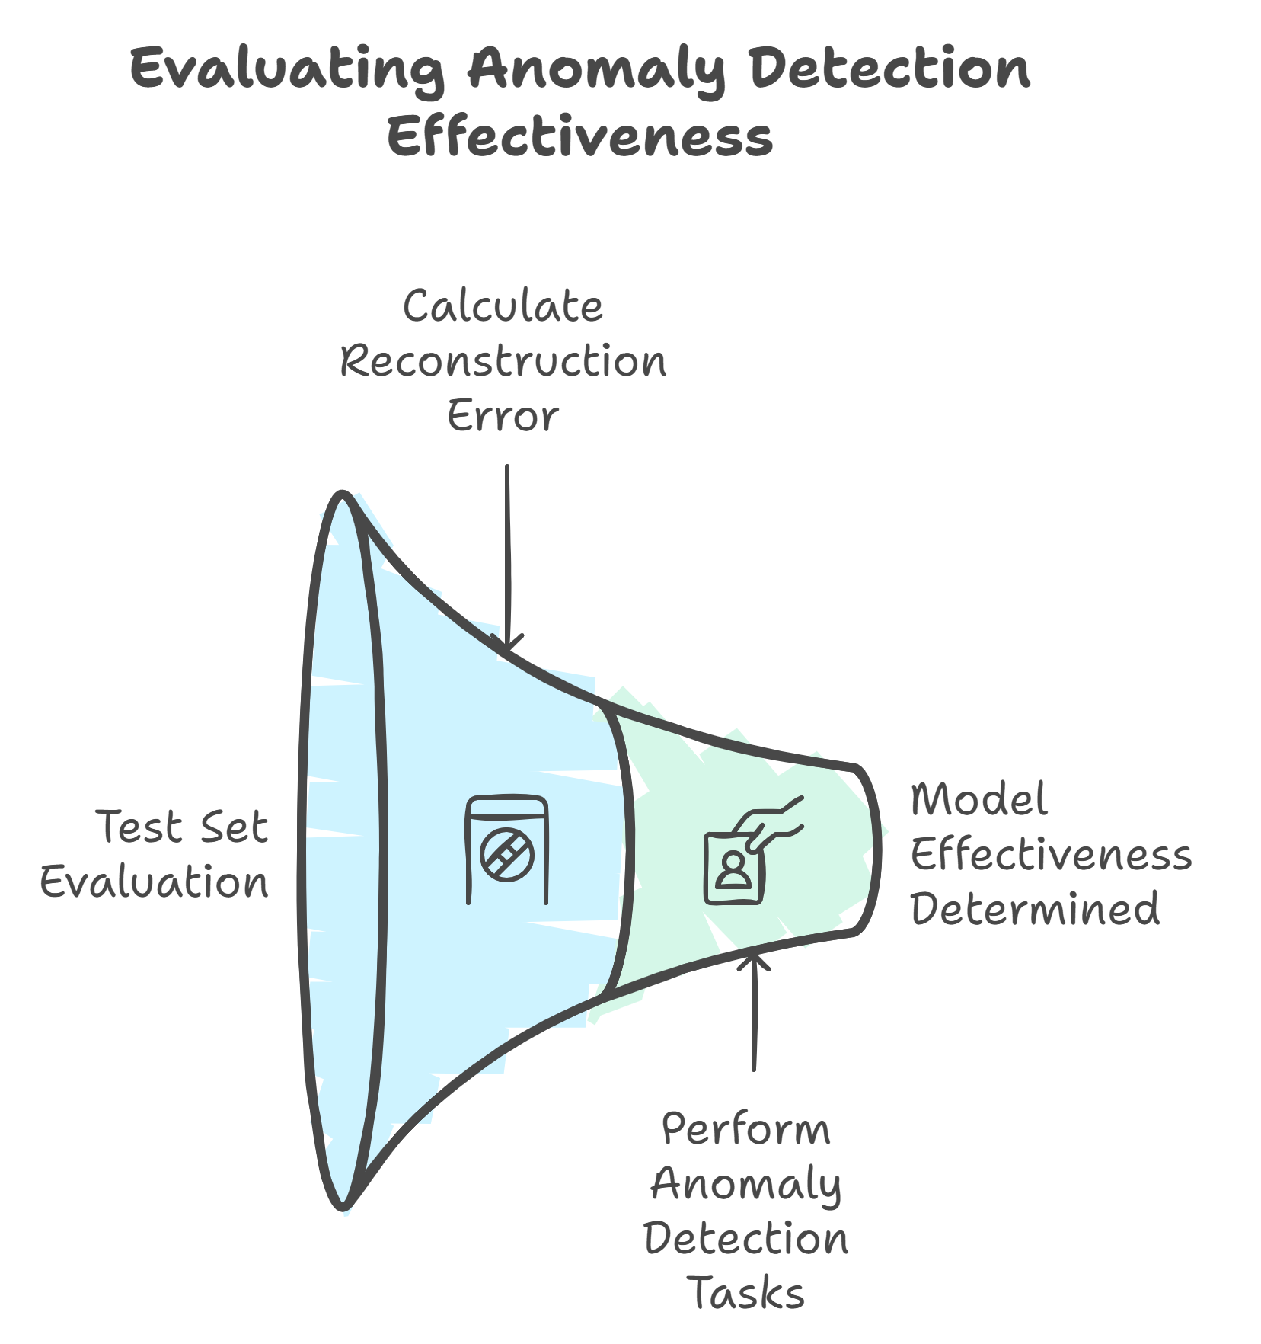
ANOMALY DETECTION

Slide 21
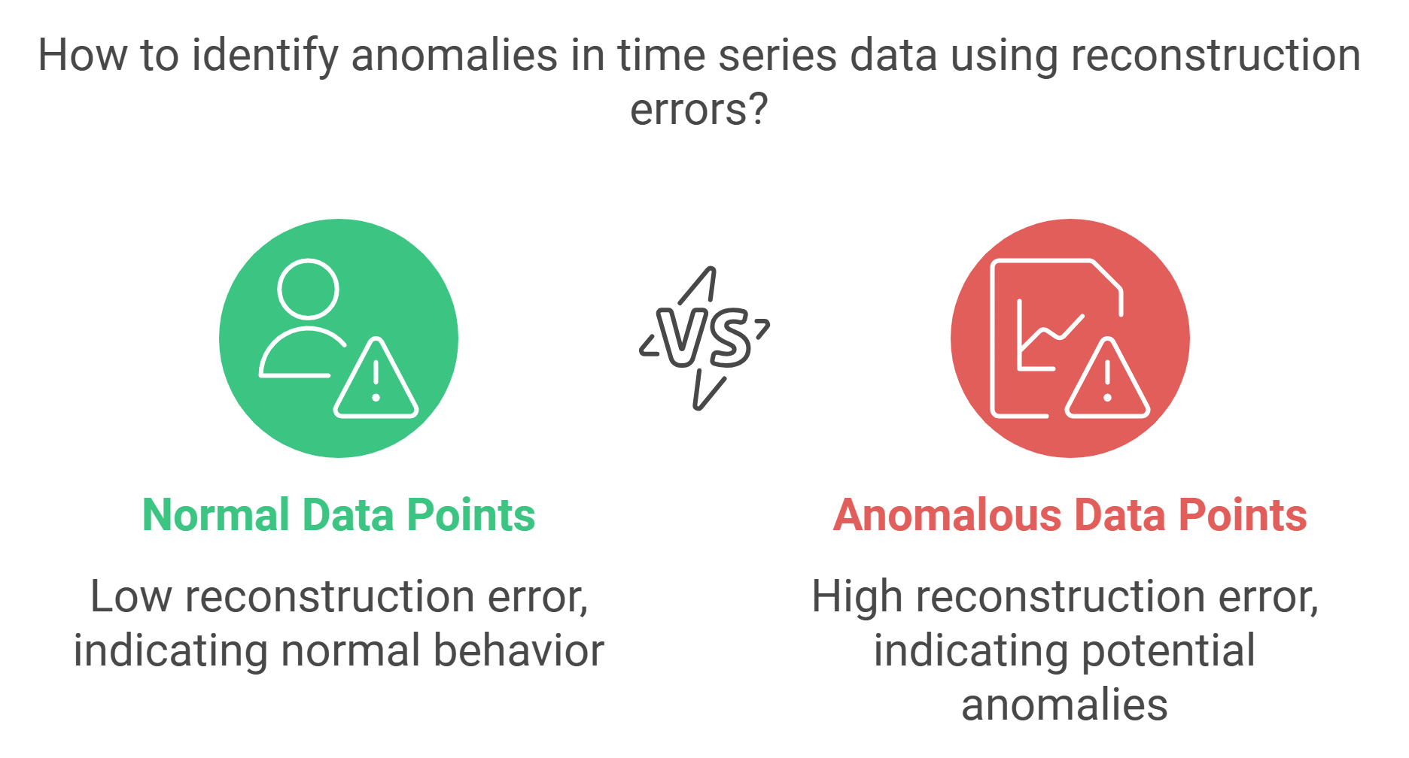
IDENTIFYING ANOMALIES

Slide 22
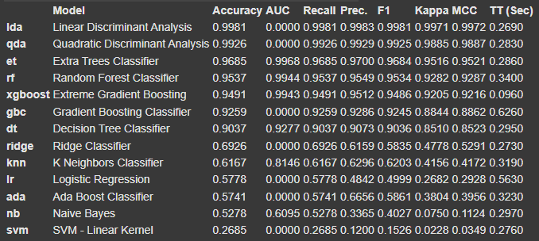
RESULTS
Model Performance Metrics for Different Classifiers

Slide 23

RESULTS

Slide 24
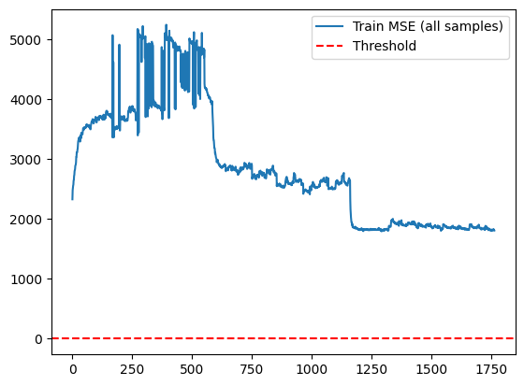
RESULTS
Training Mean Squared Error

Slide 25
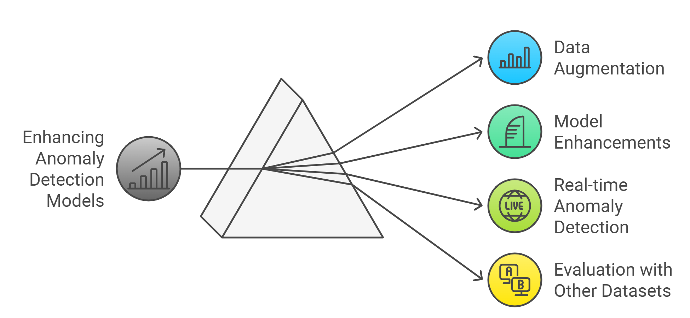
FUTURE SCOPE

Slide 26
THANK YOU

