Slide 1
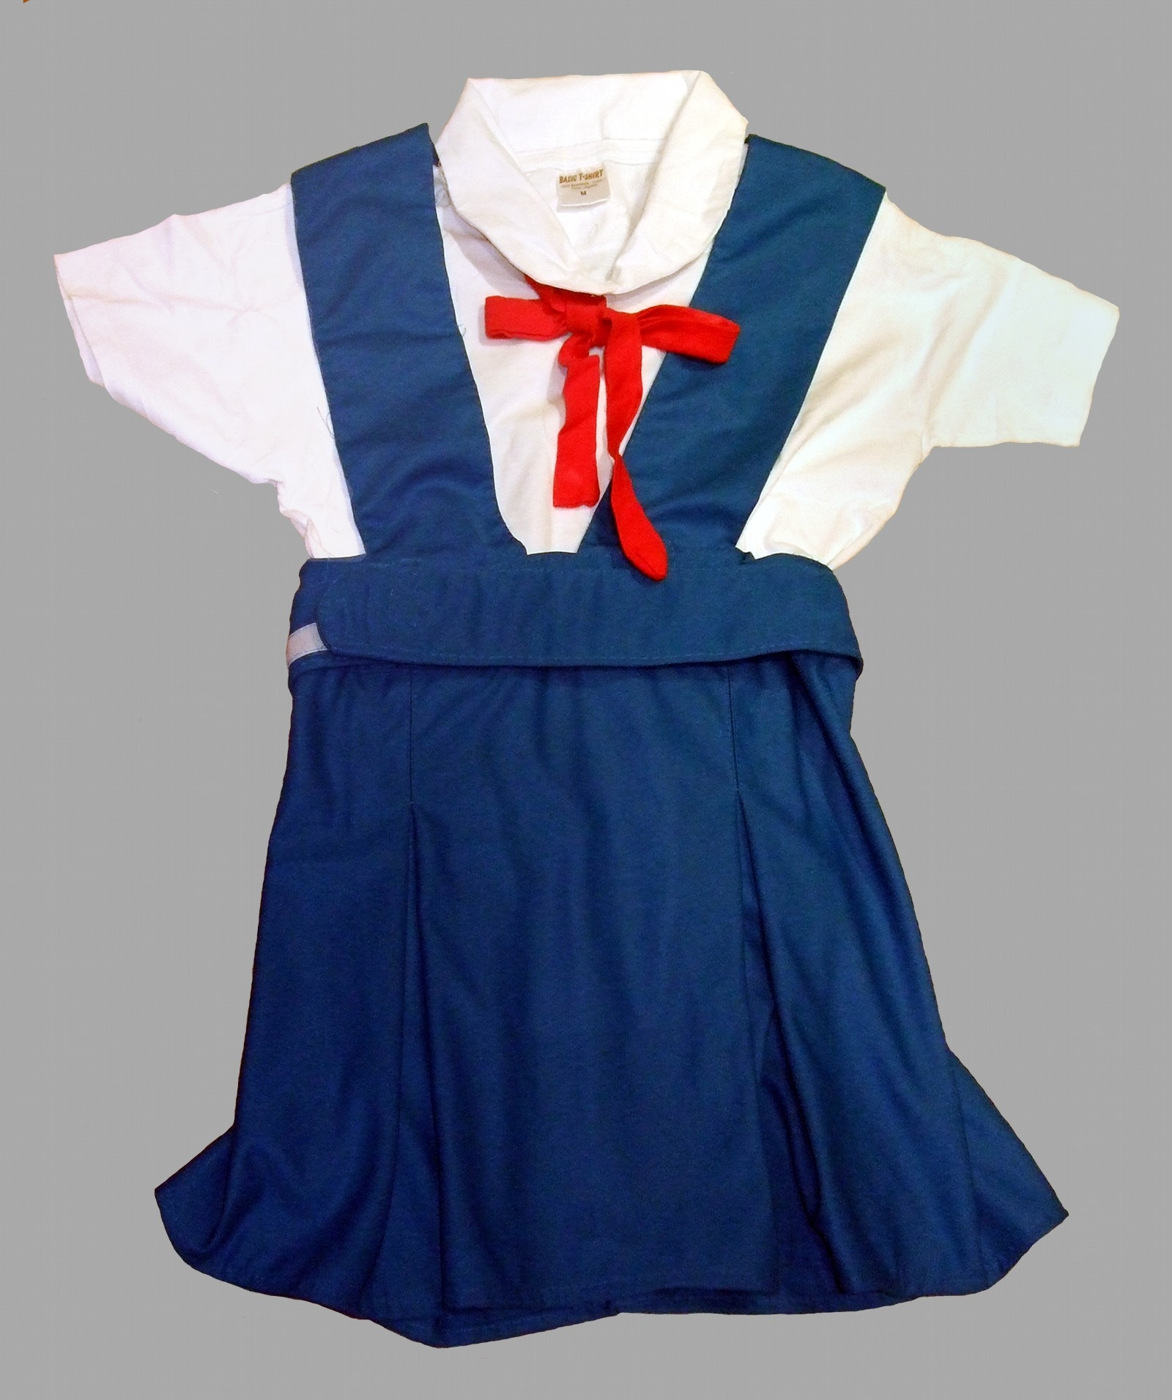
UNIFORM STORE
Presented by - group 3
Saanya, Ruhi, Soumya, Rohini, Ramya, Shravya, Sivaranjani, sindhuja

Slide 2


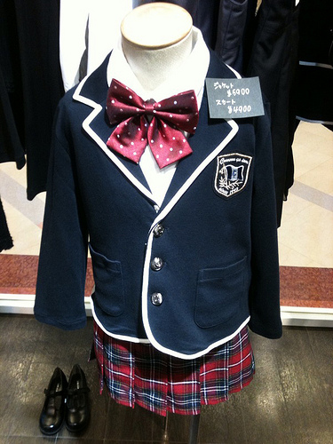
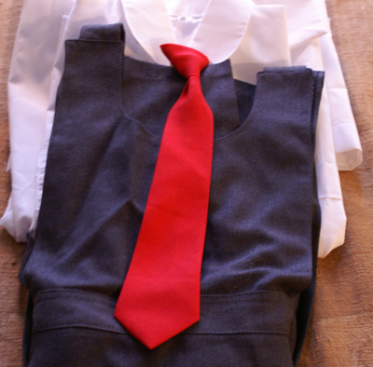
Agenda
Sprint 1
Manual Testing
Test Execution
Test Metrics
Post Execution Activities
Sprint 2
Automation Testing
Planning Activities

Slide 3
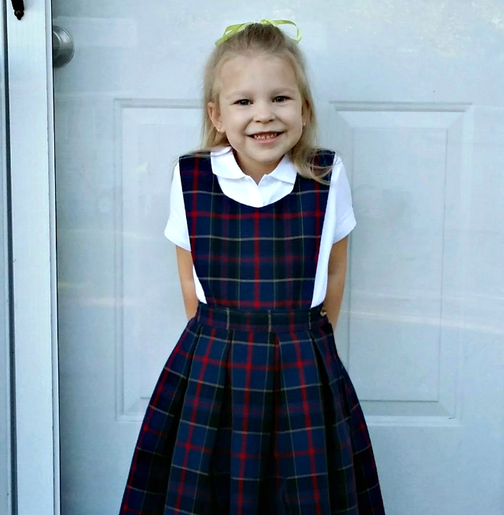

Sprint 1
Manual testing

Slide 4
Manual Testing
Activities​ performed in Manual Testing:
Planning of User stories in Jira​Jira tasks assigned for allocation of work to team members
Test design process-​
Scenarios- categorised based on business risks​
Test cases​
Pre-conditions and specification for data creation​
Test design techniques applied wherever necessary ​
Review process and baseline of testcases​

Slide 5
Test Execution
Preparation of test data​
Smoke test including pre-condition check​
Start of Test execution​
Defect logging if any –2 cycles​
Follow ups​
Bug allocation to development team​
Updating of issue log
Updating of defect log​

Slide 6
Test Metrics
Modules wise No. of test cases written-​
Defect age ​
Category wise defect analysis based on priority, severity, status ​
Causal analysis using fishbone diagram and 5 why analysis​
Pareto chart 80-20 graph based on defect causes​

Slide 7
Post Execution Activities
Like to have features in application communicated to developers.​
On going issues discussed during the pre-production move of release 1.​
Review of acceptance criteria.​
Planning for regression test cases using manual/automation approach.​

Slide 8
Sprint 2
Automation testing

Slide 9
Planning Activities
Planning activities-selection of test cases for automation under​
Smoke test​
Sanity test​
Regression test​
Task allocation for automation test cases to automation testers​
Techniques followed -Selenium , Java ,maven, testNG, PageObjectModel, Cucumber frameworks selected for the automation ​testing.

Slide 10
Test Execution
Preparation of test data​
3 types of testing are performed:
Smoke Test
Sanity Test
Regression Test
Start of Test execution​
Follow ups​
Bug allocation to development team​
Updating of issue log
Updating of defect log​

Slide 11
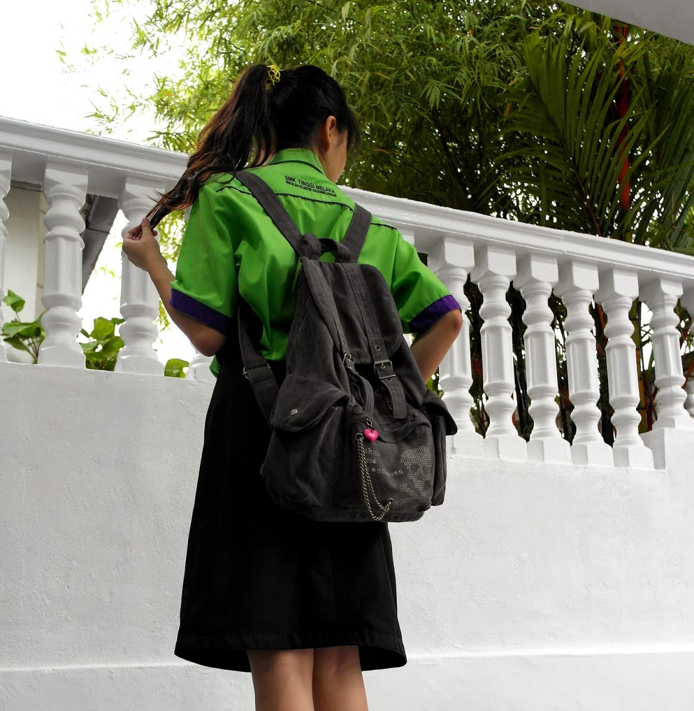
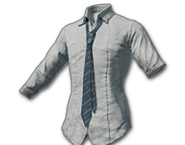
Thank you
Group 3: Uniform Store

