Slide 1
Filesystem & VFS

Slide 2
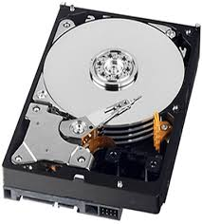
Hard disk

Slide 3
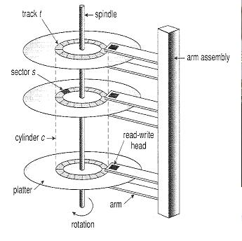
Driver to Hard disk abstraction
Block device driver
Hard disk controller
C
H/T
S
Hard disk

Slide 4
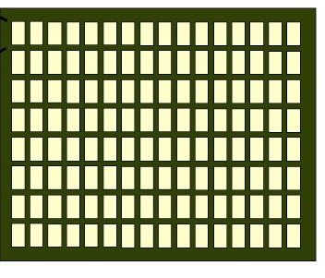
Filesystem to Hard disk abstraction
Filesystem
Block device driver
Hard disk controller
C
H/T
S
Hard disk

Slide 5
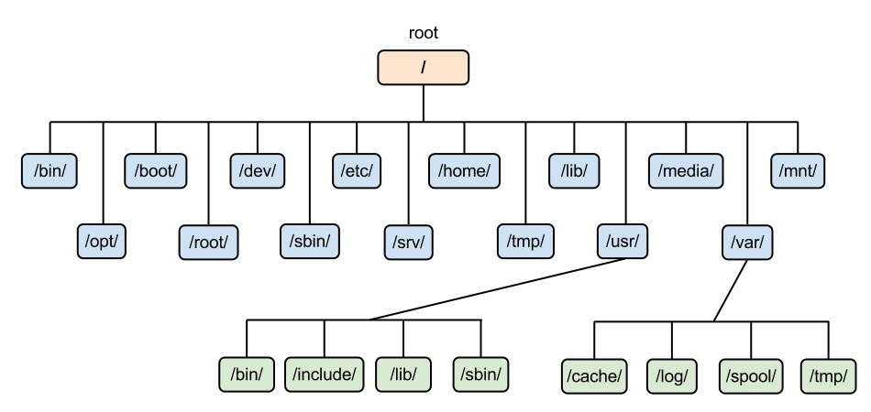
Applicationto Hard disk abstraction
Application
Filesystem
Block device driver
C
H/T
S
Hard disk controller
Hard disk

Slide 6
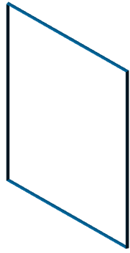
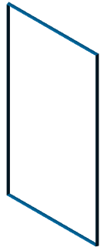



Driver to Hard disk abstraction
Hard disk controller
Block device driver
Hard disk

Slide 7
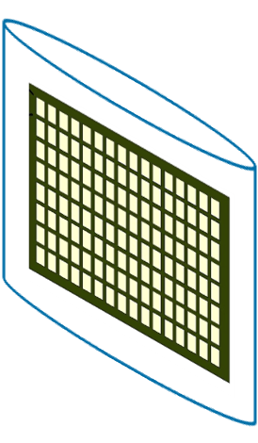
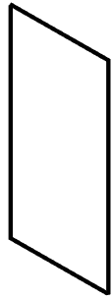
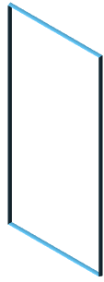
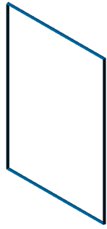



Filesystem to Hard disk abstraction
Hard disk controller
Hard disk
Filesystem
Block device driver

Slide 8



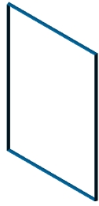



Filesystem to Hard disk abstraction
Application
Filesystem
Block device driver
Hard disk controller
Hard disk

Slide 9
Question
Application
Filesystem
Hard disk
kmod.c block 2 2,48,05
2,48,06

Slide 10
Application
VFS
ext2
proc
vfat
One Hard disk with three partition
/dev/sda1
memory
/dev/sda3

