Slide 1
Introduction to Unix Operating System
Prabhunath G

Slide 2
Table of Contents
Operating System – Definition
System Software
Operations of System Software
Subsystems of System Software Memory Management Process Management File Management IPC Interrupt Handling

Slide 3
Cont..
Unix Architectures
Types of Kernel - Monolithic - Micro - Modular Monolithic
Execution Environments
3G/1G VAS partition
Register set – Pentium II
System Call mechanism
Linux kernel linked list

Slide 4
What is a System?
What is an Operating System?
What is an Operating System Software?

Slide 5
Subsystems of an operating system software
Memory Management
Process Management
File Management
Inter process Communication
Interrupt Handling
IO Management

Slide 6
Memory Management
Allocating Memory for application’s code, data, heap, stack
Facilitating translation of Virtual address to Physical address

Slide 7
Memory Management Cont..
stack
Device Memory
Heap
Data
Code
Memory
VAS
PAS

Slide 8
Process Management
Optimal sharing of processor time to processes
Scheduler

Slide 9
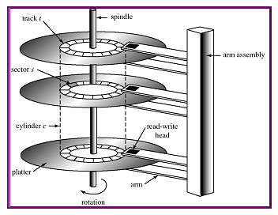
File Management
File System
Structural organization of data on a media

Slide 10
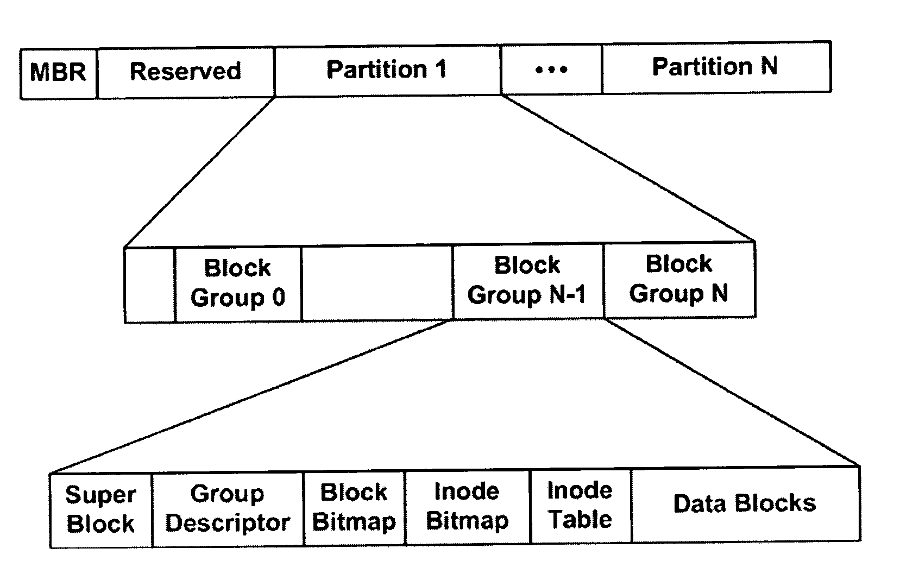
File System Structures

Slide 11
File Management Cont..
VFS
Supports multiple file systems

Slide 12
File Management Cont..
Secondary Media ( E.g Hard disk)
App
VFS
FS

Slide 13
IO Management
IO
Keyboard
Monitor

Slide 14
Inter process Communication
Message Queues
Pipes :
Named pipes
Unnamed Pipes
Shared Memory
Semaphores

Slide 15
Interrupt Handling
Top Half
Bottom Half
Softirqs
Tasklets
Worker threads

Slide 16
Event Generation
CPU
PIC
0
IRQ
Ethernet Driver
INTR
1
2
IRQ
INTA
3
Display Device

Slide 17
UNIX 1973
Application
Library
System call wrapper
User space
Kernel space
System call definition
MM
PM
IPC
FS
IO
DD
HARDWARE

Slide 18
UNIX 1983
Application
Library
System call wrapper
User space
Kernel space
System call definition
MM
PM
IPC
VFS
TCP/IP
IO
FS
DD
HARDWARE

Slide 19
Monolithic vs Microkernel
Application
Library
System call wrapper
User mode
System call definition
VFS
IPC, File System
Application
Application
IPC
UNIX
Server
Device
Driver
File
Server
Scheduler, Virtual Memory
Kernel mode
Device Drivers, Dispatcher,…
Basic IPC, Virtual Memory, Scheduling
Hardware
Hardware

Slide 20
UNIX variant – Linux - 1993
Application
Library
System call wrapper
User space
Kernel space
System call definition
MM
PM
IPC
VFS
TCP/IP
tty
FS
DD
HARDWARE

Slide 21
GNU/Linux 1997 - Modular Monolithic
Application
Library
User space
System call wrapper
Kernel space
System call definition
PM
N/W
Base Kernel
MM
VFS
IPC
FS1
FS2
Sound
driver
Frame buffer
HID
Modules
D1
SATA
ethernet
D2
HARDWARE

Slide 22
UNIX 2003
Application
Library
User space driver
System call wrapper
User space
Kernel space
System call definition
MM
PM
IPC
VFS
TCP/IP
IO
Graphics & Sound
FS
DD
HARDWARE

Slide 23
Execution Environments
Application
Application
Library
Library
System call wrapper
User space
Kernel space
Kernel
System call definition
Kernel
HARDWARE
Kernel based execution environment
Free RTOS
OS based execution environment
GNU/Linux

Slide 24
3G / 1G Virtual Address Space Partition
0xFFFF_FFFF
1G
Kernel
VAS
0xC000_0000
3G
User
VAS
0x0000_0000

Slide 25
Register set – Pentium II
General purpose register
Segmentation
register
Model specific register
eax
cs
SYSENTER_CS_MSR
ebx
ds
SYSENTER_EIP_MSR
ecx
ss
edx
es
SYSENTER_ESP_MSR
esi
edi
ebp
Stack pointer register
Instruction pointer register
esp
eip

Slide 26
System Call Mechanism
User Mode
Kernel Mode
xyz() {
…
SYSENTER
…
}
sysenter_entry:
…
sys_xyz()
…
SYSEXIT
sys_xyz() {
…
}
….
xyz()
…
System Call invocation in application program
Wrapper routine in libc standard library
System call handler
System call service routine

Slide 27
System Call Mechanism
User Mode
Kernel Mode
System
Call
trigger
Exception handler
App
Libc
CPU
Control unit
System call function
open
<fd>
sysenter
return
MODE SWITCH
SWITCH MODE
sysenter_entry()
sysexit
__sys_open()
return <ret>

Slide 28
sysenter and sysexit
__kernel_vsyscall;
pushl %ebp
movl %esp %ebp
sysenter
sysenter_entry
pushl &SYSENTER_RETURN
pushl __USER_CS
pushl %ebp
movl (%ebp) %ebp
SAVE_ALL (save all GP registers)
call *sys_call_table (0, %eax, 4)
RESTORE_ALL (Restore GP registers from kernel stack)
popl%esp
popl %cs
popl %eip
User mode to Kernel mode
SYSENTER_CS_MSR
__KERNEL__CS
cs
SYSENTER_ESP_MSR
Kernel stack pointer
esp
SYSENTER_EIP_MSR
sysenter_entry()
eip
esp
cs
SYSENTER_RETURN:
popl %ebp
ret
eip

Slide 29
sysenter and sysexit
__kernel_vsyscall;
pushl %ebp
movl %esp %ebp
sysenter
entry_SYSENTER_32
pushl &SYSENTER_RETURN
pushl __USER_CS
pushl %ebp
movl (%ebp) %ebp
SAVE_ALL (save all GP registers)
call do_fast_syscall_32
do_syscall_32_irqs_on(regs)
RESTORE_ALL (Restore GP registers
from kernel stack)
sysexit
User mode to Kernel mode
SYSENTER_CS_MSR
__KERNEL__CS
cs
SYSENTER_ESP_MSR
Kernel stack pointer
esp
SYSENTER_EIP_MSR
entry_SYSENTER_32
eip
Kernel mode to User mode
cs
__USER__CS
esp
user stack pointer
CPU control unit
operations
SYSENTER_RETURN:
popl %ebp
ret
eip
SYSENTER_RETURN

Slide 30
System call mechanism - Parameter Passing
Passing Parameters
eax
System call number
ebx
Parameter 1
ecx
Parameter 2
edx
Parameter 3
esi
Parameter 4
edi
Parameter 5
ebp
Parameter 6
What if function takes more than 6 parameters ?
Ref Bovet – Page - 416

Slide 31
Linux Kernel linked list
struct list_head {
struct list_head *next;
struct list_head *prev;
}
Struct {
.
.
.
struct list_head list;
.
.
.
}

Slide 32
System Call Mechanism
User Mode
Kernel Mode
sysenter_entry:
…
sys_xyz()
…
SYSEXIT
sys_xyz() {
driver_xyz
}
driver_xyz() {
…
}
xyz() {
…
SYSENTER
…
}
….
xyz()
…
System Call invocation in application program
Wrapper routine in libc standard library
System call handler
System call service routine
Kernel module

Slide 33
System Call Mechanism
User Mode
Kernel Mode
sysenter_entry:
…
sys_xyz()
…
SYSEXIT
sys_xyz() {
file_xyz
}
file_xyz() {
…
}
xyz() {
…
SYSENTER
…
}
….
xyz()
…
System Call invocation in application program
Wrapper routine in libc standard library
System call handler
System call service routine
Kernel module

