Slide 1
Process management

Slide 2
Contents
Process – understanding from user perspective
Need for asynchronous programming
Creating process using fork()
Understanding of process from kernel perspective
Process semantics
exec() and its need
vfork ()
COW – copy on write mechanism
Threads – understanding from user perspectibve
Creating threads using pthread_create()
Understanding of threads from Kernel perspective
Thread semantics

Slide 3
Cont..
Task – What is task?
Task semantics?
Creating a task – clone()
Task’s state space
Scheduler – form of scheduler?
Real time threads Vs non-real time threads
Scheduling Algorithm for real time tasks
  FIFO
  Round Robin
Scheduling Algorithm for non real time tasks
  CFS
Signals

Slide 4
Cont..
Introduction to POSIX compliant pthread library
Creation of thread using pthread function
  pthread_create()
  pthread_join()
  pthread_detach()
  pthread_self()
  pthread_exit()
Synchronization Mechanisms
Mutual exclusion
  pthread_mutex_init()
  pthread_mutex_lock()
  pthread_mutex_unlock()
  pthread_mutex_trylock()
  pthread_mutex_destroy()

Slide 5
Cont..
Conditional variable
  pthread_cond_init()
  pthread_cond_signal()
  pthread_cond_wait()
  pthread_cond_timedwait()
  pthread_cond_destroy()

Slide 6
Cont..
Real time scheduling
  pthread_attr_init()
  sched_get_priority_max()
  sched_get_priority_min()
  pthread_attr_getschedpolicy()
  pthread_attr_setschedpolicy()
  pthread_attr_getschedparam()
  pthread_attr_setschedparam()
  pthread_attr_getinheritsched()
  pthread_attr_setinheritsched()
  pthread_attr_destroy()
  pthread_getschedparam()
  pthread_getschedparam()
Priority inversion
Priority inheritance
Priority ceiling

Slide 7
Process
Process is a program (code / data / heap / stack ) which is copied to the memory and readied to be processed a.k.a execution
Transformation of a program
  Source code ->relocatable object file ->executable object file->process

Slide 8
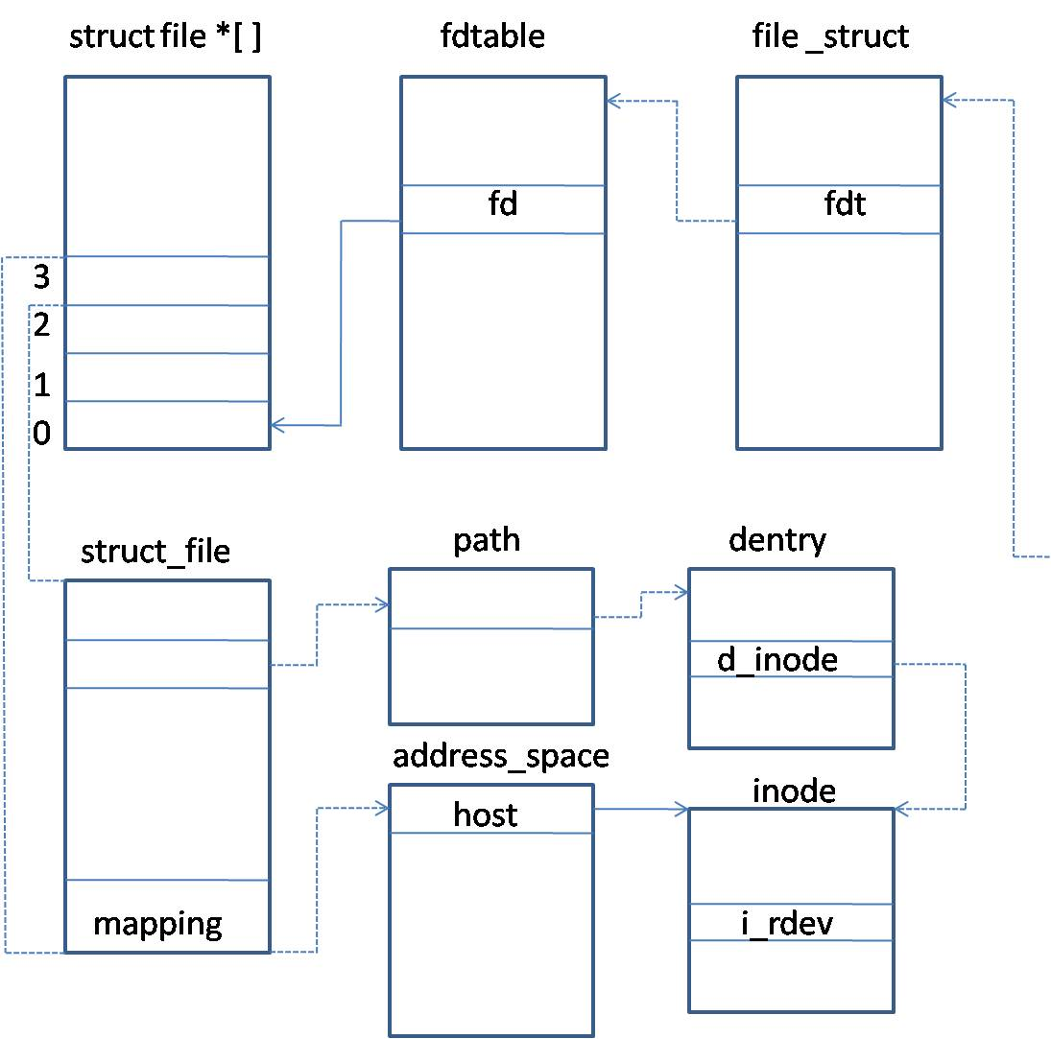
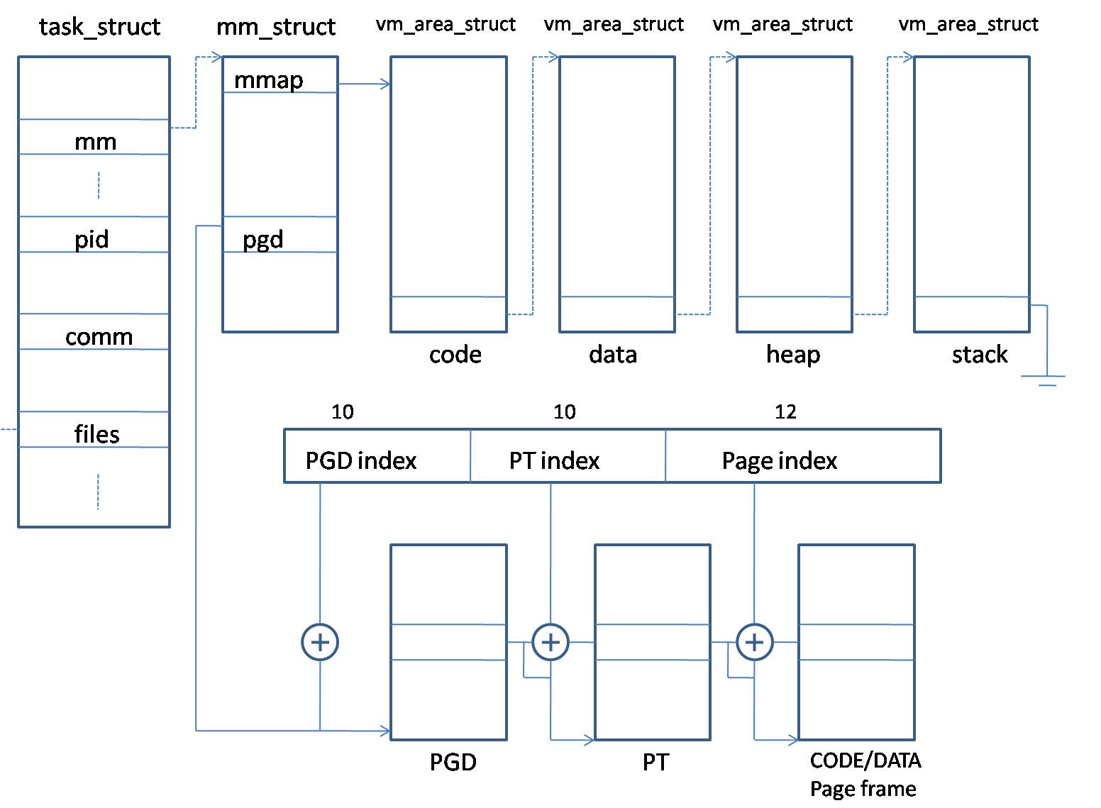
Process descriptor with Process

Slide 9
Self Sustaining system software design
The first two processes (swapper and init) are statically created by the kernel.
Rest of the processes will be spawned/created by init process
init will be the forefather of all the processes in the system.
Bash is the key process created by init which is a launch pad for launching programs to execution

Slide 10
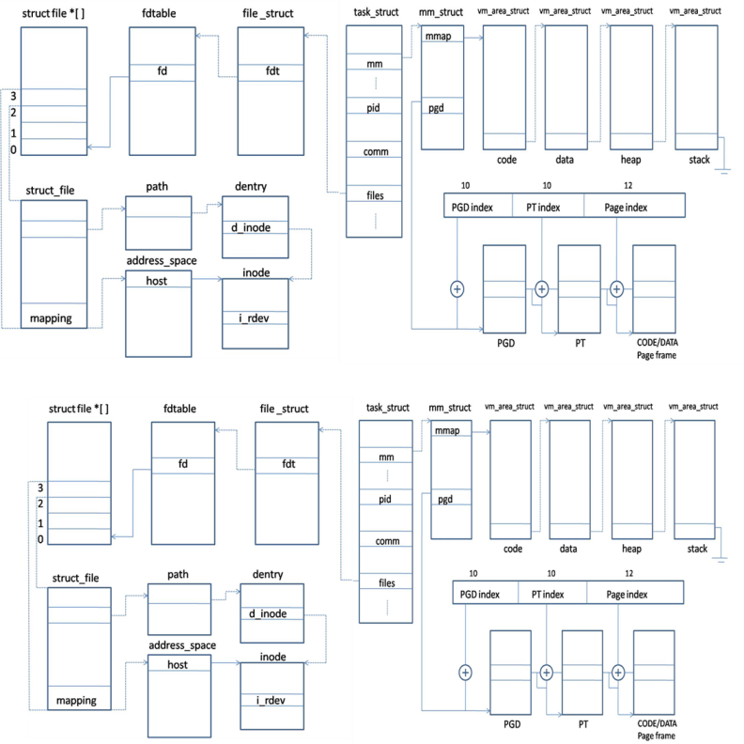
Process creation

Slide 11

PID

Slide 12
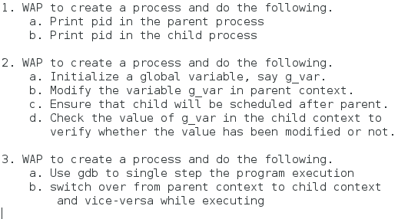
Fork examples

Slide 13
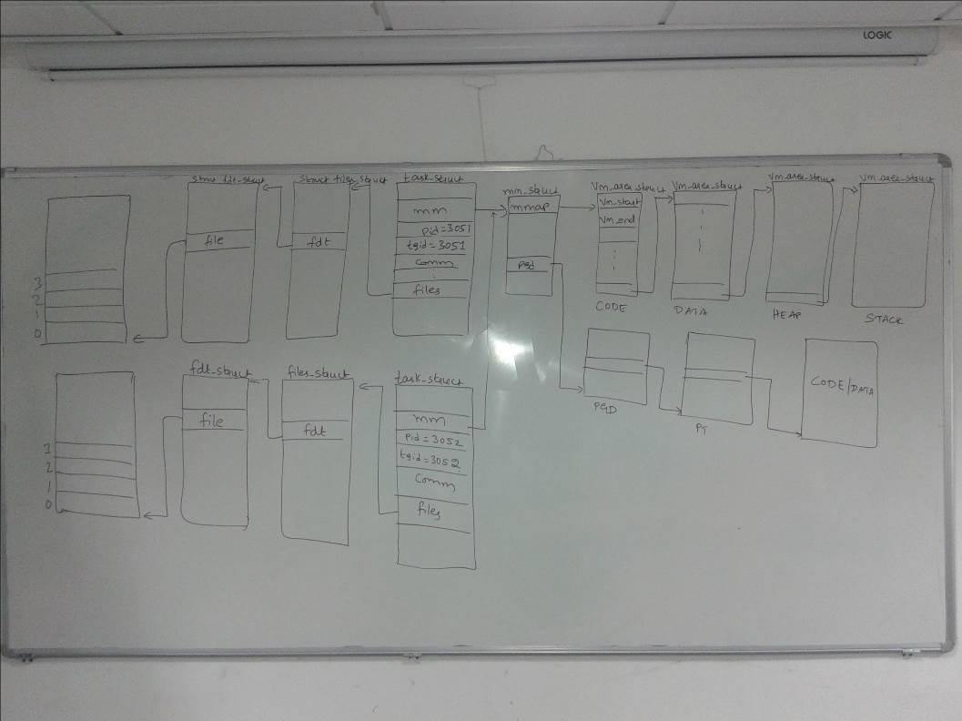
vfork

Slide 14
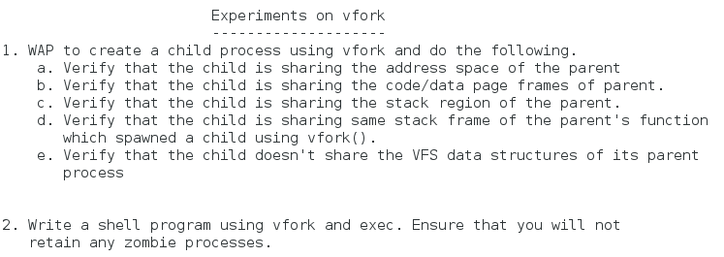
Vfork

Slide 15
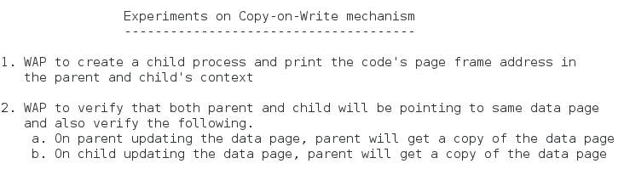
COW

Slide 16
Shell using fork

Slide 17
Clone

Slide 18
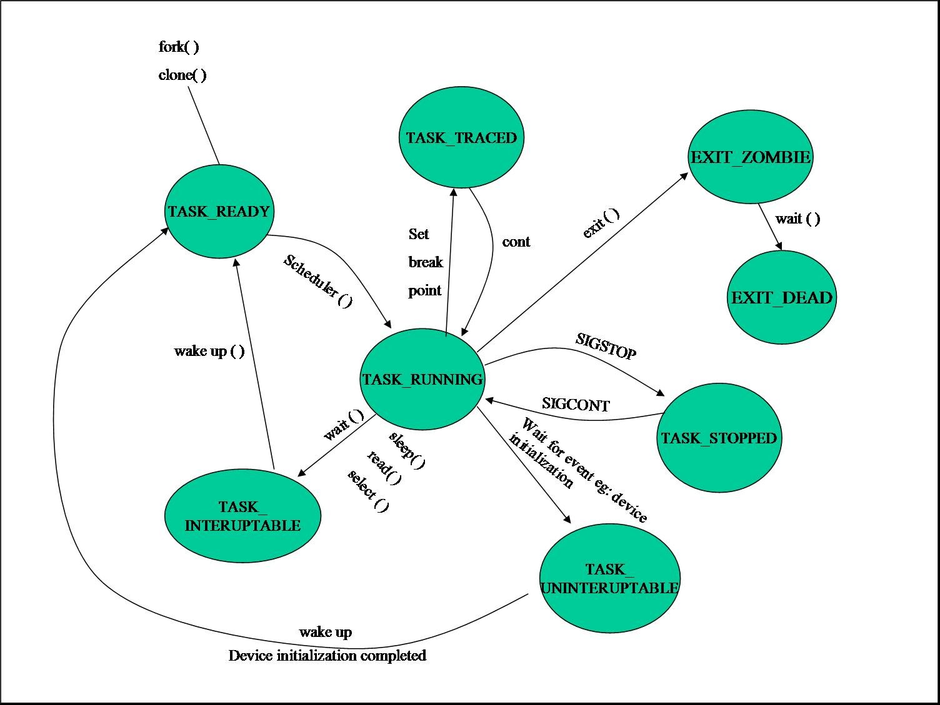
Task space

Slide 19
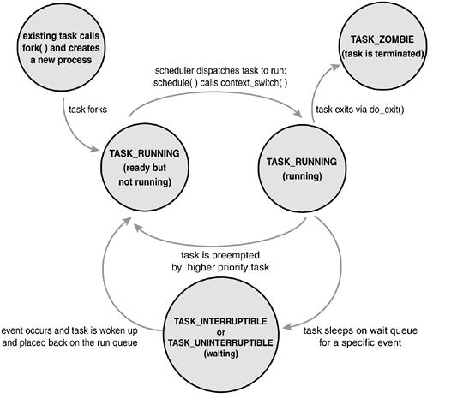
Task space

Slide 20
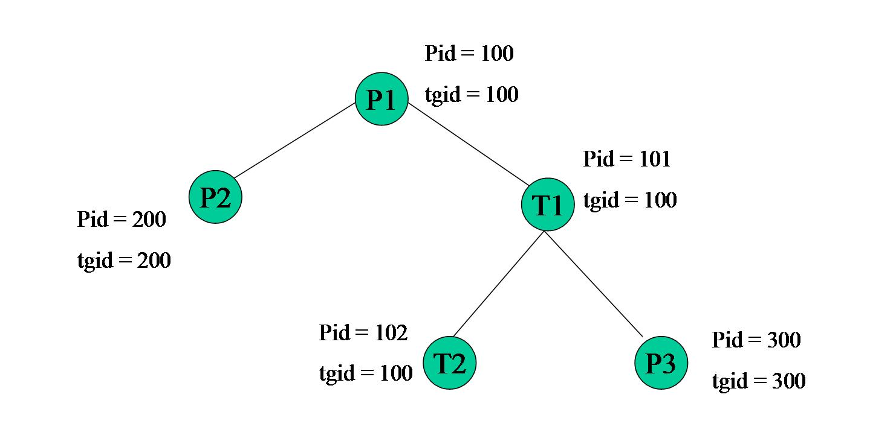
Task creation

Slide 21
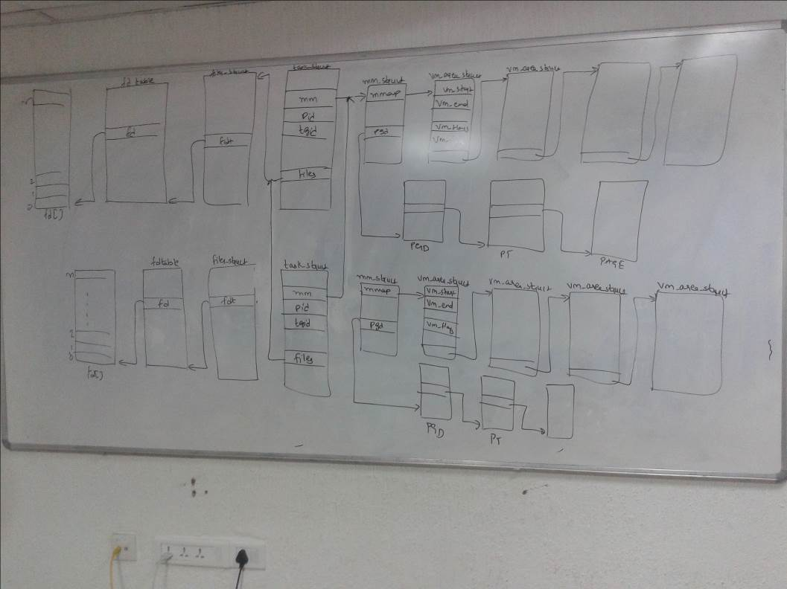
Thread creation

Slide 22
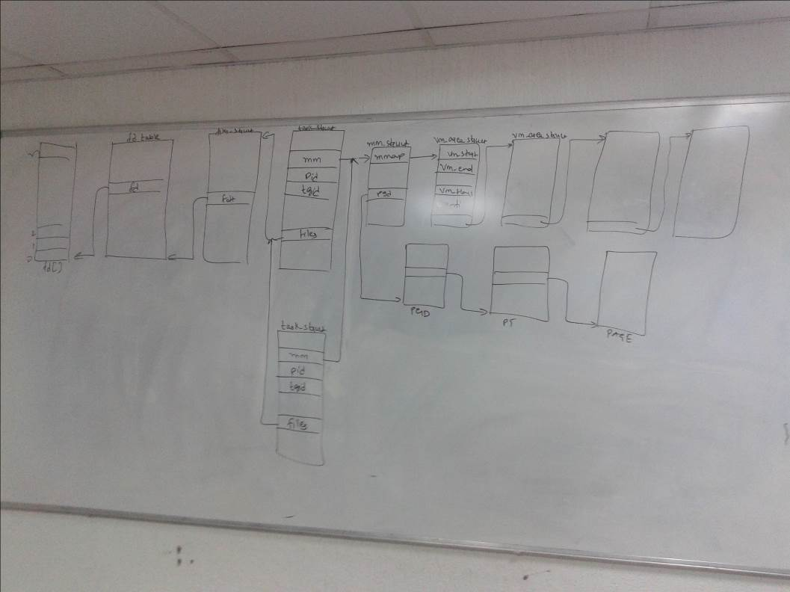
Thread creation 1

Slide 23
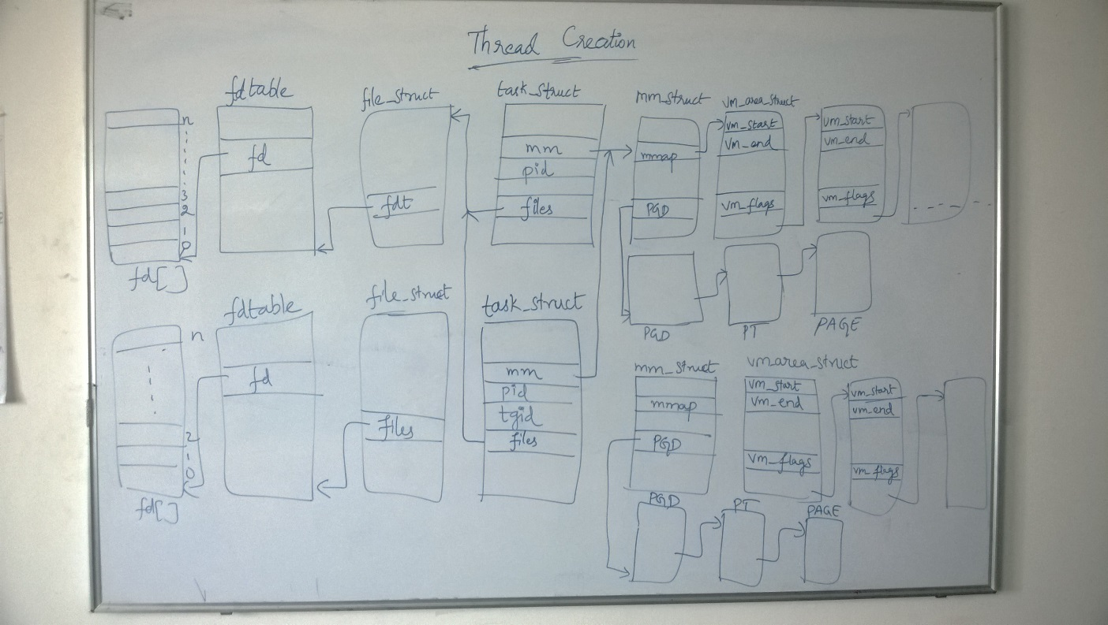
Thread creation 2

Slide 24
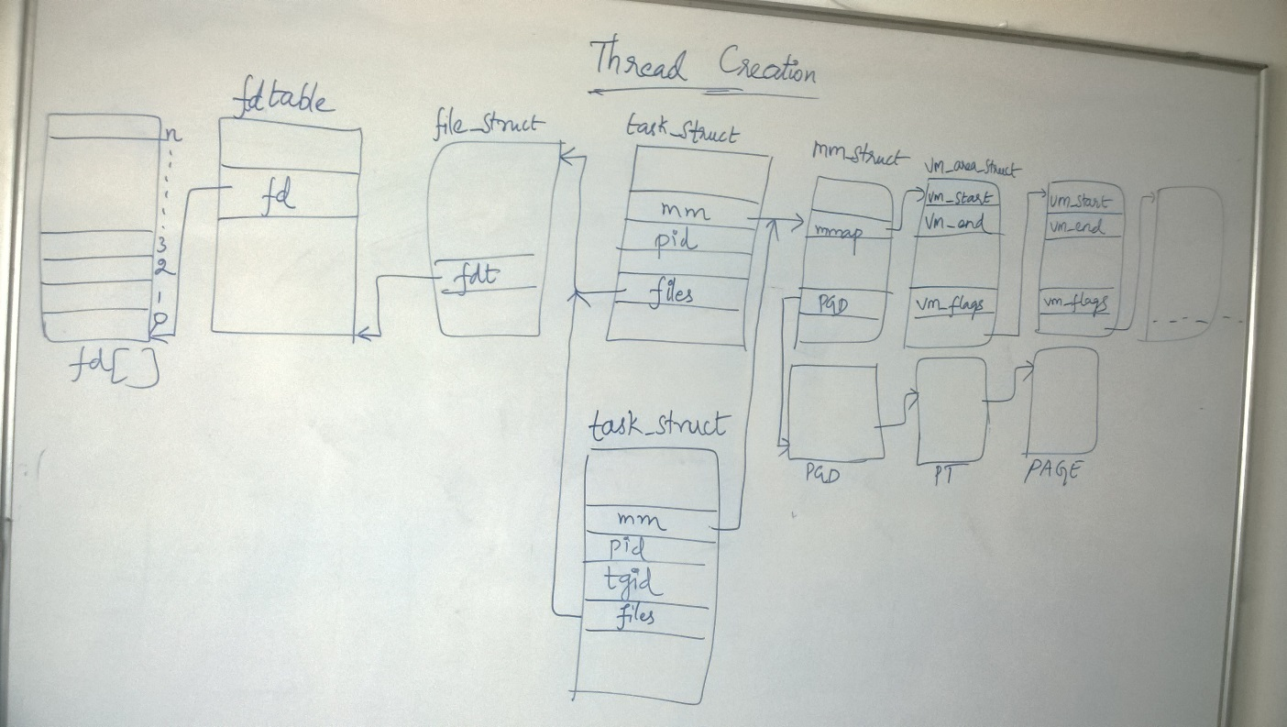
Thread creation 3

Slide 25
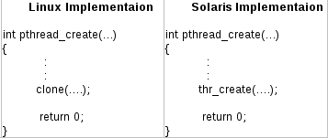
POSIX library

Slide 26
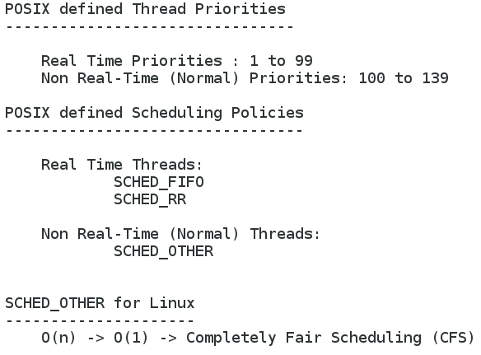
POSIX policies

Slide 27
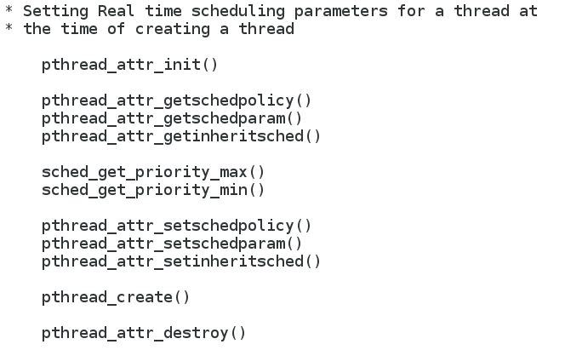
Realtime scheduling

Slide 28
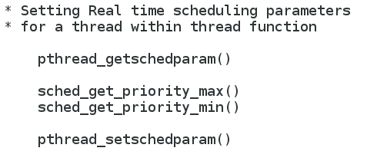
Realtime scheduling 2

Slide 29
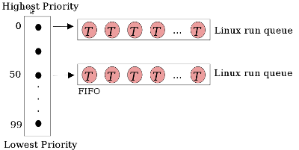
Linux runqueue

Slide 30
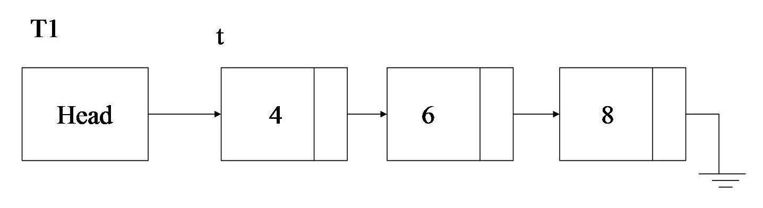
ME_01

Slide 31
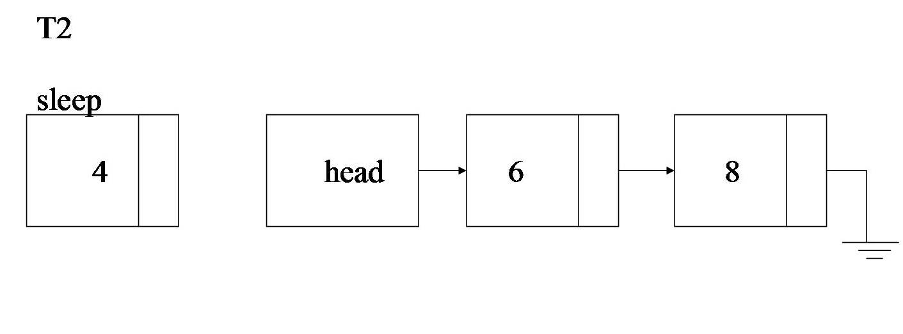
ME_02

Slide 32
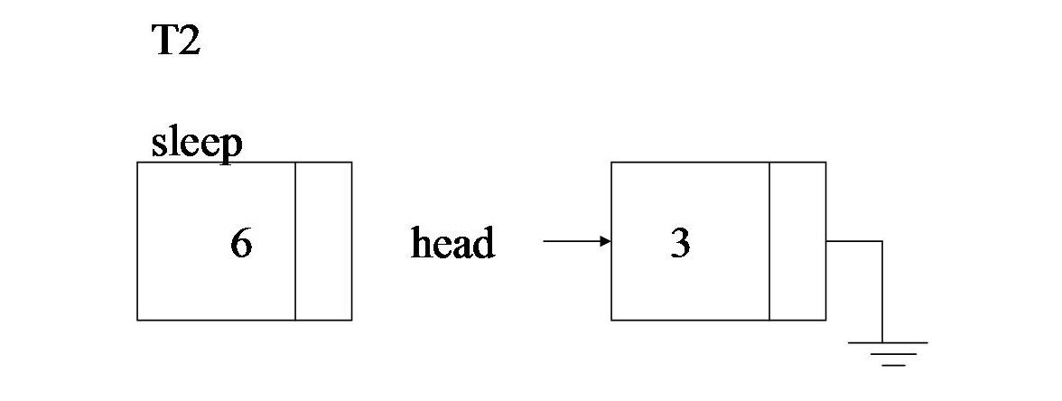
ME_03

Slide 33
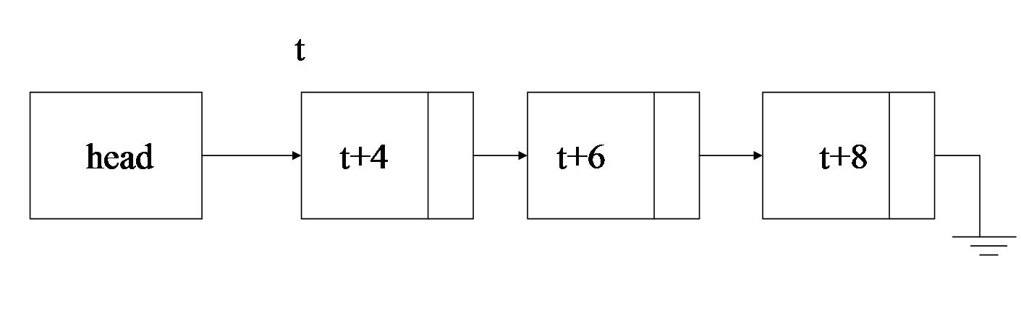
ME_04

Slide 34
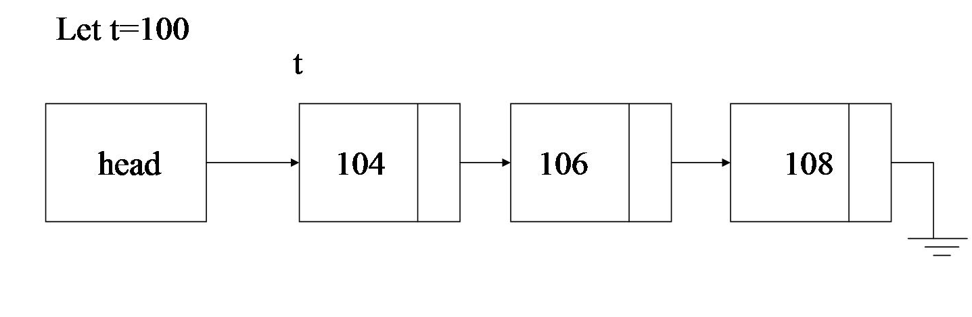
ME_05

Slide 35
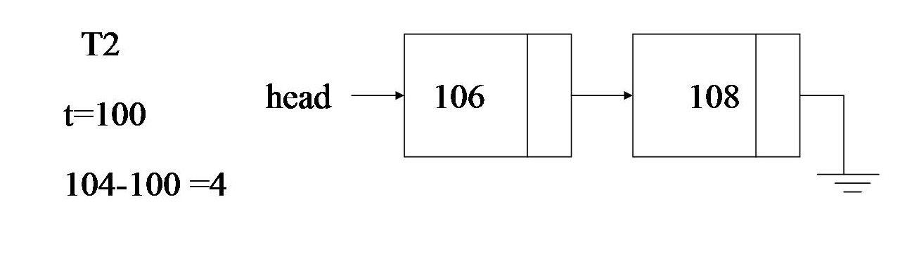
ME_06

Slide 36
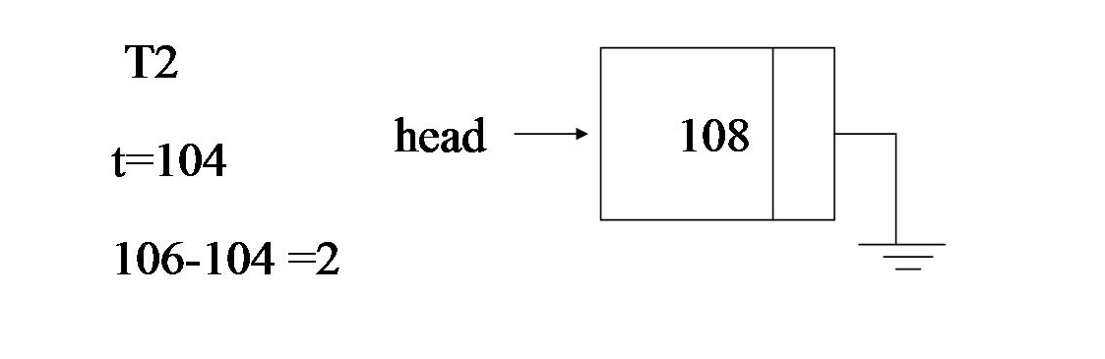
ME_07

Slide 37
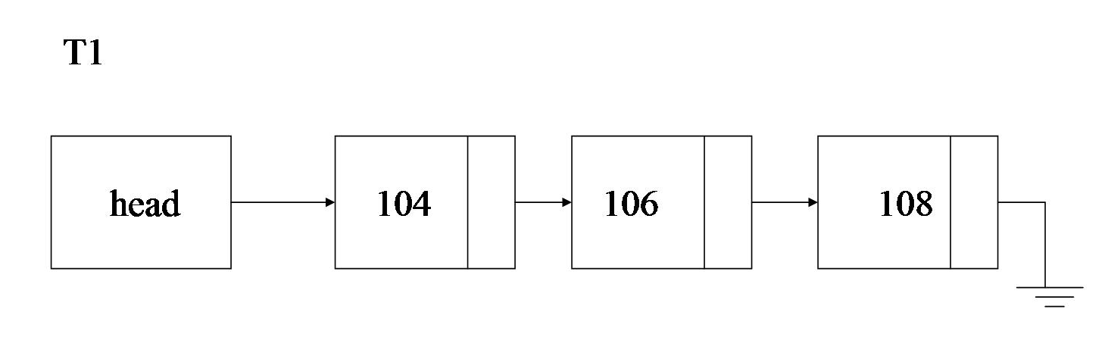
ME_08

Slide 38
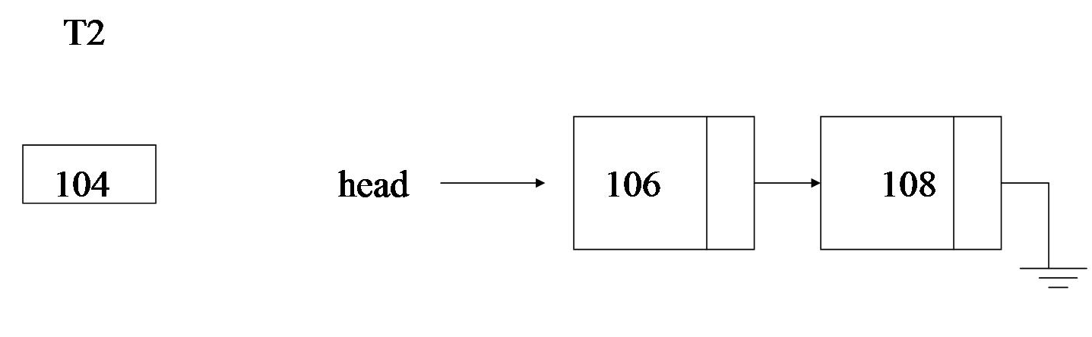
ME_09

Slide 39
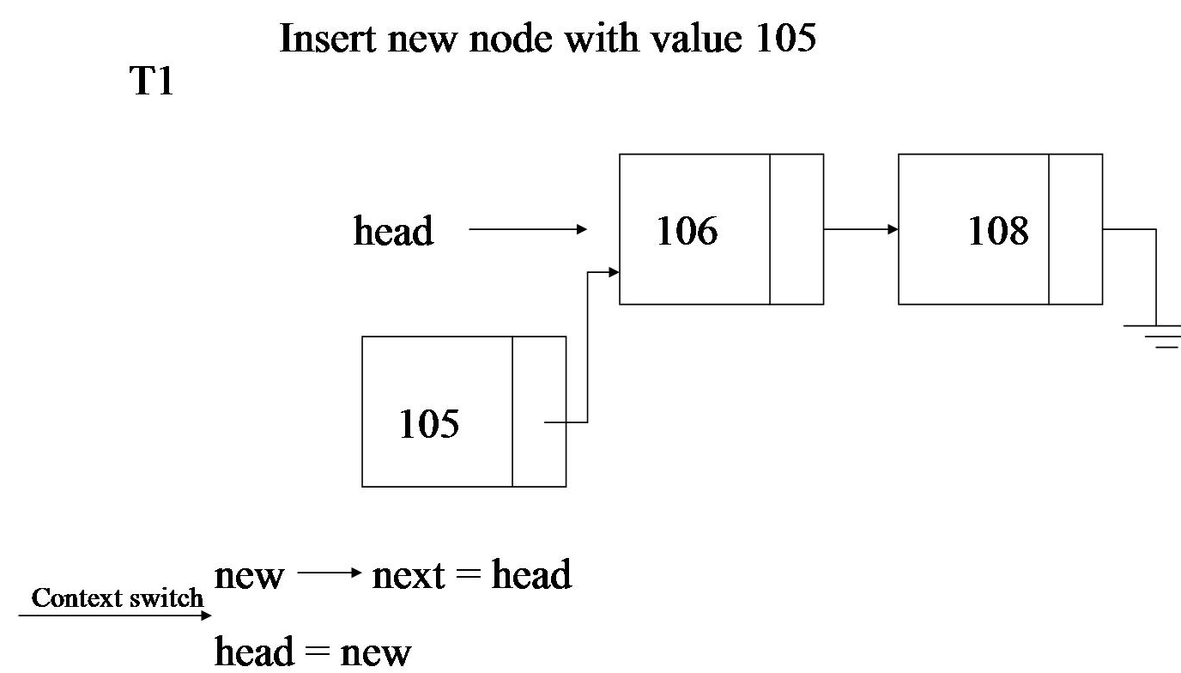
ME_10

Slide 40
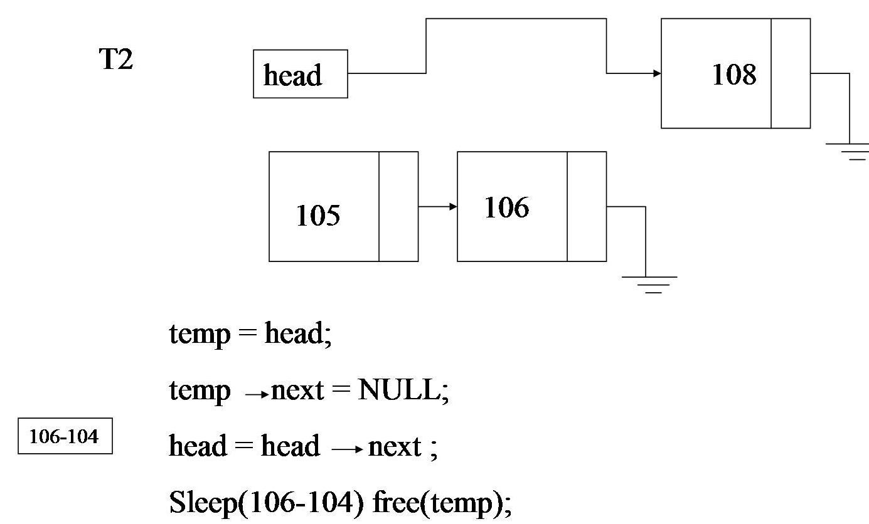
ME_11

Slide 41
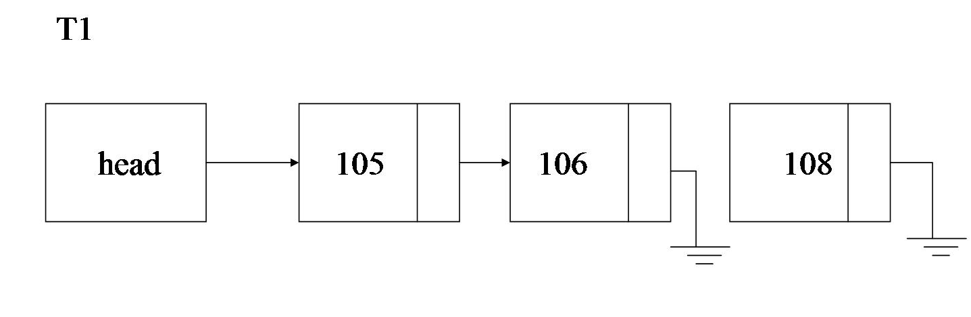
ME_12

Slide 42
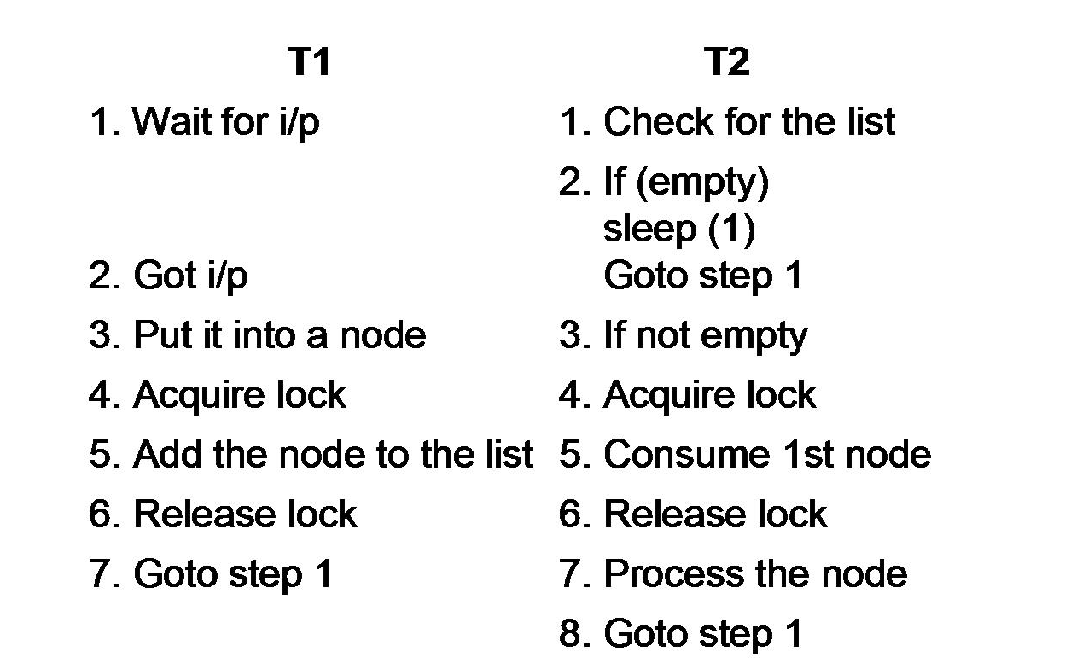
ME_13

Slide 43
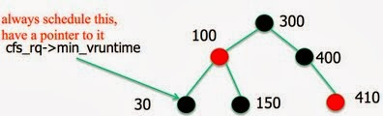
Red black tree

Slide 44
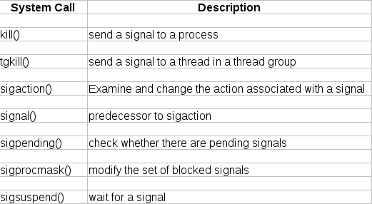
Sig_syscalls

Slide 45
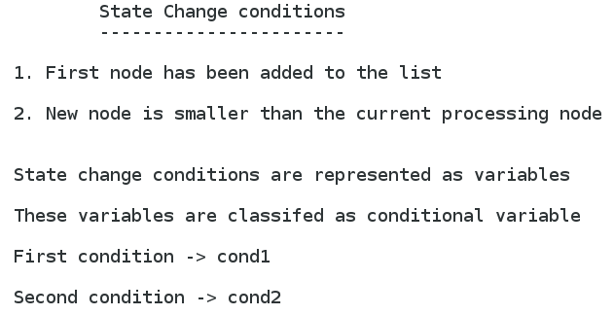
Conditional Variable

Slide 46
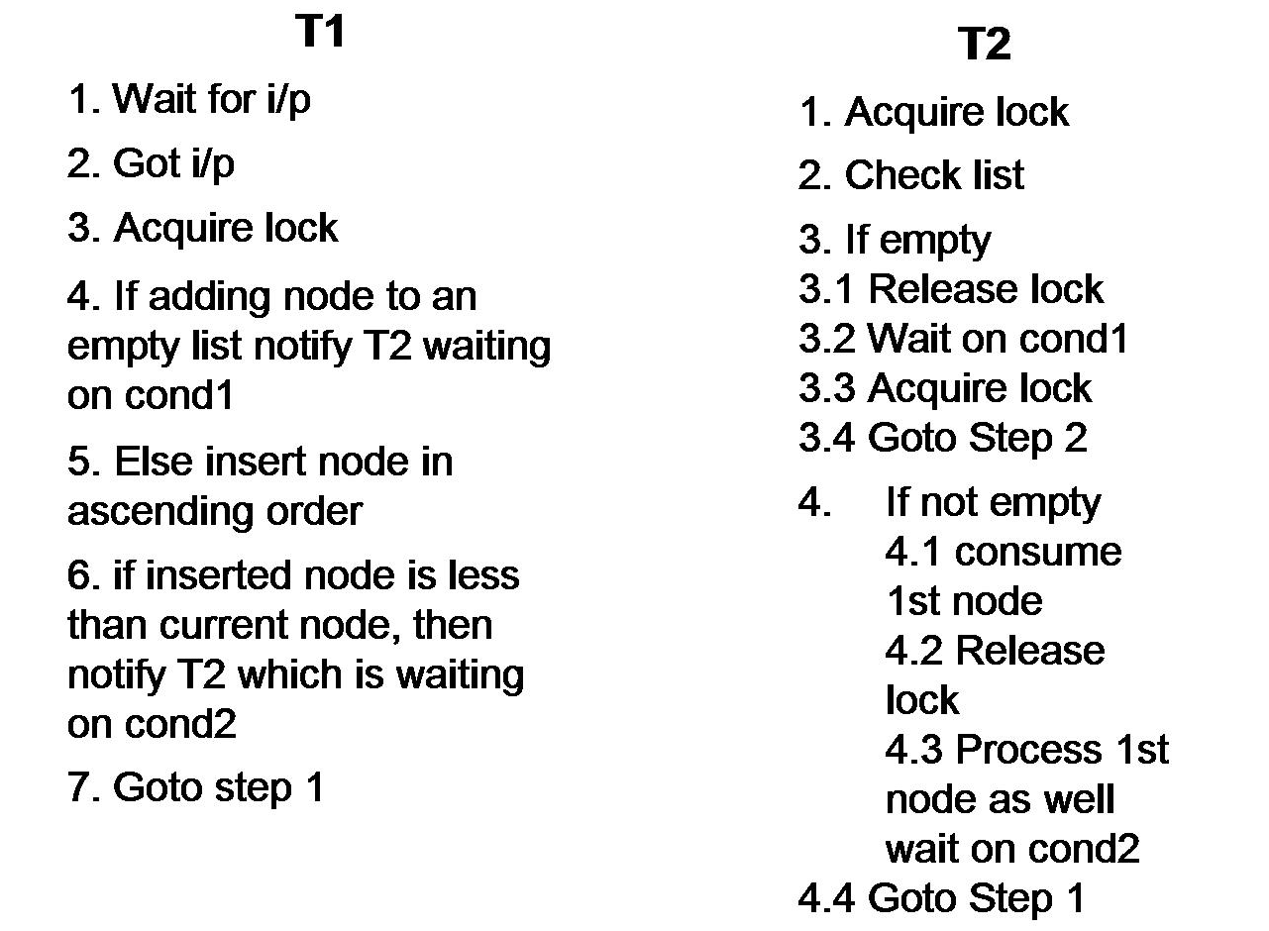
Conditional variable

Slide 47
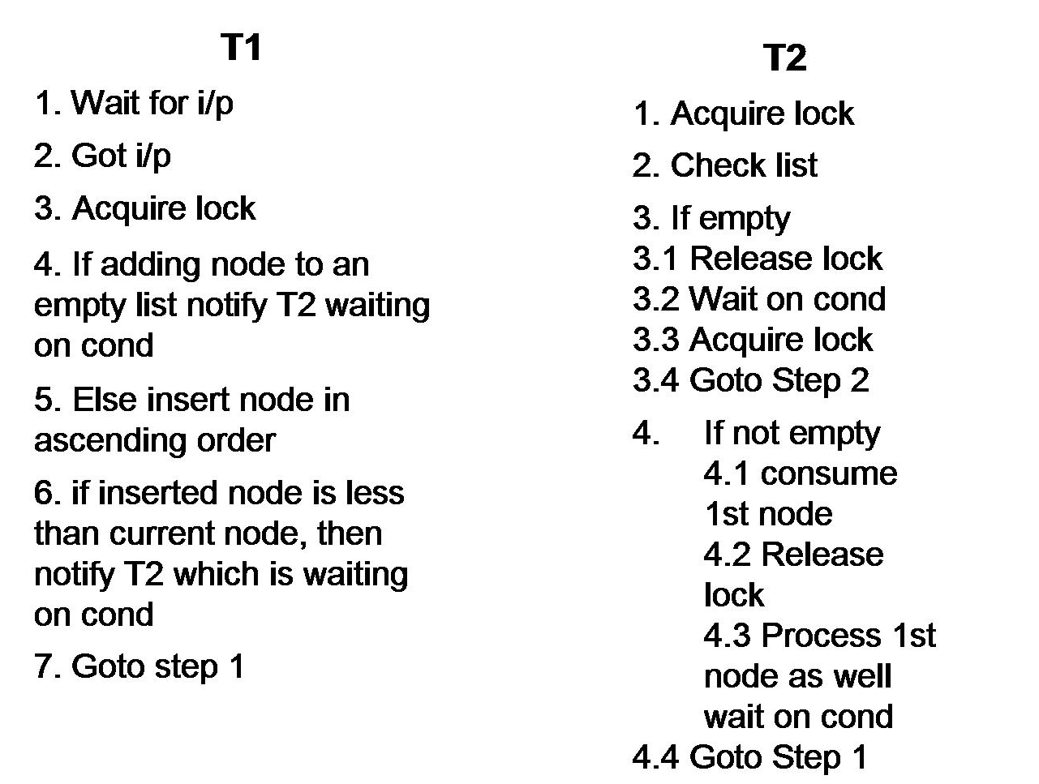
Conditional variable

Slide 48
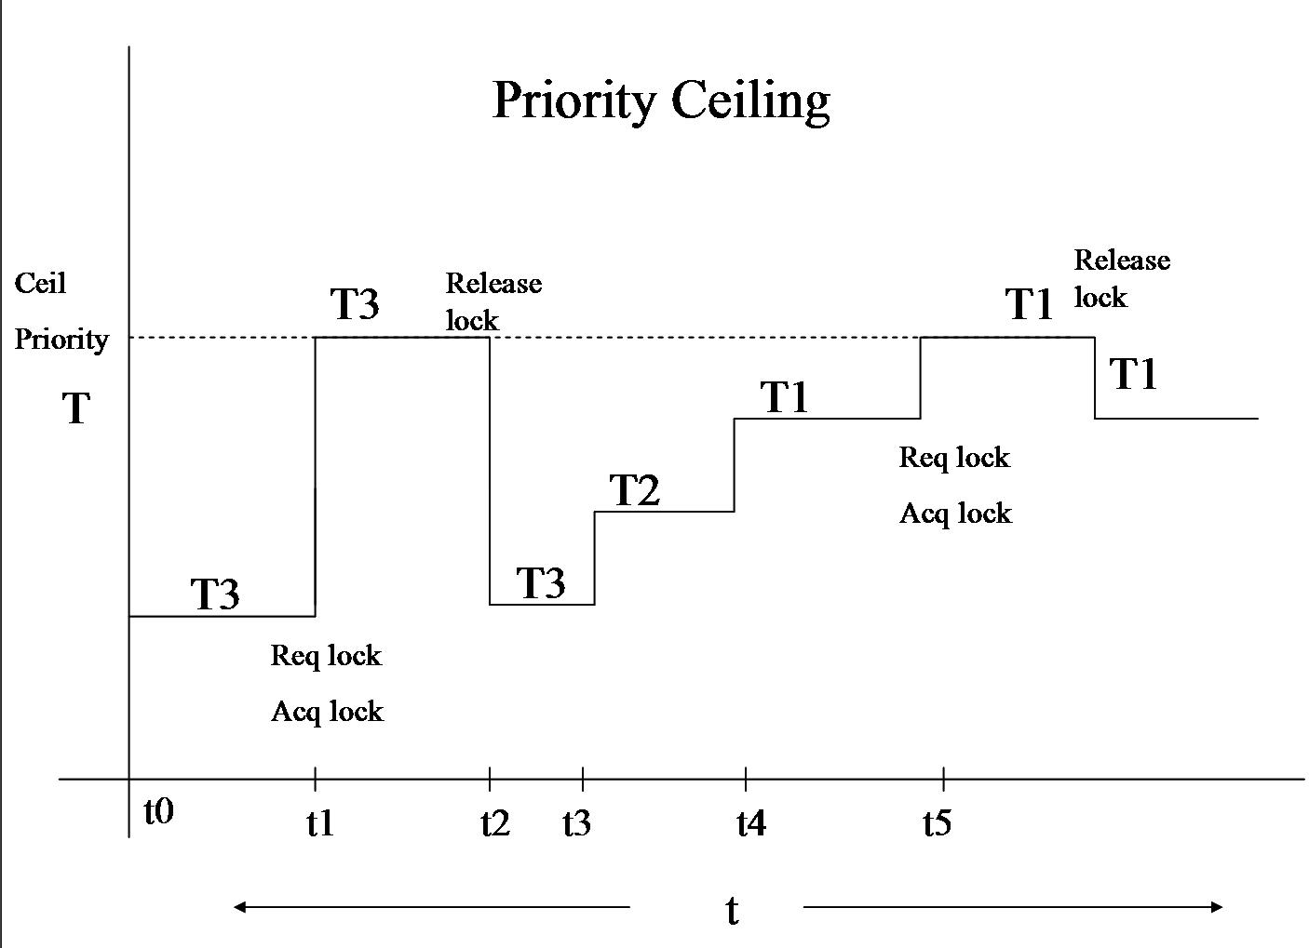
Priority ceiling

Slide 49
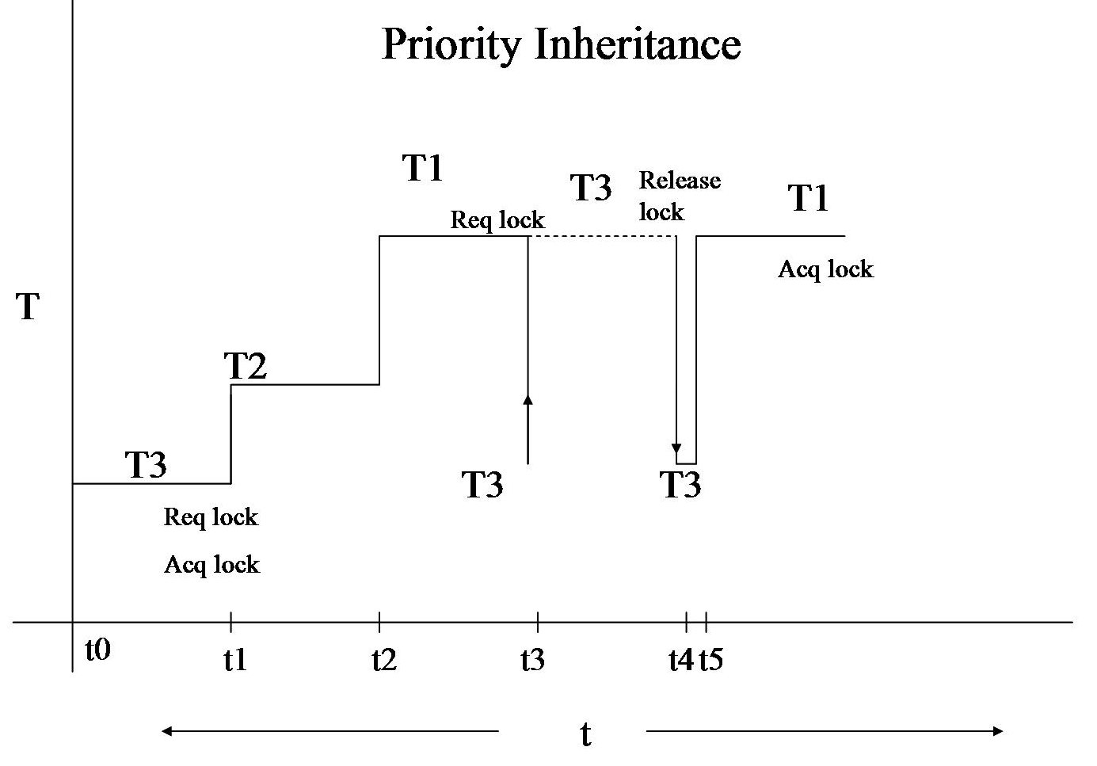
Priority inheritence

Slide 50
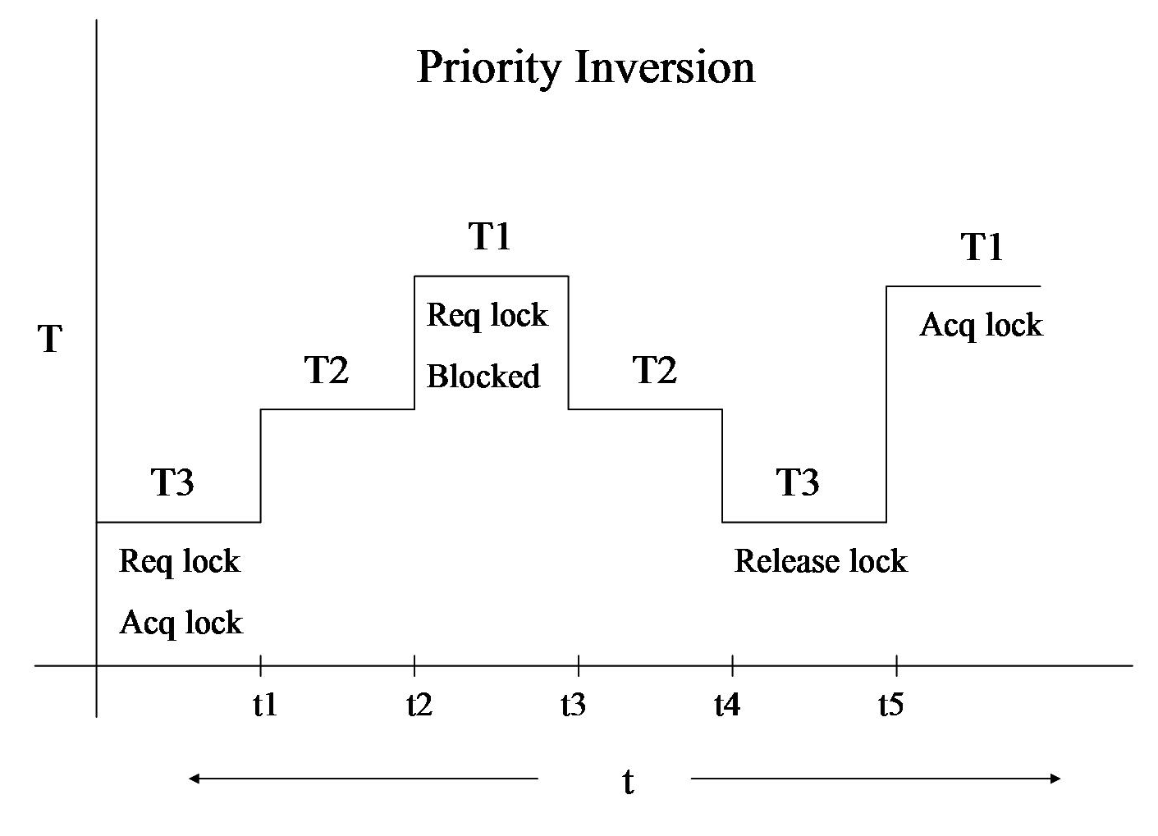
Priority inversion

Slide 51
Iterative Server
A
mget
S
Client
server
Video mp4 (2GB)
B
File transfer…
Client
mget
wait

Slide 52
Concurrent server
Server 1
A
Video mp4 (2GB)
Client
File transfer…
fork()
mget
server
B
Client
mget
fork()
Server 2
File transfer…
Video mp4 (2GB)

Slide 53
Potential parallelism in the problem
C = A * B + C
R = (A + B) * (C + D)
A
B
A
B
C
D
*
+
+
C
+
*
C
R

Slide 54
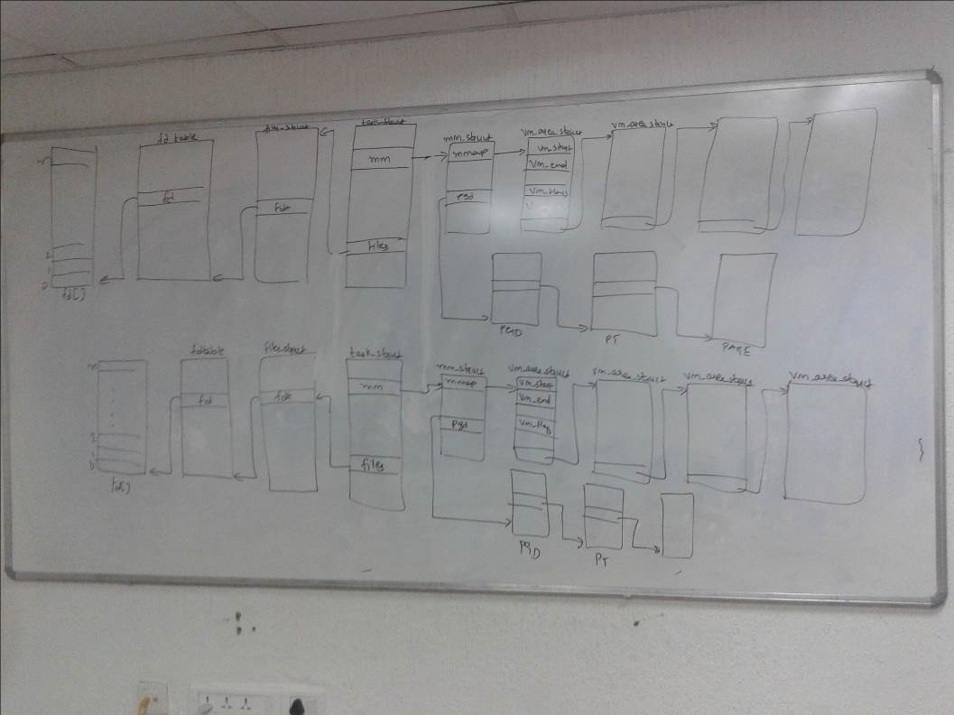
Process creation

