Slide 1
Prolog
A declarative language based on first-order logic
1972

Slide 2
Prolog
The Prolog programming language first appeared in 1972 …
... Watergate burglars arrested (leading to resignation of US President Richard Nixon)
… Apollo 19 returned to Earth, the last moon landing

Slide 3
1972 Top Grossing Movie

Slide 4
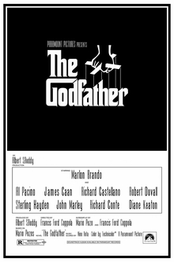
1972 Top Grossing Movie
The Godfather
The Poseidon Adventure
What’s Up, Doc?
Deliverance
Jeremiah Johnson

Slide 5
#1 Song of 1972

Slide 6
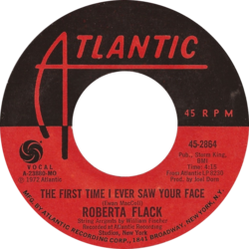
#1 Song of 1972
1. "The First Time Ever I Saw Your Face" Roberta Flack
2. "Alone Again (Naturally)" Gilbert O'Sullivan
3. "American Pie" Don McLean
4. "Without You" Harry Nilsson
5. "The Candy Man" Sammy Davis Jr.
6. "I Gotcha" Joe Tex
7. "Lean on Me" Bill Withers
8. "Baby, Don't Get Hooked on Me" Mac Davis
9. "Brand New Key" Melanie
10. "Daddy Don't You Walk So Fast" Wayne Newton

Slide 7
Top TV Series of 1972

Slide 8
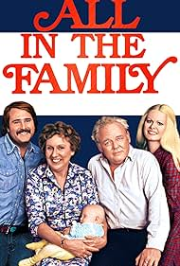
Top TV Series of 1972
1. All in the Family 2. Sanford and Son 3. Hawaii Five-O 4. Maude 5. Bridget Loves Bernie 6. The NBC Sunday Mystery Movie 7. The Mary Tyler Moore Show 8. Gunsmoke 9. The Wonderful World of Disney 10. Ironside

Slide 9
1972 Most Popular Video Game

Slide 10
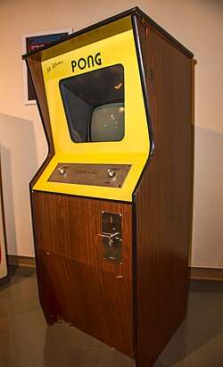
1972 Most Popular Video Game

Slide 11
Prolog Major Features
Declarative programming
You describe the problem, not describe the computational steps to solve it.
Unification
General-purpose matching of expressions
Haskell had something similar, but not as powerful
Automatic backtracking
Depth-first search is built-in, and Prolog can automatically try a new computational path after it reaches a dead-end.
Recursion and list processing
Has good support for lists and no explicit loop structures.

Slide 12
Prolog Major Features
Logical flavor
Uses ideas and terminology from first-order logic
Symbolic AI applications
A popular language for programs that reason with facts and rules
e.g. expert systems, question answering, theorem proving, planning, …
Support for natural language grammar rules in the form of Definite Clause Grammers (DCGs).

