Slide 1

Smart IoT & ML System for Food Monitoring
22AIE213 Machine Learning
22AIE211 Introduction to IOT
Team Members | Registration No
K S Venkatram | CB.SC.U4AIE23236
Sanggit Saaran K C S | CB.SC.U4AIE23247
Vishal Seshadri B | CB.SC.U4AIE23260
Surya HA | CB.SC.U4AIE23267
1

Slide 2
Introduction
Food wastage and inefficient storage management are major challenges due to manual tracking, leading to spoilage and increased costs.
Our project introduces a smart IoT and ML system for automated food monitoring, reducing human intervention.
RFID-based tracking ensures real-time inventory logging, while ML-driven image recognition predicts spoilage patterns.
Environmental sensors monitor temperature and humidity, preventing premature food deterioration.
LLM generates personalized recipes based on available ingredients to reduce waste and improve convenience.
2

Slide 3
Literature Review
No | Title | Journal and Year | Authors | Key Outcomes | Limitations
1 | Real-time RFID-based Item Tracking using IoT & Efficient Inventory Management using Machine Learning. | IEEE Xplore 2020 | Ayaskanta Mishra, et al. | Improved inventory tracking using RFID and IoT, enhanced efficiency with machine learning, increased accuracy, reduced losses, and optimized supply chain. | High RFID infrastructure costs, signal interference issues, and deployment challenges due to environmental factors.
2 | An Intelligent IoT-Based Food Quality Monitoring Approach Using Low-Cost Sensors. | Symmetry 2019 | Alexandru Popa, et al. | Developed an IoT-based food monitoring system with gas, temperature, and humidity sensors for real-time food quality assessment, enhancing safety and reducing waste. | Limited to vacuum-packed foods, potential sensor inaccuracies, and dependency on IoT infrastructure.
3

Slide 4
Literature Review
No | Title | Journal and Year | Authors | Key Outcomes | Limitations
3 | A Smart IOT and Cloud based Food Monitoring System- Review. | ICAST 2022 | Aryan Suryavanshi, et al. | IoT and cloud-based food monitoring system uses sensors to track temperature, humidity, gas emissions, and light intensity, ensuring food safety and reducing waste. | Dependence on sensor accuracy, potential data transmission issues, high initial setup cost, and challenges in integrating with existing food supply chain systems.
4 | Monitoring Fresh Fruit and Food Using IoT and Machine Learning to Improve Food Safety and Quality. | Journal of Propulsion Technology 2023 | Priya Mangesh Nerkar, et al. | IoT and ML-based system using K-means clustering and PCA for food safety monitoring; image classification via KNN and Naïve Bayes improved perishable food tracking. | Dependency on high-resolution cameras and cloud infrastructure; limited scalability for large-scale food monitoring systems.
4

Slide 5
Literature Review
No | Title | Journal and Year | Authors | Key Outcomes | Limitations
5 | Use of Machine Learning and Artificial Intelligence in Food Spoilage Detection | IJERA 2024 | Disha Manoj Bongarde, et al. | ML and AI improve food spoilage detection using IoT sensors, electronic noses, and predictive modeling, enhancing food safety and waste reduction. | Requires large datasets, high implementation costs, dependency on sensor accuracy, and integration challenges with traditional food supply chains.
6 | Data-Driven IoT Smart Refrigerators for Medication Storage with Deep Learning Analytics | ICoICI 2024 | U. Kavitha, et al. | IoT smart refrigerators with deep learning (LSTM) optimize medication storage, improve adherence, and reduce pharmaceutical waste through real-time monitoring and predictive analytics. | High computational requirements, sensor data errors, integration challenges with healthcare IT systems, and limited handling of long-term dependencies in time-series data.
5

Slide 6
Objective
IoT-enabled Smart Refrigerator for real-time food tracking and freshness monitoring.
Automated Inventory Management – RFID and Camera tracking ensures seamless logging and real-time updates of stored food items.
Intelligent Spoilage Detection – Machine learning-driven image recognition identifies food items and predicts spoilage patterns.
Optimized Storage Conditions – Continuous temperature and humidity monitoring prevents premature food deterioration.
Remote Accessibility & Monitoring – Real-time data transmission to a cloud-based dashboard enables remote supervision and control.
LLM-Powered Recipe Generation – LLM powered recipe generation creates personalized meal plans by analyzing available ingredients, prioritizing expiring items, nutrition, and cooking difficulty.
6

Slide 7
Expected Outcome
A fully functional food storage system with RFID and Camera based tracking for inventory management.
Real-time freshness tracking using temperature, humidity sensors, and ML spoilage prediction.
Real-time notifications for low stock levels, expired food, and unfavorable storage conditions.
LLM-powered recipe generation, providing personalized meal suggestions based on available ingredients and expiry dates.
AI-driven meal planning, including dietary-based recommendations and alternative ingredient suggestions.
Enhanced food safety and reduced waste, making food storage more sustainable, efficient, and intelligent.
7

Slide 8
Relevance to Machine Learning (ML)
Food Product Detection (SVM) :
Model: SVM will classify food items and detect spoiled products using extracted features from CNN.
CNN will extract features from the Food-101 dataset to predict food expiry dates.
Dataset: Food-101 dataset combined with custom data on food types, storage conditions, and expiry
dates.
Expiry Detection (Random Forest) :
Model: Random Forest will detect temperature and humidity inside the fridge, to identify fluctuations that may lead to food spoilage.
Dataset: Trained on real-time sensor data from the fridge, including temperature, humidity, and other environmental factors.
8

Slide 9
Relevance to Machine Learning (ML)
Recipe Generation (LLaMA 2) :
Model: LLaMA 2 will generate personalized recipes based on available ingredients, prioritizing expiring items and dietary preferences.
Dataset: Recipe datasets and Pre-Trained model (RecipeBERT) will be used to provide a diverse range of meal suggestions.
9

Slide 10
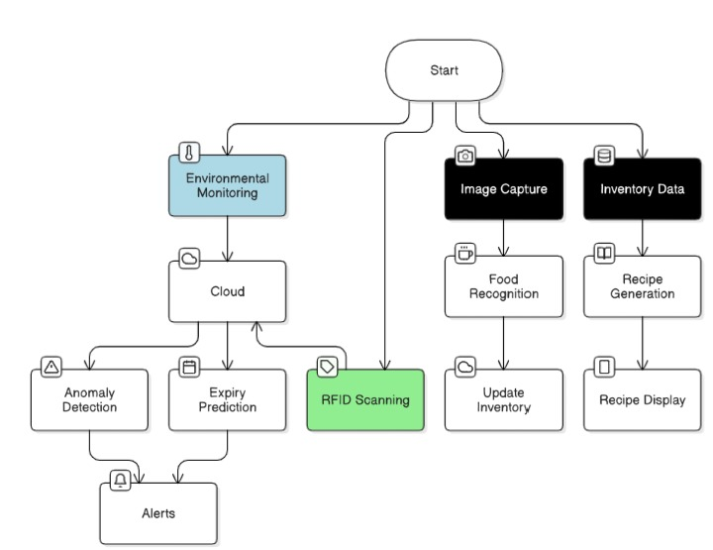
Workflow
Fluctuation detection
13

Slide 11
Relevance to Communication & IoT
Sensor Integration for Environmental Monitoring :
The DHT22 sensor monitors temperature and humidity in the storage area, transmitting data via ESP32 for real-time tracking and analysis.
RFID-Based Food Inventory Management :
The MFRC522 RFID sensor tracks food items in storage, linking them to a unique ID. The ESP32 transmits this data to manage inventory and monitor expiry statuses.
Real-Time Data Transmission to the Cloud :
The ESP32 Wi-Fi module sends sensor data and food images to cloud platforms like Firebase, enabling remote monitoring and analysis.
10

Slide 12
Relevance to Communication & IoT
Image Capture for Spoilage Detection :
A camera module (connected to ESP32) captures images of stored food for spoilage detection using a CNN model. The ESP32 processes and transmits this data to the system.
Alerts and Notifications :
An OLED screen, buzzer, and LED indicators provide real-time alerts for food spoilage or environmental issues, managed by the ESP32.
11

Slide 13
Flow Diagram
MFRC522 RFID sensor + ESP32
ESP32 (Wi-Fi)
IP webcam+ ESP32
Web Interface, LED indicators
DHT22 + ESP32
Monitors storage conditions and transmits data to the cloud.
Tracks food items and their expiry status
Sends sensor and food inventory data to Firebase.
Captures images for CNN-based spoilage detection.
Notifies users of spoilage or environmental issues.
12

Slide 14
References
[1] Mishra, A. and Mohapatro, M., 2020, December. Real-time RFID-based item tracking using IoT & efficient inventory management using Machine Learning. In 2020 IEEE 4th Conference on Information & Communication Technology (CICT) (pp. 1-6). IEEE.
[2] Popa, A., Hnatiuc, M., Paun, M., Geman, O., Hemanth, D.J., Dorcea, D., Son, L.H. and Ghita, S., 2019. An intelligent IoT-based food quality monitoring approach using low-cost sensors. Symmetry, 11(3), p.374.
[3] Suryavanshi, A., Thakker, R., Waghela, H. and Kamble, P., 2022, December. A SMART IOT and CLOUD based Food Monitoring System-Review. In 2022 5th International Conference on Advances in Science and Technology (ICAST) (pp. 508-512). IEEE.
[4] Nerkar, P.M., Shinde, S.S., Liyakat, K.K.S., Desai, S. and Kazi, S.S.L., 2023. Monitoring fresh fruit and food using Iot and machine learning to improve food safety and quality. Tuijin Jishu/Journal of Propulsion Technology, 44(3), pp.2927-2931.
14

Slide 15
References
[5] Bongarde, D., Pandit, S. and Pandit, H., Use of Machine Learning and Artificial Intelligence in Food Spoilage Detection.
[6] Kavitha, U., Pattnaik, M., Jayaprakash, S., Yuvaraj, S., Ponnaian, G. and Meenakshi, B., 2024, August. Data-Driven IoT Smart Refrigerators for Medication Storage with Deep Learning Analytics. In 2024 Second International Conference on Intelligent Cyber Physical Systems and Internet of Things (ICoICI) (pp. 467-472). IEEE.
15

