Slide 1
Who made this voice?
Training-free attribution of audio deepfakes, studied with speech-processing tools
Saaransh Garg (2024AIB1011) · [Partner name]
AI553 Speech & Audio Processing · IIT Ropar · November 2026
Notes:
Hi, we are ... Our project studies TADA, an Interspeech 2025 method that tells you WHICH speech generator produced a fake clip, without training any model. We use the tools from this course — spectra, cepstra, LPC, sampling, quantisation — to understand why it works and where it breaks.

Slide 2
Detection is not enough: we need attribution
1
Detection
2
Attribution
3
Open set
Is this clip real or fake?
WHICH generator made it?
…or a generator we have never seen?
Well studied: binary decision.
Forensics, takedowns, accountability.
New TTS systems appear every month.
TADA (Stan et al., Interspeech 2025): embed each clip with a frozen pre-trained speech model (w2v-BERT 2.0), average one early layer over time, then label it with k-nearest neighbours. Nothing is trained, and adding a new generator just means adding its clips.
Notes:
Detection asks real or fake. Attribution asks which system - like ballistics for audio. And because new generators appear constantly, the system must also be able to say: I don't know this one. TADA's answer is surprisingly simple: no training at all, just nearest neighbours in the space of a pre-trained speech model.

Slide 3
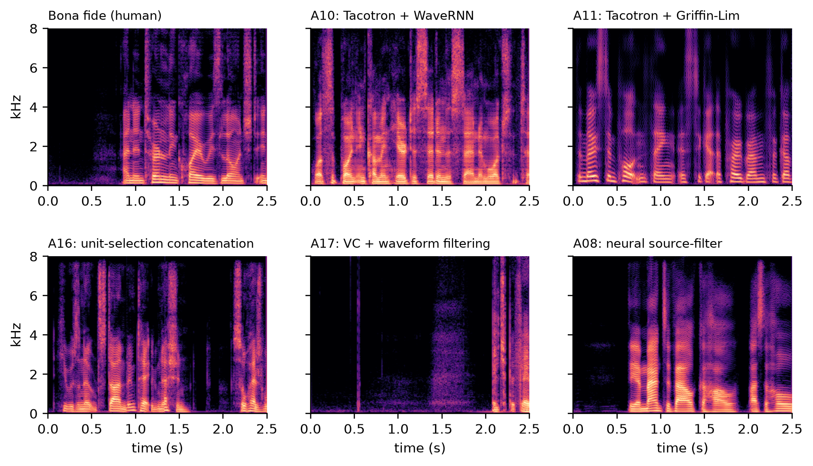
Every generator leaves a fingerprint
Text
Acoustic model
Vocoder
Waveform
Vocoder families in ASVspoof 2019
Source-filter: WORLD, STRAIGHT
LPC filtering (voice conversion)
Griffin-Lim: phase from |STFT|
Neural: WaveNet, WaveRNN
Concatenation of real recordings
Notes:
A TTS system is a chain: text, acoustic model, then a vocoder that makes the waveform. The vocoders are exactly the course models - source-filter (WORLD), LPC filtering, Griffin-Lim phase reconstruction from the STFT magnitude, neural vocoders. Each leaves artefacts: look at the high band of Griffin-Lim, the noise floor of neural source-filter. These consistent artefacts are the fingerprint.

Slide 4
Method: two ways to turn a clip into one vector
w2v-BERT 2.0 (frozen)
layer 4 of 24
mean over time
1024 numbers
Clip x[n]
16 kHz
k-NN, k = 21
→ which generator?
→ unknown? (distance)
MFCC / LFCC / LPCC
(course features)
mean & std
over frames
Fair tests
5 random 80:20 splits
5 splits with unseen SPEAKERS
8 channel degradations of the test audio
Course baselines
MFCC (mel), LFCC (linear), LPCC (Levinson–Durbin)
LFCC on 0–4 kHz vs 4–8 kHz
GMM per generator on LFCC frames (trained)
Notes:
Top branch is TADA: the frozen model, layer 4, averaged over time to 1024 numbers. Bottom branch is the course: MFCC, LFCC and LPC cepstra, summarised by mean and standard deviation over frames. Both go to the same nearest-neighbour classifier. We also train a GMM per generator as a classical statistical baseline. The key test is speaker-disjoint splits.

Slide 5
Data: ASVspoof 2019 LA, 19 real generators
19
9,800
107
292 / 1,216
generators (TTS + VC)
clips, 8.9 hours
speakers, 3 disjoint partitions
parquet blocks downloaded
1
Speaker confound
Every generator speaks with the same voices. Does kNN learn the system or the speaker?
2
Hidden duplicates
A16 and A19 are 'new' eval systems that re-use the A04 and A06 algorithms: a free control experiment.
3
Laptop budget
7.6 GB corpus, slow link: we read only metadata, plan a speaker-balanced sample, fetch only needed blocks.
Notes:
We use ASVspoof 2019 Logical Access: 19 generators from 2018-era TTS and voice conversion, with speaker labels. Train/dev contain A01-A06, eval contains A07-A19 with different speakers. Two eval systems secretly reuse old algorithms - that's our control. We downloaded a speaker-balanced subset without fetching the whole 7.6 GB.

Slide 6
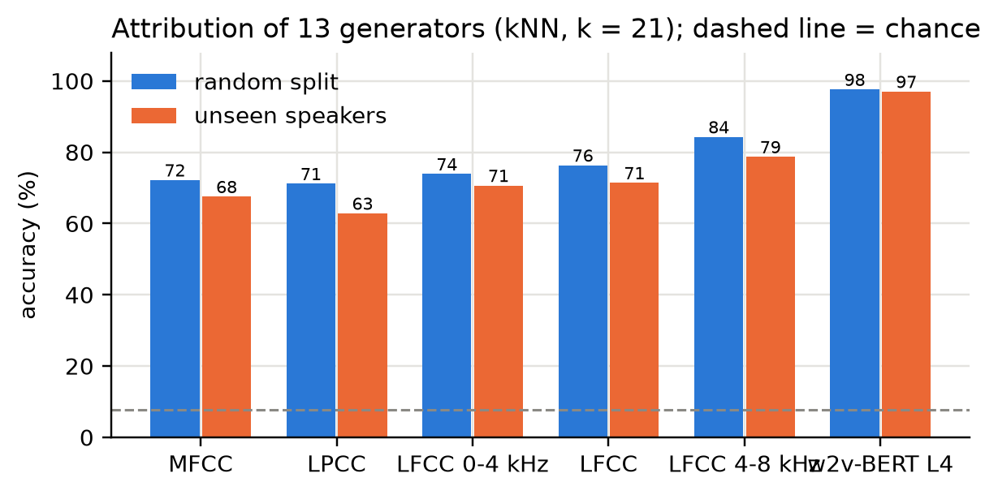
Result 1: SSL wins; the mel scale hides the fingerprint
97.6%
w2v-BERT layer 4 + kNN, 13 generators (chance 7.7%)
72.2%
MFCC + kNN
Course insight: LFCC on the 4–8 kHz band alone (84.3%) beats full-band LFCC (76.4%) and MFCC (72.2%). The mel scale is built for human hearing and squeezes the high band, exactly where vocoder artefacts live. A GMM on LFCC frames reaches 96.6%, but it must be trained.
Notes:
Blue is a random split, orange is unseen speakers. The frozen model reaches 97.6 percent; MFCC only 72. The interesting course result: LFCC using only 4 to 8 kHz beats the full band. The mel scale compresses high frequencies because humans don't need them - but forensics does. The GMM on frame-level LFCC is close, 96.6, but needs EM training for every new generator.

Slide 7
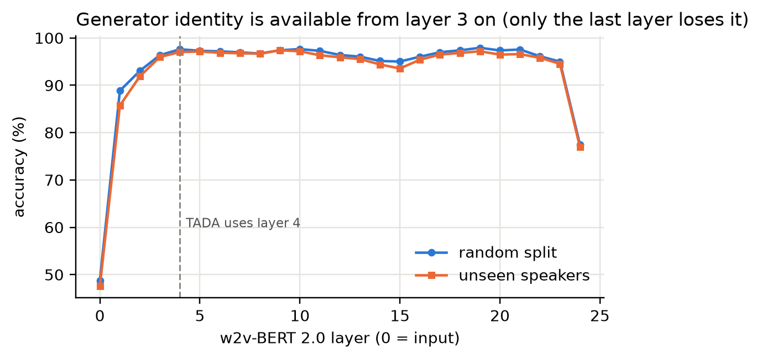
Result 2: it recognises the generator, not the speaker
Accuracy on unseen speakers
w2v-BERT L4
97.6 → 97.0
−0.6
MFCC
72.2 → 67.6
−4.6
LPCC
71.2 → 62.9
−8.3
Layers: the input projection gives only 49%; from layer 3 on accuracy sits at 96–98% until the last layer (78%). TADA's layer 4 is the cheapest layer at peak accuracy (4 of 24 blocks). Pairs sharing an acoustic model but not the vocoder (A14/A15) are separated perfectly.
Notes:
If the method just recognised voices, accuracy would collapse when test speakers are new. It drops only 0.6 points for the frozen model, but 5 to 8 points for MFCC and LPCC - the classical features lean on the speaker. The layer curve shows generator identity appears by layer 3 and stays until the last layer; layer 4 is simply the cheapest choice.

Slide 8
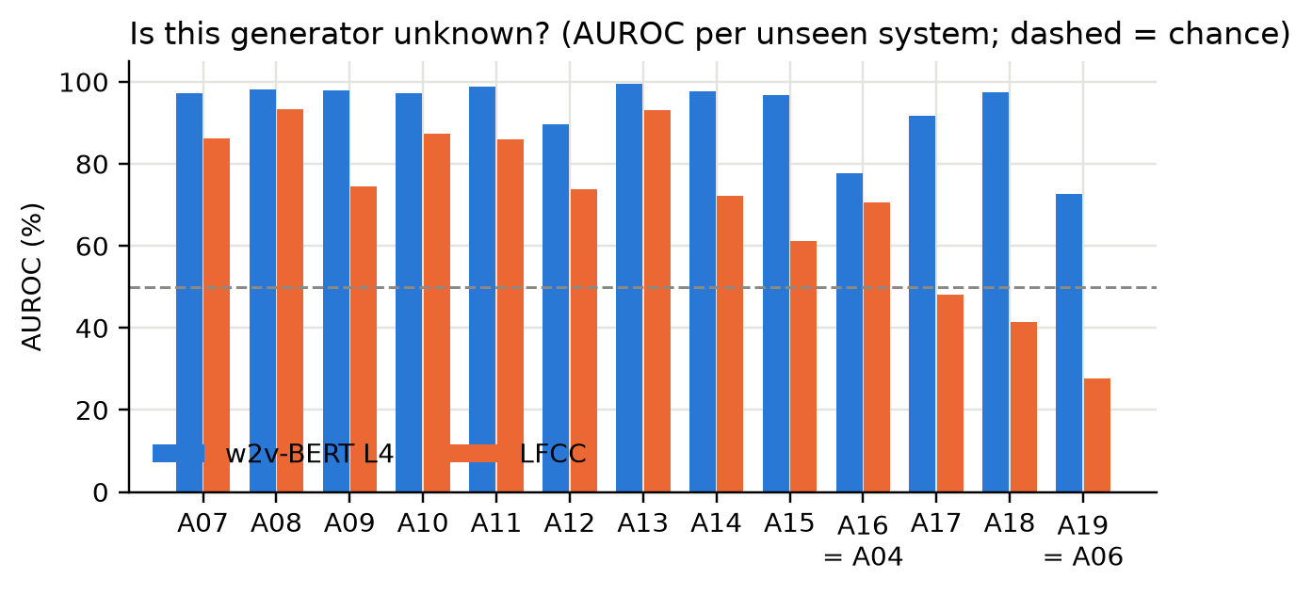
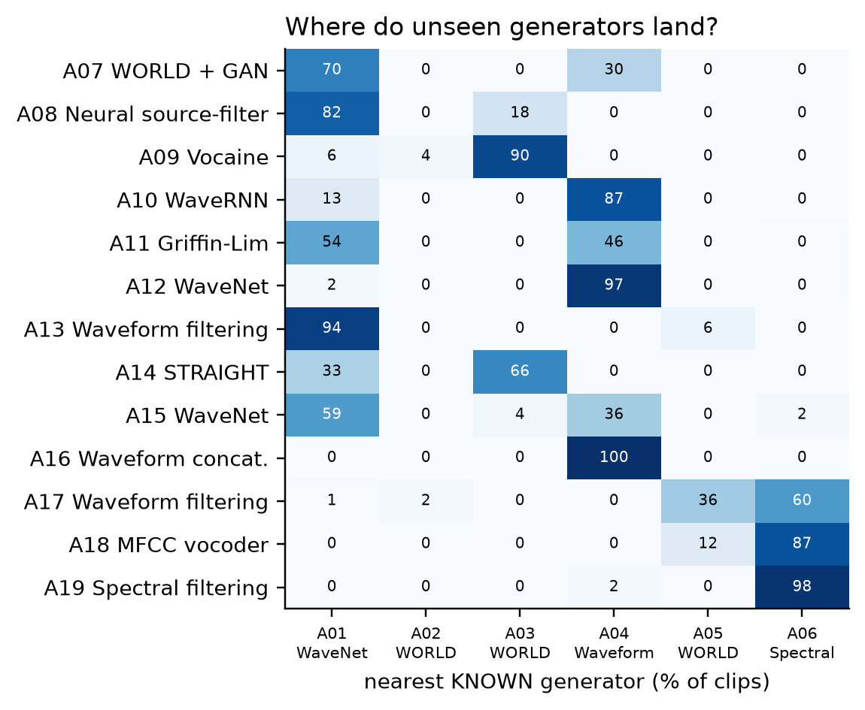
Result 3: spotting generators it has never seen
96.6%
Built-in control worked: forced to pick a known system, 100% of A16 clips land on A04 and 98% of A19 on A06, which are their true algorithms. They also look far less 'new' than the others (AUROC 78 / 73 vs 90–100).
AUROC for new generators (MFCC 77.9%)
Notes:
We store only A01-A06 and ask: is this clip from something unknown? The distance to the 21 nearest known clips separates new generators with 96.6 percent AUROC. And the control: A16 and A19 are relabelled copies of A04 and A06. When we force a choice, the method maps them to exactly those originals - it is matching the algorithm, not the label.

Slide 9
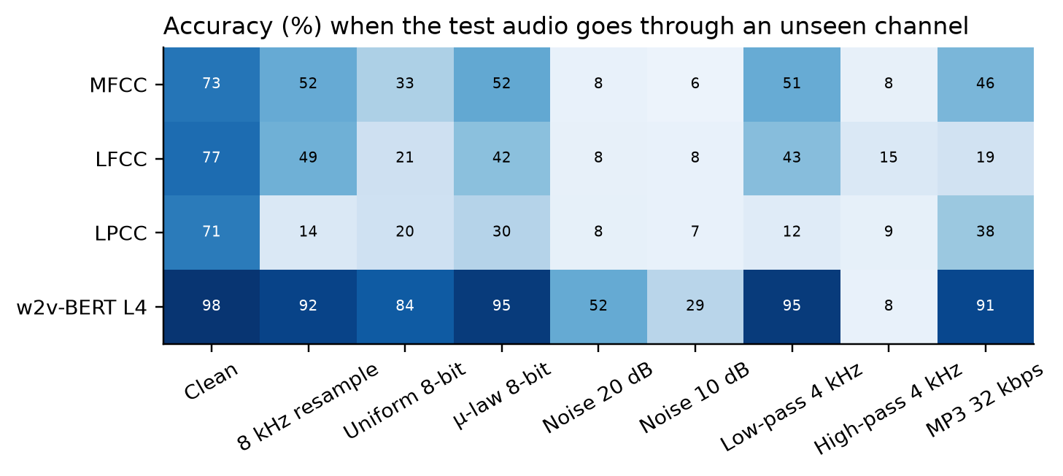
Result 4: channel effects from the course
Sampling theorem
8 kHz resample (anti-alias removes > 4 kHz): 92%
Quantisation
μ-law 8-bit 95% beats uniform 8-bit 84%: companding
Perceptual coding
MP3 32 kbps: 91%
Breaks
white noise 20 dB: 52%; keeping only 4–8 kHz: chance
Takeaway: the clean fingerprint bank still works after telephone-band resampling, μ-law and MP3, while MFCC/LFCC/LPCC collapse. Additive noise masks the low-level detail the fingerprint lives in, so a real system needs noisy examples in its support set.
Notes:
Every column is a course topic. Resampling to 8 kHz removes everything above 4 kHz by the sampling theorem; the frozen model still gets 92 percent. Mu-law beats uniform 8-bit quantisation, exactly as the SQNR argument predicts. MP3 is fine. Noise is the real weakness - and every classical feature collapses on almost every channel.

Slide 10
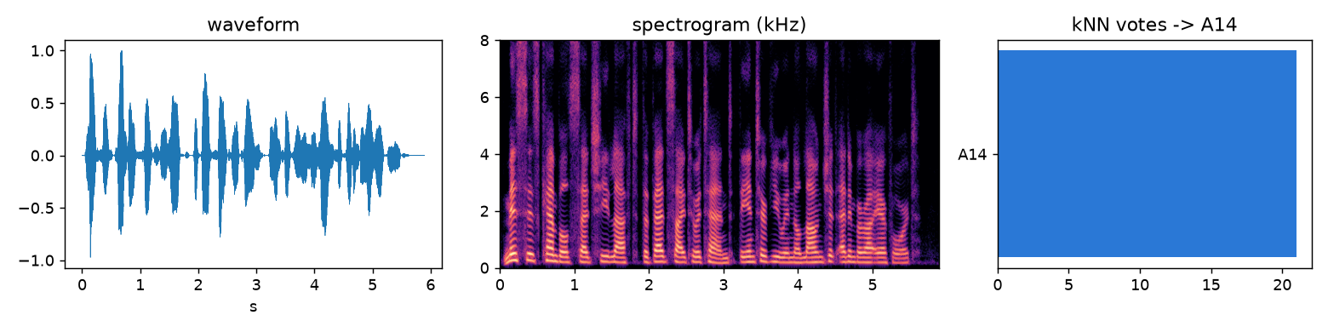
Live demo: python demo.py
python demo.py
random held-out clip → generator, 21-NN votes, nearest clips (often other speakers)
python demo.py --file demo_clips/human.flac
real speech → 'bonafide (human speech)'
python demo.py --file demo_clips/modern_tts.flac
2025 TTS never seen → weak vote agreement, large distance: the open-set limitation
Notes:
Live: run demo.py on a random eval clip - it prints the prediction, the votes, and the nearest neighbours, which are usually different speakers with the same generator. Then a human clip, then a modern 2025 TTS clip that the bank has never seen: the votes split and the distance is high - an honest limitation.

Slide 11
Takeaways
1
Training-free works
Frozen w2v-BERT + kNN: 97.6% over 13 generators, 97.0% on unseen speakers, 96.6% AUROC for new generators.
2
Course tools explain why
The fingerprint is fine spectral detail, strongest at 4–8 kHz: compressed by the mel scale, removed by noise, mostly kept by μ-law and MP3.
3
Honest limits
Assumes the clip is fake (needs a human/fake gate); open set across datasets is hard; noise breaks it; 9.8k-clip subset of one corpus.
AI-tool disclosure: Claude Code (Anthropic) assisted with code, experiments and drafting; all numbers come from our scripts.
Notes:
Three takeaways. One: you do not need to train anything to attribute deepfakes. Two: the course tools explain why - the fingerprint is high-frequency spectral detail that the mel scale squeezes and noise hides. Three: the limits - it assumes the clip is fake, open-set across datasets is hard, and noise breaks it. Thank you - questions?

