Slide 1
Data Structures
Lecture 4
AVL and WAVL Trees
Haim Kaplan and Uri Zwick November 2016

Slide 2
Balanced search trees
O(log n) worst-case time for all operations
AVL trees (1962)
Red-Black trees (1972)
…
WAVL trees (2009)
Splay trees (amortized bounds)
B-trees (non-binary)

Slide 3
AVL trees [Adel’son-Vel’skii, Landis (1962)]
AVL trees are search trees

Slide 4
+ External leaves
25
9
33
5
13
29
59
2
11
20
31
18
23

Slide 5
External leaves
Unifies the treatment of base cases
A single object EXT used to represent all external leaves

Slide 6
AVL trees [Adel’son-Vel’skii, Landis (1962)]
1
k
1
Each node has a rank
k−1
k−1
Each edge has a rank difference
1
k
2
k−1
k−2

Slide 7
External leaves
rank of a external leaf = −1
Every node is a 1,1-, 1,2- or 2,1-node
k
z
k
z
k
z
1
1
1
2
2
1
k−1
x
y
k−1
k−1
x
y
k−2
k−2
x
y
k−1

Slide 8
+ ranks
4
25
1
2
3
9
2
33
2
1
1
2
1
5
2
13
1
29
0
59
1
2
2
1
2
1
1
1
0
2
0
11
1
20
0
31
1
1
−1
1
1
−1
1
1
−1
−1
0
18
0
23
−1
−1
−1
−1
1
1
1
1
−1
−1
−1
−1
−1
−1

Slide 9
External leaves
Define rank of a external leaf = −1
Every node is a 1,1-, 1,2- or 2,1-node
➔ Rank of a leaf = 0
0
y
1
1
−1
−1

Slide 10
A node with a single external leaf
1
y
1
2
0
x
−1
1
1
−1
−1

Slide 11
Nodes in AVL trees
x
parent
rank
key
info
left
right
Each node has a rank
Need only one extra bit per node
(Enough to keep
rank difference = x.parent.rank-x.rank
or rank parity)

Slide 12
Height – Length of longest path to leaf
4
1
3
2
height
depth
2
8
1
7
0
10
0
5

Slide 13
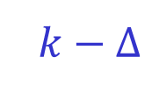

rank = height
Lemma: If all leaves have rank 0, all rank differences are positive, and each parent has a child or rank difference 1, then the rank of each node is equal to its height
Easy proof by induction:
k
z
1
Δ≥1
k−1
x
y
k−Δ
k−1
$k−Δ$
Therefore the height of $z$ is k

Slide 14
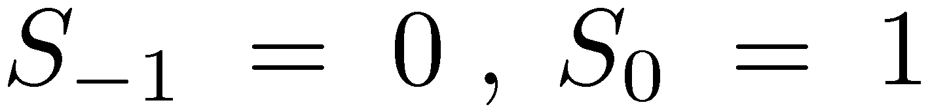
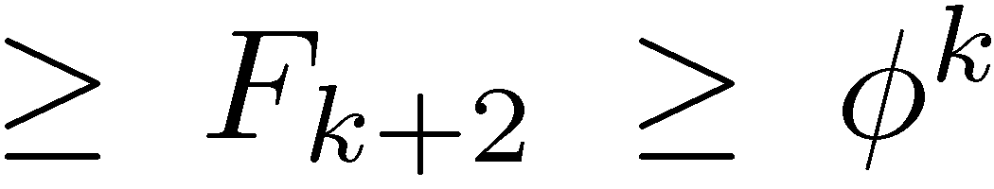

AVL trees [Adel’son-Vel’skii, Landis (1962)]
k
S_{k} – minimal number of nodes in an AVL tree of rank k
k−1
k−2
$$k≤\log_{φ}{n}≤1.4404\log_{2}{n}$$

Slide 15
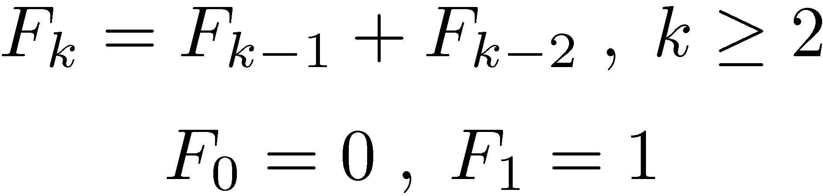
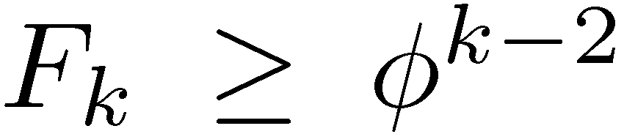
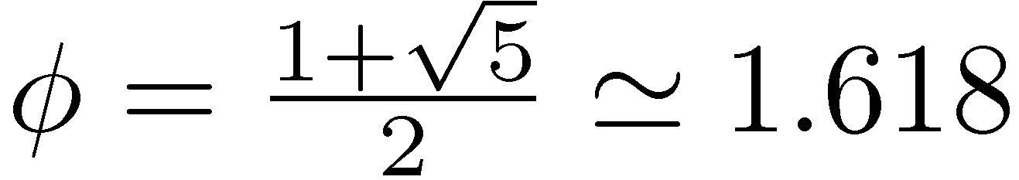
Fibonacci numbers
n | 0 | 1 | 2 | 3 | 4 | 5 | 6 | 7 | 8 | 9
F_{n} | 0 | 1 | 1 | 2 | 3 | 5 | 8 | 13 | 21 | 34

Slide 16
The challenge
If we insert or delete a node from an AVL tree, the resulting tree is not necessarily an AVL tree
After insertions and deletions we may need to restructure the tree
To restructure the tree we use rotations
We want to update the tree in O(log n( time

Slide 17
AVL insertion

Slide 18
AVL Insertion
Replace an external leaf by a new node x
Case A: The parent y is a leaf
0
y
1
y
1
1
1
2
−1
−1
0
x
−1
1
1
Give x a rank of 0
−1
−1
Increase the rank of y to 1
Potential problem at y
Notes:
We insert a new node x as a child of a leaf y. We initially give x rank 0. The AVL rule is violated.
Converts a 1,1-node into a 0,1-node and creates a new 1,1-now. Hence, the potential is increased by 1.
If we don’t consider internal leaves, then again the potential increases by 1. (y now has potential 1.)

Slide 19
AVL Insertion
Replace an external leaf by a new node x
Case A: The parent z is a leaf
0
z
0
z
1
1
0
1
−1
−1
0
x
−1
1
1
Give x a rank of 0
−1
−1
Problem: rank difference 0
Notes:
We insert a new node x as a child of a leaf z. We initially give x rank 0. The AVL rule is violated.
Converts a 1,1-node into a 0,1-node and creates a new 1,1-now. Hence, the potential is increased by 1.
If we don’t consider internal leaves, then again the potential increases by 1. (z now has potential 1.)

Slide 20

AVL Insertion
Replace an external leaf by a new node x
Case B: The parent z is not a leaf
1
z
1
z
2
1
1
1
−1
0
0
x
0
1
1
1
1
1
1
−1
−1
−1
Resulting tree is a valid AVL tree
Notes:
We insert a new node x as a child of a unary node y. We initially give x rank 0. Everything is ok.
Again, the potential of z becomes 1.

Slide 21
Rebalancing after insertion
Case 1: Promote
0
z
1
z
0
1
1
2
0
x
−1
0
x
−1
Promote z, i.e., increase its rank by 1
Problem is either fixed or moved up
Notes:
The potential of z drops from 1 to 0. If this is not the final step, then the potential of the parent of z does not increase. If this is the last step, then the parent of z becomes 1,1 and gets one unit of potential.

Slide 22
AVL: Insertion rebalancing
3 cases (up to symmetry)
k
z
k
z
k
z
0
1
0
2
0
2
k
x
y
k−1
k
x
y
k−2
k
x
k−2
y
1
2
2
1
k−1
a
b
k−2
k−2
a
b
k−1
Case 1
Case 2
Case 3
x is the only node with rank difference 0

Slide 23
Rebalancing after insertion
Case 1: Promote
k
z
k+1
z
0
1
1
2
k
x
y
k−1
k
x
y
k−1
Promote z, i.e., increase its rank by 1
Problem is either fixed or moved up
Notes:
The potential of z drops from 1 to 0. If this is not the final step, then the potential of the parent of z does not increase. If this is the last step, then the parent of z becomes 1,1 and gets one unit of potential.

Slide 24
Rotations
y
x
Right rotate
x
c
a
y
C
A
a
b
b
c
A
B
B
C
Left rotate

Slide 25
Double Rotation
y
y
z
x
d
z
d
x
y
D
D
a
z
x
c
a
b
c
d
A
C
A
B
C
D
b
c
a
b
B
C
A
B

Slide 26
Rebalancing after insertion
Case 2: Single rotation
k
z
k
x
0
2
1
1
k
x
y
k−2
k−1
a
z
k−1
1
2
1
1
k−1
a
b
k−2
k−2
b
y
k−2
Rotate right
Demote z
Rebalancing complete!
Notes:
Increases the potential by 2.

Slide 27
Rebalancing after insertion
Case 3: Double rotation
k
z
k
b
0
2
1
1
k
x
k−2
y
k−1
x
z
k−1
2
1
1
1
k−2
a
b
k−1
k−2
a
c
d
y
k−2
Double rotation
c
d
Demote x,z Promote b
Rebalancing complete!

Slide 28
AVL Insertion - Summary
Find insertion point
Insert new node
Rebalance
Number of promotions ≤ height = O(log n)
Number of rotations ≤ 2
Worst-case time = O(height) = O(log n)
What is the amortized number of rebalancing steps?

Slide 29
AVL Insertion Amortized number of rebalancing steps
Potential = Φ = ??
The insertion itself increases the potential by at most a constant
Non-terminal promotion decrease the potential by at least 1
Final promotion, rotation and double rotation increase the potential by O(1)
amort( #steps ) = O(1)

Slide 30
Rebalancing after insertion
Case 1: Promote
k
z
k+1
z
0
1
1
2
k
x
y
k−1
k
x
y
k−1

Slide 31
AVL Insertion Amortized number of rebalancing steps
Potential = Φ = number of 1,1-nodes

Slide 32
Rebalancing after insertion
Non-terminal promote
k+1
u
k+1
u
1
1
0
1
k
z
k+1
z
0
1
1
2
k
x
y
k−1
k
x
y
k−1
ΔΦ = −1
u stops being 1,1
Notes:
The potential of z drops from 1 to 0. If this is not the final step, then the potential of the parent of z does not increase. If this is the last step, then the parent of z becomes 1,1 and gets one unit of potential.

Slide 33
AVL Insertion Amortized number of rebalancing steps
Potential = Φ = number of 1,1-nodes
The insertion itself increases the potential by at most a constant
Non-terminal promotion decrease the potential by at least 1
Final promotion, rotation and double rotation increase the potential by O(1)
amort( #steps ) = O(1)

Slide 34
AVL deletion

Slide 35
AVL Deletion
Replace item to be deleted with its successor or predecessor, if needed
Delete the appropriate node
Perform a sequence of demotions, rotations and double rotations to restore balance
Rotations are not terminal cases
Total deletion time = O(height) = O(log n)

Slide 36
AVL Deletion
Deleting a leaf y
1
1
2
z
z
z
1
1
1
2
2
1
0
0
0
−1
0
1
y
u
y
y
u
1
1
2
z
z
z
2
1
2
2
3
1
−1
0
−1
−1
1
x
u
x
−1
x
u
Problem (Demote z)
Problem

Slide 37
AVL Deletion
Deleting a unary node y
2
2
3
z
z
z
1
1
1
2
2
1
1
1
1
0
1
2
y
u
y
u
y
u
1
2
1
2
1
2
0
x
−1
0
x
−1
0
x
−1
2
2
3
z
z
z
2
1
2
2
3
1
0
x
u
1
0
x
u
0
0
x
u
2
Problem (Demote z)
Problem

Slide 38
AVL: Deletion rebalancing
4 cases (up to symmetry)
k+2
z
k+3
z
2
2
3
1
k
x
y
k
k
x
y
k+2
1
1
k+1
a
b
k+1
k+3
z
k+3
z
3
1
3
1
k
x
y
k+2
k
x
y
k+2
1
2
2
1
k+1
a
k
k
k+1
b
a
b

Slide 39
AVL: Rebalancing after deletion
Case 1: Demote
k+2
z
k+1
z
2
2
1
1
k
x
y
k
k
x
y
k
Demote z, i.e., decrease its rank by 1
Problem is either fixed or moved up

Slide 40
AVL: Rebalancing after deletion
Case 2: Single Rotation (a)
k+3
z
k+3
y
3
1
1
2
k
x
y
k+2
k+2
z
b
k+1
1
1
2
1
k+1
a
b
k+1
k
x
a
k+1
Rotate left
Demote z Promote y

Slide 41
AVL: Rebalancing after deletion
Case 3: Single Rotation (b)
k+3
z
k+2
y
3
1
1
1
k
x
y
k+2
k+1
z
b
k+1
2
1
1
1
k
k+1
k
k
a
b
x
a
Rotate left
Problem solved or moved up
Demote z twice

Slide 42
AVL: Rebalancing after deletion
Case 4: Double Rotation
k+3
z
k+2
a
3
1
1
1
k
y
k+2
x
k+1
z
k+1
y
1
2
1
1
k+1
b
a
k
k
x
c
d
b
k
c,d are of rank k or k−1
d
c
Problem solved or moved up

Slide 43
AVL Deletion - Summary
Replace item to be deleted with its successor or predecessor, if needed
Delete the appropriate node
Perform a sequence of demotions, rotations and double rotations
Rotations are not terminal cases
Total deletion time = O(height) = O(log n)
What is the amortized cost of rebalancing?

Slide 44
AVL Trees – Cost of rebalancing
If there are only insertions, the amortized cost of rebalancing, as we saw, is O(1)
If there are only insertions, and then only deletions, the amortized cost of rebalancing is again O(1)
But, if insertions and deletions are intermixed, the amortized cost of rebalancing may be Ω(log n)
Can the amortized cost of rebalancing, in the general case, be brought down to O(1)?

Slide 45
WAVL trees [Haeupler-Sen-Tarjan (2009)]
At most two rotations both in insertions and deletions
Amortized cost of rebalancing is O(1)
Allow 2,2-nodes Every (internal) leaf is still a 1,1-node
rank ≠ height

Slide 46
WAVL trees [Haeupler-Sen-Tarjan (2009)]
k
WAVL trees are search trees
k−2 or k−1
k−2 or k−1
Each rank-difference is 1 or 2
rank of each external leaf -1 and internal leaf is 0

Slide 47
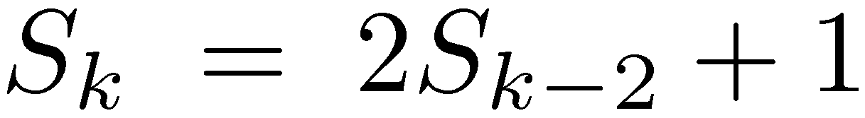


WAVL trees [Haeupler-Sen-Tarjan (2009)]
k
S_{k} – minimal number of nodes in an WAVL tree of rank k
k−2 or k−1
k−2 or k−1
$$S_{0}=1, { S}_{1}=2$$

Slide 48
WAVL Insertion
Exactly like AVL insertion
No 2,2-nodes created
2,2-nodes may be destroyed
(Check this!)
If there are only insertions, WAVL trees are just AVL trees

Slide 49
WAVL deletion

Slide 50
WAVL Deletion
New cases to consider
Deletion becomes somewhat simpler
Rotations are now terminal cases

Slide 51
WAVL Deletion
Deleting a leaf y
1
1
z
z
1
1
1
2
0
y
u
0
0
y
−1
1
1
z
z
2
1
2
2
−1
x
u
0
−1
x
−1
Problem! (Why?) (Demote z)

Slide 52
WAVL Deletion
Deleting a leaf y
1
1
2
z
z
z
1
1
1
2
2
1,2
0
y
u
0
0
y
−1
0
y
u
0,1
1
0
2,3
2
z
z
z
2
1
1
1
3
1,2
−1
x
u
0
−1
x
−1
−1
x
u
0,1
Demote z (May cause a problem)
Problem

Slide 53
WAVL Deletion
Deleting a unary node y
2
2
3
z
z
z
1
1
1
2
2
1,2
1
0,1
1
y
u
0
1
y
2
y
u
u
1
2
1
2
1
2
0
x
−1
0
x
−1
0
x
−1
2
2
3
z
z
z
2
1
2
2
3
1,2
0
x
u
0,1
0
x
u
0
0
x
u
2
Problem

Slide 54
WAVL: Deletion rebalancing cases
4 cases (up to symmetry)
k+3
z
3
2
k
x
y
k+1
Case 1: Demote
k+3
k+3
k+3
z
z
z
3
1
3
1
3
1
k
k+2
k
x
y
k+2
k
x
y
y
k+2
x
2
2
1,2
1
1
2
k
a
b
k
k,k+1
a
b
k+1
k+1
b
a
k
Case 2: Double Demote
Case 3: Rotate
Case 4: Double Rotate

Slide 55
WAVL: Rebalancing after deletion
Case 1: Demote
k+3
z
k+2
z
3
2
2
1
k
x
y
k+1
k
x
y
k+1
Problem is either fixed or moved up

Slide 56
WAVL: Rebalancing after deletion
Case 2: Double demote
k+3
z
k+2
z
3
1
2
1
k
x
y
k+2
k
x
y
k+1
2
2
1
1
k
a
b
k
k
a
b
k
Demote z and y
Problem either solved or moved up

Slide 57
WAVL: Rebalancing after deletion
Case 3: Rotate
k+3
z
k+3
y
3
1
1
2
k
k+2
k+2
z
b
k+1
x
y
1,2
1
2
1,2
k,k+1
a
b
k+1
k
x
a
k,k+1
If z is a 2,2-leaf, demote it

Slide 58
WAVL: Rebalancing after deletion
Case 4: Double Rotate
k+3
z
k+3
a
3
1
2
2
k
y
k+2
x
k+1
z
k+1
y
1
2
1
1
k+1
b
a
k
k
x
c
d
b
k
d
c

Slide 59
WAVL Insertion/Deletion - Summary
# promotions/demotions ≤ height = O(log n)
Number of rotations ≤ 2
Worst-case time = O(height) = O(log n)
What is the amortized number of rebalancing steps?
Notes:
We insert a new node x as a child of a unary node y. We initially give x rank 0. Everything is ok.
Again, the potential of y becomes 1.

Slide 60
WAVL Insertion/Deletion Amortized number of balancing steps
Potential = Φ = ???
Insertions/Deletions themselves increase the potential by at most a constant
Non-terminal Promotions/Demotions steps decrease the potential
Terminal step increase the potential by at most a constant
amort( #steps ) = O(1)
Notes:
We insert a new node x as a child of a unary node y. We initially give x rank 0. Everything is ok.
Again, the potential of y becomes 1.

Slide 61
Cases that need to decrease potential
k+1
u
k+1
u
1
0
k
z
k+1
z
0
1
1
2
k
x
y
k−1
k
x
y
k+1
k+5
u
k+5
u
2
3
k+3
z
k+2
z
3
2
2
1
k
x
y
k+1
k
x
k+1
y
k+5
k+5
u
u
2
3
k+3
z
k+2
z
3
1
2
1
k
x
y
k+2
k
x
y
k+1
2
2
1
1
k
a
b
k
k
a
b
k

Slide 62
WAVL Insertion/Deletion Amortized number of balancing steps
Potential = Φ = (number of 1,1-nodes) + 2 × (number of 3,2 and 2,2-nodes)
Insertions/Deletions themselves increase the potential by at most a constant
Non-terminal Promotions/Demotions steps decrease the potential
Terminal step increase the potential by at most a constant
amort( #steps ) = O(1)
Notes:
We insert a new node x as a child of a unary node y. We initially give x rank 0. Everything is ok.
Again, the potential of y becomes 1.

Slide 63
WAVL: Rebalancing after insertion
Non-terminal Promote
k+1
u
k+1
u
1
0
k
z
k+1
z
0
1
1
2
k
x
y
k−1
k
x
y
k+1
Potential of u drops from 1 to 0: ΔΦ = −1
Notes:
The potential of z drops from 1 to 0. If this is not the final step, then the potential of the parent of z does not increase. If this is the last step, then the parent of z becomes 1,1 and gets one unit of potential.

Slide 64
WAVL: Rebalancing after deletion
Non-terminal Demote
k+5
u
k+5
u
2
3
k+3
z
k+2
z
3
2
2
1
k
x
y
k+1
k
x
y
k+1
Potential of z drops from 2 to 0: ΔΦ = −2
Potential of u (and of x,y) does not change

Slide 65
WAVL: Rebalancing after deletion
Non-terminal Double Demote
k+5
u
k+5
u
2
3
k+3
z
k+2
z
3
1
2
1
k
x
y
k+2
k
x
y
k+1
2
2
1
1
k
a
b
k
k
a
b
k
Potential of y drops from 2 to 1: ΔΦ = −1

Slide 66
AVL vs. WAVL
 | Depth | Number of Rotations per update | Amortized cost of rebalancing
AVL | 1.45 log₂n | O(log n) | O(log n)
WAVL | 2 log₂n | 2 | O(1)
Theorem: The depth of a WAVL tree generated by a sequence of m insertions, and an arbitrary number of deletions, is at most log_{φ} m ≤ 1.45 log₂m

Slide 67
Joining and Splitting binary search trees

Slide 68
Joining two binary search trees
T₁
x
T₂
y
z
Join(T₁,x,T₂)
Suppose that all keys in T₁ are less than x.key and that all keys in T₂ are greater than x.key
The tree formed is a valid search tree, but may be very unbalanced, even if T₁ and T₂ are balanced

Slide 69
Joining two (W)AVL trees efficiently
Assume rank(T₁) ≤ rank(T₂)
T₂
k+1
c
k+1,k+2
T₁
x
k
a
b
k,k−1
Join(T₁,x,T₂)
b – first vertex on the left spine of T₂ with rank ≤ k
Do rebalancing from x, if needed
O(log n) time
O( rank(T₂) − rank(T₁) + 1 ) time (if ranks maintained explicitly)

Slide 70
Splitting
a
b
E
c
F
x
A
d
e
G
c
a
e
b
E
B
f
A
d
F
C
x
B
f
D
H
C
D
H
G

Slide 71
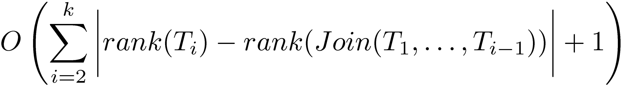
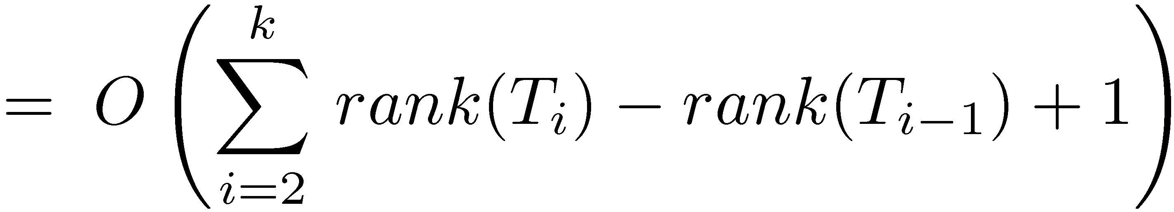
Splitting with efficient joins
Suppose we need to join T₁ ,T₂ ,…,T_{k} where rank(T₁) ≤ rank(T₂) ≤ … ≤ rank(T_{k})
Suppose rank(Join(T₁,…,T_{i})) ≤ rank(T_{i}) + c

Slide 72
Rank and Select

Slide 73
Additional dictionary operations
Select(D,i) – Return the i-th largest item in D (indices start from 0)
Rank(D,x) – Return the RANK of x in D, (i.e., the number of items x is larger than)
Can we still use (W)AVL trees?
Keep sub-tree sizes!

Slide 74
Caution!
Rank now has two meanings…
Which is unfortunate…
This is the established terminology…

Slide 75
Sub-tree sizes
10
3
6
1
1
3
2
1
1
1
x.size = x.left.size + x.right.size + 1
EXT.size = 0

Slide 76
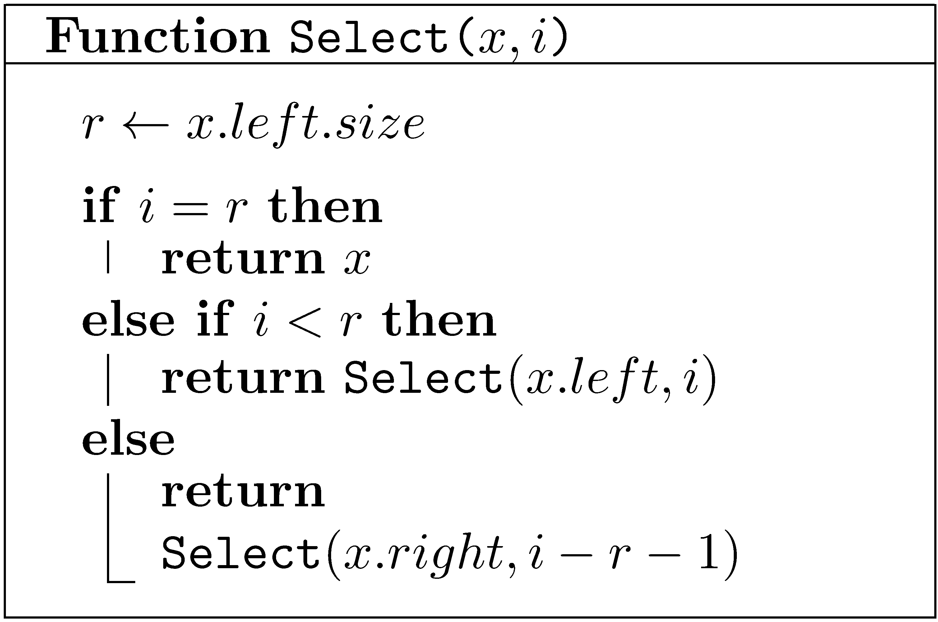
Selection
Note: 0 ≤ i < n

Slide 77
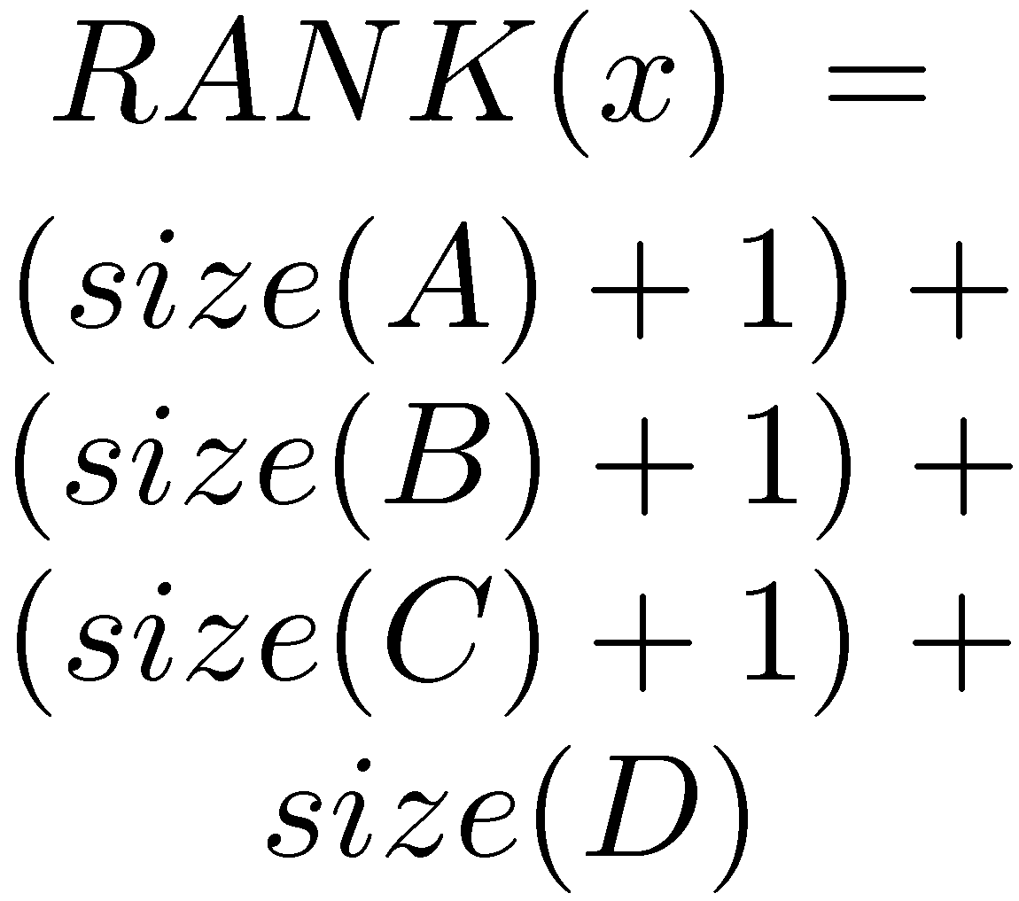
RANK
a
b
E
c
F
A
d
e
G
B
f
C
x
D
H

Slide 78
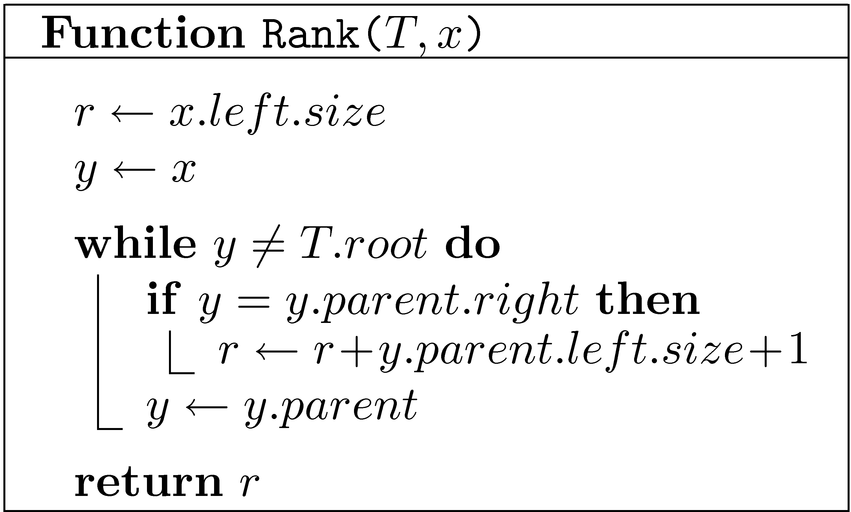
RANK
Recall that EXT.size=0

Slide 79
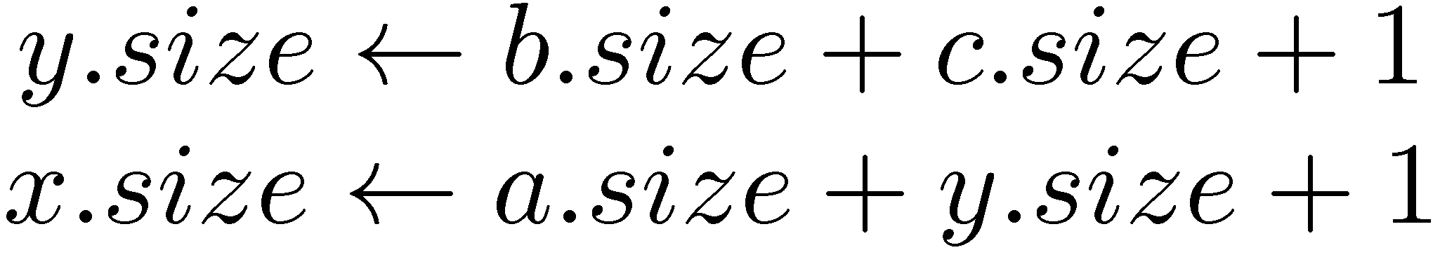
Easy to maintain sizes
y
x
Right rotate
x
c
a
y
C
A
a
b
b
c
A
B
C
B

Slide 80
Finger Search trees
Maintain a pointer to the minimum element
Select(T,k) in O(log k) time
T

Slide 81
Lists as Trees
[ a b c d e f ]
3
d
0
a
1
b
4
e
1
b
0
a
c
5
f
4
e
2
3
d
5
f
2
c

Slide 82
Lists as Trees
Maintain the items in a tree: i-th item in node of rank i
List-Node → Tree-Node
Tree-Nodes have no explicit keys (Implicitly maintained ranks play the role of keys)
Retrieve(i) → Select(i)
Select, Insert-Rebalance and Delete-Rebalance do not use keys

Slide 83
Lists as Trees: Insert
To insert a node z in the i-th position, where 0≤i<n:
Find the current node of rank i.
If it has no left child, make z its left child.
Otherwise, find its predecessor
and make z its right child.
To insert a node z in the last position (i=n):
Find the last node and
make z its right child
Fix the tree

Slide 84
Lists as Trees: Delete
Delete a node z in the same way a node is removed from a search tree

Slide 85
Implementation of lists
 | Circular arrays | Doubly Linked lists | Balanced Trees
Insert/Delete- First/Last | O(1) | O(1) | O(log n)
Insert/Delete(i) | O(i+1) | O(i+1) | O(log n)
Retrieve(i) | O(1) | O(i+1) | O(log n)
Concat | O(n+1) | O(1) | O(log n)
Split(i) | O(i+1) | O(i+1) | O(log n)
O(i+1) can be replaced by O(min{i+1,n−i})

Slide 86
Splay Trees (Self-adjusting trees) [Sleator-Tarjan (1983)]
Do not maintain any balance!
When a node is accessed, splay it to the root
A node is splayed using a sequence of zig-zig and zig-zag steps
Amortized cost of each operation is O(log n)
Total cost of n operation is O(n log n)
Many other amazing properties

Slide 87
Zig-Zig
z
x
y
D
y
A
x
C
z
B
A
B
D
C
Rotate y-z left, then rotate x-y left

Slide 88
Zig-Zag
z
x
y
A
z
y
D
x
A
B
C
D
C
B
Rotate x-y right, then rotate x-z left

Slide 89
Splaying (example)
i
i
i
h
J
h
J
h
J
g
I
g
I
g
I
f
H
f
H
f
H
A
e
A
e
A
a
d
G
d
G
d
e
B
c
B
a
B
b
F
G
C
b
F
b
c
E
D
a
c
E
C
D
E
F
D
C

Slide 90
Splaying (example cont)
i
i
h
a
J
h
J
g
I
h
a
I
f
f
H
g
i
f
A
d
e
H
I
J
A
a
g
e
B
b
F
G
d
e
A
d
H
F
G
c
E
b
F
G
B
b
B
c
C
D
c
E
E
C
D
C
D

Slide 91
Splay Trees (Self-adjusting trees) [Sleator-Tarjan (1983)]
Amortized cost of each operation is O(log n)
Total cost of n operation is O(n log n)
Many other amazing properties
Some intriguing open problems
Play with them yourself:
http://webdiis.unizar.es/asignaturas/EDA/AVLTree/avltree.html

