Slide 1
BCA · SEMESTER 3 · VSIT,VIPS
Vocational
Training
Course
Vocational / Skill-Based Summer Training | 36+ Hour Certification Module

Slide 2
TOPIC
Hospital Billing & Operations Analytics
BCA · SEMESTER 3 · VSIT,VIPS
NAME
Saarth
ROLL NO.
05329802025
Vocational
Training
Course
CLASS
BCA - Section EA
COLLEGE
Vivekananda Institute of Professional Studies (VSIT)
A 5-Tool Data Pipeline: Python -> MySQL -> Matplotlib -> Excel -> Tableau
Vocational / Skill-Based Summer Training | 36+ Hour Certification Module

Slide 3
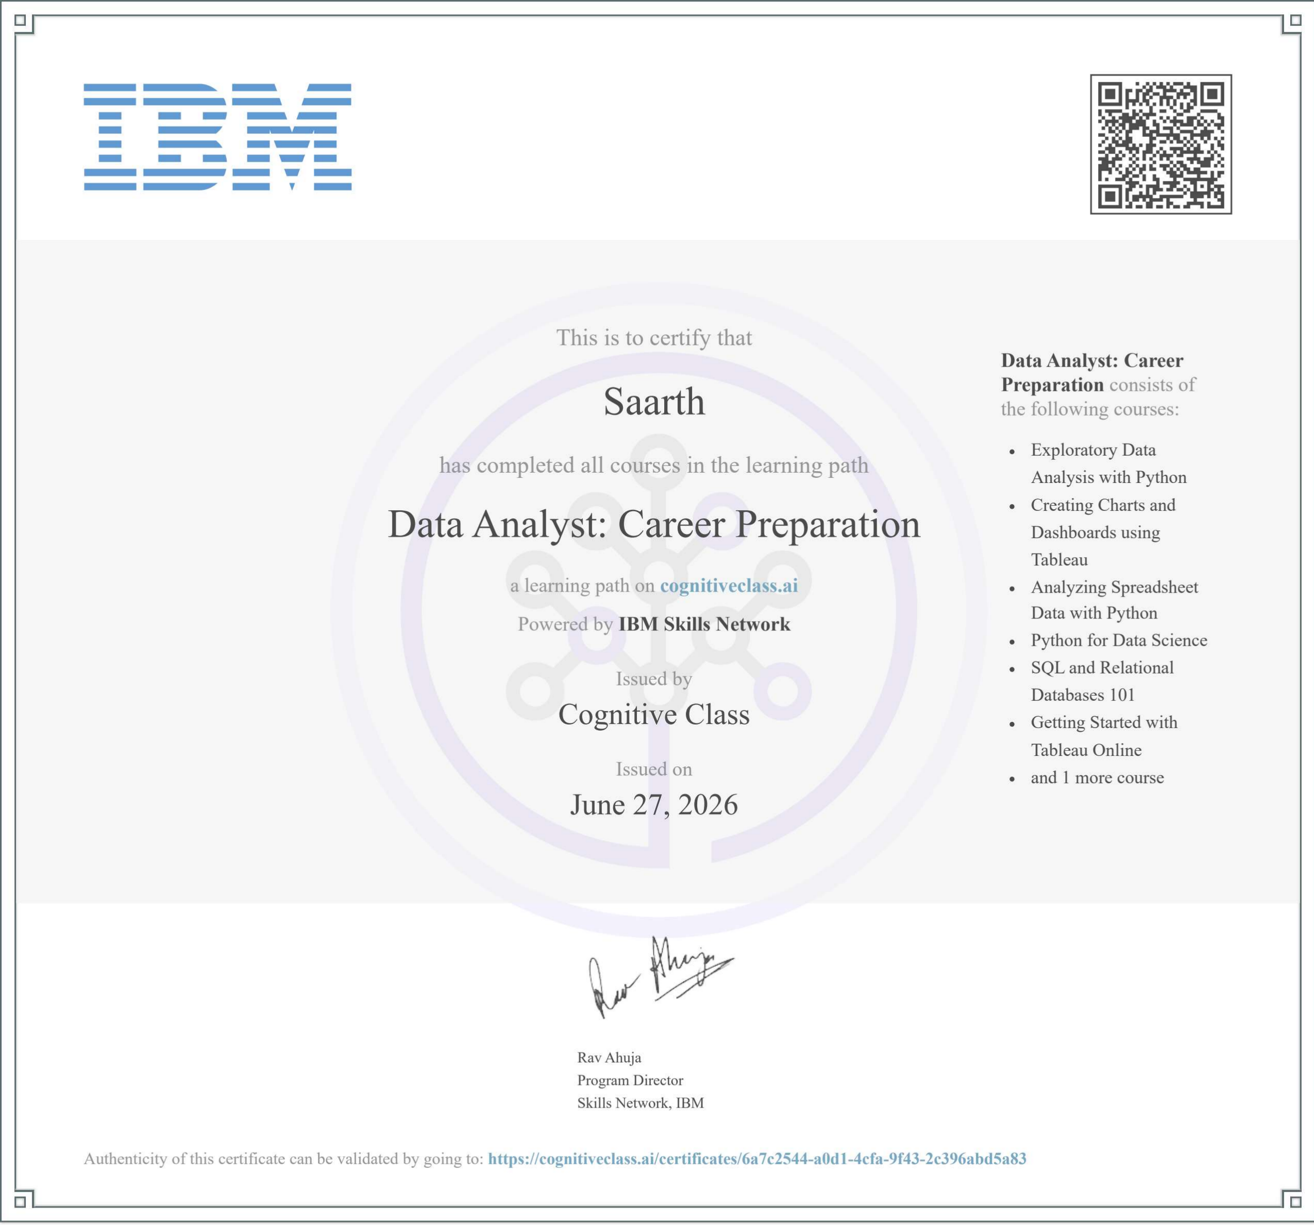
Training
Framework
Certification Pathway &Hours Logged
36 total tracked hours across two certification blocks - exceeding the 30-hour college requirement.
VERIFIED CERTIFICATE
COURSE 1 - IBM DATA ANALYST PATH
SQL and Relational Databases 101
5 hrs
Python for Data Science
18 hrs
Analyzing Spreadsheet Data with Python
2 hrs
Hospital Billing & Operations Analytics
2
Getting Started with Tableau Online
1 hr
Exploratory Data Analysis with Python
1 hr
Data Wrangling Using Python
1 hr
Creating Charts & Dashboards using Tableau
1 hr
TOTAL
36 hrs

Slide 4
Training
Framework
Certification Pathway & Hours Logged
36 total tracked hours across two certification blocks - exceeding the 30-hour college requirement.
VERIFIED CERTIFICATE
COURSE 2 - MS EXCEL
COURSE 1 - IBM DATA ANALYST PATH
SQL and Relational Databases 101
5 hrs
Python for Data Science
18 hrs
Analyzing Spreadsheet Data with Python
2 hrs
Getting Started with Tableau Online
1 hr
Exploratory Data Analysis with Python
1 hr
Data Wrangling Using Python
1 hr
Creating Charts & Dashboards using Tableau
1 hr
TOTAL
36 hrs
Hospital Billing & Operations Analytics
2

Slide 5

VERIFIED CERTIFICATE
COURSE 2 - MS EXCEL
Introduction to MS Excel - Simplilearn
7 hrs
Hospital Billing & Operations Analytics

Slide 6
PROJECT BRIEF
Dataset & Problem Statement
PROBLEM STATEMENT
Raw hospital billing logs contain blanks, duplicate records, and unformatted columns. This project builds a clean data pipeline to optimize resource loads and track revenue across clinical wings.
DATASET
Healthcare Dataset by Prasad Patil - Kaggle | ~55,000 patient records
kaggle.com/datasets/prasad22/healthcare-dataset
KEY COLUMNS
- Name, Age, Gender, Blood Type
- Medical Condition, Test Results
- Date of Admission, Discharge Date
- Doctor, Hospital, Insurance Provider
- Billing Amount, Room Number
- Admission Type, Medication
Hospital Billing & Operations Analytics
3

Slide 7
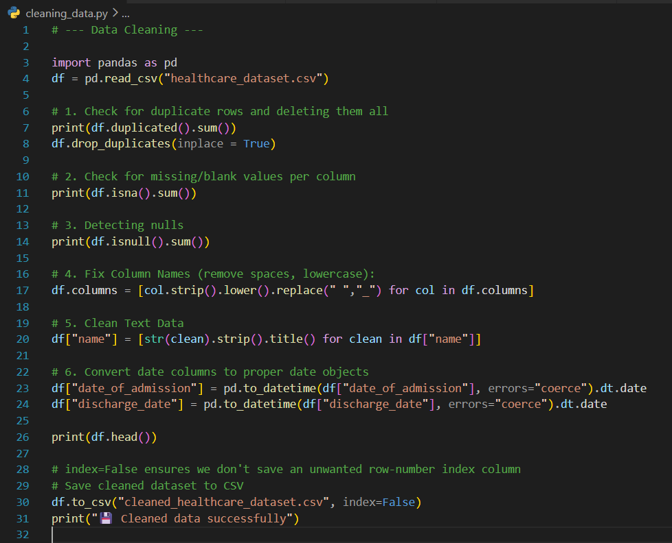
TASK 1 :-
Cleaning the Raw CSV in Python
cleaning_data.py - removes duplicates, handles nulls, standardizes column names and text, fixes date types, then saves a clean CSV checkpoint.
Hospital Billing & Operations Analytics
4

Slide 8
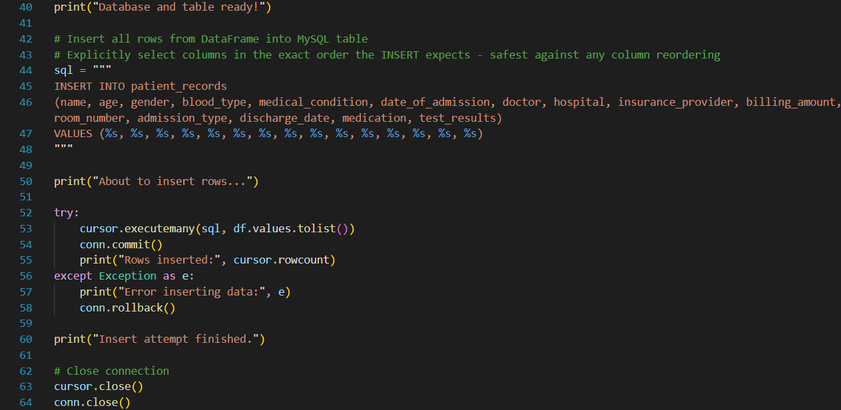
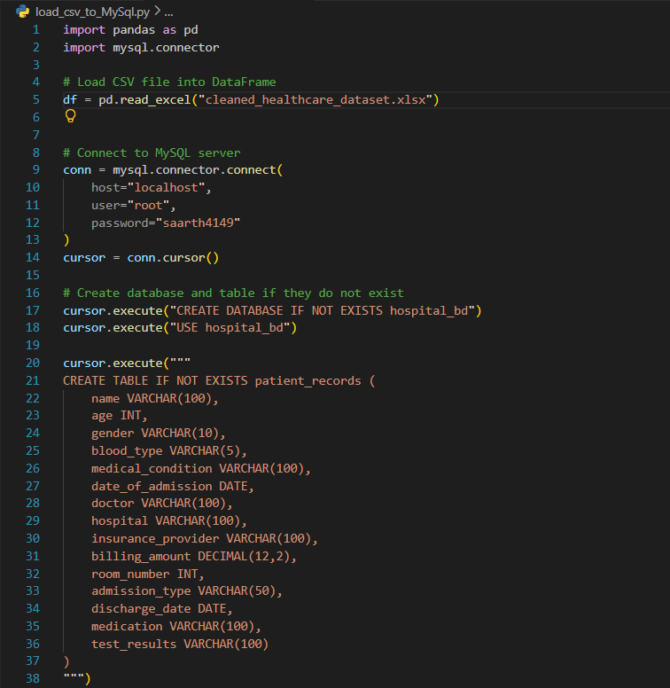
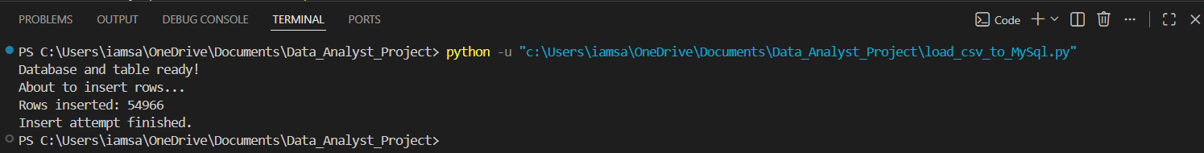
TASK 2 :-
Loading Clean Data into MySQL
load_csv_to_MySql.py - connects to MySQL, creates the database/table schema, then inserts all cleaned rows via executemany().
54,966 clean rows successfully inserted
Hospital Billing & Operations Analytics
5

Slide 9
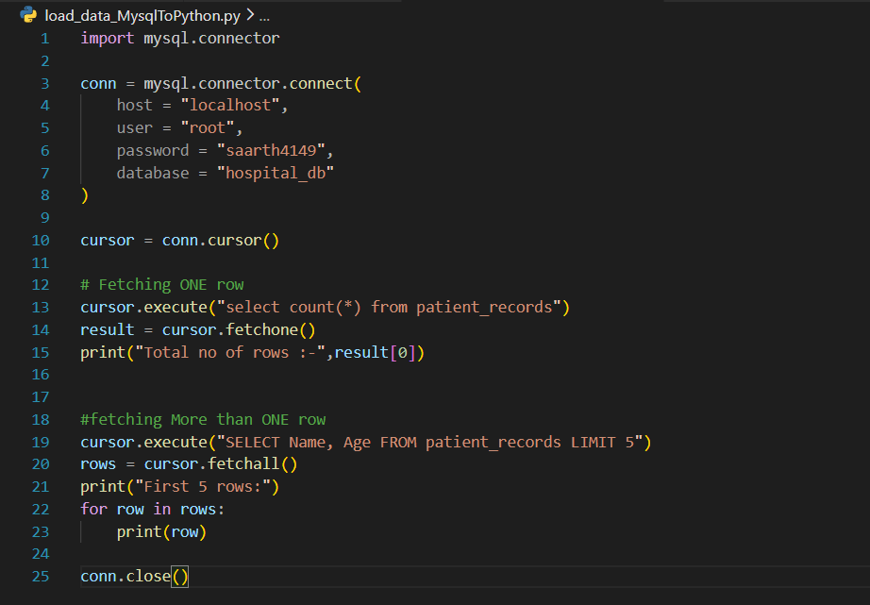
TASK 3 :-
Reading MySQL Data Back into Python
load_data_MysqlToPython.py - mysql.connector pulls live records from patient_records, proving the DB is genuinely queried, not just written to once.
Hospital Billing & Operations Analytics
6

Slide 10
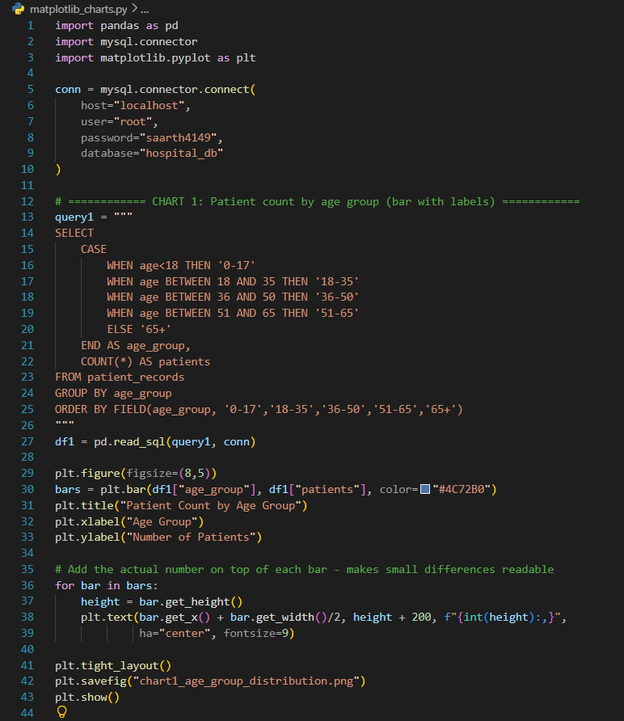
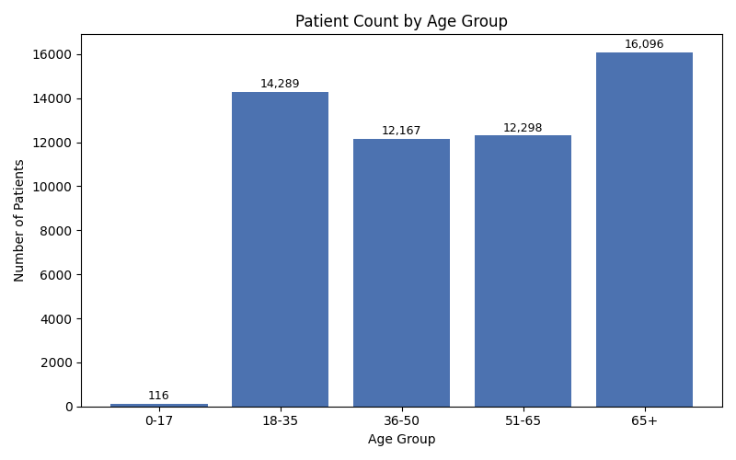
TASK 4 :-
Generating Charts with Matplotlib
matplotlib_charts.py - pulls each summary directly from MySQL via pd.read_sql(), then plots and saves 4 verification charts.
Patient Count by Age Group
Hospital Billing & Operations Analytics
7

Slide 11
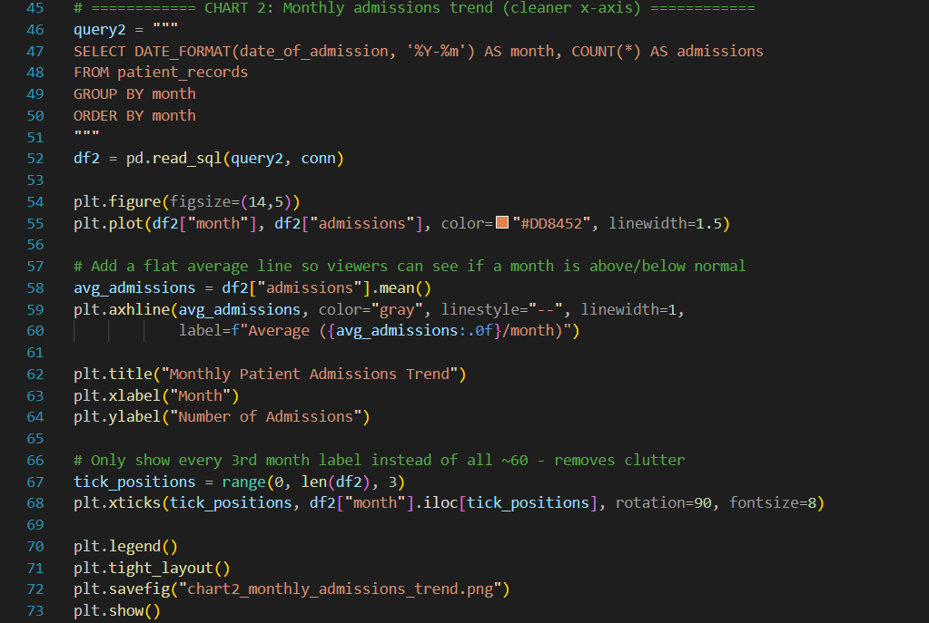
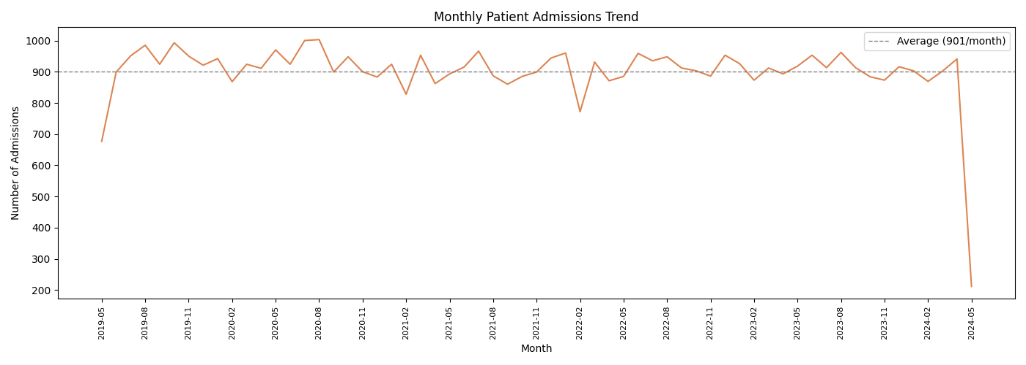
Monthly Admissions Trend
Hospital Billing & Operations Analytics

Slide 12
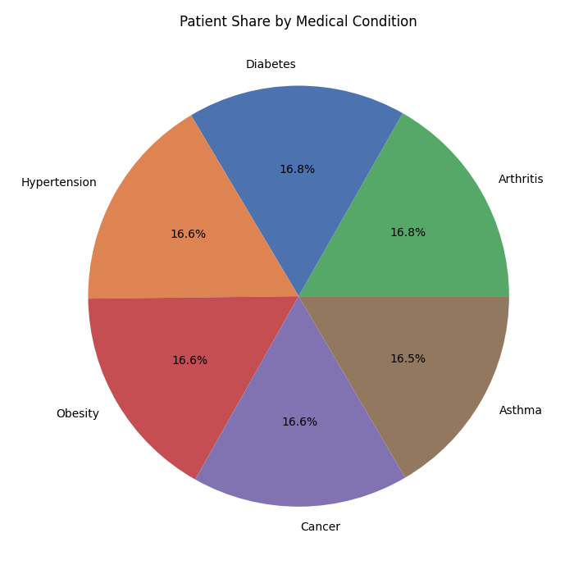
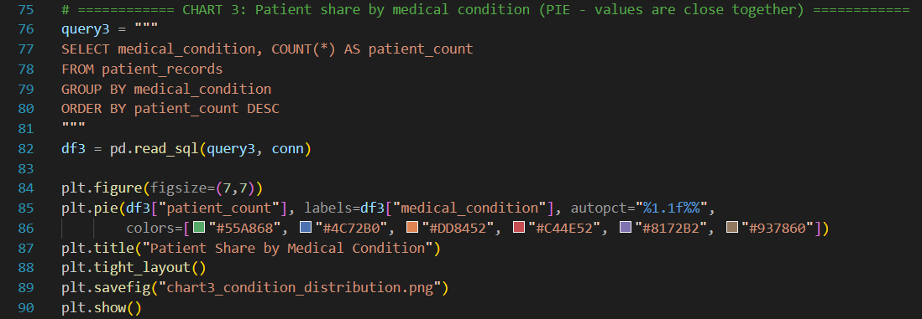
Patient Share by Condition
Hospital Billing & Operations Analytics

Slide 13
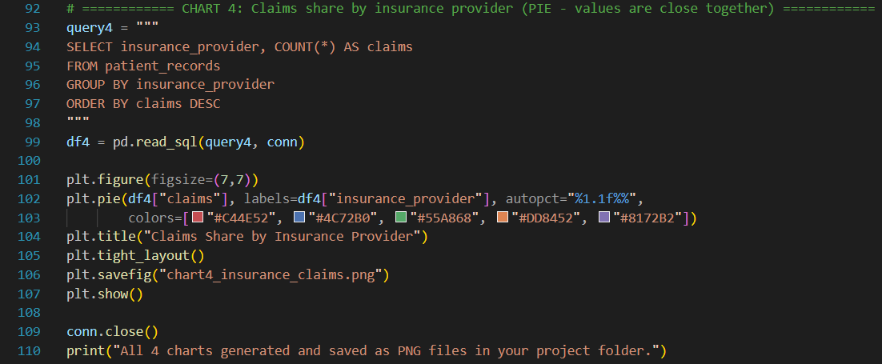
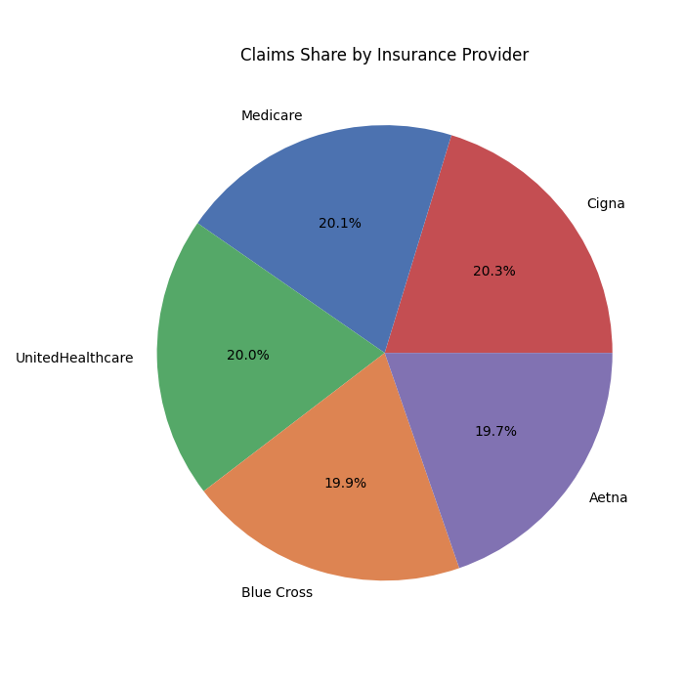
Claims Share by Insurance Provider
Hospital Billing & Operations Analytics

Slide 14
TASK 5 :-
Excel: Building the Reporting Layer
Cleaned data from MySQL is exported into Excel, where it's structured into a formatted table, then summarized through Pivot Tables and their charts.
WHAT WAS BUILT
Hospital_Clean_Report.xlsx -- the cleaned dataset is loaded into a structured Excel Table (with headers, banding, and frozen top row), forming the base layer for all reporting that follows.
View file: cleaned_healthcare_dataset_with_pivot.xlsx
PIVOT TABLES & CHARTS BUILT
1
2
3
Pivot_Condition
Pivot_Admission
Pivot_Insurance
Avg. billing & patient count by medical condition, visualized as a column chart
Medical Condition x Admission Type cross-tab, visualized as a clustered column chart
Claims volume & total revenue by insurance provider, visualized as a column chart
Hospital Billing & Operations Analytics
9

Slide 15
Pivot Chart:-
Excel Pivot Table:-
Row Labels | Count of billing_amount | Average of billing_amount
Arthritis | 9,218 | 25,511.8
Diabetes | 9,216 | 25,660.5
Hypertension | 9,151 | 25,503.1
Obesity | 9,146 | 25,804.4
Cancer | 9,140 | 25,152.3
Asthma | 9,095 | 25,633.5
Grand Total | 54,966 | 25,544.3
Hospital Billing & Operations Analytics

Slide 16
Pivot Chart:-
Excel Pivot Table:-
Row Labels | Elective | Emergency | Urgent | Grand Total
Arthritis | 25,479.59 | 25,497.11 | 25,558.38 | 25,511.78
Asthma | 25,253.91 | 25,893.70 | 25,761.37 | 25,633.46
Cancer | 25,671.84 | 24,867.22 | 24,900.21 | 25,152.32
Diabetes | 26,032.12 | 25,471.61 | 25,484.65 | 25,660.48
Hypertension | 25,555.09 | 25,471.37 | 25,479.25 | 25,503.06
Obesity | 25,687.73 | 25,820.55 | 25,903.82 | 25,804.36
Grand Total | 25,612.14 | 25,505.33 | 25,514.53 | 25,544.31
Hospital Billing & Operations Analytics

Slide 17
Pivot Chart:-
Excel Pivot Table:-
Row Labels | Elective | Emergency | Urgent | Grand Total
Arthritis | 25,479.59 | 25,497.11 | 25,558.38 | 25,511.78
Asthma | 25,253.91 | 25,893.70 | 25,761.37 | 25,633.46
Cancer | 25,671.84 | 24,867.22 | 24,900.21 | 25,152.32
Diabetes | 26,032.12 | 25,471.61 | 25,484.65 | 25,660.48
Hypertension | 25,555.09 | 25,471.37 | 25,479.25 | 25,503.06
Obesity | 25,687.73 | 25,820.55 | 25,903.82 | 25,804.36
Grand Total | 25,612.14 | 25,505.33 | 25,514.53 | 25,544.31
Hospital Billing & Operations Analytics

Slide 18
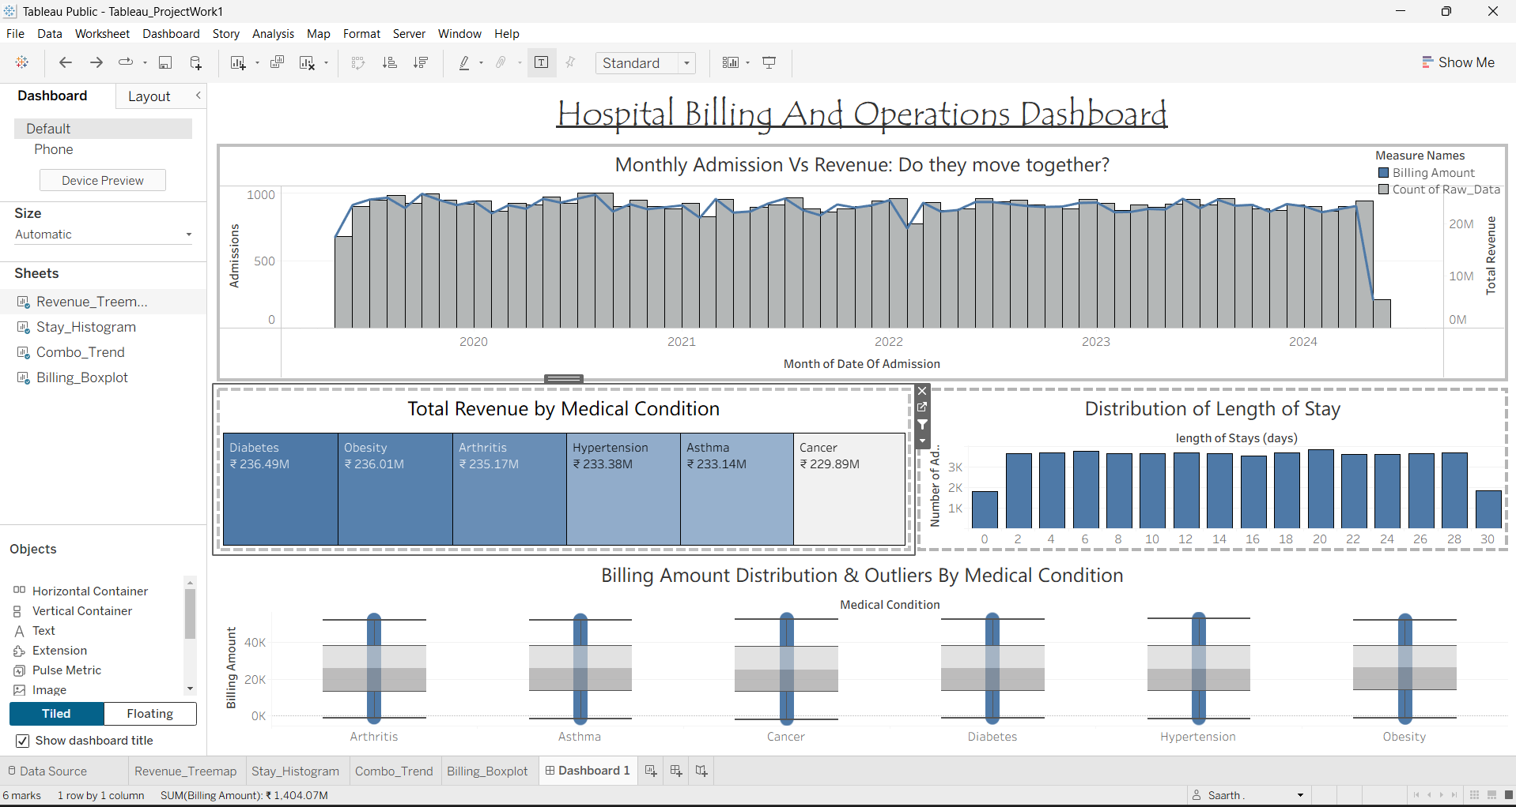
TASK 6 :-
Excel Pivot Tables -> Tableau Dashboard
Cleaned MySQL data feeds Excel for structured Pivot Table reporting, then Tableau for a live, interactive executive dashboard.
TABLEAU - LIVE DASHBOARD
EXCEL
Hospital_Clean_Report.xlsx
Pivot_Condition
Avg. billing & patient count by medical condition
Pivot_Admission
Condition x Admission Type cross-tab
Pivot_Insurance
Claims volume & revenue by provider
Hospital Billing & Operations Analytics
9

Slide 19
Summary & Key Learnings
Pipeline Integration
Successfully connected 5 tools - MySQL, Python, Matplotlib, Excel, Tableau - into one coherent, reproducible workflow rather than isolated exercises.
1
Honest Statistical Finding
Billing amount and length of stay show minimal variance across condition, admission type, age, and insurance - a genuine synthetic-data property, reported rather than forced into a false narrative.
2
Volume Drives Revenue
Since per-patient billing is nearly constant, total monthly revenue tracks patient admission volume almost directly - confirmed visually via the dual-axis combo chart.
3
Real-World Data Skills
Practiced core professional habits: duplicate/null handling, format normalization, SQL aggregation, and choosing the right chart type for what the data actually shows.
4
Thank you.

