Slide 1
CASE STUDY: REVENUE INSIGHTS IN THE HOSPITALITY DOMAIN

Slide 2
BUSINESS OBJECTIVE
AtliQ is a company that owns multiple hotel chains across various cities of India
The Managing director / CEO of AtliQ wants to incorporate ‘Business and Data Intelligence’ to identify and track the source of revenue for AtliQ hotels
Hence, it is decided to develop a KPI Dashboard for AtliQ, using May-22 to July-22 data, which can help track its revenue sources and other relevant KPIs across various dimensions
It’ll help the management take strategic business decisions based on the insights generated from the dashboard

Slide 3
PROBLEM STATEMENT / PROJECT SCOPE
Identify the data sources pertaining to revenue management
Clean and model the data as per requirement for analysis
Create a revenue dashboard that measures important KPIs
Relevant filters need to provided to slice and dice the data
The dashboard should depict both high level and granular insights

Slide 4
SOLUTION APPROACH
There are 5 tables provided for tracking revenue, 3 dimension tables (date, hotel, room) and 2 fact tables (bookings, aggregated bookings)
Power BI was the tool used for creating the visualization/dashboard
The data was imported, analysed and transformed as per necessity within Power Query
The relationships between the tables were created within Power Pivot

Slide 5
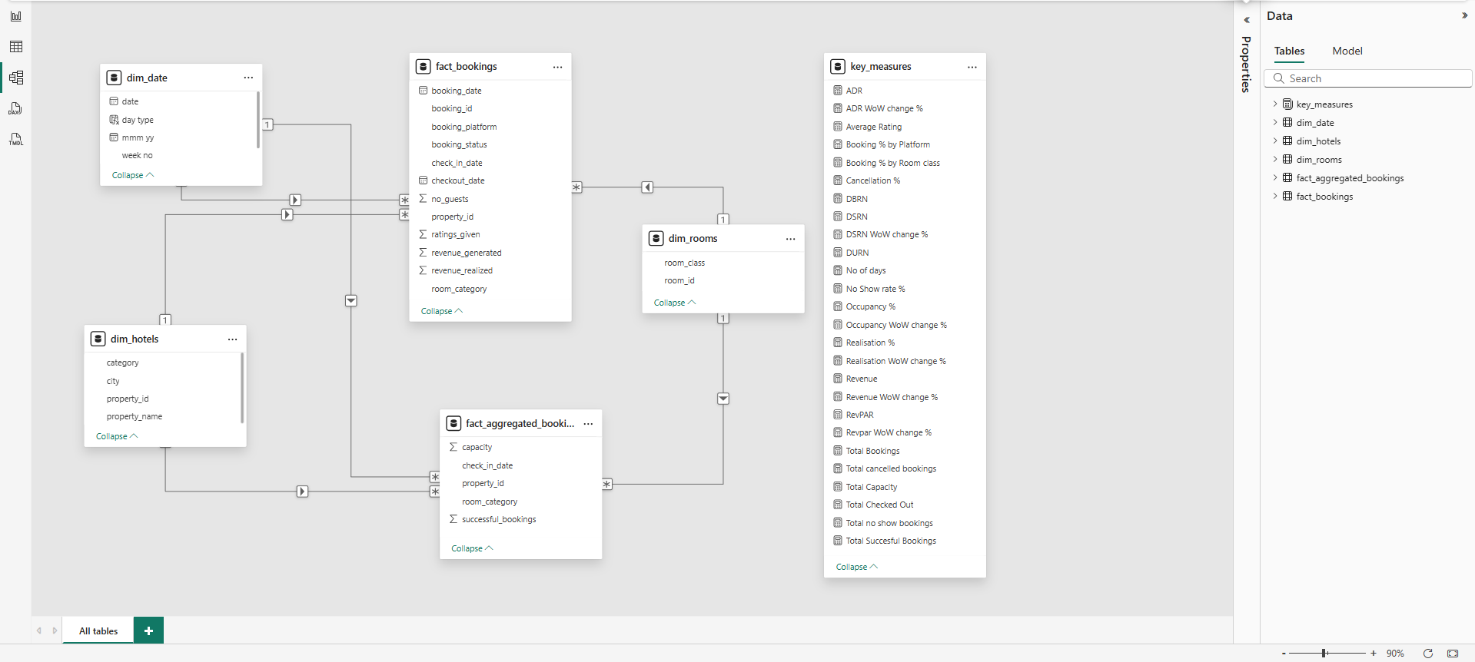
DATA MODELLING IN POWER PIVOT

Slide 6
SOLUTION APPROACH
Measures were created to calculate the KPIs. Few of them are shown below:
Revenue = Sum of revenue_realized from Bookings table (in Rs.)
Total bookings = Count of booking_id from Bookings table
Avg rating = Average of ratings from Bookings table
Total capacity = Sum of capacity from Aggregated bookings table
Total successful bookings = Sum of successful bookings from Aggregated bookings table

Slide 7
SOLUTION APPROACH
Measures were created to calculate the KPIs. Few of them are shown below:
Occupancy rate = Total successful bookings / Total capacity (in %)
Total cancelled bookings = Count of booking_id with status=‘cancelled’ from Bookings table
Cancellation rate = Total cancelled bookings / Total bookings (in %)
Avg stay duration = Average days stayed by customer in a room per booking

Slide 8
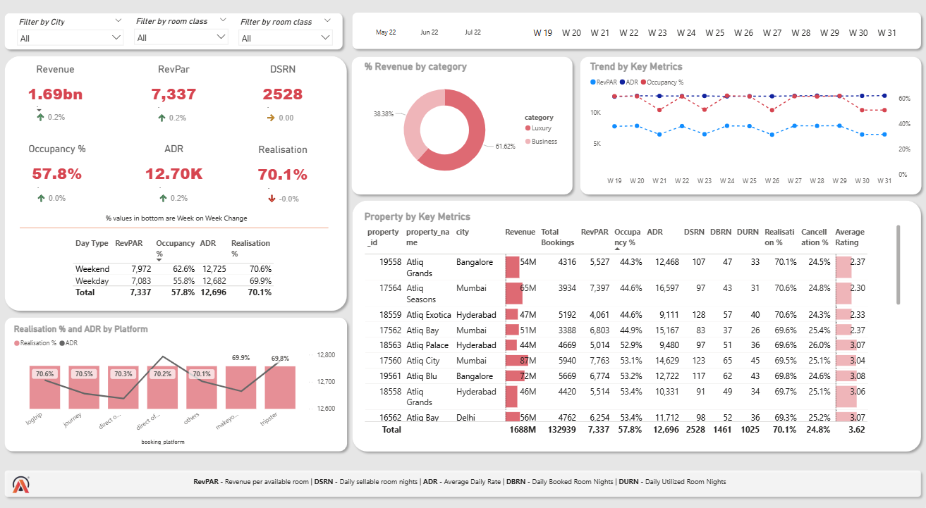
REVENUE DASHBOARD

Slide 9
BUSINESS OUTCOMES
The following are some important business insights derived from the revenue dashboard:
Mumbai generates highest revenue and Delhi the least revenue during May 2022 to July 2022. Company need to focus on increasing the revenue in Delhi.
The occupancy rate is higher during weekends across all cities, months and booking platforms. Leverage this insight to increase revenue generated during weekends.

Slide 10
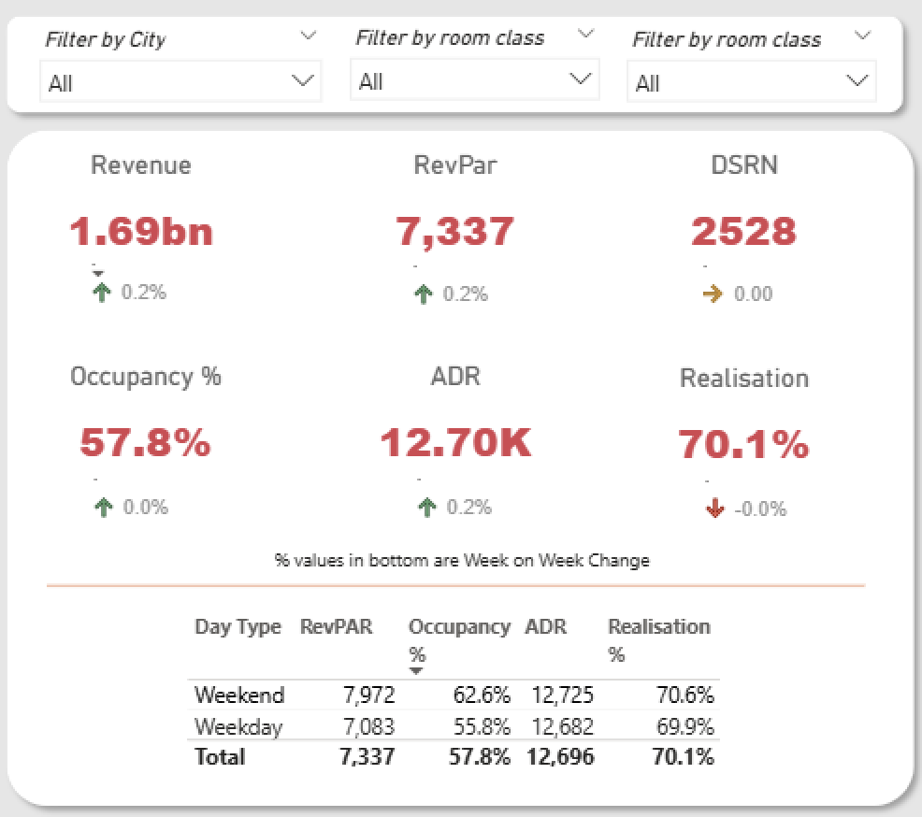
BUSINESS OUTCOMES
The following are some important business insights derived from the revenue dashboard:
When we see this table in isolation, weekday and weekend RevPAR differ only because occupancy changes, while ADR stays almost the same. This indicates the hotels aren’t using weekday/weekend or dynamic pricing. A major opportunity for the chain is to introduce weekday/weekend pricing for their leisure hotels.

Slide 11
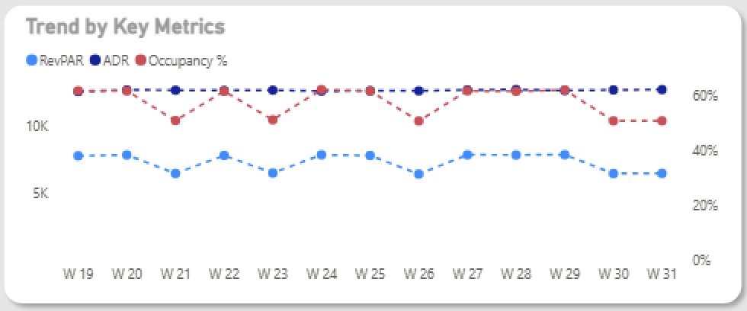
BUSINESS OUTCOMES
The following are some important business insights derived from the revenue dashboard:
Occupancy is fluctuating week to week, which is normal. However, ADR remains almost flat, even during the May–July summer holiday period when prices typically vary due to higher travel. This indicates the hotels are not using dynamic pricing.

Slide 12
THANK YOU!

