Slide 1
Project Presentation of CO-OP Project at Industry (Module-2) (22CS421)
On
ResolveX
Supervised By
Dr. Gurpreet Singh
Department of Computer Science and Engineering,
Chitkara University, Punjab
Saarthak Goyal
2210990756
Saksham Katyal
2210990764

Slide 2
Introduction
In residential societies, educational institutions, and workplaces, complaint handling is often managed through manual registers, phone calls, emails, or informal messaging groups. These traditional methods lead to delays, lack of proper tracking, miscommunication, and loss of important records. Residents and members frequently face difficulties in registering complaints and checking their resolution status. Society management teams also struggle to maintain transparency, assign responsibilities, and communicate announcements effectively. In addition, tasks such as staff management, salary tracking, and role assignment are handled manually,
which increases errors and inefficiency. Therefore, a centralized and structured digital system is required to manage complaints and administrative activities efficiently.
2

Slide 3
Objective
The objective of this project is to develop a Smart Complaint Management System that enables residents to register and track complaints while allowing administrators to manage issues, send announcements, assign roles, monitor staff activities, and maintain organized digital records through a single integrated platform.
3

Slide 4
Proposed Solution
The proposed system is a web-based application designed to simplify and digitize complaint handling and society management operations. Residents can log in to the portal to raise complaints related to plumbing, electricity, maintenance, security, or other issues and track their resolution status in real time. The system includes an admin dashboard that allows authorized personnel to view complaints, assign them to staff members, update status, and monitor progress. The major components of the system include user authentication, complaint registration module, admin control panel, role management system, staff management section, announcement broadcasting feature, and salary management module, which work together to ensure smooth functioning and proper documentation.
4

Slide 5
Key Features
Key features include secure login for residents and administrators, online complaint
submission, issue categorization, real-time tracking, and status updates. The admin dashboard allows sending announcements to all residents, assigning roles to committee members, managing society staff, recording salary payments, and maintaining service logs. The system also stores complaint history for future reference and improves transparency between residents and management.
5

Slide 6
Technology Used​
The system is developed using modern web technologies such as HTML, CSS, JavaScript, and a backend framework integrated with a secure database for storing user data, complaint records, staff details, and salary information. The application follows a structured and user-friendly design approach.
6

Slide 7
Expected Outcome & Benefits
The expected outcome is an efficient, transparent, and user-friendly digital platform that
improves communication between residents and management. It reduces manual workload, ensures faster complaint resolution, and helps administrators manage staff roles, salaries, and announcements from one place. The system maintains proper records, enhances accountability, and supports better decision-making for society operations.
7

Slide 8
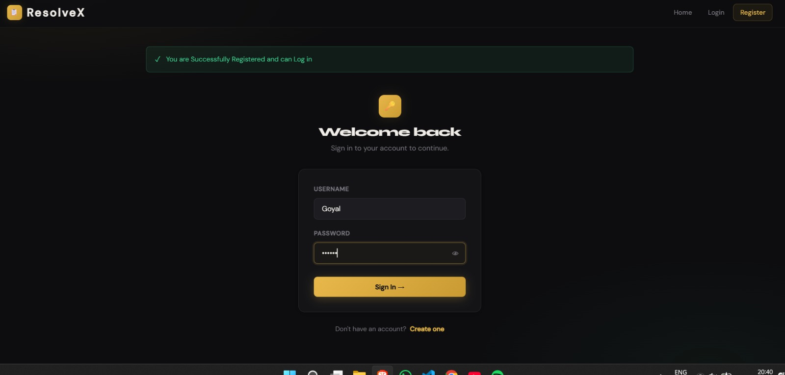
Screenshots
8

Slide 9
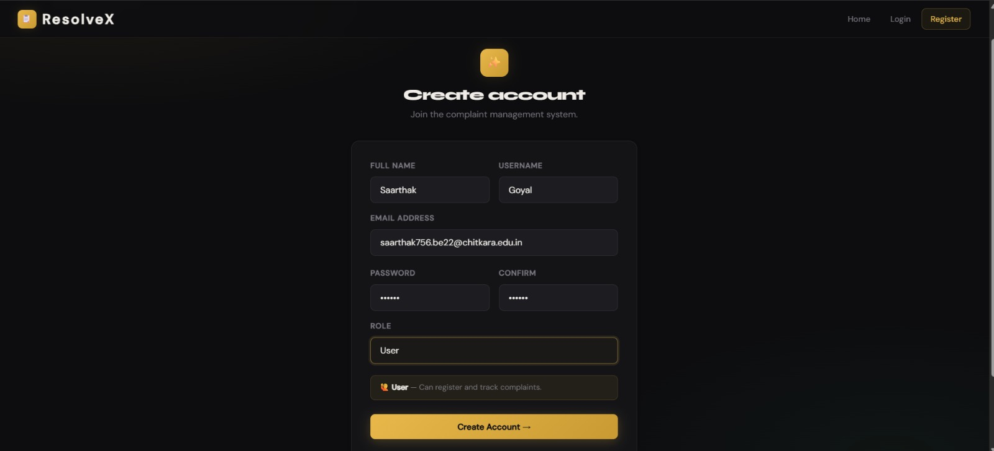
Screenshots
9

Slide 10
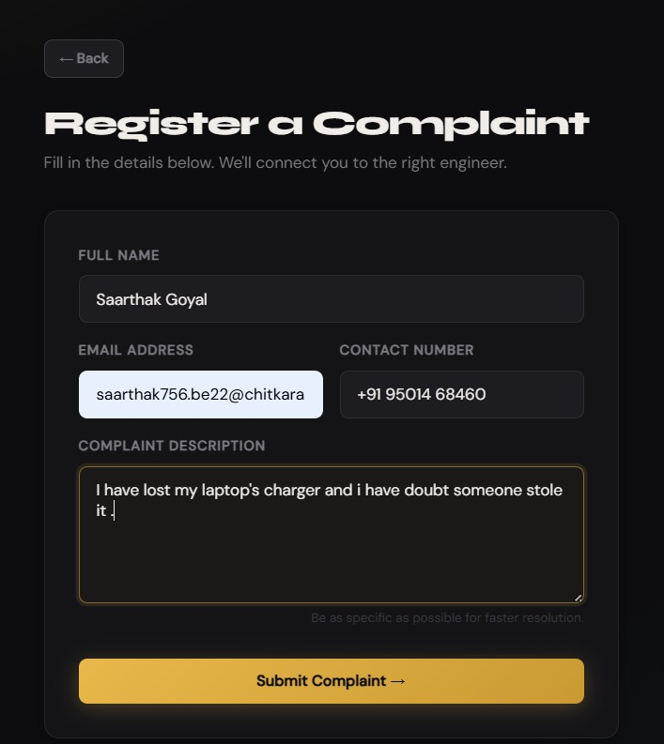
Screenshots
10

Slide 11
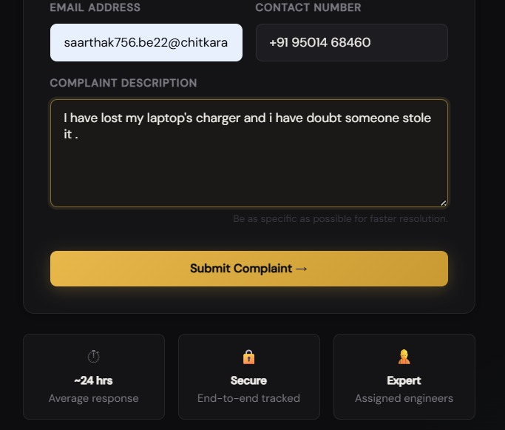
Screenshots
11

Slide 12
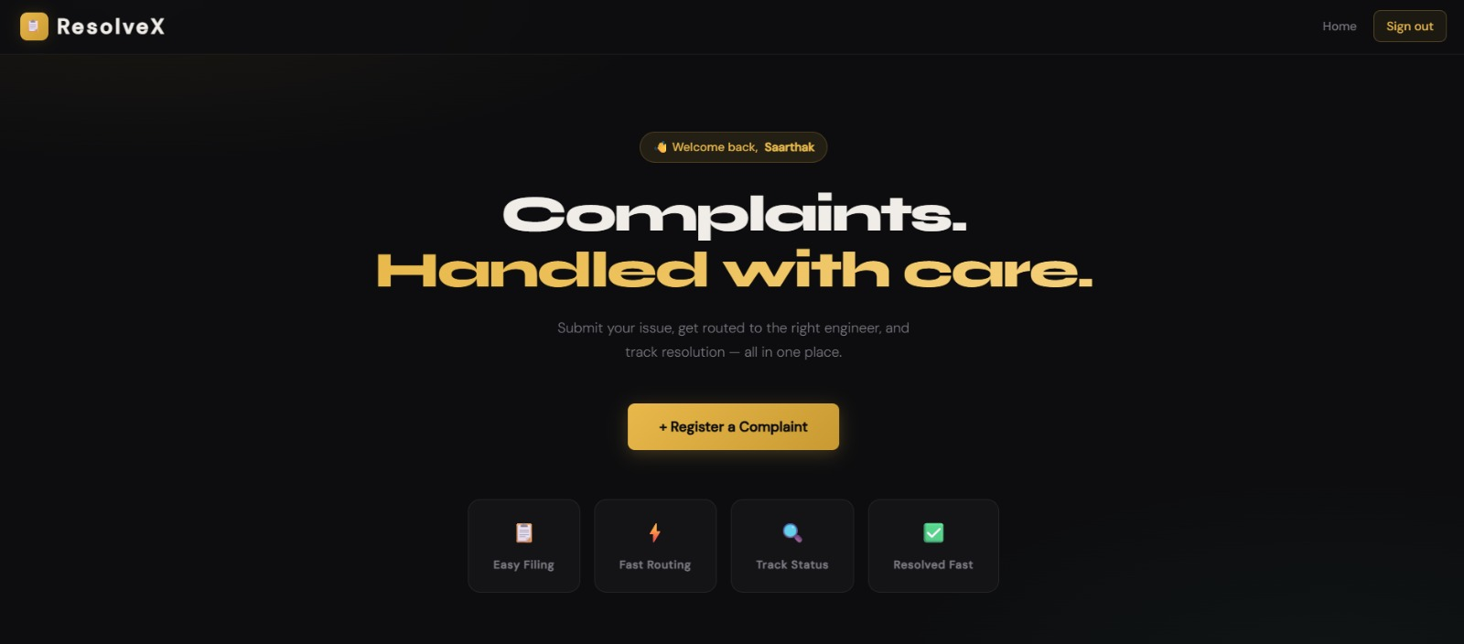
Screenshots
12

Slide 13
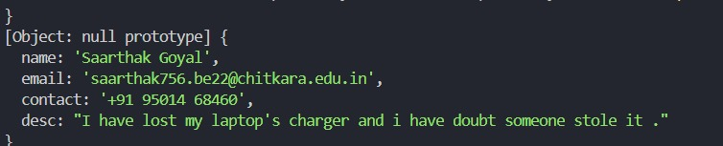

Screenshots
13

Slide 14
Thank You
14

