Slide 1
Thesis discussion
(Thesis based on Emerson project)

Slide 2
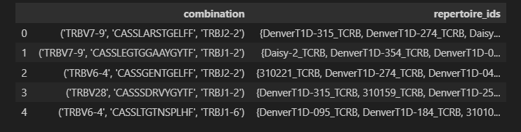
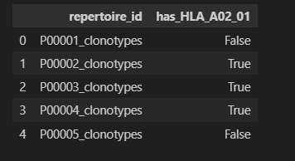
Analysis process
Match patient’s with TCR’s
Read all the patient files and make a dictionary where key = combination, value = list of reperoire_ids
Match HLA-labelling of patient’s
Match the HLA-labelling with the patient files (A_02_01_features.txt contains the indices to the patient files)
*Results obtained using Emerson training dataset

Slide 3
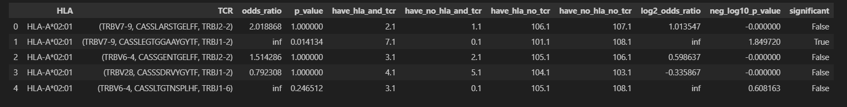
Analysis process
Fisher-exact method
Make a dataframe where every row contains the TCR (combination), the p-value and odds ratio of fisher_exact method (use psuedocount of 0.1)
*Results obtained using Emerson training dataset

Slide 4
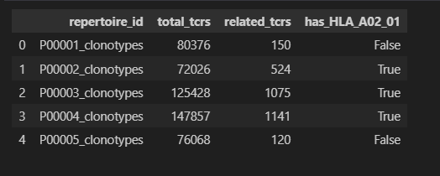
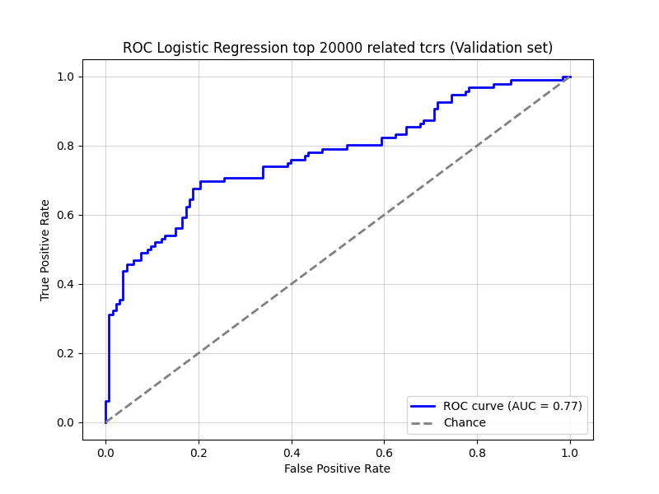
Analysis process
Train a classifier model
Logistic regression model
Features:
#Total TCR’s
#HLA-02.01 related TCR's (from the fisher_exact_results_df where p-value < 0.05 and odds_ratio > 1)
Calculate metrics
ROC
Sensitivity, specificity, accuracy
*Results obtained using Emerson dataset

Slide 5
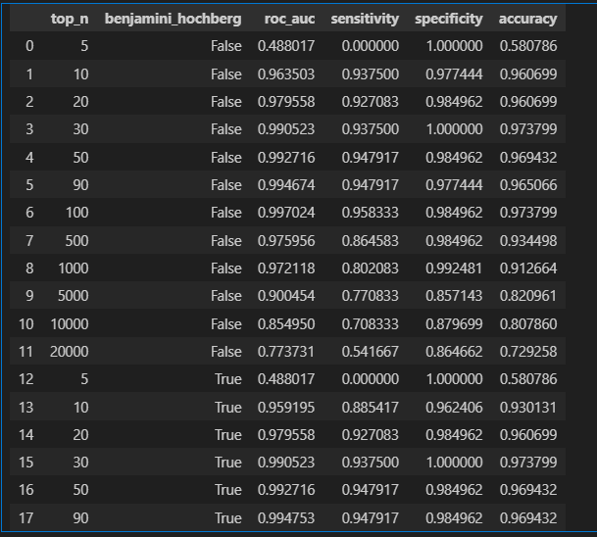
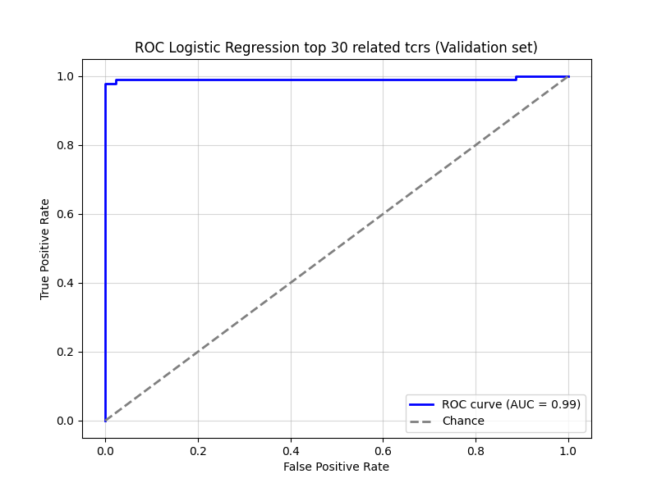
Overview of Implemented Extensions
Train a classifier model for different top_n related TCR’s
top_n = [5, 10, 20, 30, 50, 90, 100, 500, 1000, 5000, 10000, 20000]
*Results obtained using Emerson validation dataset

Slide 6
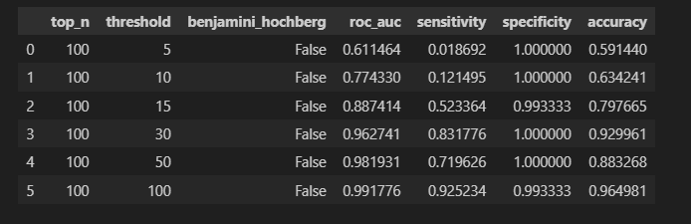
Overview of Implemented Extensions
Make the training data imbalanced
Reduce amount of positive datapoints of HLA-A to find a minimum threshold until where our trained model stays reliable
thresholds = [5, 10, 15, 30, 50, 100]
*Results obtained using Emerson validation dataset

Slide 7
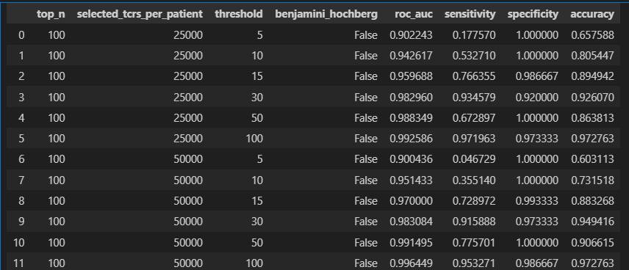
Overview of Implemented Extensions
Select only top x TCR’s in patient files
For the validation dataset, select only the first 25 000 or 50 000 TCR’s in the patient’s data file
Usually, there is less data available for validation than for training
*Results obtained using Emerson validation dataset

Slide 8
Overview of Implemented Extensions
Semi-supervised learning
Load one of the trained models on the Emerson data
Label the data of Mitchel using the loaded model
Use the labeled data of Mitchel together with the Emerson data to improve model
*Results obtained using Emerson validation dataset

Slide 9
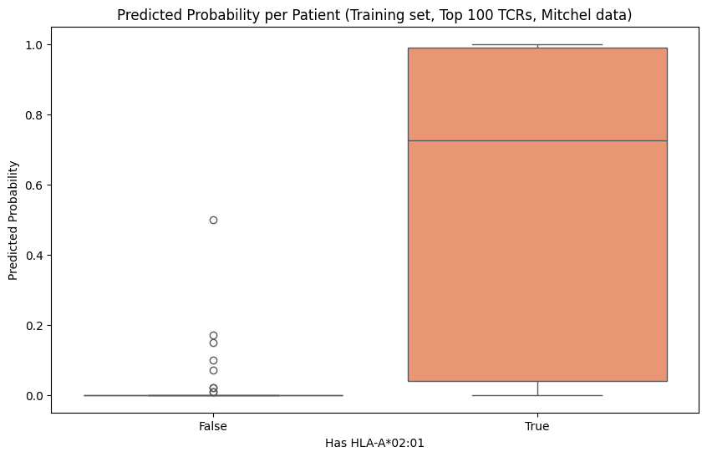
Overview of Implemented Extensions
Semi-supervised learning
Select only rows where prediction of HLA-A label is 0.8 or higher
50 extra datapoints
From 15 datapoints in original model to 65 datapoints in retrained model
*Results obtained using Mitchel dataset
*Results obtained using Emerson validation dataset

Slide 10
Limitations and possible improvements
Limitations
Model/training Improvements
Some HLA’s are rare
Only few datapoints (data is imbalanced)
Emerson dataset is quite large, but not every dataset has as many repertoires
Give datapoints weights (= importance factor)
Datapoints of minority class get higher weights
Use different classifier (more suitable for imbalanced data)
Resampling: Under/over-sampling
Use suitable evaluation metric for imbalanced data (example: F1-score)
Use K-fold cross validation

Slide 11
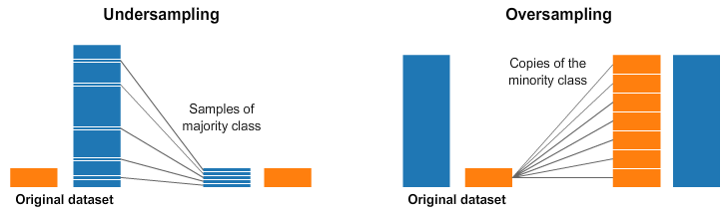
Resampling
Undersampling and oversampling

Slide 12
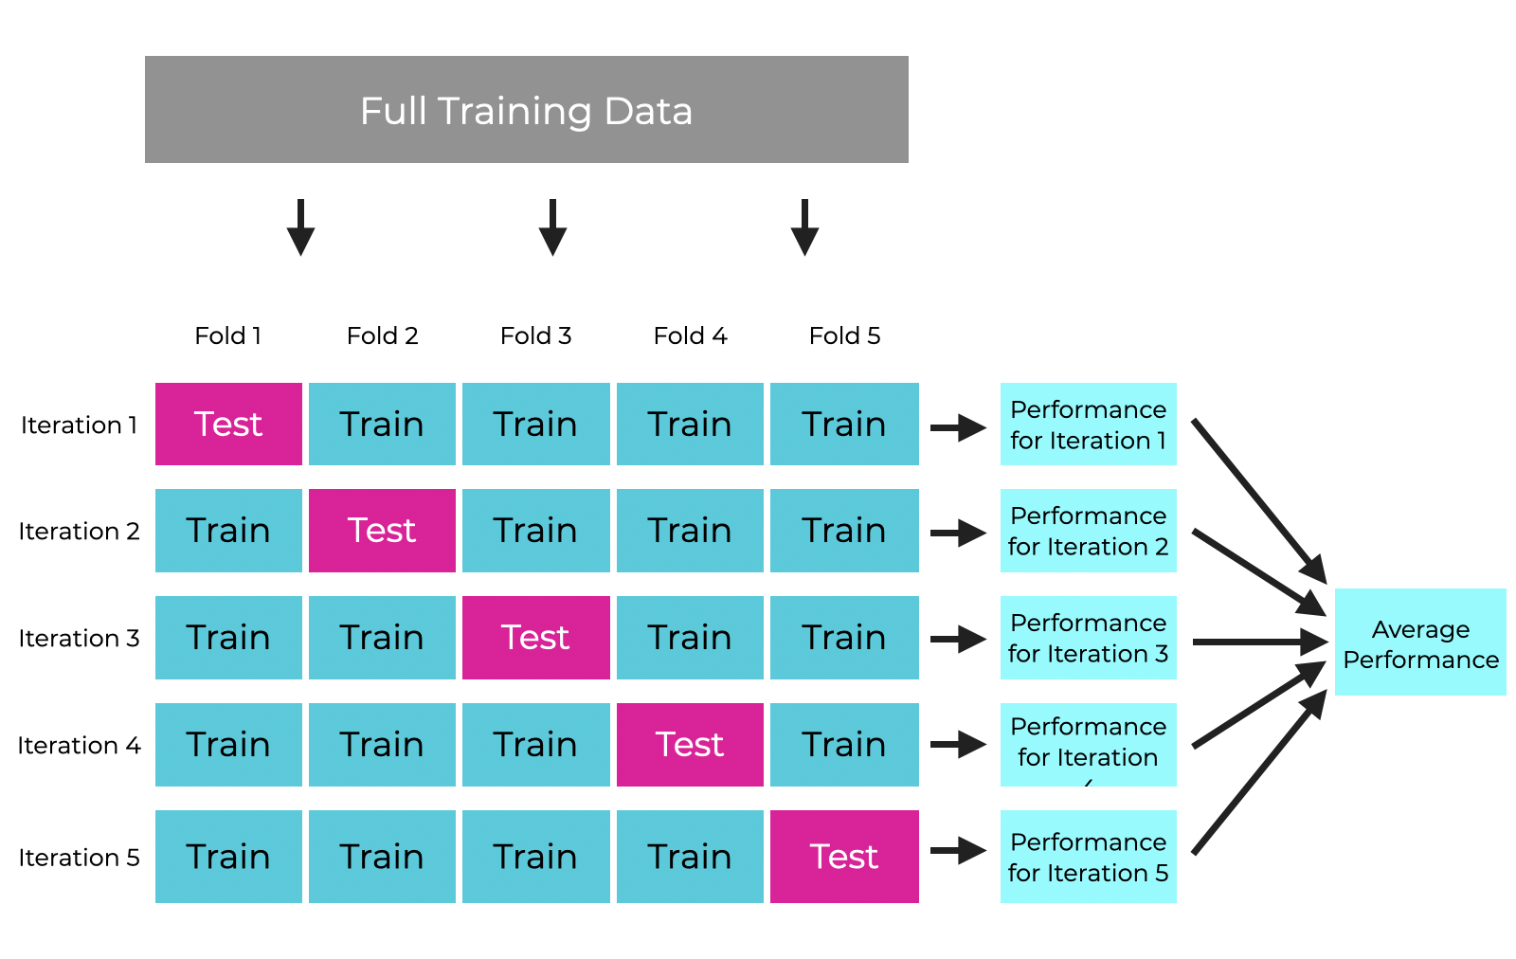
K-fold cross validation

