Slide 1
MUSIC MAVEN
NISHANTH J S
RAKSHITHA V
SAARUMATHI T
VISHNUPRABHA P G

Slide 2
MUSIC MAVEN
A generative AI chatbot designed for music enthusiasts.
Helps users search for specific songs effortlessly.
Provides direct links to songs for seamless listening experiences.
Highlights:
Powered by advanced AI and search algorithms.
Streamlines music discovery.

Slide 3
OUTLOOK
Vision:
Revolutionizing the way people discover and access music.
Bridging the gap between user queries and precise music recommendations.
Mission:
To be the go-to AI assistant for music search and discovery.
Enhance user experience by offering instant access to songs via reliable links.
Future Prospects:
Expand to recognize hums and snippets for advanced song identification.
Integrate with emerging platforms to cater to diverse global audiences.

Slide 4
ABSTRACT
Music Maven is a generative AI chatbot designed for music enthusiasts.
It helps users search for specific songs and provides direct links to access them.
Powered by advanced AI and search algorithms, Music Maven streamlines music discovery, offering an effortless and engaging user experience.

Slide 5
NEED OF MUSIC MAVEN
Purpose:
Recommend a song according to the preferences of the user.
Give the song of the artist that is asked by the user
User Journey:
1. User types the song name or description.
2. The chatbot processes the query.
Target Audience:
Music enthusiasts
Creators,
Casual listeners.

Slide 6
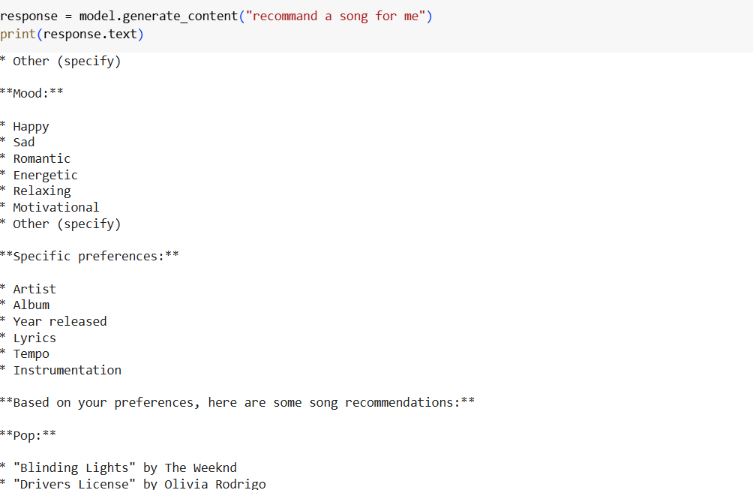
WORKFLOW
Generate API
Set up your API key
Initialize the Generative Model

Slide 7
THANK YOU

