Slide 1
ETL 程式開發框架
Bucky Lee, Jesse Wei
2021.09.01

Slide 2
Agenda
SQL Generator (SQLG) 說明
Data Inventory 資料轉置填寫說明
Planner 使用說明

Slide 3
Data Inventory 使用目的
儲存來源與目的資料的對應關係與轉換邏輯 ( Meta data )
產生一致性的ETL程式，簡化 ETL 程式設計工作
產生 scheduler 相關Job-Flow/Job設定，簡化 ETL Job 建置工作
SOURCE
T1.D
STAGE
STG_M_T1
ODS
ODS_M_T1
DW
SD_REC.D
PB_REC.D
STG_D_SD_REC
STG_D_PB_REC
ODS_D_SD_REC
ODS_D_PB_REC
ODH_D_PB_REC
ACCT
CUST
JS1
JS4
JS7
JS2
JS5
JS8
JS3
JS6
Data Inventory

Slide 4
Data Inventory 使用目的 - Sample: Design pattern: PULL-FILE
Source
DW
DW_PARTY_INI
DW_PARTY
WATCH_TABLE
EXTRACT_D
GENERATE_H
Stage
COPY_TO_STAGE
TRUNC_STG
LOAD_STG
COMP_STAGE_CNT
ODS
LOAD_ODS
Scheduler
SQL Generator
SRC
ACCT_T24.bat
Stage
STG_ACCT_T24.bat
ODS
ODS_ACCT_T24.ddl
ODS_ACCT_T24.sql
ETLFCT_SRC.sql
DW
DW_PARTY.sql
DW_PARTY.ddl
ACCT_T24.sql
ETLFCT_SRC.bat
STG_ACCT_T24.sql
STG_ACCT_T24.ddl
Notes:
Flow: ODS, DW
Process
Procedure
Steps:

Slide 5
SQLG Process Hierarchy - Data stage/storage map
Stage
ODS
SQLG
Output & Process
Import
Project
Process
Source
DW
DM
Flow
Template
Source System
ODS
Output & Process Template
DW
Import Template
Storage
Staging Area
DM

Slide 6
SQLG data flow
 | Source sys | SRC | STG | ODS | DW | DM | Status
Load data | X | File | Table | Table | Table | Table | V
CDC | X | X | Table | Table | Table | Table | V
Extract - File | V | File | Table | Table | Table | Table | V
Extract - Link | V* | dblink | Table | Table | Table | Table | TBD
Extract - Pipe | V** | Pipe dblink | Table | Table | Table | Table | TBD
* Use Output & Process Template
** SRC/STG should merge into one program
Notes:
DataArchitect

Slide 7
SQLG Process Hierarchy - Program Map
Stage
ODS
SQLG
Output & Process
Import
Project
Process
Source
DW
DM
Flow
Template
SRC
ODS
Output & Process Template
DW
Import Template
PROCESS
STAGE
DM
SRC.bat SRC.sql
STG_SRC.bat
STG_SRC.sql
STG_SRC.ddl
ODS_SRC.sql
ODS_SRC.ddl
DW_SUB.sql
DW_SUB.ddl
DM_SUB.sql
DM_SUB.ddl
Notes:
Debug

Slide 8
Data Inventory 使用目的 - 建模過程紀錄
1
4
5
Industry Model+ TW Template
Template Workshop
Current Logical Model
轉換規則
Required Logical Model
資料對應
Required Physical Model
Data Model(BDM, AWM)+Rules: 1.1
LDM: Entity/Attribute: 1.2
LDM: Entity/Attribute: : 2.1
PDM: Entity/Attribute: : 2.2
BDM: Business Data Model
LDM: Logical Data Model
PDM: Physical Data Model
2
BDM Source Files
1
3
TOBE 設計
4
差異分析
5
C.系統實踐
Notes:
DataArchitect
8

Slide 9
Data Inventory 使用目的 - 模型轉換過程
1
4
5
ETL Job Planning
Ext Job Flow
Ext Steps
Data Inventory(PDM)
Logical 2 PDM
Internal Entity*
Data Model(LDM)
Common Type
Fundamental
Associative
Model Specific Type
Anchor
Supportive
Temp Table
Stored Proc.
View
PDM 2 Flow
5
4
3
2
1
Internal Entity*: INI/Shapshot/CTE

Slide 10
Data Inventory 種類 - Integrated Template
Object Type
Mapping Rule Type
DI Object
Reference
External Table
View
Stored Procedure
Job
Table
ODS
Table
CTE
Union
BEFORE SQL
User temp table
Type I & II
Program
Initial
Snapshot
Package*
SQLG Framework
Process Model
Requirement

Slide 11
SQLG 使用週期
Design
Production
Deploy
Analysis
Multiple Debug Mode
Test Case
Variable Substitution
Log tracking
DB Connect
Repeating job
Multiple DB support
Multiple Object Support
BigData Process mode
Initial/Delta Program
Snapshot Program
User defined rule
Job/Job flow mapping
30+ Analysis Formula
10+ Standard analytic report template
Planning Workbench integration
FileMerge Integration
Notes:
DataArchitect

Slide 12
SQLG 使用方式
UI, User Interface
QAT, Quick Access Toolbar
Menu
Button
CLI, Command Line Interface
Command Line Batch
Powershell API
API
Formula
VBA
Templating
XSLT
Variable substitution*
Configuration
Output
SQL/XML/JSON/Stored Procedure
Variable substitution
User defined
Parameter: Project level
{{Variable}}
Table: Column level
{Variable}
Debug
{{DEBUG_UT_VAR}}
User define variable list
{{FMT_USER_VAR}}
System pre-defined
Database/Schema
Symbol table

Slide 13
ETLM DevOps Process - Lifecycle
Operation
Development
JobFlow
Job Steps
Program
ETL
Job
QC
Housekeep
Job Control
System Architect
Data Inventory
System
ETL Program
Init
Data Model
Snapshot
Main ETL
Subject
ETL Program, Job Grouping
Notes:
Job Control
ETL Program, Job Grouping

Slide 14
EDW Model DevOps Process - System View
Operation
Development
JobFlow
Job Steps
Program
ETL
Job
QC
Housekeep
Job Control
System Architect
Data Inventory
System
ETL Program
Init
Data Model
Snapshot
Main ETL
Subject
DEV WB
OP WB
Scheduler
UI
Op
Adm
Engine
Core
API
SQLG
vba Toolkit
vtLog
Merge
Split
Update
Compare
FileMerge
DW
ODS
vtUnit
udf
ETL Program
Notes:
Job Control
ETL Program, Job Grouping

Slide 15
功能介面
功能介面
功能執行模式
操作介面 (UI, User Interface)
選單(Menu)
工具列(QuickAccessToolbar)
組合按鈕 (Combo Button)
功能按鈕 (Function Button)
命令行介面 (CLI, Command Line Interface)
sqlgBatch.bat
程式介面 (API, Application Interface)
Run
sqlgGenScriptRun gProject
Data Inventory
diRef(), diJoin()
Format
vtPrintf(FormatString, …)
Gen SQL by select
Gen SQL by List
Gen SQL All

Slide 16
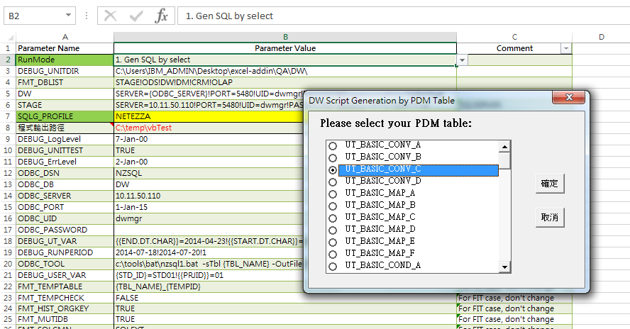
功能執行模式 - 基本功能: Gen SQL by select
操作:
選擇[RunMode]
“1. Gen SQL by select”
按[Run]按鈕
出現選擇對話框
選擇Object後, 按[確認]
特點:
適合臨時性，不熟悉的執行方式
系統會提供提示, 需要較多步驟, 進行選擇及確認

Slide 17
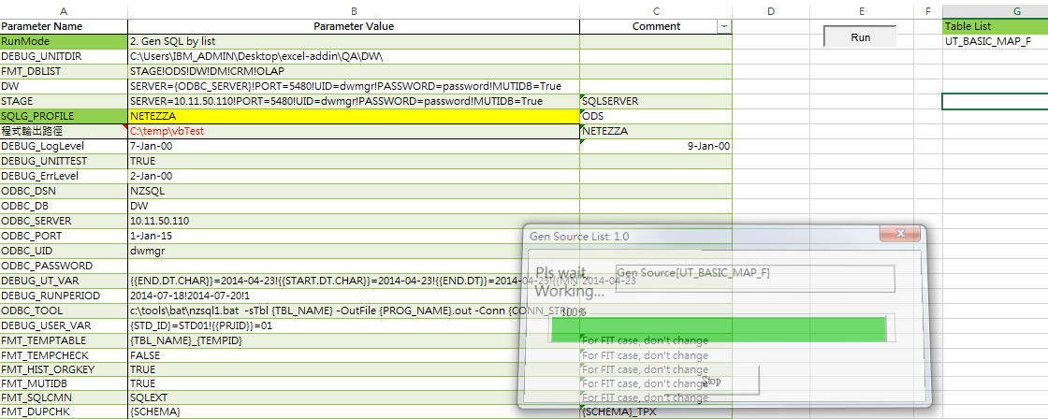
功能執行模式 - 基本功能: Gen SQL by List
操作:
選擇[RunMode]
“2. Gen SQL by list”
按[Run]按鈕
特點:
適合日常開發的執行方式
可以對一或任意Object產生SQL
[Table List] 下標明要產生的Object List

Slide 18
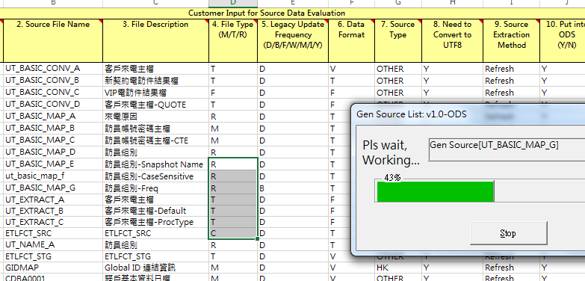
功能執行模式 - 基本功能: Gen SQL by List (Cont.)
操作:
選擇[RunMode]
“2. Gen SQL by list”
[Table List] 清空
使用表格(ActiveSheet)為下列工作表格時
表格清單:
Data Inventory Summary
Table Summary
明細欄位清單:
Data Inventory Detail
DATAMAPPING
選擇表格
單選或多選不同資料列
點擊選單或工作列(QAT)
特點:
適合日常開發的執行方式
可以對一或任意Object產生SQL
可隨時點選要產生的Object List

Slide 19
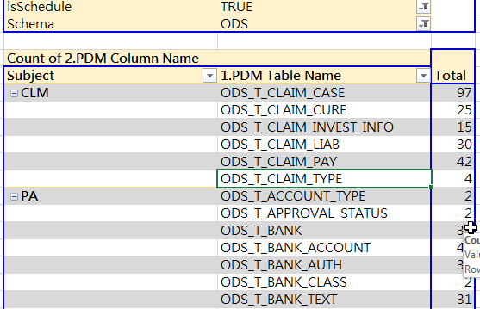
功能執行模式 - 基本功能: Gen SQL by List (Cont.)
操作:
選擇[RunMode]
“2. Gen SQL by list”
[Table List] 清空
任意工作表格時
點選表格名稱清單
選擇表格
單選或多選不同資料列
點擊選單或工作列(QAT)
特點:
適合日常開發的執行方式
可按DB, Schema, Subject及系統等自訂分類角度執行

Slide 20
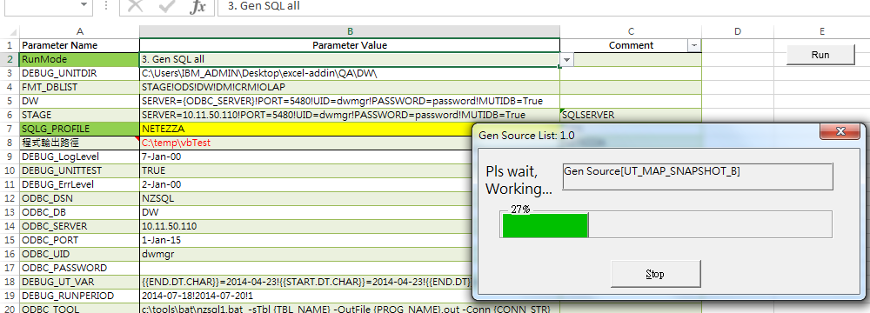
功能執行模式 - 基本功能: Gen SQL All
操作:
選擇[RunMode]
“3. Gen SQL all”
按[Run]按鈕
特點:
適合整合測試的執行方式
可以對所有Object產生SQL
參數”FMT_PDMTYPELIST” 設定可限制要產生的類型。適用在合併的DI 產生程式使用, 可跳過像R1等不適合匯總產生的Object。

Slide 21
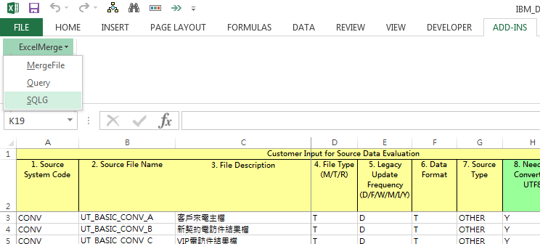
功能操作 -選單
操作:
ADD-INS> ExcelMerge > SQLG
結果
按[RunMode]執行
Gen By Table List
Gen All
Gen By Selected Table
..
特點:
可在同一工作簿(Workbook)任意工作表(Worksheet)中操作
可按[RunMode]參數自訂對應指令,請參考 “設定”
Excel 版本: All
HotKey
[Alt]-X-E-S

Slide 22
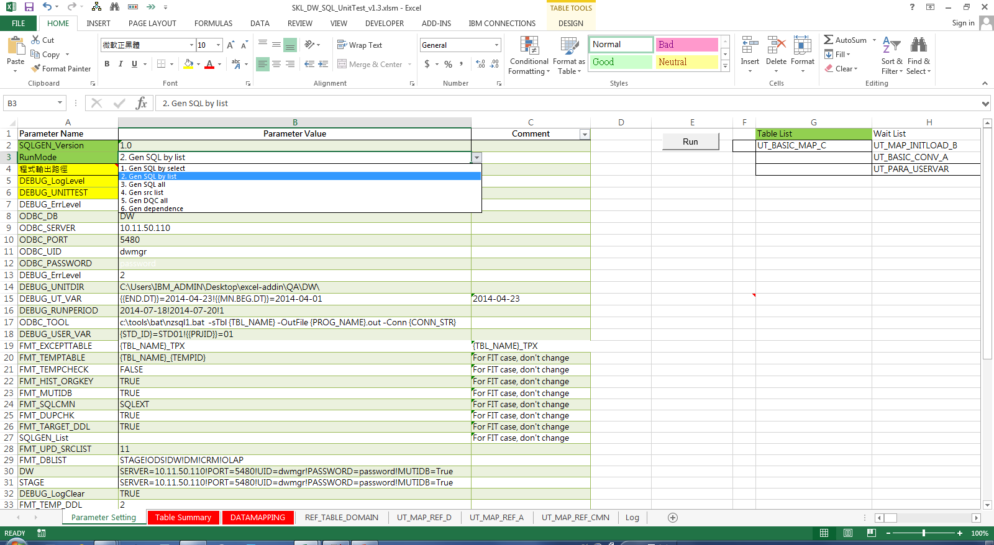
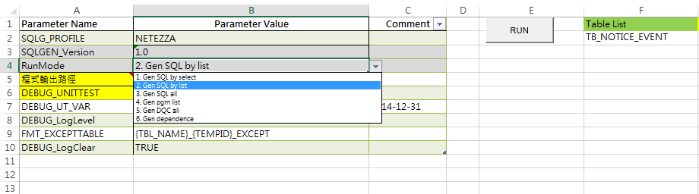
功能操作 - 工具列(QAT, Quick Access Toolbar)
操作:
直接點選工作列
結果
按[RunMode]執行
Gen By Table List
Gen All
Gen By Selected Table
Gen Depend
特點:
可在同一工作簿(Workbook)任意工作表(Worksheet)中操作
可按[RunMode]參數自訂對應指令,請參考 “設定”
單擊執行(One Click Run)
Excel 版本: 2010+
Notes:
???

Slide 23
功能操作 - 工具列(QAT, Quick Access Toolbar)
操作:
直接點選工作列LogParse
結果
清除巨集公式絕對路徑
顯示最後結果, 或
整理Log
特點:
Notes:
???

Slide 24
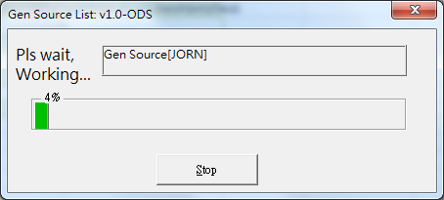
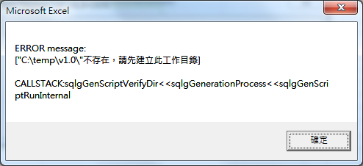
對話框
執行進度
執行進度監控
可按Stop終止
eg. 例如2000+ Table 可能需要10分鐘, 可在過程隨時終止.
訊息提示
錯誤或相關訊息提示
設定: [DEBUG_ErrLevel ]
1: 僅列印到Log, 繼續執行
2: 訊息提示框
3: 列印到Log, 終止

Slide 25
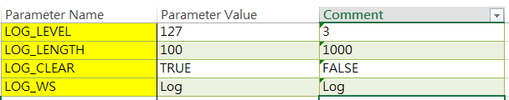
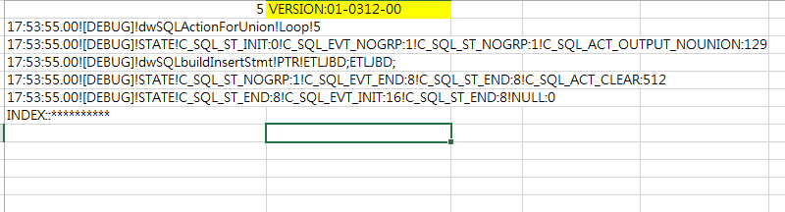
LOG訊息
預設Logger
Worksheet
工作表名稱為 “Log”
Log記錄
包括, 系統, 錯誤, 追踪及除錯等訊息
Log設定
LOG_LEVEL: 顯示訊息種類
LOG_LENGTH: 最多的Log 行數
LOG_CLEAR: 每次執行會自動清除
LOG_WS: Log工作表名稱
Addin Version Number
核對功能版本
Addin Version Number

Slide 26
設定 - 工作表 “Parameter Setting”
常用變數
必設: 設定程式輸出路徑
Parameter Name | Parameter Value
SQLG_VERSION | 1.0
DIR_OUTPUT | C:\Project\ABC\053.EDW\ETL\pgm\dw
LOG_LEVEL | 3
DEBUG_UNITTEST | TRUE
Excel格式的版本控制
必設, 指定程式目錄
選擇性, 問題LOG輸出等級 , 127 印出所有問題
選擇性, 程式輸出方式, TRUE 表示可輸入取代變數後的SQL, 直接在SQL 前端, 如Aginity 執行
26
Notes:
除錯模式(Debug Mode)

Slide 27
Agenda
SQL Generator (SQLG) 說明
Data Inventory 資料轉置填寫說明
Planner 使用說明

Slide 28
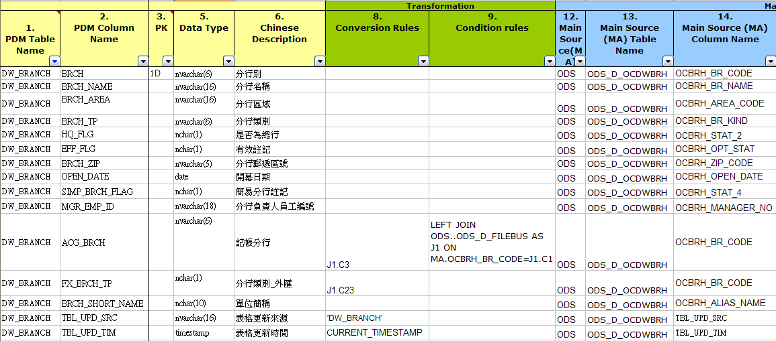
DW Data Inventory -填寫樣版介紹
目的表格內容
來源表格內容
轉換/過濾 條件
Notes:
目的表格/轉換條件/來源表格

Slide 29
DW Data Inventory -填寫原則 -資料轉置規則
需考慮re-run機制與資料轉置頻率來填寫轉置規則
命名:
RegEx: ^[\w]*[:alpha:]+[\d]*(_[PV][\d]*){0,1}$
規則類型
目標表格*
RegEx: [PDM_NAME]+\d*
e.g. SDM_CLAIM_CASE01
CTE, Common Table Expression*
RegEx: [PDM_NAME]+\d*(_V[\d]*)
e.g. SDM_CLAIM_CASE01_V1
用戶暫存表*:
RegEx: [PDM_NAME]+\d*(_P[\d]*)
e.g. SDM_CLAIM_CASE01_P1
表格類型
目標暫存表格命名請使用TMPn_[PDM_NAME]
系統暫存表*, 例外表*:
RegEx: ^\wd*(_(TP1|TPX))
e.g. SDM_CLAIM_CASE_TP1, SDM_CLAIM_CASE_TPX
表格參照時使用{{URI_NAME}}寫作
Ex. {{ODS}}.TBLNAME, {{DW}}.TBLNAME
*, 可按專案需求變更參數, 設定不同規則
**, PDM_NAME: Physical Data Model Name
***, RegEx: Regular Expression, 正規表達式
****, URI_NAME, 按DB類型決定是SCHEMA, DB

Slide 30
DW Data Inventory -填寫原則 - 別名
別名(Table Alias)使用
來源表格: MA
Join表格:
RegEx: \b\w
e.g. SCC ← SDM_CLAIM_CASE
Common Table Expression表格: V1…Vn
暫存表格: P1…Pn
所有欄位轉換時都需帶上別名
Ex. MA.COLNAME, SCC. COLNAME, V1. COLNAME

Slide 31
DW Data Inventory - Table Summary
本頁面主要紀錄檔案相關資訊(包含檔名、轉檔頻率、是否留存歷史資料…等等。)
主要分為以下區塊：
PDM Base Info: 檔案的基本相關資訊。
PDM Transformation Info : Table的相關資訊,頻率以及檔案的類型
Related Monthly Table Info : Snapshot Table參數
Source Format: 來源資料的格式
User Defined Field : 彈性欄位

Slide 32
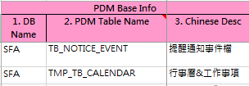
DW Data Inventory - PDM Base Info
1. DB Name, EDW 系統歸類
Multiple DB 環境下，內容DB名稱
Multiple Schema 下，為Schema名稱
2. PDM Table Name: 資料表名稱
3. Chinese Desc: 資料表的檔案說明
Notes:
ExtOption
ProcessMode
Subject

Slide 33
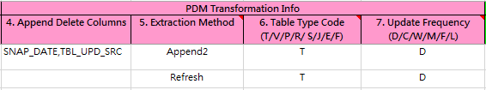
DW Data Inventory - PDM Transformation Info
4. Append Delete Columns
Extraction/Load Method 若為 Append ，程式會根據此欄位刪除舊資料
5. Extraction Method
6. Table Type Code (T/V/P/R/S/J/E/F)
7. Update Frequency (D/C/W/M/F/L)
Notes:
ExtOption
ProcessMode
Subject

Slide 34
Extraction Method - Refresh
Initial::
STAGE ODS
REFRESH::
STAGE ODS
ODS
DW
Notes:
EntryLevel

Slide 35
Extraction Method - Upsert
Initial::
STAGE ODS
UPSERT::
STAGE ODS
ODS
DW
Notes:
EntryLevel

Slide 36
Extraction Method - Append:
UPSERT ::
STAGE ODS
APPEND:: JOB_FLOW_START_DT
STAGE ODS
Notes:
EntryLevel

Slide 37
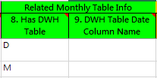
DW Data Inventory - Related Monthly Table Info
8. Has DWH Table:
D: Daily, M: Monthly, <空白>: 無 Snapshot table
9. DWH Table Date Column Name:
如果有Snapshot Table, 此欄填入欲新增為歷史表格的日期欄位名稱, 例如DATA_YM
Notes:
ExtOption
ProcessMode
Subject

Slide 38
DW Data Inventory - Related Monthly Table Info (Cont)
Default Column Name
FMT_SNAPS_COLS
Y;DATA_YR!M;DATA_YM!M1;DATA_YM!D;SNAP_DT!S;DATA_YM
“”, Enforce defined by table

Slide 39
DW Data Inventory - Source
10. Source File Name:
Planner, 用於參考Dependency資訊
11. Source File Description:
SQLG, 預設會自動填入Dependency Table List
{{FMT_UPD_SRCLIST}}, 指定要更新的欄位, 預設為11，0不填, 10 則直接更新Planner 會使用的欄位
Notes:
ExtOption
ProcessMode
Subject

Slide 40
DW Data Inventory - DATAMAPPING
本頁面主要紀錄轉換規則相關資訊
主要分為以下區塊：
PDM
Transformation
Main Source (MA)

Slide 41
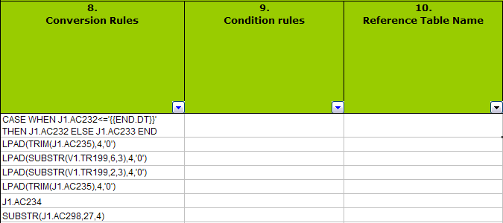
DW Data Inventory 使用範例 - 1. Conversion
Conversion
* Please refer to 13. Helper Function A
41

Slide 42
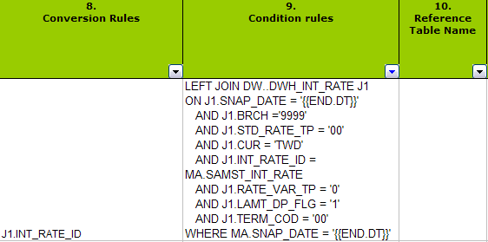
DW Data Inventory 使用範例 - 2. Condition rules
LEFT JOIN DW..DWH_INT_RATE J1 ON J1.SNAP_DATE = '{{END.DT}}'
AND J1.BRCH ='9999‘ AND J1.STD_RATE_TP = '00‘ AND J1.CUR = 'TWD'
AND J1.INT_RATE_ID = MA.SAMST_INT_RATE AND J1.RATE_VAR_TP = '0'
AND J1.LAMT_DP_FLG = '1' AND J1.TERM_COD = '00‘ WHERE MA.SNAP_DATE ='{{END.DT}}'
JOIN + WHERE
42

Slide 43
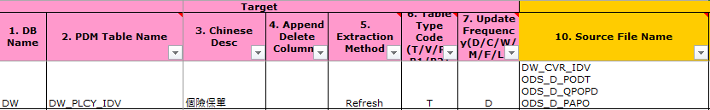
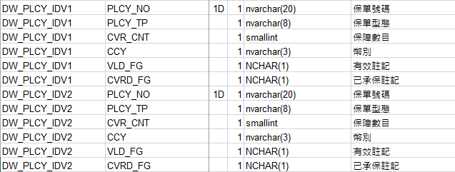
DW Data Inventory 使用範例 - 3. Union
UNION ALL
SELECT MA.POLICY_NO AS PLCY_NO ,MA.POLICY_TYPE AS PLCY_TP ,MA.COVERAGE_CNT AS CVR_CNT ,MA.CURRENCY_1 AS CCY ,CASE WHEN …
,CASE WHEN …AS CVRD_FG
FROM ODS..ODS_D_PODT as MA
LEFT JOIN ODS..ODS_D_QPOPD J1 ON J1.POLICY_NO=MA.POLICY_NO
UNION ALL
SELECT MA.POLICY_NO AS PLCY_NO ,MA.POLICY_TYPE AS PLCY_TP ,MA.COVERAGE_CNT AS CVR_CNT ,MA.CURRENCY_1 AS CCY ,CASE WHEN …
,CASE WHEN …
FROM ODS..ODS_D_PAPO as MA
LEFT JOIN DW_PLCY_IDV1_V1 V1 ON
43

Slide 44
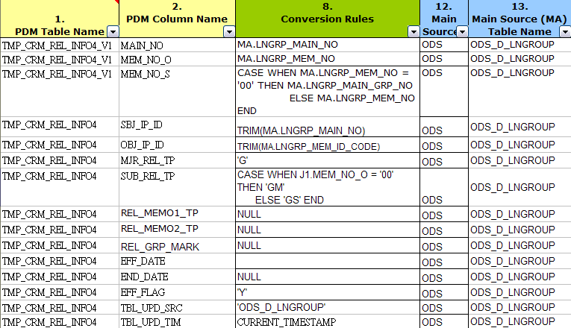
DW Data Inventory 使用範例 - 4. CTE
COMMON TABLE EXPRESSION (CTE)
WITH TMP_CRM_REL_INFO4_V1 AS (
SELECT MA.LNGRP_MAIN_NO AS MAIN_NO,
MA.LNGRP_MEM_NO AS MEM_NO_O,
……
FROM ODS..ODS_D_LNGROUP as MA ORDER BY 1,2) SELECT
TRIM(MA.LNGRP_MAIN_NO) AS SBJ_IP_ID,
……
FROM ODS..ODS_D_LNGROUP as MA
INNER JOIN TMP_CRM_REL_INFO4_V1 AS J1
ON MA.LNGRP_MAIN_NO = J1.MAIN_NO……;
44

Slide 45
DW Data Inventory 使用範例 - 5. Schedule only
Job Flow Group
14. Scheduling: 填Group No.
Ex. 組織與個人分開Flow
Job
Initial Job Group
Job steps
Job Dependency
45

Slide 46
DW Data Inventory 使用範例 - 5. Schedule only
Job Flow Group
Job
Job steps
Initial job step
Snapshot job step
User defined job steps
Job Dependency
46

Slide 47
DW Data Inventory 使用範例 - 5. Schedule only
Job Flow Group
Job
Initial Job Group
Job steps
Job Dependency
Dependency
11 → System advice dependency
10 → Manual or formula maintain, for circular check
47

Slide 48
DW Data Inventory 使用範例 - 6.參數設定
Row Labels | Description | Default Value | Count of Code
Debug |  |  | 9
DEBUG_ErrLevel | Error 發生時的處理方式 | 2 | 1
DEBUG_LogClear | Log auto clear every run | FALSE | 1
DEBUG_LogLevel | Log訊息等級 | 0 | 1
DEBUG_PREEMPTIVE | PREEMPTIVE table pattern | _INI | 1
DEBUG_QW_REPLACE | 置換{{ }} When Debug Mode | TRUE | 1
DEBUG_RUNPERIOD | Perodical run mode | "" | 1
DEBUG_UNITDIR | vbUnit test directory for source compare | C:\Users\IBM_ADMIN\Desktop\excel-addin\QA\DW\ | 1
DEBUG_UNITTEST | Unit test mode for SQL generator | FALSE | 1
DEBUG_UT_VAR | 置換{{ }}變數名稱清單, 換為常數 | NULL | 1
ODBC |  |  | 9
ODBC_DB | ODBC參數 | NULL | 1
ODBC_DSN | ODBC參數 | NULL | 1
ODBC_PASSWORD | ODBC參數 | NULL | 1
ODBC_PORT | ODBC參數 | NULL | 1
ODBC_ROWS | ODBC參數 | NULL | 1
ODBC_SEQEXEC | Sequence execution SQL | FALSE | 1
ODBC_SERVER | ODBC參數 | NULL | 1
ODBC_TOOL | ODBC Tool for SQL execution, {TBL_NAME}, {PROG_NAME} used as param passing | "" | 1
ODBC_UID | ODBC參數 | NULL | 1
Output |  |  | 2
Program Output | ETL 程式檔輸出目錄 | NULL | 1
程式輸出路徑 | ETL 程式檔輸出目錄 | NULL | 1
SQLFormat |  |  | 19
DEBUG_USER_VAR | 置換{{ }}用戶變數名稱清單, 換為常數 | NULL | 1
FMT_DBLIST | 置換{{ }}DB名稱清單, 將保留字換為變數符號 | STAGE!ODS!DW!DM!CRM | 1
FMT_DUPCHK | Duplicate check before insert to target | TRUE | 1
FMT_EXCEPTTABLE | Exception Table 命名方式 | {TBL_NAME}_TPX | 1
FMT_HIST_ORGKEY | History table with organization key | TRUE | 1
FMT_HIST_TRANCOL | History table column of transaction date | HIST_TRANS_DATE | 1
FMT_ID4_CTE | Rule ID for CTE | V | 1
FMT_ID4_TEMP | Rule ID for user temp table | P | 1
FMT_MUTIDB | Multiple Schema or DB mode | TRUE | 1
FMT_PDM_NAMECHK | Check table name strickly | FALSE | 1
FMT_PDMTYPELIST | List for parsable entity type | T, V, S, P, R | 1
FMT_PROG_INI | Program naming for initial load | {TBL_NAME}_INI | 1
FMT_SQLCMN | SQL Common Library | SQLEXT | 1
FMT_SRCLIST_TP | Type for source list | 0 | 1
FMT_SYS_TBLLIST | 系統表格清單, 產生來源表格清單會自動排除 | _V_DUAL!DUAL | 1
FMT_TARGET_DDL | Is DDL include target table, used for itf table import | TRUE | 1
FMT_TEMP_DDL | USER Temp Table DDL type | 2 | 1
FMT_TEMPTABLE | Temp Table 命名方式 | {TBL_NAME}_{TEMPID} | 1
FMT_UPD_SRCLIST | Flag to Update Source @ Table Summary | 11 | 1
SQLToolkit |  |  | 3
RunMode | 快速鍵執行方式 | 1 | 1
SQLGEN_List | Validation List | (blank) | 1
SQLGEN_Version | Template 版本 | v1.0 | 1
Template |  |  | 3
WS_DI_CODE | REF_TABLE_DOMAIN | REF_TABLE_DOMAIN | 1
WS_DI_DETAIL | DATAMAPPING | DATAMAPPING | 1
WS_DI_SUMMARY | Table Summary | Table Summary | 1
Grand Total |  |  | 45
48
Notes:
與RANK.FIRST_VALUE.LAST_VALUE寫法相同
RANK() OVER(PARTITION BY A ORDER BY B)
FIRST_VALUE() OVER(PARTITION BY A ORDER BY B)

Slide 49
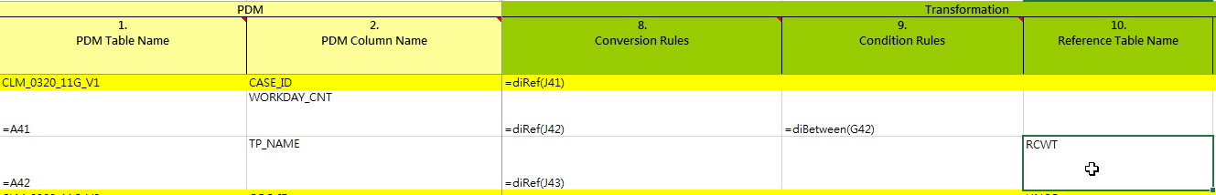
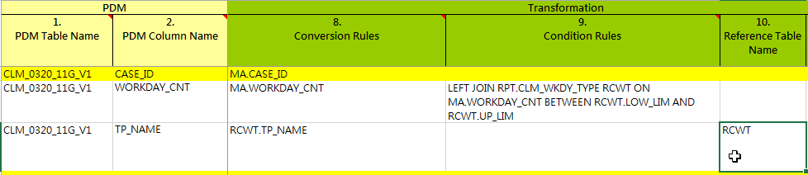
DW Data Inventory 使用範例 - 7. Helper Function
49

Slide 50
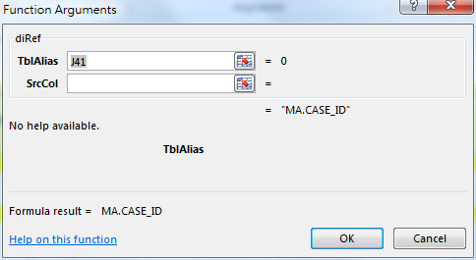
DW Data Inventory 使用範例 - 7. Helper Function : A. Conversion Rules
=diRef(J41)
Set “MA”
IF TableAlias == “”
Set Target Column
IF Source Column == “”
Sample for composite
SUM(CLCL.SDM_PAY)
=vtprintf("SUM({0})",diRef(J92))
50

Slide 51
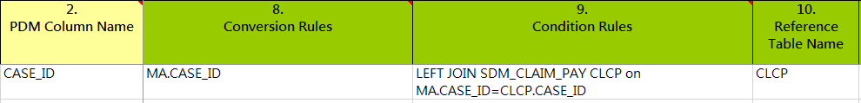
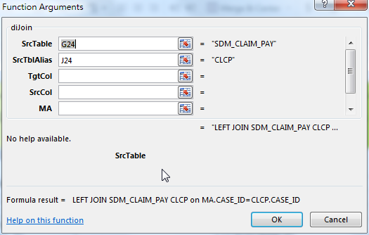
DW Data Inventory 使用範例 - 7. Helper Function : B. Condition: Join
=diJoin(G24, “CLCP”)
51

Slide 52
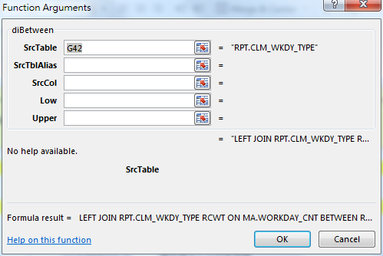
DW Data Inventory 使用範例 - 7. Helper Function : B. Condition: Between
=diBetween(G42)
=diFunc(“SUM”)
=diCase
=diIF
52

Slide 53
DW Data Inventory 使用範例 - 7. Helper Function : B. Condition: IF
=diCase
=diIF
53

Slide 54
DW Data Inventory 使用範例 - 7. Helper Function : B. Condition: Mapping
diReplace (Source, MapRule, optional DefaultValue)
=diReplace(diRef(),$J$551:$K$555)
Allow
Vertical or Horizontal
Default Value
RESULT
REPLACE(REPLACE(REPLACE(REPLACE(REPLACE(MA.PAR_VAL,'',coalesce(MA.PAR_VAL,'X')),'',coalesce(MA.PAR_VAL,'X')),'',coalesce(MA.PAR_VAL,'X')),'',coalesce(MA.PAR_VAL,'X')),'',coalesce(MA.PAR_VAL,'X'))

Slide 55
Agenda
SQL Generator (SQLG) 說明
Data Inventory 資料轉置填寫說明
Planner 使用說明

Slide 56
Domain driven DevOps Process - System View
Operation
Development
Job Control
JobFlow
Job Steps
Program
ETL
Job
QC
Housekeep
System Architect
Data Inventory
System
ETL Program
Init
Data Model
Snapshot
Main ETL
Subject
Planner
Scheduler
Job
Airflow
UI
Op
Adm
Engine
CLI
API
SQLG
vba Toolkit
vtLog
Merge
Split
Update
Compare
FileMerge
DW
ODS
vtUnit
udf
ETL Program
Notes:
Job Control
ETL Program, Job Grouping

Slide 57
Daily job - Planner
Initial Base Plan
Net Change Plan
Monitor
Select Plan Basis
Plan update
Schedule
Manual submit
Re-plan
Online
Report
Gen Base Plan
BasePlan
DeltaPlan
名詞說明:
Plan Basis: 計劃範圍
Element: 計劃要素
Base Plan: 基礎計劃
Delta Plan: 增量計劃
Net Change: 淨需求計劃

Slide 58
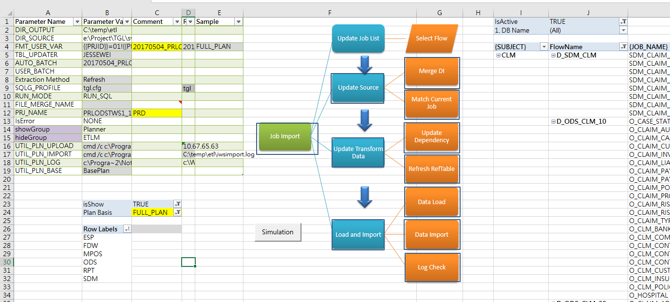
畫面/名詞對應說明
名詞說明:
Plan Basis: 計劃範圍
Element: 計劃要素
Base Plan: 基礎計劃
Delta Plan: 增量計劃
Net Change: 淨需求計劃
Base Plan: 基礎計劃
Delta Plan: 增量計劃
Net Change: 淨需求計劃
Plan Basis: 計劃範圍
Element: 計劃要素

Slide 59
Operation
Job Import
Update Job List
Match Current Job
Merge DI
Load and Import
Update Transform Data
Update Source
Data Load
Data Import
Log Check
Update Dependency
Select Flow
Refresh RefTable
Plan scoping
Extraction
Transformation
Load

Slide 60
Role and Operation - Data Inventory: Devops
Data Inventory
Configuration
Parameter
Generate Stored Procedure
Job Schedule Group

Slide 61
Role and Operation - Data Inventory: Devops
Data Inventory
Configuration
Parameter
Generate Stored Procedure
Job Schedule Group
Data Set: Data-Job
Frequency slicing
App-Job:
“Table Summary” only
Manual dependency
[JobStepTemplate]: predefined rule

Slide 62
Schedule internval - DI “7. Update Frequency”
preset | meaning | cron
None | Don’t schedule, use for exclusively “externally triggered” DAGs
@once | Schedule once and only once
@hourly | Run once an hour at the beginning of the hour | 0 * * * *
@daily | Run once a day at midnight | 0 0 * * *
@weekly | Run once a week at midnight on Sunday morning | 0 0 * * 0
@monthly | Run once a month at midnight of the first day of the month | 0 0 1 * *
@yearly | Run once a year at midnight of January 1 | 0 0 1 1 *
Notes:
@once
@hourly
@daily
@weekly
@monthly
@yearly

Slide 63
Role and Operation - Data Inventory: Devops
Data Inventory
Configuration
Parameter
Generate Stored Procedure
Job Schedule Group
Setup job schedule group
logical job schedule group into physical job schedule group
For better admin view and track
Set “Table Summary”!{14. Scheduling (Y/N/#)}
Numeric

Slide 64
Role and Operation - Data Inventory: Devops : Job Grouping Rule
Project
Program
Subject
System
Table
Frequency
User Defined Group
Flow-based
System
User Defined Group
Subject
Frequency
Job-based
Initial Load
Main Load
Snapshot
DQC
Export
…
Specific Temp
Specific Initial

Slide 65
Role and Operation - Data Inventory: Devops : Job Schedule Rule
Scheduling
Merging Rule
Remove unscheduled pre-job
Remove system table (DUAL,..)
Self-reference (DI)
Defaulting Rule
ETLDB
Pseudo Entity
Temp table*
(TP1)
View
Self-reference (After conv)
Remove unscheduled pre-job
Default Map
De-duplicate
Reference Code
Target
Source: Skip
Data Inventory
Templating Rule
Subtype
inheritance
JobSteps
No dependency

Slide 66
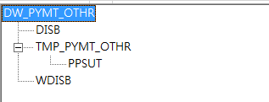
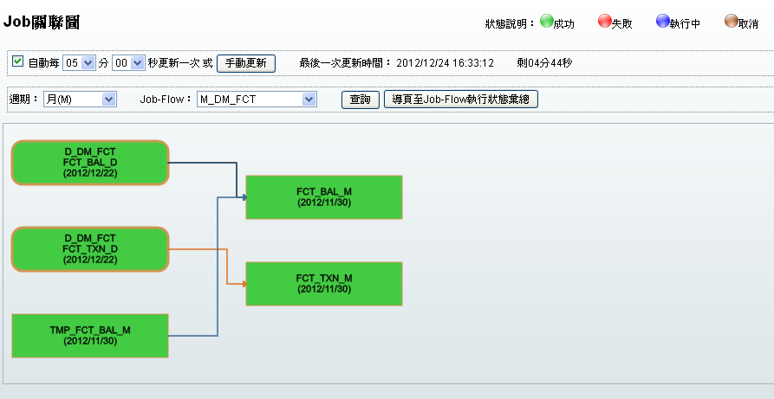
Role and Operation - Data Inventory: Devops:Job Schedule Rule: Dependency
Scheduler
Data Mapping

Slide 67
Role and Operation - Data Inventory: Devops : Scheduling Policy: Entity
Data Mapping
Scheduler
Project
DW_PYMT_OTHR
DW_PYMT_OTHR_INI
D_DW_Financial
DW_PYMT_OTHR
DWH_PYMT_OTHR
Project
Financial
Daily
DW_PYMT_LOAN
DW
DW_PYMT_OTHR
Init Load
Snapshot
Main Data
….

Slide 68
Q&A

