Slide 1
Data Warehouse
ETL and Data Model
Training Material

Slide 2
Preparation before attend - Installation
Install SQLG Addin
Check SQLG toolbar
Install and configure DBclient
ODBC DSN: ODPDEVPSG
Install Client tools for DB
SSMS
* 路徑:
IEC1 PSG 資料治理 - Documents\Project File - PMS\01_PM\0190_Training\ETL參考工具\SQLG\PPT

Slide 3
SQLG工具相關檔案 - 附加檔案
安裝清單
必要的工具: sqlg-install.zip
addinstall.bat: 安裝程式, 命令行執行程式,
inst-addin.ps1: Powershell script, 支援Addin 安裝
Excel.officeUI: Quick Access Toolbar設定
addin-dw-v1.0.xla : 執行程式
vtFileMerge-v1.2.xla : 執行程式
選擇性檔案
*.cfg : 設定檔, 儲存專案相同參數

Slide 4
SQLG工具相關檔案 - 外部工具說明
ODBC Driver
需先安裝DB Client, ODBC driver
SQL前端工具
Netezza:
Windows UI: Aginity
Command Line: NZSQL
A Powershell script for SQL command client
SQL server
Windows UI: QTODBC
Command Line: SQLCMD
Oracle
Windows UI: QTODBC
Command Line: SQLplus
DB2
Windows UI: QTODBC
Command Line: db2

Slide 5
Preparation before attend - Documentation
Data model for training
ex…
Training Material
LI-BDM-Train-v1.0.pptx
LI_TRN_Data Inventory_v2.1.xlsm
Documentation
IBM_SQLG_Introduction.pptx
IBM_OP_Data Inventory_Intro.pptx

Slide 6
Agenda
Developer Training
Overview
SQLG Introduction
DI-OP Introduction
Dev procedure
DI-ODS QuickStart
Data Architect Training
SQLG Introduction - Architect
FileMerge and Excel
Q&A
Notes:
SELECT 'DROP TABLE ' || table_name || ';' FROM user_tables;

Slide 7

Before start
手機關靜音
學員登記表
檢查文件
檢查安裝
Check network
Check ODBC

Slide 8

Before start (cont.)
下載 LI_TRN_Data Inventory_v2.1a.xlsm到本機
啟動 DB Client Tool, SSMS in MSSQL
在教材上, 修改成自己的上課編號
Eg. {STUD_ID}=ODP01
ODP02
Notes:
C:\Users\username\AppData\Roaming\Microsoft\AddIns

Slide 9
Agenda
Developer Training
Overview
SQLG Introduction
DI-OP Introduction
Dev procedure
DI-ODS QuickStart
Data Architect Training
SQLG Introduction - Architect
FileMerge and Excel
Q&A

Slide 10
Exercise 1-1
Program: TRN_{STUD_ID}_11G
Start your program
Open LI_TRN_Data Inventory_v1.0.xlsm
Start Oracle client tool
Run
Gen by list
Check Result
Check DB
Check SQLG version
Check output program
Notes:
Instructor notes:
Open SQL developer, ask student locate schema and query table.
Demo hot key [ALT]-6, [ALT]-7
Open SQL developer, ask student find his/her table result. Eg. TRN_ODS01_11G
SELECT COUNT(*) from TRN_ODS01_11G
Open SQL from C:\TEMP\ETL\UT\TRN_{STUD_ID}_11G
Check *.ddl
Check *.sql
Explain Major program content
Check Excel log and version
Switch SQL_PROFILE to no UT
Switch to [pvtProgress], explain how score calculated

Slide 11
Overview – Reference Material
Topic | Material | Comment
SQLG Introduction | IBM_SQLG_Introduction.pptx
DI-OP Introduction | IBM_OP_Data Inventory_Intro.pptx
FileMerge Introduction | Util-FileMerge-v1.2.pptx
Notes:
Instructor notes:
Confirm material, confirm material source

Slide 12
Overview – Terminology - SQLG
Abbr. | Terminology | Category | Comment
SQLG | SQL Generator | ETL | 讀取Excel (DI) 定義的資料對映規則，產生資料轉換的SQL程式。
DI | Data Inventory | SQLG | Model/ Metdata in spreadsheet format, data mapping rule
UDFF | User Defined Flexible Field | SQLG | DI have reserve 15 UDFF for user defined
AuditCol | Audit Column | SQLG | Housekeeping column, set by parameter or DI e.g. Updater, Updated time, Data date

Slide 13
Overview – Terminology - Common/ODS
Abbr. | Terminology | Category | Comment
CTE | Common Table Expression | SQL | ANSI 92 SQL
ODP | Operational Data Platform, | LI-ODS | ODS 服務平台
SCHD | Scheduler, Airflow | LI-ODS | 排程系統
INT | Integration Data Zone | LI-ODS | 匯總資料集
Notes:
SQLG
CTE
Audit Column
OP
Data warehouse
EOP
DM
Data mart
EOP

Slide 14
Agenda
Developer Training
Overview
SQLG Introduction
DI-OP Introduction
Dev procedure
DI-IM QuickStart
Data Architect Training
SQLG Introduction - Architect
FileMerge and Excel
Q&A

Slide 15
SQLG Introduction
IBM_SQLG_QuickStart.pptx
IBM_SQLG_Introduction.pptx

Slide 16
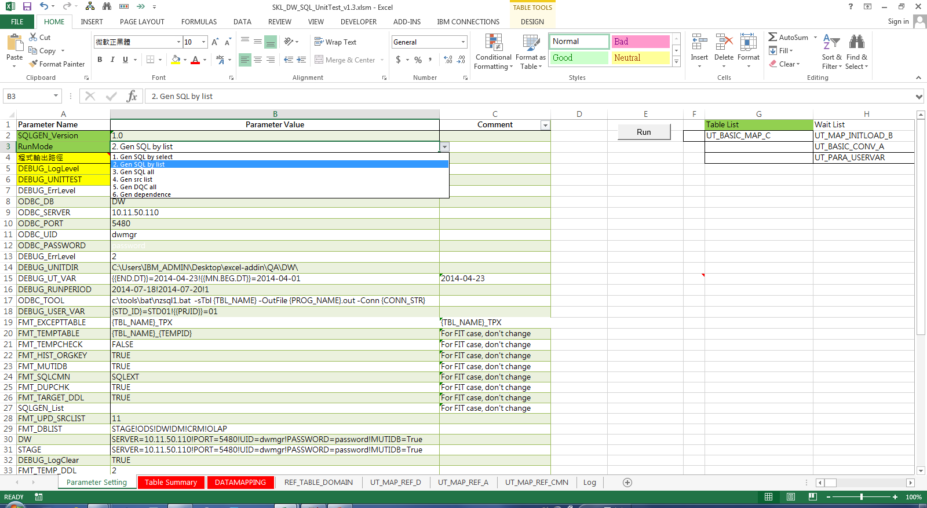
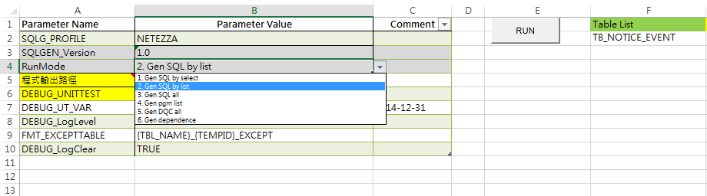
功能操作 - 工具列(QAT, Quick Access Toolbar)
操作:
直接點選工作列vtLogParse
結果
清除巨集公式絕對路徑
顯示最後結果, 或
整理Log
特點:
方便共用操作
Notes:
***

Slide 17
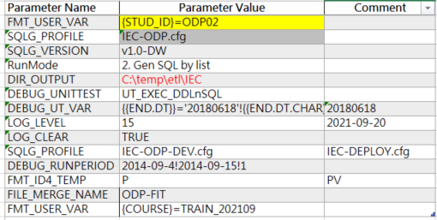
Exercise 1-2
Program: TRN_{STUD_ID}_12G
Operation
{{RunMode}}
{{DIR_OUTPUT}}
{{DEBUG_UNITTEST}}
{{DEBUG_UT_VAR}}
{{LOG_LEVEL}}: 7 → 15
{{SQLG_PROFILE}}: ***.cfg → Blank
Notes:
Instructor notes:
Run 12G
Check how to debug
Open SQL file, to see how parameter impact in Step 3.4
Run every RunMode as PPT
By Select
By List
All
Gen Dependency
Explain parameter in comment table
DEBUG_UNITTEST
DEBUG_UT_VAR
LOG_LEVEL: Change from 7 to 15, check what’s different
SQLG_PROFILE: clear UT-TRN.cfg
Restore SQL_PROFILE

Slide 18
Agenda
Developer Training
Overview
SQLG Introduction
DI-OP Introduction
Dev procedure
DI-IM QuickStart
Data Architect Training
SQLG Introduction - Architect
FileMerge and Excel
Q&A

Slide 19
DI-OP Template Introduction
IBM_OP_Data Inventory_Intro.pptx

Slide 20
Exercise 2-1
Program: TRN_{STUD_ID}_21G
Objective: A. CTE without UNION
Operation
Run and Check Fail Log
Open and Check SQL
What’s wrong
Enable Join, then Run
Go [DATAMAPPING]!I57, Update cell value
From ‘-- =diJoin(G57,J57)
To =diJoin(G57,J57)
Run and Check Fail Log
Enable table alias
Update J56 with FREQ
Or Update J56, J61,J62,J3 with FREQ
Notes:
Instructor notes:
Review 11G/12G
Symmetry / Asymmetry
Run 21G,
Check how to debug
Open SQL file
Explain remark/comment area for SQLG. Like G/J/K column
diJoin(), click [fx] button, check hint from function
diRef(), explain parameter can be cell or string value. All blank will bring up default value
Excel 單引號注意事項

Slide 21
Exercise 2-1
Program: TRN_{STUD_ID}_21G
Objective: B. CTE vs. Temp table
Operation
Run, Check ODP-FIT.sql, Check target table
Switch to [Parameter Setting], update parameter as ‘V’
Run, Check ODP-FIT.sql, Check target table
Switch to [Parameter Setting], update parameter as ‘P’
Run, Check ODP-FIT.sql, Check target table
FMT_ID4_TEMP | V | V change to P
Notes:
Instructor notes:
Review 11G/12G
Symmetry / Asymmetry
Run 21G,
Check how to debug
Open SQL file
Explain remark/comment area for SQLG. Like G/J/K column
diJoin(), click [fx] button, check hint from function
diRef(), explain parameter can be cell or string value. All blank will bring up default value
Excel 單引號注意事項

Slide 22
Exercise 2-2
Program: TRN_{STUD_ID}_22G
Rule Number
TRN_{STUD_ID}_22G ←
TRN_{STUD_ID}_22G1
TRN_{STUD_ID}_22G2
UNION
CTE UNION
TABLE UNION
Operation
Run and Check Fail Log
Open and Check SQL
Enable union: Update D65:D89 as 1
Notes:
Instructor notes:
Run 22G,
Check how to debug
Open SQL file
Change D81 to from “1” to “2”

Slide 23
Exercise 2-3
Program: TRN_{STUD_ID}_23G
Check duplicate
Operation
Run and Check Fail Log
Open and Check SQL
Add [FILE_NAME] as PK
Set C91, C99 as 2
Or set C91, C99 as 1
Or set C91, C99 as *
Notes:
Instructor notes:
Run 23G,
Check
Change H101[TRN_{STUD_ID}_23G!SRC_TYPE] to from “P” to “G”

Slide 24
Exercise 3 - Extraction Method
Program: TRN_{STUD_ID}_31G
Extraction-Refresh
Program: TRN_{STUD_ID}_32G
Extraction-Upsert
Program: TRN_{STUD_ID}_33G
Extraction-Append
Notes:
Instructor notes:
Copy list 31G,32G,33G to [G2:G4]
Initial step
DEBUG_UNITTEST =UT_EXEC_DDLnSQL
[C8]=2014-09-06
Run, and check result
Check your table count
Delta data
DEBUG_UNITTEST =UT_EXEC_SQL_PERIOD
Verify {{DEBUG_RUNPERIOD}}=2014-09-4!2014-09-15!1
Run, and check result
Check your table count

Slide 25
DI file tracking
MDM ALL
..ALL_DI.xls
ODS
..SRC_[CLM|UNB|.].xls
INT
..SDM_[CLM|UNB|.].xls
Staging
STAGE
..PM-eBaoDD...xlsm
Data Mart
Phantom level
RPT
..RPT_[CLM|UNB|.].xls
APP
..RPT_[CLM|UNB|.].xls

Slide 26
Exercise 4
Program: TRN_{STUD_ID}_41G
Referential
Operation:
Check Fail Log
Update J132
Program: TRN_{STUD_ID}_42G
Reference Table Type
Program: TRN_{STUD_ID}_43G
Other Table Type
Notes:
Instructor notes:
41G: [ALT-5], drill thru, drill down
42G: Review how worksheet map to db table in column name
43G:
Run
Review program, only DDL
Review DB object
Drop view TRN_ODS00_43G
Change [Table Summary]! 6. Table Type from “V” to “T”
Run
Review program and data

Slide 27
Exercise 5-1
Program: TRN_{STUD_ID}_51G
User temp table and debug
Debug: CTE
WITH TRN_ODS00_51G_V1 AS (
SELECT
MA.PRJ_ID AS PRJ_ID
,MA.FILE_NAME AS FILE_NAME
,'T' AS IS_DAILY
,'F' AS IS_MONTHLY
,'F' AS IS_INIT
FROM UT.ETLFCT_1R MA
WHERE MA.FILE_FREQ='D'
) SELECT * from TRN_ODS00_51G_V1
Debug: TEMP table
SELECT * from TRN_ODS00_51G_V1
Notes:
Instructor notes:
CTE
Run and Validate Source
Open Client Tool
FMT_ID4_TEMP = PV
User Temp Table
Run and Validate Source
Open Client Tool

Slide 28
Exercise 6-1
Program: TRN_{STUD_ID}_61G
SetToFlag type 1
Program: TRN_{STUD_ID}_62G
SetToFlag type 2
Notes:
Instructor notes:
61G:
62G:

Slide 29
Helper Function Summary
Excel UDF: diUDF
SQLG macro
%{Excel UDF}
Macro function, dxUDF
Excel xla path issue
Cell cursor
Excel 255 Limitation
Name | Description | Sample
diRef
diIF
diCase
diFunc
diReplace
diQW
diJoin
Name | Description | Sample
dxRef
dxNA
dxSum
dxReplace
dxJoin
Notes:
***

Slide 30
Exercise 6-2
Program: TRN_{STUD_ID}_PARAM
Job parameter
Notes:
Instructor notes:
61G:
62G:

Slide 31
Agenda
Developer Training
Overview
SQLG Introduction
DI-OP Introduction
Dev procedure
DI-IM QuickStart
Data Architect Training
SQLG Introduction - Architect
FileMerge and Excel
Q&A

Slide 32
Data Architecture

Slide 33


數位化轉型技術 -明確的資料架構和資料流(Data pipeline in Data Zone View)
OSS
CDC
Stage
ODS
INT
DM
APP
使用單位
使用領域
負責領域
開發技術
Business / Operational Support System
ERP
MES/BDC
DB link
CRM
其他
Change Data Capture
File
CDC
資料平台/ SQL server and GreenPlum
報表工具
Drop Zone
CMN
STG
SRC
Landing Zone
ODS
Integration Zone
Public Zone (Data Mart)
INT
Domain
Tableau Server
Tableau / Web
Tableau Desktop
File
參考架構: 資料平台, ODP: Operational Data Platform
Notes:
Process Standard
治理平台不只是管標準資料 只要資料準備好 DZ LZ IZ 都可以連 標準資料建議存在IZ

Slide 34
Exercise 7
Program: TRN_{STUD_ID}_71G
STAGE to ODS

Slide 35
Exercise 7
Program: TRN_{STUD_ID}_72G
ODS to SDM

Slide 36
Exercise 7
Program: TRN_{STUD_ID}_73G
SDM to FOP/RPT

Slide 37
Exercise 7
Program: CLM_0350_PARAM
TRN_{STUD_ID}_74G
Job parameter

Slide 38
Agenda
Developer Training
Overview
SQLG Introduction
DI-OP Introduction
Dev procedure
DI-ODS QuickStart
Data Architect Training
SQLG Introduction - Architect
FileMerge and Excel
Q&A

Slide 39
DI-ODS Template QuickStart
IBM_ODS_Data Inventory_QuickStart.pptx

Slide 40
Agenda
Developer Training
Overview
SQLG Introduction
DI-OP Introduction
Dev procedure
DI-ODS QuickStart
Data Architect Training
SQLG Introduction - Architect
FileMerge and Excel
Q&A

Slide 41
SQLG Introduction - DataArchitect
IBM_SQLG_Introduction.pptx

Slide 42
Agenda
Developer Training
Overview
SQLG Introduction
DI-OP Introduction
Dev procedure
DI-ODS QuickStart
Data Architect Training
SQLG Introduction - Architect
FileMerge and Excel
Q&A

Slide 43
FileMerge Introduction

Slide 44
Planner QuickStart

Slide 45
Scheduler DevOps Process - Workbench
Operation
Development
JobFlow
Job Steps
Program
ETL
Job
QC
Housekeep
Job Control
System Architect
Data Inventory
System
ETL Program
Init
Data Model
Snapshot
Main ETL
Subject
DEV WB
OP WB
Scheduler
UI
Op
Adm
Engine
Core
API
SQLG
vba Toolkit
vtLog
Merge
Split
Update
Compare
FileMerge
Rule
Depend Relation
RunTime
vtUnit
ETL Program, Job Grouping
Notes:
Job Control
ETL Program, Job Grouping

Slide 46
Deployment Pattern - The DevOps approach
PROD
SIT
DEV
IBM-Planner [Data Mapping]
Arrow could be
- Putty, or ODBC
Notes:
Job Relation ***

Slide 47
Deployment Pattern - The Waterfall approach
PROD
SIT
DEV
IBM-Planner [Data Mapping]
Scheduler-Deploy
Notes:
Job Relation

Slide 48
Daily job - Planner
Initial Base Plan
Net Change Plan
Monitor
Select Plan Basis
Plan update
Schedule
Manual submit
Re-plan
Online
Report
Gen Base Plan
BasePlan
DeltaPlan

Slide 49
Plan Basis - Sample
BDS
Operational applications
個險
團險
Operational repositories
Oracle
AS400
Data acquisition
Golden Gate
旅平險
財務
申訴
其他
SQL server
File
Staging
RPT
FOP
STAGE
SRC
ODS
ODS
Summary Data Mart
Data Mart
SDM

Slide 50
Plan Basis
BDS
Operational applications
個險
團險
Operational repositories
Oracle
AS400
Data acquisition
Golden Gate
旅平險
財務
申訴
其他
SQL server
File
Staging
RPT
FOP
STAGE
SRC
ODS
ODS
Summary Data Mart
Data Mart
SDM
Plan Basis
ODS
SDM
RPT
ODS_ONLY
ODS
NO_ODS
SDM
RPT
FOP
ODS_ONLY
ODS
RPT_BASE
SDM
RPT

Slide 51
Operation Sequence - by planner role
Plan Type Role | Base Plan | Delta Plan | Net Change | Simulation | Action
DEVELOPER - Subject |  |  |  |  | [JobImport]
- By Flow |  |  |  |  | [Netchange] [JobImport]
- FOP |  |  |  |  | [Netchange] [JobImport]
- Rush job |  |  |  |  | [Netchange] [UpdateSource] <Job update> [Simulation]
ARCHITECT - Baseplan |  |  |  |  | [JobImport]
- Set plan basis - Batch chg |  |  |  |  | [UpdateSource] <Change Base> <ftp>
- Set baseplan |  |  |  |  | [UpdateSource] <Change Base>
ADMIN - Import |  |  |  |  | $iws_reset.sh $iwsimport
- Reset |  |  |  |  | $iwsplandate.py
- Replan |  |  |  |  | $iws_plan.sh

Slide 52
Q&A

Slide 53
Todolist: before start
Prepare
時程, 分 2 天, D1: 2 hr, D2: < 2 hr
時間,
學員名單:
評分方式
交巻 +1
正確 +1
前3名 + 1,2,3
分組比賽
獎品
團體/ 個人各一名

Slide 54
ODBC admin for 32 bit
管理員權限授權
tnsname.ora
ODBC 設定
C:\Windows\SysWOW64\odbcad32.exe
Excel 安全性設定

