Slide 1

資料庫設定 IBM Services

Slide 2
Agenda
Directory
Data Architecture
Env setup
ODBC
Unit test DB

Slide 3
Directory
Sqlext installation
PMS> 99_Tools\9920_Install\sqlext.mssql\IEC
SQLG config
PMS> 99_Tools\9920_Install\addin
Airflow config
Airflow: /home/{user}/config/conn.json

Slide 4


數化轉型技術: -明確的資料架構和數據資料流(Data pipeline in Data Zone View)
數位轉型-技術
OSS
CDC
Stage
ODS
INT
DM
APP
使用單位
使用領域
負責領域
開發技術
Business / Operational Support System
ERP
MES/BDC
DB link
CRM
其他
Change Data Capture
File
CDC
數據平台/ SQL server and GreenPlum
報表工具
Drop Zone
CMN
STG
SRC
Landing Zone
ODS
Integration Zone
Public Zone (Data Mart)
INT
Domain
Tableau Server
Tableau / Web
Tableau Desktop
File
參考架構: 數據平台, ODP: Operational Data Platform
Notes:
Process Standard
治理平台不只是管標準資料 只要資料準備好 DZ LZ IZ 都可以連 標準資料建議存在IZ

Slide 5
資料標準類別 - Category 與Data Zone 對應關係
Discover
Develop
Culture
ODS
INT
DM
APP
Stage
IEC Data Platform
Data Standard
Analytics
Regulation
IFRS
Policy Basis
Topics
PRO
Domain
Term/Concept
Dashboard
PLN
採購方式與採購金額分佈
製造商與Commodity組成分析
採購方式與採購金額分佈
供應商預測計劃
庫存採購收料數量
Term/Class
採購方式
採購件
BASE
Notes:
Process Standard

Slide 6
DB Schema - ODS
Schema | Usage | Tools | Privilege
SQLEXT | Stored Procedure | Airflow | Airflow 用戶執行
STAGE | Drop Zone, System interfaced source data | Db link | Airflow 用戶讀寫,
SRC | Drop Zone, Manual upload source data | Airflow+SQLEXT | Airflow 用戶讀寫,
ODS | Landing Zone, Operating Data Store | Airflow+SQLEXT | Airflow 用戶讀寫,
INT | Integration Zone | Airflow+SQLEXT | Airflow 用戶讀寫,
DM | Public Zone, Data Mart | Export tool | Airflow 用戶讀寫,
APP | Public Zone, End user computing table | Db link | Airflow 用戶讀寫, 一般用戶唯讀

Slide 7
SQLEXT installation
PMS> 99_Tools\9920_Install\sqlext.mssql
schema.ddl
Create schema for all data zone
holiday.ddl
Holiday table for working calendar
fn_AddBusinessDays.sql
Business day function on working calendar
etldate.sql
ETL date function for SQLG macro
sp_drop_if_exists.ddl
Drop if function for MSSQL

Slide 8
SQLG config
PMS> 99_Tools\9920_Install\addin
IEC-PSG-DEV.cfg
IEC-PSG-SIT.cfg
IEC-PSG-PROD.cfg

Slide 9
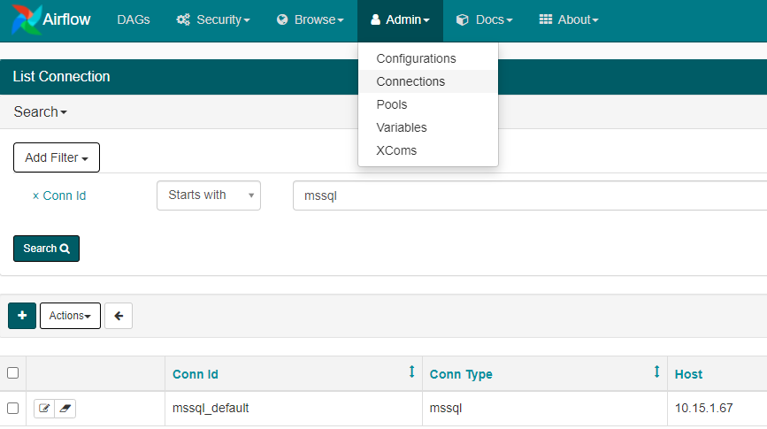
Airflow config
Airflow: /home/{user}/config/conn.json
"mssql_default": {
"conn_type": “ SQL Server",
"host": "10.15.1.67",
"schema": "DGDEV",
"login": "難難難難",
"password": "難難難難",
"port": "1433"
},

