Slide 1
Data Engineering Pipeline
Sai Saathvik Domala

Slide 2
Problem Statement
Build a reliable, end‑to‑end data ingestion pipeline capable of processing messy, real‑world CSV data into clean, analytics‑ready SQL tables.
The goal is to demonstrate your ability to:
- Design a scalable schema.
- Ingest and preprocess raw data.
- Apply robust data quality controls.
- Communicate tradeoffs and engineering decisions clearly.

Slide 3
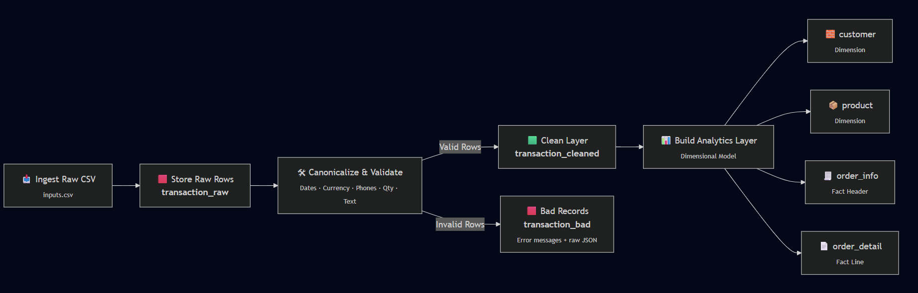
Architecture Overview
Ingest raw input
Dump raw rows into transaction_raw
Canonicalize and validate → produce clean_rows + bad_rows
Derive final analytics layer split into Dims and Fact Table
  Customer, Product, Order_info, Order_detail

Slide 4
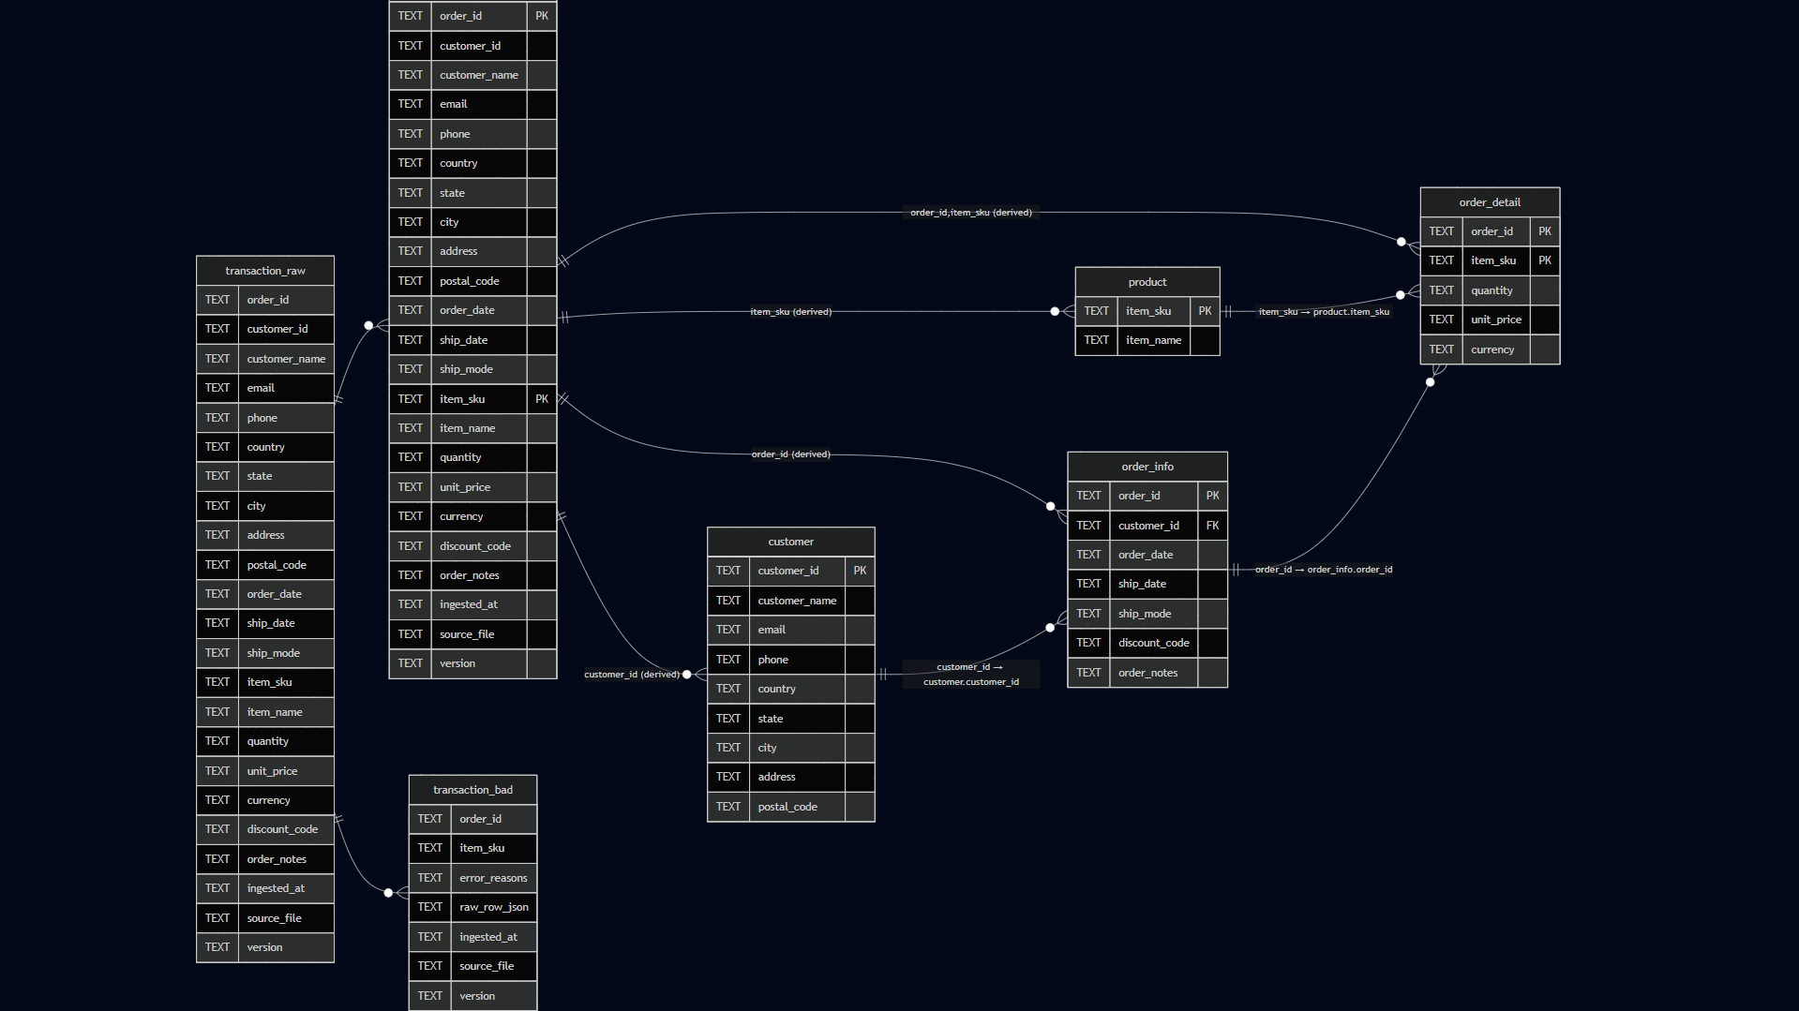
Schema Design

Slide 5
Why This Schema Works Well
3- Layer Architecture
  Bronze: Raw staging
  Silver: Clean & Bad tables
  Gold: customer, product, order_info, order_detail
Star-schema layout for analytics
  Traceable: Every clean/bad row maps back to raw data.
  Reliable: Natural keys enforce idempotency and eliminate duplicates.
  Analytics‑ready: Star schema supports BI and reporting use cases.
  Production‑aligned: Mirrors real-world ingestion patterns (Raw → Clean → Dims/Facts).
  Extensible: Easy to add SCD2, FX normalization, enrichment, & metadata tables.

Slide 6
Key Engineering Considerations
Read‑as‑TEXT ingestion
Schema‑on‑read (ELT) approach
Strict canonicalization before validation
Three‑Layer Architecture (Bronze → Silver → Gold)
UPSERT‑based ingestion
Global data normalization
Reproducibility & lineage : ingested_at, source_file, version
SCD‑Friendly

Slide 7
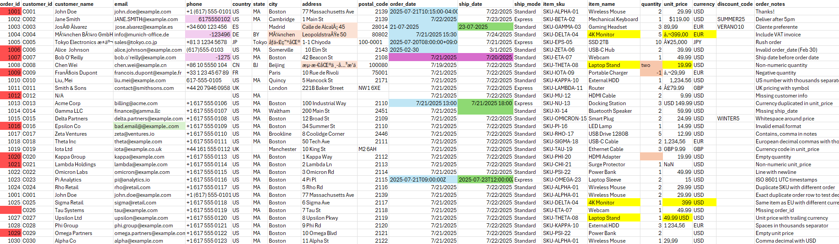
Data Quality Handling
Color | Issue Type
🔴 Red | Bad records
🟩 Light Green | Invalid email format
🟪 Light Purple | Inconsistent phone format
🟧 Light Orange | Non‑ASCII / corrupt text
🔵 Light Blue | Inconsistent order date formats
🟢 Dark Green | Inconsistent ship date formats
🟡 Yellow | Conflicting prices for same product
🟣 Dark Purple | order_date > ship_date
🟧 Dark Orange | Inconsistent numeric format

Slide 8
Data Quality Handling
Unicode normalization
Whitespace cleanup
Phone normalization with country codes
Unified Timestamp
Currency Mapping
Quantity parsing (words → numbers)
Duplicate detection: exact + conflicting
Validation: required fields, business rules

Slide 9
Known Limitations
All TEXT columns; no DB type enforcement
No schema evolution or SCD2
Hardcoded reference dictionaries
No ingestion metadata table
Limited observability
No CI/CD or automated tests
SQLite limits scalability

Slide 10
Next Steps
Add SCD2 for customer/product
Schema evolution + drift detection
Currency normalization + FX tables
Rules engine (YAML/JSON)
Ingestion_run table + structured logs
DQ dashboards (Grafana/Metabase)
Unit/data tests + GitHub Actions
Migrate to PostgreSQL + Airflow/Prefect
Add checkpointing + partitioned ingestion

Slide 11
Thank You!

