Slide 1
FixMyStay - Hostel Complaint Management System

Slide 2
INTRODUCTION
FixMyStay is a web-based Hostel Complaint Management System designed to
make it easier for students to report and track complaints related to hostel
facilities. In many hostels, the current system for filing complaints is manual.
Students either write their issues in a register or report them verbally to the
warden. This traditional method often causes delays, miscommunication, and
complaints being forgotten or ignored.
FixMyStay solves this problem by providing an online platform where students
can quickly file complaints anytime, from anywhere. The system allows hostel
staff (admins) to view and manage these complaints efficiently. Students can
also track the status of their complaints—whether it is pending, in progress, or
resolved.
This system makes the complaint process faster, more transparent, and more organized. It improves communication between students and hostel staff and ensures that issues are resolved on time. FixMyStay helps create a better hostel living experience for all students.

Slide 3
PROBLEM DEFINITION
In most hostels, student complaints are managed through manual processes, such as writing complaints in a register or verbally informing hostel staff. This method often results in delays, lost complaints, and a lack of communication between students and hostel authorities. Students have no clear way to track the status of their complaints, which leads to frustration and dissatisfaction. Hostel staff also find it difficult to manage multiple complaints without a structured system. To solve these issues, there is a need for an automated, transparent complaint management system that simplifies and speeds up the entire process.
Key Points:
Manual complaint handling (registers or verbal communication) is inefficient.
Complaints are often delayed, forgotten, or unresolved.
Students cannot track the status of their complaints.
Poor communication between students and hostel management.
Difficulty for staff to manage and prioritize multiple complaints.
Leads to delays in issue resolution and student dissatisfaction.
A digital, automated system is needed for efficiency and transparency.

Slide 4
EXISTING SYSTEM
Complaints are recorded in physical registers or communicated verbally.
Some hostels use emails or messaging apps (e.g., WhatsApp) for complaints.
There is no proper tracking of complaints.
Students are not informed about the progress or status of their issues.
Complaints can be forgotten, overlooked, or delayed.
Hostel staff struggle with managing multiple complaints effectively.
Lack of accountability and transparency in the complaint resolution process.

Slide 5
Proposed Model
The proposed system, FixMyStay, is a web-based Hostel Complaint Management System designed to simplify and automate the complaint process in hostels. Students can easily file complaints online by filling out a structured form, providing details such as complaint title, description, category, and room number. The system allows students to track the status of their complaints in real-time, ensuring transparency and accountability. Hostel administrators can view all submitted complaints on their dashboards, prioritize them based on urgency, and update their status as "Pending", "In Progress", or "Resolved". The system is user-friendly and helps both students and hostel staff save time, improve communication, and ensure faster resolution of issues. It also maintains a complete history of complaints in the database for future reference and analysis.

Slide 6
Modules of the System
🔹 User Authentication Handles login and signup for students and admins. Ensures only authorized users can access the system.
🔹 Student Dashboard Displays all complaints submitted by the student. Shows complaint statuses and allows editing pending complaints.
🔹 Complaint Filing Enables students to file new complaints by filling out details like title, description, category, and room number. Validates input before submission.
🔹 Admin Dashboard Allows hostel admins to view, manage, and update the status of all complaints. Helps prioritize and resolve issues quickly.
🔹 Database Management Stores user data and complaint records securely in a MySQL database. Maintains complaint history for future reference.

Slide 7
UML Diagrams
🔹 Use Case Diagram Shows how users interact with the system.
Actors: Student, Admin
Use Cases: Login, Register, File Complaint, View Complaints, Update Status It explains the functional requirements by showing user actions and system responses.
🔹 Class Diagram Represents the system's main entities and their relationships.
Classes: User, Complaint
Attributes: User ID, Name, Email, Complaint ID, Title, Status, etc. Describes how data is structured in the system and how objects relate.
🔹 Activity Diagram Shows the workflow of filing and resolving a complaint.
Steps: Student logs in → Files complaint → Admin views → Updates status → Student tracks status Helps visualize the process and flow of actions in the system.

Slide 8
Frontend Implementation
The frontend of FixMyStay is built using HTML, CSS, and JavaScript. It provides a simple and user-friendly interface for both students and admins.
HTML creates the structure of pages like home, login/signup, dashboard, complaint form, and complaints list.
CSS makes the pages visually appealing and responsive. It styles buttons, forms, and tables for a consistent look.
JavaScript adds interactivity. It validates forms, shows alerts, and updates data without reloading pages.
Students can file complaints, view status, and edit/delete pending complaints.
Admins can view and update complaint statuses easily from their dashboard.
The frontend communicates with the backend using API requests for smooth data exchange.

Slide 9
Advantages
Results
Easy Complaint Filing Students can file complaints online at any time without visiting the hostel office.
Real-Time Status Tracking Students can check the status of their complaints anytime, improving transparency.
Reduces Manual Work Eliminates the need for manual registers and paperwork, saving time for hostel staff.
Faster Resolution of Issues Admins can quickly view and prioritize complaints, leading to quicker resolutions.
Better Communication Improves communication between students and hostel authorities by providing updates.
Secure and Organized Data Storage Complaints and user data are securely stored in the database for easy access and future reference.
User-Friendly Interface Simple and easy-to-use design, making it accessible even for non-technical users.

Slide 10
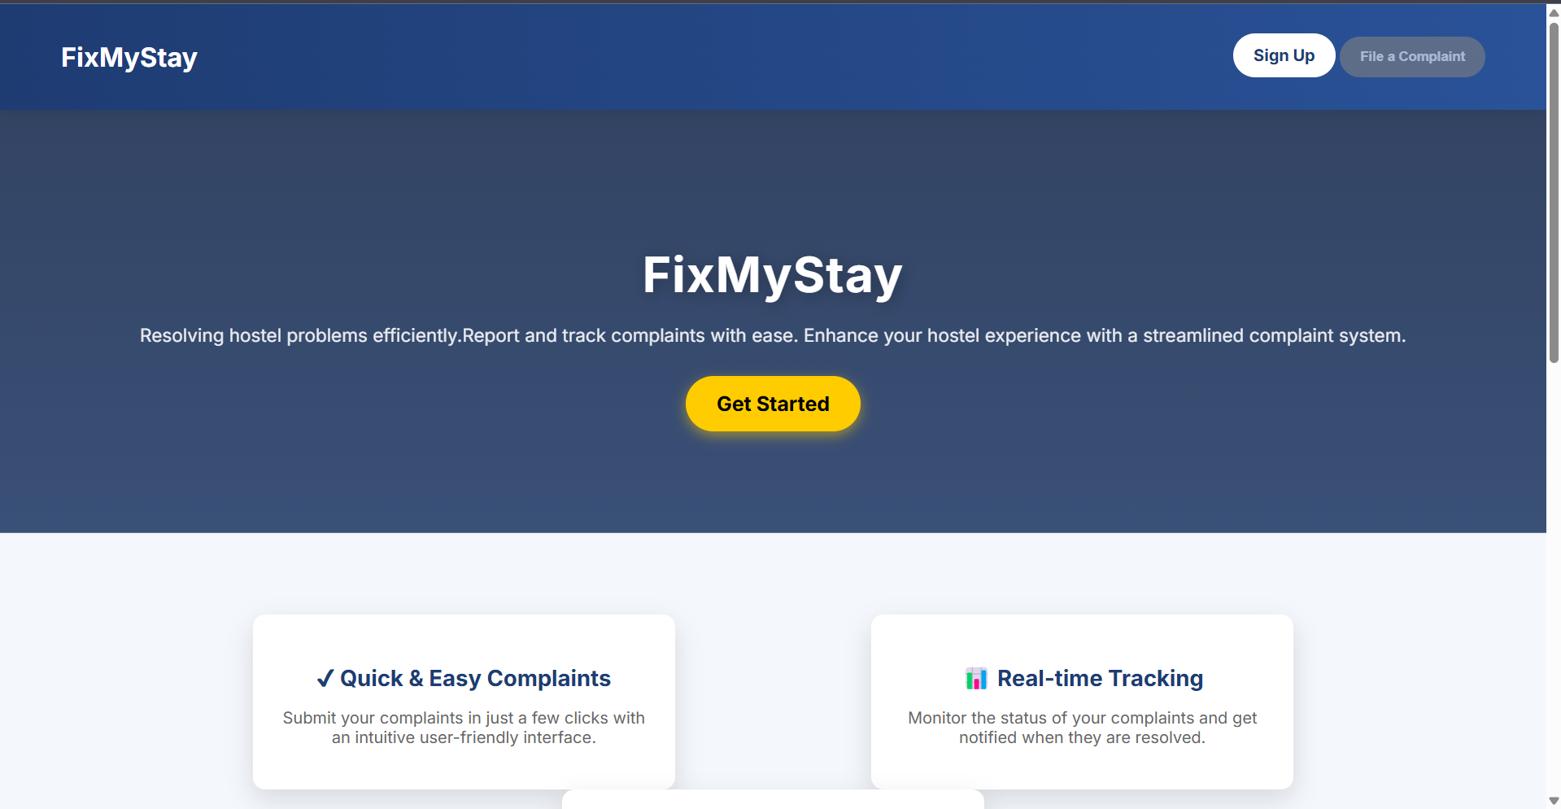
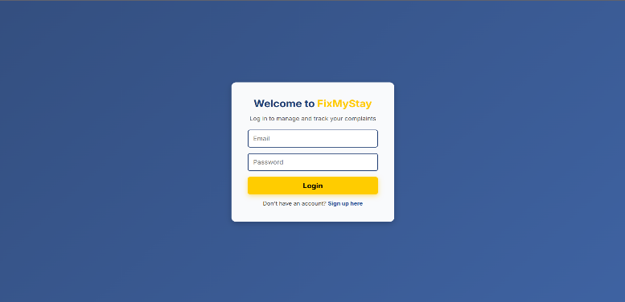
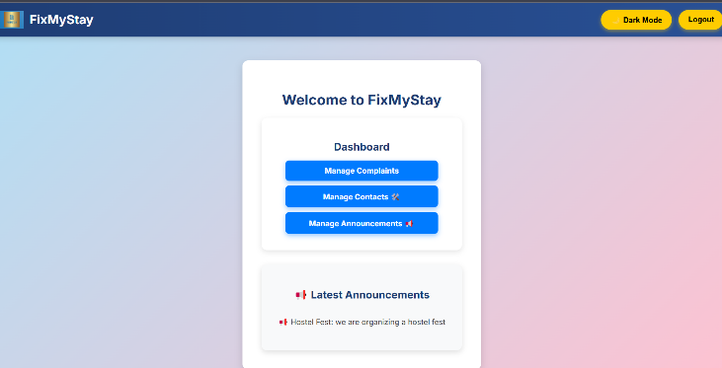
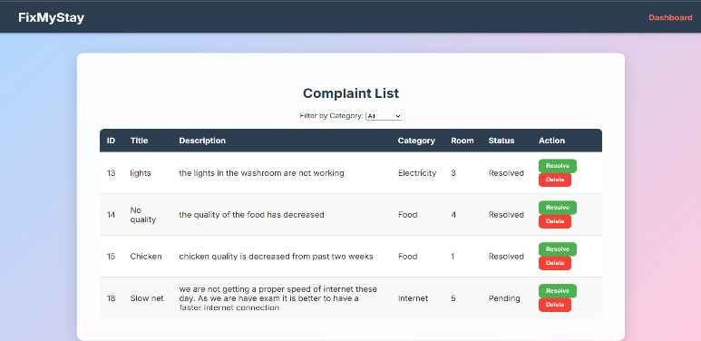
Results
Screenshots from the system showing Home Page, Login, Signup, Dashboard, Complaint Form, and Complaints List.

Slide 11
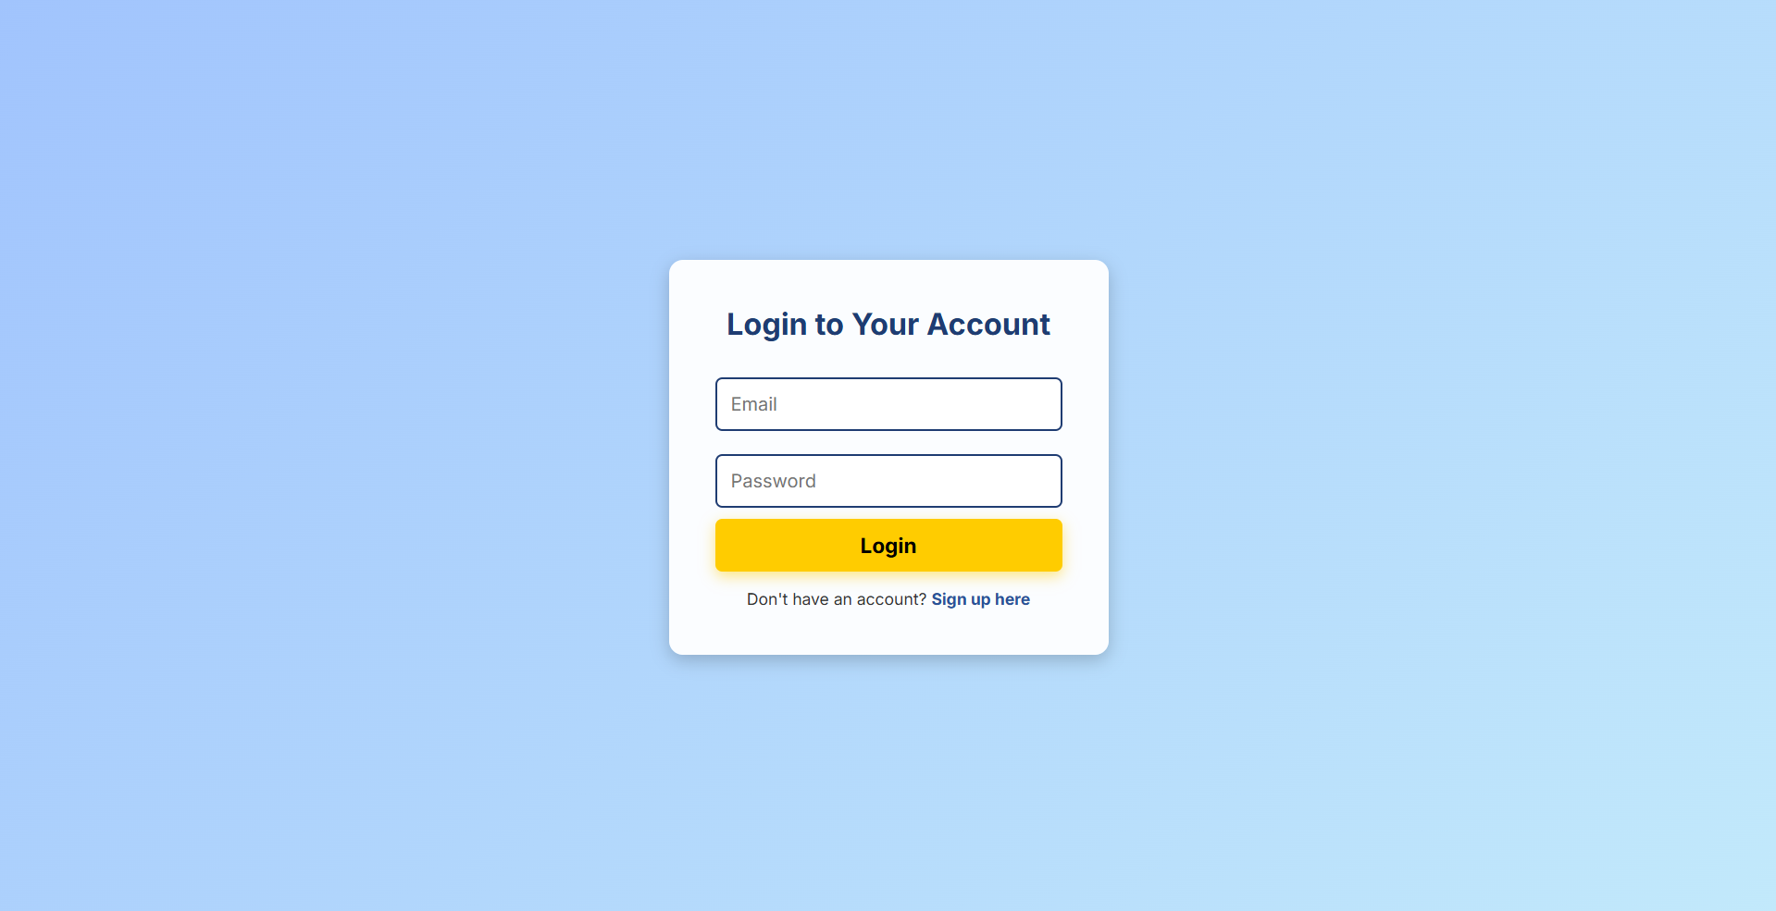
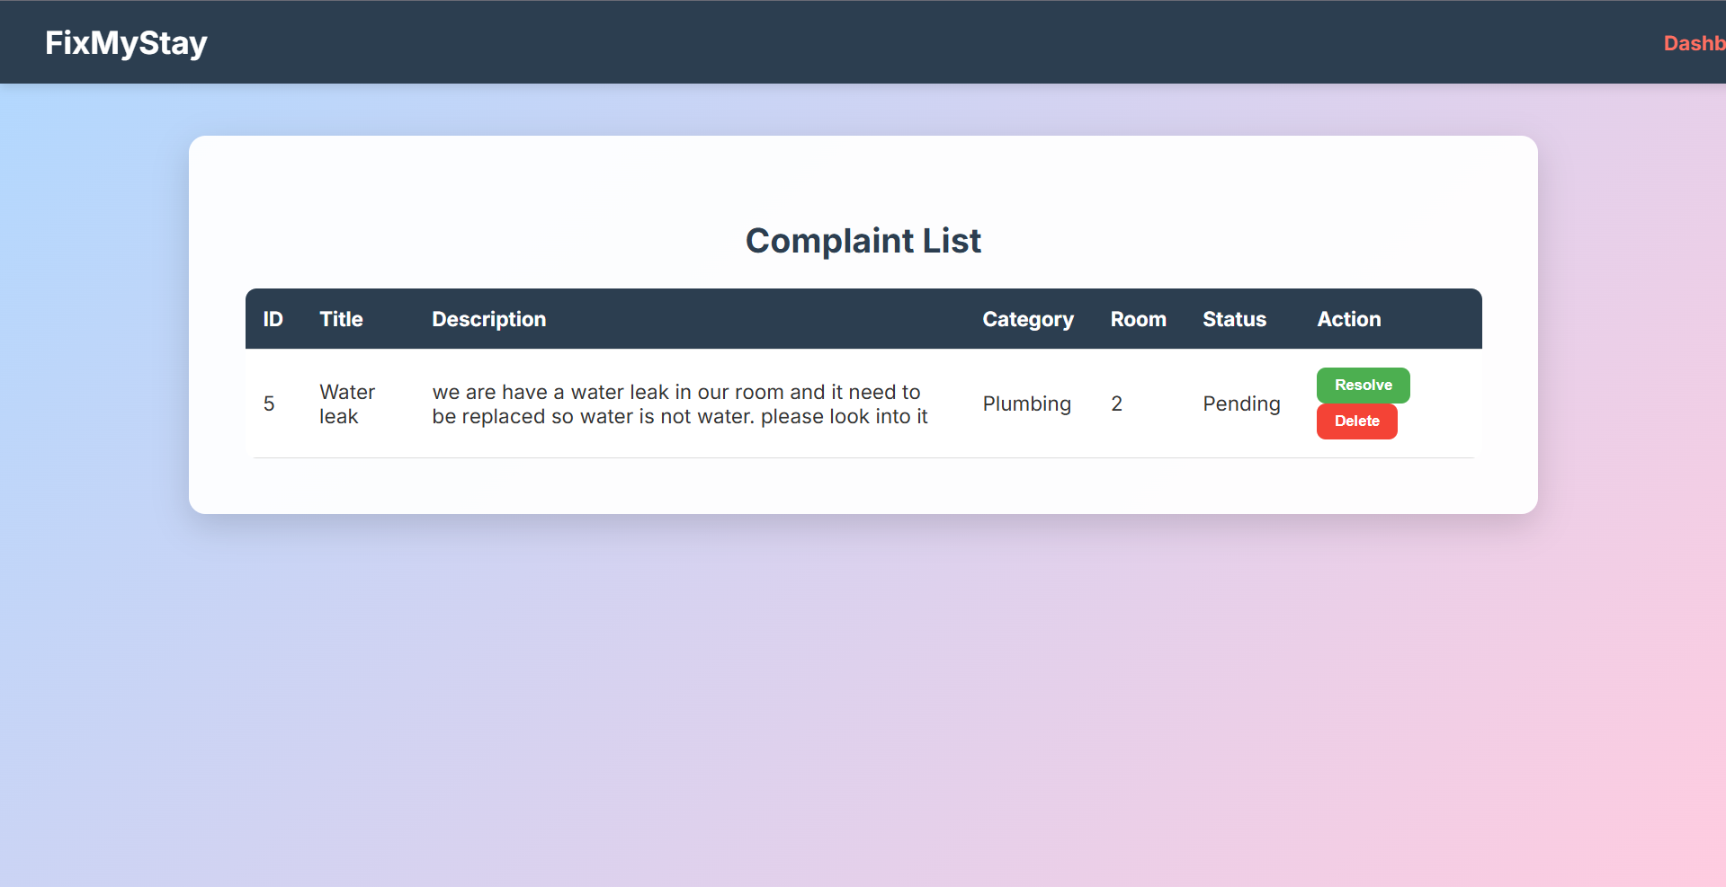
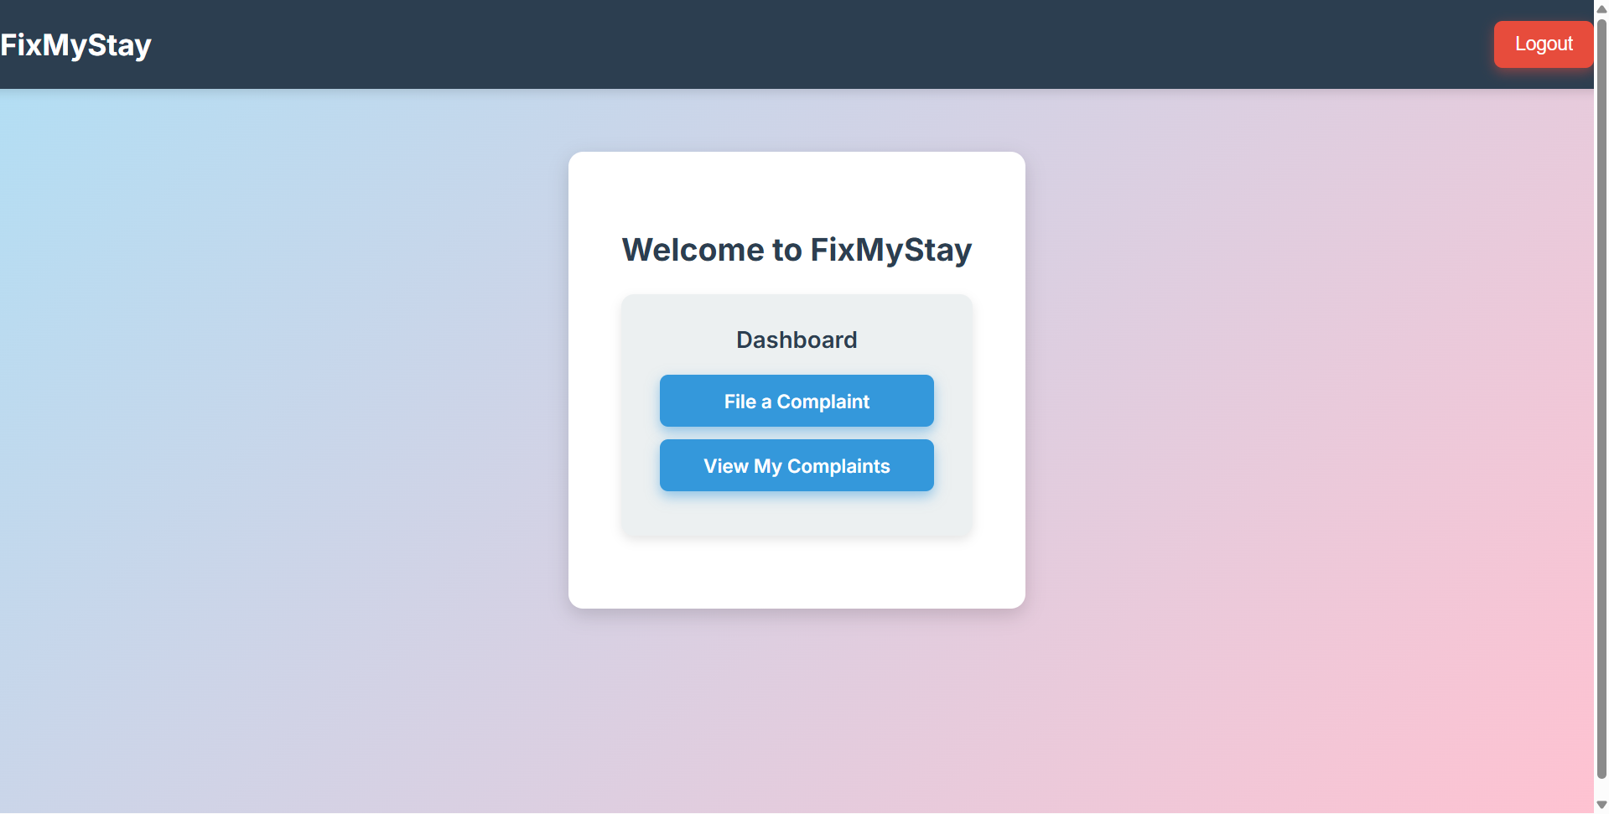
Possible Future Enhancements
Mobile Application Support Develop an Android or iOS app to make complaint submission and tracking easier and more accessible for students.
Real-Time Notifications Send SMS or email alerts to students and admins whenever the status of a complaint changes.
Feedback and Rating System Allow students to give feedback and rate the resolution process after their complaint is addressed.
Multi-Hostel Management Expand the system to support multiple hostels or campuses under a single platform.
Advanced Analytics and Reports Provide reports on complaint types, resolution time, and frequent issues to help management make better decisions.

Slide 12
Conclusion
FixMyStay is a smart and efficient Hostel Complaint Management System that solves the problems of manual complaint handling in hostels. It makes the process of filing, tracking, and resolving complaints faster, more transparent, and more organized. The system helps improve communication between students and hostel staff, ensuring that issues are addressed on time.
By reducing paperwork and providing real-time updates, FixMyStay improves the overall hostel experience for students. It also makes complaint management easier for the hostel administration, saving time and effort. The project successfully demonstrates the importance of automation in improving hostel services and student satisfaction.

Slide 13

Department of CSE
Vignan’s University, Guntur
Team Members:
R. Nagaramya (231FA04488)
G. Siva (231FA04615)
Bachali Saathvik (231FA04657)
Rahul Kumar (231FA04G24)

