Slide 1
Multi-Omics Predictive Model for Cancer Stage Classification
Presented by: Angela Xu, Pratibha Pradeep, Saathvik Chandupatla

Slide 2
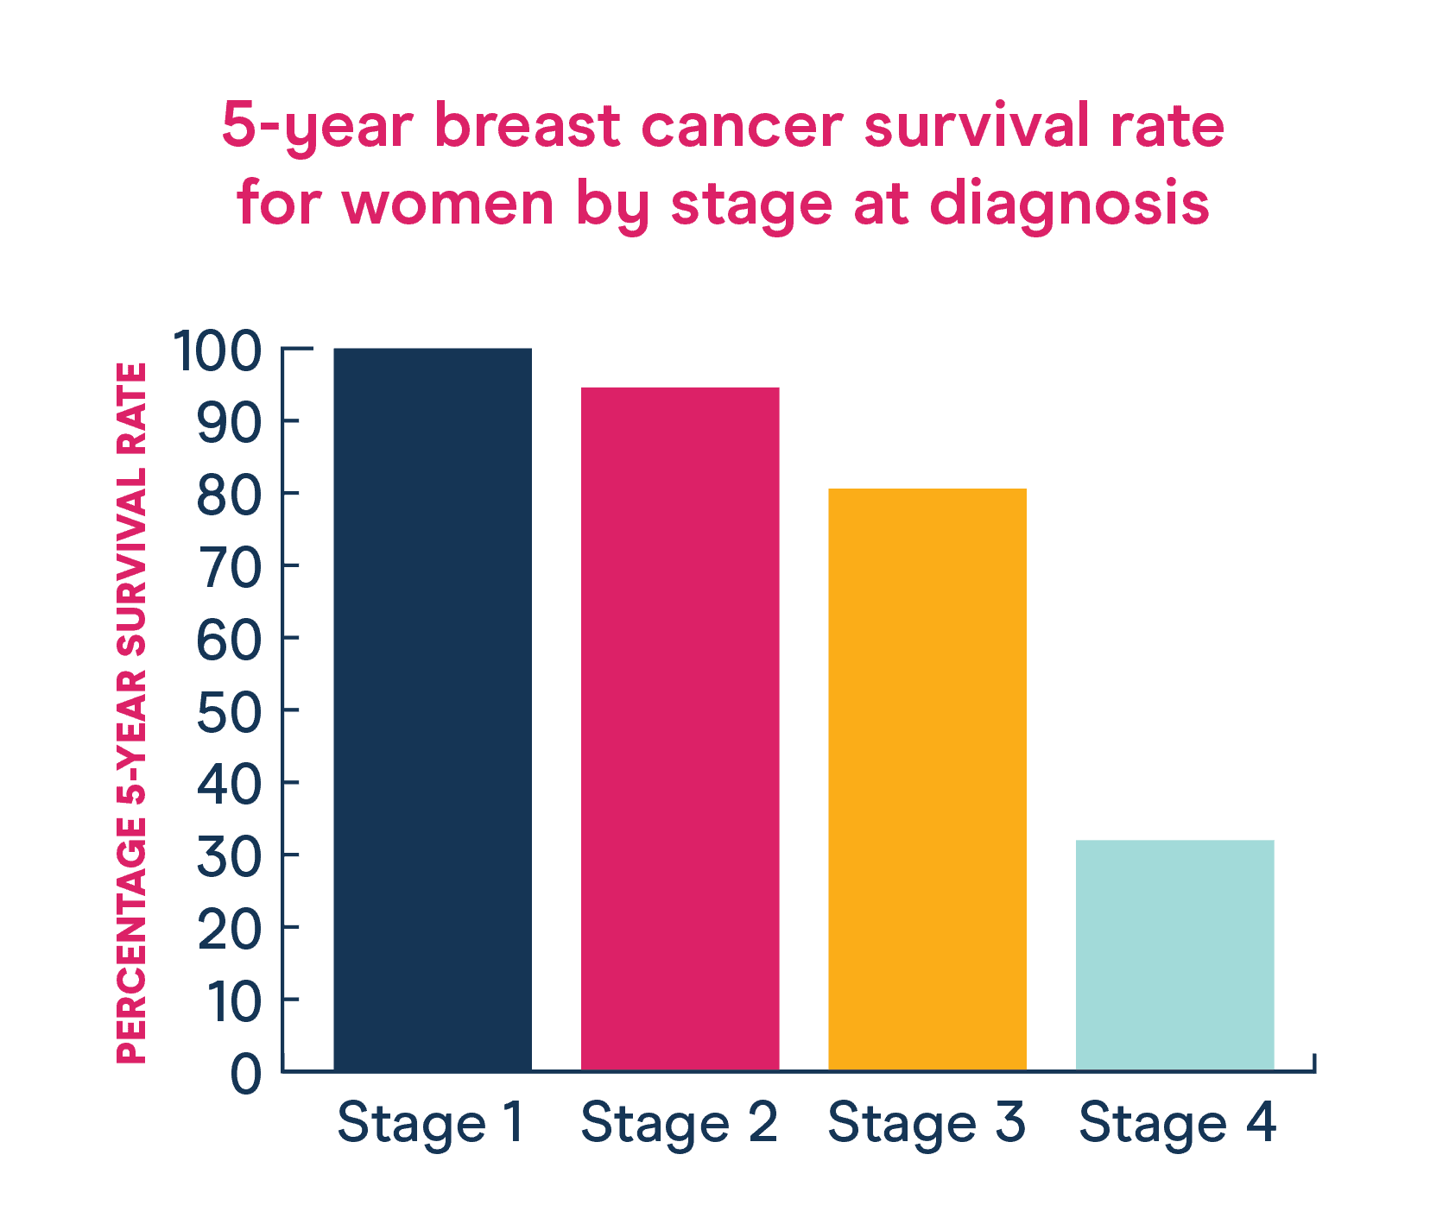
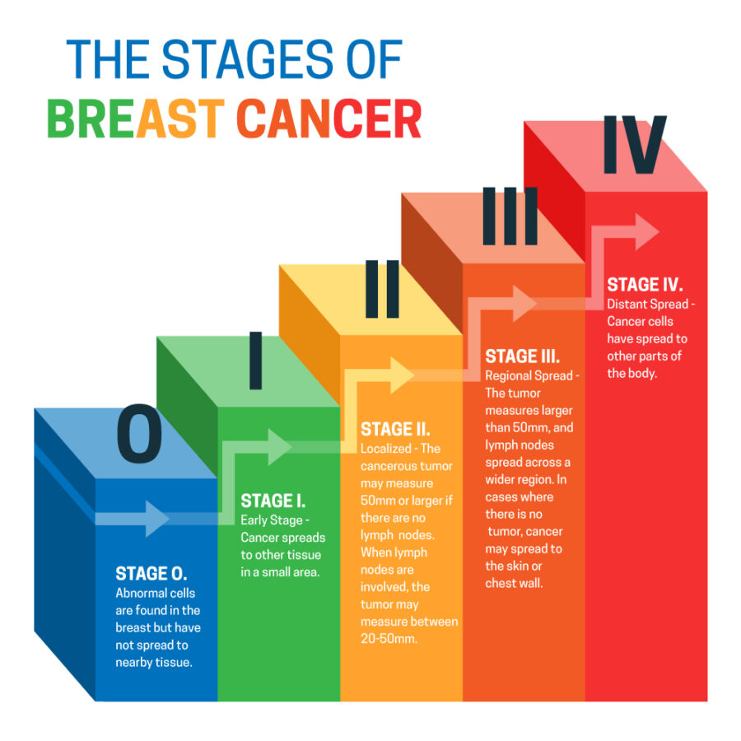
Breast Cancer: affects 13% of women in the US
Image taken from: https://www.westsuburbanmc.com/understanding-the-5-stages-of-breast-cancer-and-prognosis/
Image taken from: https://nbcf.org.au/about-breast-cancer/breast-cancer-stats/
Notes:
In the United States of America, one out of eight women will develop breast cancer, the rate of incidence increases by one percent every year. Breast cancer is a leading cause of cancer related mortality in women. Survival based prediction models would be beneficial to estimate the need for aggressive treatment in patients. One such feature that is commonly looked at to predict mortality is tumor stage. Here, we attempt to combine genetic sequencing and pathology imaging data to see if these metrics will be sufficient for predicting tumor stage. This project will demonstrate if the use of image analysis in combination with multi-omics can be useful for predicting factors closely related to survivability in breast cancer patients.

Slide 3
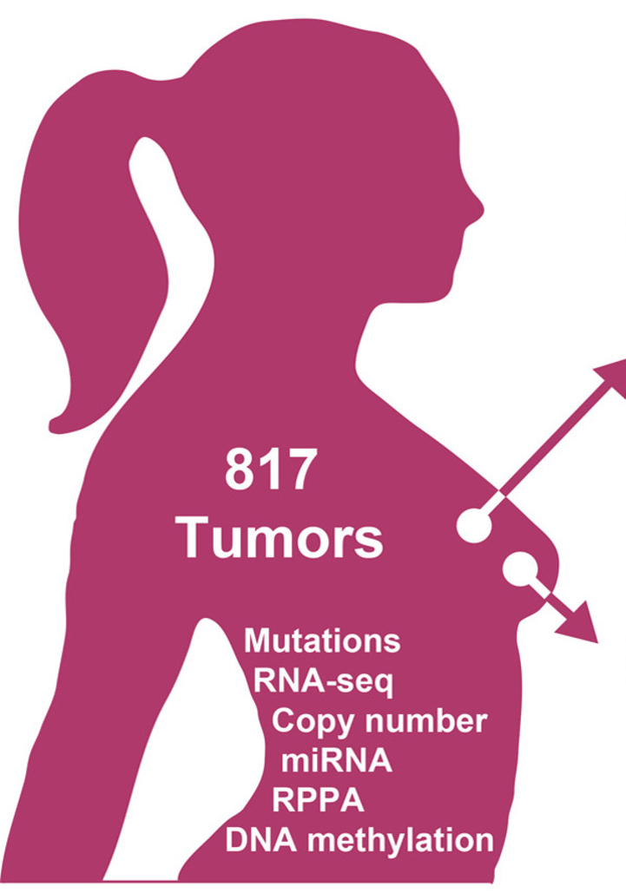
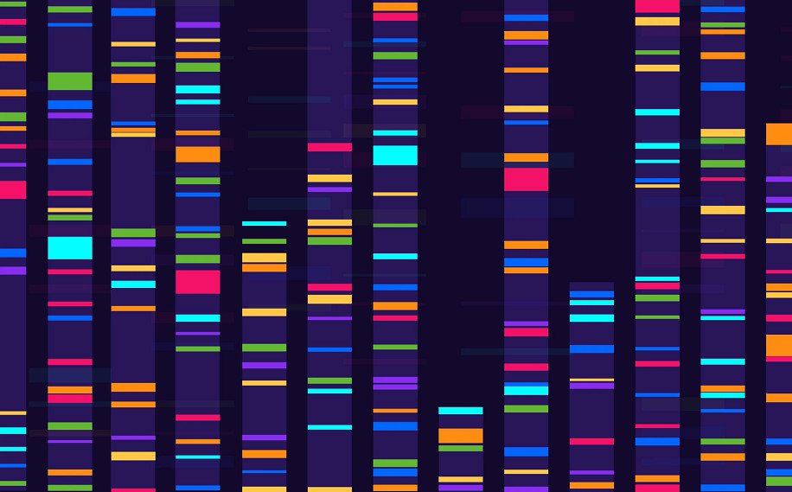
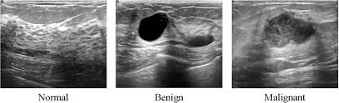
The Cancer Genome Atlas Breast Invasive Carcinoma (TCGA-BRCA)
84 patients with images and gene expression data
33 patients with both
Image taken from web
93 patients with tissue images
Image taken from: https://www.kaggle.com/datasets/samdemharter/brca-multiomics-tcga, https://www.data-in-brief.com/
Notes:
The data utilized in this experiment was performed using the Breast Invasive Carcinoma, or BRCA dataset. This dataset contains clinical, genetic, and pathological data pertaining to the cancer diagnosis. At the time of data acquisition, only 84 were reported to contain images taken from the same medical device, GE 1.5 Tesla magnet strength scanners, along with genomic data. Surprisingly, once the data was accessed, only 33 of the reported 84 patients had both pathology images and genetic sequence data available. At this point it would have been beneficial to go find more data available to us for training because 33 is a small sample size, however, there are instances in the molecular clinical field where obtaining a sufficiently large dataset is difficult. So we decided to attempt predictive modeling to see what challenges small sample size would give us.

Slide 4
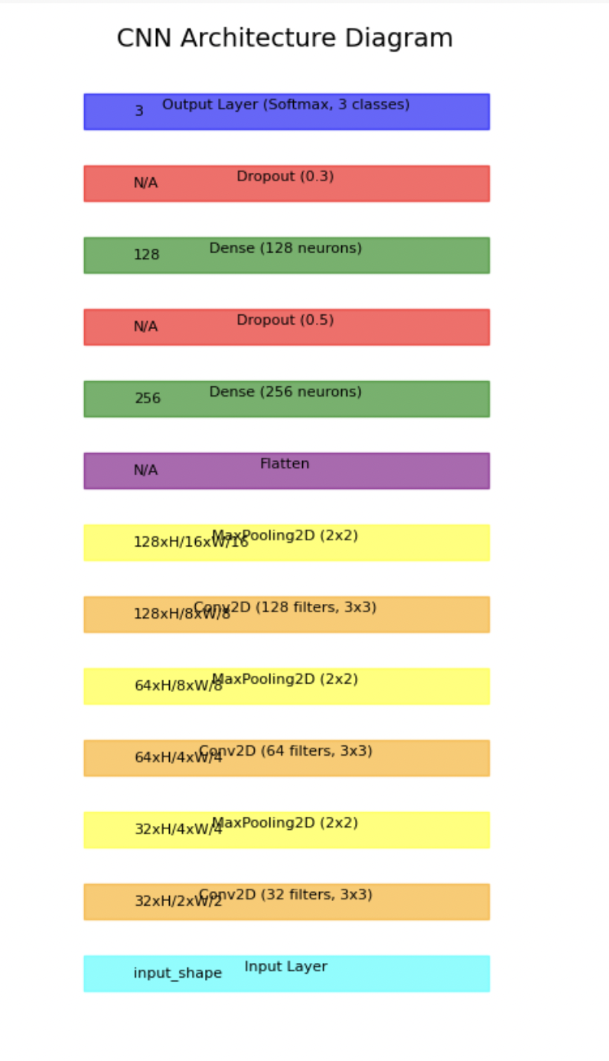
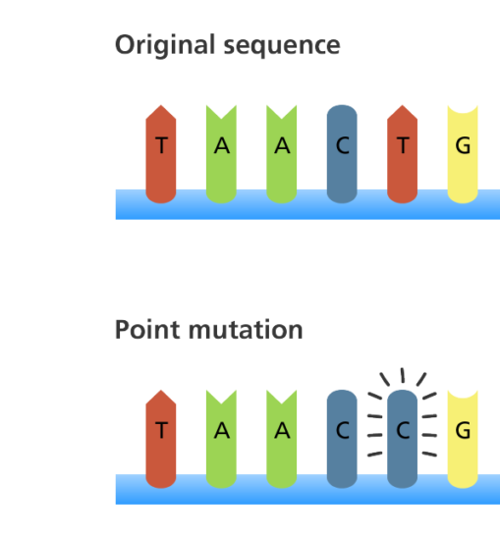
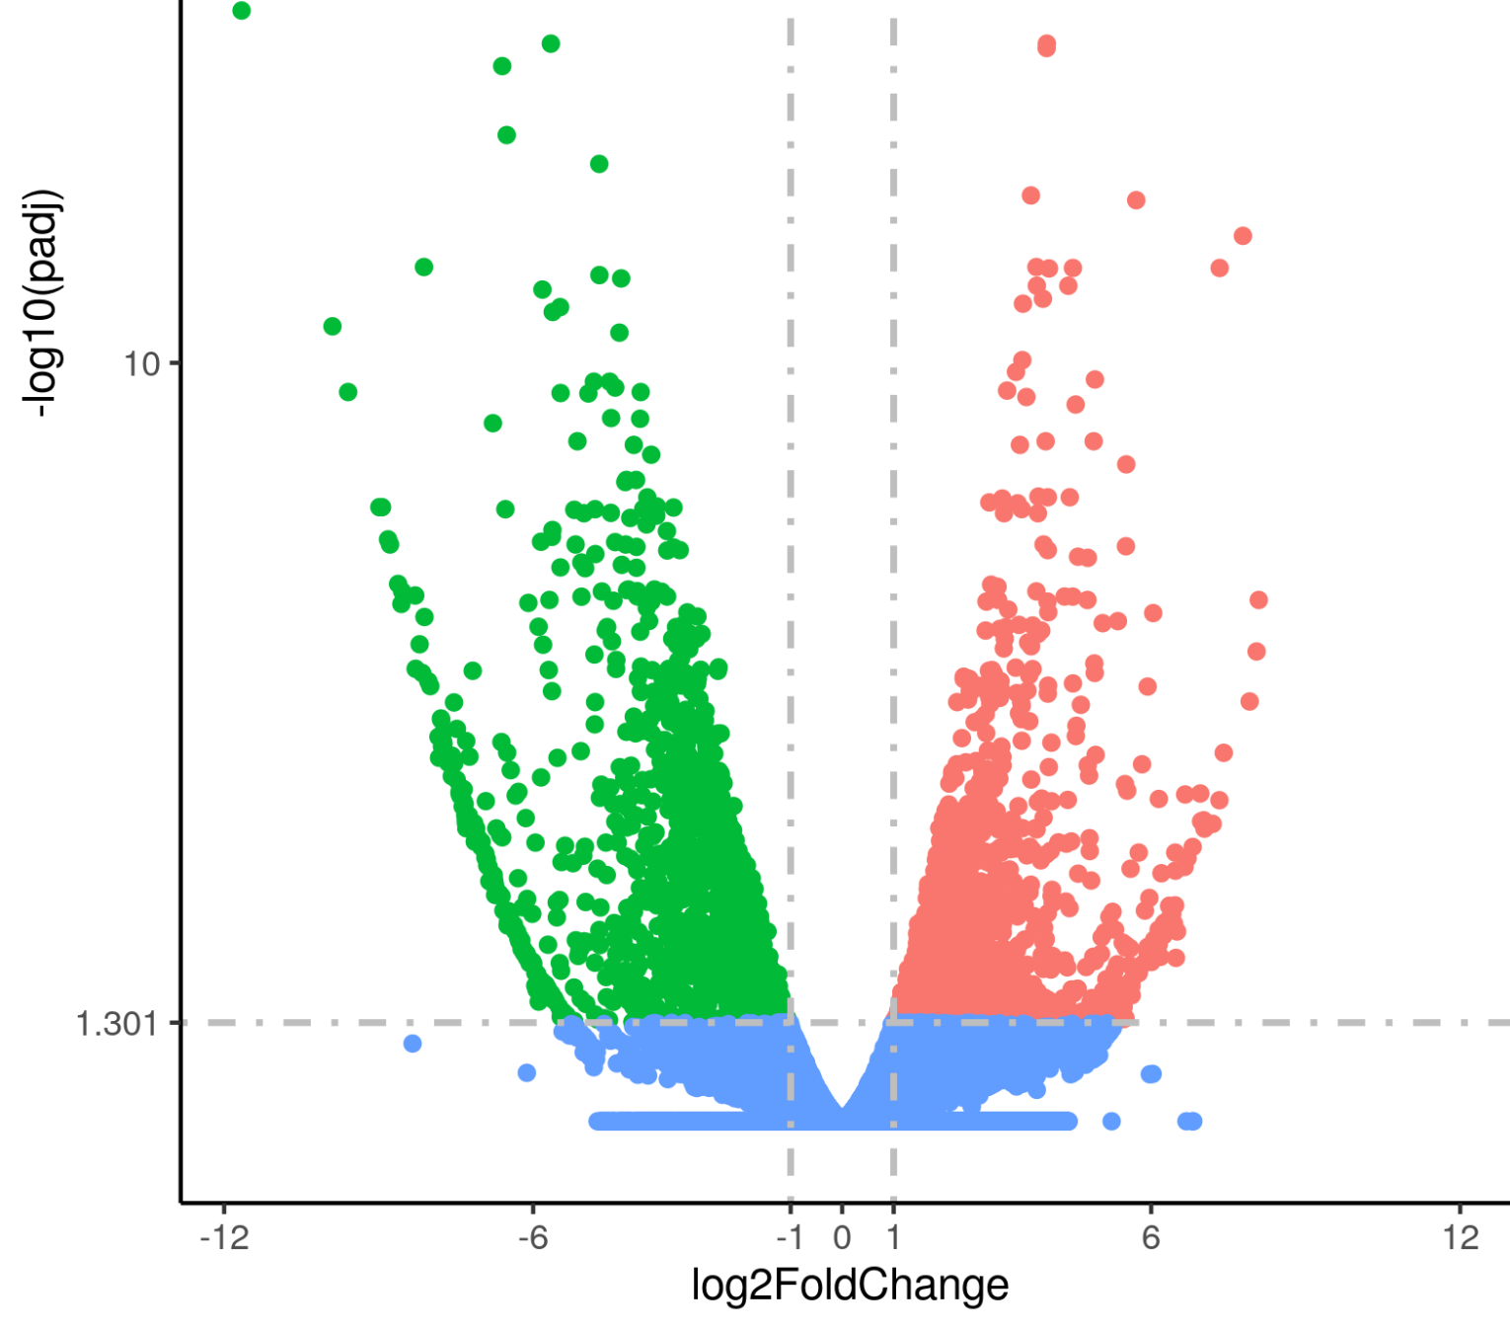
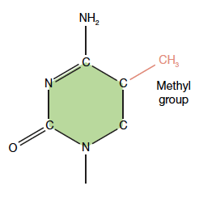
Model flow
RF Prediction
Multi-omics dataset
CNN Prediction
LOO
Adaboost
Random Forest Classifier
Final classification
RF Prediction
Notes:
We aimed to recapitulate the modeling experiment performed by a group who attempted cancer survivability prediction models using sequencing multi-omics. And we also added a twist with the addition of pathology image data. For clinical molecular studies, many models have focused on utilizing a singular omics dataset to train classification, leaving a question of if a greater variety of datasets may improve survival predictions. Random forest classifier was run on the combination of RNAseq, miRNA, methylation, and mutational sequencing data for each patient as features. Considering the low patient sample size, the classifier was trained using the leave-one-out cross validation method to utilize the maximum amount of data available. These predictions were then combined through adaboost to achieve the final classification.

Slide 5
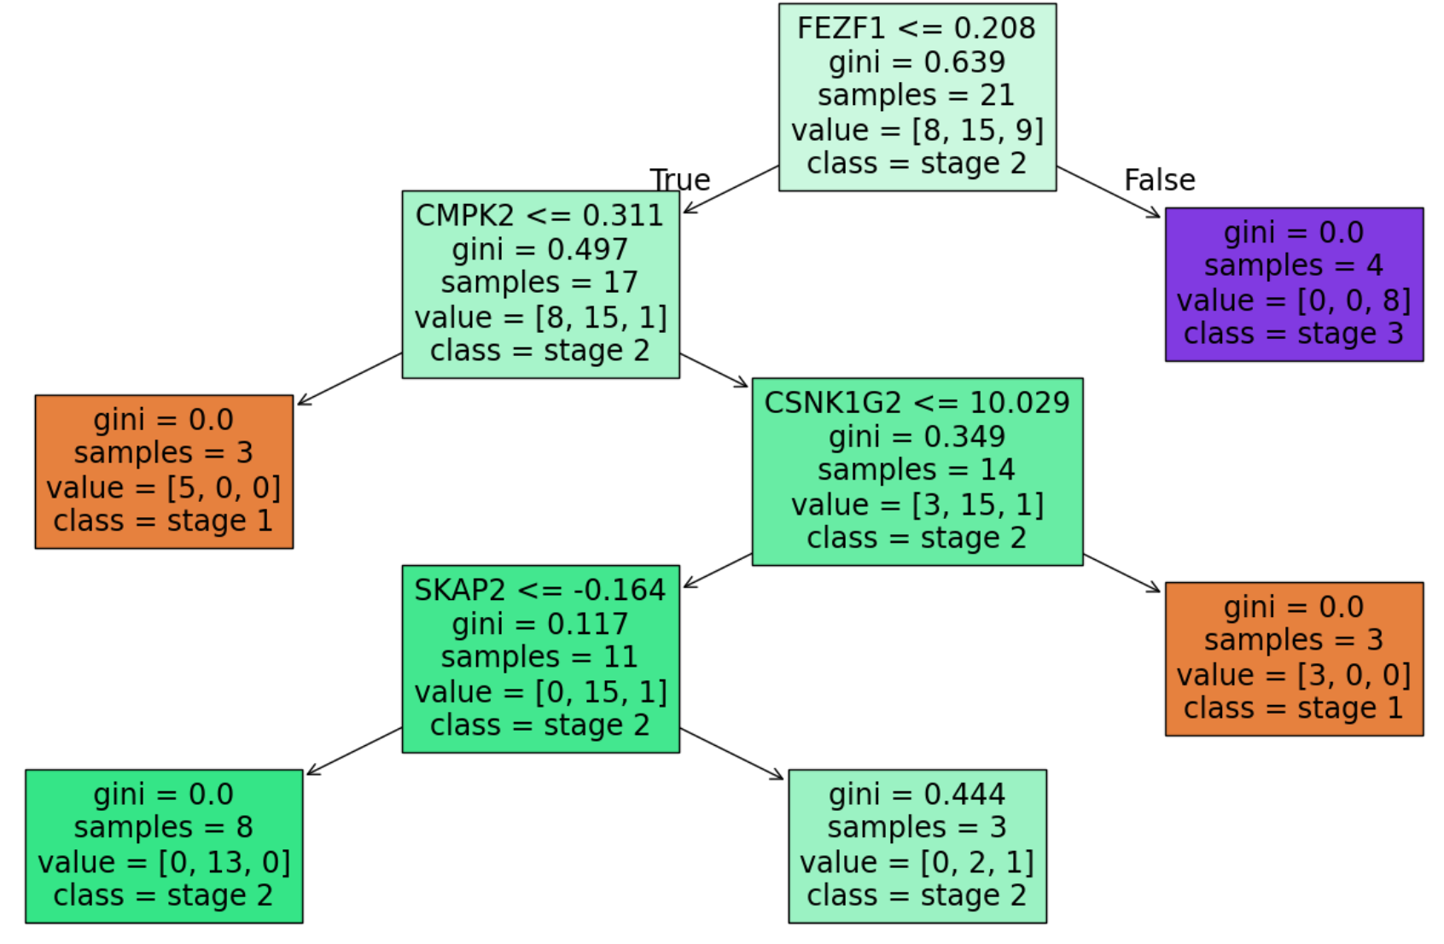
Random Forest Classifier highlights known cancer genes
FEZF1 - TF promotes cell growth and migration
CMPK2 - macrophage activation
SKAP2 - immune regulator
Notes:
Random forest classification was around 50% accurate which is better than random guessing the three stages of cancer per patient. The gene features used by the decision trees were genes known to be related to breast cancer, highlighted in this section over here, these genes are related to cell over proliferation and immune activity in cells commonly used to clear cancerous cells. This suggests that although the classification predictions were not completely accurate, the random forest can identify genes that play a role in breast cancer development.

Slide 6
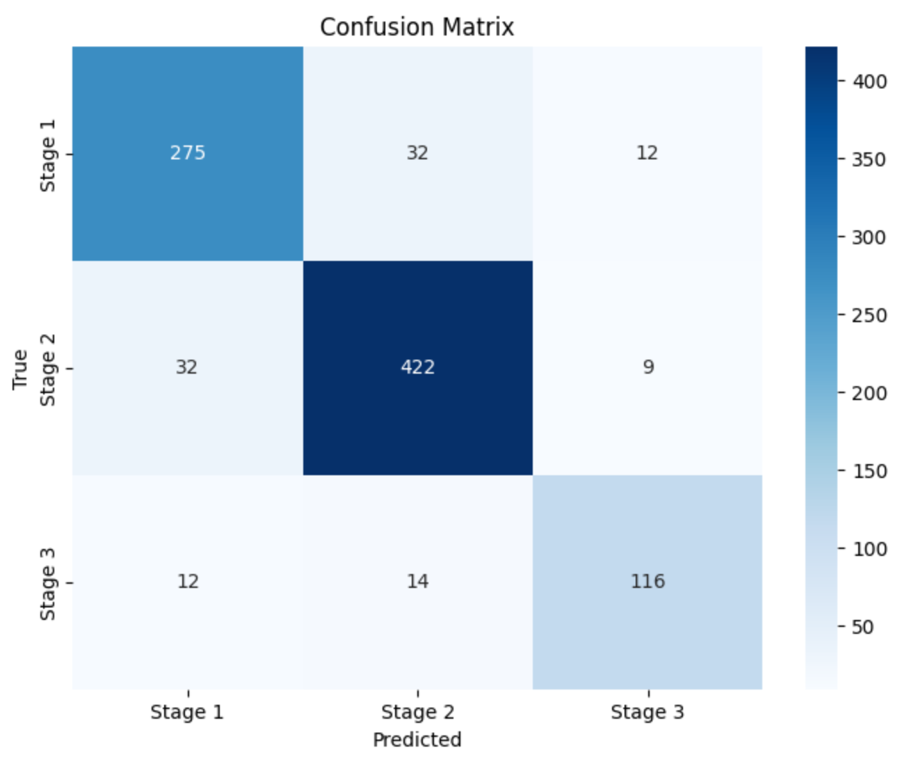
CNN confusion matrix
True predictions
Diagonal represents the correctly classified cases, indicated a fairly accurate model
Misclassifications
Model struggles in differentiating Stage 1 and 2 sometimes
Model Bias
High concentration of Stage 2 -> potential bias?

Slide 7
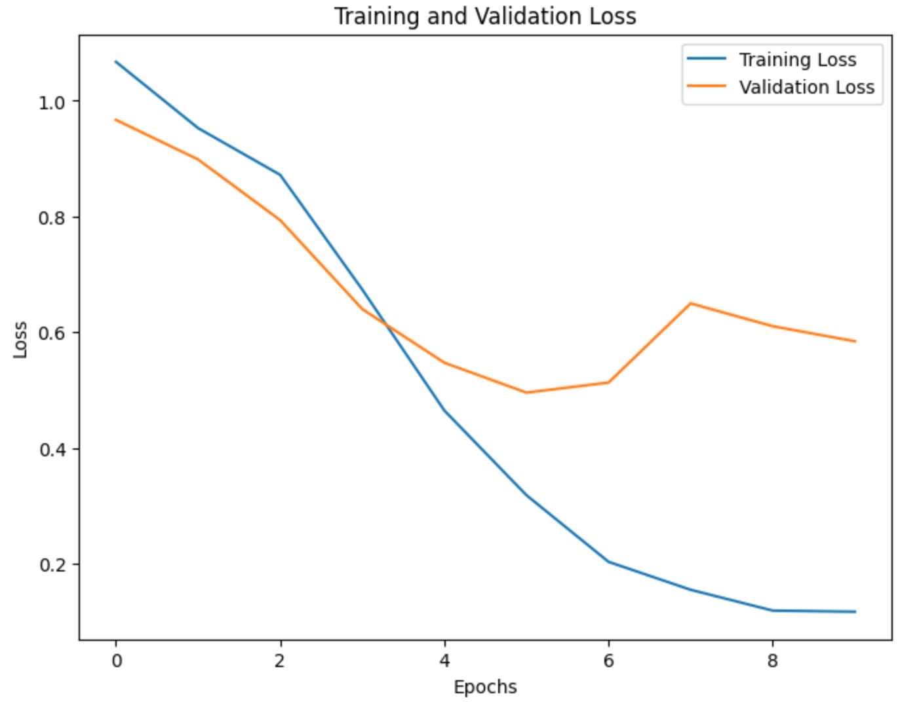
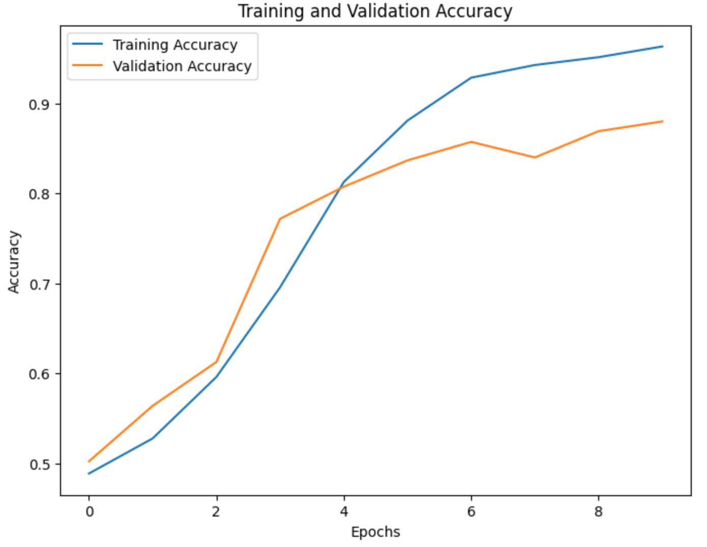
CNN training and validation accuracy/loss

Slide 8
Adaboost combines prediction improving class accuracy
Random Forest Classifier (~50% classification accuracy)
Adaboost
100% Classification Accuracy
Convolutional Neural Network Image Classifier (85% classification accuracy)
Notes:
The predicted classification outcomes of the random forest classifier and CNN were given to an Adaboost classifier as features, which integrated both image and genomic based classification models, boosting the classification accuracy to 100%

Slide 9
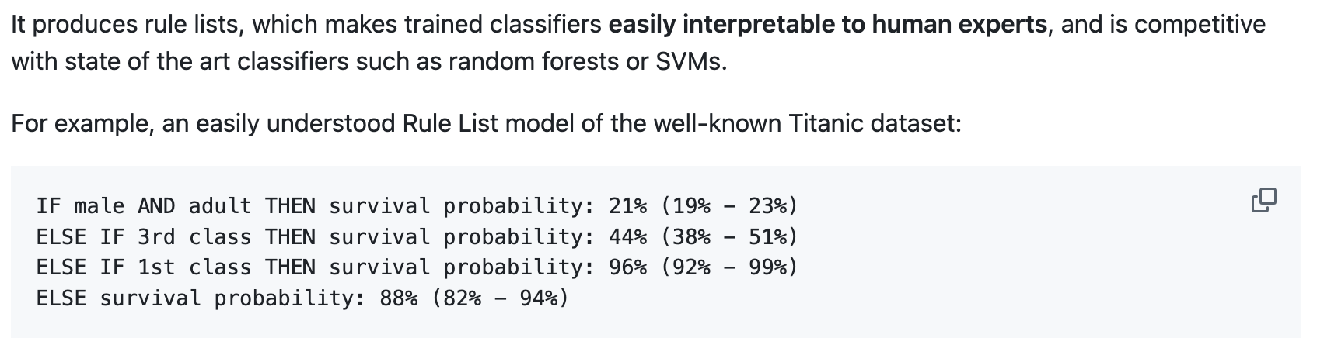
Gene expression data future directions
More patient samples
Chemically challenging - would like to include an extra feature focusing on batch sequencing
Be interesting to run a classifier with human readable interpretability
sklearn-expertsys
Letham et al., 2015
Notes:
Generalizing a high dimensional dataset such as gene expression data can be difficult with low sample size, likely led to overfitting in this initial attempt. This has highlighted need to increase sample size. I’m especially interested in including an extra feature that I did not see when analyzing this genomic dataset which is labeled batch sequencing. Expression data of the same sample can change with every sequencing run, these differences are referred to as batch effect. I’m interested to see how batch effect can impact molecular clinical data.
Future directions can include using graphical or bayesian models trained on gene expression data that have weights on known important genes. It would be interesting to use these techniques to find a set of gene targets related to the development of breast cancer. I would be interested in playing around with expertsys, which is this Bayesian rule list classifier which gives a small set of features to target for a given outcome that is human readable.

Slide 10
Image analysis data future directions
Explainability and Interpretability:
Incorporate attention mechanisms or Grad-CAM (Gradient-weighted Class Activation Mapping) to highlight regions of interest, helping clinicians interpret model predictions.
Data Augmentation and Balancing:
Use advanced augmentation techniques to improve model robustness against data variability.
Larger Datasets:
Had to limit the size of image data used due to a lack of computing power.
Robustness to Data Variability:
Conduct robustness testing on data with noise, artifacts, or from different imaging devices.

Slide 11
Citations
https://www.breastcancer.org/facts-statistics
Kang HYJ, Ko M, Ryu KS. Prediction model for survival of younger patients with breast cancer using the breast cancer public staging database. Sci Rep. 2024 Oct 28;14(1):25723. doi: 10.1038/s41598-024-76331-y. PMID: 39468113; PMCID: PMC11519337.
Poirion OB, Jing Z, Chaudhary K, Huang S, Garmire LX. DeepProg: an ensemble of deep-learning and machine-learning models for prognosis prediction using multi-omics data. Genome Med. 2021 Jul 14;13(1):112. doi: 10.1186/s13073-021-00930-x. PMID: 34261540; PMCID: PMC8281595.
Lingle, W., Erickson, B. J., Zuley, M. L., Jarosz, R., Bonaccio, E., Filippini, J., Net, J. M., Levi, L., Morris, E. A., Figler, G. G., Elnajjar, P., Kirk, S., Lee, Y., Giger, M., & Gruszauskas, N. (2016). The Cancer Genome Atlas Breast Invasive Carcinoma Collection (TCGA-BRCA) (Version 3) [Data set]. The Cancer Imaging Archive
Vasaikar SV, Straub P, Wang J, Zhang B. LinkedOmics: analyzing multi-omics data within and across 32 cancer types. Nucleic Acids Res. 2018 Jan 4;46(D1):D956-D963. doi: 10.1093/nar/gkx1090. PMID: 29136207; PMCID: PMC5753188.
https://www.linkedomics.org/data_download/TCGA-BRCA/
Benjamin Letham, Cynthia Rudin, Tyler H. McCormick, David Madigan "Interpretable classifiers using rules and Bayesian analysis: Building a better stroke prediction model," The Annals of Applied Statistics, Ann. Appl. Stat. 9(3), 1350-1371, (September 2015)

Slide 12
Random Forest Classifier highlights known cancer genes
One of the decision trees generated by random forest splits the data by genes known to be related to cancer.
Notes:
Random forest classification was around 50% accurate which is better than random guessing the three stages of cancer per patient. The gene features used by the decision trees were genes known to be related to breast cancer, highlighted in this section over here, these genes are related to cell over proliferation and immune activity in cells commonly used to clear cancerous cells. This suggests that although the classification predictions were not completely accurate, the random forest can identify genes that play a role in breast cancer development.

