Slide 1
Unsupervised Categorization of Radio Pulsar Candidates
UE24CS352A Machine Learning, Mini-Project
Teammate 2: PES1UG24CS419
Problem Statement 3 | HTRU2 dataset | 1,639 confirmed pulsars

Slide 2
From "is it a pulsar" to "what kind of pulsar"
The supervised half separates signal from noise. This half looks inside the signal.
Teammate 1 classifies all 17,898 candidates as pulsar or non-pulsar.
This half asks a different question: do the confirmed pulsars themselves fall into distinct groups?
  - Fitted on the 1,639 pulsars only. The 16,259 non-pulsars are dropped, since including them would just recover the supervised split.
  - 8 features: mean, standard deviation, excess kurtosis and skewness of the integrated profile and of the DM-SNR curve.
  - All features standardised first, because k-means and the SOM both compare points by Euclidean distance and the raw columns differ by orders of magnitude.

Slide 3
Method
K-means (scikit-learn), k = 3, ten restarts, swept over k = 2 to 10.
Self-Organizing Map, 5x5 grid, written from scratch in NumPy:
  - Competition: find the Best Matching Unit, the node nearest the sample in Euclidean distance.
  - Cooperation: weight every node by a Gaussian centred on the BMU, measured in grid coordinates, not input space. This is what preserves topology.
  - Adaptation: w = w + lr(t) h(t) (x - w), with learning rate and radius both decaying geometrically over 100 epochs.
PCA is fitted after clustering, for plotting only.
  - Clustering runs in the full 8-dimensional space. Projecting first would discard variance before the algorithms ever see it.

Slide 4
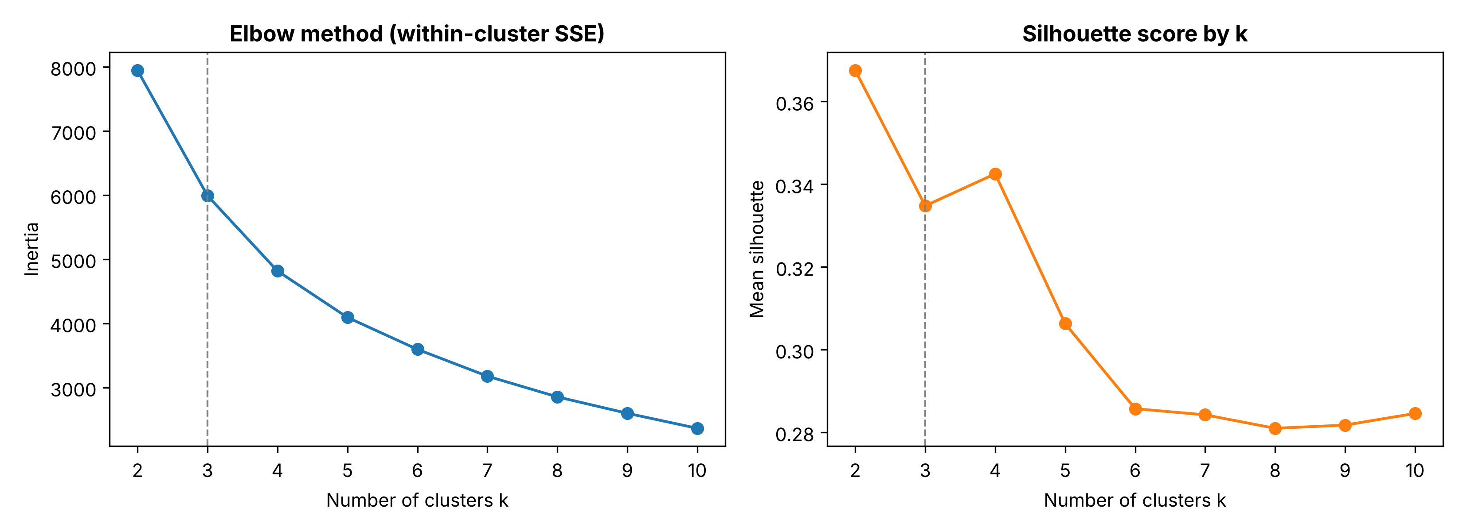
Choosing k: the two criteria disagree
Inertia elbows at k = 3. Silhouette peaks at k = 2.
  - We keep k = 3: it is at the elbow, it matches the reference paper, and the k = 2 solution merges two groups that differ physically.
  - Inertia measures compactness only; the silhouette also rewards separation, so on continuous data it favours fewer clusters.

Slide 5
Three groups, described by their raw feature means
Cluster | n | mean_ip | kurt_ip | skew_ip | mean_snr | std_snr | skew_snr
0 | 739 | 71.57 | 2.04 | 6.82 | 38.65 | 57.91 | 8.04
1 | 679 | 28.62 | 5.01 | 29.19 | 77.09 | 66.12 | 1.52
2 | 221 | 93.18 | 1.01 | 2.87 | 3.44 | 21.99 | 101.43
Cluster 0 (739): the typical population, mid-range profile with a moderately dispersed DM-SNR curve.
Cluster 1 (679): low profile mean, strong profile skew, highest DM-SNR mean. Bright and sharply peaked.
Cluster 2 (221): high profile mean, very weak DM-SNR curve, extreme DM-SNR skew. Small and distinctive.

Slide 6
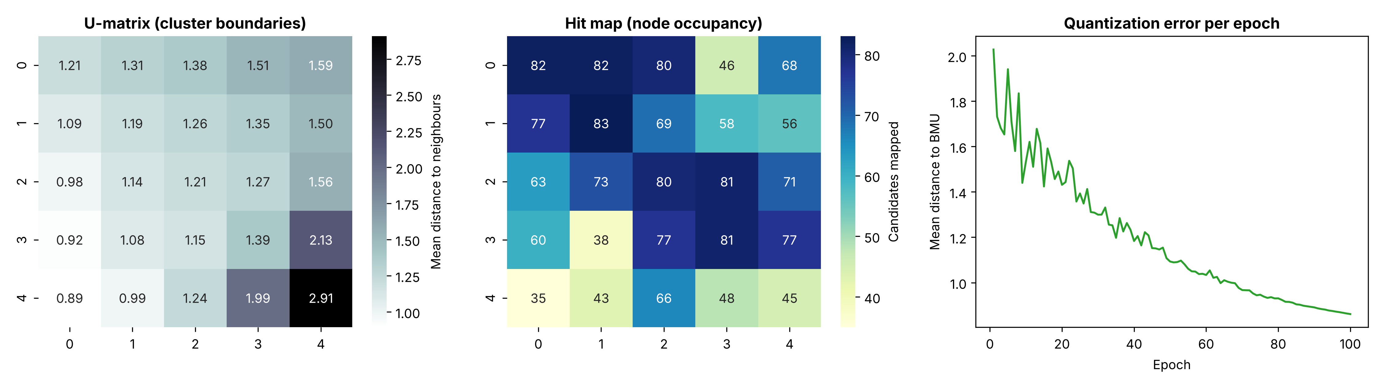
The SOM trained cleanly
Quantization error fell from 2.028 to 0.861 over 100 epochs, and flattened.
All 25 of 25 nodes occupied, so no dead units and the grid is not oversized.
The U-matrix ridge in one corner is where cluster 2 separates.

Slide 7
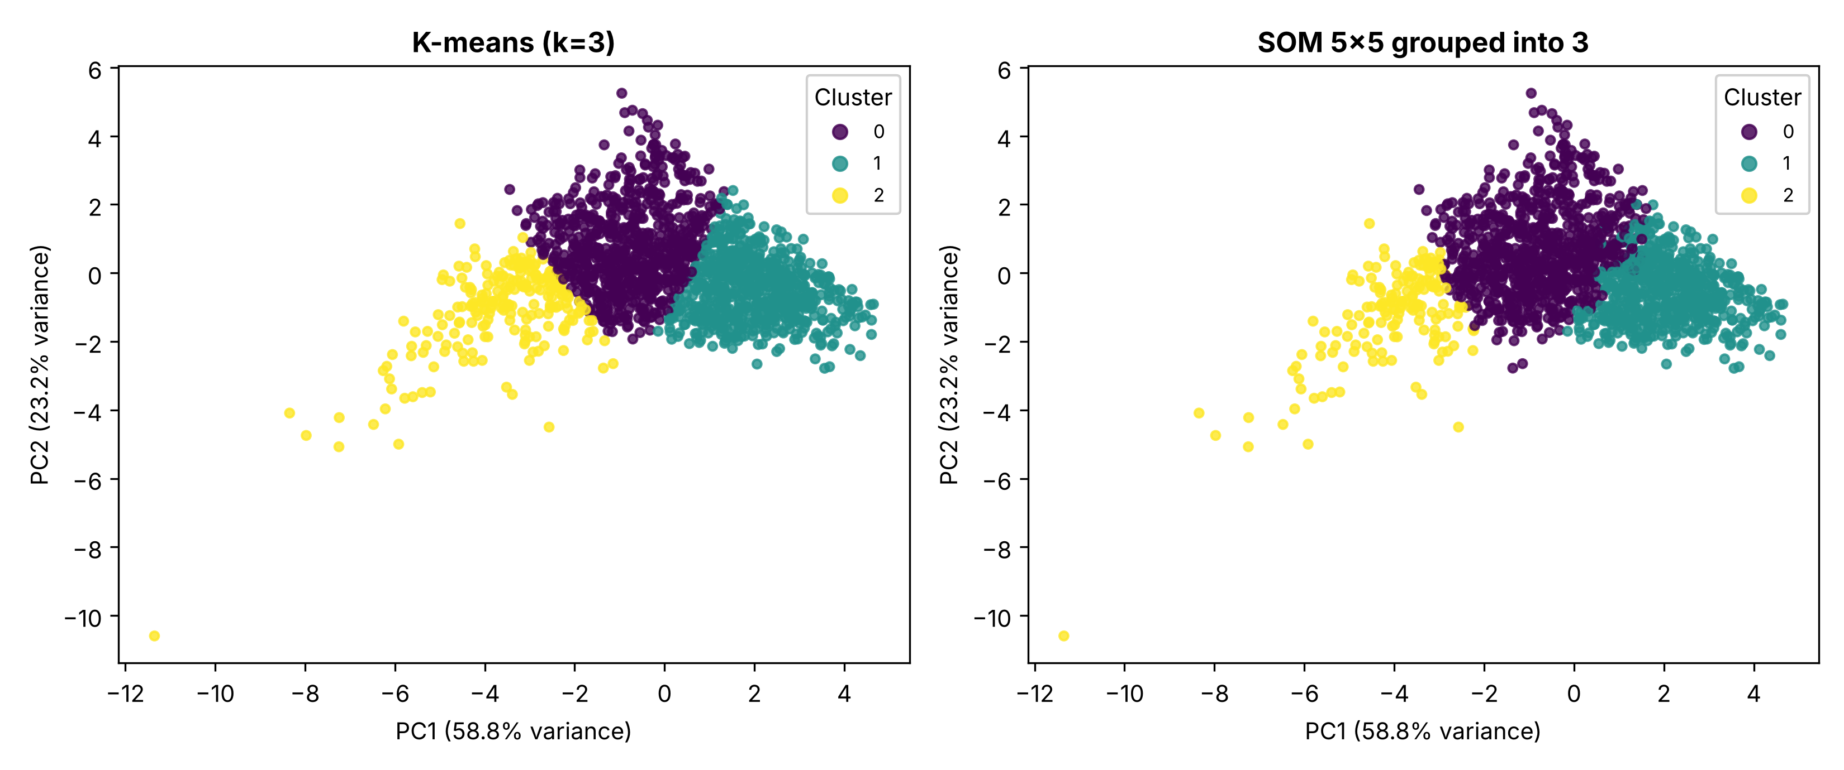
Two different algorithms, the same three groups
Method | Clusters | Silhouette
K-means | 3 | 0.3348
SOM 5x5, codebook grouped into 3 | 3 | 0.3316
SOM raw BMU assignment | 25 | 0.1715
The two methods agree on the group for 93.3% of candidates. Independent methods converging is the real evidence the structure is in the data, not the algorithm.

Slide 8
Two details worth being precise about
Comparing a 5x5 SOM with k-means at k = 3:
  - The map produces 25 micro-clusters, which is not comparable with 3. Following Vesanto and Alhoniemi (2000), the 25 codebook vectors are clustered into 3 groups and each candidate inherits the group of its BMU. Clustering 25 vectors is far cheaper than re-clustering 1,639 samples.
Why the raw 25-node silhouette (0.171) looks bad:
  - It is low by construction, not because the map failed. With 25 clusters over 1,639 points, neighbouring nodes overlap heavily, and overlap is exactly what the silhouette penalises.
PCA retains 82.0% of variance in two components (PC1 58.8%, PC2 23.2%).
  - PC1 sets profile shape (kurtosis +0.89, skewness +0.84) against profile mean (-0.87): a "narrow, peaked profile" axis. PC2 is dispersion.

Slide 9
Demo: Pulsar Candidate Explorer
streamlit run app/demo_app.py
Enter the eight measurements for one candidate, or start from a preset, and the app returns:
  - A pulsar verdict with its probability, from Teammate 1's GDA model. Reusing it rather than reimplementing keeps the two halves consistent.
  - The k-means cluster and the SOM cluster, plus the Best Matching Unit coordinates on the 5x5 grid.
  - A flag when the two methods disagree, which usually means the candidate sits near a cluster boundary.
  - A PCA scatter plot marking where the candidate falls among the 1,639 known pulsars.

Slide 10
Conclusions and limitations
The pulsar population carries real internal structure: three groups of 739, 679 and 221, recovered independently by two algorithms.
Separation is moderate (silhouette 0.33). The limitation is the feature set, not the algorithms.
  - HTRU2 gives summary statistics of the profile and the DM-SNR curve, so frequency and timing information is already averaged away. Pulsars separate best by period and dispersion measure, and neither survives into these eight columns. Adding them is the next step.
Three further caveats:
  - No ground truth for the sub-types, so validation is internal only. Confirming cluster 2 as a known class needs a catalogue cross-match such as the ATNF.
  - k = 3 is a judgement call. The silhouette alone would have picked k = 2.
  - The SOM depends on initialisation. The seed is fixed, and the three-group structure survives reseeding, but the map shifts.

