Slide 1
Pulsar Candidate Classification
UE24CS352A Machine Learning Mini-Project • Teammate 1 (Supervised Half)
GDA Baseline (Scratch) | Random Forest (Scikit-Learn & Scratch) | Fold-Level Upsampling & Threshold Tuning

Slide 2
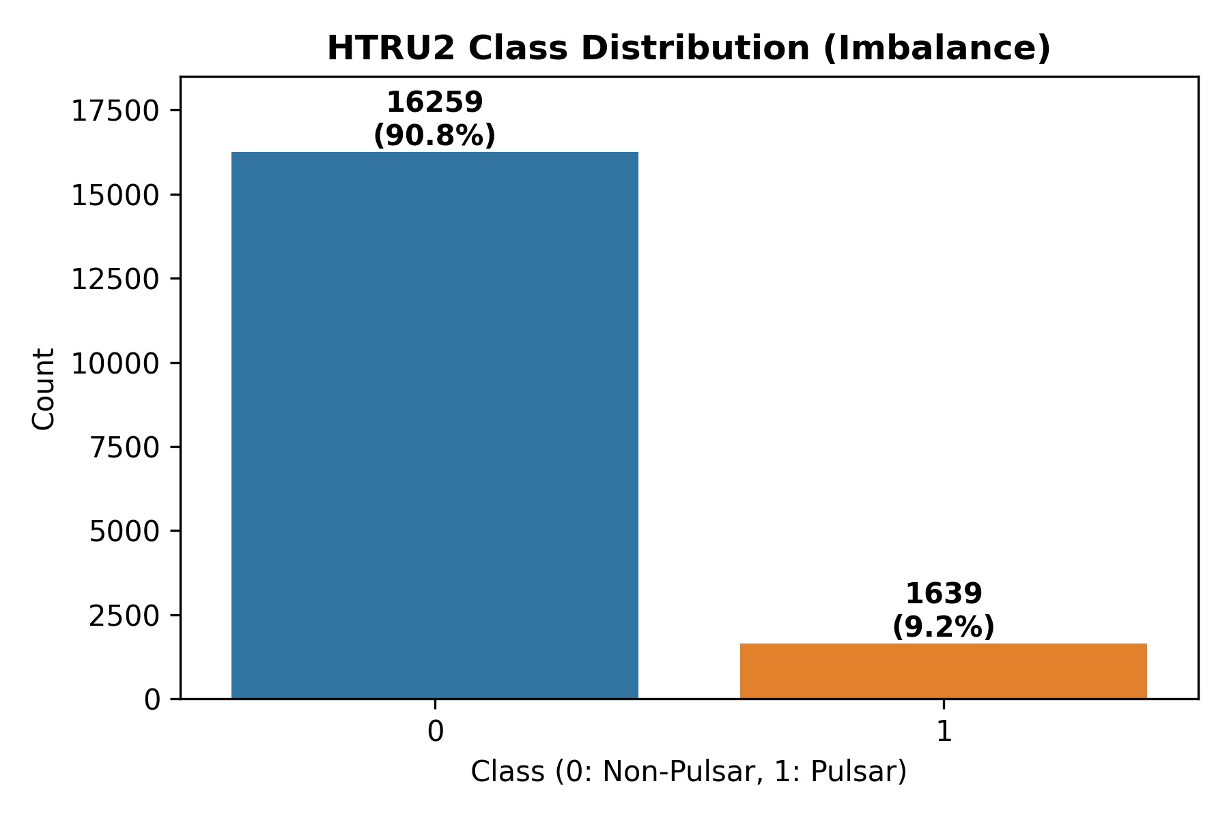
SUPERVISED PIPELINE (TEAMMATE 1)
Problem Statement & HTRU2 Dataset Overview
Astronomical Context & Challenge
• Radio pulsar search surveys generate millions of candidate signals.
• The vast majority are spurious noise or Radio Frequency Interference (RFI).
• HTRU2 Dataset: 17,898 total candidates collected by HTRUS survey.
• Severe Class Imbalance: 16,259 non-pulsars (90.84%) vs 1,639 true pulsars (9.16%). Imbalance ratio ~1:9.9.
• Goal: Automated binary classification to isolate true pulsars with high recall.

Slide 3
SUPERVISED PIPELINE (TEAMMATE 1)
Supervised Learning Models & Mathematical Formulations
1. Gaussian Discriminant Analysis (GDA Baseline from Scratch)
• Generative model assuming class-conditional Gaussian distributions: y ~ Bernoulli(φ), x|y=k ~ N(μ_k, Σ).
• Prior: φ = (1/N) Σ 1{y^(i) = 1}
• Means: μ_0 = Σ 1{y^(i)=0} x^(i) / Σ 1{y^(i)=0}, μ_1 = Σ 1{y^(i)=1} x^(i) / Σ 1{y^(i)=1}
• Shared Covariance: Σ = (1/N) Σ (x^(i) - μ_y^(i))(x^(i) - μ_y^(i))^T
• Posterior Probability: P(y=1|x) computed via sigmoid of log-likelihood ratio.
2. Random Forest (Scikit-Learn & From Scratch)
• Ensemble of uncorrelated decision trees using Bootstrap Sampling and Random Feature Subsets (√p features).
• Splits evaluated by maximizing Information Gain: IG = E(parent) - (N_left/N) E(left) - (N_right/N) E(right).
• Shannon Entropy: E(S) = - Σ p(x) log_2 p(x).

Slide 4
SUPERVISED PIPELINE (TEAMMATE 1)
5-Fold CV Protocol with Fold-Level Upsampling
Preventing Data Leakage via Strict Fold Isolation
• Data Split: 80% Stratified Training Set (N=14,318) and 20% Held-out Test Set (N=3,580).
• Class Imbalance Handling: Random Minority Oversampling (ROS) applied to training folds ONLY.
• Crucial Requirement: Validation folds and held-out test set are NEVER upsampled (kept at raw 1:9.9 distribution).
• Hyperparameter Search: Scikit-learn Random Forest tuned using RandomizedSearchCV optimizing for Recall.
• Tuned Hyperparameters: n_estimators=200, min_samples_split=2, max_features='log2', max_depth=110.

Slide 5
SUPERVISED PIPELINE (TEAMMATE 1)
Empirical Performance Comparison (Test Set, N=3,580)
Model | Threshold | Accuracy | Recall | Precision | Specificity | ROC AUC
GDA Baseline (Scratch) | 0.50 | 97.91% | 89.63% | 87.76% | 98.74% | 0.9708
GDA Baseline (Opt Th.) | 0.39 | 97.57% | 90.85% | 83.94% | 98.25% | 0.9708
RF (Scikit-Learn) | 0.50 | 97.88% | 88.41% | 88.41% | 98.83% | 0.9678
RF (Scikit-Learn Tuned) | 0.20 | 96.76% | 91.16% | 77.46% | 97.32% | 0.9678
RF From Scratch | 0.50 | 97.21% | 90.85% | 80.98% | 97.85% | 0.9752
RF From Scratch (Th 0.2) | 0.20 | 90.95% | 93.29% | 50.33% | 90.71% | 0.9752

Slide 6
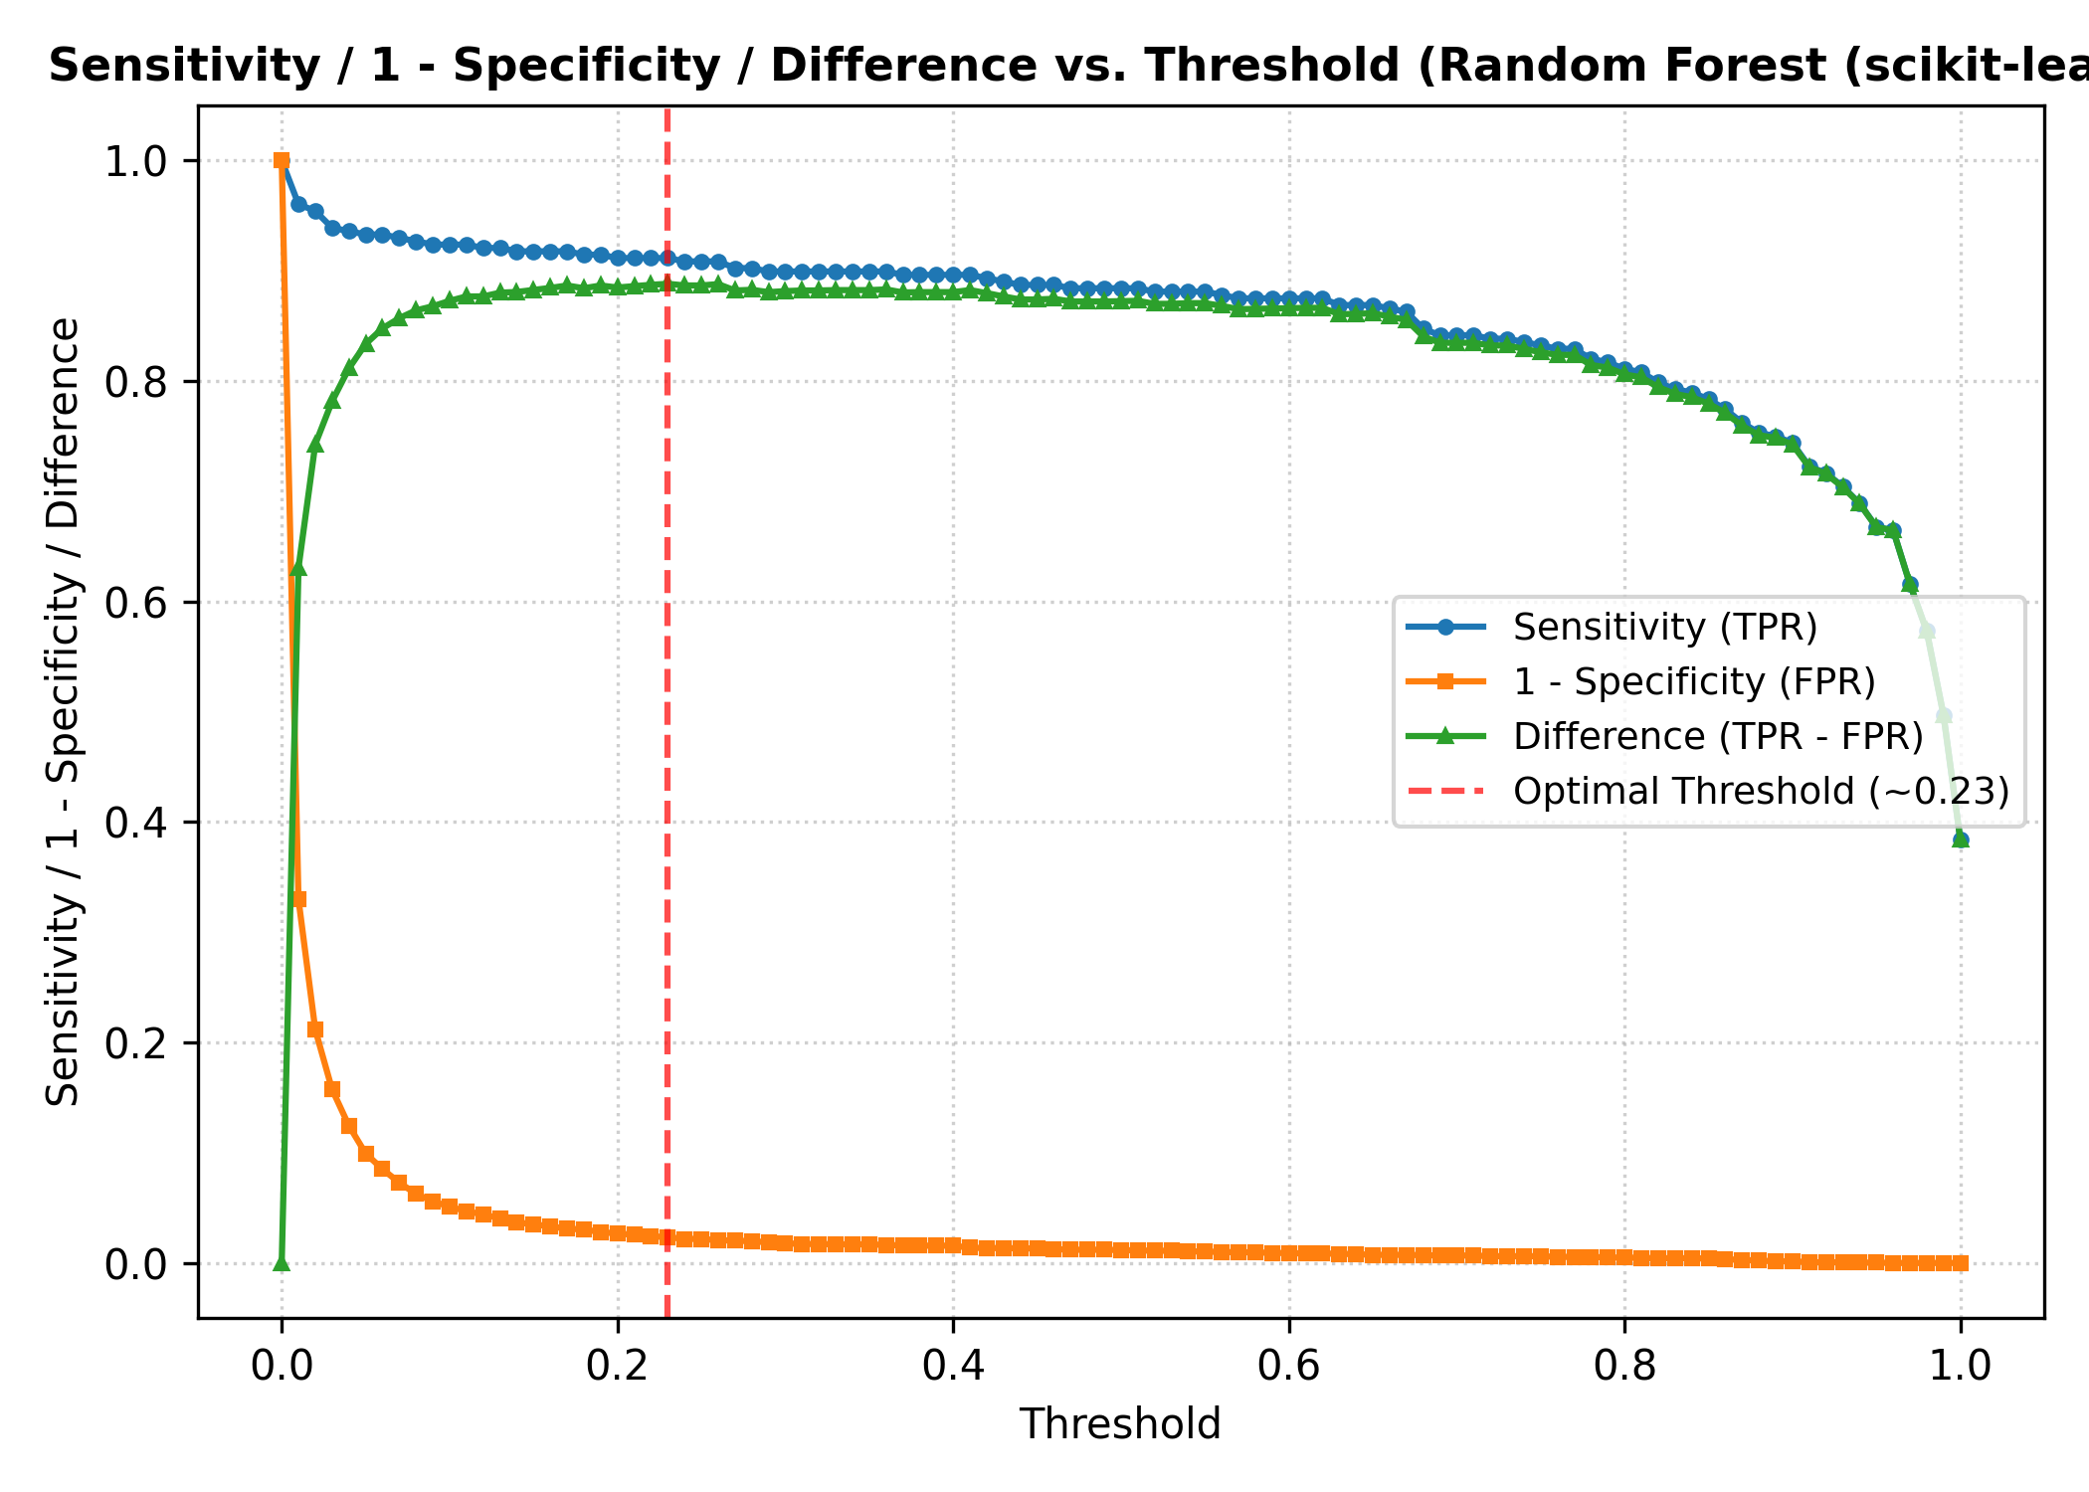
SUPERVISED PIPELINE (TEAMMATE 1)
Threshold Optimization (0.5 → 0.2 to Maximize Recall)
Why Lower Decision Threshold?
• Astronomical Tradeoff: Discarding a true pulsar star is far more costly than inspecting a false candidate.
• Benchmark Alignment: Debesai et al. lowered threshold from 0.5 to 0.2 to boost recall.
• Threshold Sweep Plot: Sensitivity (TPR), 1-Specificity (FPR), and TPR-FPR difference plotted from 0.0 to 1.0.
• Result: Moving threshold to ~0.2 raises recall to 91.16% (sklearn RF) and 93.29% (scratch RF).

Slide 7
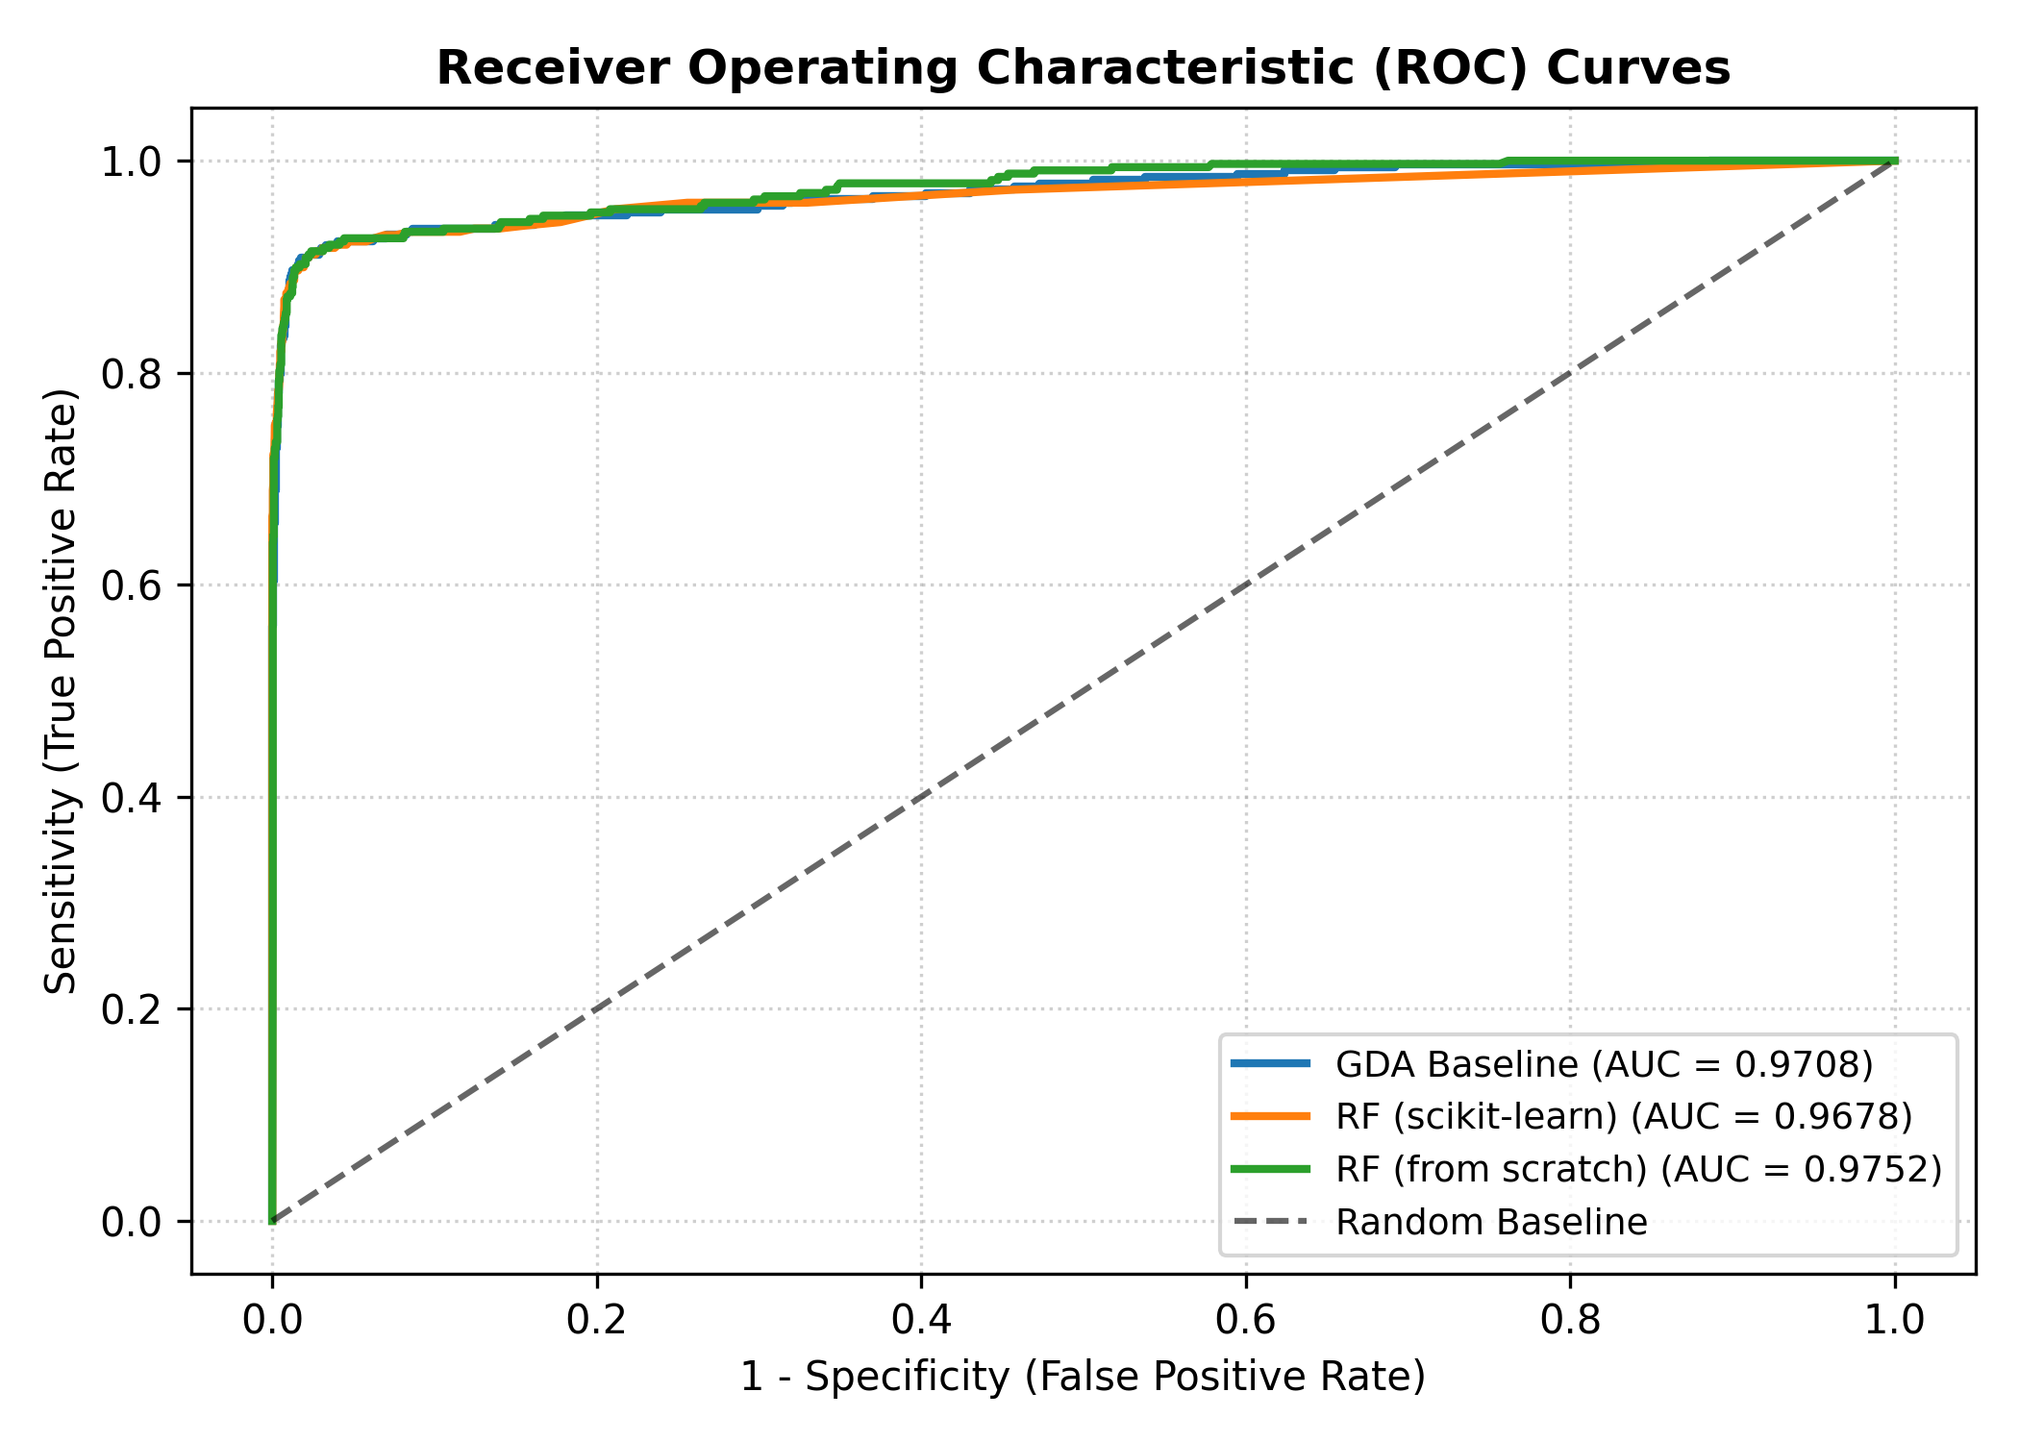
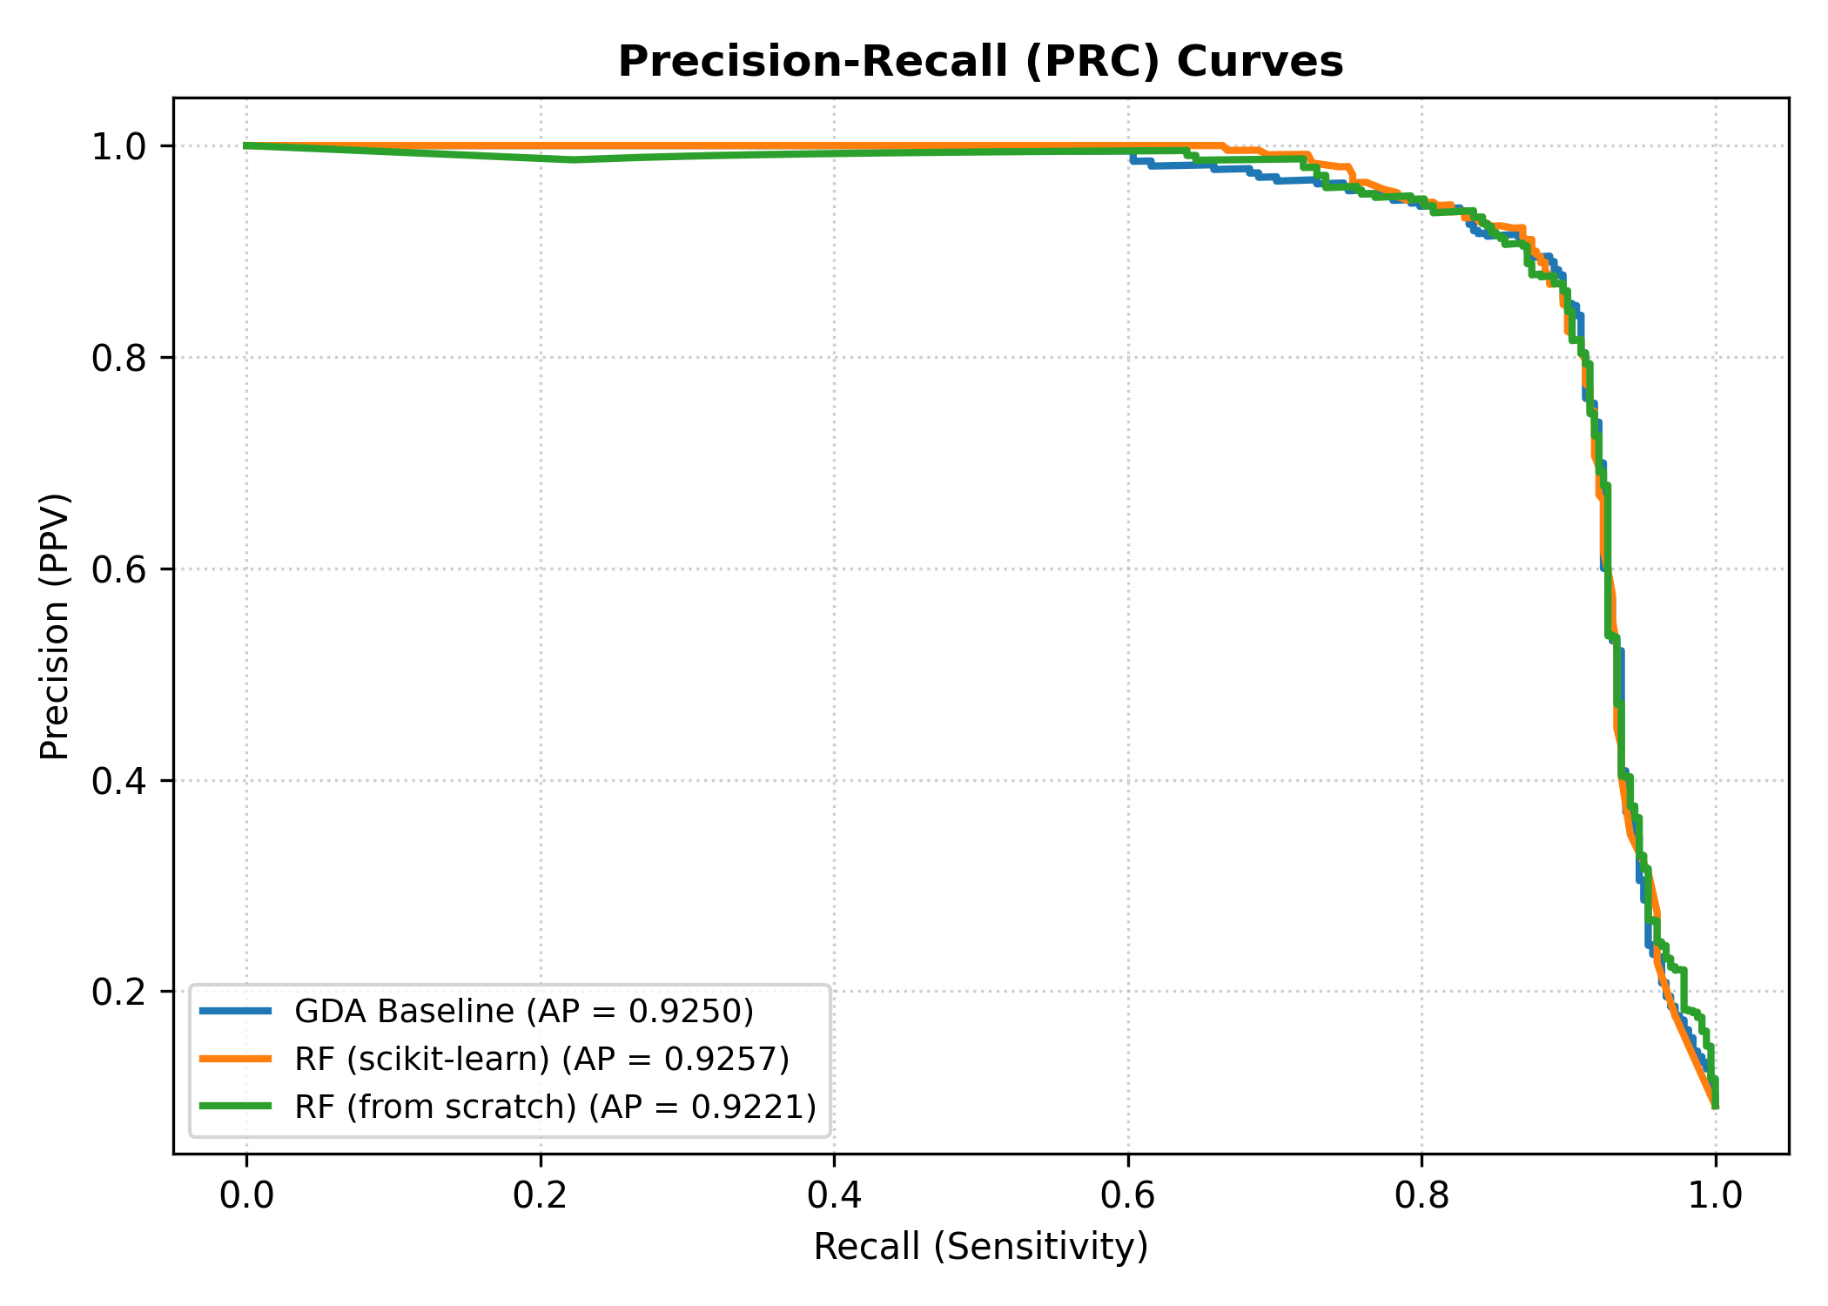
SUPERVISED PIPELINE (TEAMMATE 1)
ROC and Precision-Recall Diagnostic Curves

Slide 8
SUPERVISED PIPELINE (TEAMMATE 1)
Summary & Handoff to Teammate 2 (Unsupervised)
Key Takeaways (Teammate 1)
• Successfully implemented GDA Baseline from scratch matching mathematical formulas.
• Tuned Scikit-Learn Random Forest and implemented pure NumPy Random Forest from scratch.
• Rigorous 5-fold CV with fold-level upsampling prevented data leakage and produced realistic evaluation.
• Threshold sweep demonstrated optimal operational point at ~0.2 threshold maximizing pulsar recall.
• Handoff to Teammate 2: Positive candidate subset (N=1,639 pulsars) is structured and ready for PCA, K-means (k=3), and Self-Organizing Map (SOM 5x5 grid) unsupervised clustering.

