Slide 1
Internship Update - DeepTek
Saatvik Maheshwari

Slide 2
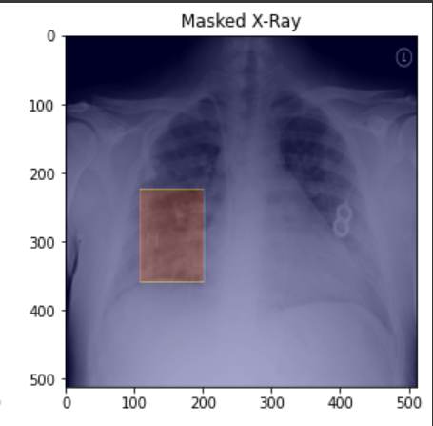
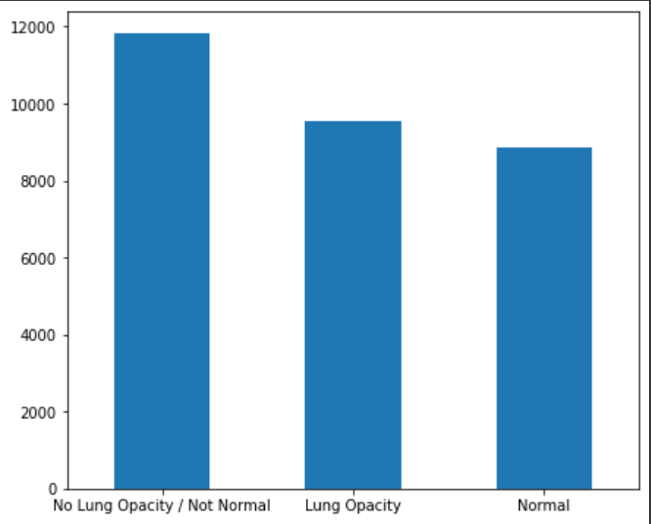
Problem Statement and Dataset
The RSNA Pneumonia detection dataset was provided to me.
The training data consists of the patient IDs and the coordinates of the pneumonia bounding box (if present) in the patient's lung X-Ray.
Another dataframe contained the class information, namely lung opacity.
On kaggle, the test images were provided but not labels.

Slide 3
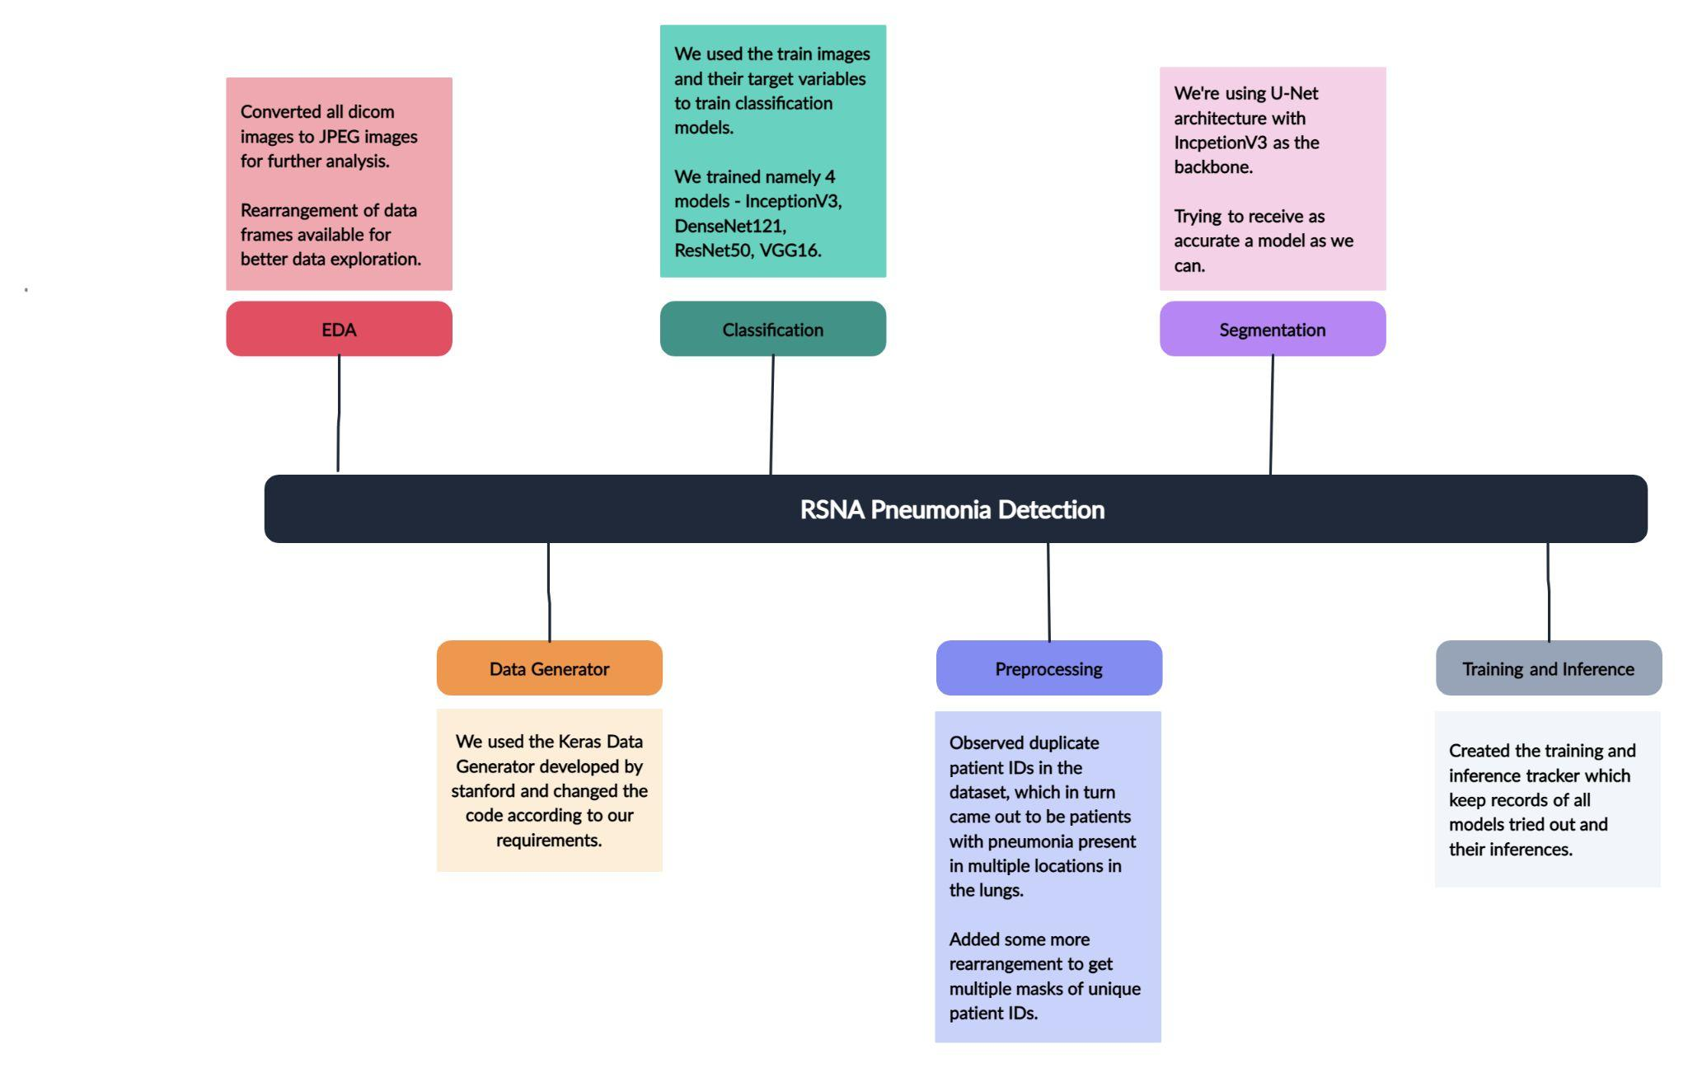
Timeline

Slide 4
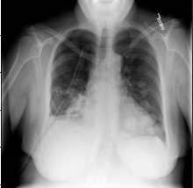
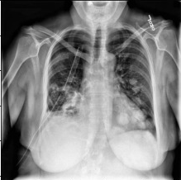
A data generator basically helps the programmer to make efficient use of the memory available.
The amount of RAM required to load a large images dataset is not available and Data Generator allows us to load every image one at a time into the RAM and train them accordingly. We used parts of the Keras Data Generator developed by Stanford.
We used OpenCV’s CLAHE (Contrast Limited Adaptive Histogram Equalization) filter to make our X-Rays better for feature extraction.
Data Generator
Before
After

Slide 5
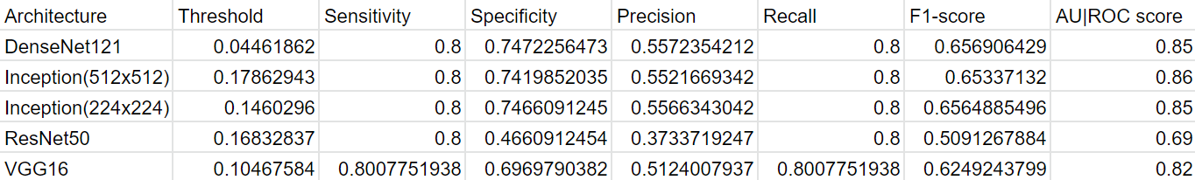
I have trained 4 models for classification which include DenseNet121, InceptionV3, ResNet50 and VGG 16.
The metrics of the models trained are as follows:
Classification Models

Slide 6
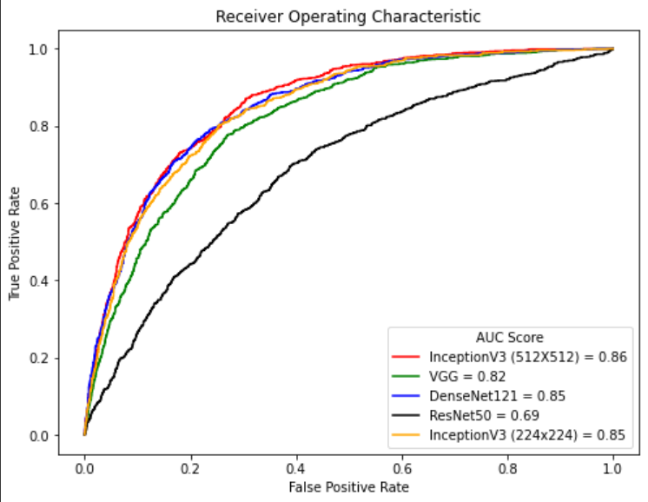
InceptionV3 outperforms all other architectures.
Similar performance for image sizes 512 and 224
Model Comparison

Slide 7
DICOM format of images was a new to me. I learnt about this format and converted it to an appropriate format for our models.
Not having worked with image datasets of large size before, I never had the exposure to learn about memory optimization for training Deep Learning models. This led me to learn about and implement a Data Generator.
Duplicates and other irregularities in the data caused issues for training segmentation models. After thorough EDA and preprocessing, we were able to handle multiple annotations for the same patient. This way , we were able to create a more usable dataset for segmentation modelling.
Challenges and Issues

Slide 8
Future Actions
Improving performance of Segmentation Models
Tuning for better classification and masks
Trying out more architectures
Debugging and error correction for errors being faced currently.

Slide 9
Thank You

