Slide 1

PA
PathAhead
★ INDIA'S PREMIUM CAREER GUIDANCE
Your Career
Starts Here.
Helping Intermediate students make smarter career decisions before college through practical workshops and future-ready learning.
★ 4.9/5 Trusted by 30+ colleges
Workshops for Inter 1st & 2nd Year Students

Slide 2
The problem we solve
Every year, thousands of students choose their future in the dark.
×
No real guidance
×
Unaware of new careers
Career and branch decisions made on hearsay, pressure or guesswork — not aptitude.
Little exposure to AI, Data Science and modern engineering domains before college.
×
Confusion over choices
×
Decisions made too late
Overwhelmed by colleges, courses, scholarships and roadmaps with no clear map.
By the time clarity comes, the best opportunities have already passed.

Slide 3

OUR PURPOSE
“No student should choose
their future by accident.”
Give them clarity early — and you change the entire course of their life.

Slide 4
Who we are
PathAhead brings honest, practical, future-ready career guidance directly into schools and junior colleges.
✓
✓
Our Mission
Our Vision
To empower every Intermediate student in India with the clarity, awareness and practical guidance they need to make confident, future-ready career decisions — before college.
A future where career guidance is a standard part of every student's education — where choosing a path is driven by aptitude and awareness, not confusion or pressure.

Slide 5
Two signature workshops
Interactive 2-hour sessions, tailored to exactly where each student is in their journey.
FOR INTER 1st YEAR
FOR INTER 2nd YEAR
Future Ready
Career Blueprint
Lay a strong foundation early — career awareness, future skills and confidence from day one.
Make the right choices before college — a complete, decision-focused roadmap.
✓ Career Awareness
✓ Communication Skills
✓ College Selection
✓ Career Roadmap
✓ Engineering Branches
✓ Personality Development
✓ Technology Domains
✓ AI Careers
✓ AI Awareness
✓ Career Planning
✓ Programming Languages
✓ Q&A Session
✓ Future Skills
✓ Scholarships

Slide 6
The PathAhead difference
We turn guesswork into a clear, confident plan.
×
Without guidance
✓
With PathAhead
× Streams chosen on hearsay & pressure
✓ A clear, personalised sense of direction
× Little awareness of AI & future careers
✓ Real awareness of AI & technology careers
× Confusion over colleges & scholarships
✓ Confidence in college & branch choices
× Decisions made too late, with regret
✓ A concrete roadmap they act on — now

Slide 7
Careers we open students' eyes to
We make students aware of where tomorrow's opportunities really are.
AI
Artificial Intelligence
DS
Data Science
CS
Cybersecurity
Machine learning, generative AI and the careers reshaping every industry.
Turning data into decisions — one of today's most in-demand fields.
Ethical hacking and security careers protecting the digital world.
CL
Cloud & DevOps
SE
Software Engineering
RB
Robotics & IoT
The backbone of the internet and the fast-growing roles behind it.
What developers actually do, and the languages worth learning first.
Where hardware meets intelligence — automation and mechatronics.

Slide 8
What every student receives
A complete career starter kit they'll use all year long.
✓
✓
✓
Career Guide
Technology Roadmap
Engineering Guide
Clear guide to options after Intermediate, matched to interests.
What to learn and when — a practical path through modern skills.
Every major branch explained — what it is and where it leads.
✓
✓
✓
Career Checklist
Resource Kit
Certificate + Community
A step-by-step checklist to keep career planning on track.
Curated links, tools and reading to keep learning after.
Participation certificate and access to a future-ready community.

Slide 9
Why colleges partner with us
A win for your students and your institution — with zero hassle for your team.
✓
✓
✓
Better student outcomes
Enhanced reputation
Zero hassle
More informed stream, college and career decisions.
Position your institution as forward-thinking and student-first.
We bring content, mentors and materials — you provide the venue.
✓
✓
✓
Future-ready content
Flexible scheduling
Certificates & reports
AI, technology and modern engineering, kept current every term.
Sessions arranged around your academic calendar.
Participation certificates and feedback to share with parents.

Slide 10
How it works
From booking to breakthrough — a simple, structured, stress-free process.
1
2
3
4
Inquiry
Planning
Delivery
Follow-up
You reach out via the form or phone with your requirements.
We confirm dates, batch size, stream and objectives together.
A 2-hour interactive workshop delivered on your campus.
Certificates, resources and a feedback report for your records.

Slide 11
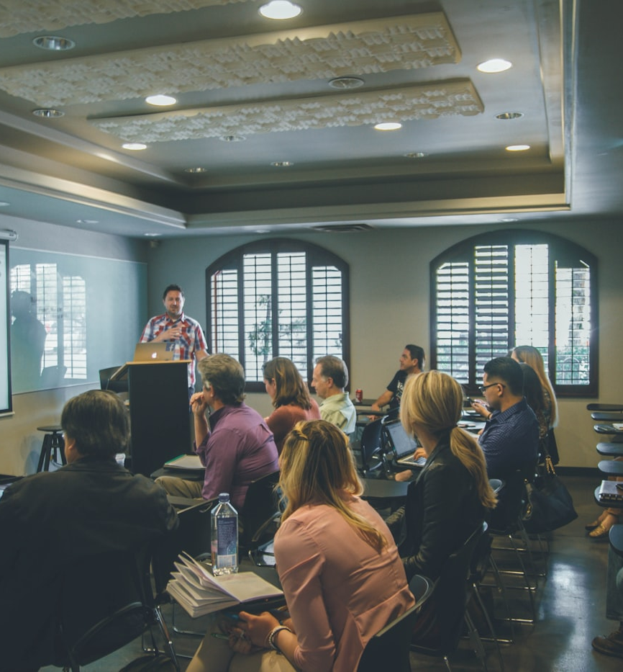


PathAhead in action
Interactive, engaging sessions delivered right on your campus.
On-campus workshops
Engaged students
Career mentoring
Future-ready skills

Slide 12
Our impact so far
Trusted across schools and junior colleges in India.
5,000+
50+
30+
4.9/5
Students guided
Workshops delivered
Partner institutions
Average rating

Slide 13
Trusted by students, teachers & principals
“
“
“
“The workshop gave me total clarity on which engineering branch fits me.”
“Engaging and relevant. Our students were talking about AI careers for days.”
“Professional and valuable. We're making PathAhead an annual part of our calendar.”
A
Ananya R.
S
S. Kumar
D
Dr. Priya M.
Inter 2nd Year Student
Faculty, Junior College
Principal

Slide 14
Give your students an edge.
Book a PathAhead workshop and help your students step into college with clarity and confidence.
✓
Call us: +91 7780109877 • +91 9989057655
✓
Email us: nirishapavuluri@gmail.com
✓
saathwik.13@gmail.com
✓
Book online: Visit our website to book a workshop
PathAhead — Your Career Starts Here.

