Slide 1

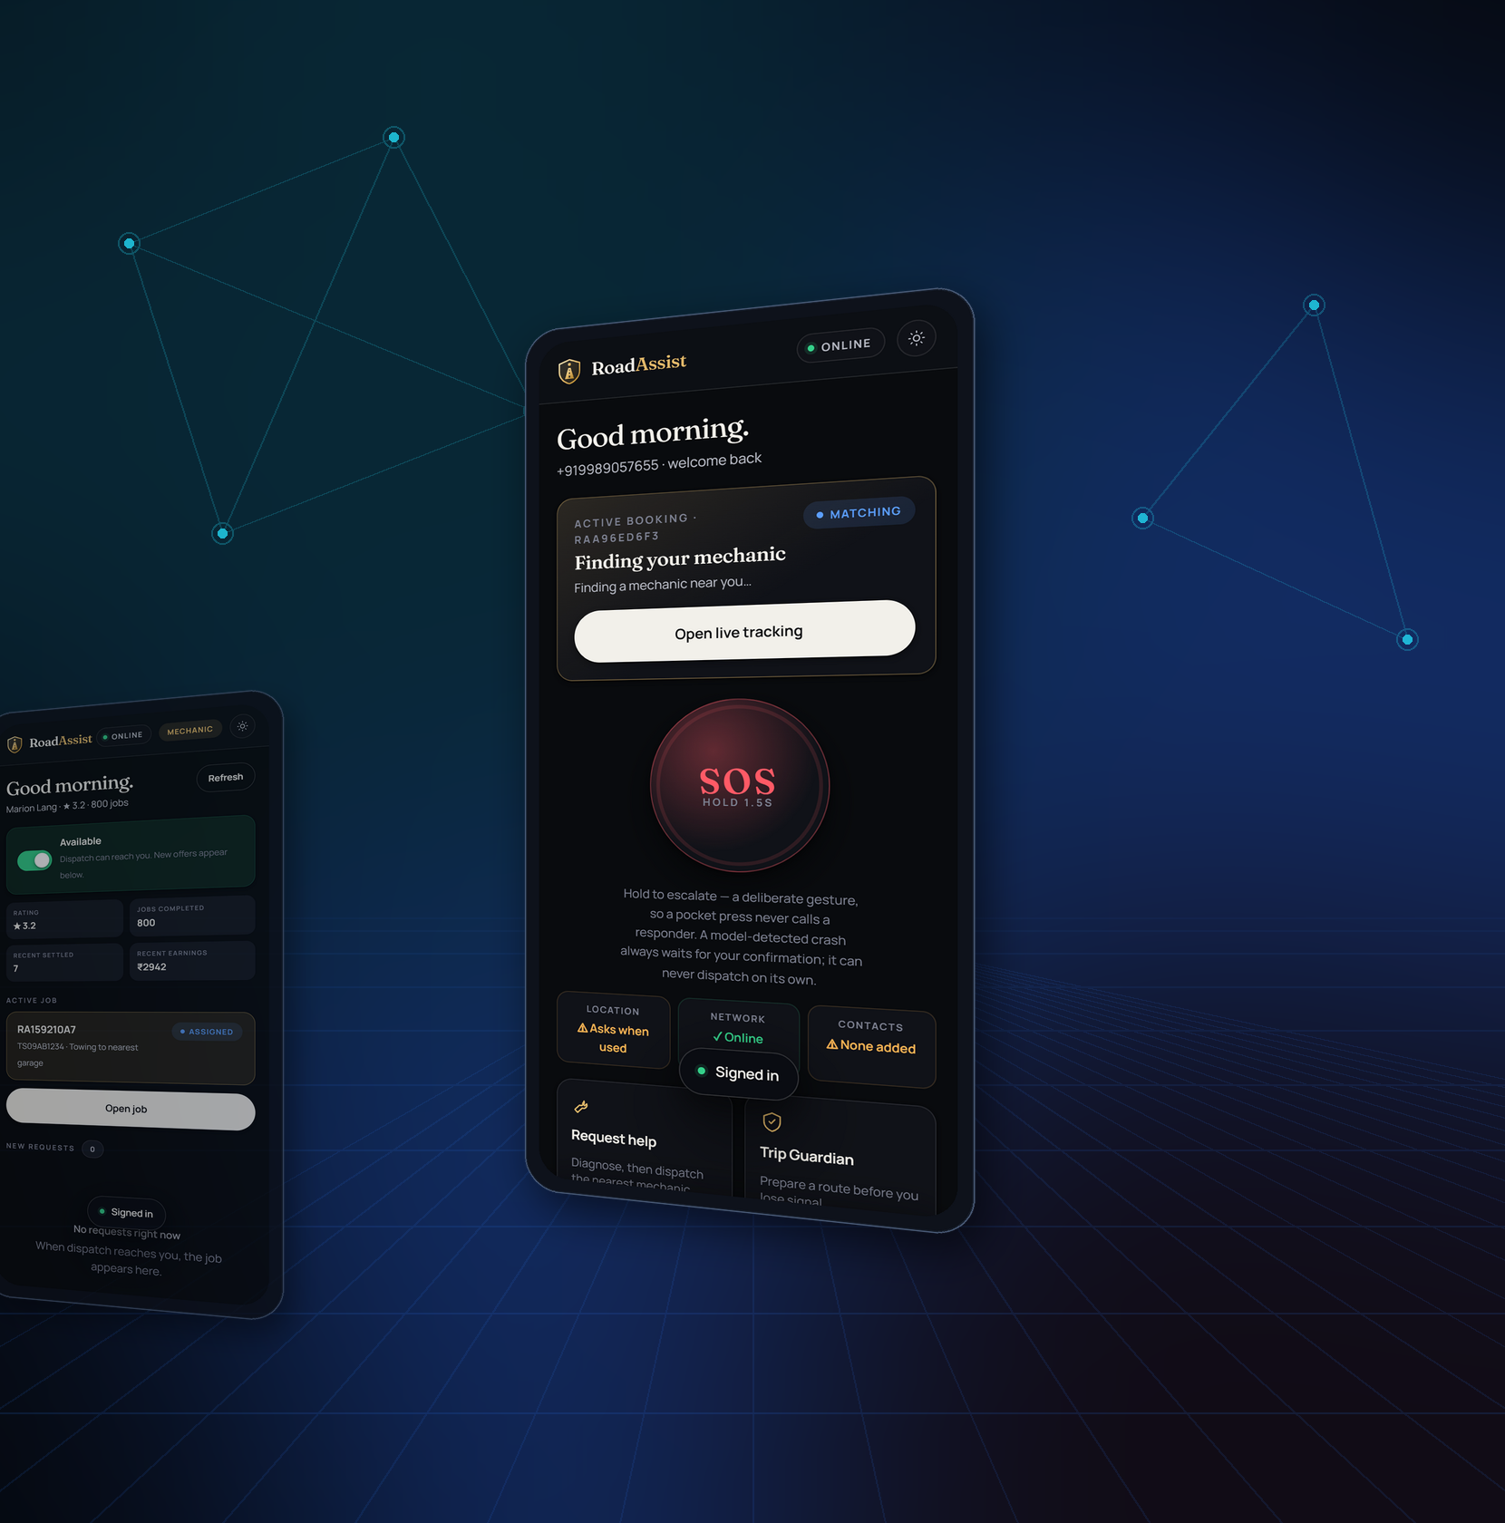
SWE4004 · CLOUD COMPUTING AND APPLICATIONS
ROADASSIST
BHARAT
AI-POWERED ROADSIDE ASSISTANCE
& EMERGENCY MOBILITY PLATFORM
AI
CLOUD
MOBILITY
SAFETY
A working platform used to demonstrate Cloud Computing Modules 1-4
ROADASSIST BHARAT · SWE4004 CLOUD COMPUTING AND APPLICATIONS
01
Notes:
MEANING
Opening frame. RoadAssist Bharat is a real, working roadside-assistance platform, and this deck uses it as the worked example for Cloud Computing Modules 1-4.
SAY
"This is RoadAssist Bharat - an AI-assisted roadside assistance and emergency mobility platform for India. What I want to show today is not just the application, but how every layer of it maps onto the cloud computing concepts in Modules 1 through 4."
CONCEPT DEMONSTRATED
Framing only. The four chips - AI, Cloud, Mobility, Safety - are the four threads running through the deck.
RELATION TO ROADASSIST
The platform genuinely exists: TypeScript, Fastify, PostgreSQL with PostGIS, a Progressive Web App, 58 API routes, 61 database tables.
IF ASKED
"Is this real or a mockup?" - It is real and running. I can show the live application, the test suite and the database at any point.
TRANSITION
"Let me start with the problem it exists to solve."

Slide 2

THE REAL-WORLD PROBLEM
WHEN THE ROAD STOPS,
THE PROBLEM STARTS.
BREAKDOWN
Flat tyre, dead battery,
overheating, no fuel
UNCERTAINTY
What is wrong?
Is it safe to drive?
FINDING HELP
Who is nearby?
Are they free?
LOCATION
Describing where you are
on an unmarked road
WAITING
No ETA, no visibility,
no progress
SAFETY
Roadside at night,
nobody informed
Every one of these six failures is an information problem before it is a mechanical one.
The driver cannot diagnose, cannot locate, cannot summon, and cannot see what happens next.
A cloud platform is the natural answer, because the information needed - who is nearby, what the fault is, where the vehicle is, who has been told - lives in different places and must be brought together in real time.
ROADASSIST BHARAT · SWE4004 CLOUD COMPUTING AND APPLICATIONS
02
Notes:
MEANING
The six-stage chain from breakdown to danger. Deliberately no statistics - none are invented anywhere in this deck.
SAY
"When a vehicle stops, the mechanical fault is only the first problem. The driver then cannot diagnose it, cannot describe where they are, cannot tell who is nearby, and has no visibility of help arriving. Each of those is an information problem, and information problems are what cloud platforms solve."
CONCEPT DEMONSTRATED
Motivation for centralised, always-available services - the goals and benefits of cloud adoption, Module 1.
RELATION TO ROADASSIST
Each stage maps to a built feature: AI diagnosis, GPS with PostGIS location, dispatch, live tracking, and the Raksha SOS system.
IF ASKED
"Do you have data on breakdown frequency?" - I deliberately did not invent figures. The design is driven by the failure chain, not by claimed statistics.
TRANSITION
"So the vision is a single platform that closes every one of those gaps."

Slide 3

PROJECT VISION
IMPLEMENTED
ONE PLATFORM. EVERY ROAD. EVERY RESPONSE.
CUSTOMER
PWA · offline-first
LIVE MAP
OpenStreetMap
ROADASSIST CLOUD PLATFORM
AI DIAGNOSIS
rules engine
Fastify API · PostgreSQL + PostGIS
58 routes · 61 tables · role-scoped access
RAKSHA / SOS
emergency path
MECHANIC
dispatch console
AUTHORITY
road health
The cloud platform is the backbone: the only component every actor talks to, and the only place that knows the whole truth about a booking, an incident or a vehicle.
ROADASSIST BHARAT · SWE4004 CLOUD COMPUTING AND APPLICATIONS
03
Notes:
MEANING
The ecosystem. Six actors, one central platform. No actor talks directly to another.
SAY
"Six participants: the customer, AI diagnosis, the mechanic, the live map, the Raksha emergency system, and the road authority. None talk to each other directly. Everything goes through the central platform, and that is what makes the platform authoritative."
CONCEPT DEMONSTRATED
Centralised, network-accessible shared services - the essential cloud characteristics, Module 1.
RELATION TO ROADASSIST
Verified: 58 API routes, 61 tables, seven roles - citizen, mechanic, admin, gov_officer, fleet_admin, fleet_driver, support.
IF ASKED
"Why must everything go through the centre?" - Because booking state is server-authoritative. If a mechanic's phone could tell a customer's phone directly that a job was finished, the two devices could disagree. The server is the single source of truth, and the state machine there is the only thing allowed to change a booking's state.
TRANSITION
"Which raises the question this course is really about - why does this need the cloud at all?"

Slide 4

MODULE 1 · THE BRIDGE
ARCHITECTURAL CONCEPT
WHY ROADASSIST NEEDS THE CLOUD
CUSTOMER
MECHANIC
AUTHORITY
WEBSITE / PWA
CENTRAL CLOUD PLATFORM
Centralised services
Anywhere access
Shared resources
Scalability
Availability
Real-time exchange
COMPUTE
STORAGE
NETWORK
DATA
Without the cloud, each actor would hold its own copy of the truth and reconcile it later. With it, one authoritative service is reachable from any road, on any device, at any hour.
M1 · UNDERSTANDING
M2 · ENABLING TECH
M3 · INFRASTRUCTURE
M4 · ARCHITECTURES
04
Notes:
MEANING
The bridge slide - it turns the project story into the Module 1 story.
SAY
"Four kinds of consumer - customers, mechanics, authorities and the public website - all reach one central platform, which draws on compute, storage, network and data. The six capabilities in the middle band are exactly the cloud characteristics from Module 1."
CONCEPT DEMONSTRATED
Module 1: goals and benefits of cloud adoption, and the essential characteristics.
RELATION TO ROADASSIST
All four consumer types exist as real surfaces: the customer PWA, the mechanic console, the RAKSHA authority dashboard, and the public site.
IF ASKED
"Could this not just be one server?" - It could, and in development it is. The cloud model matters because demand is uneven and geographically spread, and because an emergency service should not have a single point of failure. That is an architectural argument, which is why this slide is labelled architectural concept rather than implemented.
TRANSITION
"So let us take Module 1 properly."

Slide 5
ORIGINS · CONCEPTS · CHARACTERISTICS
ARCHITECTURAL CONCEPT
MODULE 1 — UNDERSTANDING CLOUD COMPUTING
THE FIVE ESSENTIAL CHARACTERISTICS
WHAT THE CLOUD SUPPLIES ROADASSIST
On-demand self-service
CLOUD
A user signs in and books assistance; nobody provisions anything.
Broad network access
Reachable from any phone browser - the PWA needs no install.
COMPUTE
API + AI diagnosis
STORAGE
PostgreSQL + PostGIS
Resource pooling
One platform, one database, one API serve every customer and mechanic.
Rapid elasticity
NETWORK
HTTPS + tile proxy
SERVICES
auth · booking · SOS
Capacity can follow demand; festival and monsoon peaks are not steady state.
Measured service
DATA
61 tables · audit chain
Usage is observable per request, which is what makes scaling decidable.
Cloud computing grew out of utility computing, grid computing and virtualisation. RoadAssist consumes it the way a home consumes electricity: on demand, metered, without owning the plant.
M1 · UNDERSTANDING
M2 · ENABLING TECH
M3 · INFRASTRUCTURE
M4 · ARCHITECTURES
05
Notes:
MEANING
The five essential characteristics, each tied to something concrete, plus the five resource categories the cloud supplies.
SAY
"Cloud computing has five essential characteristics. On-demand self-service - a customer books assistance without anyone provisioning a thing. Broad network access - it is a Progressive Web App, so any phone browser reaches it. Resource pooling - one platform serves every customer and mechanic. Rapid elasticity - demand is not steady; monsoon and festival travel spike it. Measured service - usage is observable per request."
CONCEPT DEMONSTRATED
Module 1 - origins and influences, basic concepts and terminology, cloud characteristics.
RELATION TO ROADASSIST
Storage is genuinely PostgreSQL 16 with PostGIS 3.4.3. The data layer is 61 tables, including a hash-chained tamper-evident audit log.
IF ASKED
"Which characteristic is weakest in your build?" - Honestly, rapid elasticity. The application is designed to scale horizontally because request handling is stateless behind a JWT, but automatic scaling is not implemented. I label that rather than claim it.
TRANSITION
"Next - who actually plays which role in this picture."

Slide 6
MODULE 1 · ROLES AND BOUNDARIES
ARCHITECTURAL CONCEPT
WHO USES THE CLOUD?
CLOUD PROVIDER
Owns and operates the physical estate: data centres,
hardware, hypervisors, network fabric, storage arrays.
Physical servers
Hypervisor
Storage array
Network fabric
Boundary of provider responsibility
ROADASSIST PLATFORM (cloud consumer, then provider)
Consumes provider resources; itself provides a
service to its own users. A dual role.
Fastify API
Booking engine
AI rules
Auth + RBAC
Boundary of application responsibility
CLOUD CONSUMERS / END USERS
citizen
mechanic
admin
gov_officer
Seven roles exist in the database.
fleet_admin
fleet_driver
support
M1 · UNDERSTANDING
M2 · ENABLING TECH
M3 · INFRASTRUCTURE
M4 · ARCHITECTURES
06
Notes:
MEANING
Three layers, two boundaries. The key insight is that RoadAssist sits in the middle and is BOTH a cloud consumer and a cloud provider.
SAY
"Module 1 defines roles and boundaries. At the top, the cloud provider owns the physical estate - data centres, hypervisors, storage. In the middle, RoadAssist consumes those resources but itself provides a service to its users, so it holds a dual role. At the bottom are the end users, and in our database that is seven distinct roles."
CONCEPT DEMONSTRATED
Module 1 - roles and boundaries: cloud provider, cloud consumer, cloud service owner, and where responsibility changes hands.
RELATION TO ROADASSIST
The seven roles are real and enforced: citizen, mechanic, admin, gov_officer, fleet_admin, fleet_driver, support. Authorization is checked at the resource, not just the route.
IF ASKED
"What is the difference between a cloud consumer and a cloud service owner?" - RoadAssist is a consumer with respect to the infrastructure provider, and a service owner with respect to its own users. The same organisation can hold both roles, and this diagram shows exactly where the line falls.
TRANSITION
"Given those roles - which service and deployment model does RoadAssist correspond to?"

Slide 7
MODULE 1 · DELIVERY AND DEPLOYMENT MODELS
ARCHITECTURAL CONCEPT
WHERE DOES ROADASSIST FIT?
Architectural mapping. The project runs on local containers in development; no commercial cloud provider is used.
MODEL
WHO MANAGES WHAT
ROADASSIST MAPPING
STATUS
IaaS
Provider gives virtual machines,
storage and network; you manage the OS up
Where the containers and database would
run in a deployed environment
MAPPING
PaaS
Provider also manages runtime and
scaling; you deploy code only
Fastify API could be deployed as a
managed Node service
MAPPING
SaaS
Consumer uses finished software
over the network
What the customer, mechanic and
authority actually experience
IMPLEMENTED
DEPLOYMENT MODELS
PUBLIC
Shared provider estate.
Lowest cost, least control.
PRIVATE
Dedicated estate. Suits the
government / RAKSHA tenant.
HYBRID
Public for the citizen app,
private for authority data.
M1 · UNDERSTANDING
M2 · ENABLING TECH
M3 · INFRASTRUCTURE
M4 · ARCHITECTURES
07
Notes:
MEANING
The service and deployment model matrix, mapped honestly. Note the STATUS column - only SaaS is marked implemented.
SAY
"Three delivery models. Infrastructure as a Service gives you virtual machines and you manage upward - that is where our containers and database would sit in a deployment. Platform as a Service adds the managed runtime. Software as a Service is finished software over the network, and that is precisely what our customer, mechanic and authority users experience today. So RoadAssist IS a SaaS application; the IaaS and PaaS rows are architectural mapping, not claims."
CONCEPT DEMONSTRATED
Module 1 - cloud delivery models and cloud deployment models.
RELATION TO ROADASSIST
Deployment is deliberately labelled a mapping. The project runs on Docker Compose locally, and is currently exposed over an HTTPS tunnel for demonstration. No commercial cloud provider is used, so no claim is made about one.
IF ASKED
"Which deployment model would you choose?" - Hybrid. The citizen-facing app suits public cloud for reach and cost, while RAKSHA authority data and the medical break-glass records are exactly the kind of data that belongs in a private, jurisdiction-bounded estate. Note that India's data-residency expectations push in the same direction.
TRANSITION
"Every model brings benefits and matching risks."

Slide 8
MODULE 1 · GOALS, RISKS AND CHALLENGES
ARCHITECTURAL CONCEPT
CLOUD BENEFITS VS CLOUD CHALLENGES
BENEFITS
RISKS AND CHALLENGES
Scalability
Security
One platform serves a city or a state without redesign.
Handled: OTP, rotating refresh tokens, resource-scoped RBAC.
Availability
Privacy
A breakdown at 2am must reach a live service.
Medical data is break-glass only, and every read is logged.
Centralised services
Network dependency
One authoritative booking state, not many copies.
Answered: offline-first PWA with an idempotent sync journal.
Remote access
Availability dependency
Any phone browser, no install, no app store.
An emergency path cannot fail silently - SOS never queues.
Resource sharing
Resource management
Customers, mechanics and authorities share one estate.
Rate limits per number and per IP guard shared capacity.
Operational flexibility
Data protection
Providers are swappable behind adapters.
Hash-chained audit log makes tampering detectable.
M1 · UNDERSTANDING
M2 · ENABLING TECH
M3 · INFRASTRUCTURE
M4 · ARCHITECTURES
08
Notes:
MEANING
Benefits on the left, risks on the right - and critically, each risk names how RoadAssist actually answers it.
SAY
"Cloud brings scalability, availability and centralisation, but it also brings real risks. What I want to show is that we did not just list them - each one has a concrete answer in the build. Network dependency is answered by an offline-first PWA with an idempotent sync journal. Data protection is answered by a hash-chained audit log where tampering is detectable. Privacy is answered by break-glass medical access that is logged and notified."
CONCEPT DEMONSTRATED
Module 1 - goals and benefits, risks and challenges.
RELATION TO ROADASSIST
All six risk answers are implemented and tested. The audit chain has a test that forges an entry and confirms the chain detects the broken link.
IF ASKED
"What happens if the network is down during an emergency?" - This is the most important design decision in the project. Ordinary actions like adding a vehicle are queued and replayed idempotently. But SOS and payments are never queued - they fail loudly and tell the user to call 112 directly, because an emergency that silently waits for signal is worse than one that admits it failed.
TRANSITION
"That covers Module 1. Module 2 asks what technologies make the cloud possible."

Slide 9
THE FIVE TECHNOLOGIES BENEATH EVERY CLOUD
ARCHITECTURAL CONCEPT
MODULE 2 — CLOUD ENABLING TECHNOLOGY
DATA CENTER
Physical estate:
compute, storage,
power, cooling
VIRTUALIZATION
One physical host,
many isolated
runtimes
WEB TECHNOLOGY
HTTP, REST, the
browser as the
universal client
MULTITENANCY
One instance,
many isolated
tenants
SERVICE TECH
Capabilities exposed
as independent
services
ROADASSIST BHARAT
Customer PWA · Mechanic console · RAKSHA authority dashboard · Public site
Web technology — IMPLEMENTED
Service technology — IMPLEMENTED
Multitenancy — SCHEMA PRESENT
Virtualization — CONTAINERS ONLY
Data center — PROVIDER LAYER
Honest position: the top two are built into the application; multitenancy exists in the schema; virtualization is container-level, not a hypervisor we operate; the data centre belongs to whichever provider hosts it.
M1 · UNDERSTANDING
M2 · ENABLING TECH
M3 · INFRASTRUCTURE
M4 · ARCHITECTURES
09
Notes:
MEANING
The five Module 2 technologies, with an honest status chip under each. This slide sets up the next three.
SAY
"Module 2 covers the five technologies that make cloud computing possible: data centres, virtualization, web technology, multitenancy, and service technology. I want to be precise about which of these we actually operate. Web technology and service technology are built into the application. Multitenancy exists in the database schema. Virtualization for us is containers, not a hypervisor we run. And the data centre belongs to whichever provider hosts the system."
CONCEPT DEMONSTRATED
Module 2 - the full set of cloud enabling technologies.
RELATION TO ROADASSIST
Docker Compose provides three local services: PostGIS, Redis and Redpanda. Redis and Redpanda are provisioned but not yet used by application code - I state that rather than imply a message-driven architecture that does not exist.
IF ASKED
"You said Redpanda is unused - why is it there?" - It was provisioned as the event-bus stand-in for a future move to event-driven dispatch. It is honest to say it is scaffolding for planned work rather than pretend the system is already event-driven.
TRANSITION
"Starting with the physical foundation."

Slide 10
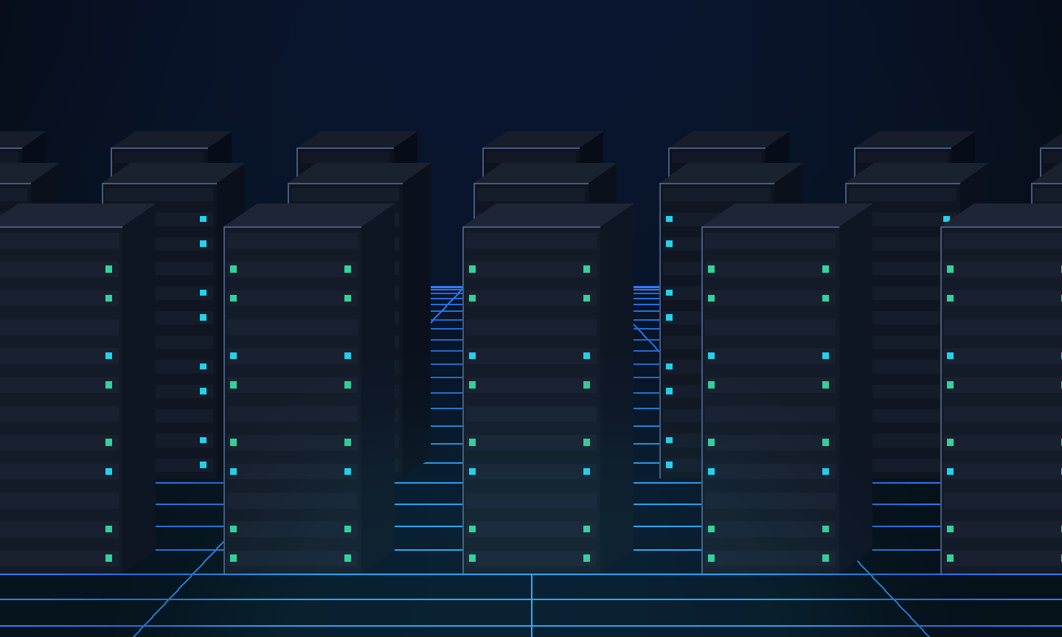
MODULE 2 · DATA CENTER TECHNOLOGY
ARCHITECTURAL CONCEPT
THE CLOUD NEEDS A PHYSICAL FOUNDATION.
WHAT A DATA CENTRE PROVIDES
Compute
Racked servers running virtualized workloads
Storage
Disk arrays and storage networks
Networking
Switching fabric, routing, external links
Power
Redundant supply and battery / generator backup
Cooling
Thermal management that bounds density
Monitoring
Environmental and hardware telemetry
DATA CENTRE
CLOUD RESOURCES
ROADASSIST SERVICES
M1 · UNDERSTANDING
M2 · ENABLING TECH
M3 · INFRASTRUCTURE
M4 · ARCHITECTURES
10
Notes:
MEANING
Physical infrastructure is the base of every cloud claim. This slide keeps the abstraction honest.
SAY
"Everything we call 'the cloud' ultimately runs on physical machines in a building with power and cooling. A data centre supplies compute, storage, networking, power, cooling and monitoring. Those become cloud resources, and cloud resources are what RoadAssist services consume."
CONCEPT DEMONSTRATED
Module 2 - data center technology: the physical substrate and why density, power and cooling bound what the cloud can offer.
RELATION TO ROADASSIST
This layer is the provider's, not ours. In development the equivalent is a single machine running Docker containers. That is stated rather than dressed up.
IF ASKED
"Why does cooling matter to a software project?" - Because it bounds server density and therefore cost per unit of compute, which is ultimately what makes on-demand elastic pricing possible for a consumer like us.
TRANSITION
"The technology that turns one physical machine into many usable ones is virtualization."

Slide 11
MODULE 2 · VIRTUALIZATION TECHNOLOGY
ARCHITECTURAL CONCEPT
ONE PHYSICAL SYSTEM. MULTIPLE VIRTUAL RESOURCES.
Honest scope: RoadAssist uses OS-level virtualization (Docker containers) in development. We do not operate a hypervisor — that layer belongs to the infrastructure provider.
AUTH
BOOKING
AI
MAP
RAKSHA
SYNC
VIRTUAL SERVER 1
API · auth · booking
VIRTUAL SERVER 2
AI diagnosis · rules
VIRTUAL SERVER 3
Map proxy · RAKSHA
HYPERVISOR / VIRTUALIZATION LAYER
PHYSICAL SERVER · CPU · MEMORY · DISK · NIC
M1 · UNDERSTANDING
M2 · ENABLING TECH
M3 · INFRASTRUCTURE
M4 · ARCHITECTURES
11
Notes:
MEANING
The classic virtualization stack, read bottom-up, with an explicit honesty band at the top.
SAY
"Read this from the bottom. One physical server. Above it a hypervisor, which is the layer that lets a single machine present itself as several isolated ones. Above that, virtual servers, each carrying a share of the workload. And above those, the actual RoadAssist services. I want to be precise: we use OS-level virtualization - Docker containers - not a hypervisor we operate ourselves. That distinction matters."
CONCEPT DEMONSTRATED
Module 2 - virtualization technology; hardware independence, server consolidation, isolation.
RELATION TO ROADASSIST
Docker Compose runs PostGIS, Redis and Redpanda as isolated containers. The API itself runs as a Node process. In a deployed environment these become virtual servers on provider infrastructure.
IF ASKED
"Difference between a virtual machine and a container?" - A virtual machine virtualizes hardware and runs its own kernel; a container virtualizes the operating system and shares the host kernel. Containers are lighter and start faster, VMs give stronger isolation. We use containers.
IF ASKED
"Why is virtualization useful?" - Consolidation, isolation and portability. Several workloads share one machine safely, and a workload can be moved between machines because it no longer depends on specific hardware.
TRANSITION
"Above virtualization sit the technologies the user actually touches."

Slide 12
MODULE 2 · WEB · MULTITENANT · SERVICE TECHNOLOGY
PARTIALLY IMPLEMENTED
FROM CLOUD INFRASTRUCTURE TO USER SERVICES
WEB TECHNOLOGY
MULTITENANT TECHNOLOGY
SERVICE TECHNOLOGY
IMPLEMENTED
SCHEMA PRESENT
IMPLEMENTED
HTTP / REST
One instance
AUTH / OTP
BOOKING
58 JSON routes, uniform error envelope
A single deployment serves every tenant
AI DIAGNOSIS
MAP
Browser client
Fleet tenancy
No install; the URL is the app
fleets + fleet_members tables exist
RAKSHA / SOS
PAYMENT
PWA
Gov tenancy
OFFLINE SYNC
AUDIT
Manifest + service worker, installable
gov_jurisdictions + gov_officers
Offline shell
Isolation by role
19 assets cached for a dead network
Queries scoped to the caller, not the route
Each capability is an independently addressable service behind one API contract.
M1 · UNDERSTANDING
M2 · ENABLING TECH
M3 · INFRASTRUCTURE
M4 · ARCHITECTURES
12
Notes:
MEANING
The three user-facing Module 2 technologies side by side, each with its true status.
SAY
"Web technology is fully implemented - 58 REST routes, and a Progressive Web App that installs to the home screen and keeps a 19-asset shell cached for offline use. Service technology is fully implemented - eight independent capabilities behind one API contract. Multitenancy I mark honestly as schema-present: the fleet and government tenancy tables exist and role-scoped queries are enforced, but we have not yet run genuinely separate tenants in production."
CONCEPT DEMONSTRATED
Module 2 - web technology, multitenant technology, service technology.
RELATION TO ROADASSIST
All verified: the manifest declares four shortcuts and five icons; the service worker caches 19 shell assets; fleets, fleet_members, gov_jurisdictions and gov_officers all exist as tables.
IF ASKED
"What is multitenancy?" - One running instance of the software serving multiple independent customer organisations, with their data isolated from one another. Our tenants would be vehicle fleets and government jurisdictions, and isolation is enforced by scoping every query to the caller's identity rather than trusting the route.
TRANSITION
"Module 3 goes one level deeper - the specific infrastructure mechanisms."

Slide 13
MODULE 2 · SERVICE TECHNOLOGY IN PRACTICE
IMPLEMENTED
CONSUMING A CLOUD SERVICE: PAYMENTS
ROADASSIST — cloud consumer
TWO SETTLEMENT PATHS — ON PURPOSE
1 Invoice created
Amount is the invoice total.
Never read from the request.
BROWSER CALLBACK
POST /v1/payments/:id/confirm — the client returns the signed payload
2 Create order
Server-to-server, HTTP Basic.
POST /v1/orders
WEBHOOK · the one that matters
POST /v1/webhooks/razorpay — signature over the raw body IS the auth
3 Checkout opens
Client gets the key ID only.
The key SECRET never leaves us.
WHY A WEBHOOK AT ALL?
4 Signature verified
HMAC-SHA256(order|payment).
No match, no settlement.
A customer can pay and immediately close the tab, lose signal, or have the page killed. The money has still moved. The browser is not a reliable narrator, so settlement cannot depend on it.
RAZORPAY — cloud provider (SaaS)
VERIFIED — 22 AUTOMATED CHECKS
Forged signature refused
Unsigned webhook 401
Default provider is mock. Live keys need a KYC-verified account.
Amount mismatch refused
Replay settles once
M1 · UNDERSTANDING
M2 · ENABLING TECH
M3 · INFRASTRUCTURE
M4 · ARCHITECTURES
13
Notes:
MEANING
Module 2's service technology, made concrete. This is the one slide where RoadAssist is visibly a cloud CONSUMER of somebody else's SaaS, which is the Module 1 roles-and-boundaries idea in action.
SAY
"This is service technology in practice. Payments are not something we built - they are a cloud service we consume. Razorpay is the provider, we are the consumer, and the boundary between us is a set of web APIs. Follow the flow on the left. The invoice total is the amount; it is never read from the request, so a client cannot choose what it owes. We create the order server to server. The browser receives only the key ID - the key secret never leaves our server. And when checkout finishes, the signature is re-computed on our side before anything settles."
THE POINT ABOUT THE WEBHOOK
"On the right is the design decision I would most like to be asked about. There are two settlement paths. The browser callback is convenient. The webhook is the one that matters, because a customer can pay and immediately close the tab, and the money has still moved. If settlement depended on their browser surviving, we would take real money and never close the invoice. Razorpay retries the webhook until it gets a 2xx, so that is the path that actually guarantees correctness."
CONCEPT DEMONSTRATED
Module 2 - service technology (a capability consumed as an independent service over web APIs). Module 1 - cloud consumer and cloud provider roles, and the boundary between them. Module 3 - the network perimeter, since the webhook is authenticated by signature rather than by a session.
RELATION TO ROADASSIST
Implemented and tested: 22 automated assertions against a local stub of the Orders API - no account and no money needed to prove it. The default provider is 'mock', which settles locally; production refuses to boot on a real gateway with no webhook secret configured.
IF ASKED
"Why is the webhook authenticated differently from the rest of your API?" - Because Razorpay has no user session and no bearer token to present. The signature over the raw request body IS the authentication. That is also why our JSON parser retains the raw body: a re-serialised body would produce a different hash.
IF ASKED
"How do you stop someone paying one rupee for a four-hundred rupee job?" - Three ways. The amount is taken from the invoice, not the request. The signature covers the order id, so a payment cannot be re-pointed at a different order. And the webhook re-checks the captured amount against the invoice and refuses a mismatch with a 409.
IF ASKED
"Is this live?" - The integration is complete and tested against a stub. Live keys require a KYC-verified Razorpay business account, so the deck does not claim live transactions.
TRANSITION
"That completes Module 2. Module 3 goes one level deeper, into the infrastructure mechanisms themselves."

Slide 14
THE FIVE BUILDING BLOCKS
ARCHITECTURAL CONCEPT
MODULE 3 — CLOUD INFRASTRUCTURE MECHANISMS
NETWORK
PERIMETER
Controlled boundary
between the internet
and internal services
VIRTUAL
SERVER
Virtualized compute
running platform
workloads
CLOUD STORAGE
DEVICE
Persistent, addressable
storage for platform
data
CLOUD USAGE
MONITOR
Collects usage and
performance data for
billing and scaling
RESOURCE
REPLICATION
Multiple instances of
a resource for scale
and resilience
PARTIAL
CONCEPT
PARTIAL
PARTIAL
CONCEPT
ROADASSIST PLATFORM
Each mechanism is examined next against what the project actually does
PARTIAL means a real but limited form exists — for example a health endpoint reporting database latency is a usage monitor, but not a full monitoring stack. CONCEPT means the mechanism is designed for, not built.
M1 · UNDERSTANDING
M2 · ENABLING TECH
M3 · INFRASTRUCTURE
M4 · ARCHITECTURES
14
Notes:
MEANING
The five Module 3 mechanisms with honest status chips, setting up the next four slides.
SAY
"Module 3 defines five infrastructure mechanisms: the network perimeter, virtual servers, cloud storage devices, cloud usage monitors, and resource replication. I have marked each with what we actually have. Three are partial - real but limited. Two are architectural concepts we designed toward but did not build."
CONCEPT DEMONSTRATED
Module 3 - the complete set of infrastructure mechanisms.
RELATION TO ROADASSIST
Being specific about 'partial' matters. Our health endpoint reports database latency and provider status on every call - that is genuinely a usage monitor, but it is not Prometheus and Grafana, and I will not claim it is.
IF ASKED
"Why not just say you implemented all five?" - Because that would be false, and an evaluator can check. Precision about what exists is worth more than an inflated claim.
TRANSITION
"Starting at the boundary - the network perimeter."

Slide 15
MODULE 3 · NETWORK PERIMETER
PARTIALLY IMPLEMENTED
PROTECTING THE CLOUD BOUNDARY
INTERNET
Untrusted. Any client, any network.
OTP
NETWORK PERIMETER
DEFENCE
IN
DEPTH
TLS termination · trusted-proxy rules · rate limiting
JWT
API GATEWAY
Schema validation on every request (Zod)
RBAC
APPLICATION SERVICES
OWNER
Authentication · role gate · resource-level ownership
DATABASE
AUDIT
Parameterised queries · append-only audit chain
Verified: a forged X-Forwarded-For header from an untrusted peer is ignored, so the per-IP rate limit cannot be bypassed. No specific firewall product or cloud provider service is claimed.
M1 · UNDERSTANDING
M2 · ENABLING TECH
M3 · INFRASTRUCTURE
M4 · ARCHITECTURES
15
Notes:
MEANING
Defence in depth as five concentric layers, each with a real control.
SAY
"The network perimeter is the controlled boundary between the untrusted internet and internal services. Ours is layered. TLS terminates at the edge. Rate limits apply per phone number and per IP. Every request body is schema-validated with Zod. Then authentication, then a role gate, then - crucially - an ownership check at the resource itself, not just at the route. Finally the database, with an append-only audit chain."
CONCEPT DEMONSTRATED
Module 3 - network perimeter; controlled access and secure communication.
RELATION TO ROADASSIST
This is tested. We ran an attack where a client forges the X-Forwarded-For header to mint itself a fresh rate-limit bucket. With trust configured to loopback only, the forged header is ignored and all requests land in one bucket.
IF ASKED
"Why check ownership at the resource and not the route?" - Because a route-level check only asks 'may this role do this kind of thing'. A resource check asks 'may this specific user touch this specific booking'. Without the second, any authenticated mechanic could drive any customer's job.
IF ASKED
"Do you use a firewall or WAF?" - Not one we operate. That belongs to the hosting provider, so I do not claim it.
TRANSITION
"Behind the perimeter sits virtual compute."

Slide 16
MODULE 3 · VIRTUAL SERVER
ARCHITECTURAL CONCEPT
VIRTUAL COMPUTE FOR ROADASSIST SERVICES
AUTH
BOOKING
AI
MAP
RAKSHA
SYNC
API RUNTIME
Fastify · Node · stateless per request
VIRTUAL SERVER
isolated, allocatable compute unit
PHYSICAL INFRASTRUCTURE
provider-owned estate
Architectural concept. Today the API runs as a single Node process; the isolation boundary shown is the deployment target, not current infrastructure.
M1 · UNDERSTANDING
M2 · ENABLING TECH
M3 · INFRASTRUCTURE
M4 · ARCHITECTURES
16
Notes:
MEANING
How virtualized compute would carry the platform's workloads, read bottom-up, with the honesty band at the base.
SAY
"A virtual server is an isolated, allocatable unit of compute carved out of physical infrastructure. Our API runtime would sit on one. Critically, request handling is stateless - the session lives in a signed token, not in server memory - which is precisely what allows more virtual servers to be added without redesigning anything."
CONCEPT DEMONSTRATED
Module 3 - virtual server; workload isolation and allocation.
RELATION TO ROADASSIST
The statelessness is real and is the enabling property. Today it runs as one Node process, which I label clearly.
IF ASKED
"What is a virtual server?" - A software-defined server that behaves like a physical one but shares underlying hardware with others, allocated on demand and isolated from its neighbours.
IF ASKED
"Why does statelessness matter?" - Because if a user's session lived in one server's memory, their next request would have to reach that same server. Since ours lives in a JWT the client presents, any instance can serve any request - which is the precondition for load balancing and horizontal scaling.
TRANSITION
"Compute is only half of it. Data has to persist and survive."

Slide 17
MODULE 3 · CLOUD STORAGE DEVICE AND RESOURCE REPLICATION
PARTIALLY IMPLEMENTED
DATA MUST BE AVAILABLE WHEN USERS NEED IT.
CLOUD STORAGE — WHAT WE HOLD
RESOURCE REPLICATION
IMPLEMENTED
ARCHITECTURAL CONCEPT
Identity & sessions
PRIMARY
authoritative writes
users, roles, sessions, otp_challenges
Vehicle data
vehicles, user_vehicles, documents
replication stream
Booking records
REPLICA A
read scale-out
REPLICA B
failover standby
bookings, booking_events, offers
Service & money
invoices, payments, reviews
Emergency
incidents, responses, emergency_contacts
BACKUP
point-in-time restore
RAKSHA operations
edge_devices, detections, road_segments
Audit
Today: a single PostgreSQL instance. No replica is configured — stated, not implied.
hash-chained, append-only, tamper-evident
M1 · UNDERSTANDING
M2 · ENABLING TECH
M3 · INFRASTRUCTURE
M4 · ARCHITECTURES
17
Notes:
MEANING
What we genuinely store on the left; how replication would work on the right, clearly marked as concept.
SAY
"On the left is real: 61 tables covering identity, vehicles, bookings, money, emergencies, RAKSHA operations, and a hash-chained audit log. On the right is the replication architecture - a primary taking authoritative writes, replicas for read scale-out and failover, and backups for point-in-time restore. I want to be explicit: today we run a single PostgreSQL instance. No replica is configured. The dashed lines mean designed-for, not built."
CONCEPT DEMONSTRATED
Module 3 - cloud storage device and resource replication.
RELATION TO ROADASSIST
Storage is PostgreSQL 16 with PostGIS 3.4.3. The audit table is genuinely append-only with database rules preventing update and delete, and the chain is verified on read.
IF ASKED
"What is resource replication?" - Creating multiple instances of the same resource - usually storage or a server - so that load can be spread and a failure of one does not lose the service.
IF ASKED
"Why have you not implemented replication?" - It is an infrastructure configuration rather than an application change, and it needs a hosted database to be meaningful. The application is already written so that it would not need modifying - reads and writes both go through one data layer.
TRANSITION
"To decide when replication or scaling is needed, you must first measure."

Slide 18
MODULE 3 · CLOUD USAGE MONITOR
PARTIALLY IMPLEMENTED
OBSERVE. MEASURE. OPTIMIZE.
Cloud usage monitoring architecture. Metric values below are illustrative of the mechanism — no measurements are claimed.
CPU
MEMORY
STORAGE
NETWORK
compute pressure
working set
growth rate
throughput
REQUESTS
ACTIVE USERS
SERVICE LOAD
ERROR RATE
per endpoint
concurrency
queue depth
failed calls
WHAT ROADASSIST ACTUALLY MEASURES TODAY
GET /health returns database latency and live provider status · every request is logged with a unique id and response time · model_predictions records AI latency and fallback use
RESOURCE PLANNING
PERFORMANCE
SCALABILITY DECISIONS
AVAILABILITY
M1 · UNDERSTANDING
M2 · ENABLING TECH
M3 · INFRASTRUCTURE
M4 · ARCHITECTURES
18
Notes:
MEANING
The monitoring mechanism as architecture, plus a clearly separated band of what we genuinely measure.
SAY
"A cloud usage monitor collects runtime data - CPU, memory, storage, network, request counts, concurrency, service load, errors. That data is what makes resource planning, performance work, scaling decisions and availability guarantees possible. The bars here illustrate the mechanism; they are not our measurements. What we do genuinely have is in the band below: a health endpoint reporting live database latency and provider status, per-request logging with response times, and a model_predictions table recording AI latency and whether the fallback was used."
CONCEPT DEMONSTRATED
Module 3 - cloud usage monitor; measured service, which is also the fifth essential characteristic from Module 1.
RELATION TO ROADASSIST
The health endpoint is real and I can call it live. The per-request logging is Fastify's, with a generated request id on every call.
IF ASKED
"Are those real numbers?" - No, and I have labelled them illustrative. Inventing measurements would be dishonest. What I can show live is the health endpoint returning genuine database latency.
IF ASKED
"What is cloud usage monitoring for?" - Two things: billing, because measured service is how consumption is charged; and control, because you cannot scale or plan capacity against data you do not have.
TRANSITION
"With measurement in place, Module 4 asks what architectures you can then build."

Slide 19
EIGHT ARCHITECTURES + CLOUD OPERATIONS
ARCHITECTURAL CONCEPT
MODULE 4 — FUNDAMENTAL CLOUD ARCHITECTURES
WORKLOAD
DISTRIBUTION
RESOURCE
POOLING
DYNAMIC
SCALABILITY
ELASTIC
CAPACITY
ROADASSIST BHARAT
as a cloud architecture
SERVICE LOAD
BALANCING
CLOUD
BURSTING
ELASTIC DISK
PROVISIONING
REDUNDANT
STORAGE
Plus cloud operations: migration, static scheduling and dynamic scheduling — covered on slide 23.
M1 · UNDERSTANDING
M2 · ENABLING TECH
M3 · INFRASTRUCTURE
M4 · ARCHITECTURES
19
Notes:
MEANING
The major transition slide. RoadAssist sits at the centre, surrounded by the eight fundamental architectures.
SAY
"Module 4 defines the fundamental cloud architectures. Eight of them surround the platform here: workload distribution, resource pooling, dynamic scalability, elastic resource capacity, service load balancing, cloud bursting, elastic disk provisioning and redundant storage. Plus cloud operations - migration and scheduling - which I cover separately. Over the next five slides I take these in pairs and show what each would mean for RoadAssist specifically."
CONCEPT DEMONSTRATED
Module 4 - the complete set of fundamental cloud architectures.
RELATION TO ROADASSIST
These are architectures the platform is designed to accept rather than ones it currently runs. The design decisions that make them possible - statelessness, a single data layer, idempotent operations - are implemented.
IF ASKED
"Which of these eight do you implement?" - None as running infrastructure, and I say so plainly. What I did implement are the application properties that make them adoptable without a rewrite: stateless request handling, idempotency keys, and server-authoritative state.
TRANSITION
"Starting with the two that govern how work is spread."

Slide 20
MODULE 4 · WORKLOAD DISTRIBUTION + RESOURCE POOLING
ARCHITECTURAL CONCEPT
DISTRIBUTE WORK. SHARE RESOURCES.
WORKLOAD DISTRIBUTION
RESOURCE POOLING
AI diagnosis
SHARED POOL
Booking
COMPUTE
API + AI workers
STORAGE
database + uploads
Map tiles
DISTRIBUTION LOGIC
route by type and load
Mechanic poll
NETWORK
bandwidth + tile cache
SERVICES
auth · booking · map
SOS
WORKER 1
WORKER 2
One pool serves every tenant and every request type. A map-tile burst and an AI diagnosis draw on the same underlying capacity, which is exactly why pooling improves utilisation over dedicated allocation.
WORKER 3
Implemented today in a limited form: the map tile proxy keeps a shared in-memory tile cache, so one user's fetch serves the next user's request.
M1 · UNDERSTANDING
M2 · ENABLING TECH
M3 · INFRASTRUCTURE
M4 · ARCHITECTURES
20
Notes:
MEANING
Two architectures side by side: distributing incoming work, and pooling the resources that work draws on.
SAY
"Workload distribution routes incoming requests across multiple workers. On the left are our five real request types - AI diagnosis, booking, map tiles, mechanic polling and SOS - which have genuinely different shapes. Map tiles are bursty and cacheable; SOS is rare but must never wait. On the right, resource pooling means those all draw on one shared pool of compute, storage, network and services rather than each having dedicated capacity."
CONCEPT DEMONSTRATED
Module 4 - workload distribution architecture and resource pooling architecture.
RELATION TO ROADASSIST
There is a genuine, if small, instance of pooling already: the map tile proxy maintains a shared in-memory cache, so a tile fetched for one user is served from memory to the next. That is resource pooling at application scale.
IF ASKED
"What is resource pooling?" - Grouping computing resources so they serve multiple consumers from a common pool, assigned on demand, rather than dedicating fixed capacity to each. It raises utilisation, because peaks in one workload use capacity another is not using.
IF ASKED
"How would you distribute SOS differently?" - SOS should be prioritised, not just distributed. In a queue-based design it would take a dedicated high-priority path so a surge of map requests could never delay an emergency.
TRANSITION
"Distribution assumes fixed capacity. Scalability changes the capacity itself."

Slide 21
MODULE 4 · DYNAMIC SCALABILITY + ELASTIC RESOURCE CAPACITY
ARCHITECTURAL CONCEPT
THE CLOUD ADAPTS TO DEMAND.
LOW
NORMAL
HIGH
PEAK
LOW
Night · few journeys
Weekday commute
Monsoon · poor roads
Festival travel
Demand recedes
1 instance
2 instances
4 instances
6 instances
1 instance
DYNAMIC SCALABILITY
ELASTIC RESOURCE CAPACITY
Instances are added and removed automatically as measured demand crosses thresholds.
Existing instances are resized — more CPU and memory allocated to the same server.
Architectural capability. RoadAssist does NOT implement automatic scaling. It is written to accept it: request handling is stateless, so instances are interchangeable.
M1 · UNDERSTANDING
M2 · ENABLING TECH
M3 · INFRASTRUCTURE
M4 · ARCHITECTURES
21
Notes:
MEANING
A demand timeline with instance count rising and falling, and the precise distinction between the two architectures.
SAY
"Demand on a roadside assistance platform is not steady. Night is quiet. Weekday commuting is normal. Monsoon brings poor road conditions and more breakdowns. Festival travel is the peak. Then it recedes. Dynamic scalability adds and removes whole instances as demand crosses thresholds. Elastic resource capacity instead resizes the instances you already have - more CPU and memory to the same server. Scaling out versus scaling up."
CONCEPT DEMONSTRATED
Module 4 - dynamic scalability architecture and elastic resource capacity architecture.
RELATION TO ROADASSIST
I state clearly that automatic scaling is not implemented. What is implemented is the property that makes it possible: the session lives in a JWT the client presents, so no instance holds user state and any instance can serve any request.
IF ASKED
"What is the difference between dynamic scalability and elastic capacity?" - Dynamic scalability changes the NUMBER of resources - horizontal, scale out. Elastic resource capacity changes the SIZE of existing resources - vertical, scale up. Scaling out generally suits stateless web workloads; scaling up suits a database that is hard to shard.
IF ASKED
"Have you implemented autoscaling?" - No. Claiming it would be false and easily checked. The design decisions that permit it are done.
TRANSITION
"Adding instances only helps if traffic is spread across them."

Slide 22
MODULE 4 · SERVICE LOAD BALANCING + CLOUD BURSTING
ARCHITECTURAL CONCEPT
KEEPING SERVICES RESPONSIVE UNDER LOAD
SERVICE LOAD BALANCING
CLOUD BURSTING
USER
USER
USER
USER
PRIMARY ENVIRONMENT
Baseline capacity — private or on-premises. Handles normal demand.
LOAD BALANCER
even distribution + health checks
CAPACITY LIMIT REACHED
SERVER 1
SERVER 2
SERVER 3
ADDITIONAL PUBLIC CLOUD CAPACITY
Overflow only, released when the peak passes. Pay for the burst, not the year.
The balancer also removes an unhealthy instance from rotation, which is how load balancing contributes to availability, not only to throughput.
Natural fit: a festival weekend or a regional weather event is exactly a short, predictable burst.
Neither is currently implemented. RoadAssist runs a single API process behind an HTTPS tunnel for demonstration; both are described as target architecture.
M1 · UNDERSTANDING
M2 · ENABLING TECH
M3 · INFRASTRUCTURE
M4 · ARCHITECTURES
22
Notes:
MEANING
Load balancing on the left, cloud bursting on the right, with an unambiguous honesty band.
SAY
"A load balancer spreads incoming requests evenly across instances and, just as importantly, health-checks them - an unhealthy server is removed from rotation, so load balancing serves availability as well as throughput. Cloud bursting is different: you run a baseline private environment, and when it hits its capacity limit you overflow into public cloud capacity temporarily, releasing it afterwards. For us the natural trigger is a festival weekend or a regional weather event - a short, fairly predictable burst."
CONCEPT DEMONSTRATED
Module 4 - service load balancing architecture and cloud bursting architecture.
RELATION TO ROADASSIST
Neither is implemented, and the band says so. Today there is one API process reached through an HTTPS tunnel.
IF ASKED
"What is cloud bursting?" - A hybrid pattern where an organisation runs its normal load on private infrastructure and temporarily 'bursts' into public cloud when demand exceeds that baseline, then releases the extra capacity.
IF ASKED
"Why is bursting attractive here?" - Because our peaks are short and event-driven. Buying permanent capacity for a few festival weekends is wasteful; renting it for those days is not.
TRANSITION
"Compute scales - but so must storage."

Slide 23
MODULE 4 · ELASTIC DISK PROVISIONING + REDUNDANT STORAGE
ARCHITECTURAL CONCEPT
STORAGE THAT GROWS WITH THE SYSTEM
ELASTIC DISK PROVISIONING
REDUNDANT STORAGE
DATA ARRIVES
bookings · detections · documents · audit
PRIMARY
authoritative
REPLICA
synchronised copy
STORAGE POOL
allocated on demand, billed on use
Vehicle information
registrations, class, documents
Booking records
MONTH 1
state history, offers, invoices
Service records
MONTH 6
completed work, reviews, ratings
Audit information
MONTH 12
hash-chained, must survive intact
RAKSHA operational data
Capacity follows actual growth rather than being bought up-front for a size nobody can predict.
detections, road health, devices
The audit chain is the strongest case: it is legally meaningful only if it cannot be lost.
Current implementation: one PostgreSQL instance with a fixed local volume. Both architectures on this slide are target state.
M1 · UNDERSTANDING
M2 · ENABLING TECH
M3 · INFRASTRUCTURE
M4 · ARCHITECTURES
23
Notes:
MEANING
Storage elasticity on the left, storage redundancy on the right, with the honest current state at the foot.
SAY
"Elastic disk provisioning means storage capacity is allocated as data actually arrives and billed on use, rather than bought up-front at a size nobody can predict. Redundant storage means a synchronised replica exists so a failure of the primary does not lose the data. For us the strongest case for redundancy is the audit chain - it is only legally meaningful if it cannot be lost."
CONCEPT DEMONSTRATED
Module 4 - elastic disk provisioning architecture and redundant storage architecture.
RELATION TO ROADASSIST
Today: one PostgreSQL instance on a fixed local Docker volume. Both are target state and the band says so.
IF ASKED
"What is elastic disk provisioning?" - Storage allocated dynamically as needed and charged by actual consumption, instead of a fixed pre-purchased volume.
IF ASKED
"What is redundant storage?" - Keeping duplicate copies of data on separate devices or locations, so that a hardware failure or site loss does not destroy it. It is about durability and availability, and it is distinct from backup, which is about recovering an earlier point in time.
TRANSITION
"Finally, how the cloud is operated day to day."

Slide 24
MODULE 4 · MIGRATION · STATIC AND DYNAMIC SCHEDULING
ARCHITECTURAL CONCEPT
OPERATING THE CLOUD
MIGRATION
STATIC SCHEDULING
DYNAMIC SCHEDULING
Moving a workload or resource from one host to another — for maintenance, consolidation, cost, or to recover from a failing node.
Allocation decided in advance and held. Predictable, simple to reason about, but blind to what actually happens at runtime.
Allocation recomputed as demand changes. Higher utilisation, at the cost of needing live measurement to decide on.
Source host
Plan fixed ahead
Observe demand
workload moves
Slot 1 · Slot 2 · Slot 3
Recompute placement
Target host
Unchanged under load
Rebalance workloads
Closest real analogue in the project: dispatch is a scheduler. It observes which mechanics are available and where, then allocates a job — a dynamic scheduling decision at application level.
M1 · UNDERSTANDING
M2 · ENABLING TECH
M3 · INFRASTRUCTURE
M4 · ARCHITECTURES
24
Notes:
MEANING
The three cloud operations, each as a small vertical flow, with a genuine application-level analogue at the foot.
SAY
"Three operations. Migration moves a workload from one host to another - for maintenance, consolidation, cost, or to escape a failing node. Static scheduling decides allocation in advance and holds it: predictable, but blind to runtime reality. Dynamic scheduling recomputes as demand changes: better utilisation, but it needs live measurement to decide on - which is exactly why the usage monitor from Module 3 matters."
CONCEPT DEMONSTRATED
Module 4 - cloud operations: migration, static scheduling, dynamic scheduling.
RELATION TO ROADASSIST
There is a real analogue. Our dispatch engine is a scheduler: it queries PostGIS for available mechanics near the breakdown, ranks them by rating, distance and experience, and allocates the job. That is a dynamic scheduling decision made on live state - just at application level rather than infrastructure level.
IF ASKED
"What is the difference between static and dynamic scheduling?" - Static fixes the allocation before execution and does not revisit it; dynamic re-evaluates during execution using current load. Static is cheaper to run and easier to predict; dynamic gets better utilisation.
IF ASKED
"Give an example of migration in your system." - Not implemented at infrastructure level. Conceptually, moving the database container to a larger host during a festival period, with the application unchanged because it addresses the database by connection string, not location.
TRANSITION
"Let me now put every layer together in one architecture."

Slide 25

THE COMPLETE PICTURE
ROADASSIST BHARAT — CLOUD ARCHITECTURE
CLIENTS
CUSTOMER PWA
MECHANIC CONSOLE
AUTHORITY DASHBOARD
PUBLIC SITE
IMPLEMENTED
API / WEB SERVICES
FASTIFY · 58 ROUTES · JSON · SCHEMA-VALIDATED
IMPLEMENTED
PLATFORM SERVICES
AUTH
BOOKING
AI
MAP
RAKSHA
PAYMENT
NOTIFY
SYNC
IMPLEMENTED
COMPUTE / VIRTUAL RESOURCES
STATELESS API INSTANCES · CONTAINERISED SERVICES
PARTIALLY
STORAGE / DATABASE
POSTGRESQL 16 + POSTGIS 3.4.3 · 61 TABLES · AUDIT CHAIN
IMPLEMENTED
CLOUD INFRASTRUCTURE
PROVIDER ESTATE — DATA CENTRE · HYPERVISOR · NETWORK · STORAGE
ARCHITECTURAL
CROSS-CUTTING CLOUD ARCHITECTURES — MODULE 4
SECURITY BOUNDARY
LOAD BALANCING
RESOURCE POOLING
MONITORING
SCALABILITY
REPLICATION
Right-hand badges give the honest status of each layer.
25
Notes:
MEANING
The single most important technical slide. Six layers top to bottom, cross-cutting architectures down the left, and a status badge on every layer.
SAY
"This is the whole system in one picture. At the top, four client surfaces - all built. Below them, the Fastify API with 58 schema-validated routes. Below that, eight platform services. Then compute, which I mark partial because it is containerised but not orchestrated. Then storage - PostgreSQL with PostGIS, 61 tables and the audit chain. And at the base the cloud infrastructure, which belongs to the provider. Down the left are the cross-cutting concerns from Module 4 that wrap every layer."
CONCEPT DEMONSTRATED
Integration of all four modules - this is where they meet.
RELATION TO ROADASSIST
Every layer marked IMPLEMENTED can be demonstrated live right now.
IF ASKED
"Walk me through a single request." - A customer taps Request Assistance. HTTPS to the API. Schema validation. Token verified, role checked, then vehicle ownership checked at the resource. The booking service creates a record and the state machine moves it from DRAFT to REQUESTED. Dispatch queries PostGIS for nearby available mechanics and ranks them. Offers are written. The response returns. Every step is logged with a request id.
TRANSITION
"And this is what that architecture delivers to a stranded driver."

Slide 26
THE COMPLETE USER JOURNEY
IMPLEMENTED
FROM BREAKDOWN TO RESOLUTION
LOGIN
OTP · JWT
VEHICLE
select / add
AI DIAGNOSIS
rules engine
REQUEST
guided, 5 steps
MECHANIC MATCH
PostGIS + ranker
BOOKING
state machine
LIVE TRACKING
distance + ETA
SERVICE
mechanic drives it
PAYMENT
invoice-derived
REVIEW
feeds the ranker
SUPPORTED AT EVERY STEP BY THE CLOUD PLATFORM
Compute
Storage
Network
Services
Security
Monitoring
Verified end to end by an automated browser suite driving this exact journey across both applications — 115 browser assertions, plus 165 API, 26 security and 22 payment-gateway assertions.
ROADASSIST BHARAT · SWE4004 CLOUD COMPUTING AND APPLICATIONS
26
Notes:
MEANING
The full ten-step journey, and the honest claim that it is automatically tested end to end.
SAY
"This is the journey the platform actually delivers. Login by OTP. Select a vehicle. AI diagnosis names a likely cause. A guided five-step request. Mechanic matching using PostGIS and a deterministic ranker. A booking governed by the state machine. Live tracking with distance and ETA. The mechanic drives the job. Payment derived from the invoice, never from the client. And a review, which feeds back into the ranker that chooses who gets dispatched next time."
CONCEPT DEMONSTRATED
The cloud platform as the enabler of every step - the synthesis of all four modules in one user-visible flow.
RELATION TO ROADASSIST
This whole flow is covered by an automated browser test suite: 115 browser assertions driving both applications, plus 165 API assertions, 26 security assertions and 22 payment-gateway assertions. 345 in total, all passing.
IF ASKED
"Is the review loop real?" - Yes, and it closes properly. The dispatch ranker weights a mechanic's rating at 34 percent of their score, and a review recomputes that rating from the actual review rows, shrunk toward the platform mean so a single rating cannot make or break someone.
TRANSITION
"So, to close."

Slide 27
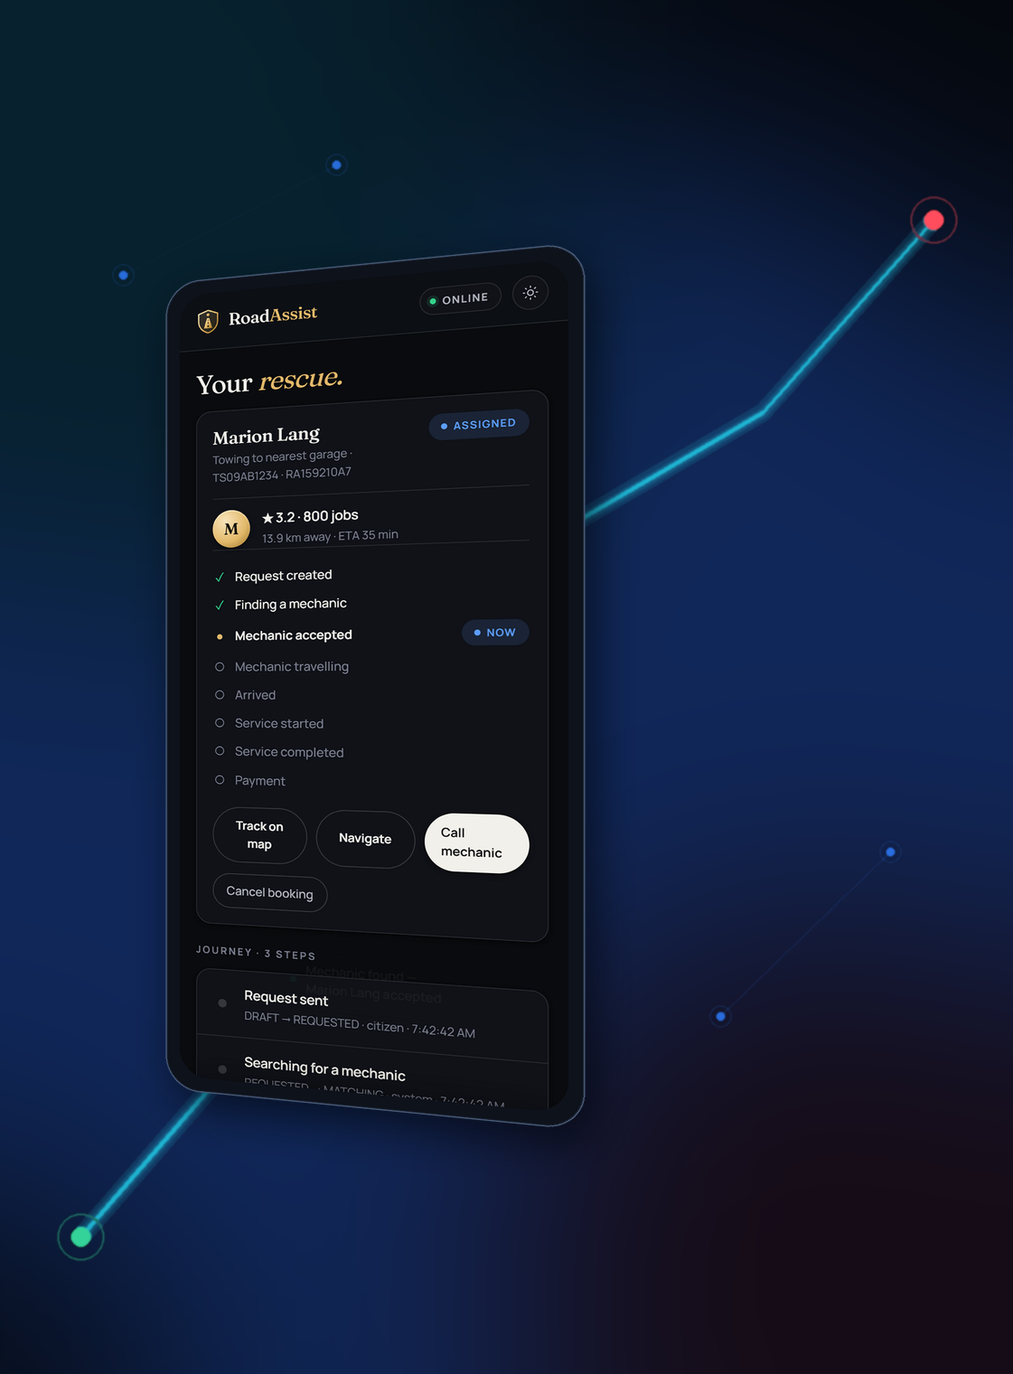
WHEN THE ROAD STOPS,
ROADASSIST BHARAT
KEEPS YOU MOVING.
AI + CLOUD + MOBILITY + SAFETY
AI
CLOUD
MAP
MECHANIC
RAKSHA
SAFETY
A working platform, used to demonstrate Cloud Computing Modules 1 through 4.
27
Notes:
MEANING
The closing frame. Deliberately quiet - one statement, one equation, nothing else competing.
SAY
"When the road stops, RoadAssist Bharat keeps you moving. AI, cloud, mobility and safety - four threads, one platform. And throughout this presentation I have tried to be precise about which parts are built and which are architecture, because I think that distinction is what makes the cloud analysis worth anything. Thank you - I am happy to take questions, and I can show the live system."
CONCEPT DEMONSTRATED
Synthesis.
RELATION TO ROADASSIST
Everything claimed as implemented can be demonstrated on request.
IF ASKED
"What would you do next?" - Three things in order: configure a read replica so the redundant storage architecture stops being theoretical; put the API behind a real load balancer with two instances; and move dispatch onto the event bus that is already provisioned but unused, which would let SOS take a priority path.
TRANSITION
"To the module mapping and questions."

Slide 28
SWE4004 · SYLLABUS COVERAGE
ACADEMIC MODULE MAPPING
MODULE 1
UNDERSTANDING CLOUD COMPUTING
Slides 4, 5, 6, 7, 8
Origins and influences · basic concepts and terminology · goals and benefits · risks and challenges · roles and boundaries · cloud characteristics · delivery models (IaaS/PaaS/SaaS) · deployment models
MODULE 2
CLOUD ENABLING TECHNOLOGY
Slides 9, 10, 11, 12, 13
Data center technology · virtualization technology · web technology · multitenant technology · service technology (Razorpay gateway integration)
MODULE 3
CLOUD INFRASTRUCTURE MECHANISMS
Slides 14, 15, 16, 17, 18
Network perimeter · virtual server · cloud storage device · cloud usage monitor · resource replication
MODULE 4
FUNDAMENTAL CLOUD ARCHITECTURES
Slides 19, 20, 21, 22, 23, 24
Workload distribution · resource pooling · dynamic scalability · elastic resource capacity · service load balancing · cloud bursting · elastic disk provisioning · redundant storage · migration · static scheduling · dynamic scheduling
Every syllabus topic from Modules 1-4 appears in the main narrative, not in an appendix.
28
Notes:
MEANING
The required syllabus coverage map. Every Module 1-4 topic, with the slide numbers where it is treated.
SAY
"For completeness, this maps every syllabus topic to where it appears. Module 1 across slides 4 to 8. Module 2 across 9 to 12. Module 3 across 13 to 17. Module 4 across 18 to 23. The point I want to make is that these are not an appendix - they are the spine of the presentation. RoadAssist is the worked example throughout."
CONCEPT DEMONSTRATED
Complete syllabus coverage.
RELATION TO ROADASSIST
Every module was taught through the project rather than alongside it.
IF ASKED
"Which topic did you find hardest to map honestly?" - Cloud bursting. It is a genuinely useful pattern for our demand profile, but there was no honest way to claim any part of it exists, so I presented it purely as target architecture with the reasoning for why it fits.
TRANSITION
"And finally, a short reference of likely questions."

Slide 29
LIKELY QUESTIONS · 1 OF 4
VIVA PREPARATION
What is cloud computing?
Why does RoadAssist need cloud computing?
On-demand network access to a shared pool of configurable computing resources, provisioned and released with minimal management effort. RoadAssist consumes compute, storage and network this way rather than owning hardware.
Because the information a stranded driver needs is spread across parties and must be combined in real time, and because demand is uneven and geographically dispersed. One authoritative service reachable from any road is the requirement.
What are the characteristics of cloud computing?
What are IaaS, PaaS and SaaS?
On-demand self-service, broad network access, resource pooling, rapid elasticity and measured service. Our PWA and booking flow demonstrate the first two directly.
Infrastructure as a Service gives virtual machines and storage; Platform as a Service adds a managed runtime; Software as a Service delivers finished software. RoadAssist IS a SaaS application; IaaS and PaaS are how it would be hosted.
Difference between public, private and hybrid cloud?
What is virtualization?
Public is shared provider infrastructure; private is dedicated to one organisation; hybrid combines both. Hybrid suits us: public for the citizen app, private for RAKSHA authority and medical data.
Abstracting physical hardware so one machine presents itself as several isolated logical ones. We use OS-level virtualization - Docker containers - not a hypervisor we operate.
Why is virtualization useful?
What is multitenancy?
Consolidation, isolation and portability. Several workloads share one machine safely, and a workload can move between machines because it no longer depends on specific hardware.
One running instance serving multiple independent tenants with isolated data. Our tenants would be vehicle fleets and government jurisdictions; the schema exists and queries are scoped to the caller.
29
Notes:
MEANING
Rapid-reference answers for the viva. Each is one to three sentences and tied to RoadAssist specifically.
SAY
Do not read this slide aloud. It is a reference to glance at while answering.
GUIDANCE
Answer in two moves: first the textbook definition in one sentence, then immediately what it means for RoadAssist. If the honest answer is that we did not implement something, say so and follow with the design decision that would make it adoptable. An examiner values a precise 'not implemented, but here is why the design permits it' far above a vague claim.
MOST LIKELY FOLLOW-UPS
"Show me." - Have the live app, the health endpoint and the test suite ready.
"What is the weakest part?" - Elasticity and replication. Both are infrastructure configuration rather than application changes, and the application is already written to accept them.

Slide 30
LIKELY QUESTIONS · 2 OF 4
VIVA PREPARATION (cont.)
What is a virtual server?
What is a network perimeter?
A software-defined server sharing physical hardware with others, allocated on demand and isolated from neighbours. Our API is stateless, so it could run on any number of them.
The controlled boundary between untrusted networks and internal services. Ours layers TLS, rate limiting, schema validation, authentication, role gating and resource-level ownership checks.
What is cloud storage?
What is resource replication?
Persistent, network-addressable storage provided as a service. Ours is PostgreSQL 16 with PostGIS - 61 tables including a hash-chained audit log.
Creating multiple instances of a resource so load can be spread and a single failure does not lose the service. Not implemented for us - we run a single database instance.
What is cloud usage monitoring?
What is workload distribution?
Collecting runtime usage and performance data for billing, capacity planning and scaling decisions. We have a limited form: a health endpoint reporting database latency, and per-request logging.
Spreading incoming work across multiple resources so no single one is overwhelmed. Our five request types - AI, booking, map, polling, SOS - have very different shapes.
What is resource pooling?
What is dynamic scalability?
Grouping resources to serve many consumers from a common pool assigned on demand. Our shared map-tile cache is a small working example.
Automatically adding or removing resource INSTANCES as demand changes - scaling out. Not implemented; the stateless design permits it.
30
Notes:
MEANING
Rapid-reference answers for the viva. Each is one to three sentences and tied to RoadAssist specifically.
SAY
Do not read this slide aloud. It is a reference to glance at while answering.
GUIDANCE
Answer in two moves: first the textbook definition in one sentence, then immediately what it means for RoadAssist. If the honest answer is that we did not implement something, say so and follow with the design decision that would make it adoptable. An examiner values a precise 'not implemented, but here is why the design permits it' far above a vague claim.
MOST LIKELY FOLLOW-UPS
"Show me." - Have the live app, the health endpoint and the test suite ready.
"What is the weakest part?" - Elasticity and replication. Both are infrastructure configuration rather than application changes, and the application is already written to accept them.

Slide 31
LIKELY QUESTIONS · 3 OF 4
VIVA PREPARATION (cont.)
What is elastic resource capacity?
What is load balancing?
Resizing existing resources - more CPU or memory to the same server - rather than adding instances. Scaling up rather than out.
Distributing requests across instances and health-checking them, so an unhealthy instance leaves rotation. It serves availability as well as throughput.
What is cloud bursting?
What is elastic disk provisioning?
Running baseline load privately and overflowing into public cloud during peaks, then releasing it. Our festival and monsoon peaks are exactly this shape.
Storage allocated as data arrives and billed on use, rather than pre-purchased at a fixed size. Not implemented - we use a fixed local volume.
What is redundant storage?
What is migration?
Duplicate copies on separate devices or sites so failure does not destroy data. Distinct from backup, which recovers an earlier point in time.
Moving a workload or resource between hosts - for maintenance, consolidation, cost, or to escape a failing node.
What is static scheduling?
How is the payment gateway integrated securely?
Allocation decided in advance and held throughout execution. Predictable and cheap, but blind to actual runtime load.
The amount comes from the invoice, never the request; the key secret never leaves the server; and settlement requires an HMAC-SHA256 signature the server re-computes. A webhook settles even if the payer's browser never returns.
31
Notes:
MEANING
Rapid-reference answers for the viva. Each is one to three sentences and tied to RoadAssist specifically.
SAY
Do not read this slide aloud. It is a reference to glance at while answering.
GUIDANCE
Answer in two moves: first the textbook definition in one sentence, then immediately what it means for RoadAssist. If the honest answer is that we did not implement something, say so and follow with the design decision that would make it adoptable. An examiner values a precise 'not implemented, but here is why the design permits it' far above a vague claim.
MOST LIKELY FOLLOW-UPS
"Show me." - Have the live app, the health endpoint and the test suite ready.
"What is the weakest part?" - Elasticity and replication. Both are infrastructure configuration rather than application changes, and the application is already written to accept them.

Slide 32
LIKELY QUESTIONS · 4 OF 4
VIVA PREPARATION (cont.)
What is dynamic scheduling?
Allocation recomputed during execution as demand changes. Our dispatch engine is a dynamic scheduler at application level: it ranks live mechanics by distance, rating and experience at request time.
32
Notes:
MEANING
Rapid-reference answers for the viva. Each is one to three sentences and tied to RoadAssist specifically.
SAY
Do not read this slide aloud. It is a reference to glance at while answering.
GUIDANCE
Answer in two moves: first the textbook definition in one sentence, then immediately what it means for RoadAssist. If the honest answer is that we did not implement something, say so and follow with the design decision that would make it adoptable. An examiner values a precise 'not implemented, but here is why the design permits it' far above a vague claim.
MOST LIKELY FOLLOW-UPS
"Show me." - Have the live app, the health endpoint and the test suite ready.
"What is the weakest part?" - Elasticity and replication. Both are infrastructure configuration rather than application changes, and the application is already written to accept them.

