Slide 1
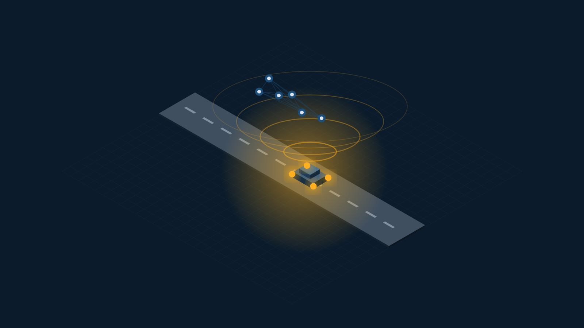
SWE4004 · CLOUD COMPUTING AND APPLICATIONS · PROJECT REVIEW 1
RoadAssist
A Cloud-Native, Offline-First Roadside Assistance Platform for India
“One Platform. Every Vehicle. Every Phone. Every Road.”
TEAM MEMBERS
V SAATWIK SAIRAAM
P SAI NIRISHA CHOWDARY
T V S JIGNESH
G PARTHAVI
24MIC7131
24MIC7122
24MIC7190
24MIC145
Backend & Cloud Database
Frontend & Mobile
AI & Data Services
DevOps, QA & Cloud Security
Course Faculty: Dr. Nagendra Panini Challa
Review 1 — Idea, Problem Statement, Architecture & Prototype
Notes:
Open with the tagline. State in one sentence: we are building a cloud-native roadside assistance platform for India, and this review covers the idea, the problem, the cloud architecture and a working prototype.

Slide 2
REVIEW 1
What We Will Cover
1
The Problem
2
Our Idea
Why roadside breakdown in India is an unsolved, high-stakes problem
One platform for every vehicle, every phone, every road
3
Cloud Foundation
4
Cloud Architecture
Delivery models, deployment model, enabling technologies, mechanisms
Scalability, load balancing, bursting, replication, storage
5
Cloud Security
6
Prototype & Output
Threats, encryption, PKI, IAM, SSO, security groups
How the system works end to end, and what we have built
Notes:
Keep this to 20 seconds. Point out that sections 3, 4 and 5 map directly onto the six course modules.

Slide 3
SECTION 1
The Problem
A vehicle breaks down in India every few seconds. The person beside it has no reliable way to get help — and the worse the location, the worse the coverage.
63 L
1.7 L
30%
< 20%
km of road network
road deaths per year
of highway deaths
have organised RSA
Largest in the world after the USA — most of it outside any service network
India records the highest road fatality count globally
Attributed to delayed emergency response, not the crash itself
Roadside assistance today is a car-owner, metro-city privilege
The four failures we are solving
No signal — help apps assume 4G; breakdowns happen where there is none
No smartphone — a large share of drivers use feature phones
Cars only — bikes, autos, trucks and tractors are excluded
No data — no authority sees where breakdowns and crashes cluster
Notes:
Lead with the human situation, then the numbers. The four failures are the ones our design decisions trace back to — refer to them again in the architecture section.

Slide 4
SECTION 1
Why Existing Solutions Do Not Work
Existing option
What it does well
Where it breaks down
Insurance / OEM RSA
Bundled with car policies
Cars only · needs a call centre · no coverage on rural highways
Local mechanic contacts
Cheap and familiar
No verification, no pricing, no tracking, no accountability
General ride/logistics apps
Good dispatch technology
Assume constant connectivity and a smartphone
Government helpline (112)
Universal and trusted
Emergency only — cannot handle a flat tyre or a dead battery
The gap: no platform covers every vehicle class, works without connectivity, and reaches a feature phone.
Notes:
Do not attack competitors. Frame it as: each solves one slice well; nobody covers the intersection of all-vehicle, no-network, no-smartphone.

Slide 5
SECTION 2
Our Idea
RoadAssist Bharat is a cloud-hosted platform that connects any stranded vehicle to the nearest verified mechanic or emergency responder — over the internet when it exists, and over SMS, IVR or on-device intelligence when it does not.
1
2
3
4
Every Vehicle
Every Phone
Every Road
Every Second
Cars, bikes, autos, trucks, buses, tractors and EVs — one platform, vehicle-class-aware diagnosis
Smartphone app, web, and full SMS / IVR / USSD access for feature phones
Offline-first: on-device AI and cached maps keep working with zero signal
Automatic crash detection escalates to contacts and responders in under 10 seconds
Delivered as a cloud service, because it cannot be delivered any other way
Demand is unpredictable and geographically spread across a subcontinent; the emergency path must never go down; and a four-person team cannot own physical infrastructure. Cloud is not a hosting choice here — it is the enabling condition.
Notes:
This is the slide the panel remembers. Say the one-sentence definition slowly, then the four pillars, then land on why it must be cloud.

Slide 6
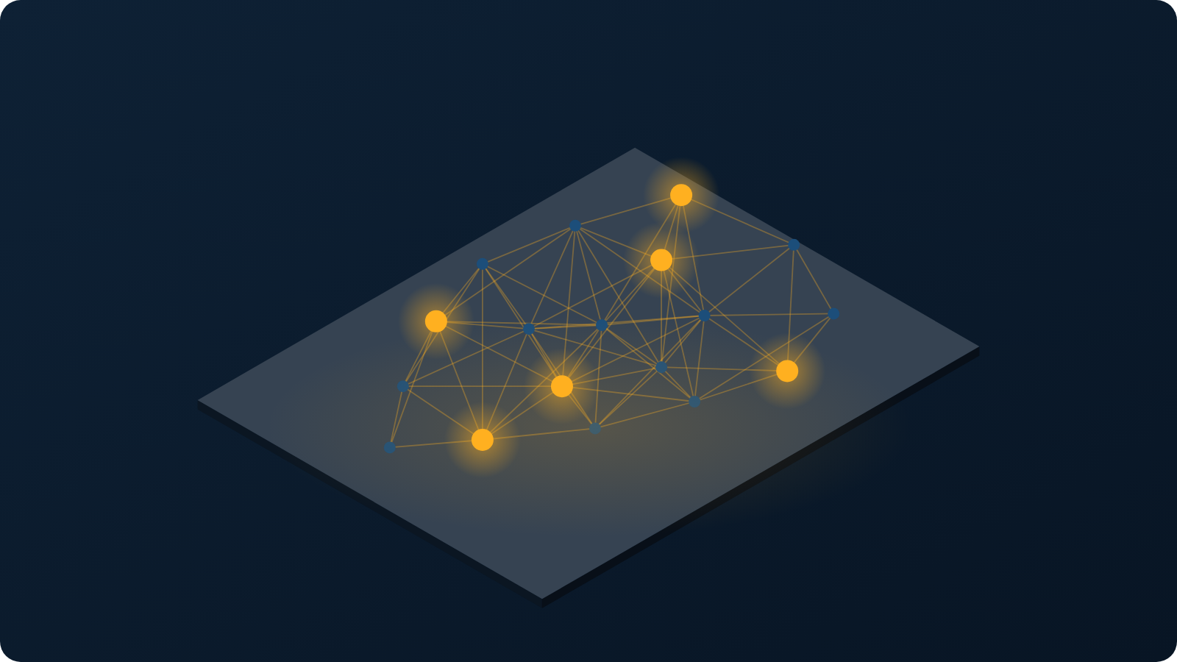
SECTION 2
The Platform at a Glance
7
client types served
Android · iOS · web · mechanic app · government · admin · feature phone
12
cloud services
Independently scalable by design — today one container, not on Kubernetes
3
availability zones
TARGET: stateless services replicated; database with multi-AZ failover
0
connectivity required
One cloud platform · every vehicle class · every district · online or offline
On-device AI and SMS keep the core journey alive with no network
Notes:
Use the map to make the scale point physically: this is not one city, it is a national network with a node wherever a vehicle is.

Slide 7

01
MODULES 1 – 3
Cloud Foundation
Concepts and models · enabling technologies · infrastructure mechanisms

Slide 8
MODULE 1 · GOALS, BENEFITS, RISKS
Why This System Must Be Cloud-Based
Elastic demand
1
Breakdown load peaks 6× at rush hour and spikes during monsoon and festivals
Proportional cost
2
We pay for the peak only while it lasts — impossible with owned servers
National reach
3
Multi-region presence puts compute near the user across the country
High availability
Risks we accept, and how we answer them
4
Vendor lock-in → containers and open standards, portable across providers
TARGET: the emergency service replicated across availability zones
Data sovereignty → all data resident in Indian regions only
Reduced control → compensated by monitoring, SLOs and audit logging
Notes:
The chart is the argument: a 10x swing between the quietest and busiest hour. Owned hardware must be sized for the peak and idles the rest of the day.

Slide 9
MODULE 1 · MODELS, ROLES AND BOUNDARIES
Where We Sit in the Cloud Stack
Cloud delivery models — we consume two, and provide one
Cloud deployment model — hybrid, by necessity
SaaS
we PROVIDE
Public cloud
RoadAssist app, mechanic portal and government dashboard delivered to end users
Main platform — booking, dispatch, AI, analytics. Elastic and cost-proportional.
PaaS
we CONSUME
Private / dedicated
TARGET PaaS: managed Kubernetes, PostgreSQL, message queue — not provisioned
Government incident data and citizen medical records — isolation is a legal requirement.
IaaS
we CONSUME
Edge / on-device
Virtual servers, virtual networks, block and object storage
Crash detection and diagnosis run on the phone, so the system survives zero connectivity.
Roles and boundaries
Cloud provider: the data centre, hypervisor and managed services. · Cloud consumer (us): application, data and configuration. · Cloud service owner: our team owns every RoadAssist service. · Cloud resource administrator: P4. · The organisational boundary ends at our virtual network; the trust boundary extends into every managed service we call.
Notes:
Be precise here — examiners like this slide. We are simultaneously a cloud consumer (of IaaS and PaaS) and a cloud provider (of SaaS to citizens, mechanics and government).

Slide 10
MODULE 2
Cloud Enabling Technologies We Use
Data centre technology
Region: Mumbai (primary) · Hyderabad (DR)
1
Multi-region, multi-AZ Indian regions with redundant power, cooling and network paths
Virtualization technology
Docker containers (Kubernetes nodes are the target, not deployed)
2
Hardware-level virtual servers plus OS-level containers for every microservice
Web technology
OpenAPI 3.1 · TLS 1.3 · WSS
3
REST over HTTPS, server-sent events for live tracking, and a Progressive Web App client
Multitenant technology
Row-level isolation + per-tenant encryption keys
4
One deployment serves citizens, mechanics, fleets and government tenants
Service technology
12 services · gateway · async event bus
5
Loosely coupled services behind an API gateway, communicating over an event bus
Notes:
Say which one is least obvious: multitenancy. Four different user classes share one deployment, isolated by row-level security and separate encryption keys.

Slide 11
MODULE 3
Cloud Infrastructure Mechanisms in Our Design
1
2
3
Network perimeter
Virtual server
Cloud storage device
Virtual private cloud with private subnets; a single public ingress protected by a web application firewall. No service is directly reachable from the internet.
TARGET: Kubernetes worker nodes built from hardened, pre-patched machine images. Nodes replaceable, never repaired in place.
Block volumes for the database, object storage for diagnostic photos and offline map packs, encrypted at rest.
4
5
Cloud usage monitor
Resource replication
BUILT: structured logs with a request id and per-operation duration. TARGET: distributed traces feeding autoscaling and SLO alerts.
TARGET: database replicas across availability zones; stateless services replicated behind the load balancer; object storage replicated to a second region.
Notes:
All five mechanisms from Module 3 appear in our design. If asked which matters most for us: resource replication, because the emergency service must survive the loss of an availability zone.

Slide 12
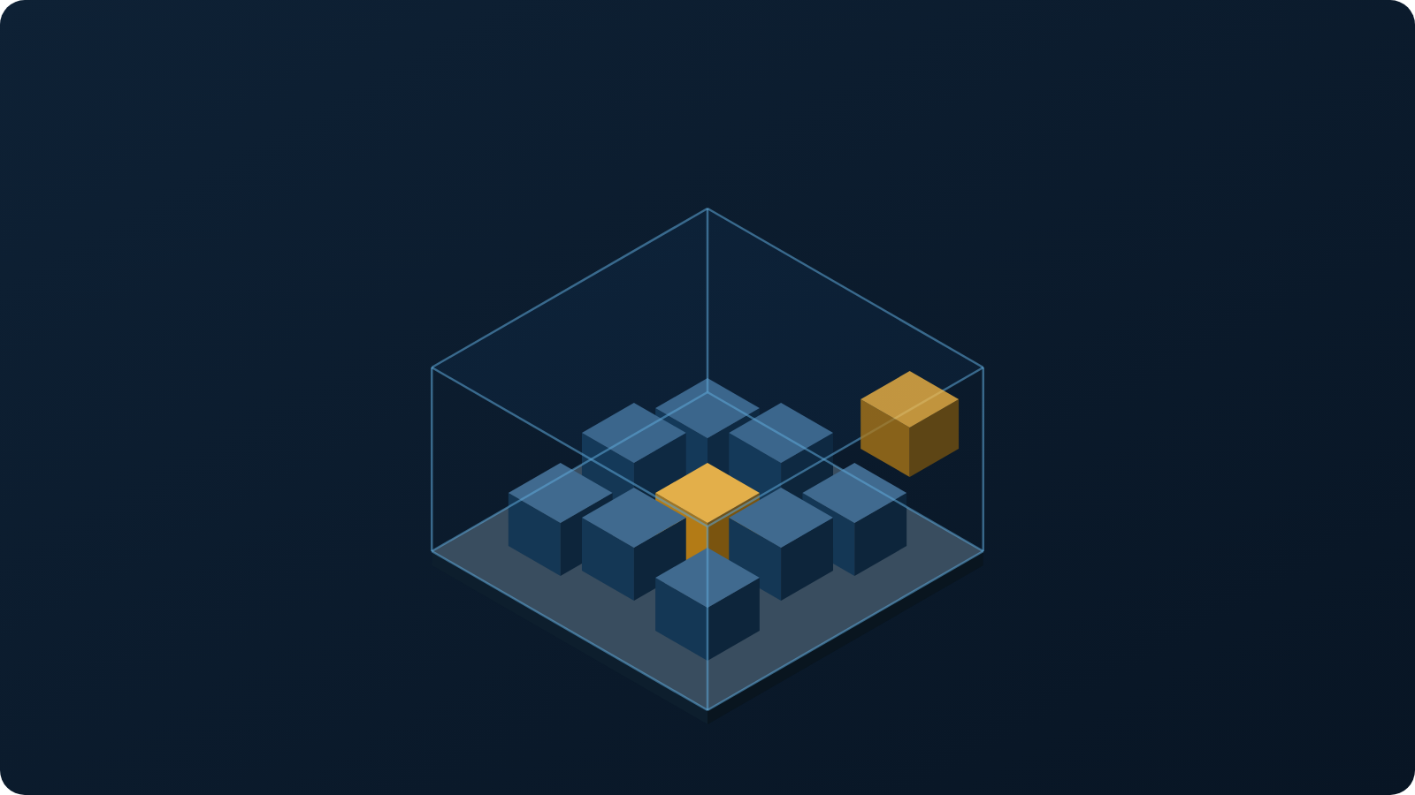

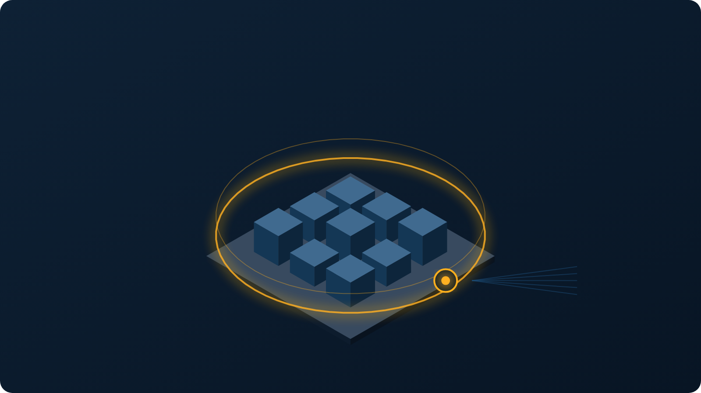
MODULES 2 & 3 · VISUALISED
Virtualization, Multitenancy and the Network Perimeter
Virtualization
Multitenancy
Network perimeter
One virtual server hosts many isolated containers. One container can be evicted and rescheduled without touching the others — which is why we can patch by replacement rather than repair.
A single deployment serves citizens, mechanics, fleets and government. Glass walls are row-level security and per-tenant encryption keys; the beam above is the shared service layer.
Every service sits inside a private virtual network. Exactly one gateway is reachable from the internet, and everything entering passes the web application firewall.
All three illustrations are drawn to the same isometric scale — the container inside the virtual server is the same unit as the pod inside the perimeter.
Notes:
Point at the amber container in the first image, then find the same unit in the third. Showing that the diagrams are one consistent model is worth a mark.

Slide 13
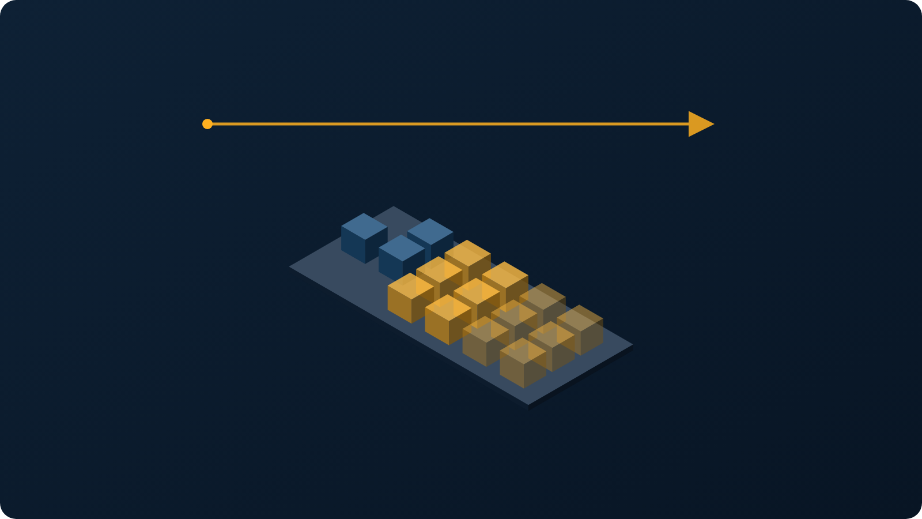
02
MODULES 4 – 5
Cloud Architecture
Fundamental architectures · cloud operations · provider and consumer perspectives

Slide 14
MODULE 4
Fundamental Cloud Architectures Applied
1
2
3
4
Workload distribution
Resource pooling
Dynamic scalability
Elastic resource capacity
Requests spread across replicas of every stateless service
Shared pools of compute, database connections and cache reused by all tenants
TARGET: autoscaler adds pods when request queue depth rises, removes them when it falls
Node pool grows and shrinks automatically with the pod count
5
6
7
8
Service load balancing
Cloud bursting
Elastic disk provisioning
Redundant storage
Layer-7 balancer with health checks; unhealthy replicas removed from rotation
Monsoon and festival surges burst into additional on-demand capacity, then release it
Storage volumes expand on demand; we are billed for what is consumed
TARGET: primary and secondary storage replicated across zones with automatic failover
Notes:
Do not read all eight. Pick three and explain them concretely: dynamic scalability, cloud bursting during monsoon, and redundant storage for the emergency path.

Slide 15
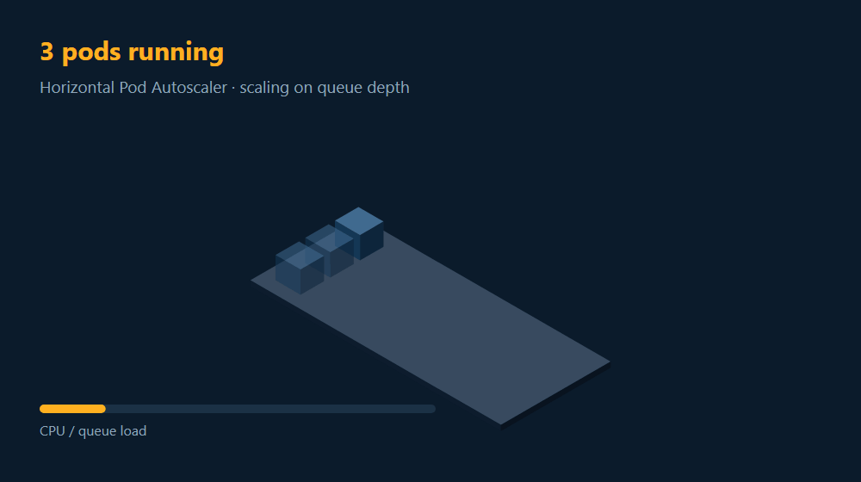
MODULE 4 · ANIMATED
DESIGN
Dynamic Scalability and Elastic Resource Capacity
Trigger
1
Queue depth per pod crosses the threshold — not CPU. Our load is I/O-bound, so CPU is the wrong signal.
Scale out
2
DESIGN: an HPA on queue depth, with a readiness gate so a pod joins only after a health check. BUILT: that readiness gate — /health returns 503 when the database is unreachable.
Elastic capacity
3
DESIGN: if the existing nodes cannot host the new pods, the cluster autoscaler adds nodes — elastic resource capacity in the Module 4 sense.
Release
4
When demand falls the pods are removed and the nodes are returned. Releasing capacity is what makes the cost proportional.
Design: how the autoscaler would add and release pods as queue depth rises and falls
Notes:
The animation loops on its own in slideshow mode. Let it run one full cycle in silence before you speak — the release phase at the end is the point.

Slide 16
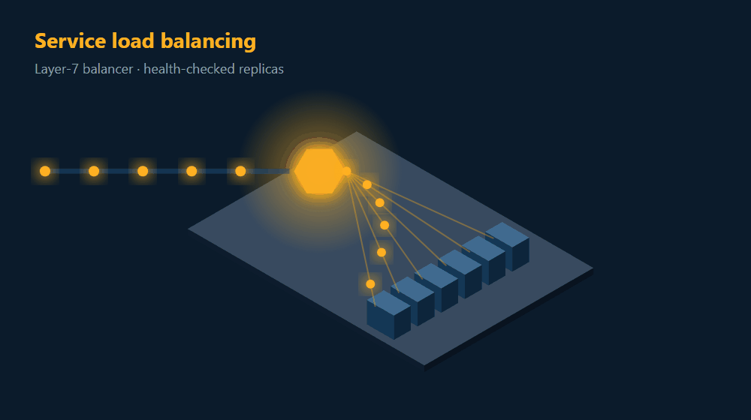
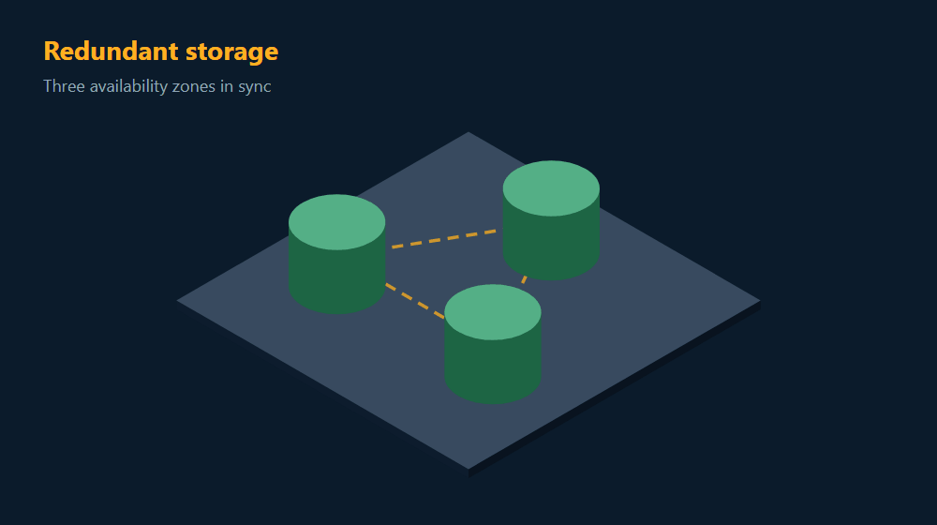
MODULE 4 · ANIMATED
DESIGN
Service Load Balancing and Redundant Storage
Workload distribution + service load balancing
Redundant storage + resource replication
One inbound stream is spread across six healthy replicas. The balancer health-checks every replica and removes any that fails, so a single sick pod never receives traffic.
TARGET: three synchronised replicas across three availability zones, so losing a zone costs no data. Not deployed — today it is one node with a documented backup procedure.
Notes:
Watch the right-hand loop until Zone C drops out — then say the sentence about zero data loss. The timing lands better than any bullet.

Slide 17
ARCHITECTURE
System Architecture — Mapped to the Cloud Service Layers
SaaS
Mobile App
(Android / iOS)
Web PWA
Mechanic App
Govt Dashboard
Feature Phone
SMS · IVR · USSD
delivered to users
PaaS
API GATEWAY · Web Application Firewall · TLS Termination · Layer-7 Load Balancer · Rate Limiting
we build on
Auth &
IAM
Booking
Dispatch
Vehicle
Emergency
AI Service
Analytics
TARGET: auto-scaling pods on managed Kubernetes · stateless · replicated across 3 AZs. TODAY: one stateless container.
IaaS
PostgreSQL
Multi-AZ + replicas
Redis Cache
resource pooling
Object Storage
photos · map packs
Event Bus
async messaging
Monitoring
usage monitor
runs it all
Virtual Servers · Virtual Private Cloud · Private Subnets · Block & Object Storage · Encrypted at Rest
Every box maps to a Module 3 mechanism or a Module 4 architecture. The emergency service (red) is deployed separately so it survives failure of the rest of the platform.
Notes:
Walk it top to bottom in three sentences — clients, gateway and services, then data and infrastructure. Then point at the red box and explain why the emergency service is isolated.

Slide 18
MODULE 4 · CLOUD OPERATIONS
Migration and Scheduling
Migration strategy
Scheduling
TARGET: live VM migration — workloads move between hosts with no downtime during maintenance
STATIC
Nightly model training and analytics batch jobs run on a fixed schedule on cheaper interruptible capacity.
Rolling deployment — pods replaced in batches, never all at once
Expand → migrate → contract — database schema changes stay backward compatible
DYNAMIC
Assistance requests are scheduled in real time by queue depth, mechanic availability and geography — the scheduler decides which node and which mechanic, per request.
Blue/green cutover with automatic rollback if error rate rises
Cloud bursting in practice — a monsoon evening
17:00
18:20
18:25
18:40
21:00
Baseline
Rain begins
Autoscale
Burst
Release
6 pods
queue depth rises
6 → 22 pods
on-demand nodes added
back to 6 pods
Notes:
The monsoon timeline is the most concrete example of cloud bursting you can give. Emphasise that capacity is released at 21:00 — that release is what makes it cost-proportional.

Slide 19
MODULE 5
Provider and Consumer Perspectives
We occupy both sides of the cloud relationship. That dual role shapes every design decision in this project.
AS A CLOUD CONSUMER
AS A CLOUD PROVIDER
Working with IaaS
Optimizing our SaaS
We select instance types, size node pools, configure the virtual network, and manage volumes and snapshots.
One multi-tenant deployment serves citizens, mechanics, fleets and government with row-level isolation.
Working with PaaS
Equipping a PaaS layer
TARGET: we would consume managed Kubernetes, managed PostgreSQL and a managed message queue — no patching, no failover scripts.
We publish APIs and webhooks so insurers and fleet operators build on our platform.
Working with SaaS
Our SLA to consumers
We consume third-party SaaS for SMS delivery, payments, maps and error reporting.
99.9% for the core platform, 99.99% for the emergency service, with published error budgets.
Notes:
If asked the difference: as a consumer we optimise for cost and reliability; as a provider we optimise for tenant isolation and the SLA we promise.

Slide 20
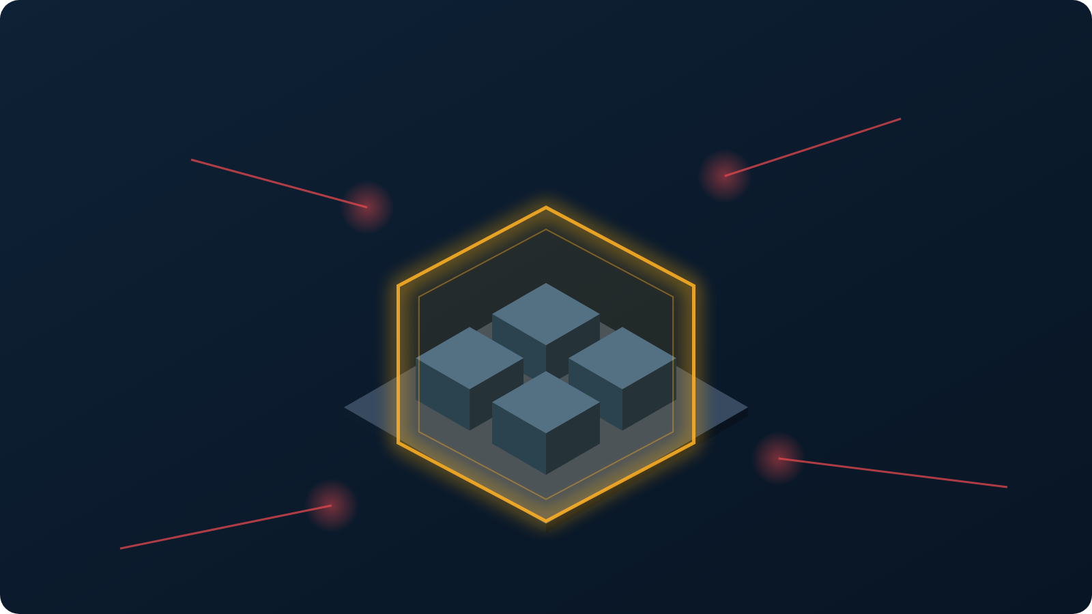
03
MODULE 6
Cloud Security
Threat agents · encryption and hashing · digital signatures · PKI · IAM · SSO · security groups

Slide 21
MODULE 6
Cloud Security — Threats and Mechanisms
Threat agents and cloud security threats
Security mechanisms we implement
Anonymous attacker
Denial of service against the public API
Encryption
Hashing
TLS 1.3 in transit; AES-256 at rest; column-level encryption for medical and identity data
Argon2 for credentials; SHA-256 hash chain making the audit log tamper-evident
Malicious service agent
Traffic eavesdropping between services
Trusted attacker
A verified mechanic escalating privileges
Digital signature
PKI
Signed payloads on the emergency 112 handoff and on all partner webhooks
Certificate authority issuing per-officer certificates for government portal access
Malicious insider
Staff access to citizen medical records
Traffic eavesdropping
Intercepting location data in transit
IAM
Single Sign-On
Insufficient authorization
Reading another user's booking by changing an ID
Seven roles, resource-scoped permissions, least privilege, no standing production access
One token issued at login, honoured across all services for its short lifetime
Virtualization attack
Escaping a container onto the host
Security groups
Hardened images
Overlapping trust boundaries
A shared tenant leaking data across tenants
Default-deny virtual firewalls; each service reachable only by its declared callers
Minimal, pre-patched machine images; nodes replaced rather than patched in place
Notes:
Pair each threat on the left with the mechanism on the right that answers it. The examiner will usually ask for one such pairing — insufficient authorization answered by resource-scoped IAM is the cleanest.

Slide 22
MODULE 6 · VISUALISED
Defence in Depth — Identity, Access and the Trust Boundary
Single Sign-On and IAM — one login, every service
1
User signs in once
One-time password verified; identity proven
2
Token issued
Short-lived signed token carries the role, never a password
3
Every service verifies
Signature checked locally — no call back to the auth service
4
Access decided per resource
Role plus ownership, so nobody reads another user's booking
5
Revocation is instant
Sign out on one device and the token family dies everywhere
Threat vectors dissolve at the perimeter; the shield is the security group, not the application
Hardened virtual server images
Every node is built from a minimal, pre-patched image with no shell tools, no default credentials and no unused ports. When a vulnerability is published we do not patch the running node — we replace it. That is only affordable because the nodes are virtual and the services on them are stateless.
Notes:
If asked for one threat-to-control pairing, use: insufficient authorization answered by resource-scoped IAM at step 4 of this flow.

Slide 23
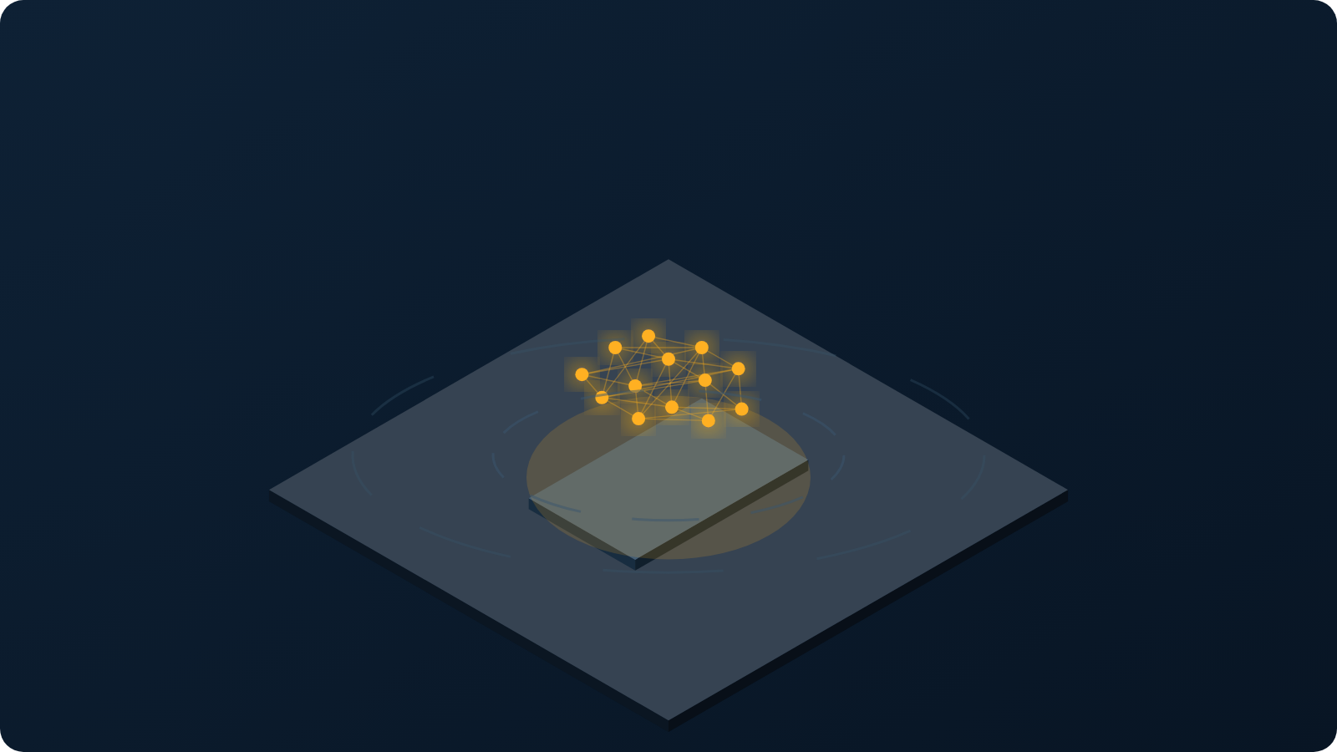
04
DELIVERABLE
Prototype and Output
How the system works end to end · what we have built for Review 1

Slide 24
PROTOTYPE
How It Works — End to End
1
2
3
4
5
6
Trigger
Capture
Diagnose
Dispatch
Track
Resolve
Vehicle breaks down, or the on-device model detects a crash
Symptoms by voice, photo or OBD scan — works fully offline
AI service returns probable fault, severity and parts needed
Geospatial query ranks nearby verified mechanics and sends offers
Live location streamed over server-sent events until the mechanic arrives
Work completed, digital invoice, cashless payment, rating
When there is no network — the path that makes this different
On-device AI
Local queue
SMS / IVR
Auto-sync
Diagnosis and crash detection run on the phone in under 120 ms
The request is stored on the device and marked pending
A feature phone completes the whole journey over text or a voice menu
On reconnect the queue replays; conflicts resolve server-side
Emergency path — under 10 seconds
Crash detected on device
30-second cancel window
Contacts alerted with live location
Nearest responder notified
ERSS 112 handoff on confirmation
Notes:
Walk the six steps quickly, then slow down for the offline row — that is the differentiator. Finish on the emergency strip and state the 10-second target.

Slide 25
THE DIFFERENTIATOR
Offline-First — Where the Cloud Cannot Reach
A roadside assistance platform that needs the internet fails at exactly the moment it is needed. Our design treats the absence of a network as the normal case, not the exception.
On-device model
≤ 15 MB
1
Diagnosis and crash detection run on the handset in under 120 ms with no connectivity at all
Local write queue
Priority ordered
2
Requests are stored on the device and marked pending; SOS always jumps the queue
SMS · IVR · USSD
No app needed
Inference runs on the handset; the broken rings are the network that is not there
3
A feature phone completes the entire journey over text or a voice menu in 8 languages
Deferred sync
Server authoritative
4
On reconnect the queue replays; conflicts resolve server-side so booking state can never corrupt
Notes:
This is the slide that separates the project from a normal CRUD app. Say plainly: the cloud does the heavy work, but nothing on the critical path depends on reaching it.

Slide 26
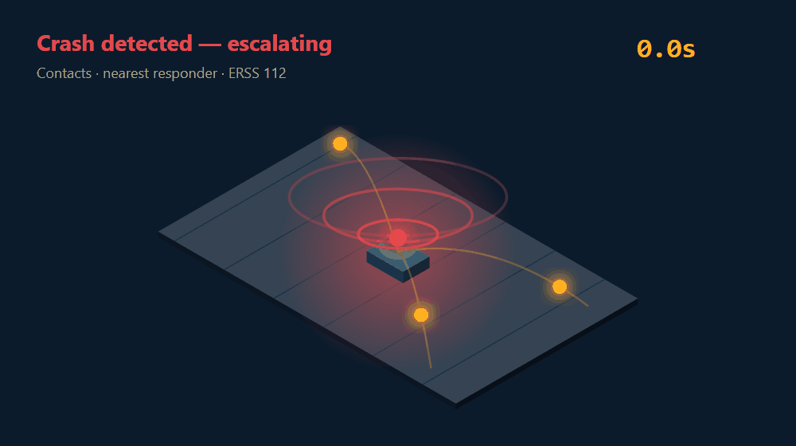
LIFE-SAFETY PATH · ANIMATED
DEMO
Crash to Responder in Under 10 Seconds
T+0s
Detected on device
The sensor model runs on the handset, so detection does not need a network
T+0s
30-second cancel window
Full-screen, audible and haptic. The model raises a signal — a human confirms
T+2s
Contacts alerted
SMS with a live location link. (Isolated emergency service is a target; today it is a module in the same process.)
T+4s
Nearest responder
Geospatial query over replicas; runs even if the main platform is down
T+9s
ERSS 112 handoff
Signed payload over mutual TLS, only after confirmation or a second signal
Live: on-device detection, expanding alert rings, and three responders converging
The AI can raise an incident. It can never dispatch one.
Notes:
Let the loop play. The red banner is the sentence to end on — it shows you have thought about what happens when the model is wrong.

Slide 27
PROTOTYPE
Final Output — What We Have Built
Request Help
AI Diagnosis
Live Tracking
Review 1 — completed
Vehicle: Maruti Swift
Confidence: HIGH
Mechanic assigned
Cloud infrastructure DESIGNED — not provisioned
Location auto-detected
Ramesh K. · 4.8 ★
Virtual network, subnets, security groups, Kubernetes cluster — none deployed
NH-48 · KM 212
Likely cause
Database deployed and seeded
Battery discharge
ETA 12 min
60 tables, multi-AZ, 100,000 rows of test data
PROBLEM
Distance 4.2 km
Authentication working end to end
Engine won't start
Severity 3 / 5
OTP login, token rotation, role-based access control
Parts: jump kit, battery
[ CALL ] [ CHAT ]
[ REQUEST ASSISTANCE ]
CI/CD pipeline live
Every commit built, tested and security-scanned automatically
DO NOT DRIVE
Clickable prototype
Complete request journey, in Hindi, on a low-end phone
Live demonstration follows this slide.
Notes:
Show the real prototype on a phone if the room allows. If not, the recorded demo is the backup — never rely on live WiFi.

Slide 28
IMPLEMENTATION
Technology Stack
Cloud & Infrastructure
Backend & Data
Frontend & Mobile
AI & Operations
Kubernetes (managed) — target
Node.js · Fastify services
React Native — Android and iOS
Python · PyTorch · ONNX on-device
Docker containers
PostgreSQL + PostGIS (multi-AZ)
Next.js progressive web app
FastAPI model serving
Terraform — infrastructure as code
Redis cache · event bus
Offline local database + sync
Prometheus · Grafana monitoring
Virtual private cloud, security groups
Object storage for media
SMS · IVR · USSD gateway
GitHub Actions CI/CD
Every component is open source or a managed cloud service on a free tier — total infrastructure cost for the project: ₹0.
Notes:
Mention that the stack was chosen for portability — containers mean we are not locked to one cloud provider, which answers the vendor lock-in risk raised earlier.

Slide 29
PLAN
Roadmap to Review 2 and Review 3
REVIEW 1
25%
Problem validated · cloud architecture designed · database and authentication deployed · prototype built
Weeks 1 – 5
COMPLETE
REVIEW 2
70%
ROADMAP: all services deployed and auto-scaling. TODAY: AI diagnosis, offline engine and inbound SMS work end to end.
Weeks 6 – 12
NEXT
REVIEW 3
100%
Emergency engine · government dashboard · load, chaos and security testing · production deployment with disaster recovery
Weeks 13 – 18
PLANNED
Notes:
Keep this short. The point is that Review 1 is genuinely complete, and Review 2 has a defined scope rather than a vague promise.

Slide 30
CONCLUSION
A cloud problem, solved with cloud architecture
Unpredictable, national-scale demand
A service that must never fail
answered in the design by dynamic scalability, elastic capacity and cloud bursting
answered today by on-device Off-Grid Mode; multi-AZ replication and redundant storage are design
Sensitive personal and medical data
Four students, no hardware budget
answered by encryption, PKI, IAM, SSO and default-deny security groups
answered by IaaS and PaaS consumption on a pay-as-you-go basis
Thank you · Questions
SWE4004 — Cloud Computing and Applications · Review 1
Notes:
Close on the four pairings. Each names a problem and the specific cloud concept that answers it — that is the argument of the whole deck in four lines.

Slide 31
APPENDIX
References
1.
Thomas Erl, Ricardo Puttini, Zaigham Mahmood — Cloud Computing: Concepts, Technology & Architecture. PHI Publications, 2013. (Course text — Modules 1–6)
2.
John W. Rittinghouse, James F. Ransome — Cloud Computing: Implementation, Management and Security. CRC Press, 2017.
3.
Sandeep Bhowmik — Cloud Computing. Cambridge University Press, 2017.
4.
Meikang Qiu, Keke Gai — Mobile Cloud Computing: Models, Implementations and Security. CRC Press, 2017.
5.
Ministry of Road Transport and Highways — Road Accidents in India, Annual Report.
6.
National Highways Authority of India — Highway operations and incident management guidelines.
7.
Digital Personal Data Protection Act, 2023 — Government of India.
8.
Telecom Regulatory Authority of India — Regulations on commercial communication and DLT registration.
Notes:
Do not read these out. They are here so the panel can see the course text is the backbone of the cloud content.

