Slide 1

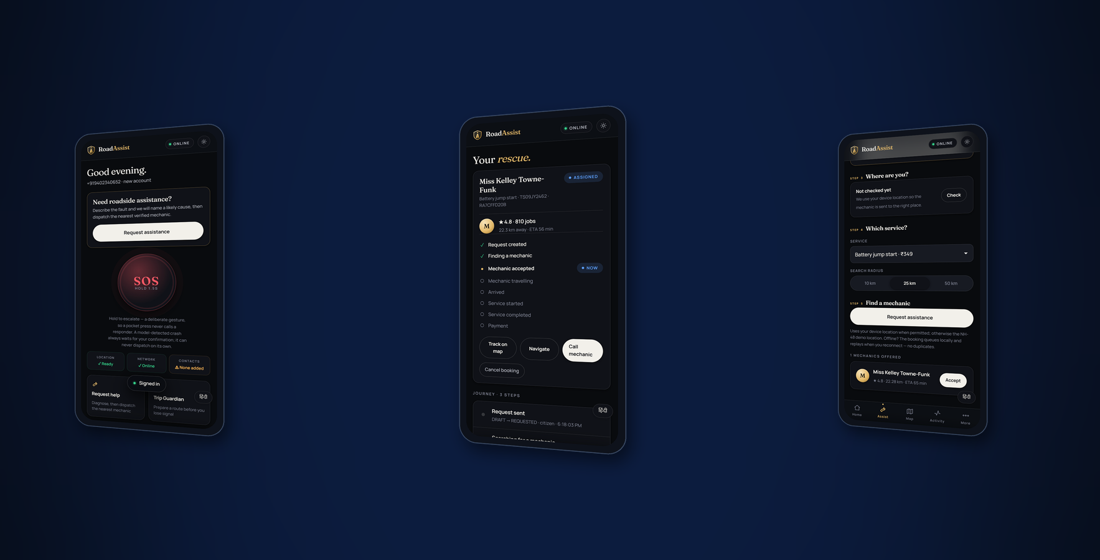
SWE4004 · CLOUD COMPUTING AND APPLICATIONS
RoadAssist Bharat
AI-Powered · Cloud-Connected · Network-Resilient
Emergency Mobility Platform
TEAM
V. Saatwik Sairaam · P. Sai Nirisha Chowdary
“RoadAssist doesn't stop when the network stops.”
T. V. S. Jignesh · G. Parthavi
FACULTY
Dr. Nagendra Panini Challa
INSTITUTION
VIT-AP University
ROADASSIST BHARAT · SWE4004 CLOUD COMPUTING AND APPLICATIONS
Notes:
Opening. Say the positioning line and the promise, then move on — the
evidence is in the next thirty slides.
The three adjectives are ordered deliberately: AI is the least novel, cloud is
expected, network-resilient is the one nobody else in this cohort will have.

Slide 2

THE PROBLEM
A breakdown is not a software problem
…until you realise the app you would use to fix it needs the network you do not have.
21:40
A Swift stops on NH-48. Two hundred kilometres from home, one bar of signal.
WHAT ACTUALLY FAILS
21:41
The driver opens a roadside-assistance app. It shows a spinner.
— Coverage is worst exactly where
breakdowns are most dangerous
— No way to know if a request was sent
21:44
Still a spinner. There is no way to tell whether anything was sent.
— No centralised incident record
21:52
They give up and start calling numbers from a sticker on the windscreen.
— Response time is unmeasured,
so it cannot be improved
ROADASSIST BHARAT · SWE4004 CLOUD COMPUTING AND APPLICATIONS
02
Notes:
One scenario, no statistics. The audience has all been on a highway
with one bar. The right-hand column is the engineering restatement.

Slide 3
THE CORE IDEA
One platform, from incident to resolution
DRIVER
reports a fault
ROADASSIST
one platform
AI + INCIDENT
INTELLIGENCE
cause · severity
· capability
DISPATCH
rank · offer
· escalate
MECHANIC
accepts, drives,
fixes
RESOLUTION
invoice · payment
· review
Every step is real application state. No manual database editing anywhere in the normal workflow.
ROADASSIST BHARAT · SWE4004 CLOUD COMPUTING AND APPLICATIONS
03
Notes:
The sentence at the bottom is the one that separates a demo from a
product, and it is literally true — the whole journey is driven through the UI.

Slide 4
WHY ROADASSIST IS DIFFERENT
Six things, and one that matters most
AI-ASSISTED
DIAGNOSIS
Rules engine, explainable,
same table on device and cloud
DYNAMIC
DISPATCH
Ranked, wave-based,
busy providers excluded
REAL-TIME
TRACKING
Server-sent events,
measured at 65 ms
SECURE
PAYMENTS
Server-side amount,
signature-verified webhook
INCIDENT
INTELLIGENCE
Severity, capability,
tamper-evident audit
OFFLINE-FIRST
EMERGENCY
SOS with no network,
stored and forwarded
“RoadAssist doesn't stop when the network stops.”
ROADASSIST BHARAT · SWE4004 CLOUD COMPUTING AND APPLICATIONS
04
Notes:
Five of these six exist in some form in competing products. The
sixth is the differentiator and the rest of the deck defends it.

Slide 5
WHAT ACTUALLY RUNS TODAY
System architecture
One container, one PostGIS database — live on Render + Neon in Singapore. Everything external is behind an adapter.
CUSTOMER
PWA · Android WebView
MECHANIC
console
AUTHORITY / FLEET
RAKSHA dashboard
WEB / PWA · service worker, IndexedDB, connectivity manager
FASTIFY API · 68 routes, 65 under /v1 · zod validation · SSE stream
AUTH + RBAC
OTP · JWT · rotation
DISPATCH
PostGIS KNN · ladder
EMERGENCY
SOS state machine
OFFLINE SYNC
journal · conflicts
PAYMENTS
order · webhook
PostgreSQL 16 + PostGIS · 56 tables · 62 FKs · 5 GiST indexes
ROADASSIST BHARAT · SWE4004 CLOUD COMPUTING AND APPLICATIONS
05
Notes:
Note what is NOT here: no Kubernetes, no load balancer, no message
broker. They are in the target architecture on slide 22, and I keep the two
diagrams apart on purpose.

Slide 6

NETWORK-RESILIENT ARCHITECTURE
Two paths, and the second one is the product
ONLINE
OFF-GRID
USER
CONNECTIVITY MANAGER
ROADASSIST CLIENT
LOCAL EMERGENCY ENGINE
CLOUD API
ENCRYPTED SYNC JOURNAL
AI · DISPATCH · DATABASE
NETWORK RETURNS → CLOUD SYNC
The connectivity manager decides which path runs — ONLINE, LIMITED or OFF-GRID — from measured evidence, never from navigator.onLine alone.
ROADASSIST BHARAT · SWE4004 CLOUD COMPUTING AND APPLICATIONS
06
Notes:
Strongest architecture slide. The point: the right column is not a
degraded version of the left, it is a different system that runs on the device.

Slide 7
THE EMERGENCY PATH
Off-grid SOS
No internet does not mean the emergency workflow disappears. It means it runs here instead.
ONLINE → SERVER
WHAT THE USER IS TOLD
SOS HELD
CONNECTIVITY
CHECK
OFF-GRID SOS CREATED
No network connection detected.
Your emergency information is stored securely on this device and will be synchronized automatically when connectivity returns.
NO → LOCAL SOS
GPS IF AVAILABLE
ENCRYPTED LOCAL STORAGE
SYNC JOURNAL (op id + digest)
“Nothing has been transmitted.”
We never claim emergency services were contacted. The 112 handoff is a stub and the API says so.
NETWORK RESTORED
SERVER SYNC — idempotent
ROADASSIST BHARAT · SWE4004 CLOUD COMPUTING AND APPLICATIONS
07
Notes:
If asked 'did you contact emergency services' — no, and the product
says so in those words. That honesty is the feature.

Slide 8
AI DIAGNOSIS
Diagnosis: rules first, model optional
SYMPTOMS
+ OBD CODES
free text and
scanned codes
VALIDATION
zod schema,
length + type
RULES ENGINE
9 rules, keyword
+ DTC scoring
REMOTE MODEL
optional, only if
configured
RESULT
cause · confidence
severity · action
THE SAFETY ASYMMETRY
STATED PLAINLY
A model may make a drivability verdict STRICTER. It can never make one laxer.
The rules result is always computed. A remote answer is used only if it clears AI_MIN_CONFIDENCE and does not contradict the rules on safety.
This is a deterministic rules engine, not machine learning. The UI labels it “rules-1.0.0”, and “LOCAL OFFLINE DIAGNOSIS” on the device.
Trained models DO exist — YOLO11 for road damage: best run YOLO11s, mAP50 0.472; RAKSHA's demo detections come from a YOLO11n, mAP50 0.443. Both measured.
ROADASSIST BHARAT · SWE4004 CLOUD COMPUTING AND APPLICATIONS
08
Notes:
Do not call the diagnosis engine AI without qualifying it. The
qualification is the credible part.

Slide 9
EXPLAINABLE, NOT OPAQUE
Incident intelligence
Every field below is derived from a rule you can read, not from a weighting nobody can inspect.
INCIDENT
raised by user
or by signal
CLASSIFICATION
breakdown · accident
medical · unsafe
SEVERITY
1–5, from the
rule that matched
REQUIRED
CAPABILITY
service type
pre-selected
DISPATCH
PRIORITY
CRITICAL for accident
and medical
EXPLAINABLE
“Battery discharged or terminals loose” — because these keywords matched, at this confidence
AUDITABLE
Every prediction writes a model_predictions row: capability, version, confidence, latency, input HASH (never the text)
HONEST
Below 55% confidence the UI says so: “At 42% this is a suggestion, not a finding”
NEVER FABRICATED
No ETA unless a provider is travelling. No location unless GPS returned one.
ROADASSIST BHARAT · SWE4004 CLOUD COMPUTING AND APPLICATIONS
09

Slide 10
SMART DISPATCH
Dispatch is dynamic scheduling
Work assigned at run time from a pool, by a score computed from live state, with timeout-driven re-scheduling.
AVAILABLE
PROVIDERS
PostGIS ST_DWithin
FILTER
off duty · already
committed · already asked
DISTANCE
KNN, true metres
SCORE
proximity 60%
rating 34%
EXPLORATION
+6% under 20 jobs
OFFER WAVE
N best, live push
ASSIGN
row-locked,
exactly one
THE BUG THIS AUDIT FOUND
PROVIDER STATES
Dispatch filtered on is_available alone — a duty toggle meaning “I am working today”, not “I am free now”. A mechanic already driving to one breakdown kept receiving offers for the next.
Fixed: provider state is DERIVED from live data.
OFFLINE
off duty — never offered
AVAILABLE
free — offerable
OFFERED
holding an offer — still offerable
BUSY / EN_ROUTE / ON_JOB
committed — never offered
ROADASSIST BHARAT · SWE4004 CLOUD COMPUTING AND APPLICATIONS
10

Slide 11
INCIDENT LIFECYCLE
Two guarded state machines
A client sends a command; only the transition table decides whether it is legal. Every change writes a timestamped event row.
BOOKING — 13 states, 15 commands
EMERGENCY — ADR-0005 in code
REQUESTED
SOS_CREATED
DETECTED / AWAITING_CONFIRMATION
THE RULE THAT IS ENFORCED
MATCHING
A model raises a SIGNAL. A human confirms an INCIDENT.
“escalate” is reachable only from CONFIRMED. There is no path from a model-detected crash to a dispatched responder that does not pass through a person.
That is one line in a transition table, and it is unit-tested.
ASSIGNED
SOS_RECEIVED
CONFIRMED — a human stands behind it
EN_ROUTE
ON_SITE
RESPONDING
contacts alerted, responder searched
IN_PROGRESS
COMPLETED
RESOLVED
closed — terminal
PAID
ROADASSIST BHARAT · SWE4004 CLOUD COMPUTING AND APPLICATIONS
11

Slide 12
LIVE UPDATES
Real-time, but never the source of truth
Server-sent events over one long-lived GET. Persist first, publish second — always.
MECHANIC
taps “En route”
BACKEND
guarded UPDATE
commits first
SSE PUBLISH
to customer
and mechanic
CUSTOMER UI
refetches the
authoritative state
MEASURED
WHEN THE STREAM DROPS
DELIVERY
65 ms, against a 6-second poll
The badge flips Live → Polling and the poll returns to its old cadence.
Delivery is at-most-once and in-process. That is acceptable ONLY because the stream is never the only path — booking state is server-authoritative and the client refetches on reconnect.
POLL WHILE LIVE
60 s customer · 45 s mechanic
RECONNECT
jittered backoff, automatic
ROADASSIST BHARAT · SWE4004 CLOUD COMPUTING AND APPLICATIONS
12

Slide 13
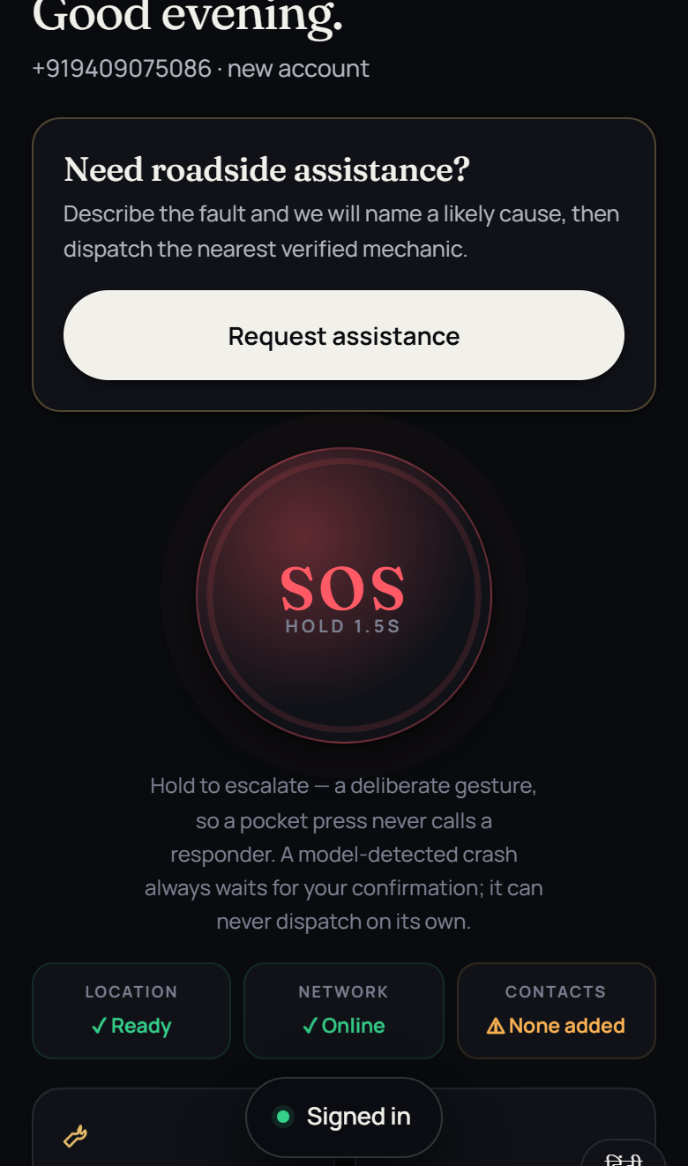
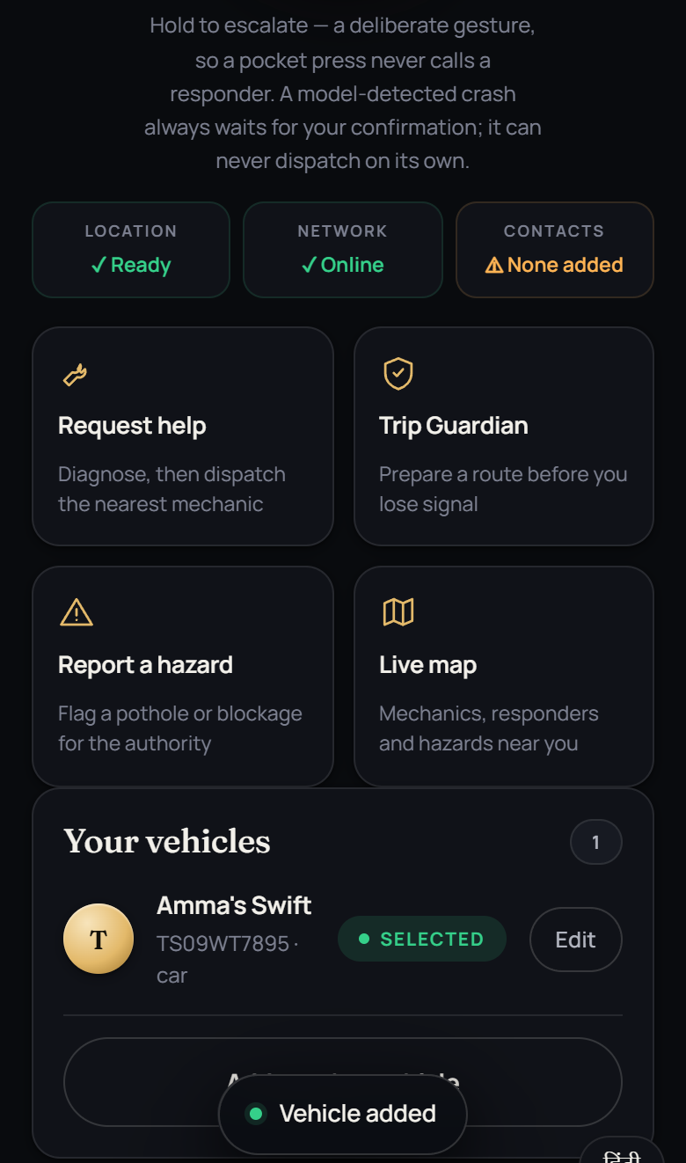
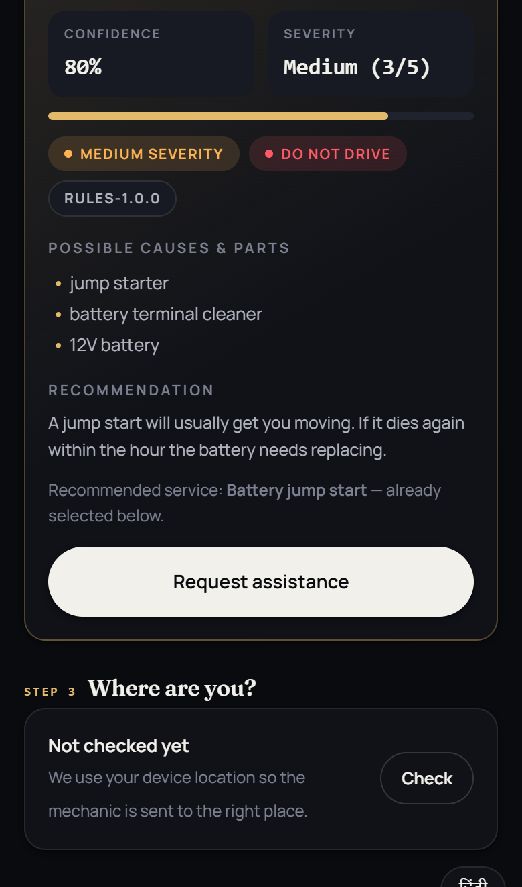
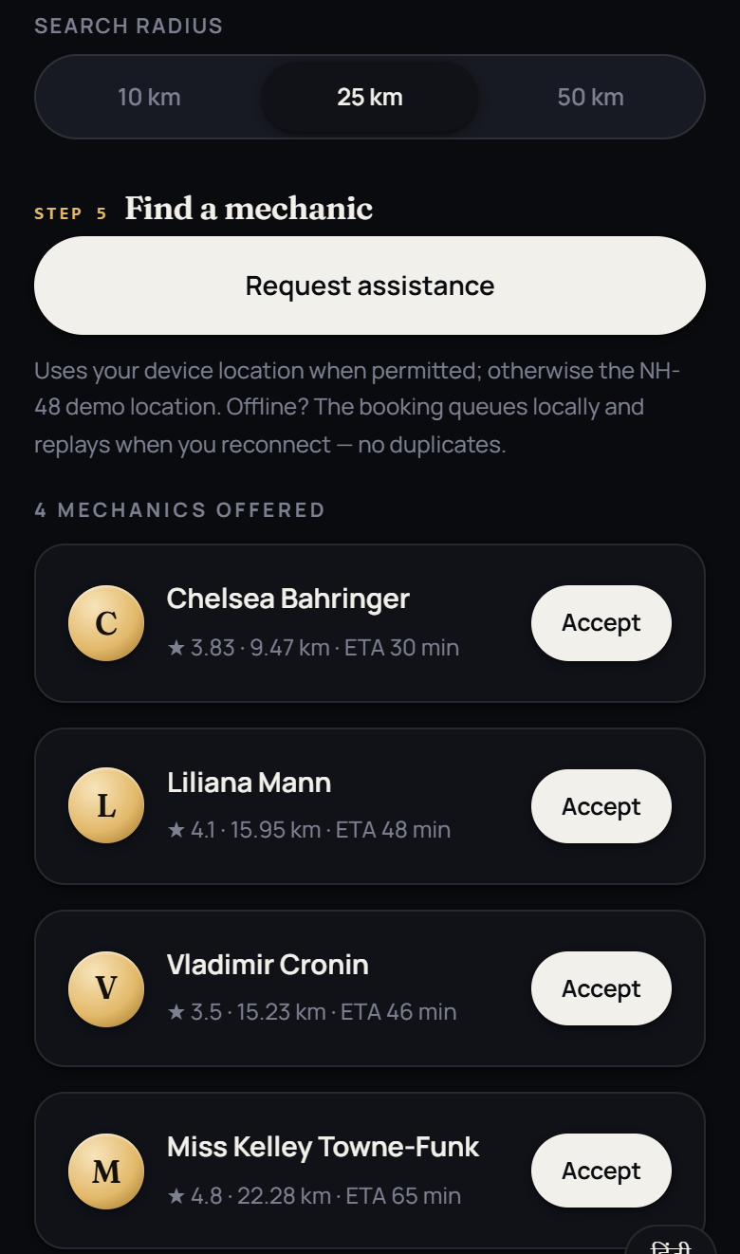
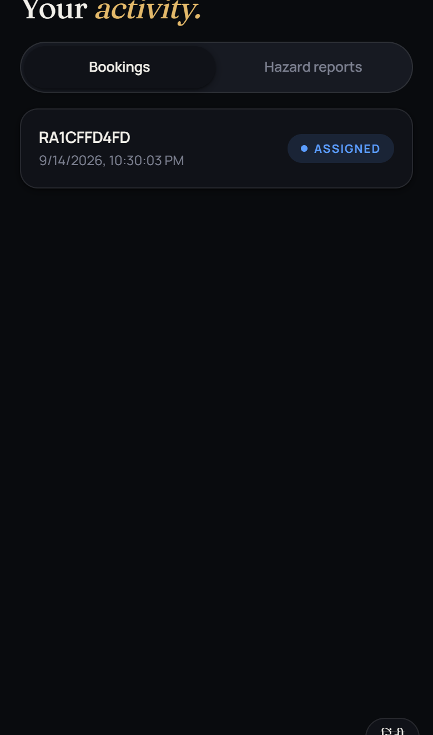
REAL SCREENSHOTS · CAPTURED FROM THE RUNNING APP
Customer application
Home · SOS + readiness
Vehicle
Diagnosis
Dispatch
Activity
Captured by scripts/capture-screens.mjs against the live API — regenerable in ninety seconds, so they cannot drift from the product.
ROADASSIST BHARAT · SWE4004 CLOUD COMPUTING AND APPLICATIONS
13

Slide 14
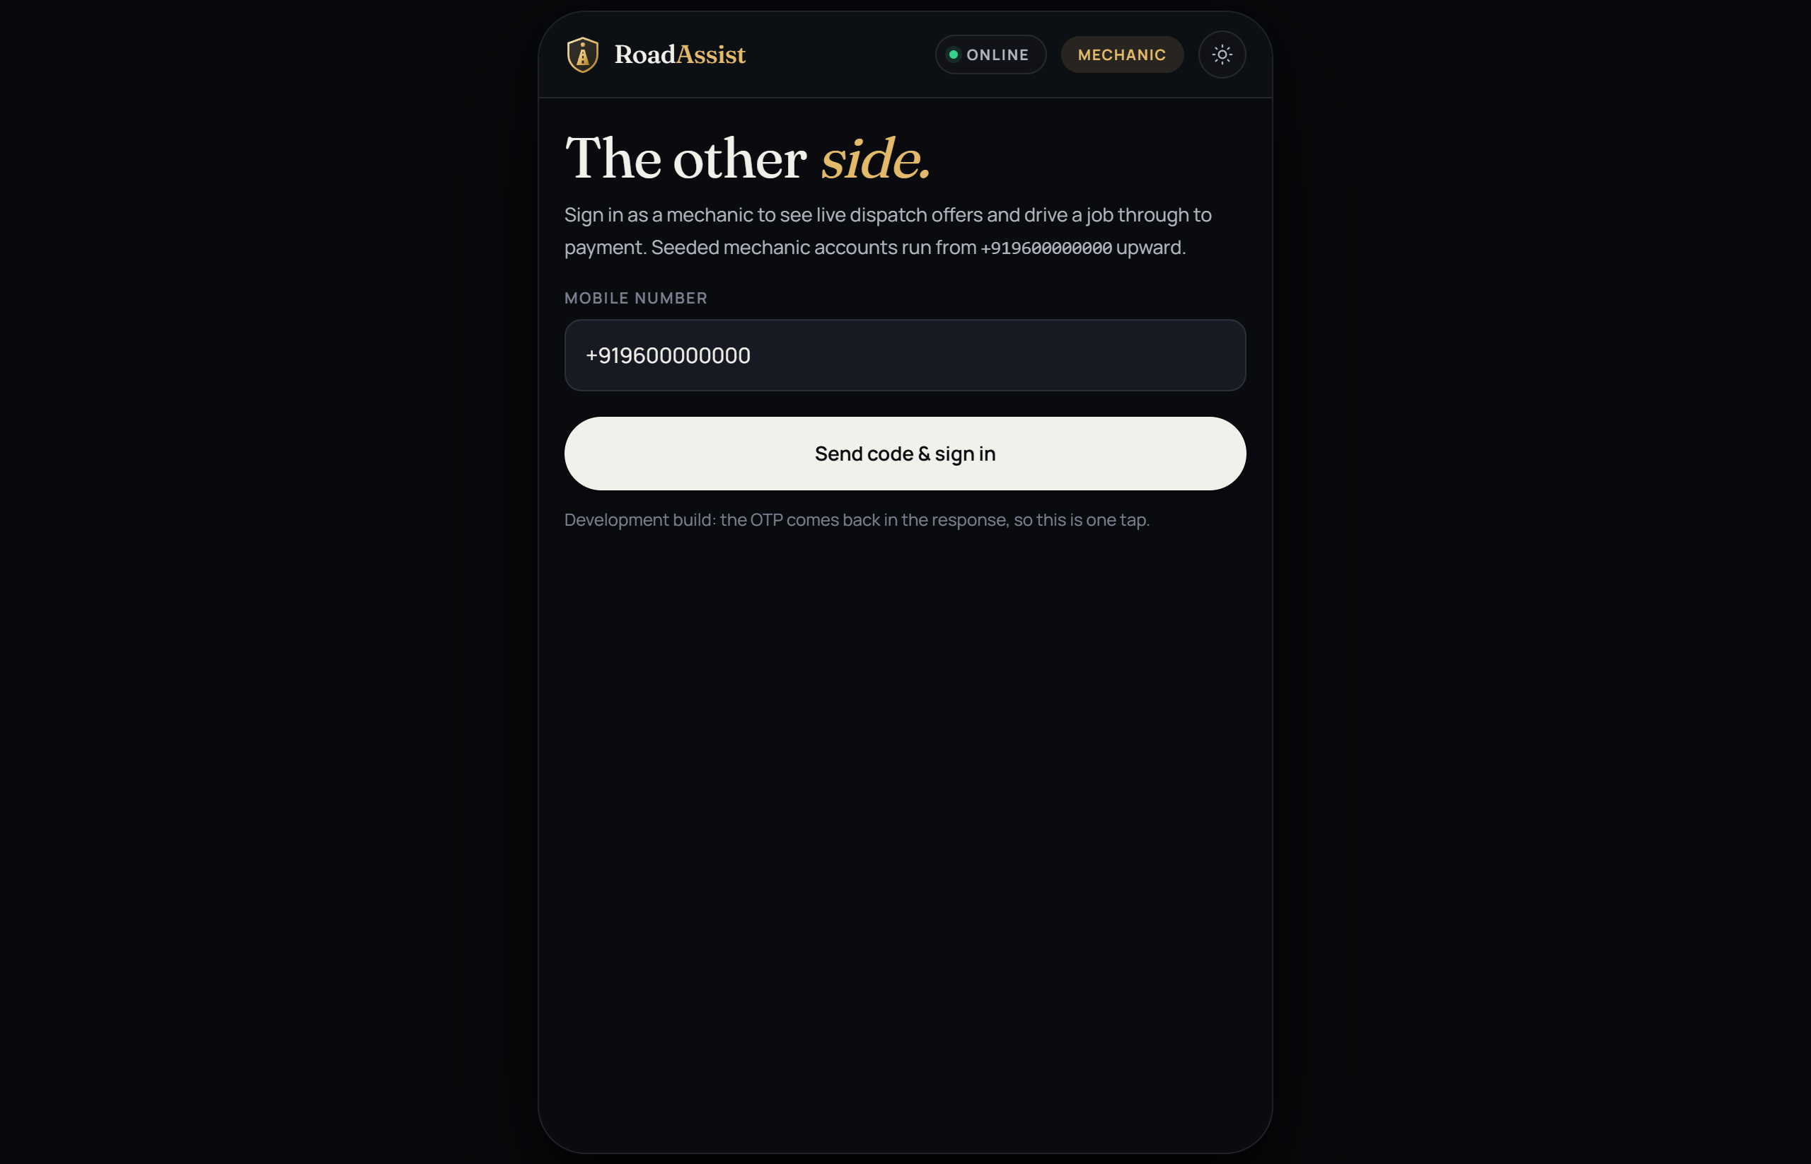
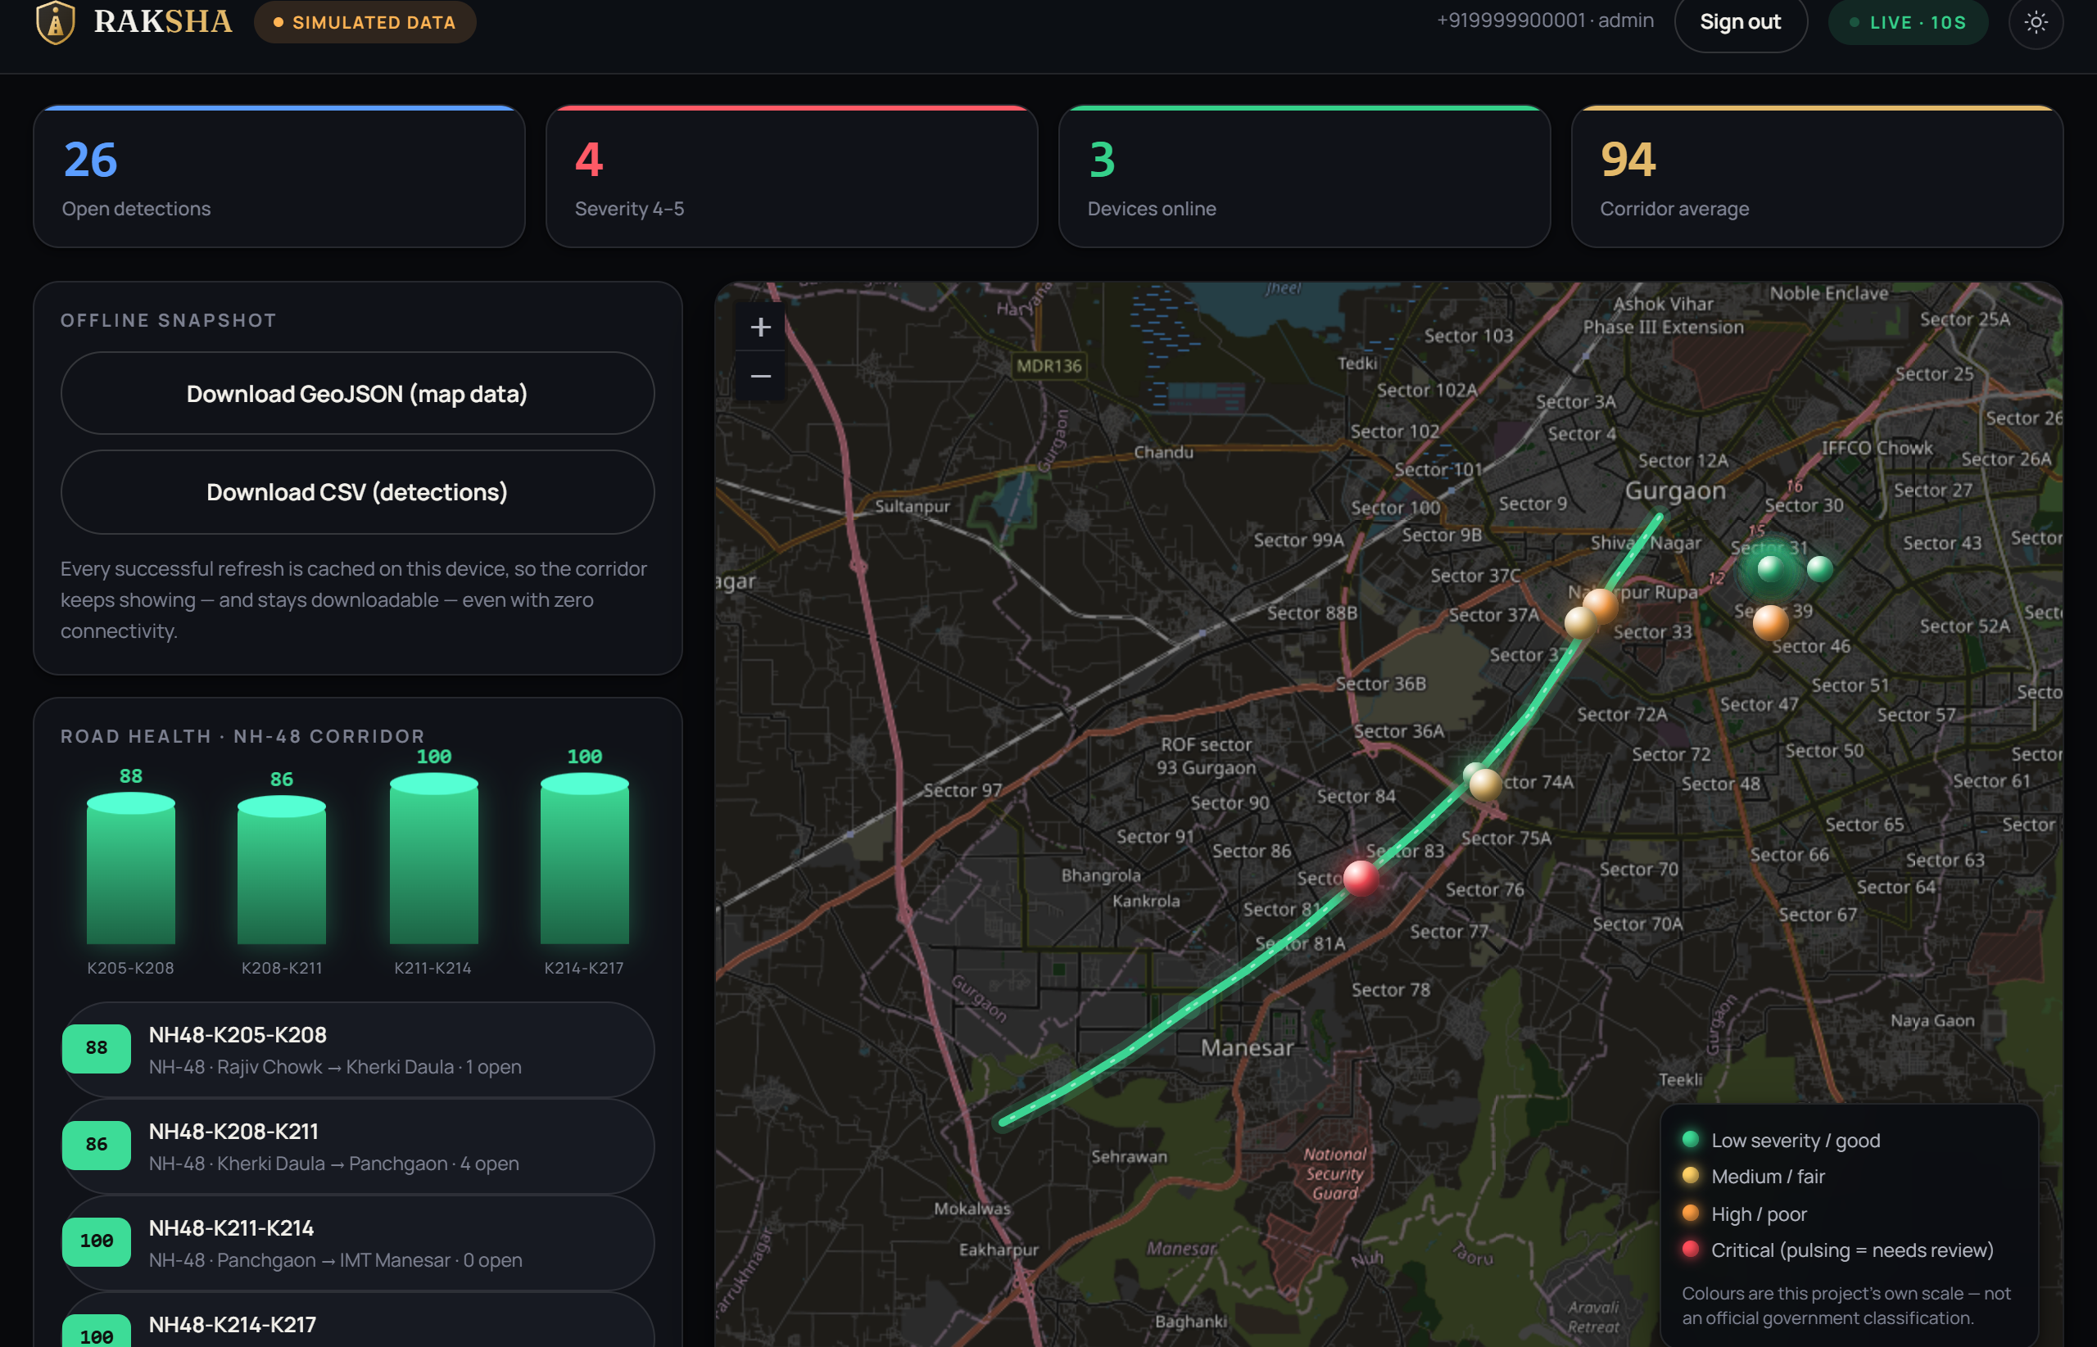
THE OTHER TWO SURFACES
Mechanic console and authority dashboard
Mechanic console · dispatch inbox, live badge, job lifecycle
RAKSHA authority · live map, road health, detection triage
Mechanic: availability · incoming request · accept · decline · en route · arrived · in service · complete — every transition persisted and pushed to the customer.
ROADASSIST BHARAT · SWE4004 CLOUD COMPUTING AND APPLICATIONS
14

Slide 15
EMERGENCY EXPERIENCE
Three states, three honest answers
ONLINE
LIMITED
OFF-GRID
— Everything works
— Requests still attempted
— SOS stored on device
— SOS reaches dispatch
— Anything that fails is STORED
— GPS still works
— Live tracking + ETA
— Slow or flaky path
— Local diagnosis
— Cloud diagnosis
— User is told it is weak
— Cached maps · no live anything
The indicator names the state in WORDS as well as colour — status is never carried by tint alone.
Under every state the primary action stays the same and stays one tap away: SOS.
ROADASSIST BHARAT · SWE4004 CLOUD COMPUTING AND APPLICATIONS
15

Slide 16
PAYMENT ARCHITECTURE
The client never decides that money arrived
INVOICE
server-computed
total
ORDER
created server-side
with that amount
CHECKOUT
gateway UI,
key id only
WEBHOOK
at-least-once
delivery
SIGNATURE
HMAC-SHA256
recomputed
SETTLEMENT
conditional on
PENDING
RECEIPT
booking → PAID
AMOUNT
Never taken from the request — it is the invoice total, and the webhook refuses a mismatch
TWO PATHS
Browser callback AND webhook. The webhook is the one that matters: a customer can pay and close the tab
IDEMPOTENT
Delivery is at-least-once, so a replayed webhook settles nothing twice
REFUSES TO BOOT
Production will not start on a real gateway with no webhook secret
CHECKED, NOT COUNTED
22 checks against a local stub of Razorpay's API, no account: forged signature, replay, wrong amount — outside the 760
ROADASSIST BHARAT · SWE4004 CLOUD COMPUTING AND APPLICATIONS
16

Slide 17
SEVEN LAYERS, AND 74 ATTACKS THAT FAIL
Security
The suite passes when the platform refuses — “we tried and could not get in” is a stronger statement than “the code looks right”.
AUTHENTICATION
OTP → JWT, rotating refresh
with reuse detection
RBAC
role gates on every
operator surface
RESOURCE OWNERSHIP
checked at the resource,
not just the route
RATE LIMITING
per principal — and never
on SOS escalation
INPUT VALIDATION
zod at every boundary,
parameterised SQL
PAYMENT VERIFICATION
server-side amount,
signed webhook
AUDIT LOG
hash-chained, append-only,
verified live
74 / 74
attacks refused
Sensitive data: medical break-glass needs a role, a LIVE incident and a written reason, and writes a tamper-evident row.
Logs redact credentials, OTP codes, phone numbers, medical fields and coordinates — and that redaction is unit-tested.
Three real vulnerabilities were found by this suite during the audit and fixed: missing request ids on 401s, a 500 on malformed JSON, an unsigned SMS intake that did not say so.
ROADASSIST BHARAT · SWE4004 CLOUD COMPUTING AND APPLICATIONS
17

Slide 18
DATABASE ARCHITECTURE
PostgreSQL 16 + PostGIS
Chosen for one query, and kept for four more reasons.
56
62
138
5
5
5
tables
foreign keys
indexes
GiST spatial
check constraints
migrations
WHY POSTGIS
“nearest available mechanic to this point” is ONE indexed query with ST_DWithin doing true metres-on-a-sphere. Without it: fetch every mechanic and compute haversine in app code.
WHY RELATIONAL
SELECT … FOR UPDATE is what stops two mechanics taking one job. Transactions are the feature, not a formality.
CONSTRAINTS
client_incident_id UNIQUE is the entire duplicate-emergency defence. Money is integer paise; ratings are CHECK 1–5.
AUDITABILITY
audit_log is hash-chained and Postgres RULES block UPDATE and DELETE — an admin cannot quietly edit it.
VERIFIED
Migrations run from an EMPTY database in this audit, then the full suite. Backup + restore rehearsed: chain intact across 639 entries.
ROADASSIST BHARAT · SWE4004 CLOUD COMPUTING AND APPLICATIONS
18

Slide 19

MODULE 1 · CLOUD COMPUTING
Where we sit in the cloud
We are a consumer of IaaS and PaaS, and a provider of SaaS to three user classes.
SaaS
We PROVIDE this: citizen app,
mechanic console, authority dashboard
PaaS
We CONSUME managed Postgres (Neon)
+ a container platform (Render)
IaaS
Compute, network, storage.
Compose is the local stand-in
IMPLEMENTED
IMPLEMENTED
PARTIAL
CHARACTERISTICS WE ACTUALLY EXHIBIT
DEPLOYMENT MODEL
Broad network access — one API serves a browser, an installed PWA, an Android WebView and a feature phone over SMS.
Resource pooling — dispatch pools providers and allocates on demand.
Public cloud. Demo: Render + Neon in Singapore — the free tiers offer no India region. Production target: an Indian region, because “No PII leaves India” — logs, backups and crash reports included.
ROADASSIST BHARAT · SWE4004 CLOUD COMPUTING AND APPLICATIONS
19

Slide 20
MODULE 2
Enabling technologies
Five topics. Four are genuinely built; one is partial and says so.
Data centre
Compose stack: PostGIS + Redis + Redpanda on a private network; DB port NOT published in production
PARTIAL
Virtualization
Multi-stage container, non-root (uid 1000), tini as PID 1, healthcheck. Built and run — 321 MB.
IMPLEMENTED
Web technology
REST over HTTPS with a uniform envelope, server-sent events for real-time, PWA with a service worker
IMPLEMENTED
Multitenancy
Row-scoped shared schema. 12 cross-tenant attacks fired; all 12 refused.
IMPLEMENTED
Service technology
Versioned /v1, 68 routes (65 under /v1), zod validation, stable error codes, idempotency keys
IMPLEMENTED
ROADASSIST BHARAT · SWE4004 CLOUD COMPUTING AND APPLICATIONS
20

Slide 21
MODULE 3
Infrastructure mechanisms
Virtual server
Container image; runs anywhere Docker runs. Full test suite passes AGAINST the image.
IMPLEMENTED
Cloud storage device
Postgres volume, upload volume, and client-side IndexedDB with AES-GCM-256 at rest
IMPLEMENTED
Cloud usage monitor
Structured JSON logs, per-request correlation id, operation duration/result, /v1/ops/overview with live counts
PARTIAL
Ready-made environment
compose → migrate → seed → start. Reference-only seed for production verified: 0 demo rows.
IMPLEMENTED
Network perimeter
DB has no published port; API on loopback behind a proxy; CORS allowlist enforced in production
PARTIAL
Resource replication
Stateless API is the precondition and is met. Nothing is replicated.
TARGET
ROADASSIST BHARAT · SWE4004 CLOUD COMPUTING AND APPLICATIONS
21

Slide 22
MODULE 4
The eight fundamental architectures
Two are built. Six are design. I will not show you an animation and call it an autoscaler.
Workload distribution
IMPLEMENTED
Service load balancing
TARGET
The dispatch engine distributes jobs across a provider pool by computed score
LB with health-checked rotation
Resource pooling
IMPLEMENTED
Cloud bursting
TARGET
Providers are a pool; state is derived and busy members excluded
Modelled evening scenario — labelled as modelled
Dynamic scalability
TARGET
Elastic disk provisioning
TARGET
HPA on queue depth. BUILT: the readiness gate — /health returns 503 when the DB is down
Storage allocated as data arrives
Elastic resource capacity
TARGET
Redundant storage
TARGET
Cluster autoscaler under the pods
Replica with failover. Backup procedure documented and rehearsed.
Three things block replication today, and each is documented where it is defined: the SSE registry, the rate limiter and the offer sweeper are in-process.
The fix for each is already designed — Redis, and the outbox → Redpanda bus already in the architecture.
ROADASSIST BHARAT · SWE4004 CLOUD COMPUTING AND APPLICATIONS
22

Slide 23
MODULE 4 · CLOUD OPERATIONS
Static vs dynamic scheduling
STATIC
DYNAMIC
Decided before run time, on a fixed schedule.
Decided at run time, from live state.
— Offer sweeper — every 10 s (OFFER_SWEEP_SECONDS)
— Dispatch: pool queried at request time
— Client booking poll — 6 s, or 60 s while streaming
— Score from live distance, rating, workload
— SSE heartbeat — every 25 s
— Wave offered; timeout re-schedules to the next wave
— Retention purge — 24 h after a sync
— A decline escalates immediately
— Assignment settled under a row lock — exactly one
RoadAssist's dispatch engine IS dynamic scheduling — it is the clearest Module 4 mechanism the project actually implements.
ROADASSIST BHARAT · SWE4004 CLOUD COMPUTING AND APPLICATIONS
23

Slide 24
TESTING
760 assertions, all executed
Against a real PostgreSQL + PostGIS and a real Chrome. 22 Razorpay stub checks sit outside this total.
Unit
225
state machines, rules, redaction, SMS coordinates, i18n segment budget
End-to-end
194
the whole API journey against real Postgres
Concurrency + real-time
77
races a sequential suite structurally cannot make
Security
74
attacks that must FAIL
Gateway security
27
webhook signatures, append-only rules, OTP ceilings
Browser / offline
163
what only a browser can prove
760 passed · 0 failed · 0 skipped • coverage 95.68% lines on the pure domain modules • 0 server errors across the sweep
ROADASSIST BHARAT · SWE4004 CLOUD COMPUTING AND APPLICATIONS
24

Slide 25
FAILURE HANDLING
Every failure has an answer
DETECT → DEGRADE → PRESERVE DATA → RECOVER. Twenty rows in the failure matrix; seven of them here.
FAILURE
DETECTED BY
USER EXPERIENCE
RECOVERY
Network lost
connectivity manager
off-grid mode; SOS stored locally
auto on reconnect
Backend unreachable
probe fails, radio up
LIMITED, then OFF-GRID
auto
Database down
/health → 503
safe 500 with a request id
auto, no restart — tested
GPS denied
geolocation error
“Unknown — denied”, never a fake fix
next fix
AI endpoint down
timeout
rules engine — nothing visible
auto
Payment fails
gateway error / bad signature
invoice stays unpaid
customer retries
Provider times out
expires_at passes
sweeper escalates to next wave
ladder continues
Each row names the suite that proves it. Database loss and backup/restore are now automated CI steps, not prose.
ROADASSIST BHARAT · SWE4004 CLOUD COMPUTING AND APPLICATIONS
25

Slide 26
IMPLEMENTATION STATUS
What is built, what is partial, what is design
Marked from the code, not from intent.
AI diagnosis
PARTIAL
Real-time
IMPLEMENTED
rules engine + trained YOLO11 for road damage
SSE, measured 65 ms
SOS — online
IMPLEMENTED
Payment
IMPLEMENTED
e2e + concurrency suites
mock on the demo — never a live account
SOS — offline
IMPLEMENTED
Fleet
PARTIAL
browser suite drives the whole scenario
schema + roles exist; no dedicated UI
Offline storage
IMPLEMENTED
Analytics
PARTIAL
IndexedDB, AES-GCM-256, survives restart
ops overview with live counts; no BI layer
Store-and-forward sync
IMPLEMENTED
Cloud autoscaling
TARGET
idempotent; duplicate proven impossible
designed; no cluster
Dispatch
IMPLEMENTED
Replication / load balancing
TARGET
ladder, timeout, busy-exclusion, race-safe
stateless API is the precondition, and is met
GREEN = code exists, database persists it, UI consumes it, AND a test exercises it. AMBER = some of that. BLUE = architecture only.
ROADASSIST BHARAT · SWE4004 CLOUD COMPUTING AND APPLICATIONS
26

Slide 27
STATED BEFORE YOU ASK
Limitations
In order of importance. Every one of these is also written in the code or the docs.
1
The demo is one free-tier instance in Singapore (Render + Neon) — no India region, no cluster.
2
Single instance only: SSE registry, rate limiter and offer sweeper are in-process.
3
The ERSS 112 handoff is a stub, and the API response says so. Emergency isolation (ADR-0005) is a design, not a deployment.
4
Payment checks run only against a local stub of Razorpay's API, outside the 760 — never a real account.
5
The diagnosis “AI” is a deterministic rules engine. Labelled as such everywhere.
6
No load test, no external penetration test, no coverage on the HTTP layer (suites run out-of-process).
7
Device encryption protects a storage dump, not script on the same origin — and the UI says exactly that.
8
GPS cold start can take minutes and may never fix indoors. The app shows “Unknown” rather than a guess.
9
No historical volume yet for predictive maintenance — the dead-zone heuristic is labelled heuristic v1.
ROADASSIST BHARAT · SWE4004 CLOUD COMPUTING AND APPLICATIONS
27
Notes:
Read two or three, not all nine. The point is that the list exists and
is specific.

Slide 28
FUTURE — LABELLED AS SUCH
Roadmap
NEXT
THEN
LATER
— Redis-backed rate limiting
— Multi-region deployment
— Predictive maintenance at volume
— Outbox → event bus for SSE fan-out
— Database read replicas
— Fleet management UI
— WAL archiving (RPO under a day)
— External APM + error reporting
— Satellite emergency communication
— Object storage for photos
— Automated backup schedule
— Mesh networking between devices
— Government emergency-network integration
Satellite, mesh and government-network integration are FUTURE and are labelled that way everywhere in the product — not implemented, not claimed.
ROADASSIST BHARAT · SWE4004 CLOUD COMPUTING AND APPLICATIONS
28

Slide 29
BUSINESS MODEL
Where the money would come from
Potential, not current. No commercial operation exists — this is a university project.
B2C
Subscription for individual drivers; pay-per-incident for non-members
B2B
Fleet operators — uptime is their cost centre; per-vehicle per-month
B2B2C
Insurers and OEMs bundling roadside cover into an existing policy
B2G
Highway authorities — RAKSHA road-health data and incident analytics
The unit economics that make it plausible: the platform runs on ZERO paid third-party accounts by default.
Maps are keyless OpenStreetMap, AI is a local rules engine, and every vendor sits behind an adapter with a working local implementation.
Current status: no revenue, no customers, no commercial deployment. Stated so the model is read as a plan, not a claim.
ROADASSIST BHARAT · SWE4004 CLOUD COMPUTING AND APPLICATIONS
29

Slide 30
COMPETITIVE ADVANTAGE
What a competitor would have to build
Not “we are better than X” — we have not benchmarked anyone. This is what is genuinely hard here.
Network resilience
An emergency workflow that runs entirely on the device, with an encrypted journal and idempotent forward-sync. This is the moat.
Honest degradation
The product never claims something reached the cloud when it did not. That is a design discipline, not a feature you can add later.
Race-safe dispatch
Row-locked assignment, wave ladder, timeout escalation, derived provider state — proven with ten simultaneous accepts.
Explainable diagnosis
The same rule table on device and cloud, with a CI test that fails the build if they diverge.
Auditability
Hash-chained append-only log, verified live in the operations view.
ROADASSIST BHARAT · SWE4004 CLOUD COMPUTING AND APPLICATIONS
30

Slide 31
THE PART THAT MATTERS
Live demonstration
PART ONE · THE FULL JOURNEY
PART TWO · THE ONE NOBODY ELSE HAS
1. Login
1. Network OFF — the UI changes immediately
2. Vehicle
2. Local diagnosis, labelled
3. Breakdown + AI diagnosis
3. Hold SOS → off-grid incident, real GPS
4. Request assistance
4. “Nothing has been transmitted”
5. Dispatch — ranked offers
5. CLOSE THE TAB. REOPEN IT.
6. Mechanic accepts
6. The incident is still there
7. Live status, no refresh
7. Network ON → automatic sync
8. Service → invoice → payment
8. “SOS synchronized”
9. Review
9. Replay the reference → duplicate refused
If any step fails, the failure IS the demonstration — nothing here fakes a success.
ROADASSIST BHARAT · SWE4004 CLOUD COMPUTING AND APPLICATIONS
31

Slide 32
RoadAssist Bharat
From breakdown to resolution — even when connectivity fails.
AI
explainable
rules engine
CLOUD
consumed and
provided
OFFLINE
the whole emergency
path on-device
REAL-TIME
65 ms, and never
the only path
SECURITY
74 attacks,
all refused
DISPATCH
dynamic, race-safe
scheduling
“RoadAssist doesn't stop when the network stops.”
760 assertions · 6 suites · 0 failures • 56 tables · 68 routes · 11 ADRs • every claim on these slides is testable
ROADASSIST BHARAT · SWE4004 CLOUD COMPUTING AND APPLICATIONS
Notes:
Close on the promise, then stop talking. If there is time, offer to run
the security suite or the concurrency suite live — they take under a minute and
they are the evidence.

