Slide 1

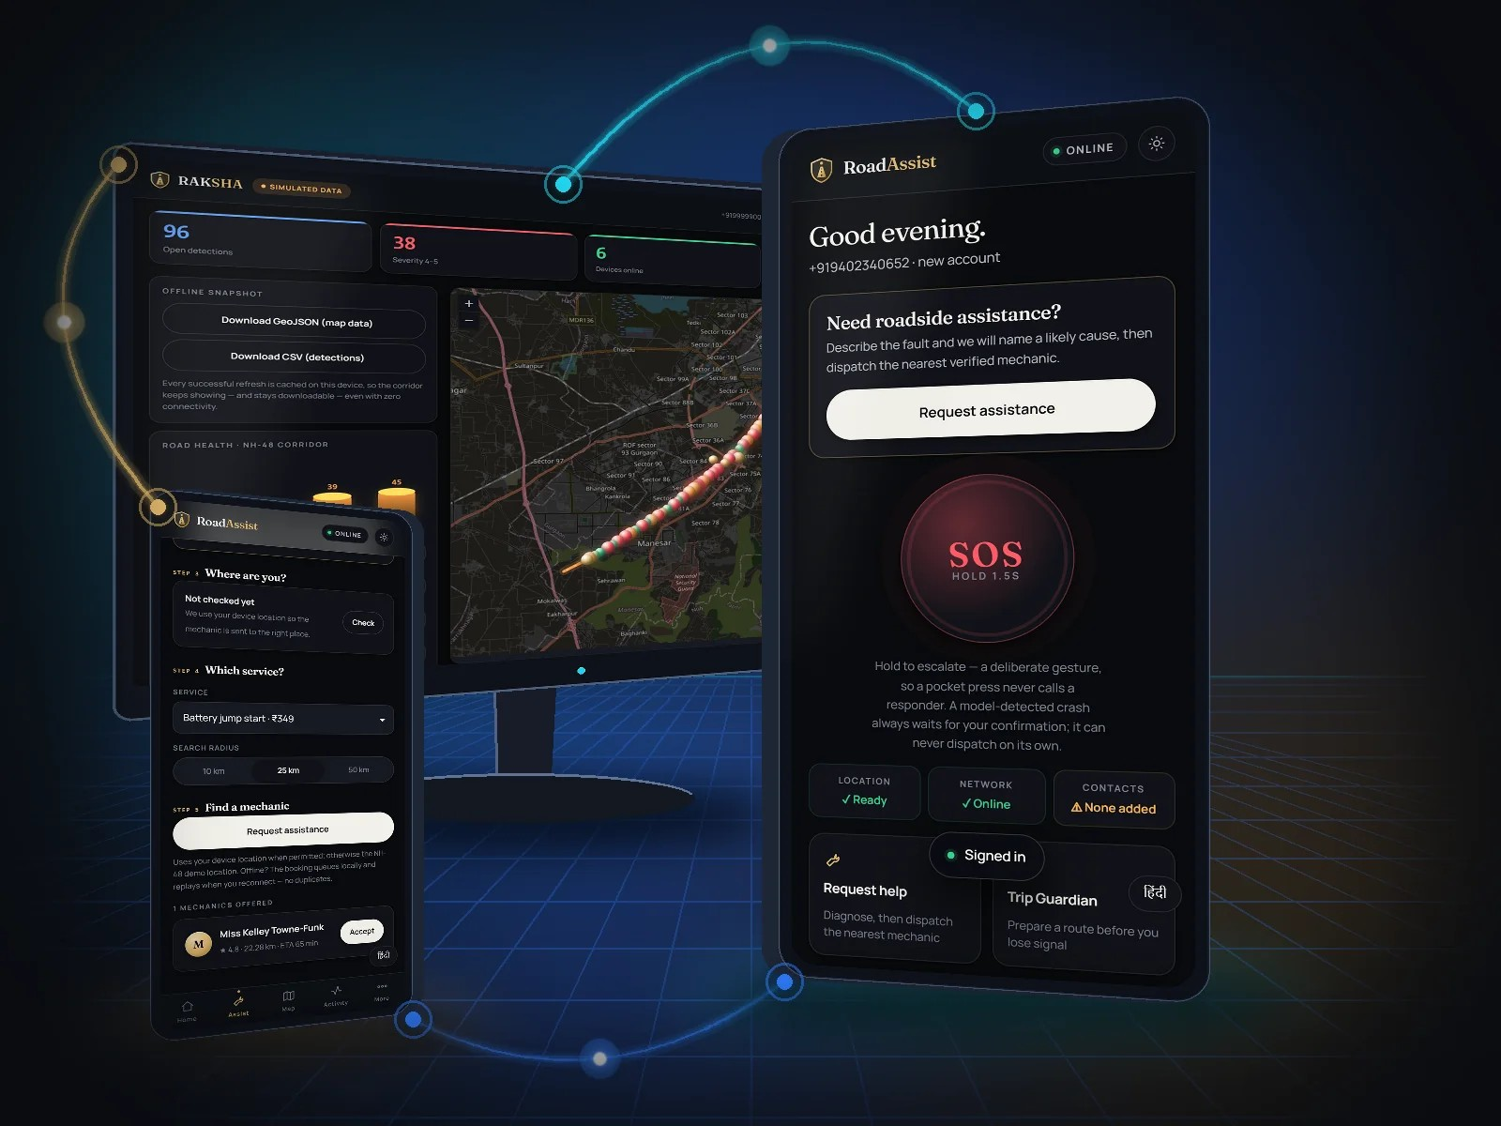
SWE4004 · CLOUD COMPUTING AND APPLICATIONS · PROJECT REVIEW
Offline-first roadside assistance and road safety for India
Help that reaches you where the network doesn't — for stranded drivers, verified mechanics and road-safety authorities.
V Saatwik Sairaam
P Sai Nirisha Chowdary
T V S Jignesh
G Parthavi
24MIC7131
24MIC7122
24MIC7190
24MIC7145
Backend & Cloud Database
Frontend & Mobile
AI & Data Services
DevOps, QA & Cloud Security
Course faculty: Dr. Nagendra Panini Challa
Notes:
Introduce RoadAssist Bharat: an offline-first roadside assistance and road-safety platform built by the four of us. The image on the right is a 3D render built from real screenshots of the running system. Every number in this deck comes from the project's measured.json, produced by the test suites and schema introspection.

Slide 2
THE PROBLEM
Breakdowns happen where help is hardest to reach
1,68,491
4,61,312
0 bars
road deaths in India in 2022
road accidents reported in 2022
the signal where many highway breakdowns happen
Existing apps assume a working network, a smartphone and a nearby partner. RoadAssist assumes none of the three.
Source: Ministry of Road Transport and Highways, Road Accidents in India 2022. The third card is a design premise, not a statistic.
RoadAssist Bharat
02
Notes:
Figures are from MoRTH's Road Accidents in India 2022 report: 4,61,312 accidents and 1,68,491 deaths. The zero-bars card is our design premise, marked as such on the slide. The platform is designed around the three things other apps assume: network, smartphone, nearby help.

Slide 3
OUR SOLUTION
One platform. Four surfaces. One process.
The citizen app, the mechanic console, the RAKSHA authority dashboard and the live map are all served by the same Fastify process — plus a feature-phone path over SMS that needs no app at all.
Citizen
Request help, SOS, track, pay
Mechanic
Ranked offers, job lifecycle
RAKSHA
Road-damage detection, triage
Feature phone
SMS booking in 8 languages
3D render built from real screenshots of the running system
RoadAssist Bharat
03
Notes:
One modular monolith (ADR-0001): every surface is plain HTML/JS served by the API process, so there is no second deployment, no CORS boundary. The feature-phone path completes a booking over SMS in eight languages; seven of the eight are machine-translated and not yet reviewed by native speakers.

Slide 4
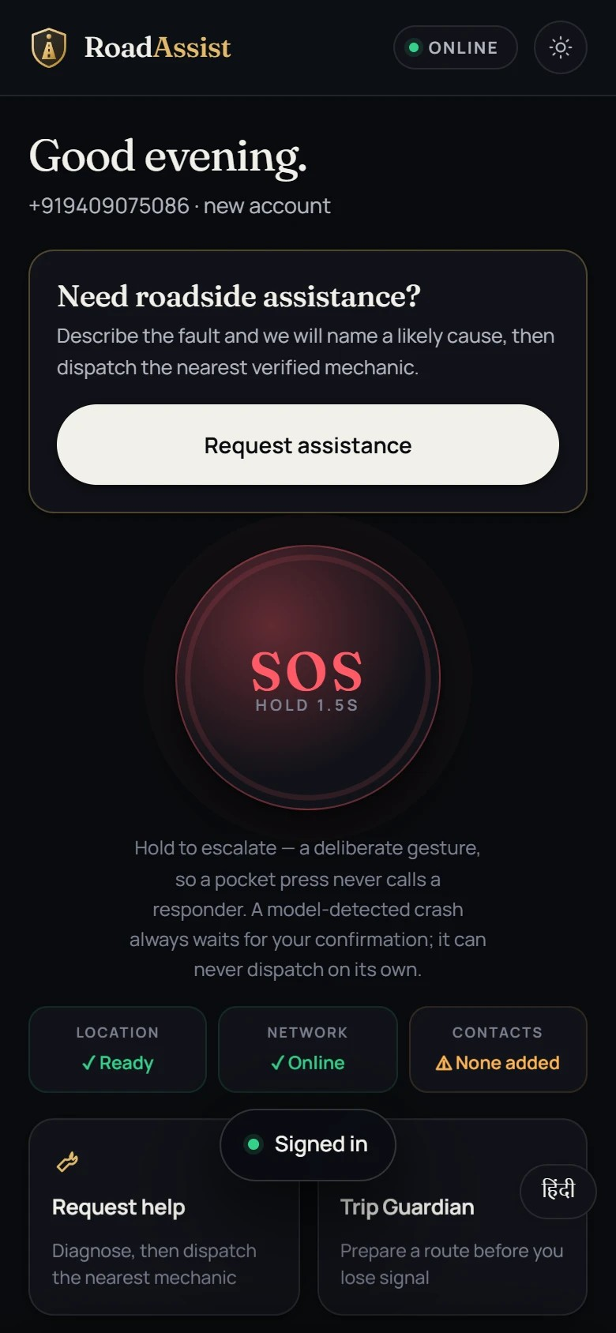
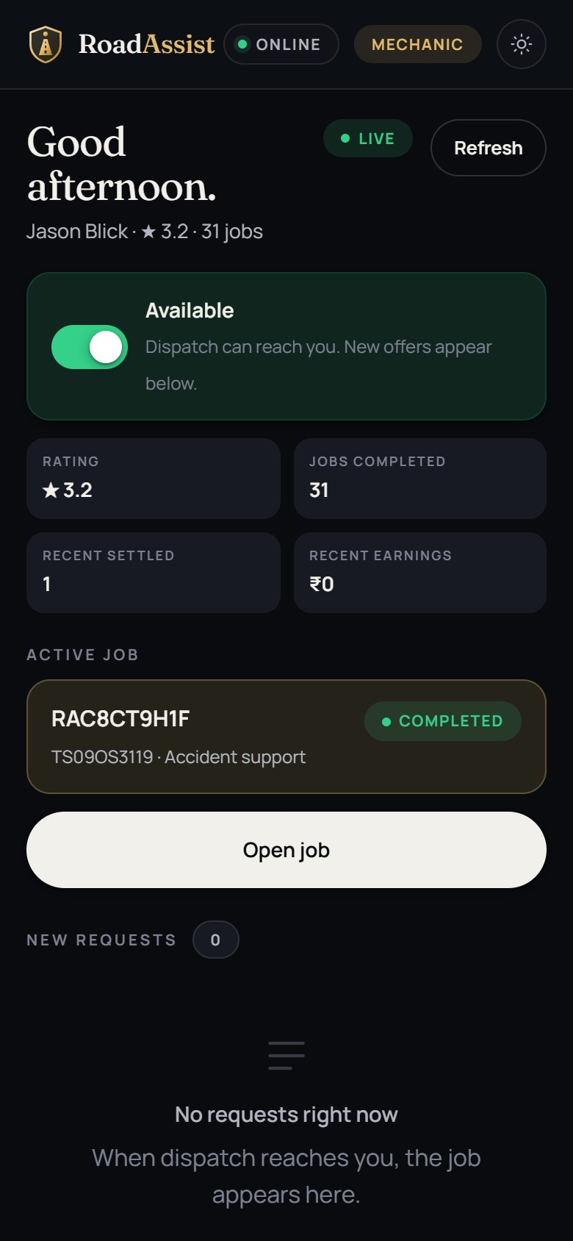
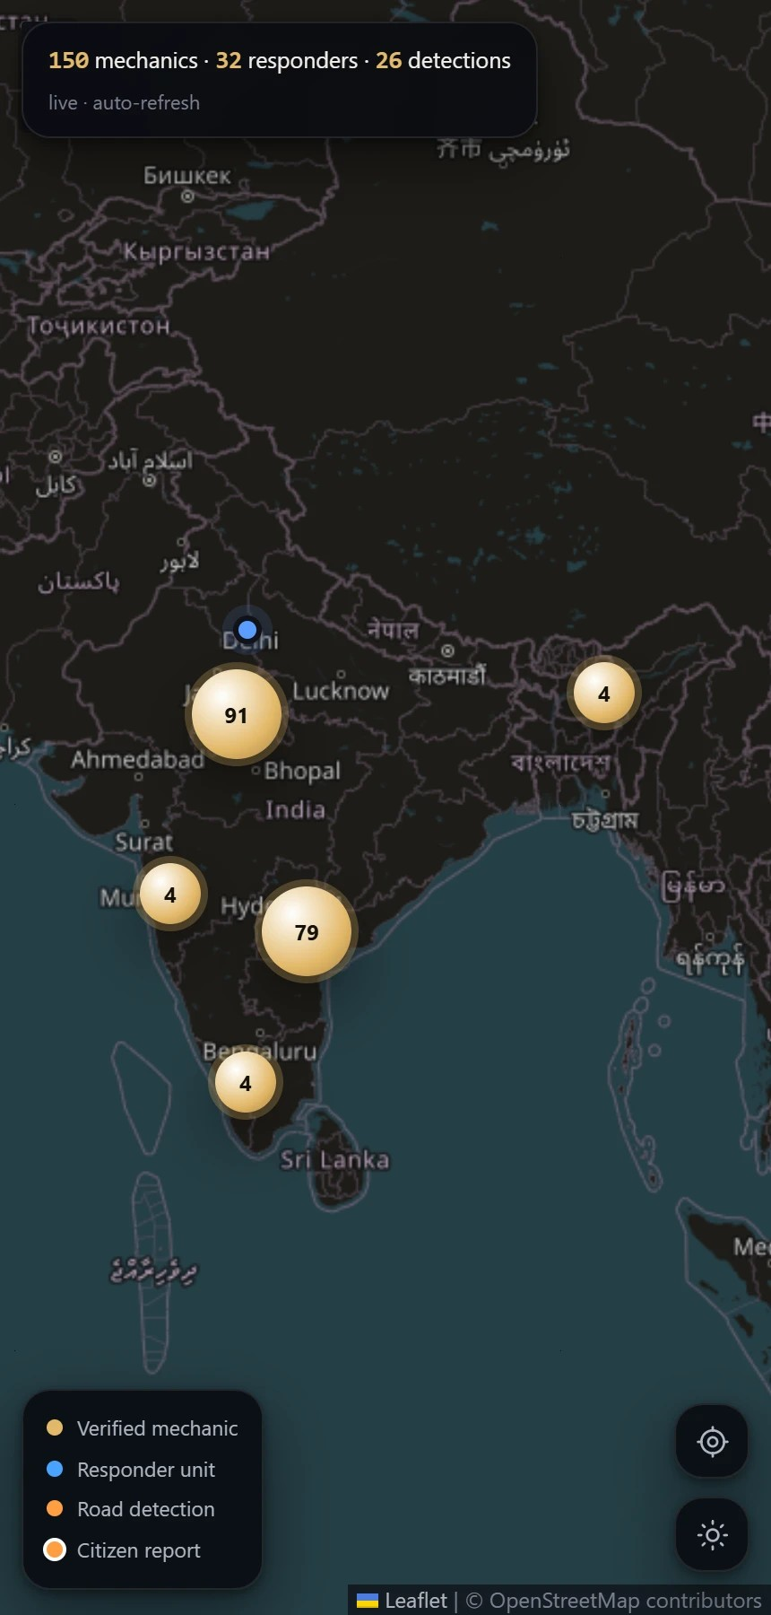
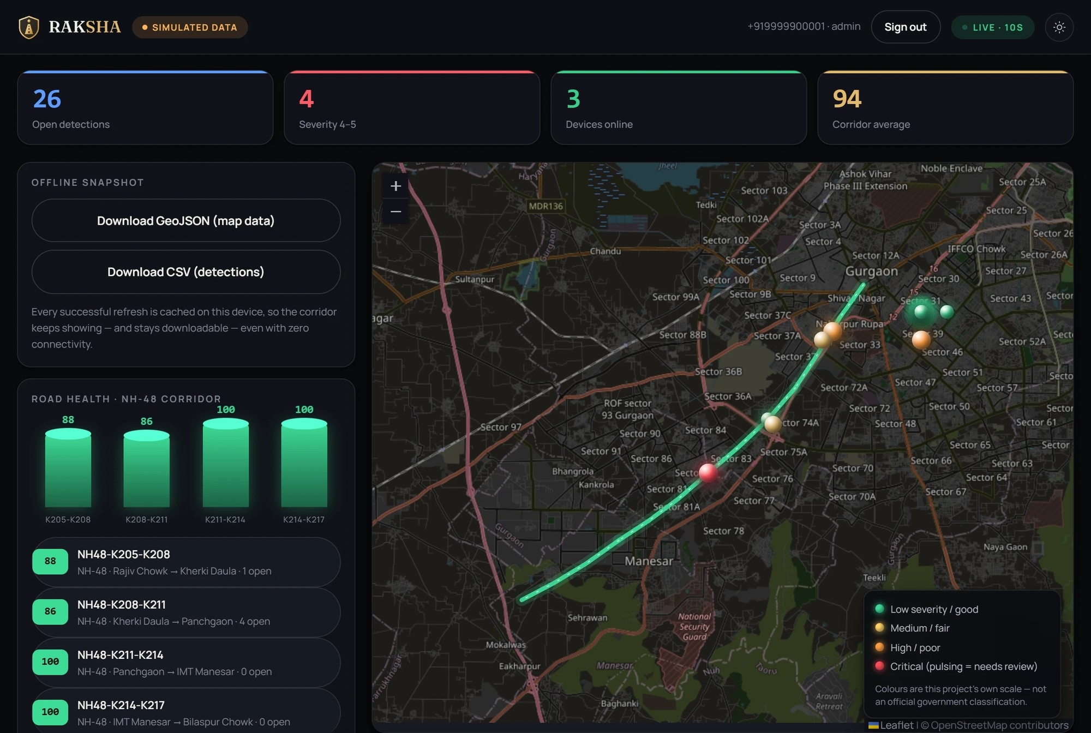
THE SURFACES
Built, running, captured — not mocked
localhost:4000
Citizen app
Mechanic console
Live map
RAKSHA authority dashboard
RoadAssist Bharat
04
Notes:
These are captures of the running platform, not mockups. The capture script signs in against the live API and refuses to take a screenshot unless the page shows what the caption claims. The mechanic console is captured signed in as a seeded mechanic.

Slide 5
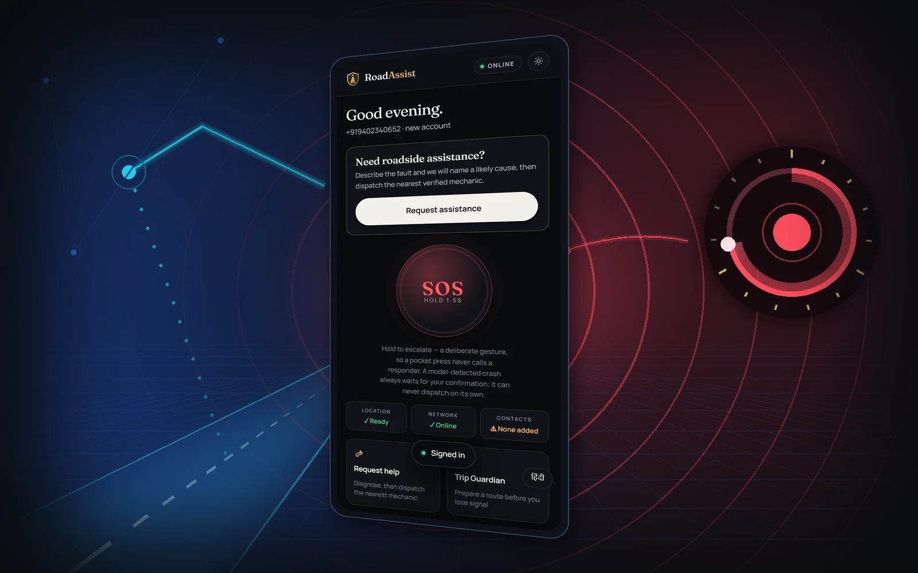
HOW IT WORKS
From a breakdown to a paid job
01
Request or escalate — SOS held 1.5 s
02
Diagnosis — a labelled rules engine
03
Dispatch — ranked by distance, ETA, rating
04
Live status — state machine over SSE
05
Off-grid SOS — stored on the device
06
Idempotent sync — never a second ambulance
07
Settlement — server-verified payment
08
Authority oversight — a person confirms
Step 01 as a 3D scene, rendered from the real home screen
RoadAssist Bharat
05
Notes:
Eight stages. Two decisions worth naming: the SOS must be held for 1.5 seconds so a pocket press never calls a responder, and two mechanics accepting one job is settled by a row lock (SELECT ... FOR UPDATE), not by timing.

Slide 6
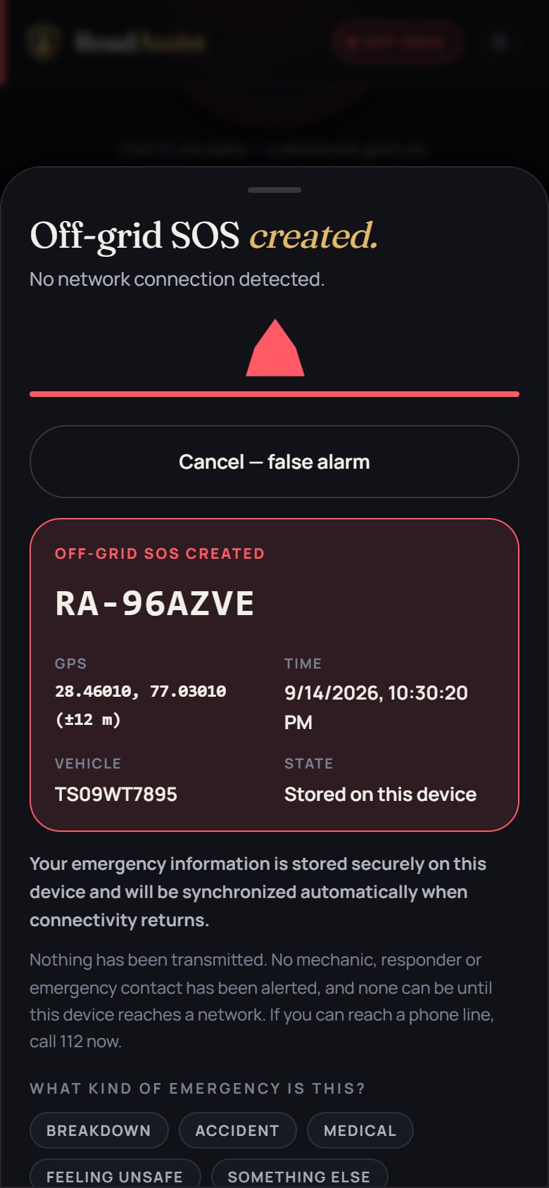
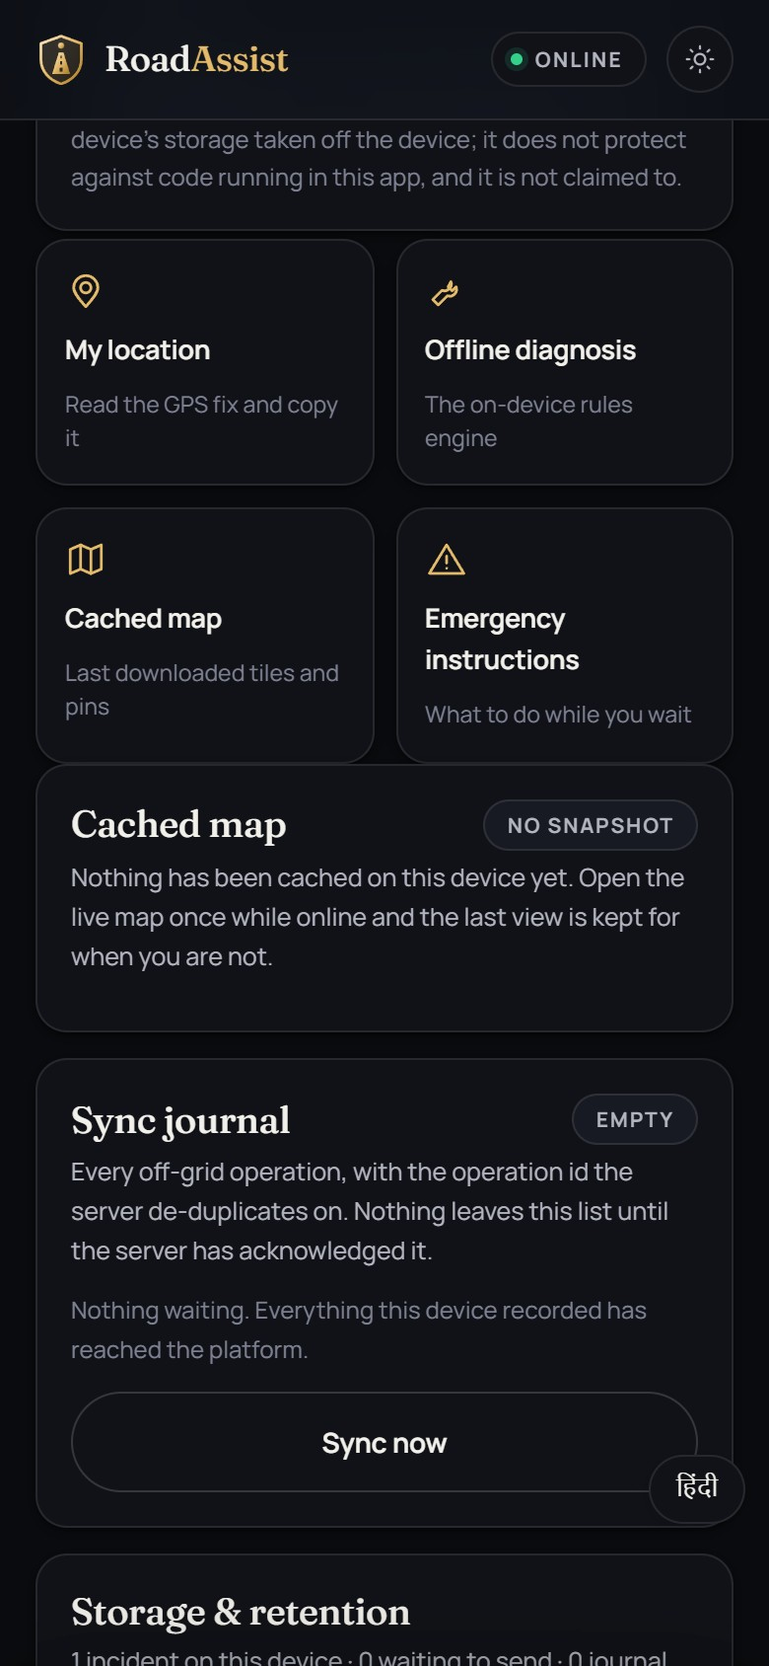
OFF-GRID MODE · ADR-0009
An SOS with no signal is still a real incident
Stored on the device
The incident gets its own reference and GPS fix, and the screen says “nothing has been transmitted” rather than pretending.
Replayed idempotently
When connectivity returns, the journal replays against a client-minted reference, so a retry becomes the same incident.
Diagnosed on the device
The same deterministic rule table the server uses runs offline, labelled as a rules engine.
No signal
Signal returns
RoadAssist Bharat
06
Notes:
Off-grid is the architecture, not a fallback. Left: an SOS raised with no network. Right: the journal synchronised once the network returned, with the platform reference. Replay is idempotent on a client-minted op id.

Slide 7
RAKSHA · AI THAT A PERSON SUPERVISES
The road reports its own damage
0.471
0.226
localhost:4000
mAP50, YOLO11 validation
mAP50-95, YOLO11 validation
CAPTURE
edge device
YOLO11
trained in this repo
RULES
severity, dedupe
HUMAN
confirms, then acts
A model never dispatches (ADR-0005). These are validation figures from the training run, not production accuracy.
RoadAssist Bharat
07
Notes:
YOLO11 trained here on RDD2022 across four countries: mAP50 0.471 and mAP50-95 0.226 on held-out validation (ai/README.md). A model-detected incident waits in a confirmation queue until a person moves it; there is no transition to dispatch that skips a human.

Slide 8
ARCHITECTURE · ADR-0001
A modular monolith on PostGIS
CLIENTS
FASTIFY API
POSTGRESQL 16 + POSTGIS
Citizen web app (PWA)
64 routes under /v1
56 tables
Android · Kotlin + Compose
Zod validation at every edge
138 indexes · 5 GiST
Mechanic console
JWT with role-based access
62 foreign keys
RAKSHA + live map
Server-sent events (ADR-0010)
Hash-chained audit log
Feature phone · SMS
Offer-expiry sweeper
5 migrations
11 architecture decision records explain every choice on this slide.
RoadAssist Bharat
08
Notes:
One Fastify process serves the API and every web surface. PostGIS is required: dispatch ranks providers with ST_DWithin over a GiST index. The audit log is hash-chained and append-only. Counts come from schema introspection through pg_depend so PostGIS's own tables are not counted.

Slide 9
EVIDENCE
Every number is measured
757
PASS
assertions across six suites, zero failures
74 attacks attempted, every one refused
22 Razorpay checks run against a local stub, outside the 757 — never counted as passing.
RoadAssist Bharat
09
Notes:
672 assertions across unit, end-to-end, concurrency, security, gateway security and browser suites, zero failures. The security suite attempts 74 attacks including cross-tenant reads, role escalation, SQL injection and forged tokens. The 22 payment-sandbox checks need an account we do not have, so they are reported as not run.

Slide 10
NO LLM · ENFORCED, NOT PROMISED
Built by us. Checked by the build.
npm run no-llm
npm run claims
fails the build on any LLM package in a manifest or a chat endpoint in source
every number in the docs must match what the suites measured
npm run residency
npm run citations
no page loads a third party; server egress is declared
every code reference in the docs still resolves
The AI in this project is a YOLO11 detector trained in this repository and a deterministic rules engine — never a language model.
RoadAssist Bharat
10
Notes:
Our faculty's requirement: LLM-based projects with minimal student contribution are not considered. We made that a build check: npm run no-llm fails on any LLM dependency or chat endpoint, and it runs in CI on every push. Even the site's answer panel is a lookup over a fixed index.

Slide 11

DEPLOYMENT
One command locally. One domain publicly.
roadassistbharat.online
git clone https://github.com/saatwik-1157/roadassist-bharat
docker compose -f docker-compose.demo.yml up
Project showcase · GitHub Pages · live
Docker image
PostGIS, migrations, seed data and the platform — no cloud account, no secrets.
Published to GHCR on every push
Render + Neon
render.yaml deploys the same image to the cloud
The same image runs locally, in CI and in the cloud.
Restart policy
The demo stack comes back by itself
RoadAssist Bharat
11
Notes:
The showcase is live at roadassistbharat.online on GitHub Pages. The platform image is built and published by CI; the demo compose file brings up PostGIS, migrates, seeds and serves every surface on port 4000. Render with a Neon PostGIS database hosts the same image.

Slide 12
THE TEAM
Four people, four responsibilities
VS
PN
TJ
GP
V Saatwik Sairaam
P Sai Nirisha Chowdary
T V S Jignesh
G Parthavi
24MIC7131
24MIC7122
24MIC7190
24MIC7145
Backend & Cloud Database
Frontend & Mobile
AI & Data Services
DevOps, QA & Cloud Security
Fastify API, PostGIS schema, dispatch and concurrency
Citizen web app, mechanic console, Android client
YOLO11 training, RAKSHA ingest, rules engine
CI, Docker, security suite, deployment
Course faculty: Dr. Nagendra Panini Challa
RoadAssist Bharat
12
Notes:
Each member owns one layer end to end. Confirm the one-line work summaries with each member before the review — they are written from the roles on our Review 1 title slide.

Slide 13

Thank you
Questions welcome — and the platform is running if you'd like to see it.
roadassistbharat.online · github.com/saatwik-1157/roadassist-bharat
Notes:
Offer a live demo: the citizen app and RAKSHA are running. Demo sign-ins: citizen +917000000000, authority +919999900001, mechanic +919600000000 — the OTP fills itself in demo mode.

